Slide 1
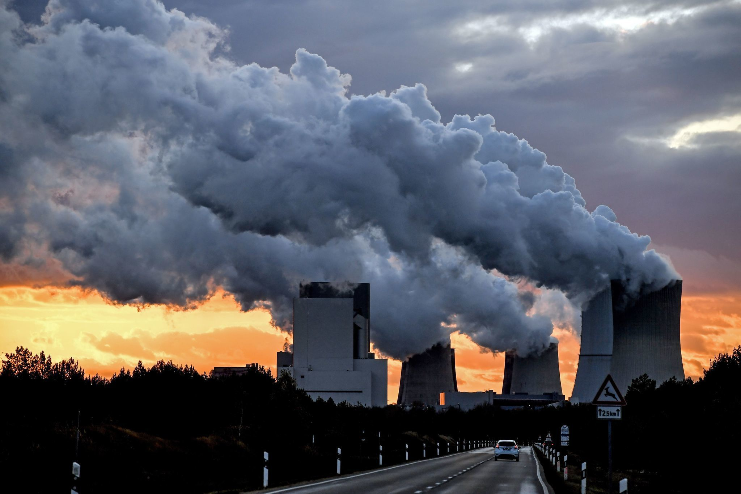
Climate change ethics
PHL 304
Fall 2018

Slide 2
Climate change ethics
PHL 304
Fall 2018
SPOOKY EDITION!

Slide 3
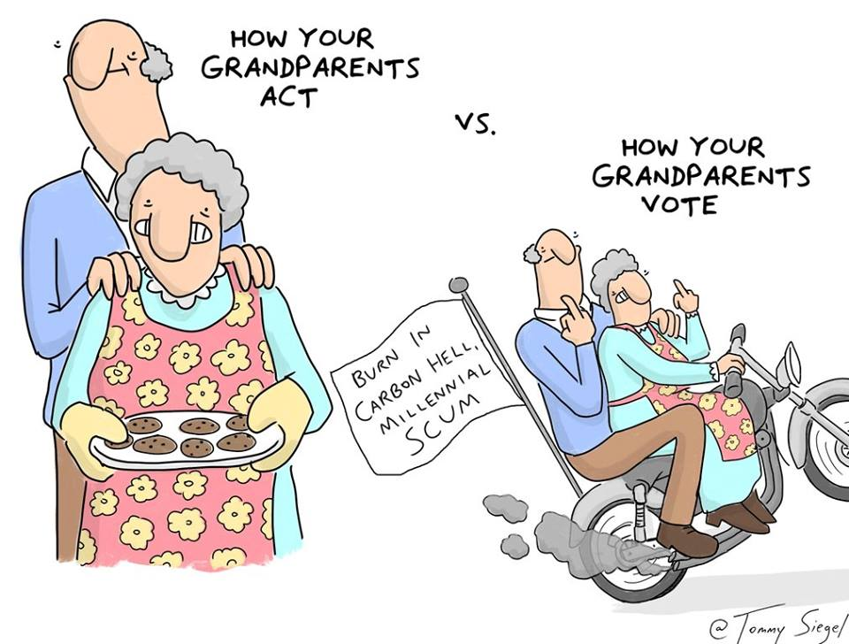

Slide 4
Notes:
The Intergovernmental Panel on Climate Change (IPCC)
http://www.ipcc.ch

Slide 5
The Fifth Assessment Report (IPCC)
The Fifth Assessment Report was released in 2014.
It is the work of more than 800 authors.
The section on the science of climate change is over 2,000 pages long and draws on 9,200 peer-reviewed scientific publications.
“The Fifth Assessment Report finds that it is ‘extremely likely that human influence has been the dominant cause of the observed warming since the mid-twentieth century’” (22).
Notes:
The Intergovernmental Panel on Climate Change (IPCC)
http://www.ipcc.ch
“In the language of the report, ‘extremely likely’ indicates a probability in the range of 95–100 percent” (22)
“Those of us who have no expertise in the scientific aspects of assessing climate change and its causes can scarcely disregard the views held by the overwhelming majority of those who do possess that expertise. Even if all of them were in agreement, it would still be possible that they are wrong, but in view of what is at stake, to rely on that possibility would be playing Russian roulette with hundreds of millions and possibly billions of lives at stake. Those who are skeptical about the science of climate change must, if they are intellectually honest, admit that there is a significant chance that the overwhelming majority of scientists have got it right; and if that is the case, they should ask themselves whether it is right to take no action and thus to run that risk” (22)

Slide 6
CONSEQUENCES
“As oceans become warmer, hurricanes and tropical storms that have largely been confined to the tropics are moving further from the equator, hitting large urban areas that have not been built to cope with them.”
“Tropical diseases are spreading beyond their previous zones.”
“Food production will rise in some regions, especially in the high northern latitudes, and fall in others, including sub-Saharan Africa.”
“Rising sea levels are beginning to threaten low-lying coastal regions, including low-lying Pacific islands, fertile delta regions, and some of the world’s most densely populated cities” (24).
Notes:
The Intergovernmental Panel on Climate Change (IPCC)
http://www.ipcc.ch
“The following impacts are already occurring and will increase in severity during the remainder of the twenty-first century” (23–24)

Slide 7
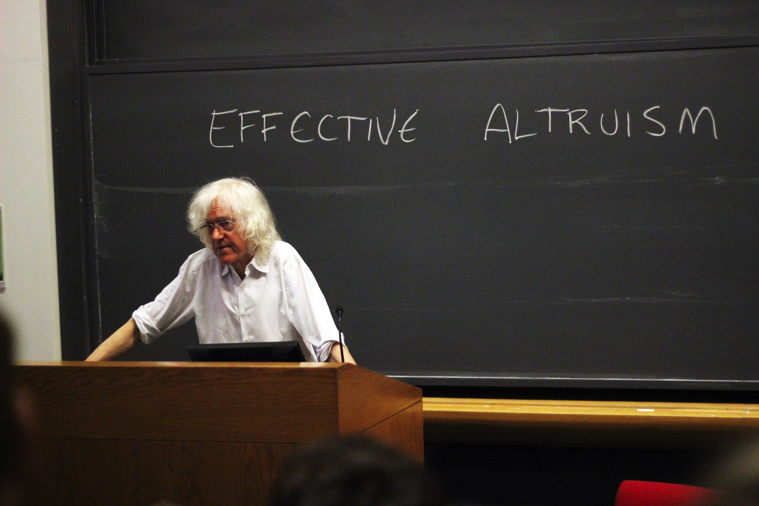
THE NONIDENTITY PROBLEM
Derek Parfit

Slide 8
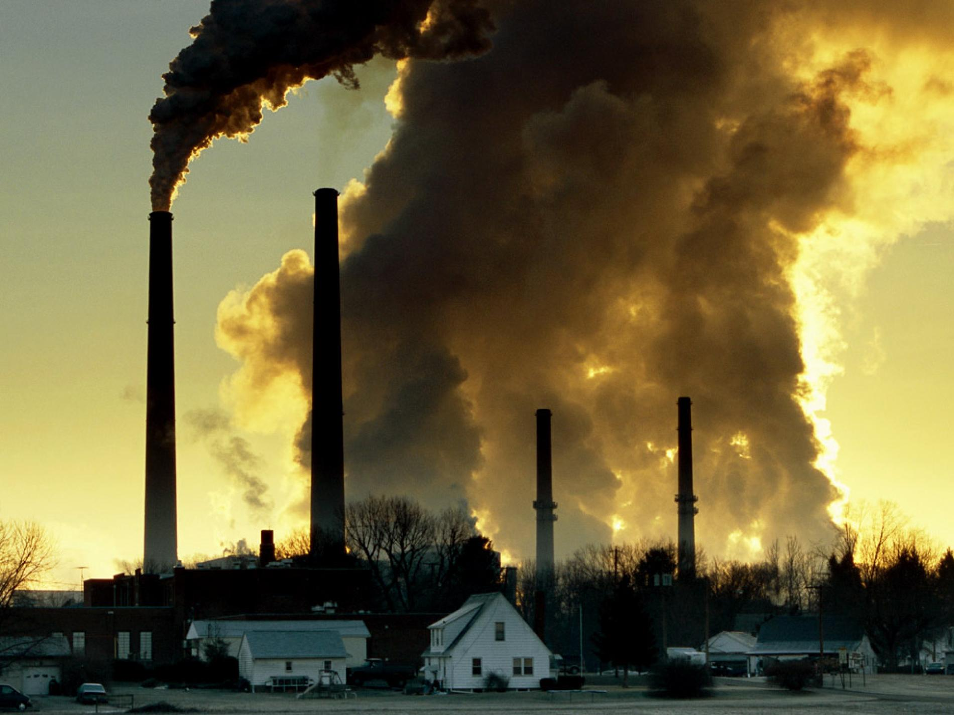
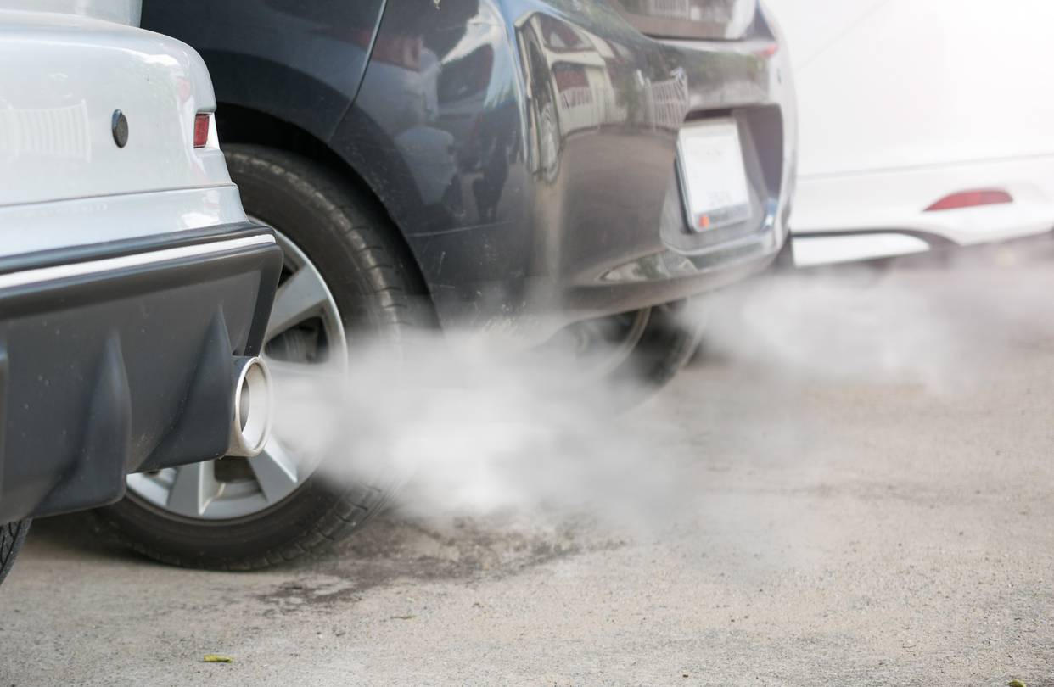
THE RISKY POLICY

Slide 9
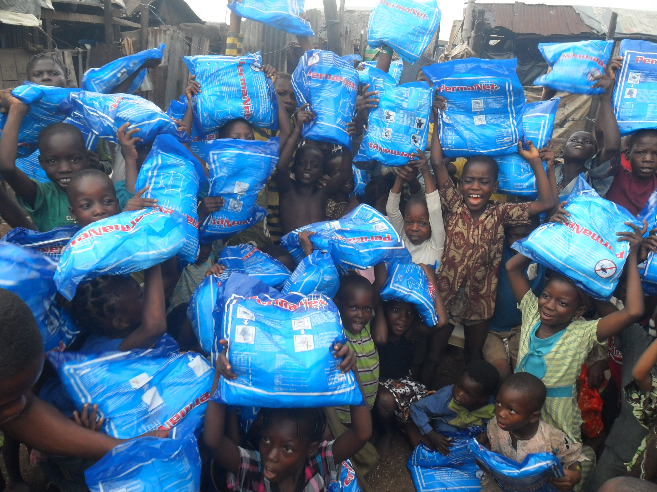
THE RISKY POLICY

Slide 10
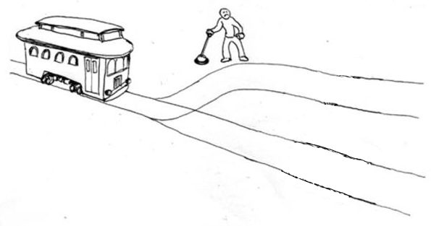
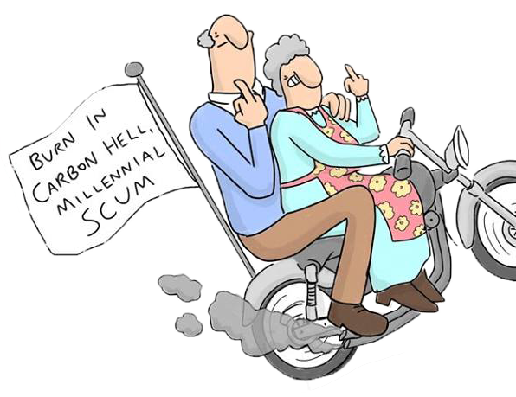
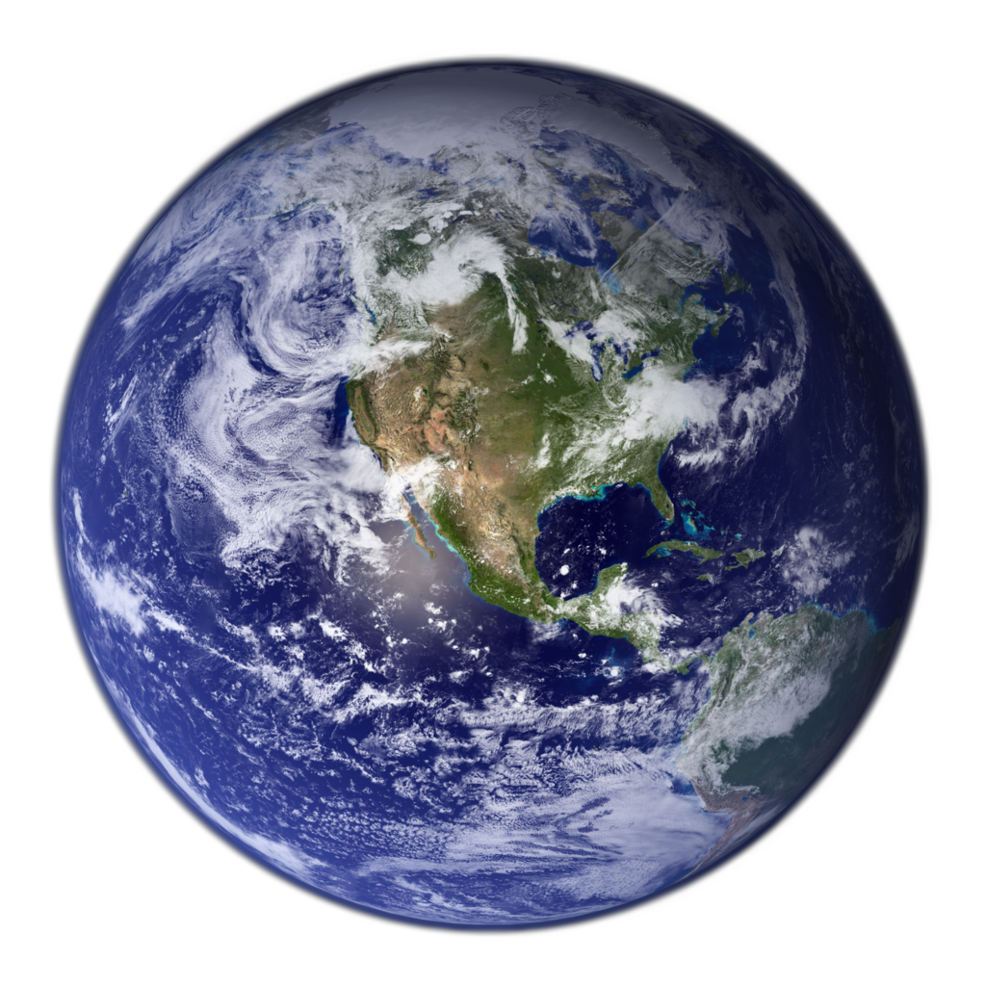
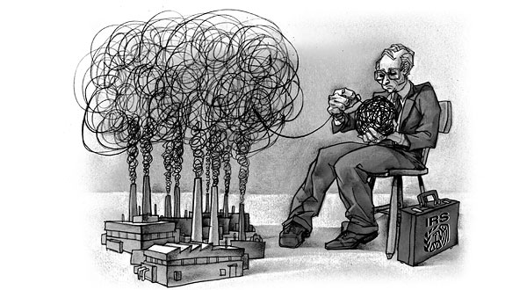
THE SAFE POLICY

Slide 11
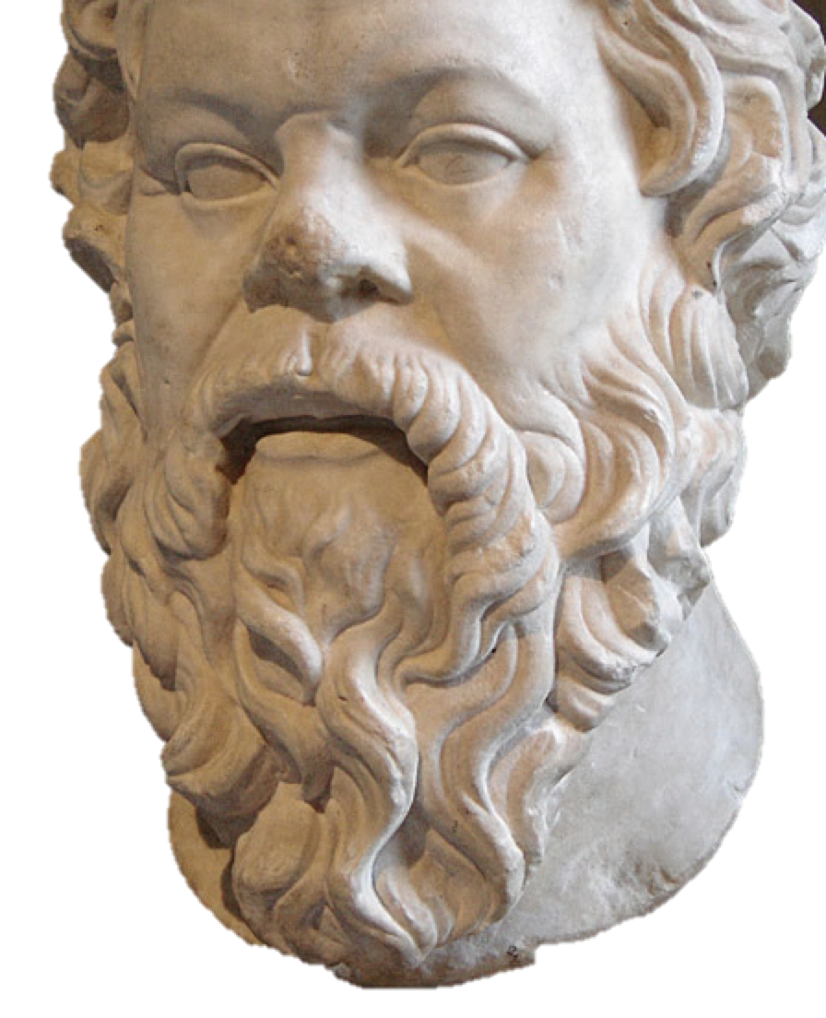
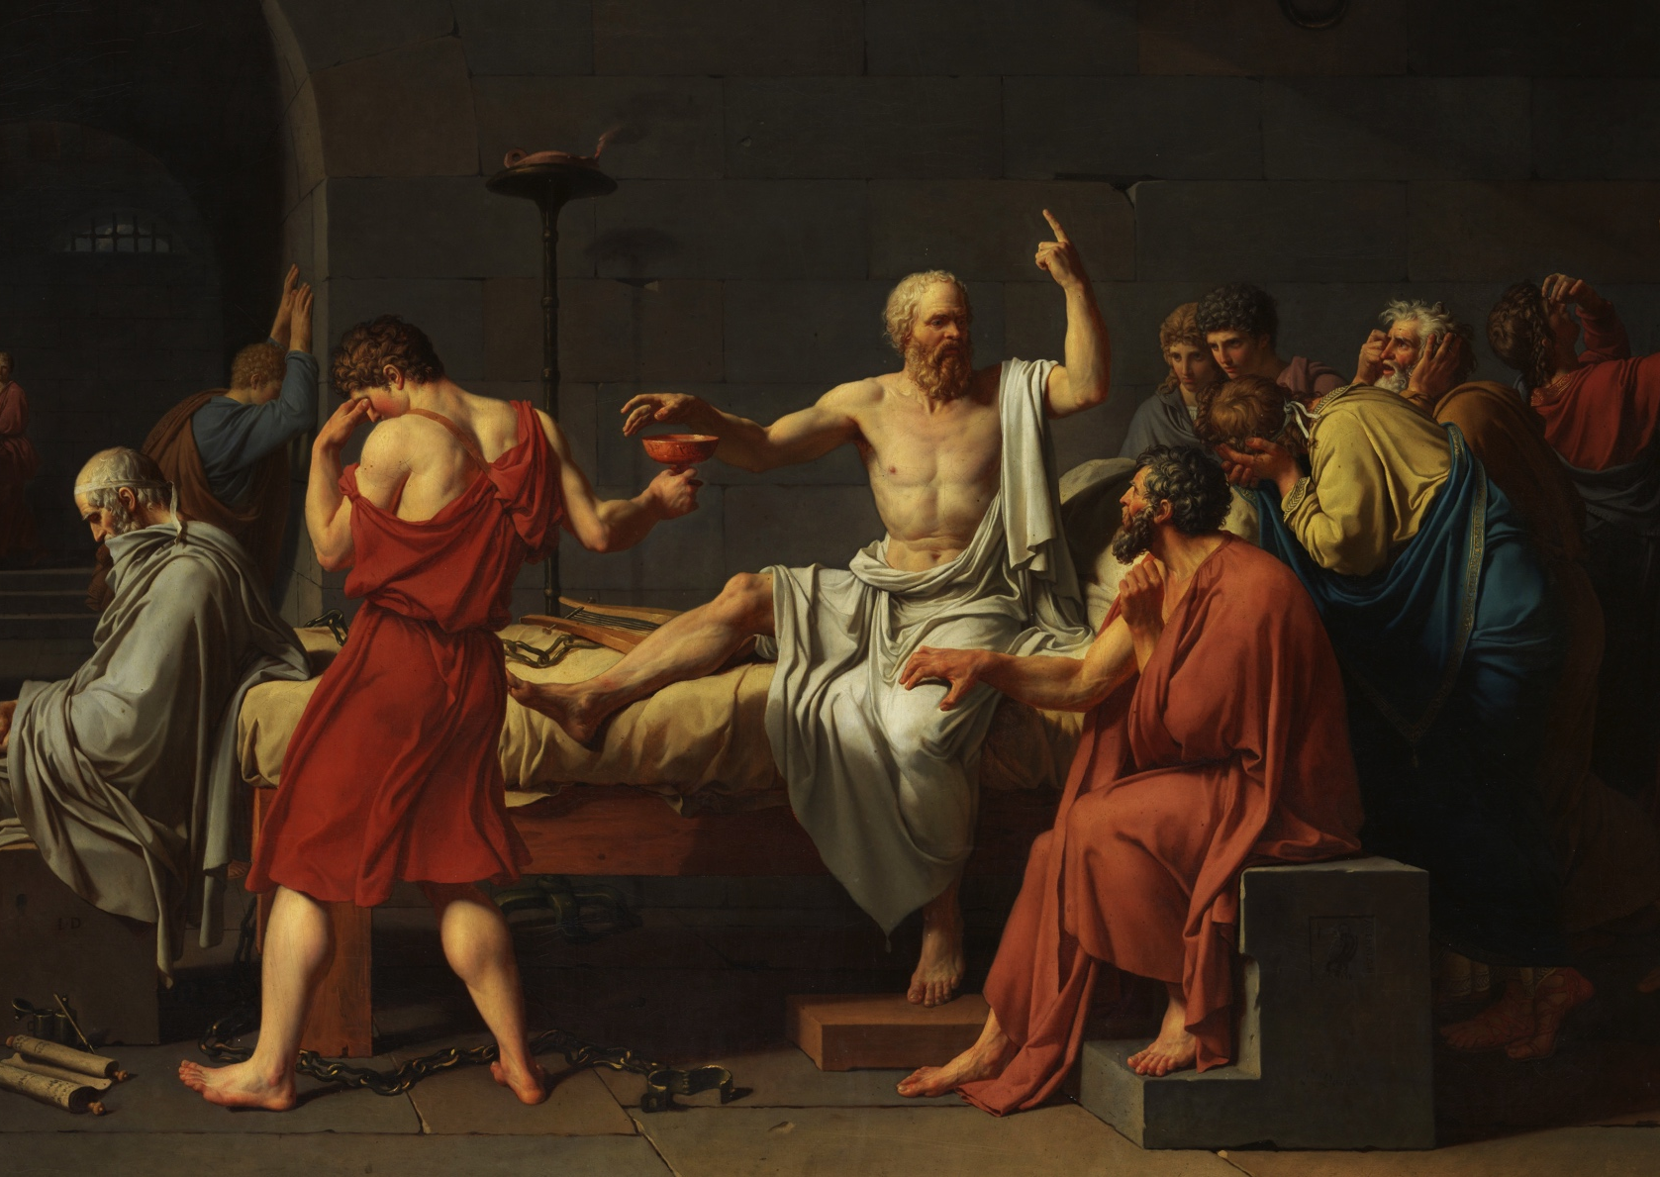
THE PRECARIOUSNESS OF EXISTENCE
taught plato
corrupted the youth
drank hemlock
lived a thug life
…
etc.
origins essentialism
the descriptive view

Slide 12
THE NONIDENTITY PROBLEM
It is wrong to adopt the Risky Policy, because it will wrong future people.
If adopting the Risky Policy will wrong these future people, then it will harm them, or make things worse for them than if we had adopted the Safe Policy instead.
It is not the case that the Risky Policy will harm these future people, or make things worse for them than if we had adopted the Safe Policy instead—if anything, it will (all things considered) benefit them!

Slide 13
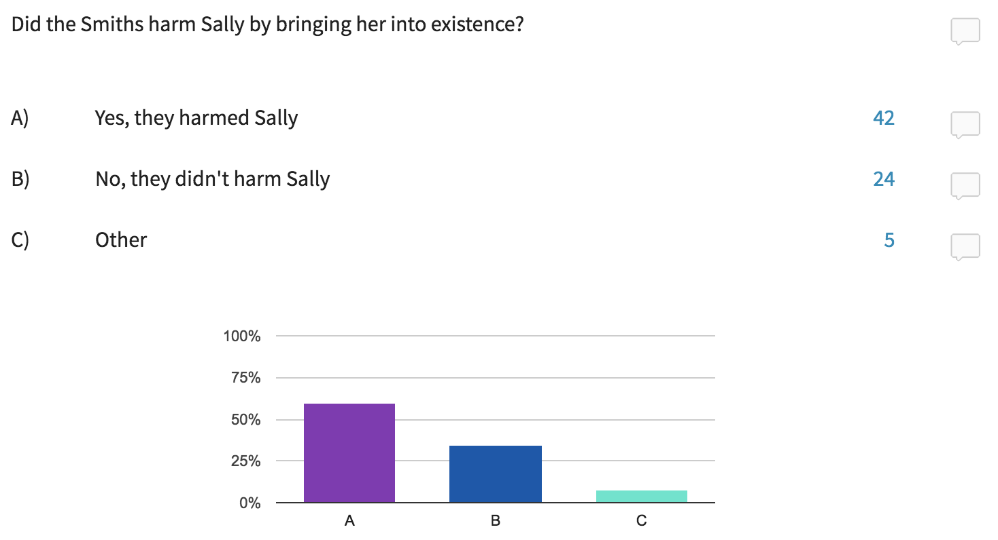
THE NONIDENTITY PROBLEM

Slide 14
THE NONIDENTITY PROBLEM
case 1
case 2

Slide 15
VIDEO EXAMPLE
https://www.youtube.com/watch?v=fRyuz6md2yw

Slide 16
THE NONIDENTITY PROBLEM
It is wrong to adopt the Risky Policy, because it will wrong future people.
If adopting the Risky Policy will wrong these future people, then it will harm them, or make things worse for them than if we had adopted the Safe Policy instead.
It is not the case that the Risky Policy will harm these future people, or make things worse for them than if we had adopted the Safe Policy instead—if anything, it will (all things considered) benefit them!

Slide 17
VIDEO EXAMPLE
https://www.c-span.org/video/?c4487608/bush-gore-kyoto

Slide 18
FAIRNESS: TWO APPROACHES
Historical principles: In order to determine whether a given distribution of goods is just, we must first ask how that distribution of goods came about.
Time-slice principles: In order to determine whether a given distribution of goods is just, we must ask whether that distribution satisfies an adequate principle of fairness, irrespective of how that distribution came about.
Robert Nozick
Notes:
“A historical principle is one that says, We can’t decide, merely by looking at the present situation, whether a given distribution of goods is just or unjust. We must also ask how the situation came about; we must know its history. Are the parties entitled, by an originally justifiable acquisition and a chain of legitimate transfers, to the holdings they now have? If so, the present distribution is just. If not, rectification or compensation will be needed to produce a just distribution” (32)

Slide 19
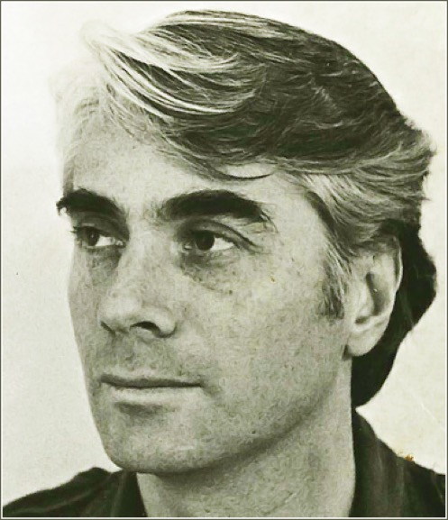
FAIRNESS: TWO APPROACHES
Historical principles: In order to determine whether a given distribution of goods is just, we must first ask how that distribution of goods came about.
Time-slice principles: In order to determine whether a given distribution of goods is just, we must ask whether that distribution satisfies an adequate principle of fairness, irrespective of how that distribution came about.
Robert Nozick
Notes:
“A historical principle is one that says, We can’t decide, merely by looking at the present situation, whether a given distribution of goods is just or unjust. We must also ask how the situation came about; we must know its history. Are the parties entitled, by an originally justifiable acquisition and a chain of legitimate transfers, to the holdings they now have? If so, the present distribution is just. If not, rectification or compensation will be needed to produce a just distribution” (32)

Slide 20
LOCKE’S LABOR THEORY
Persons have self-ownership and thus ownership of their labor.
When a person’s labor mixes with unownded land to produce a product, that person appropriates that land as property.
Appropriation is legitimate only when “there is enough, and as good, left in common for others.”
Wrongful expropriation is grounds for rectification and/or compensation.
John Locke
Notes:
“Locke’s justification of the acquisition of private property is the classic historical account of how property can be legitimately acquired, and it has served as the starting point for many more recent discussions. Its significance here is that, if it is valid and the sink is or appears to be of limitless capacity, it would justify allowing everyone to put what he or she wants down the sink, even if some put much more than others down it” (33)

Slide 21
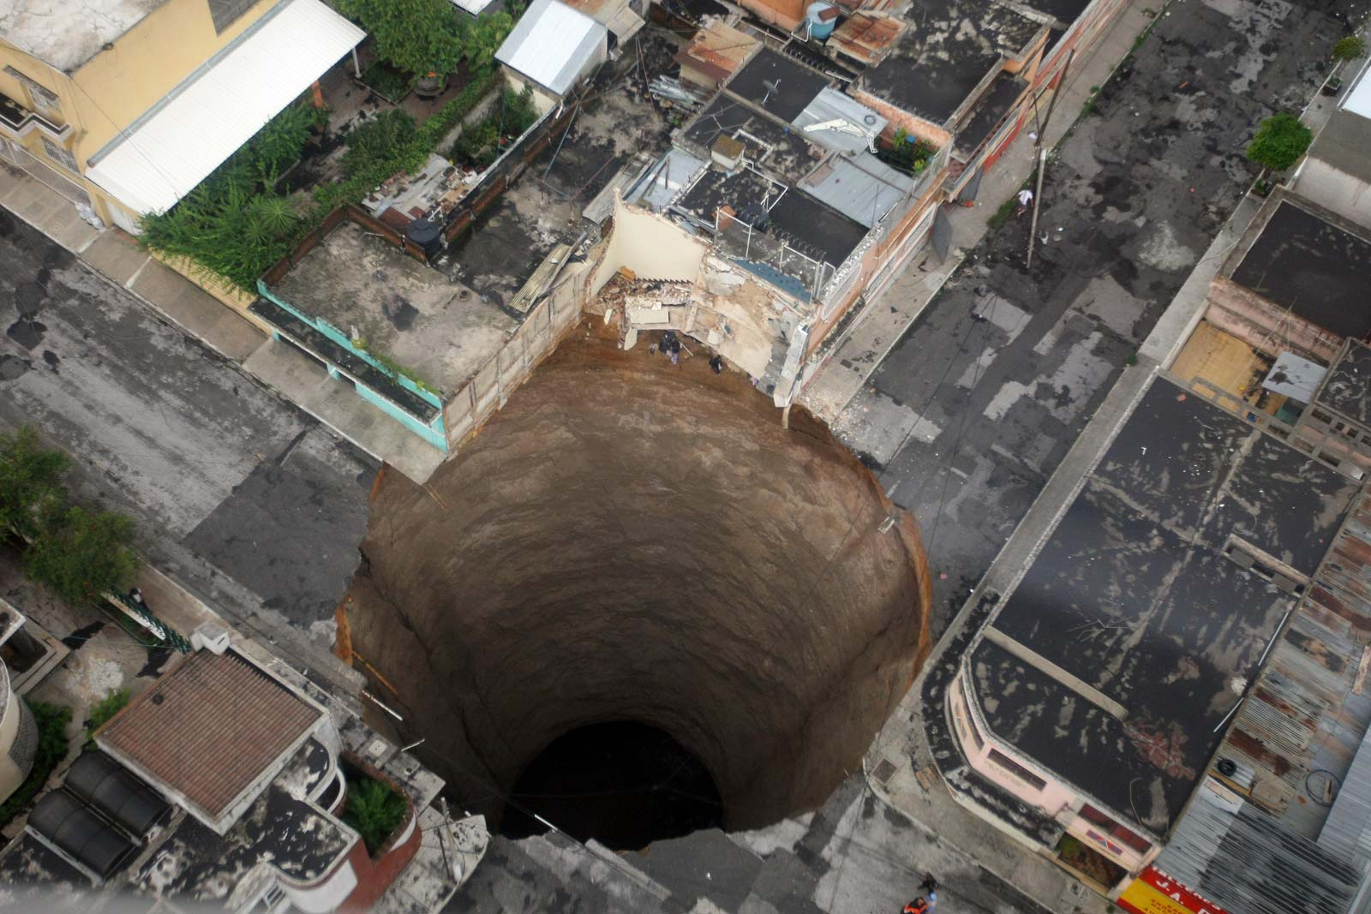
THE SINK ANALOGY
enough and as good
Notes:
“Locke’s justification of the acquisition of private property is the classic historical account of how property can be legitimately acquired, and it has served as the starting point for many more recent discussions. Its significance here is that, if it is valid and the sink is or appears to be of limitless capacity, it would justify allowing everyone to put what he or she wants down the sink, even if some put much more than others down it” (33)

Slide 22
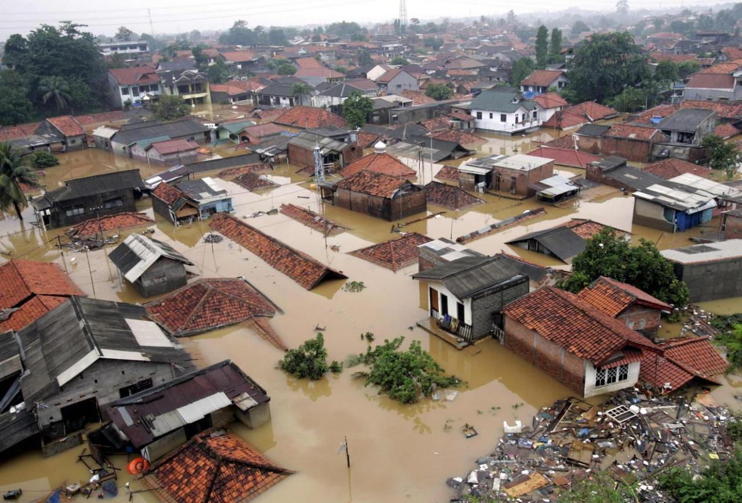
THE SINK ANALOGY
not enough and much worse
Notes:
“Locke’s justification of the acquisition of private property is the classic historical account of how property can be legitimately acquired, and it has served as the starting point for many more recent discussions. Its significance here is that, if it is valid and the sink is or appears to be of limitless capacity, it would justify allowing everyone to put what he or she wants down the sink, even if some put much more than others down it” (33)

Slide 23
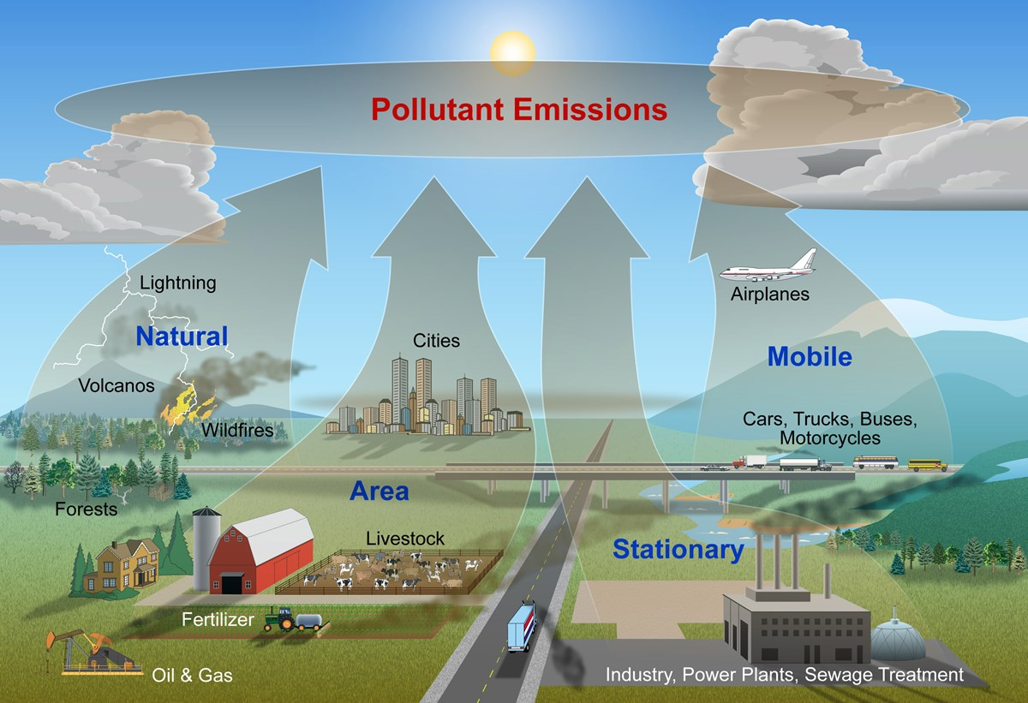
THE SINK ANALOGY
not enough and worsening
Notes:
“Locke’s justification of the acquisition of private property is the classic historical account of how property can be legitimately acquired, and it has served as the starting point for many more recent discussions. Its significance here is that, if it is valid and the sink is or appears to be of limitless capacity, it would justify allowing everyone to put what he or she wants down the sink, even if some put much more than others down it” (33)

Slide 24
THE POLLUTTER PAYS
Notes:
“One advantage of sharing a house with someone whose hair is different in color or length from your own is that when a clump of hair blocks the bath outlet, it’s easy to tell whose hair it is. ‘Get your own hair out of the tub’ is a fair and reasonable household rule, and if the blockage is too far down the pipe for anyone but a plumber to reach, then it would also seem fair and reasonable (if a little too mucky) to settle the plumber’s bill by dividing it up proportionately to the amount of hair from each person that has built up over the period that people have been using the tub and has caused the present blockage” (35)
“Carbon dioxide in the atmosphere is harder to see than hair in the bathtub, and it lasts longer. Much of the carbon emitted a century ago is still in the atmosphere, contributing to climate change, and unless we develop some new technology for removing it, about a quarter of what we emit today will still be warming the planet a thousand years from now” (35)

Slide 25
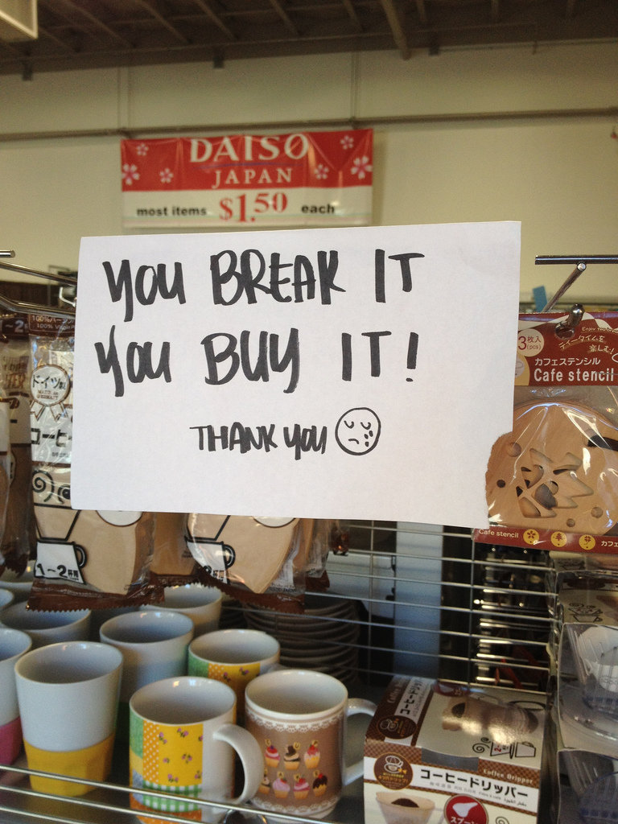
THE POLLUTTER PAYS
Notes:
“At least since 1990, however, when the Intergovernmental Panel on Climate Change published its first report, solid evidence about the hazards associated with emissions has existed, and in 1992 the developed countries themselves (including the United States under President George H. W. Bush) agreed, at the Earth Summit, to reduce emissions so as to prevent dangerous anthropogenic climate change. To wipe the slate clean on what happened since 1990 seems unduly favorable to the industrialized countries that have, despite that evidence, continued to emit a disproportionate share of greenhouse gases” (36)
“The average resident of the United States, for example, has used more than ten times as much as the average resident of China. The cumulative emissions of the United States since 1850 amount to 30 percent of the world’s total cumulative emissions. If the United States and other countries that industrialized early do not cut their emissions very soon and very sharply, it will be impossible for residents of developing countries to emit amounts that are in any way comparable to those emitted by American residents—or at least impossible for them to do so without a grave risk of climate change becoming dangerous. Because burning fossil fuels has been and largely still is a path to a high standard of living, this is unfair” (36)
“Rather, the claim is that those countries have, by taking more than their fair share of the global carbon budget, achieved a higher standard of living than developing countries while at the same time preventing people in developing countries from taking a similar path, one in which they make use of cheap fossil fuels to improve their own standard of living. Fairness in dividing up a common resource demands that we take into account not only how much everyone is using now but also how much everyone used in the past” (36)

Slide 26
THE POLLUTTER PAYS
The polluter pays principle holds that the fair response to the threat of climate change is to place greater financial burdens on those countries that have historically contributed greater amounts of greenhouse gas to the atmosphere over time.
This in turn implies that developed countries like the United States must bear almost all of the financial burden.

Slide 27
EQUAL PER CAPITA SHARES
Suppose we wipe the slate clean.
In order to avoid the dangers of climate change, we must limit global emissions.
But how can we do so fairly?
The equal per capita shares principle denies that anyone has a greater claim to the global atmospheric sink than anyone else.
The fair response is to limit everyone equally.

Slide 28
EQUAL PER CAPITA SHARES
STEP 1 | What rise in global average temperature is dangerous? What degree of risk are we prepared to run that we will exceed that limit? How much carbon dioxide can we add to the atmosphere while avoiding that risk?
STEP 2: | Use the answers to questions A–C to come up a total amount of carbon dioxide that can be emitted.
STEP 3: | Divide that number by the global population to yield the amount that each person is entitled to emit.
STEP 4: | Multiply that number by the population of a given country to determine that country’s allowance and the cuts it must make given current emission rates.

Slide 29
STEP 1
What rise in global average temperature is dangerous?1.5–2°C when compared to preindustrial levels.
What degree of risk are we prepared to run that we will exceed that limit?
If we’re prepared to run that risk, the Fifth Assessment Report tells us that we must limit cumulative emissions to 1,010 GtCO₂ (as of 2011).
33% risk of 2°C rise
Notes:
Probability of at least 66 percent that we will keep the global average temperature below 2°C
“If you are crazy enough to play Russian roulette in the traditional way—loading a single bullet into the cylinder of a revolver that can carry six bullets, spinning the cylinder, putting the muzzle to your head, and pulling the trigger—you are taking a one in six chance of killing yourself” (39)
“Compare that with the Fifth Assessment Report, a document issued by the world’s most authoritative intergovernmental body considering climate change, written by the world’s leading experts in sciences related to climate change, and vetted by representatives of the governments that have signed the Framework Convention, and what does its ‘Summary for Policymakers’ offer us? Nothing better than running a one in three risk of climate change getting completely out of control” (39–40)
“If reducing the risk to 33 percent is the best we can hope for, then the Fifth Assessment Report tells us we must limit cumulative emissions since 1861 to 790 gigatons of carbon, which is equivalent to 2,900 gigatons of carbon dioxide (GtCO₂)” (40)

Slide 30
STEP 2
Optimistically, assuming we can cut emissions to zero by 2050, that means the global population can emit 910 GtCO₂ over the next 35 years (as of 2016), or 26 GtCO₂ each year.

Slide 31
STEP 3
26 GtCO₂ per year divided equally among a global population of seven billion = an annual allowance of 3.7 tons of CO₂.
ANNUAL PER CAPITA EMISSIONS – REPORTED BY SINGER (2016)
Kuwait | 64 tons
Qatar | 43 tons
Australia | 27 tons
United States | >20 tons
Canada | >20 tons
Russia | ~15 tons
United Kingdom | ~9.3 tons
European Union | ~8.7 tons
China, Brazil, Mexico | ≤7 tons
India, Pakistan, Ethiopia, Uganda, Burkina Faso, Bangladesh | <2 tons

Slide 32
STEP 4
COUNTRY | NEEDED CUTS | BASED ON EMISSION RATES REPORTED BY SINGER IN 2016, ALLOWANCES WILL BE EXHAUSTED BY…
Australia | 85% | 2020
United States | 80% | 2022
European Union | >50% | 2030
India | None | 2050 (if emissions were almost doubled)
Pakistan | None | 2050 (if emissions were almost doubled)
Bangladesh | None | 2050 (if emissionswere almost trebled)
Notes:
“We can therefore also calculate in how many years, at present rates of emission, a country will use up its share of the greenhouse gases that it can, under the equal per capita share principle, emit up to 2050. All we have to do is multiply the fair share (3.7 tons) by 35 (the number of years remaining to 2050) and divide by the present rate of emissions” (41)

Slide 33
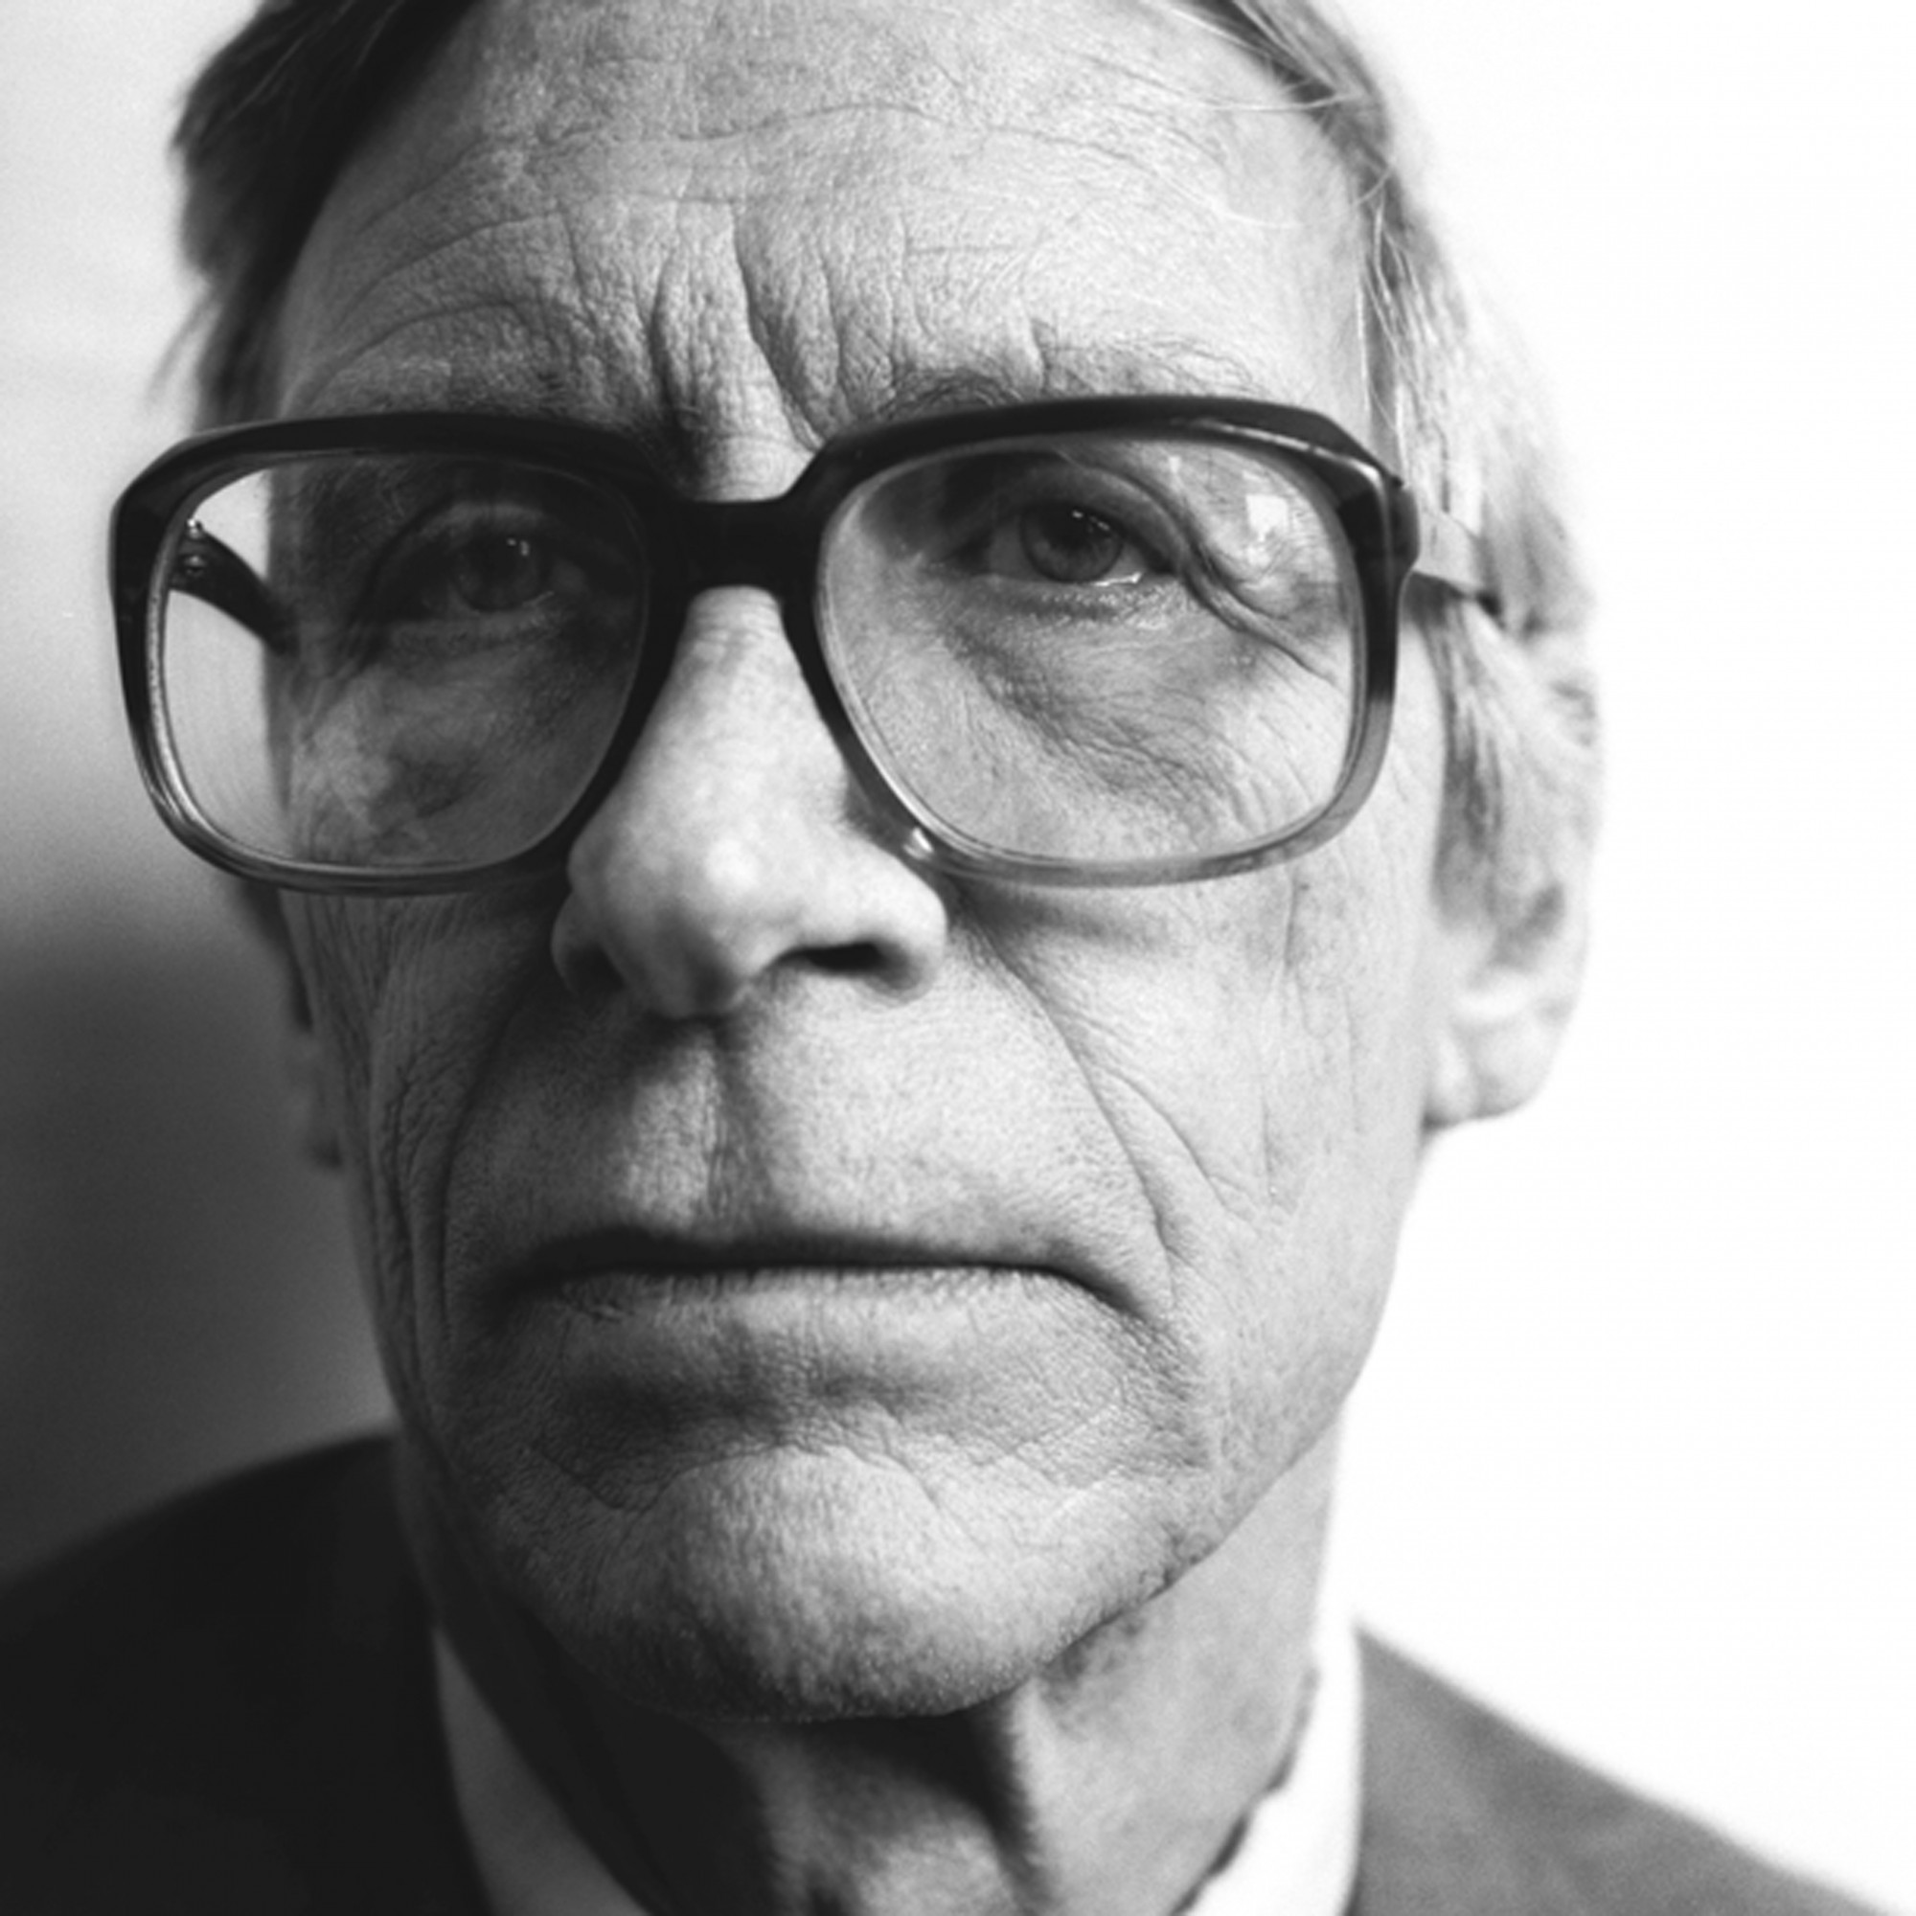
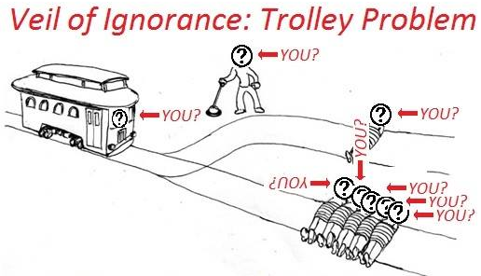
AIDING THE WORST OFF
John Rawls

Slide 34
AIDING THE WORST OFF
The Rawlsian principle of aiding the worst off holds that a fair response to the threat of climate change requires rich countries to bear all the costs of reducing emissions unless the alternative will bring about the greatest benefit for the least advantaged.
For example, a policy that would incentivize Americans to drive more fuel-efficient cars but that would prevent most Chinese from driving cars at all would be unfair unless it were to benefit the worst off.
This principle appears to demand even more of developed countries than the equal per capita shares principle.
Notes:
“Whereas the strict egalitarian is vulnerable to the objection that equality can be achieved by ‘leveling down,’ that is, by bringing the rich down to the level of the poor without improving the position of the poor, Rawls’s account is immune to this objection” (42)
“For example, if allowing some entrepreneurs to become very rich—and thus increasing inequality within the society—will give them incentives to work hard and set up industries that provide employment for the worst-off, and there is no other way to provide that employment or any similar benefit to the worst-off, then that inequality would be permissible” (42)
“[I]t is also compatible with the United States continuing to increase its greenhouse gases emissions because it is producing more goods. That will mean that other countries, including countries with far lower per capita emissions than the United States, must decrease their emissions if catastrophic climate change is to be averted” (43)
“The vast majority of the goods and services the country produces—more than 85 percent of them—are consumed in the United States. Even if we focus on the relatively small fraction of goods produced in the United States that are sold abroad, U.S. residents benefit from the employment that is created, and, of course, U.S. producers receive payment for the goods they sell abroad. Many residents of other countries, especially of the poorest countries, cannot afford to buy goods produced in the United States, and it isn’t clear that they benefit from U.S. production” (43)
“[T] he United States does not produce more efficiently, in terms of carbon dioxide emissions, than other countries. Figures published by the International Energy Agency show that the United States is about average in the quantity of emissions it produces in proportion to its GDP. It is less efficient than many developed countries like Germany, France, Italy, Singapore, Spain, or the United Kingdom and also less efficient than many developing countries in Africa, Asia, and Central and South America” (43)

Slide 35
GREATEST HAPPINESS
Classical utilitarians maintain that we morally ought to adopt those international policies that will lead to the greatest net happiness for all impacted (across time and space).
Classical utilitarianism requires us to take into account how different policies might impact the happiness of the very rich to the totally poor.
We should adopt a principle of justice only if it is likely to lead to the best consequences.
Notes:
“net happiness being what you have left when you deduct the amount of suffering the proposal causes from the amount of happiness it brings about” (44)
“Utilitarians would also have to take into account the greater hardship that might be imposed on people living in countries that have difficulty in complying with strict emission standards because their geography or climate compels their citizens to use a greater amount of energy to achieve a given level of comfort than do people living elsewhere”(46)
“Canadians, for example, could argue that it would simply not be possible to live in many parts of their country without using above average quantities of energy to keep warm” (46)
“Residents of rich countries might even advance the bolder claim that, since their affluent residents have become used to traveling by car and keeping their houses cool in hot weather, they would suffer more if they have to give up their energy-intensive lifestyle than poorer people will suffer if they never get the chance to experience such comforts” (46)

Slide 36
GREATEST HAPPINESS
PRINCIPLE | UTILITARIAN JUSTIFICATION
polluter pays | Incentivizes countries to minimize pollution
equal per capita shares | Increases the likelihood of compromise
aiding the worst off | Likely to produce more net happiness than principles that are lenient to the affluent
Notes:
“In practice, utilitarians can often support the principle of distributing resources to those who are worst-off because when you already have a lot, giving you more does not increase your utility as much as when you have only a little. One of the 700 million people in the world living on $1.90 per day will get much more benefit from an additional $100 than will someone living on $100,000 per year. Similarly, if we have to take $100 from someone, we will cause much less suffering if we take it from the person earning $100,000 than if we take it from the person earning $700 a year” (46)
“This is known as diminishing marginal utility” (46)
“When compared with giving resources to meet someone’s core needs, giving further resources at the margin to someone else whose core needs have already been satisfied will lead to less utility. Hence a utilitarian will generally favor the worst-off when it comes to distributing resources” (46)

