Slide 1
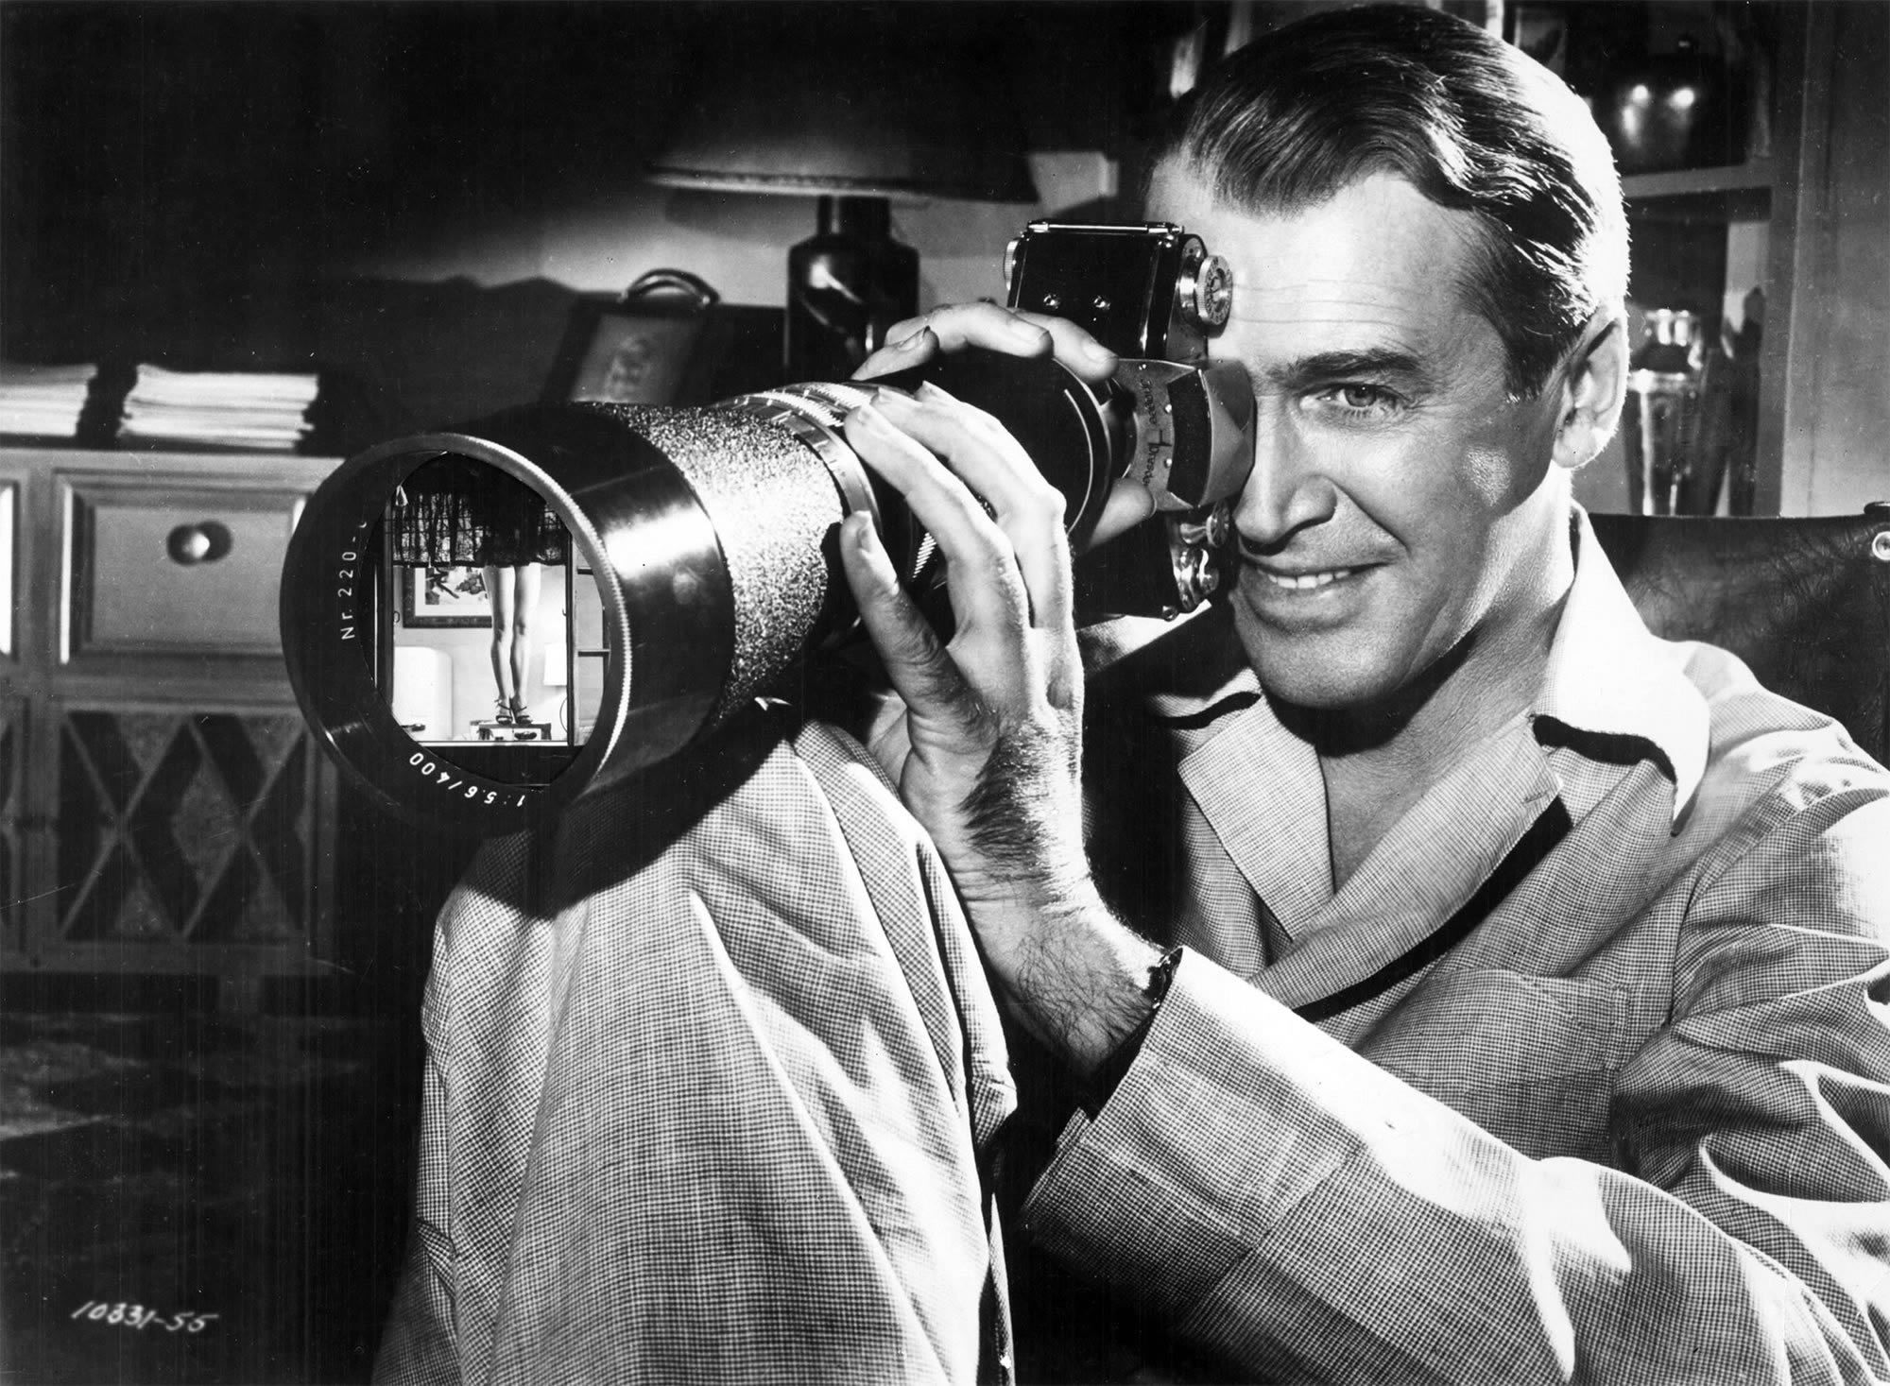
The male gaze
Notes:
Louie episode 13:57: http://www.dailymotion.com/video/x2nt7qv
News: https://www.youtube.com/watch?v=BBIjMFGkZPk
Male gaze examples
Postman: https://www.youtube.com/watch?v=WGFer3-Aguw
Bond clip: https://www.youtube.com/watch?v=gdbIINpktOs
Transformers: https://www.youtube.com/watch?v=f6L3Ef1JCC8
Robin Thicke example: https://www.youtube.com/watch?v=yyDUC1LUXSU
Sternberg: https://www.youtube.com/watch?v=SlkBAo7Q5R0
Hitchcock: https://vimeo.com/144555781
Magic Mike (opening scene)

Slide 2
THE SYMBOLIC
“[C]ultural studies theorists attempt to account for critical viewing, but they often neglect how the formal features of a film can prompt a viewer’s critical engagement with what she or he sees on screen” (149).
Notes:
The former defines the attributes of all individuals, the latter only women.

Slide 3
THE SYMBOLIC
“He” functions as the unmarked term, “she” as the marked term.
“He or she” connotes an ordering.
“She or he” sounds weird. Why?
Notes:
The former defines the attributes of all individuals, the latter only women.

Slide 4
Visual Pleasure and Narrative Cinema

Slide 5
SCOPOPHILIA
“It is said that analysing pleasure, or beauty, destroys it. That is the intention of this article” (805).
Hollywood cinema largely thrives on its ability to produce scopophilic pleasure.
Scopophilia is pleasure in looking by taking others as “objects” and “subjecting them to a controlling and curious gaze” (806).
This instinct first manifests in childhood and then continues into adulthood.
In extreme cases, this instinct can become fixated into a perversion.
Notes:
Show Tree of Life clip
Show Haneke clip

Slide 6
SCOPOPHILIA
How should we understand the notion of a “controlling and curious gaze”?
Notes:
Non-consensual elements
Active/passive distinction; one cannot avoid the gaze; being in control of the looking and the being looked at
Possibility of response
“[T]he absence of the object viewed, and its inability to return the gaze all contribute to the idea that film viewing constitutes unauthorized looking” (343).

Slide 7
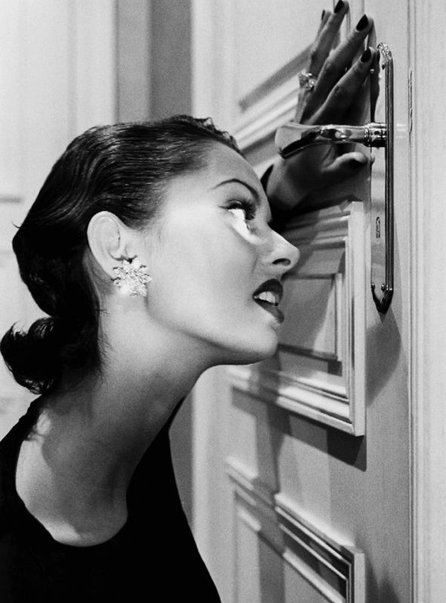
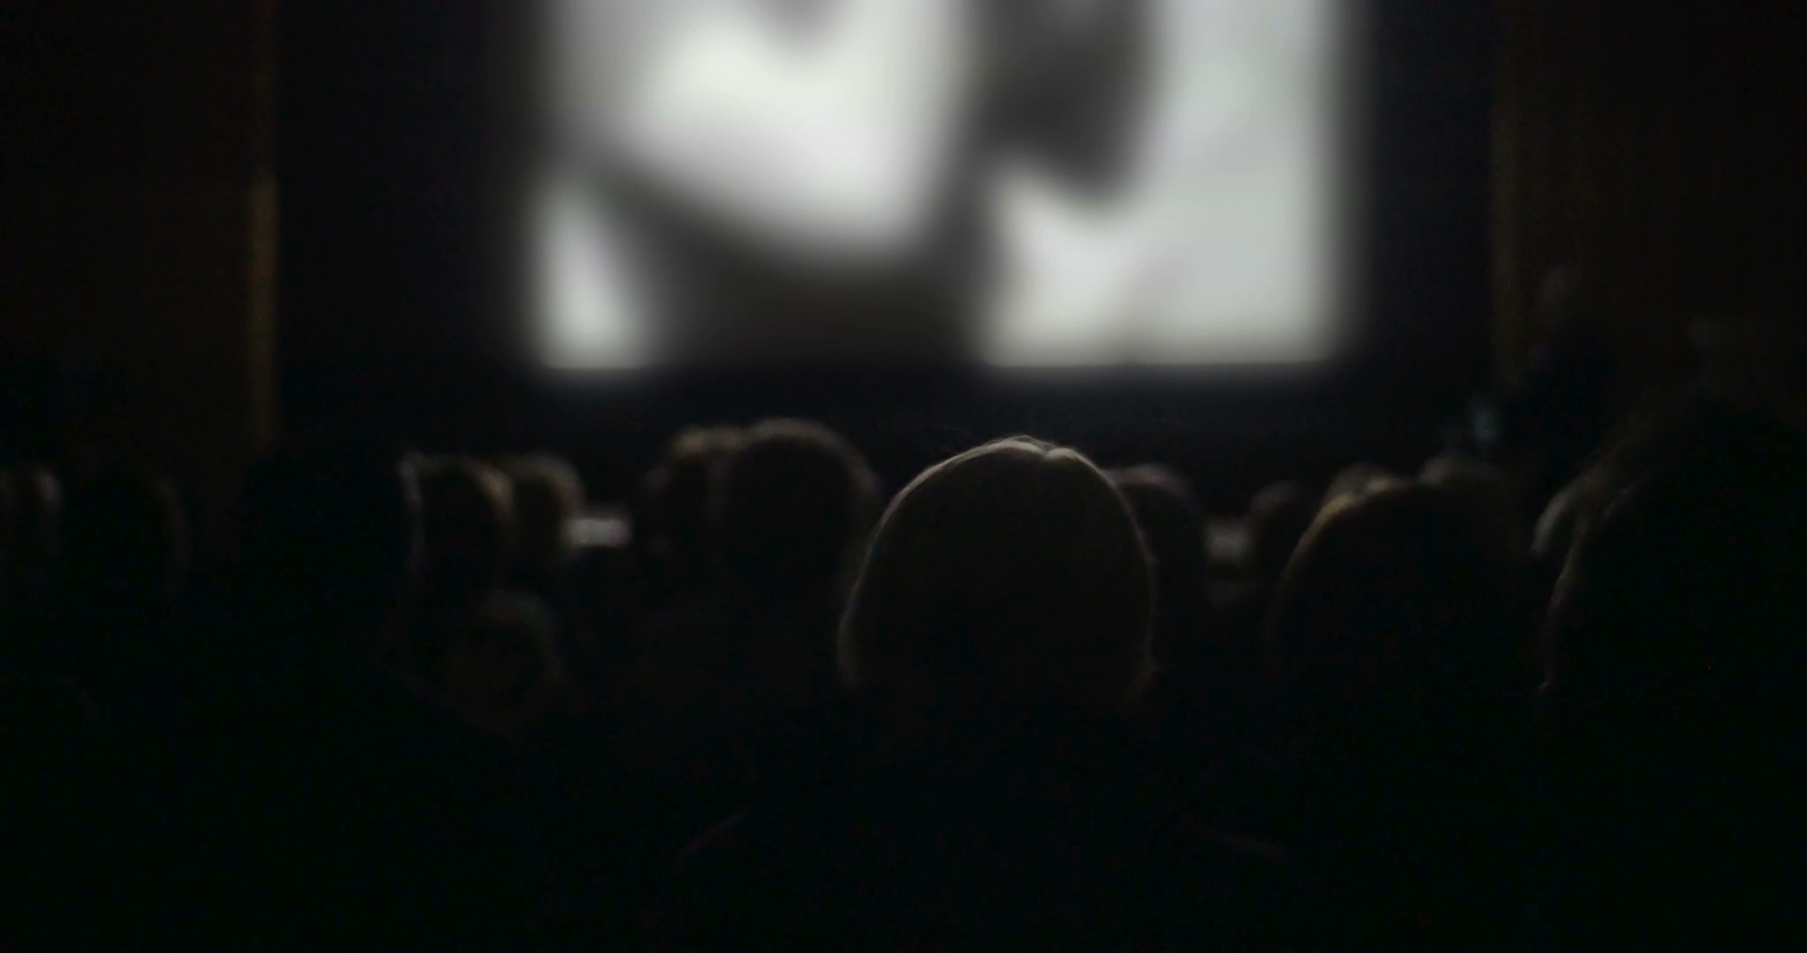
SCOPOPHILIA
Active gaze ✓
Passive object ✓
Voyeuristic experience ✓
Literal seeing ✓
Notes:
Film portrays “a hermetically sealed world which unwinds magically, indifferent to the presence of the audience, producing for them a sense of separation and playing on their voyeuristic phantasy” (806).
“Moreover, the extreme contrast between the darkness in the auditorium (which also isolates the spectators from one another) and the brilliance of the shifting patterns of light and shade on the screen helps to promote the illusion of voyeuristic separation” (806).
“Although the film is really being shown, is there to be seen, conditions of screening and narrative conventions give the spectator an illusion of looking in on a private world” (806).
This involves repression and a projection of the repressed desire on to the performer.

Slide 8
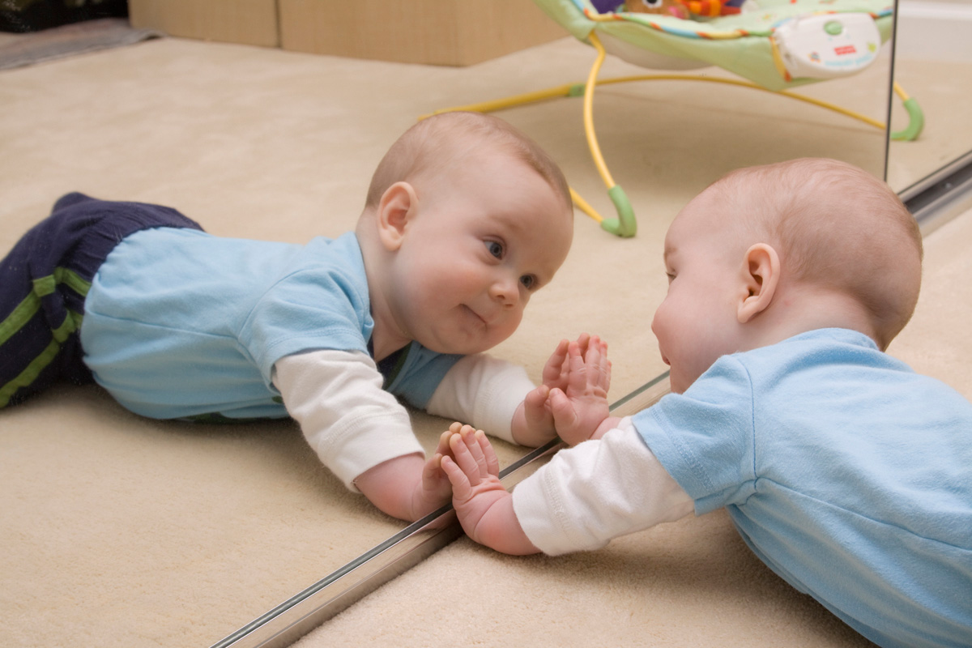
NARCISSISM
the mirror stage
Notes:
“Lacan has described how the moment when a child recognises its own image in the mirror is crucial for the constitution of the ego. Several aspects of this analysis are relevant here” (807).
“The mirror phase occurs at a time when the child’s physical ambitions outstrip his motor capacity, with the result that his recognition of himself is joyous in that he imagines his mirror image to be more complete, more perfect than he experiences his own body” (807).
“Recognition is thus overlaid with mis-recognition: the image recognised is conceived as the reflected body of the self, but its misrecognition as superior projects this body outside itself as an ideal ego, the alienated subject, which, re-introjected as an ego ideal, gives rise to the future generation of identification with others” (807).
Identification with the image seen.

Slide 9
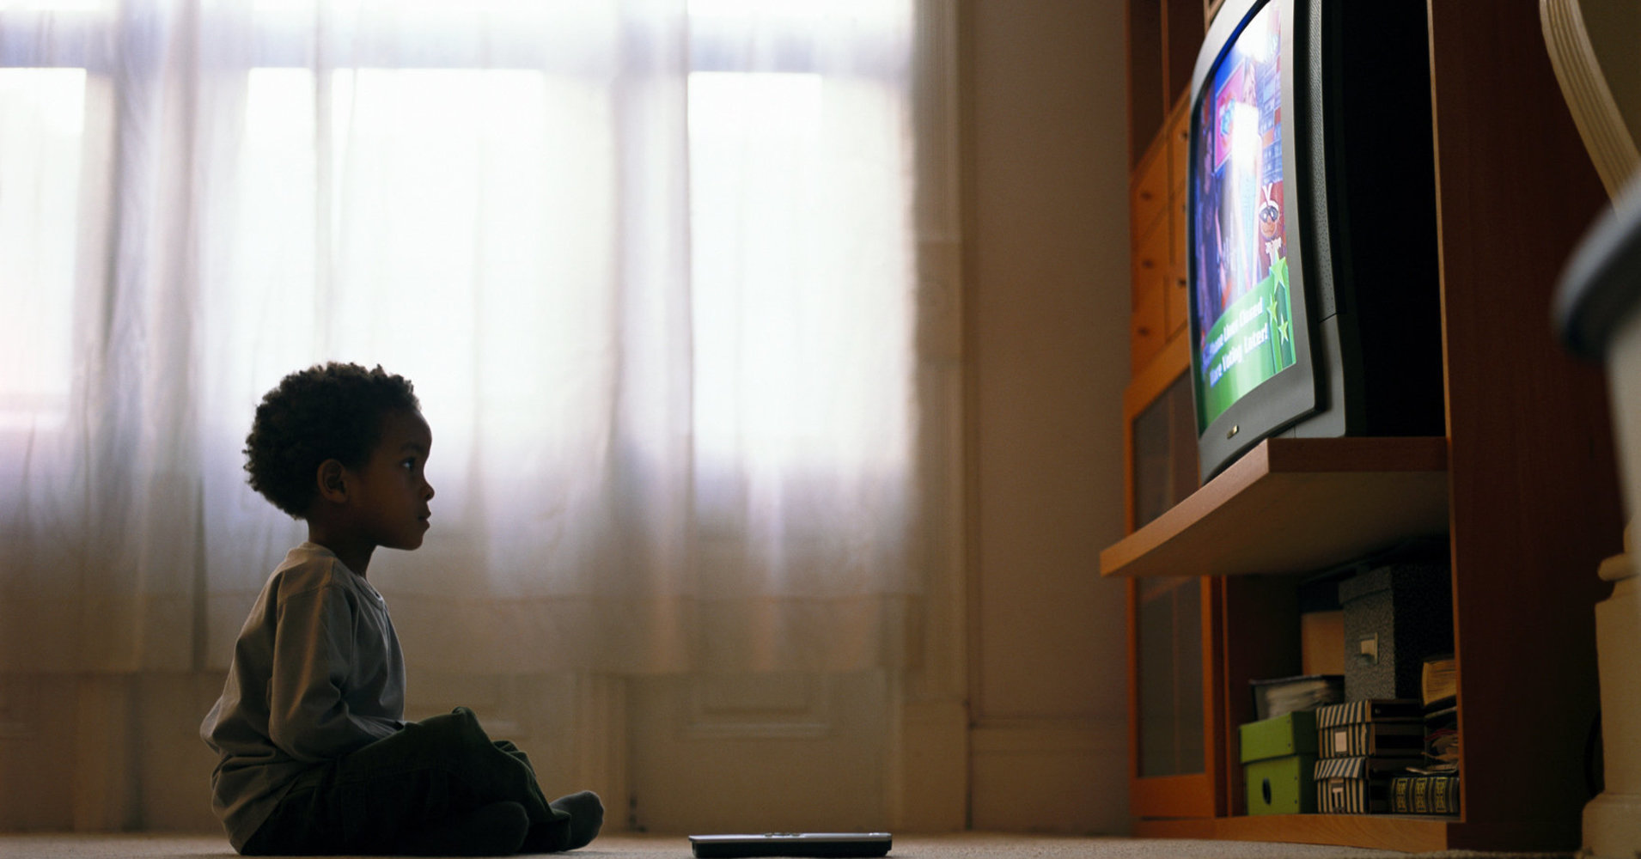
NARCISSISM
the “mirror” stage
Notes:
Identification with the image seen.
Ego-libido vs. object-libido

Slide 10
THE MALE GAZE
“[W]omen are simultaneously looked at and displayed, with their appearance coded for strong visual and erotic impact so that they can be said to connote to-be-looked-at-ness” (809).
“For a moment the sexual impact of the performing woman takes the film into a no-man’s-land outside of its own time and space” (809).
In Hollywood cinema, costume, makeup, blocking, pacing, camera positioning, camera movement, and editing are often deployed to this end.
Notes:
Show Postman, Bond clips, and Transformers
First distinction…

Slide 11
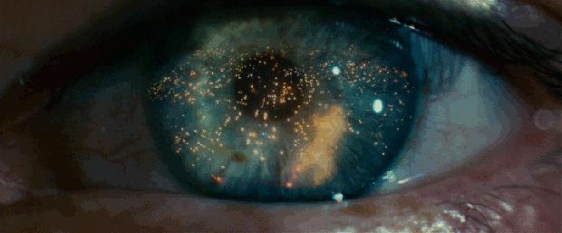
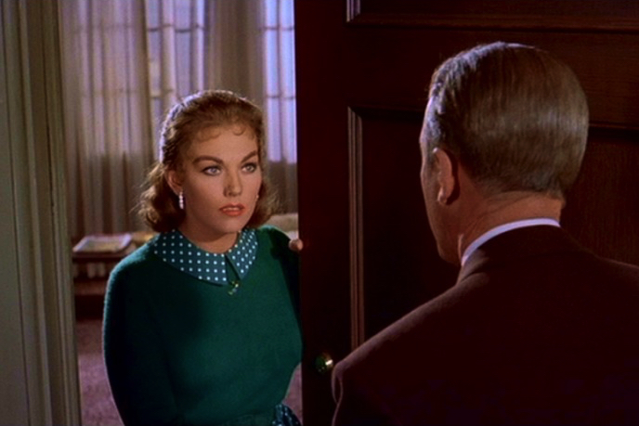
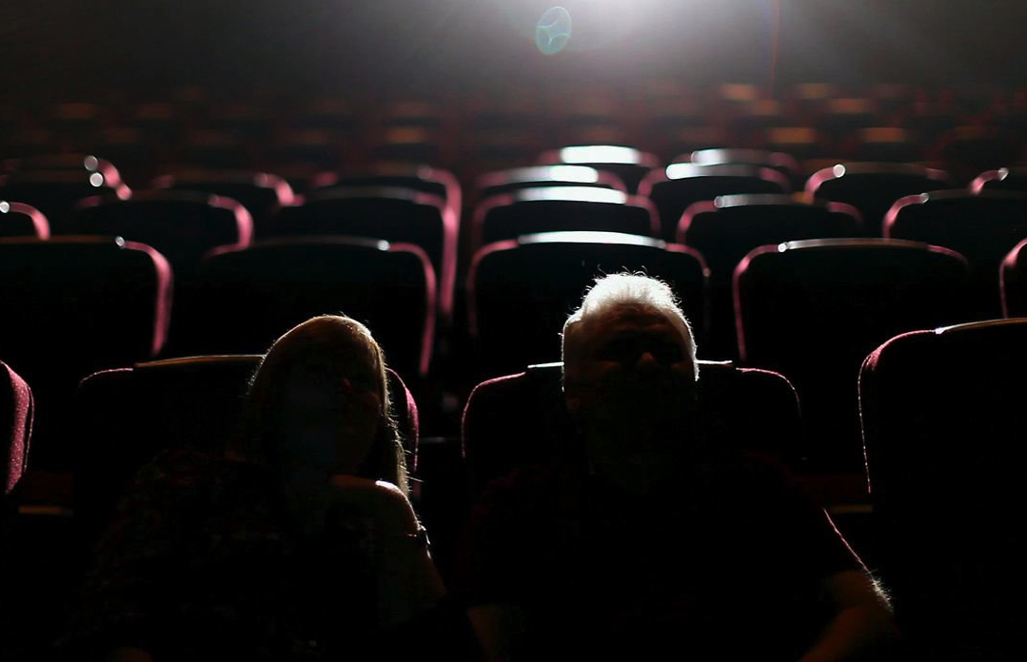
THE MALE GAZE
camera
character
spectator

Slide 12
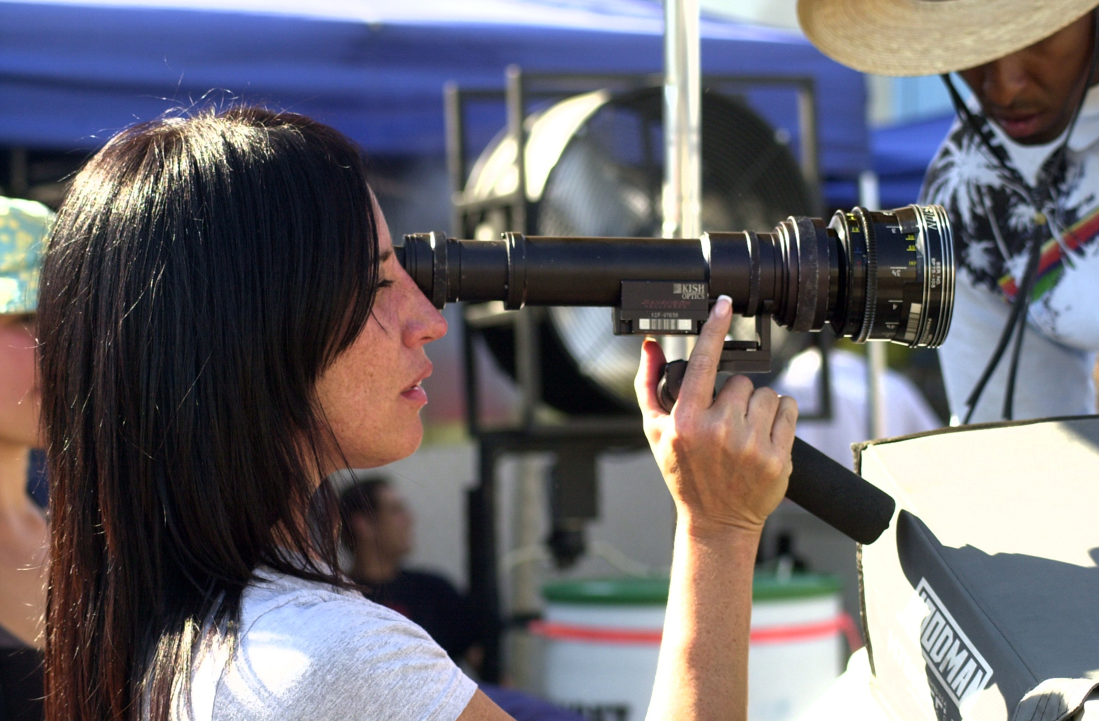
THE MALE GAZE
Diane Martel
Notes:
Show Robin Thicke clip

Slide 13
THE MALE GAZE
The male gaze (literal)
The institution of Hollywood is largely dominated by men.
Hollywood directors are often men; male characters frequently take female characters as erotic objects; and the audience is often (assumed to be) male.
The male gaze (figurative)
“The male gaze is not always male, but it is always male-dominated. . . . Movies promote a way of seeing which takes man as subject, woman as object” (Devereaux 1990, 339).
The objects of this gaze are seen as merely-to-be-looked-at in a way that reflects (and supports) a disequilibrium in power.
Notes:
“By male-dominated, feminist theorists mean male-gendered not simply possessed of male anatomy. . . . Male institutional control thus refers not to the anatomy of film world personnel, which includes both men and women, but to the way film, however authored, contributes to the hegemony of men over women” (339).
“Movies promote a way of seeing which takes man as subject, woman as object” (339).

Slide 14
THE MALE NARRATIVE
Male characters…
frequently assume active roles: they make things happen, move the story forward, erotically contemplate female characters, etc.
they are the ego ideals with whom male spectators identify.
Female characters…
frequently assume passive roles: they often fit the character types of “Good Girl” and “Dutiful Wife.”
they are objects of erotic contemplation.
their success is typically marked by their relationships with men.
they are primarily objects of scopophilic pleasure.
Notes:
Mention how this enables the male spectator and the male character to coincide.
“A male movie star’s glamorous characteristics are thus not those of the erotic object of the gaze, but those of the more perfect, more complete, more powerful ideal ego conceived in the original moment of recognition in front of the mirror. The character in the story can make things happen and control events better than the subject/spectator, just as the image in the mirror was more in control of motor coordination” (810).
Mention how it might be that women identify with them.

Slide 15
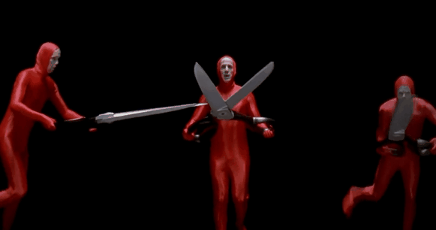
TWO STRATEGIES
castration anxiety

Slide 16
TWO STRATEGIES
Voyeurism: reenact the original trauma by investigating the woman and explaining her lack; respond to that explanation by devaluing, punishing, or saving her.
Fetishism: substitute the cinematic image as a fetish object in place of woman’s lack so that the image becomes reassuring rather than threatening.
Notes:
“This second avenue, fetishistic scopophilia, builds up the physical beauty of the object, transforming it into something satisfying in itself. The first avenue, voyeurism, on the contrary, has associations with sadism: pleasure lies in ascertaining guilt (immediately associated with castration), asserting control and subjecting the guilty person through punishment or forgiveness. This sadistic side fits in well with narrative” (811–12).
“Fetishistic scopophilia, on the other hand, can exist outside linear time as the erotic instinct is focused on the look alone” (812).
“[T]he female form itself can be turned into a fetish object, a process of fetishization that can be amplified by turning the entire scenography and cinematic image into a fetish object” (352).

Slide 17
TWO STRATEGIES
voyeurism
Notes:
“Mulvey associates voyeurism with the urge for a sadistic assertion of control and the subjugation of the guilty” (352).
“The first avenue, voyeurism, on the contrary, has associations with sadism: pleasure lies in ascertaining guilt (immediately associated with castration), asserting control and subjecting the guilty person through punishment or forgiveness. This sadistic side fits in well with narrative” (811–12).

Slide 18
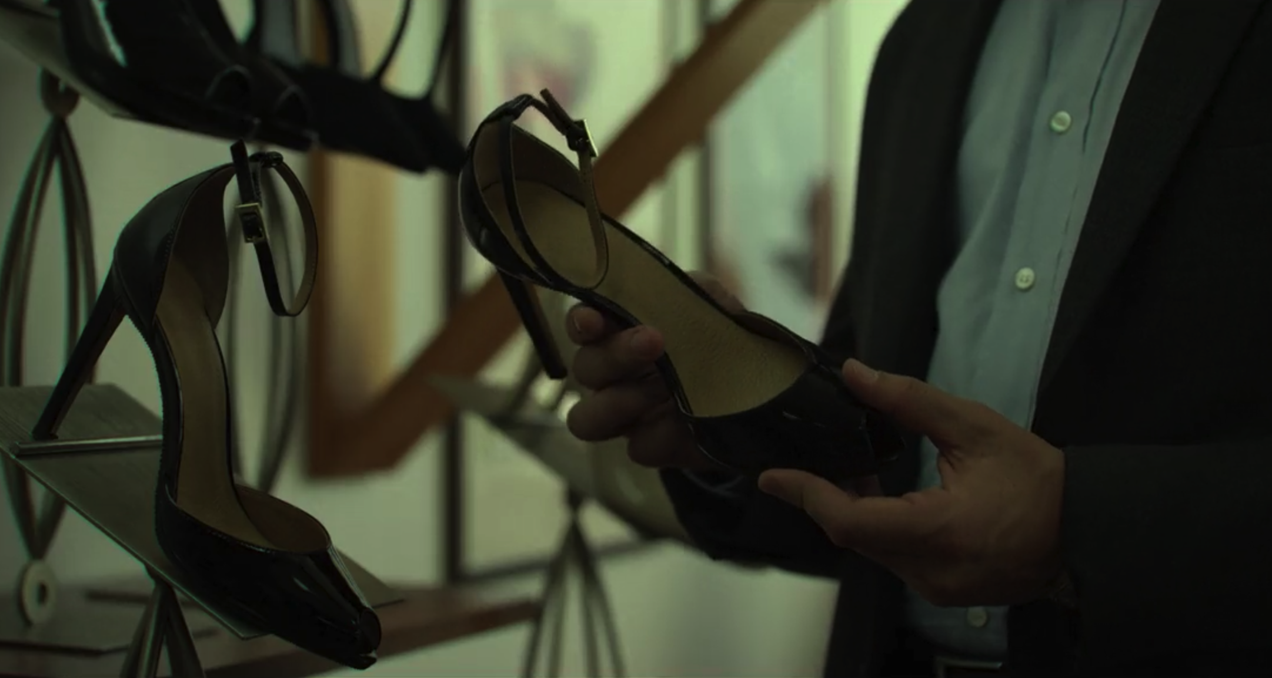
TWO STRATEGIES
fetishism
Notes:
“Fetishism outside of film involves the denial of the female’s lack of a penis by, so to speak, fastening on some substitute object, like a woman’s foot or shoe, that can stand for the missing penis” (352).

Slide 19
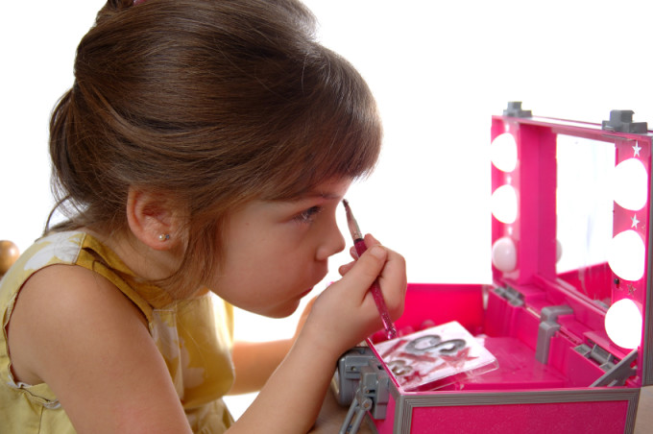
IMPLICATIONS
The way cinema structures our visual pleasure mirrors and informs how women are viewed and treated off-screen.

Slide 20
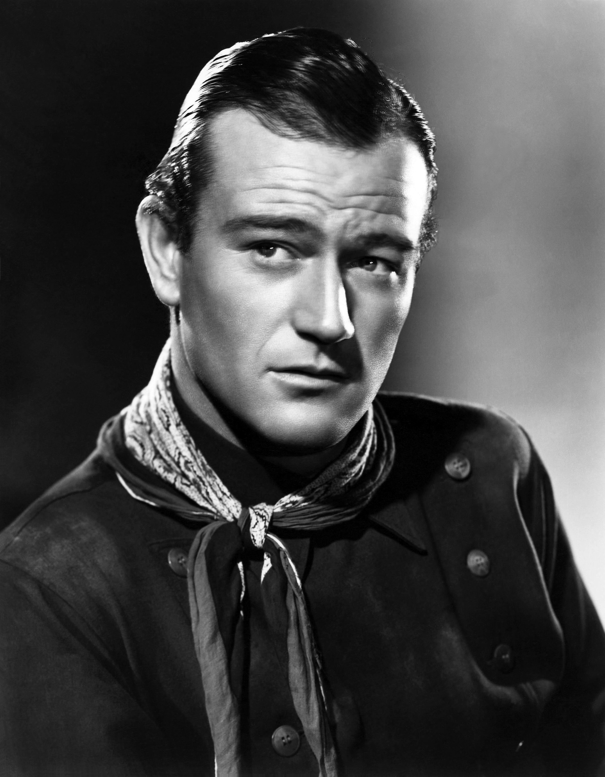
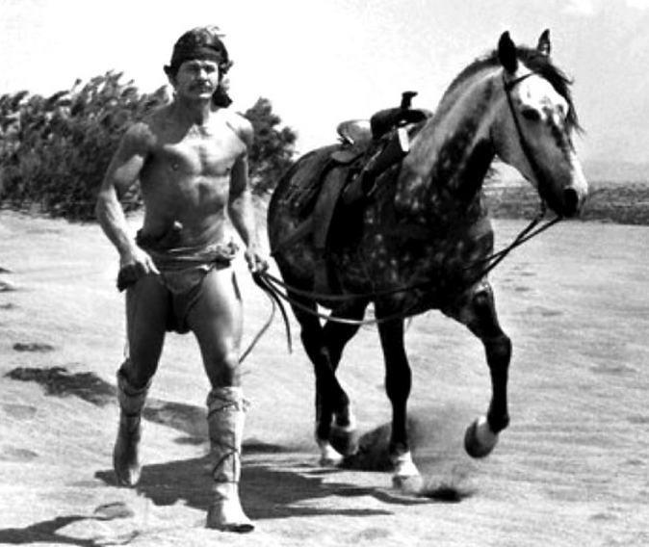
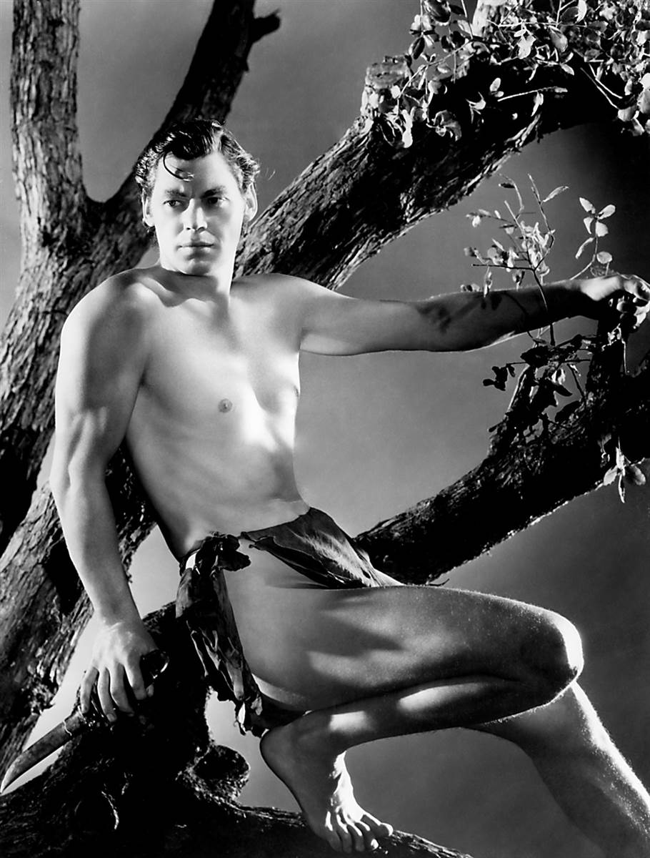
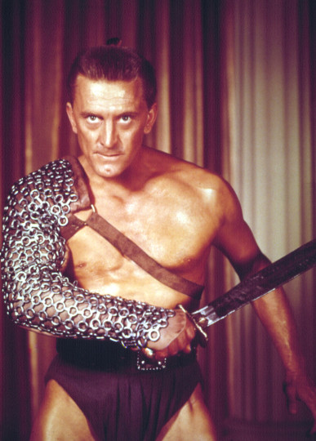
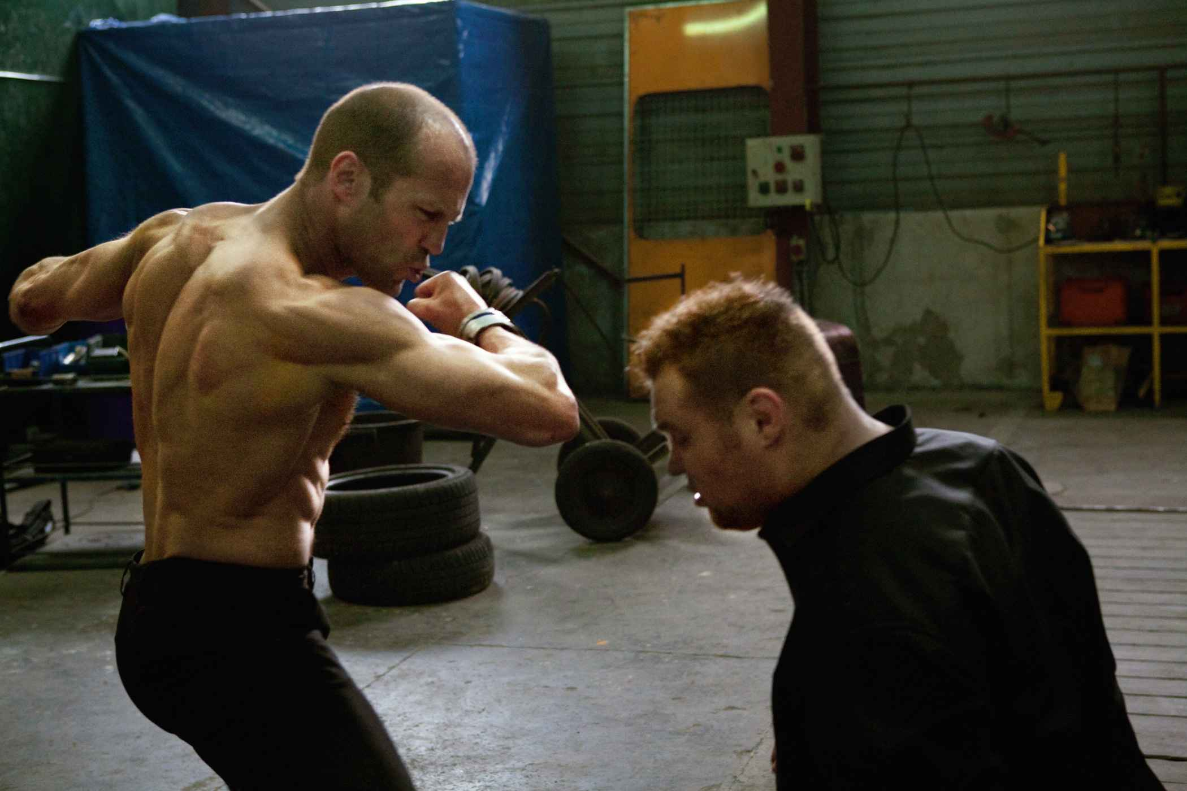
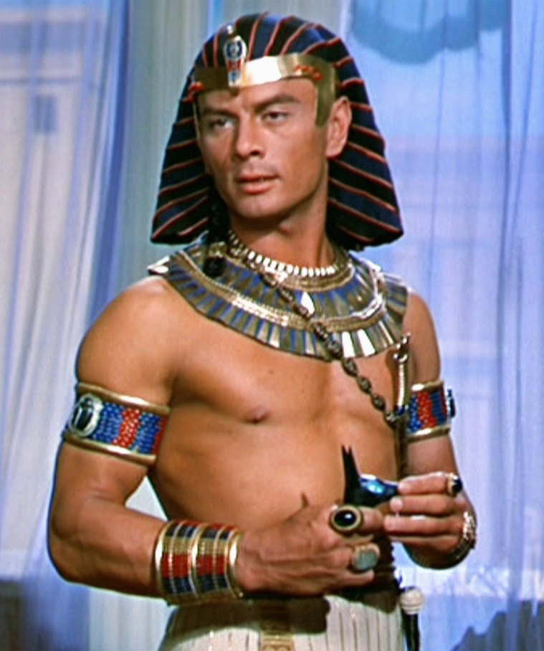
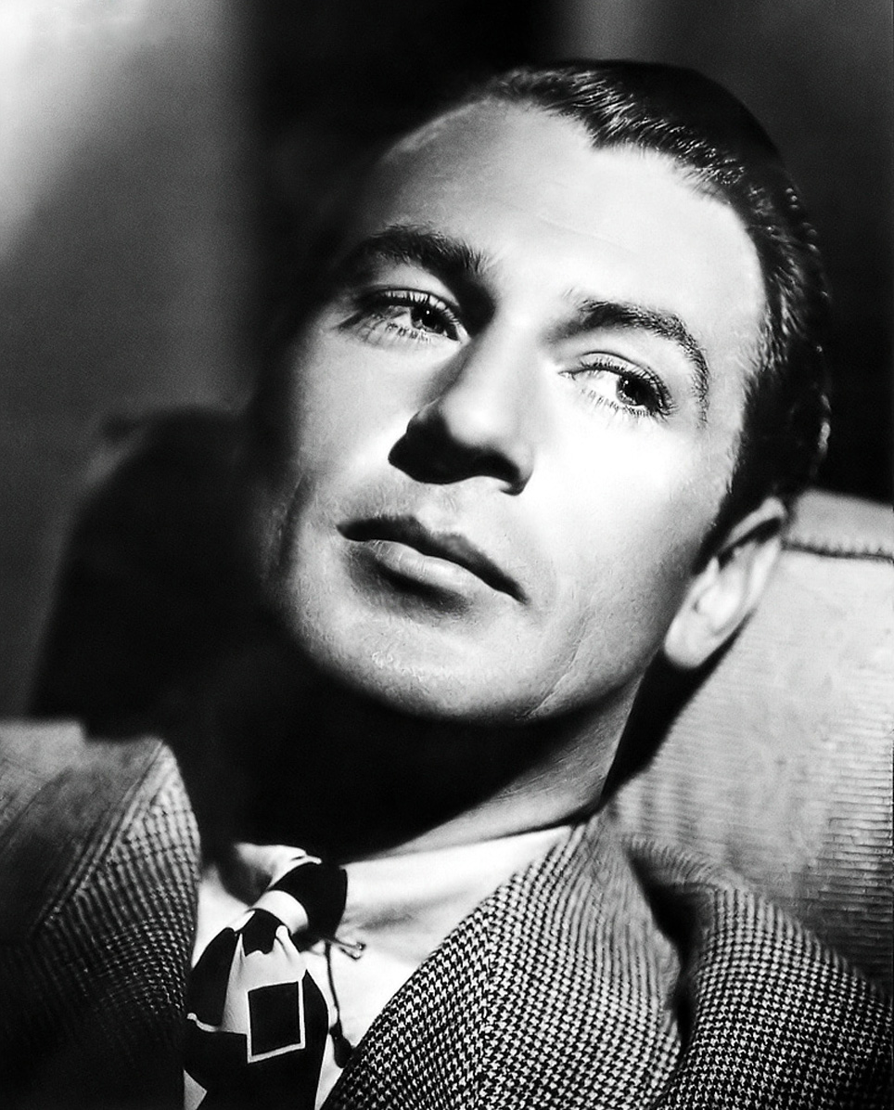
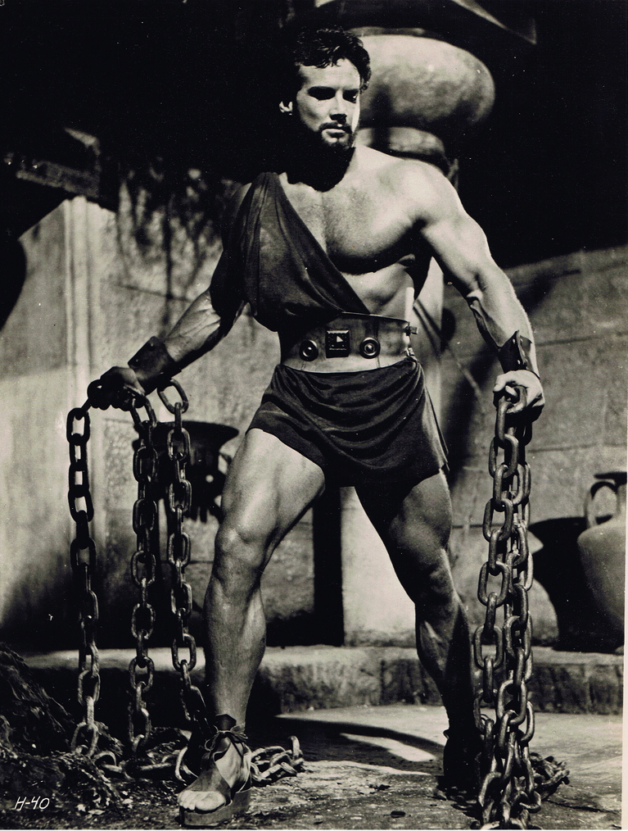
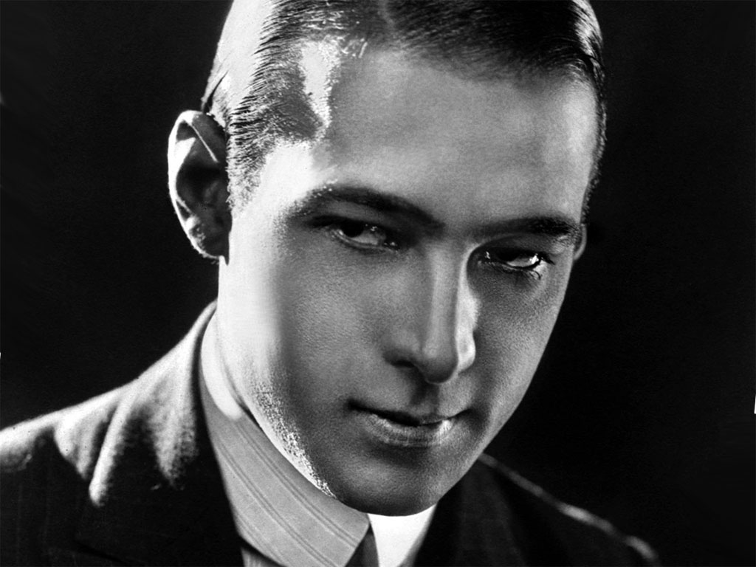
OBJECTION

Slide 21
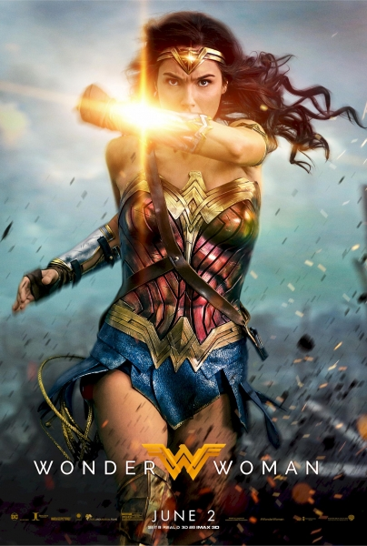
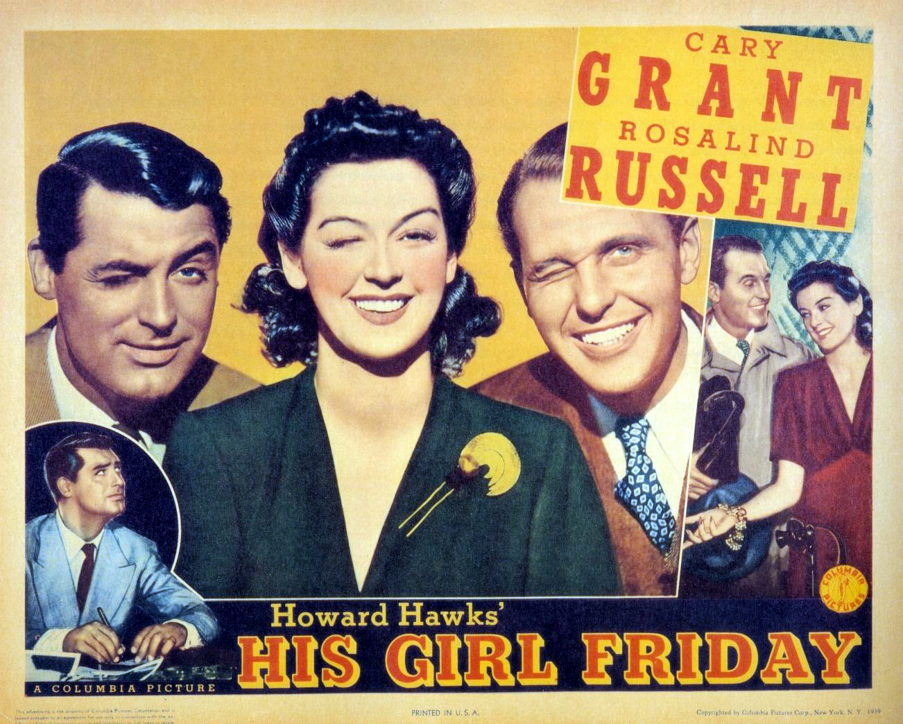
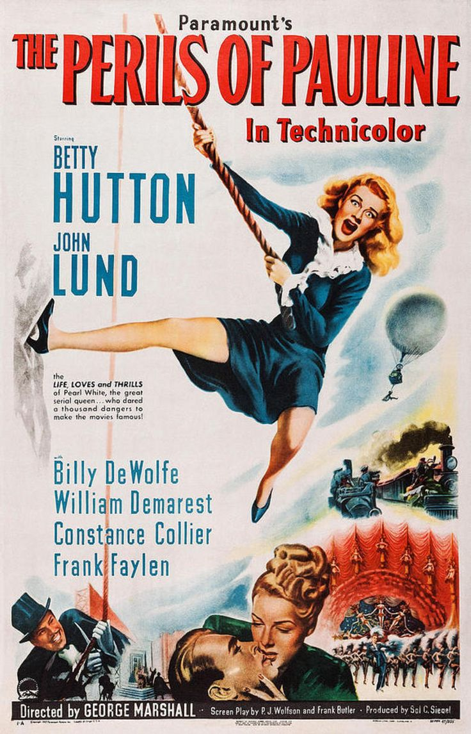
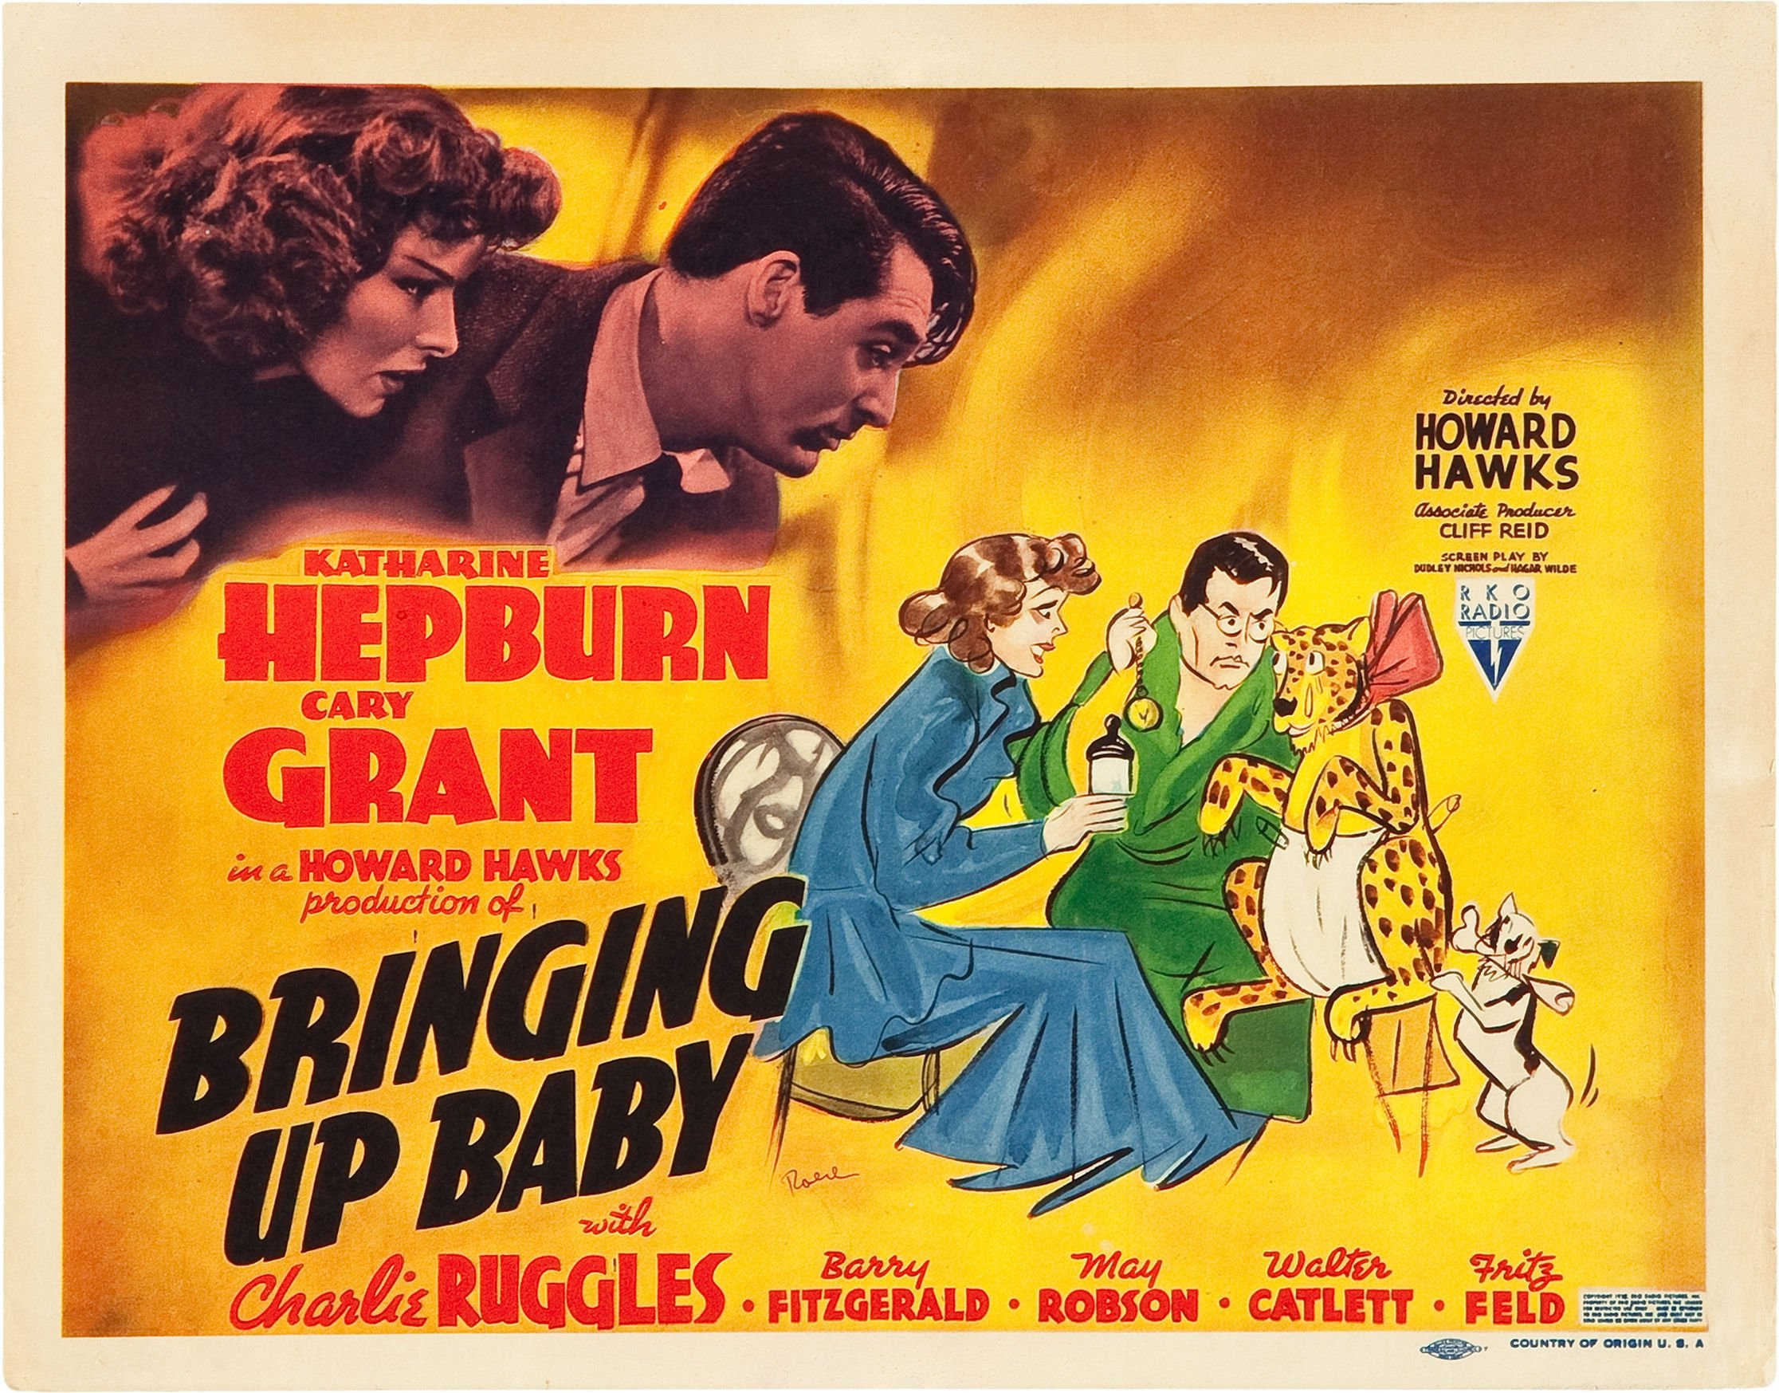
OBJECTION

Slide 22
OBJECTION
Voyeurism and fetishism are perversions; deriving visual pleasure from cinema is, presumably, not a perversion. So are the comparisons apt?
The experience of voyeurism is importantly different from cinematic experience.

Slide 23
OBJECTION

Slide 24
SCOPOPHILIA
Active gaze ✓
Passive object ✓
Voyeuristic experience ✓
Literal seeing ✓
Notes:
Film portrays “a hermetically sealed world which unwinds magically, indifferent to the presence of the audience, producing for them a sense of separation and playing on their voyeuristic phantasy” (806).
“Moreover, the extreme contrast between the darkness in the auditorium (which also isolates the spectators from one another) and the brilliance of the shifting patterns of light and shade on the screen helps to promote the illusion of voyeuristic separation” (806).
“Although the film is really being shown, is there to be seen, conditions of screening and narrative conventions give the spectator an illusion of looking in on a private world” (806).
This involves repression and a projection of the repressed desire on to the performer.

Slide 25
OBJECTIFICATION
The etymology of the term “objectification” suggests that for x to objectify y is for x to take y as an object. On that construal, almost all conscious experience is objectifying: consciousness is (almost) always consciousness-of.
Objectification-as-dehumanization involves treating something as an object of aesthetic contemplation. But is that problematic?
Objectification-as-debasement involves devaluing the worth of something through thought or action—for example, treating something as merely-to-be-looked-at.

Slide 26
THE FEMALE GAZE (?)
Does the female spectator derive the same kind of visual pleasure from looking at women as men do?
Or is it the masochistic pleasure of enjoying objectification?
Alternatively, is it the sadistic pleasure of identifying with an oppressor?
Notes:
“Since, in feminist terms, the male gaze is not only sexist, but heterosexist, might we not also ask for an account of ho the male gaze operates when the spectator is not heterosexual? Either case, can the characterization of the male gaze as ‘totally active’ be sustained? Moreover isn’t the assumed activity and control of the male spectator at odds with the widespread notion that the Hollywood film monolithically encourages a form of passive spectatorship? Equating the male gaze with the active gaze ignores the passive element involves in looking at movies. The male spectator, whatever his real political and social power, cannot interact with the on-screen woman. She appears, but is physically absent” (334).

Slide 27
THE FEMALE GAZE (?)
Men may be objectified or dehumanized on screen, but are they ever debased?
“Not only must looking come with some ‘back up’—physical, economic, social—‘being looked at’ must activate some level of female narcissism. Women themselves must not be indifferent to the gaze turned upon them; they must have internalized a certain assignment of positions” (Devereaux 1990, 341).
Notes:
“Given these distinctions, male characters, like their female counterparts, may be objectified or even, as in the case of Richard Gere, aestheticized (or eroticized). They may also be portrayed in demeaning or ‘less than fully human’ ways. They are not, however, debased in the larger sense of the word. Men are not debased in this sense because men, as men, do not lack power and status off-screen. Thus, debasement requires more than occupying a particular position on screen” (342).
“Aestheticization may not in itself be harmful, nevertheless, the Hollywood film reflects and encourages the cultural proclivity to treat the female body and the female self only as objects of aesthetic contemplation. Thus, insofar as it treats women as less than fully human, the film industry helps to lower the esteem and value granted to women in the culture. While, as I have argued, movie-making and movie-watching cannot be held solely responsible for the debasement of women, feminist theory rightly emphasizes the connection between how we represent our lives and lived experience itself” (342).

Slide 28
COMBATTING THE GAZE (?)
Within the Hollywood system, is it possible to break the structure of male/female, active/passive, or is the best we can do to simply reverse which groups of individuals realize these roles?
Notes:
Make the point about women assuming masculine positions

Slide 29
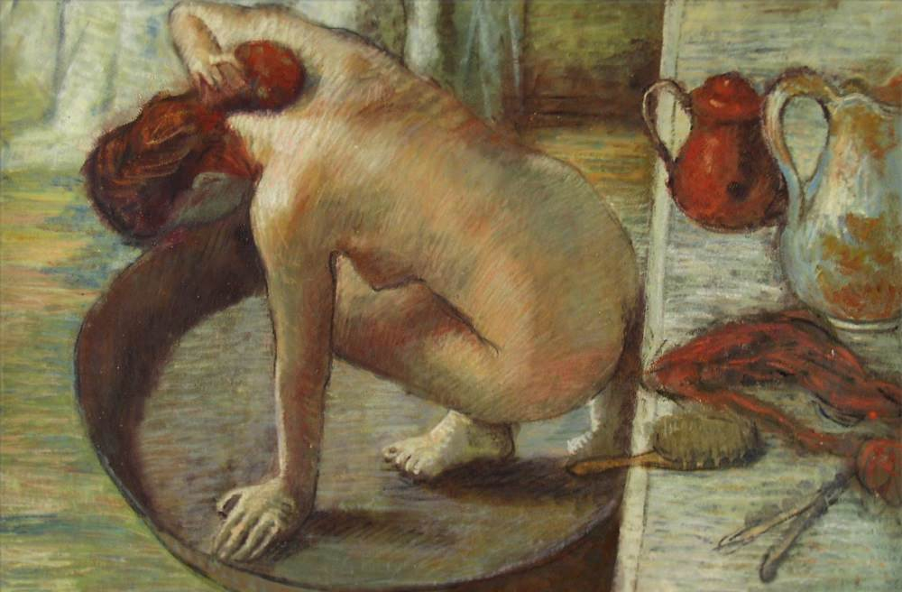
COMBATTING THE GAZE (?)
The Tub – Edgar Degas
^{“[T]he spectator} . . . is made highly conscious of the act of spectating. . . . the subject of Degas’s Bathers is indeed the voyeuristic gaze of the artist/spectator” (Callen 1995, 137).
Notes:
“The contorted poses of the figures and the unusually high or incoherent viewpoints from which they are depicted have the effect of disembodying the implied spectator” (188).
“Thus Callen writes that Degas ‘positioned his models expressly to avoid visual confrontation with the spectator. He reinforced the device of the averted eyes by exploiting poses which connote unselfconsciousness on the model’s part’ (1991: 165). She concludes that the images pander to the ‘silent voyeuristic soliloquy’ of the male gaze (1991: 166)” (188–9).

Slide 30
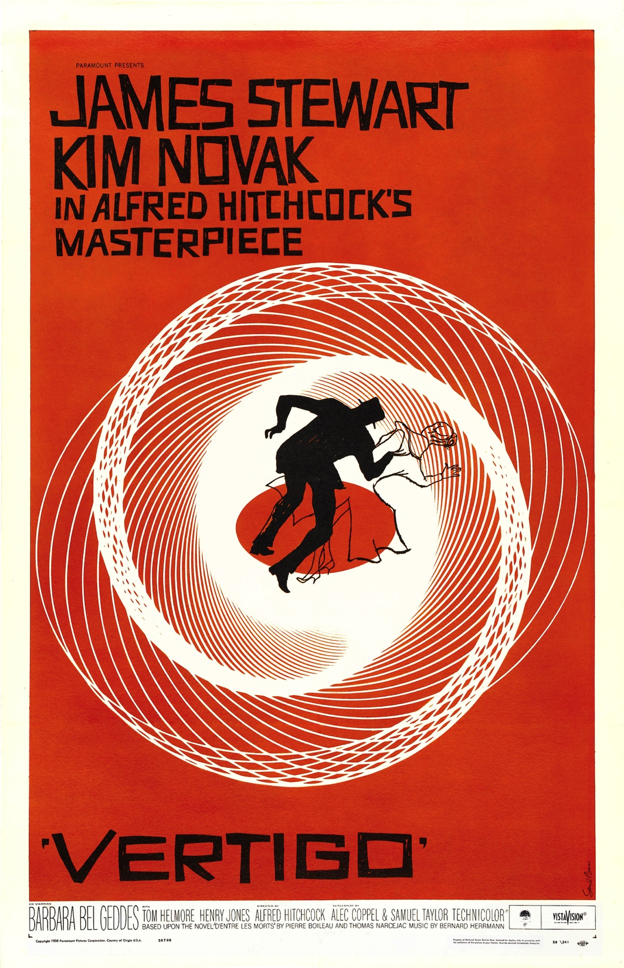
COMBATTING THE GAZE (?)
“In Vertigo, erotic involvement with the look is disorienting: the spectator’s fascination is turned against him as the narrative carries him through and entwines him with the processes that he is himself exercising. The Hitchcock hero here . . . has all the attributes of the patriarchal super-ego. Hence the spectator, lulled into a false sense of security by the apparent legality of his surrogate, sees through his look and finds himself exposed as complicit, caught in the moral ambiguity of looking” (814–15).

