Slide 1
VIDEO EXAMPLE
https://www.youtube.com/watch?v=8ixzZYxM7Hc

Slide 2
Affirmative action
PHL 304
Fall 2018

Slide 3
THE PLAN
Discuss an argument against affirmative action
Isolate the principles that it appears to presuppose
Discuss Boxill’s arguments for thinking that these principles are mistaken
Discuss Pojman’s objection to a similar argument
Discuss Pojman’s arguments against affirmative action

Slide 4
PLESSY V. FERGUSON (VIDEO)
https://www.youtube.com/watch?v=Sj54KP16Ilw

Slide 5
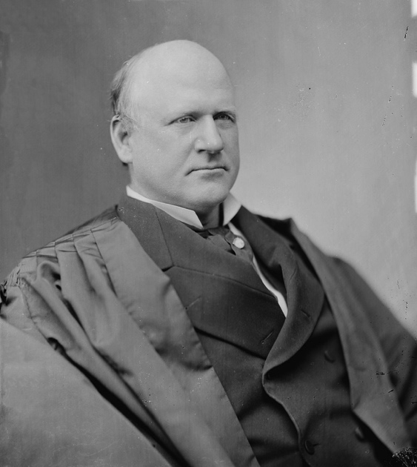
THE COLOR-BLIND PRINCIPLE
Our Constitution is color-blind.
Justice John Marshall Harlan
Notes:
“Justice Harlan found that the ‘separation of citizens on the basis of race [was a] badge of servitude . . . wholly inconsistent [with] equality before the law’” (10)

Slide 6
THE COLOR-BLIND PRINCIPLE
Color-conscious policies are designed to treat people differently because of their race, sex, gender, etc.
Some do so explicitly (e.g., segregation laws).
https://www.youtube.com/watch?v=HcnoV_S9258
Affirmative action refers to policies that give preference to certain groups in the competition for jobs and promotion and for acceptance into universities or colleges.
Bernard Boxill
Notes:
Emphasize that this should be construed as a catchall for sex, gender, etc.
“Some color-conscious policies explicitly state that persons should be treated differently because of their race, for example the segregation laws at issue in Plessy; others make no mention of race, but are still designed so that blacks and whites are treated differently, for example, the ‘grandfather’ clauses in voting laws that many states adopted at the turn of the century” (11)
“To give one instance, in Louisiana this clause stated that those who had the right to vote before or on 1 January 1867, or their lineal descendants, did not have to meet the educational, property, or tax requirements for voting” (11)
“Since no blacks had had the right to vote by that time, this law worked effectively to keep blacks from voting while at the same time allowing many impoverished and illiterate whites to vote—yet it made no mention of race” (11)

Slide 7
THE COLOR-BLIND PRINCIPLE
Perhaps we ought to aim toward a society in which people do not notice each others’ color (or gender).
Perhaps we even ought to eliminate concepts like race and gender, which can be tools of oppression.
Color-conscious policies might be the best means to the end of attaining this ideal in the future.
Bernard Boxill
Notes:
Emphasize that this should be construed as a catchall for sex, gender, etc.
“Some color-conscious policies explicitly state that persons should be treated differently because of their race, for example the segregation laws at issue in Plessy; others make no mention of race, but are still designed so that blacks and whites are treated differently, for example, the ‘grandfather’ clauses in voting laws that many states adopted at the turn of the century” (11)
“To give one instance, in Louisiana this clause stated that those who had the right to vote before or on 1 January 1867, or their lineal descendants, did not have to meet the educational, property, or tax requirements for voting” (11)
“Since no blacks had had the right to vote by that time, this law worked effectively to keep blacks from voting while at the same time allowing many impoverished and illiterate whites to vote—yet it made no mention of race” (11)
“President Lyndon Johnson used the term ‘affirmative action’ to refer to special efforts to ensure that applicants were employed at government contracting agencies without regard to race, creed, color, or national origin” (118)

Slide 8
THE COLOR-BLIND PRINCIPLE
The color-blind principle holds that it is intrinsically wrong to implement laws or policies that are designed to treat people differently because of their race, sex, gender, etc.
Boxill argues that this principle is mistaken.
Some color-conscious policies are wrong, but not in virtue of being color-conscious.
Bernard Boxill
Notes:
“I do not deny that many color-conscious policies are wrong. Jim Crow was certainly wrong, and, for different reasons, proposals for black control of inner cities and inner city schools are probably wrong” (11)
“But this is not because they are color-conscious, but for reasons which indicate that color-conscious policies like busing and affirmative action could be correct” (11)

Slide 9
THE RESPONSIBILITY ARGUMENT
If members of a group cannot help having a certain characteristic, then any policy that treats them differently simply because they possess that characteristic is wicked, unfair, and unreasonable.
No one help being black, white, male, female, etc.
Any policy that treats individuals differently simply because they are black, white, male, female, etc. is wicked, unfair, and unreasonable.
Notes:
“No one can help being white or being black, and so it seems to follow that it is wicked, unfair, and unreasonable to disqualify a person from any consideration just because he is white or black” (11)
“This, the advocates of color-blindness declare, is what made Jim Crow law heinous, and it is what makes affirmative action just as heinous” (11)
“The force of this consideration is enhanced because it seems to account for one peculiar harmfulness of racial discrimination—its effect on self-respect and self-esteem” (11–12)
“For racial discrimination makes some black people hate their color, and succeeds in doing so because color cannot be changed. Furthermore, a racially conscious society has made color seem an important part of the individual’s very essence, and since color is immutable it is easily susceptible to this approach. As a result, the black individual may come, in the end, to hate even himself” (12)

Slide 10
THE RESPONSIBILITY ARGUMENT

Slide 11
THE RESPONSIBILITY CRITERION
The responsibility criterion: It is intrinsically unjust to distribute goods on the basis of a feature for which individuals are not responsible.
The principle of equal opportunity: It is just to discriminate on the basis of people’s having a certain feature only if those people had a fair opportunity to acquire or avoid that feature.
These principles are consistent with discriminating in favor of people who have a certain feature for which they are not responsible so long as that feature is a reliable indicator of some other feature (such as ability or merit) such that it is not unjust to discriminate in favor of people who have that feature.
Notes:
“[P]eople do not choose to be, and cannot avoid being, black or white” (12–13)
“This links the question of color-blindness to the protean idea of individual responsibility” (13)
“Thus, William Frankena writes, that to use color as a fundamental basis for distributing ‘opportunities, offices, etc.’ to persons is ‘unjust in itself,’ because it is to distribute goods on the basis of a feature ‘which the individual has not done, and can do nothing about; we are treating people differently in ways that profoundly affect their lives because of differences for which they have no responsibility’” (13)
“Since this argument requires that people be treated differently in ways which profoundly affect their lives only on the basis of features for which they are responsible, I call it the responsibility criterion” (13)
“The responsibility criterion also seems to make the principle of color-blindness follow from principles of equal opportunity” (13)
“This implies that to discriminate between persons on the basis of a feature for which they can have no responsibility is to violate the principle of fair opportunity. But color (or sex) is a feature of persons for which they can have no responsibility” (13)
“[This] could support the argument that black and white children should go to the same schools because being white is a reliable indicator of being middle-class, and black children, who are often lower-class, learn better when their peers are middle-class. Similarly, it might support the argument that preferential hiring is compensation for the harm of being discriminated against on the basis of color, and that being black is a reliable sign of having been harmed by that discrimination” (13)

Slide 12
THE QUICK HANDS ANALOGY
Attended a prestigious university
Graduated top of his class
Moderately unsteady hands
Attended a prestigious university
Graduated top of his class
Very steady hands
Dr. Flat
Dr. House
Notes:
“‘If quick hands count as ‘merit’ in the case of a prospective surgeon this is because quick hands will enable him to serve the public better and for no other reason. If a black skin will, as a matter of regrettable fact, enable another doctor to do a different medical job better, then that black skin is by the same token ‘merit’ as well’” (13)
“What is proposed here is not that a black skin is a justifiable basis of discrimination because it is a reliable sign of merit or some other factor Q. A closely related argument does make such a proposal, viz., that blacks should be preferentially admitted to medical school because being black is a reliable sign of a desire to serve the black community” (13–14)
“But this is not the argument that Dworkin poses. In the example quoted above what he suggests is that being black is in itself merit, or, at least, something very like merit” (14)
“According to the responsibility criterion, we ought not to give [Dr. House] a job in surgery rather than [Dr. Flat], if [Dr. House] is a better surgeon than [Dr. Flat] only because he was born with quicker hands” (14)
“For if we do, we treat [Dr. House and Dr. Flat] ‘differently in ways that profoundly affect their lives because of differences for which they have no responsibility” (14)

Slide 13
THE QUICK HANDS ANALOGY
Attended a prestigious university
Graduated top of her class
Best equipped to treat black patients
Attended a prestigious university
Graduated top of her class
Black applicant
White applicant

Slide 14
THE QUICK HANDS ANALOGY
Affirmative action primarily concerns the distribution of jobs and offices.
Most jobs and offices are distributed to people for the purpose of producing goods and services to a larger public.
It is irrelevant whether the people who produce those goods or provide those services are responsible for the qualities that enable them to do so.
So long as it serves a “worthy end,” it is not unjust to discriminate between two individuals on the basis of a feature for which one of them is not responsible.
Notes:
“To that end, the responsibility criterion is irrelevant” (15)
“For example, the purpose of admitting people to medical schools and law schools is to provide the community with good medical and legal service. It does not matter whether those who provide them are responsible for having the skills by virtue of which they provide the goods, or whether the positions they occupy are ‘goods’ for them” (15)
“No just society makes a person a surgeon just because he is responsible for his skills or because making him a surgeon will be good for him. It makes him a surgeon because he will do good surgery” (15)
“It may be permissible for the admissions policies of professional schools to give preference to those with higher scores, even if their scores are higher than others only because they have higher native ability (for which they cannot, of course, be considered responsible), if the object is to provide the community with good professional service” (15)
“And, given the same object, if for some reason a black skin, whether or not it can be defined as merit, helps a black lawyer or doctor to provide good legal or medical service to black people who would otherwise not have access to it, or avail themselves of it, it is difficult to see how there can be a principled objection to admissions policies which prefer people with black skins—though, again, they are not responsible for the quality by virtue of which they are preferred” (15)

Slide 15
CONSIDERATIONS OF JUSTICE
Justice is distributive: it is concerned with not only increasing the total amount of a good a society enjoys, but also with how that good should be distributed among individuals.
People who are similar in ways that are relevant to justice should get equal amounts of a good, whereas people who are dissimilar in ways that that are relevant to justice should get unequal amounts of the good.
This may make for a morally relevant difference between two different policies that discriminate on the basis of a characteristic like race.
Notes:
“Consider, for example, a policy for admitting persons to medical school which resulted in better and better medical service for white people, but worse and worse medical service for black people. This policy would be unjust, however great the medical expertise—certainly a good—it produced, unless color is relevant to the receiving of good medical attention” (16)
“The point is that if black clients tend to trust and confide more in black lawyers and doctors, then color—functioning as merit—enables a good to be produced and distributed according to some principle of justice” (16)

Slide 16
WHAT ABOUT RACIST POLICIES?
The responsibility criterion implies that racist policies designed to discriminate against black people are morally problematic because black people do not choose to be black, cannot not be black, and are not responsible for being black.
This might explain why these policies are especially morally problematic.
But it is not an adequate explanation of why they are morally problematic in the first place.
These policies are unjust because they do not enable goods to be produced and distributed according to principles of justice.
Notes:
“For example, a policy denying university admission to people who parted their hair on the right side would be unjust because the way in which people part their hair is irrelevant to a just policy of school admission. It does not matter in the least, in relation to the nature and object of education, that they choose how they part their hair” (16)
“Similarly, even if black people could choose to become white, or could all easily pass as white, a law school or medical school that excluded blacks because they were black would still act unjustly. Nothing would have changed” (16)
“The arguments in support of color-blindness tend to make the harmfulness of discrimination depend on the difficulty of avoiding it” (16)
“It diverts attention from the potential harmfulness of discrimination that can be avoided and brings the specious responsibility criterion into play” (16)
“If he parts his hair on the left side he will presumably be admitted to law school. But then he will have knowingly complied with a foolish and unjust rule and this may well make him expedient and servile” (16)
“Of course, he will not be harmed to the same extent and in the same way as the victim of racial discrimination. For example, he probably will not hate himself. Unlike color, the cause of his ill-treatment is too easily changed for him to conceive of it as essential to himself. Moreover, if he chooses to keep his hair parted on the right side and thus to forego law school, he knows that he is not going to law school because he freely chose to place a greater value on his integrity or on his taste in hairstyles than on a legal education. He knows this because he knows he could have chosen to change his hairstyle” (16–17)
“As I noted earlier, this opportunity for self-assertion, and thus for self-knowledge and self-confidence, is denied the black person who is discriminated against on the basis of color” (17)

Slide 17
WHAT ABOUT RACIST POLICIES?
responsible for parting his hair
Notes:
“The arguments in support of color-blindness tend to make the harmfulness of discrimination depend on the difficulty of avoiding it” (16)
“It diverts attention from the potential harmfulness of discrimination that can be avoided and brings the specious responsibility criterion into play” (16)
“If he parts his hair on the left side he will presumably be admitted to law school. But then he will have knowingly complied with a foolish and unjust rule and this may well make him expedient and servile” (16)
“Of course, he will not be harmed to the same extent and in the same way as the victim of racial discrimination. For example, he probably will not hate himself. Unlike color, the cause of his ill-treatment is too easily changed for him to conceive of it as essential to himself. Moreover, if he chooses to keep his hair parted on the right side and thus to forego law school, he knows that he is not going to law school because he freely chose to place a greater value on his integrity or on his taste in hairstyles than on a legal education. He knows this because he knows he could have chosen to change his hairstyle” (16–17)
“As I noted earlier, this opportunity for self-assertion, and thus for self-knowledge and self-confidence, is denied the black person who is discriminated against on the basis of color” (17)

Slide 18
WHAT ABOUT RACIST POLICIES?
not responsible for being black
Notes:
“The arguments in support of color-blindness tend to make the harmfulness of discrimination depend on the difficulty of avoiding it” (16)
“It diverts attention from the potential harmfulness of discrimination that can be avoided and brings the specious responsibility criterion into play” (16)
“If he parts his hair on the left side he will presumably be admitted to law school. But then he will have knowingly complied with a foolish and unjust rule and this may well make him expedient and servile” (16)
“Of course, he will not be harmed to the same extent and in the same way as the victim of racial discrimination. For example, he probably will not hate himself. Unlike color, the cause of his ill-treatment is too easily changed for him to conceive of it as essential to himself. Moreover, if he chooses to keep his hair parted on the right side and thus to forego law school, he knows that he is not going to law school because he freely chose to place a greater value on his integrity or on his taste in hairstyles than on a legal education. He knows this because he knows he could have chosen to change his hairstyle” (16–17)
“As I noted earlier, this opportunity for self-assertion, and thus for self-knowledge and self-confidence, is denied the black person who is discriminated against on the basis of color” (17)

Slide 19
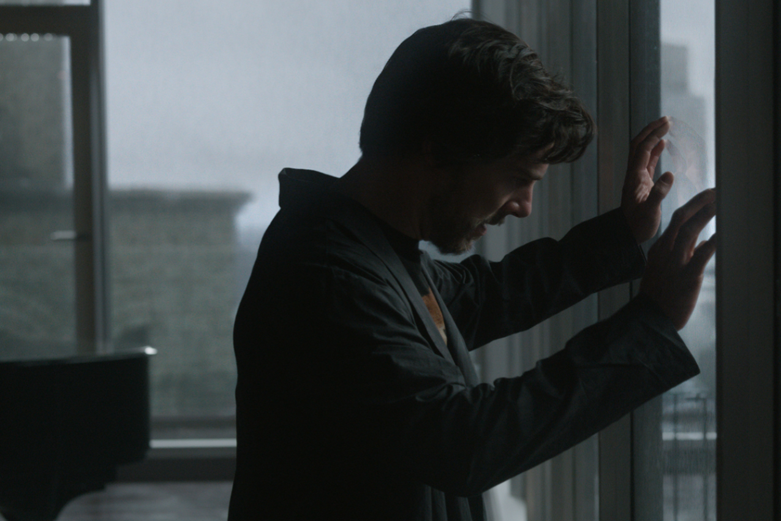
WHAT ABOUT RACIST POLICIES?
Attended a prestigious university
Graduated top of his class
Severely injured hands
Attended a prestigious university
Graduated top of his class
Very steady hands
Post-injury Dr. Strange
Dr. House
Notes:
“Suppose, for example, that a person is not admitted to medical school to train to be a surgeon because he was born without fingers. If all things he wants require that he have fingers, he may conceivably come to suffer the same self-hatred and self-doubts as the victim of racial discrimination” (17)
“Yet his case is different, and if he attends to the difference, he will not suffer as the victim of racial discrimination suffers. The discrimination that excludes him from the practice of surgery is not denigrating his interests because they are his. It is a policy that takes into account a just object—the needs of others in the community for competent surgery” (17)
“Allowing him to be a surgeon would rate other, equally important, interests below his” (17)
“But racial discrimination excludes its victim from opportunities on the basis of a belief that their interests are ipso facto less important than the interests of whites. The man without fingers may regret not being born differently, but he cannot resent how he is treated. Though his ambitions may be thwarted, he himself is still treated as a moral equal” (17)
“Racial discrimination, however, undermines its victims’ self-respect through their awareness that they are considered morally inferior. The fact that racial discrimination, or any color-conscious policy, is difficult to avoid through personal choice merely adds to its basic harmfulness if it is in the first place unjust, but is not the reason for its being unjust” (17)

Slide 20
WHAT ABOUT EQUAL OPPORTUNITY?
Boxill concedes that color-conscious policies giving preference to black people place obstacles in the path of white people.
Since these obstacles reduce opportunities, these policies may make opportunities unequal.
But so do talent-conscious policies.
It is inconsistent to oppose color-conscious policies on the grounds that they conflict with equal opportunity and yet support talent-conscious policies.
Notes:
“As I argue later, equal opportunity is not a fundamental principle of justice, but is derived from its basic principles. Often these basic principles require that opportunities be made more equal. Invariably, however, these same principles require that the process of equalization stop before a condition of perfect equality of opportunity is reached” (18)

Slide 21
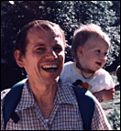
WEAK AFFIRMATIVE ACTION
Weak affirmative action involves policies that are designed to increase the opportunities of disadvantaged people to attain social goods and offices.
Dismantling segregated institutions
Advertising to groups not previously represented in privileged positions
Developing special scholarships for disadvantaged classes
Using diversity or under-representation of groups with a history of past discrimination as a tie breaker when candidates are relatively equal
The goal of weak affirmative action is equal opportunity to compete, not equal results.
Louis P. Pojman
Notes:
“We seek to provide each citizen regardless of race or gender a fair chance to the most favored positions in society. There is no more moral requirement to guarantee that 12% of professors are Black than to guarantee that 85% of the players in the National Basketball Association are White” (98)

Slide 22
STRONG AFFIRMATIVE ACTION
Strong affirmative action involves preferential treatment on the basis of race, ethnicity, sex, gender, etc., discriminating in favor of underrepresented groups against overrepresented groups.
According to Pojman, Strong AA is aimed at not only equal opportunity to compete but also equal results.
Pojman argues that Strong AA—but not necessarily Weak AA—is morally problematic.
Louis P. Pojman
Notes:
“We seek to provide each citizen regardless of race or gender a fair chance to the most favored positions in society. There is no more moral requirement to guarantee that 12% of professors are Black than to guarantee that 85% of the players in the National Basketball Association are White” (98)

Slide 23
“NO ONE DESERVES TALENT”
Society may award jobs and positions as it sees fit as long as individuals have no claim to these positions.
To have a claim to something means that one has earned it or deserves it.
But no one has earned or deserves his intelligence, talent, education or cultural values which produce superior qualifications.
If a person does not deserve what produces something, he does not deserve its products.
Therefore better qualified people do not deserve their qualifications.
Therefore, society may override their qualifications in awarding jobs and positions as it sees fit (for social utility or to compensate for previous wrongs).

Slide 24
“NO ONE DESERVES TALENT”
Mr. Frugal
Mr. Wasteful
Notes:
“Drake gambles away almost $200K in Atlantic City”
“My response: Premise 4 is false. To see this, reflect that just because I do not deserve the money that I have been given as a gift (for instance) does not mean that I am not entitled to what I get with that money” (107)
“If you and I both get a gift of $100 and I bury mine in the sand for 5 years while you invest yours wisely and double its value at the end of five years, I cannot complain that you should split the increase 50/50 since neither of us deserved the original gift” (107)
“If we accept the notion of responsibility at all, we must hold that persons deserve the fruits of their labor and conscious choices. Of course, we might want to distinguish moral from legal desert and argue that, morally speaking, effort is more important than outcome, whereas, legally speaking, outcome may be more important. Nevertheless, there are good reasons in terms of efficiency, motivation, and rough justice for holding a strong prima facie principle of giving scarce high positions to those most competent” (108)

Slide 25
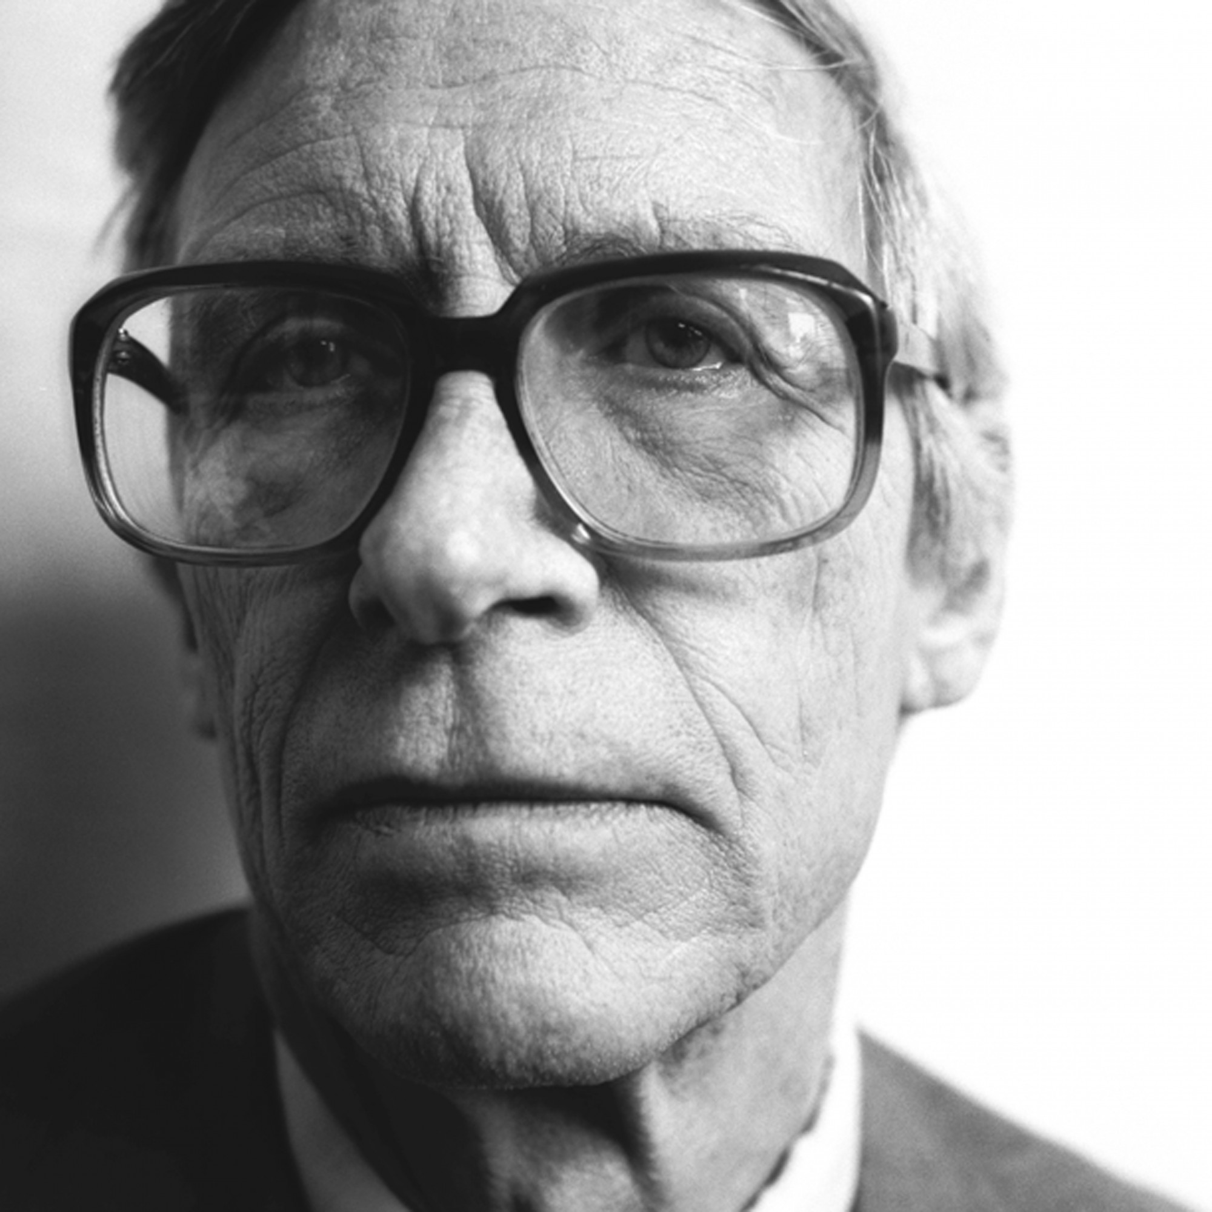
“NO ONE DESERVES TALENT”
Sorry, we gave them to the worst off.
John Rawls
Notes:
“Here are some implications: Since I do not deserve my two good eyes or two good kidneys, the social engineers may take one of each from me to give to those needing an eye or a kidney-even if they have damaged their organs by their own voluntary actions; Since no one deserves anything, we do not deserve pay for our labors or praise for a job well done or first prize in the race we win. The notion of moral responsibility vanishes in a system of levelling” (108)
“But there is no good reason to accept the argument against desert. We do act freely and, as such, we are responsible for our actions. We deserve the fruits of our labor, reward for our noble feats and punishment for our misbehavior” (108)

Slide 26
INEVITABLE DISCRIMINATION
Perhaps race, sex, gender, etc. are correlated with class.
But at least some individuals that belong to disadvantaged groups come from very rich families while at least some individuals that belong to advantaged groups come from very poor families.
Strong AA discriminates in favor of these rich individuals and against these poor individuals.
This is counterproductive to achieving the end of equal opportunity for all.
It merely creates new injustices.

Slide 27
ARBITRARINESS WORRY
Eligible for AA programs (reported by Pojman 1998)
group | percentage in population
1. Women | 52%
2. Black | 12%
3. Hispanics | 9%
4. Native Americans | 2%
5. Asians | 4%
6. Physically & Mentally Disabled | 10%
7. Welfare recipients | 6%
8. The Elderly | 25% (est. Adults over 60)
9. Italians (in New York City) | 3%
totals | 123%

Slide 28
ARBITRARINESS WORRY
Some have proposed adding homosexuals to the list.
Others have advocated putting all poor people on the list.
If there is evidence to believe that physically unattractive people, obese people, short people, and left-handed people suffer from discrimination, why shouldn’t we add them to the list as well?
This appears to leave out only white males.
But that seems arbitrary in a way that is inconsistent with justice.

Slide 29
MEDIOCRITY / INCOMPETENCE
Pojman cites claims from the Department of Health, Education, and Welfare (HEW) as evidence for thinking that Strong AA programs tend to encourage mediocrity and incompetence.
There may be both consequentialist and deontological reasons to be concerned about this.
This leads to Pojman’s argument from the principle of merit.

Slide 30
THE PRINCIPLE OF MERIT
According to Pojman, there are strong reasons for awarding positions on the basis of one’s qualifications and merits.
There are consequentialist reasons for this: adopting the rule that achievement is rewarded is likely to produce better consequences than the alternatives.
There are also deontological reasons for this: by giving people what they deserve as individuals, we show respect for their inherent worth—rather than treating those individuals as mere means to good ends.
Notes:
“Rewarding excellence both seems just to the individuals in competition and makes for efficiency” (111)
“If you and I take a test, and you get 95% of the answers correct, and I only get 50% correct, it would be unfair to you for both of us to receive the same grade, say an A, and even more unfair to give me a higher grade A+ than your B+. Al- though I have heard cases where teachers have been instructed to ‘race norm’ in grading (giving Blacks and Hispanics higher grades for the same numerical scores), most proponents of AA stop short of advocating such a practice. But, I would ask them, what's really the difference between taking the overall average of a White and a Black and ‘race norming’ it? If teachers shouldn't do it, why should administrators?” (112)
“The second pillar for meritocracy is utilitarian. In the end, we will be better off by honoring excellence. We want the best leaders, teachers, policemen, physicians, generals, lawyers, and airplane pilots that we can possibly pro- duce in society. So our program should be to promote equal opportunity, as much as is feasible in a free market economy, and reward people according to their individual merit” (112)

