Slide 1
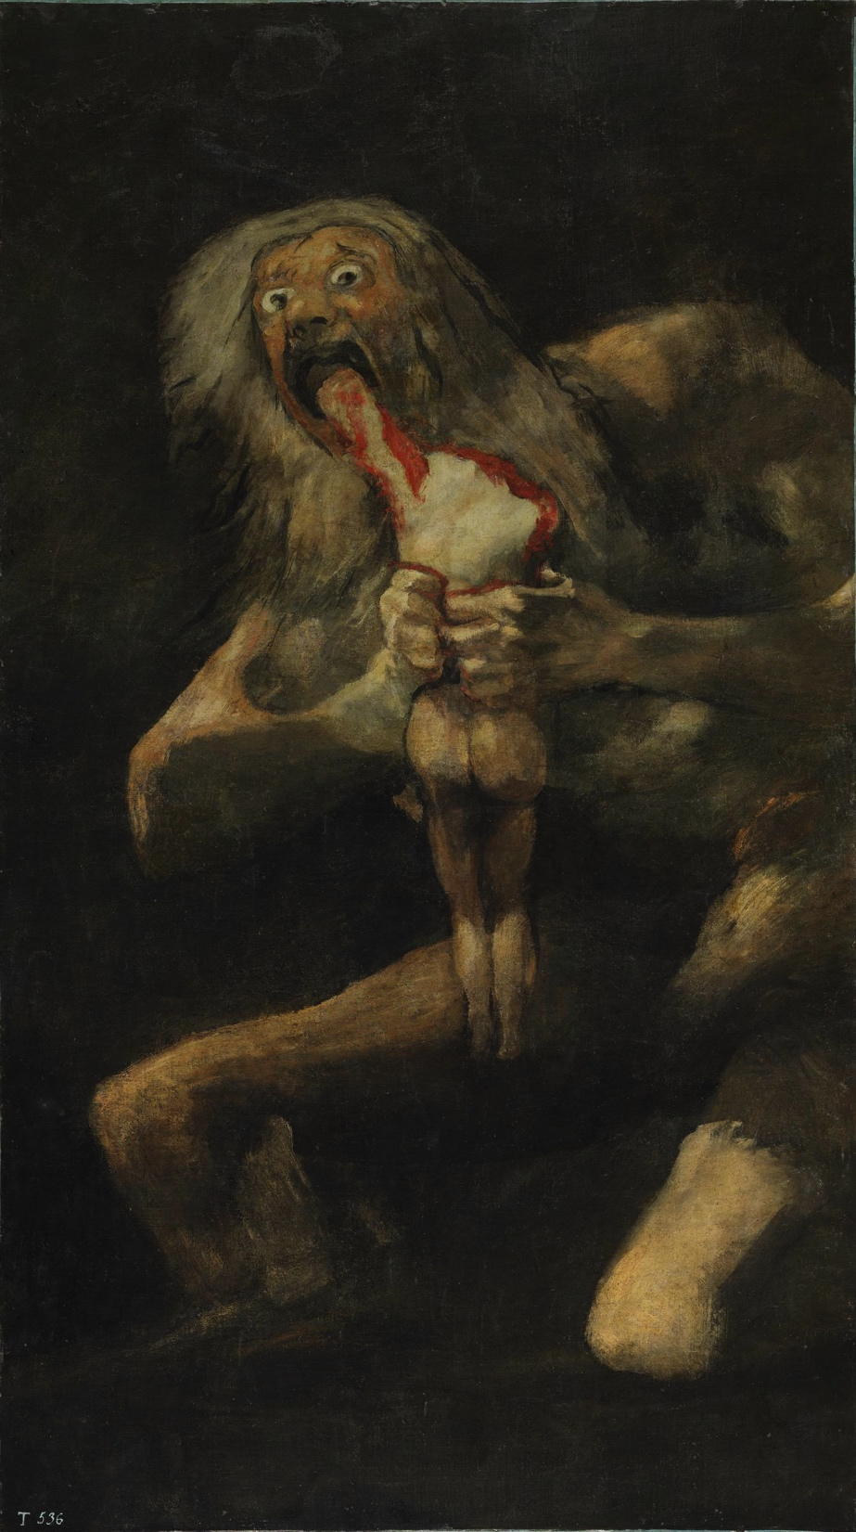
THE PARADOX OF HORROR
Notes:
Kimmel clip: https://www.youtube.com/watch?v=a8sSQSq210g&t=1m10s
The Wailing 2:24:25

Slide 2
THE EXPERIENCE OF HORROR
Many flock to works of horror in order to undergo experiences of horror.
The experience of horror appears to consist in the experience of fear and the experience of disgust.

Slide 3
THE PARADOX OF HORROR
Each of the following claims seems true:
Many of us enjoy works of horror.
Works of horror produce experiences of fear and disgust.
Fear and disgust are intrinsically unpleasant emotions.
(1) and (2) seem to imply
Many of us enjoy fear and disgust.
which, given (3), seems to imply
Many of us enjoy intrinsically unpleasant emotions.
That seems paradoxical.
So which one of (1)–(4) should we deny?
Notes:
The paradox of the enjoyment of negative emotions

Slide 4
THE PARADOX OF HORROR

Slide 5
THE PARADOX OF HORROR

Slide 6
STRATEGIES
We don’t really enjoy fear and disgust after all, but these are necessary to experience or accomplish something that we do enjoy.
We do enjoy fear and disgust, but a proper understanding of these emotions reveals that this is not paradoxical.
POLL:
Which of these strategies does Gaut adopt?
The first one
The second one

Slide 7
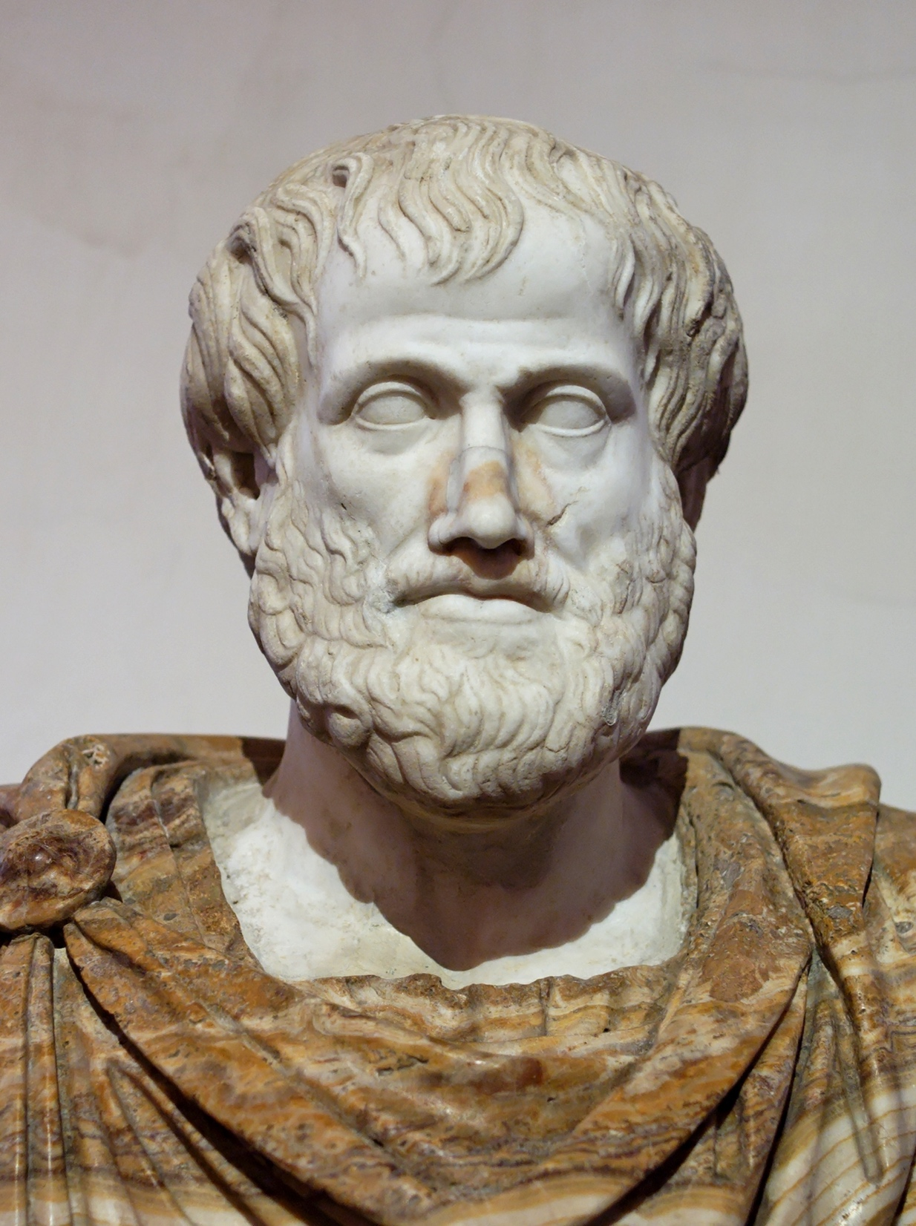
the expressivist solution

Slide 8
THE EXPRESSIVIST SOLUTION
Aristotle appears to have proposed a view like this in order to account for tragedy.
We do not enjoy the fear and disgust that works of horror produce in us, but we do enjoy the expression of these emotions whereby we relieve ourselves of them or diminish their effects.
Version 1: We unburden ourselves of these emotions through acts of make-believe.
Version 2: We diminish the effects of these emotions by coming to understand them.
Notes:
Getting rid of anger by imagining kicking someone
“[O]ne lightens one’s emotion by coming to understand what was before an unknown perturbation” (335).

Slide 9
OBJECTION
We have no antecedently felt fear or disgust of monsters, because we know that monsters don’t exist.
So there are no prior emotions for works of horror to relieve or diminish.

Slide 10
RESPONSE
Monsters can serve as metaphors for the objects of our preexisting emotions.
The things we fear or find disgusting are often social in character, but some may be deeply engrained in human psychology.

Slide 11
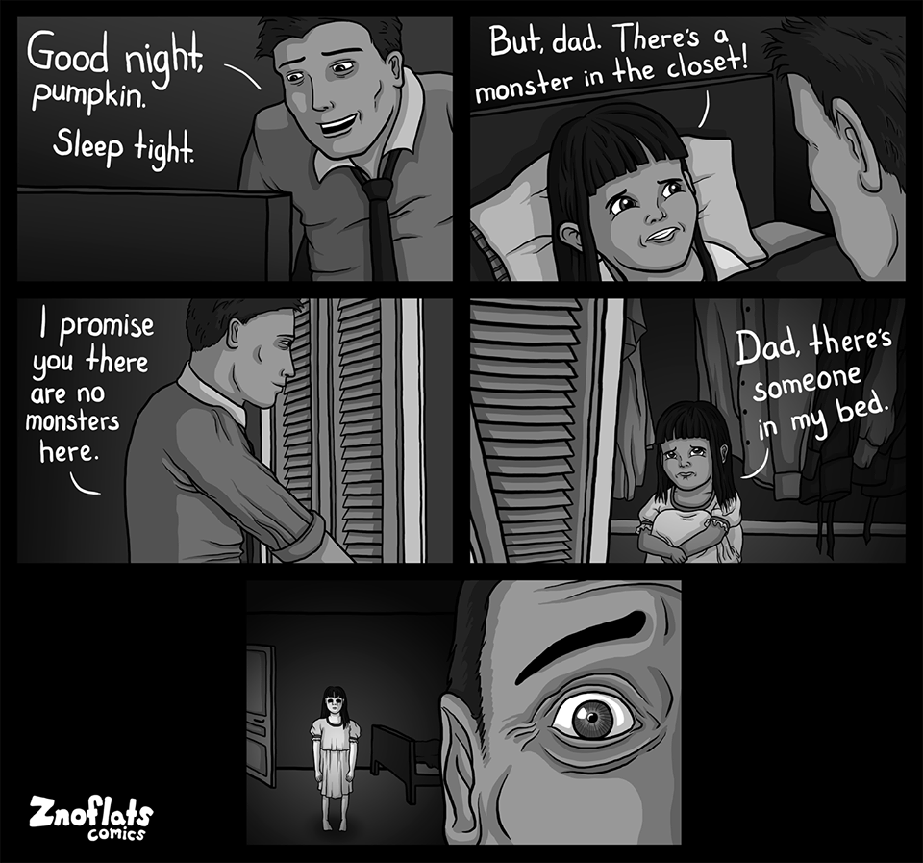
RESPONSE

Slide 12
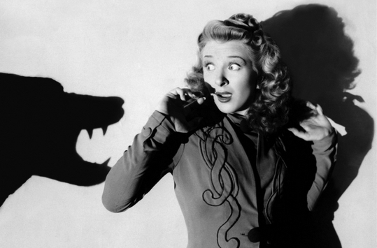
OBJECTION
I’m feeling awfully scared today, so I think I’ll go see a horror movie!
Notes:
One needs to be in a robust psychological state to endure horror

Slide 13
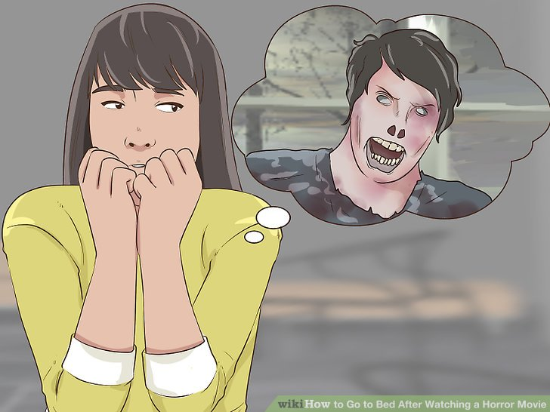
OBJECTION

Slide 14
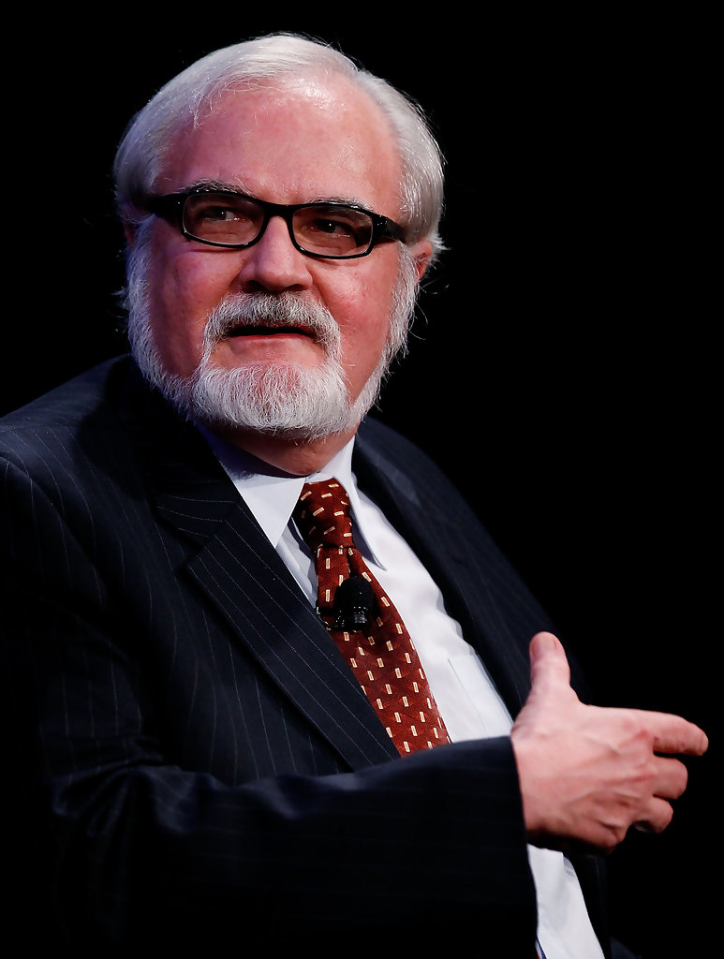
Carroll's COGNITIVISM

Slide 15
CARROLL’S COGNITIVISM
Monsters are violations of our categorical schemes.
Such violations strike us as threatening and impure.
This explains why horror fictions incite fear and disgust in their audiences.

Slide 16
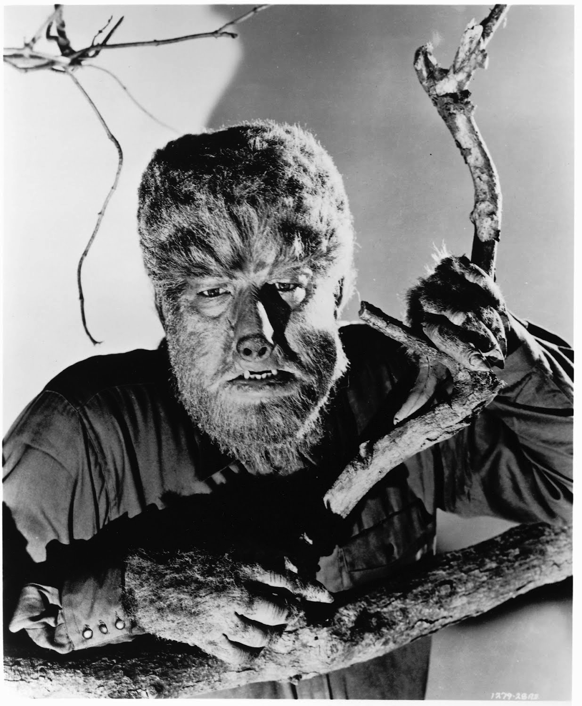
CARROLL’S COGNITIVISM
The Wolf Man (1941)

Slide 17
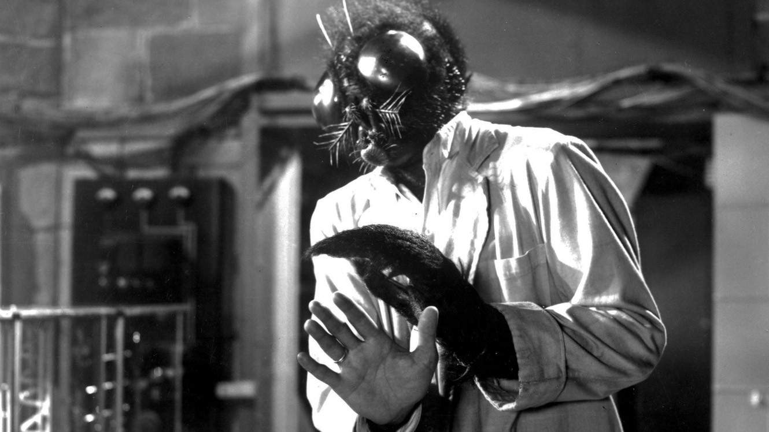
CARROLL’S COGNITIVISM
The Fly (1958)

Slide 18
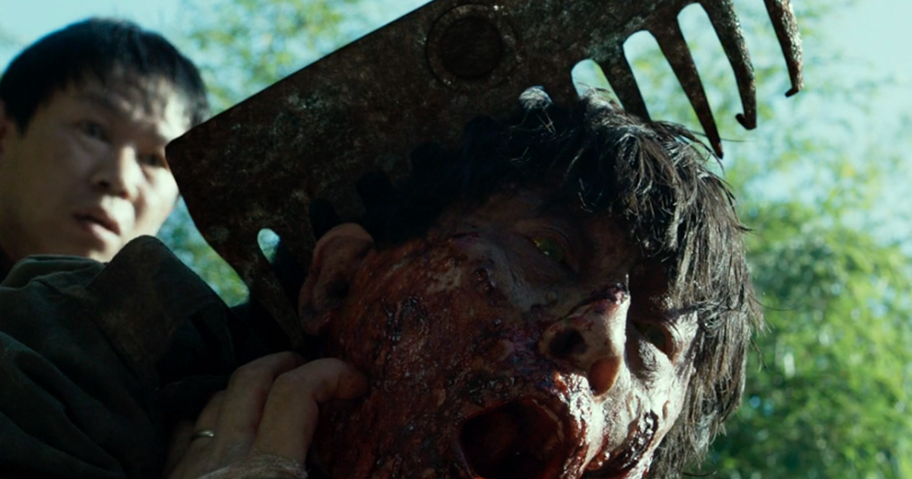
CARROLL’S COGNITIVISM
The Wailing (2016)

Slide 19
CARROLL’S COGNITIVISM
Yet, because monsters are violations of our categorical schemes, we are curious about them and find them fascinating.
Narrative techniques further heighten this curiosity and fascination.
Notes:
They “entice us to wonder whether the monster exists and what it looks like, involve us in the question of whether the characters in the fiction will come to believe in its existence and can destroy it, and so on” (334).

Slide 20
CARROLL’S COGNITIVISM
We do not enjoy the negative emotions of fear or disgust.
But we do enjoy the arousal and satisfaction of our curiosity about monsters.
Since we know that monsters are purely fictional, our negative emotions of fear and disgust are significantly less intense than they otherwise would be.
Thus, the pleasures of curiosity outweigh the displeasures of those negative emotions.
But given that monsters are violations of our categorical schemes, we can’t have the enjoyment without the fear and disgust.

Slide 21
OBJECTION
What about slasher films?
Dilemma: either count serial killers as monsters, or deny that these are works of horror.
First horn: trivializing.
Second horn: implausible; introduces a new paradox.
Notes:
“His view depends crucially on claims about monsters, defined as beings not believed to exist now according to contemporary science” (334).
We need not feel disgust at the unusual.
“Carroll’s appeal to monsters disguises the simple point that we can be disgusted by and afraid of human beings because they do evil and awful things, and no mention of monsters or of categorical violations is needed to explain our reaction” (334).

Slide 22
OBJECTION
Notes:
“[M]ost horror films are so formulaic in their plots, and their monsters and killers are so stereotypical, that it is difficult to believe that our curiosity could very often be sufficiently stimulated to overcome the purported disadvantages such works incur in producing disagreeable emotional states in us. The conventions of genre weigh too heavily on most horror fictions for Carroll’s solution to be a plausible one” (335).

Slide 23
OBJECTION
Notes:
“On Carroll’s view Norman must really be complaining that his curiosity wasn’t heightened enough. But that is not what he says, and indeed, he might say that the film was quite interesting. We are back to the core of the paradox of horror again: people seem to enjoy experiencing negative emotions” (335).

Slide 24
OBJECTION
Interesting…
But not scary at all—
what a letdown!
Norman
Notes:
“On Carroll’s view Norman must really be complaining that his curiosity wasn’t heightened enough. But that is not what he says, and indeed, he might say that the film was quite interesting. We are back to the core of the paradox of horror again: people seem to enjoy experiencing negative emotions” (335).

Slide 25
POLL
Are you inclined to accept, or to reject, Carroll’s cognitivist theory?
I am inclined to accept it
I am inclined to reject it

Slide 26
The enjoyment theory

Slide 27
THE ENJOYMENT THEORY
Each of the following claims seem true:
Many of us enjoy works of horror.
Works of horror produce experiences of fear and disgust.
Fear and disgust are intrinsically unpleasant emotions.
(1) and (2) seem to imply
Many of us enjoy fear and disgust.
which, given (3), in turn implies
Many of us enjoy intrinsically unpleasant emotions.
That seems paradoxical.
Notes:
The paradox of the enjoyment of negative emotions

Slide 28
THE ENJOYMENT THEORY
Each of the following claims seem true:
Many of us enjoy works of horror.
Works of horror produce experiences of fear and disgust.
Fear and disgust are intrinsically unpleasant emotions.
(1) and (2) seem to imply
Many of us enjoy fear and disgust.
which, given (3), in turn implies
Many of us enjoy intrinsically unpleasant emotions.
That seems paradoxical.
Notes:
The paradox of the enjoyment of negative emotions

Slide 29
THEORETICAL ADVANTAGES
We don’t enjoy fear or disgust, but rather...

Slide 30
THEORETICAL ADVANTAGES

Slide 31
THEORETICAL ADVANTAGES
Simpler, more straightforward explanation
Accounts for Norman’s complaint
Does not undermine an important aim of the genre

Slide 32
THEORETICAL ADVANTAGES
Notes:
Show Kimmel clip
Transition: disgust movies

Slide 33
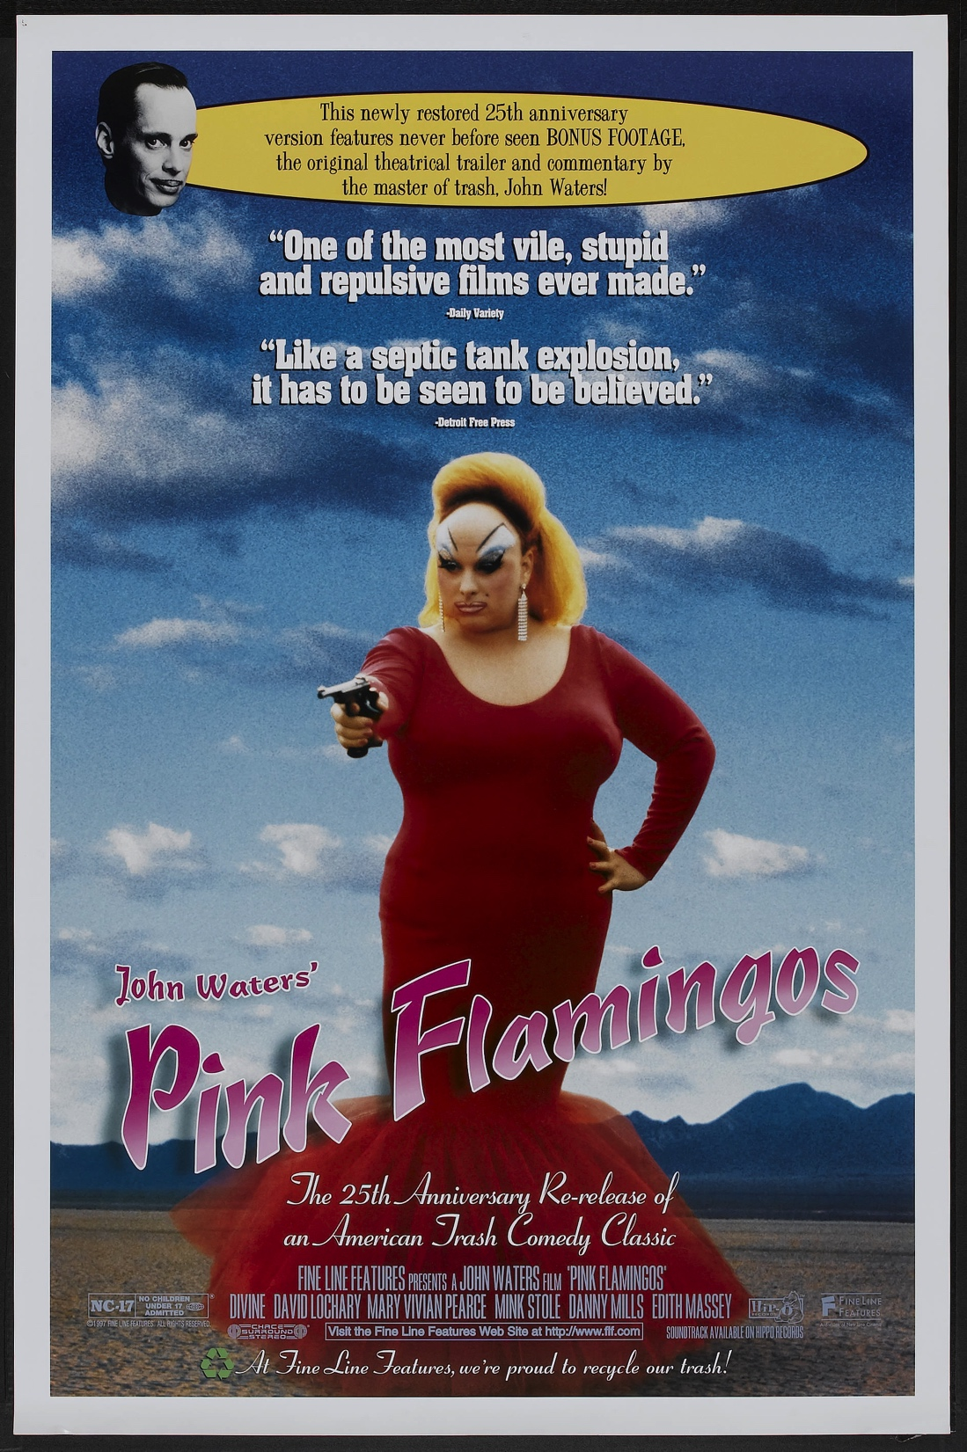
THEORETICAL ADVANTAGES
Notes:
Disgust movies

Slide 34
NOT SO FAST!
The enjoyment of negative emotions is impossible!
These cases are simply misdescribed.
“This redescription strategy will be attractive only as long as we are unable to explain away the apparent paradoxicality of the enjoyment of these emotions” (Gaut 1993, 337).

Slide 35
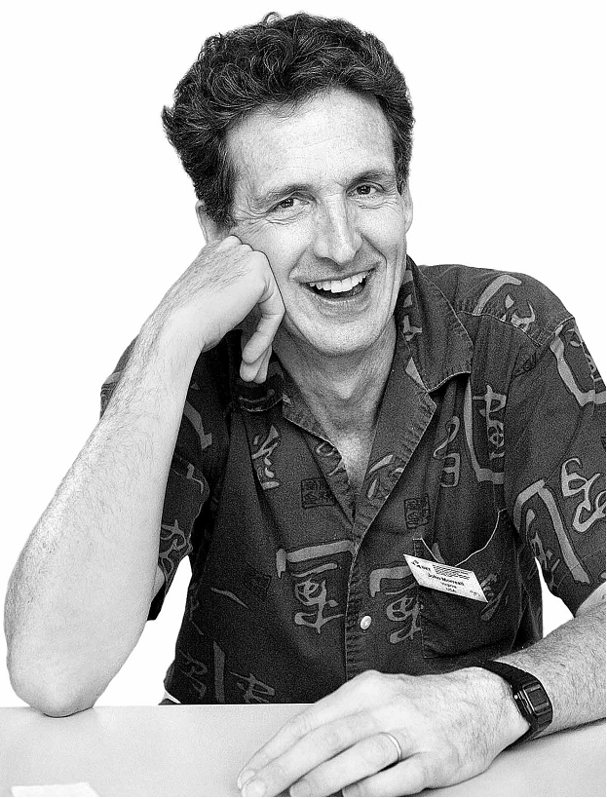
THE CONTROL THESIS
It is possible to enjoy a negative emotion when one is “in control” of the situation that gives rise to that emotion.
In the case of horror fictions, one can enjoy fear and disgust to the extent that one is psychologically capable of directing his or her attention and thoughts.
If one loses that control, then fear and disgust will cease to be enjoyable.
Marcia M. Eaton
John Morreall
Notes:
“So Suzy can enjoy her mountaineering escapades because she knows that she is skillful enough to avoid coming to harm” (338).

Slide 36
PROBLEMS
The control thesis gives us a constraint on the enjoyment of negative emotions, but it doesn’t explain how that enjoyment is possible in the first place.
It also fails to explain why it is so tempting to hold that the enjoyment of negative emotions is impossible.
Notes:
“Norman may believe that the very height of enjoyable fear is when his gaze is riveted to the gruesome spectacle, when he ‘cannot take his eyes off’ the unfolding carnage. For, after all, if one is enjoying something, then one’s attention tends to be drawn irresistibly to it” (338).

Slide 37
PROBLEMS
Notes:
“Norman may believe that the very height of enjoyable fear is when his gaze is riveted to the gruesome spectacle, when he ‘cannot take his eyes off’ the unfolding carnage. For, after all, if one is enjoying something, then one’s attention tends to be drawn irresistibly to it” (338).

Slide 38
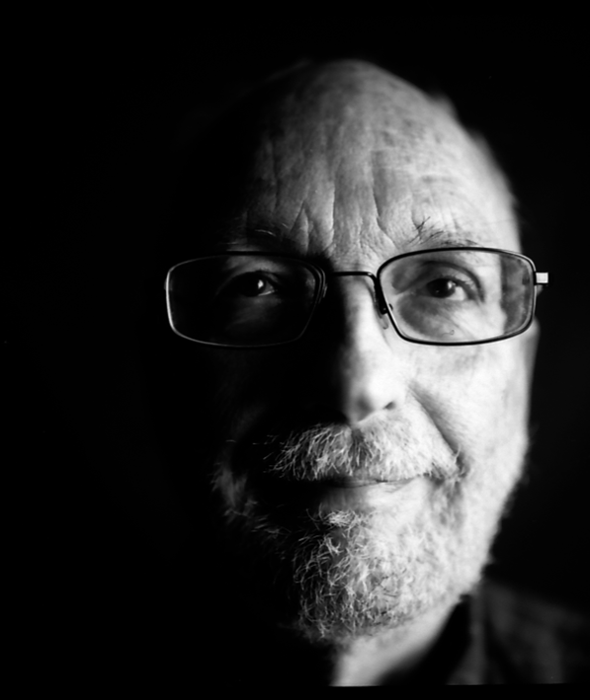
THE UNPLEASANT OBJECT THESIS
It is a purely contingent matter whether or not people enjoy the emotions.
It is not the negative emotions themselves that are intrinsically unpleasant but rather the objects of those emotions.
Kendall Walton
Alex Neill
Notes:
“‘What is clearly disagreeable, what we regret, are the things we are sorrowful about—the loss of an opportunity, the death of a friend—not the feeling or experience of sorrow itself’” (339).

Slide 39
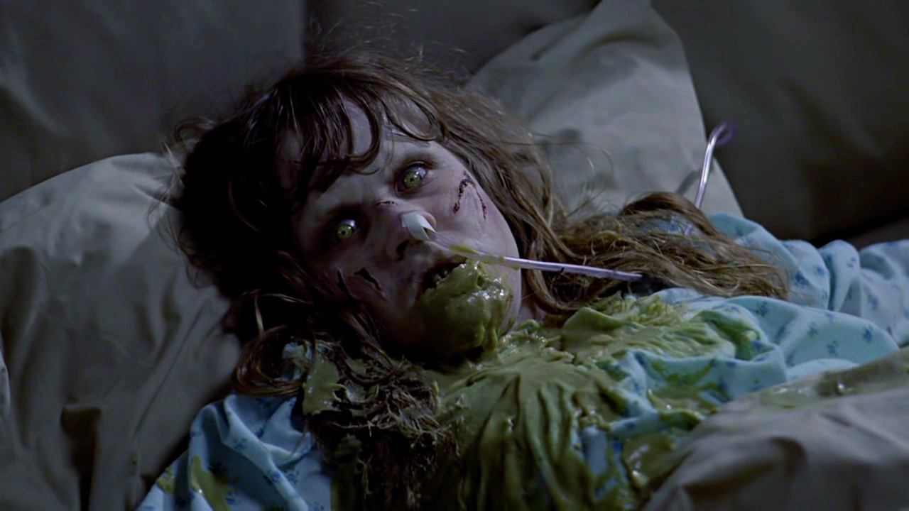
PROBLEMS
fragility =
the disposition to break under pressure
unpleasantness =
the disposition to produce unpleasant experiences

Slide 40
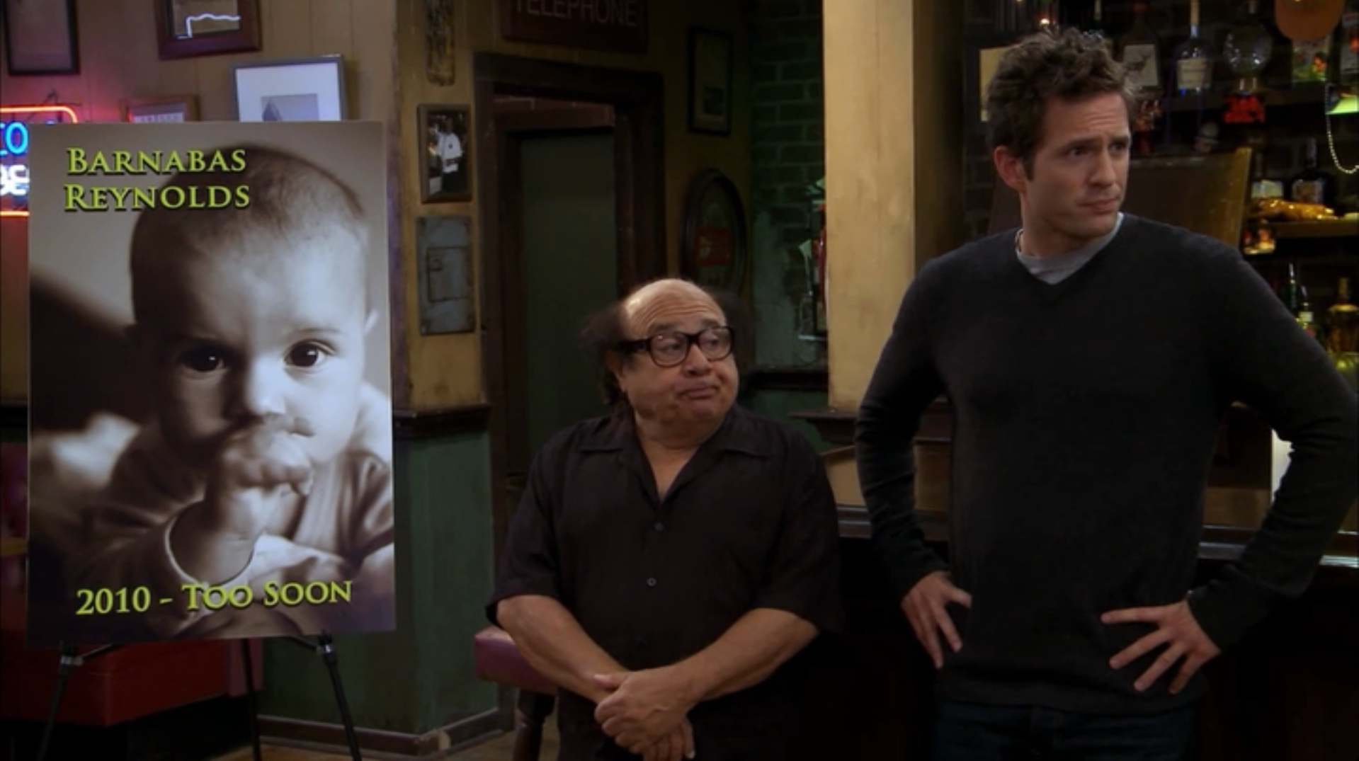
GENERAL PROBLEM
You mean you don’t feel amazing?!
Notes:
We would be reluctant to translate this as “grief.”
This suggests a conceptual constraint on the negative emotions.

Slide 41
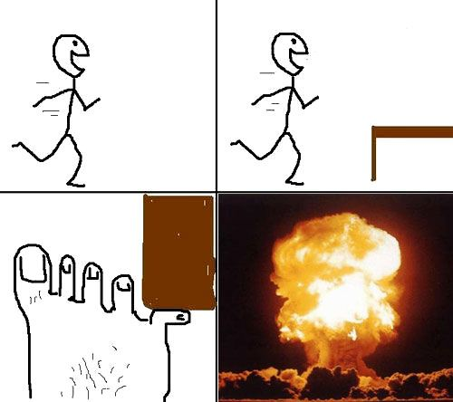
THE EVALUATION THESIS
x is in pain iff x feels like that
x is angry only if x judges someone to be guilty

Slide 42
THE EVALUATION THESIS
The negative emotions are not negative because they are unpleasant but rather because they involve negative evaluations.
It is possible to disvalue something while nonetheless finding it, and the experience of it, to be pleasant.

Slide 43
THE EVALUATION THESIS
Wow, the link between grief and displeasure is contingent as shit…
You mean you don’t feel amazing?!
Notes:
We would be reluctant to translate this as “grief.”
This suggests a conceptual constraint on the negative emotions.
The evaluative thesis can accommodate this!

Slide 44
FIRST CONSTRAINT
Strong internalism:
Necessarily, x judges that p is good only if x desires that p be the case.
Necessarily, x judges that p is bad only if x desires that p not be the case.
Weak internalism:
Necessarily, typically, x judges that p is good only if x desires that p be the case.
Necessarily, typically, x judges that p is bad only if x desires that p not be the case.
Highly atypical!
Notes:
If someone says that something is good, but has no desire to bring it about, that is good evidence that he or she is mistaken.
It is possible to be in a sate of despair and recognize something to be good but have no motivation to bring it about.
Moral perverts might be motivated to bring about things they judge to be bad.
Those are motivational deviations.

Slide 45
SECOND CONSTRAINT
Strong desire–pleasure link:
Necessarily, x desires y only if x finds the idea of y to be pleasant.
Necessarily, x desires to avoid y only if x finds the idea of y to be unpleasant.
Weak desire–pleasure link:
Necessarily, typically, x desires y only if x finds the idea of y to be pleasant.
Necessarily, typically, x desires to avoid y only if x finds the idea of y to be unpleasant.

Slide 46
THE EVALUATION THESIS
The evaluation thesis: necessarily, x fears (is disgusted by) y only if:
x negatively evaluates y;
typically, x desires to avoid y;
typically, x finds y to be unpleasant.

Slide 47
THE EVALUATION THESIS
typical
Translate x’s emotion-term t as “grief” only if x typically finds the emotion denoted by t to be unpleasant.
Notes:
We would be reluctant to translate this as “grief.”
This suggests a conceptual constraint on the negative emotions.
The evaluative thesis can accommodate this!

Slide 48
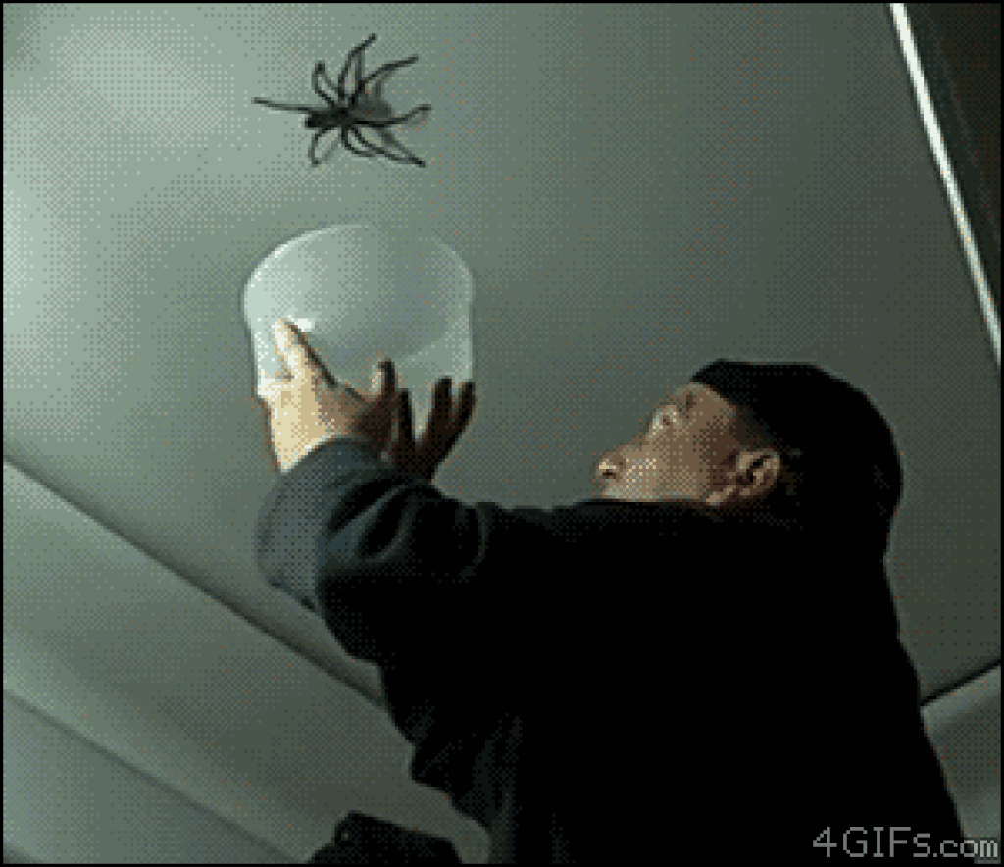
THE EVALUATION THESIS
TYPICAL CASE (NOPE)
ATYPICAL CASE

Slide 49
THE PARADOX DISSOLVED (?)
The paradox rests on the assumption that negative emotions are intrinsically unpleasant.
If the evaluation thesis is correct, that assumption is mistaken.
But it explains why that assumption was so tempting in the first place: there are conceptual connections between the emotions, desire, and pleasure.

Slide 50
POLL
Are you inclined to accept, or to reject, Gaut’s version of the enjoyment theory?
I am inclined to accept it
I am inclined to reject it

