Slide 1
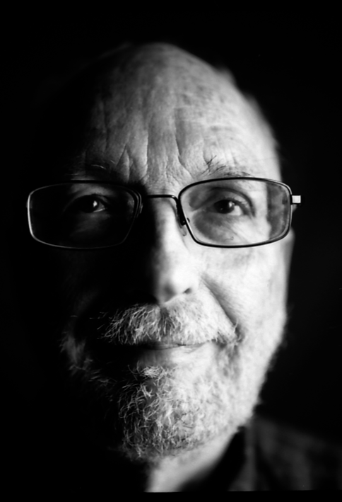
Fearing fictions
Notes:
Audience reaction to Paranormal Activity 2, https://www.youtube.com/watch?v=DCA-W_Ps5dM
Prank video, https://www.youtube.com/watch?v=YoB8t0B4jx4
Game of make believe, https://www.youtube.com/watch?v=36to0Wfj-Lg

Slide 2
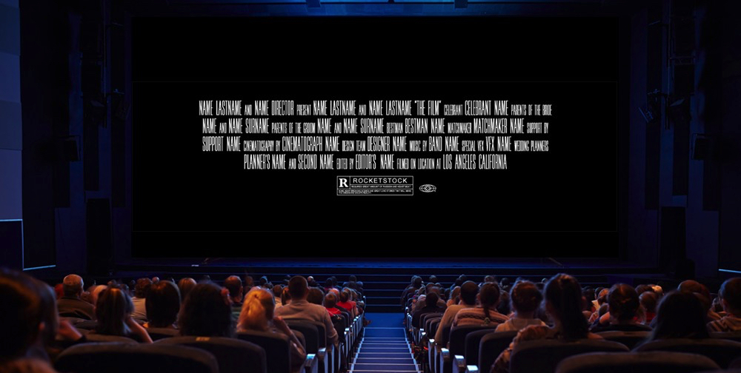
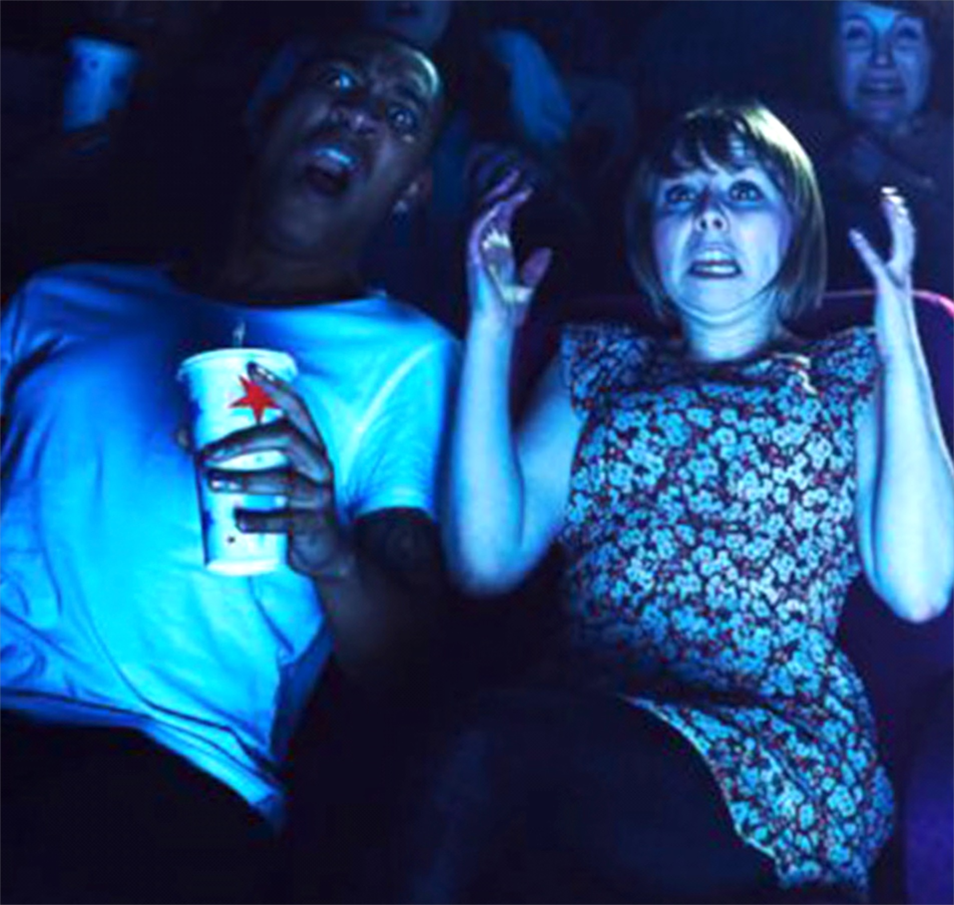
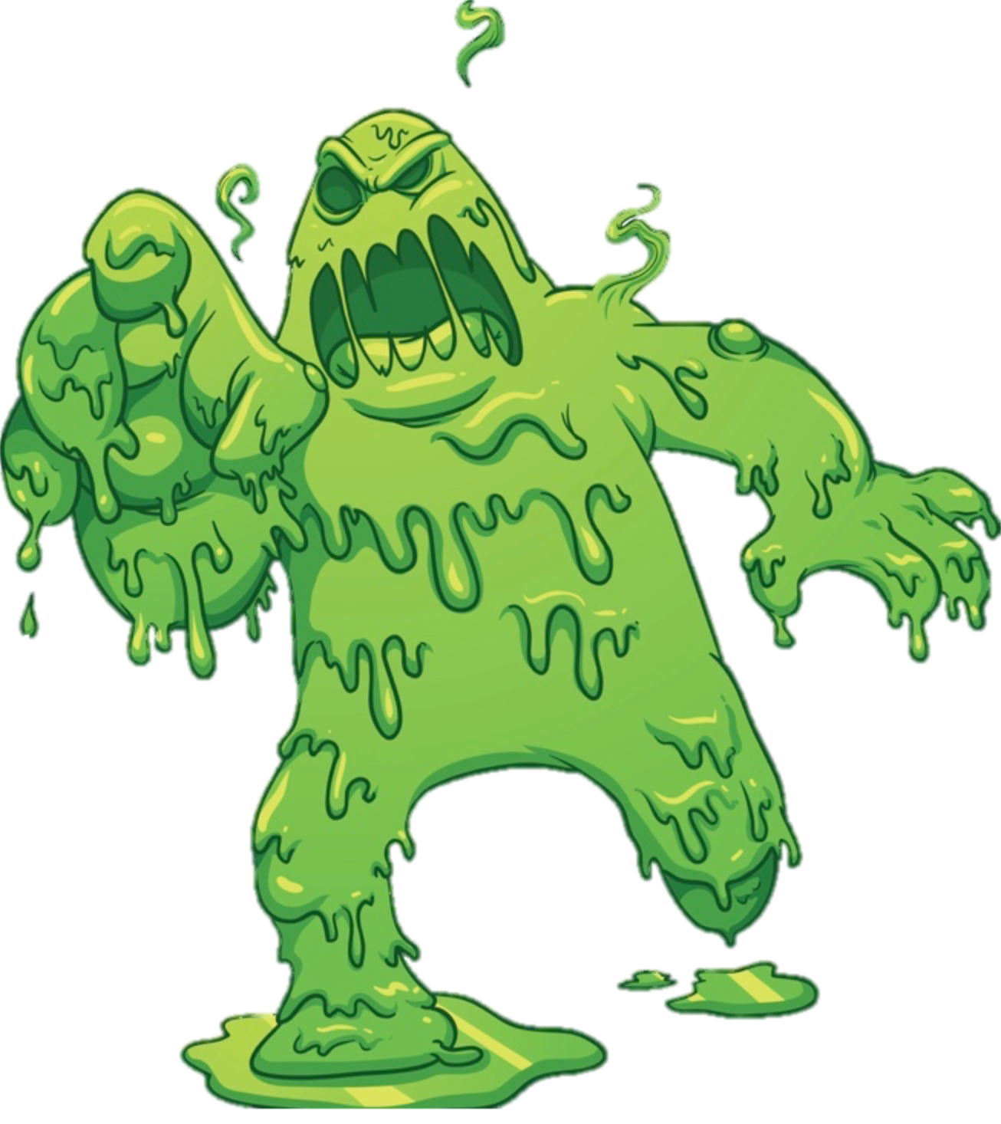
THE QUESTION
“Afterwards, still shaken, Charles confesses that he was ‘terrified’ of the slime. Was he?” (Walton 1978, 5).
Notes:
“Charles is watching a horror movie about a terrible green slime. He cringes in his seat as the slime oozes slowly but relentlessly over the earth destroying everything in its path. Soon a greasy head emerges from the undulating mass, and two beady eyes roll around, finally fixing on the camera. The slime, picking up speed, oozes on a new course straight toward the viewers. Charles emits a shriek and clutches desperately at his chair” (5).

Slide 3
THE QUESTION
We can all agree that Charles was in a physiological/psychological state that involved quickened pulse, flowing adrenaline, tensed muscles, and so on. Call it “quasi-fear.”
Is Charles’ quasi-fear genuine fear?
Notes:
People may claim that Charles was “really terrified.”
That emphasizes the intensity of the experience. We can all agree that he underwent an intense experience.
But is that claim literally true?

Slide 4
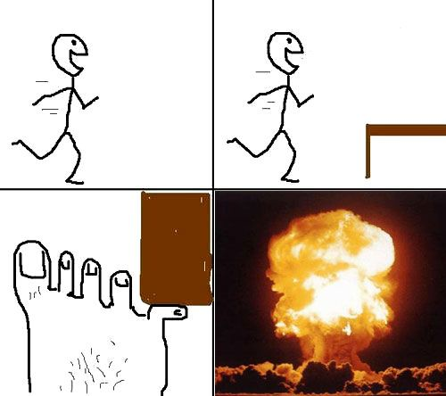
THE QUESTION
x is in pain iff x feels like that

Slide 5
WALTON’S ANSWER
“It seems a principle of common sense, one which ought not to be abandoned if there is any reasonable alternative, that fear must be accompanied by, or must involve, a belief that one is in danger” (Walton 1978, 5).
POLL: According to the above quotation, one’s having a belief that one is in danger is a _____________________ for one to experience fear.
Necessary condition
Sufficient condition
Both necessary and sufficient condition

Slide 6
WALTON’S ANSWER
“It seems a principle of common sense, one which ought not to be abandoned if there is any reasonable alternative, that fear must be accompanied by, or must involve, a belief that one is in danger” (Walton 1978, 5).
POLL: Do you agree with Walton?
Yes, I agree.
No, I disagree.

Slide 7
WALTON’S ANSWER
If Charles’ quasi-fear is genuine fear, then he believes that he is in danger.
Charles doesn’t believe that he is in danger—he is fully aware that he is watching a work of fiction.
So: Charles’ quasi-fear is not genuine fear.

Slide 8
ALTERNATIVES
Premise (2) (“Charles doesn’t believe that he is in danger”) is false.
When Charles is in a state of quasi-fear, he does (in some sense) believe that the green slime is a threat.
He also (in some sense) believes that he is watching a work of fiction and that he is in no danger at all.
These two beliefs coexist.
We indicate this by saying that people like Charles “suspend their disbelief.”
But what does that talk actually amount to?

Slide 9
ALTERNATIVE #1
Charles half believes that the slime is a threat.
Problems:
Charles’ behavior counts heavily against this.
Charles’ quasi-fear symptoms are indicative of intense fear if they are indicative of fear at all—not some watered-down half-fear!

Slide 10
ALTERNATIVE #2
For much of the movie, Charles believes that the green slime isn’t a real threat.
But when experiencing quasi-fear, he momentarily believes that the green slime is a real threat.
Problems:
We have no reason to think that Charles can’t be in a state of quasi-fear throughout the entire movie.
This response does not generalize to other attitudes toward fictions.

Slide 11
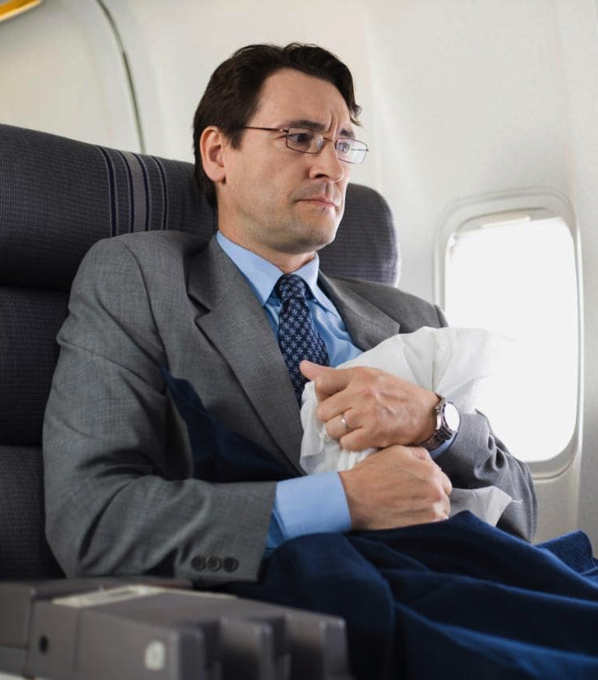
ALTERNATIVE #3
Charles has an “intellectual” belief that the green slime isn’t a real threat.
But he also has a “gut” belief that the green slime is a real threat.
POLL: Are you inclined to agree with this alternative explanation?
Yes, I am inclined to agree.
No, I am inclined to disagree.
Notes:
We infer the gut belief to rationalize his behavior.
Charles is not in a state that admits of rationalizing.

Slide 12
WALTON’S TASK
“Why is it so natural to describe Charles as afraid of the slime, if he is not, and how is his experience to be characterized? In what follows I shall develop a theory to answer these questions” (Walton 1978, 10).

Slide 13
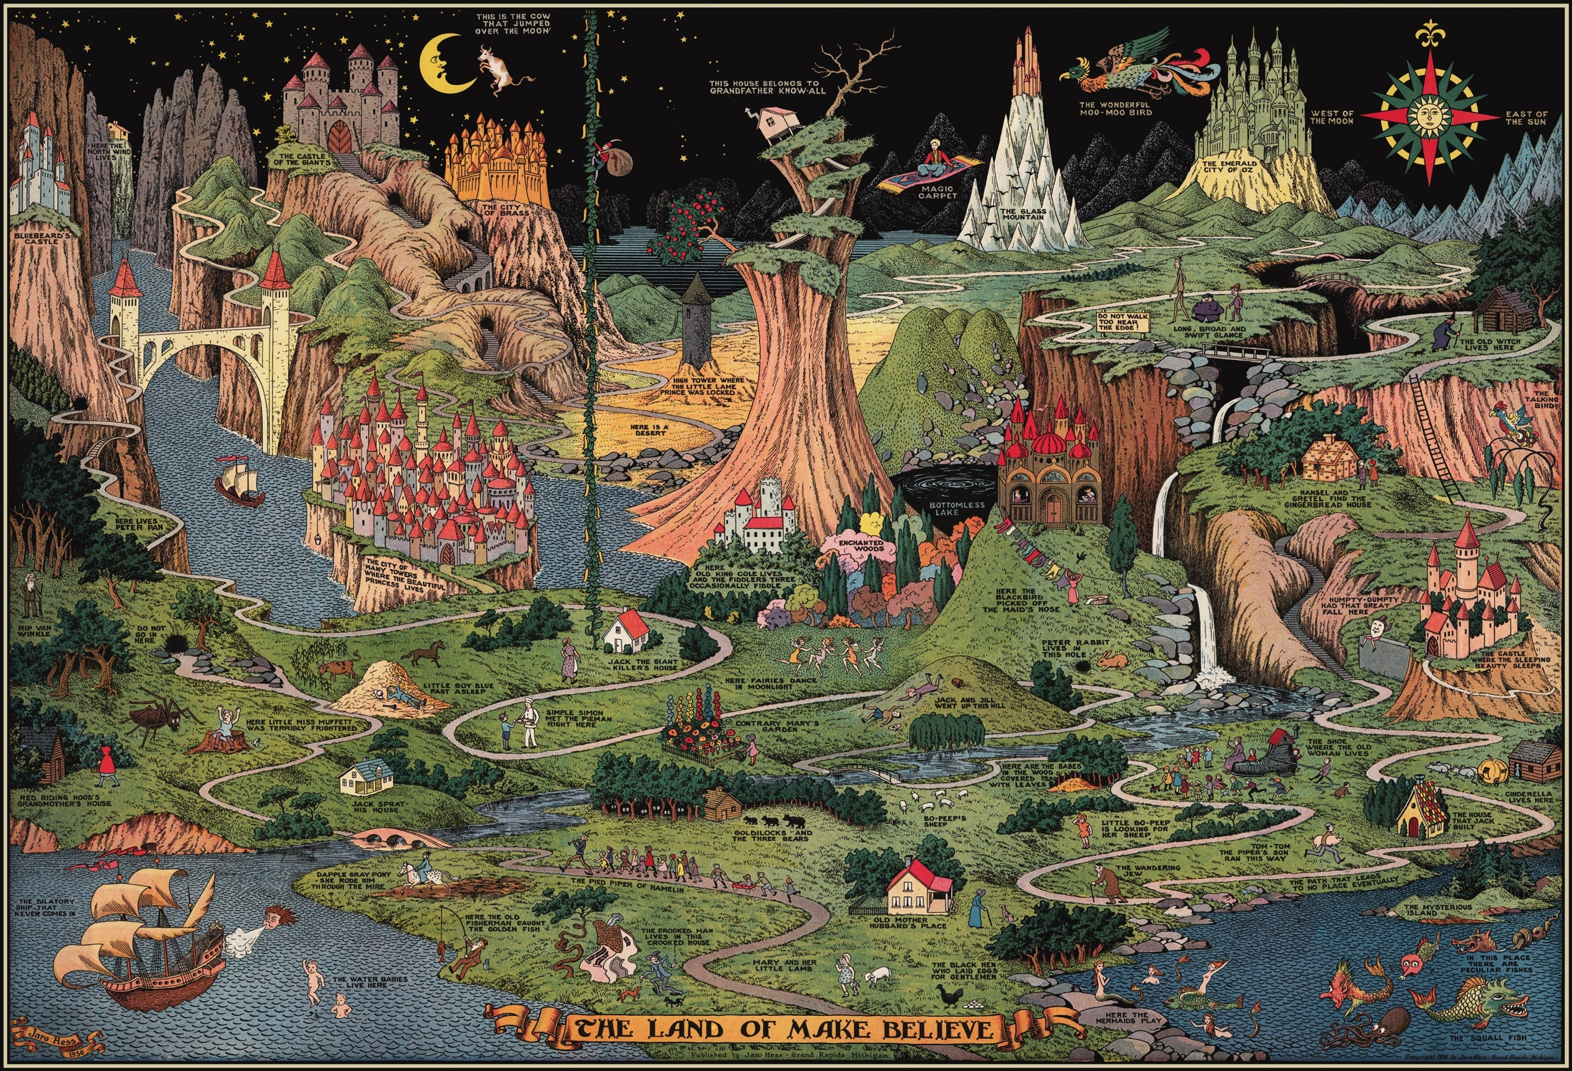
Games of make-believe

Slide 14
FICTIONAL PROPOSITIONS
A sentential operator is an expression that combines with a sentence to form a new sentence.
The resulting sentence may differ in truth-value from the original.

Slide 15
FICTIONAL PROPOSITIONS
<unicorns, existence>
Not: <unicorns, existence>
<Mrs. Gamp, fondness of gin>
In the fiction: <Mrs. Gamp, fondness of gin>
<2, being prime>
In the fiction: <2, being prime>

Slide 16
FICTIONAL PROPOSITIONS
Fictional propositions are those propositions that are true in a fiction.
Fictional worlds are collections of related fictional propositions.
Notes:
“There is, roughly, a distinct fictional world corresponding to each novel, painting, film, game of make-believe, dream, or daydream” (11).

Slide 17
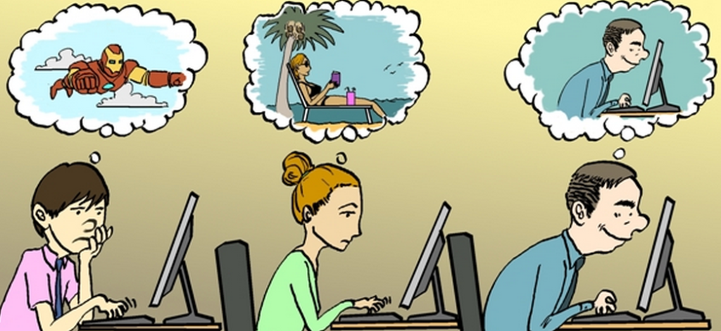
FICTIONAL PROPOSITIONS
imaginary propositions
Notes:
“Imagining is not always a deliberate, self-conscious act. We sometimes find ourselves imagining things more or less spontaneously, without having decided to do so. Thoughts pop into our heads unbidden. Dreams can be understood as simply very spontaneous imaginings” (11).

Slide 18
FICTIONAL PROPOSITIONS
make-believe propositions

Slide 19
FICTIONAL PROPOSITIONS
make-believe propositions

Slide 20
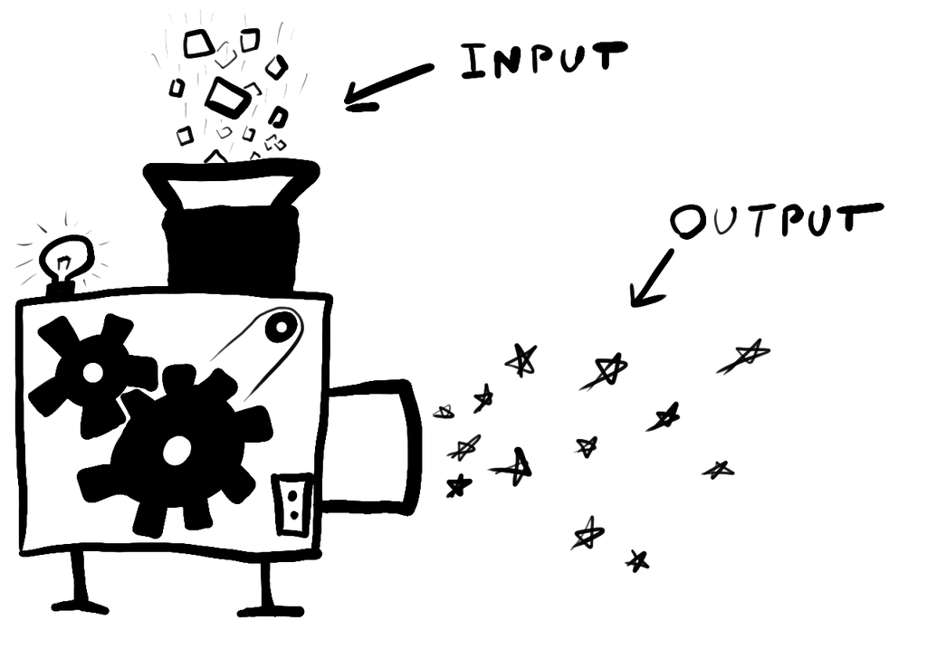
GAMES OF MAKE-BELIEVE
Games of make-believe generate fictional propositions.
They are made up of principles (or rules) concerning which kinds of propositions are to be counted as true in the fiction.
Whenever the asphalt is black, then it is make-believedly true that the floor is lava.
Whenever there is a glob of mud in a certain orange crate, then it is make-believedly true that there is a pie in the oven.
Notes:
Personal game

Slide 21
GAMES OF MAKE-BELIEVE
Principles of make-believe that are in force within a given game need not be explicitly formulated or deliberately adopted.
It may be difficult to know whether an alleged principle is really in force within a given game, since it may be difficult to know whether participants of the game (implicitly or explicitly) recognize or accept it.
But that participants to a given game are disposed to non-deliberately, spontaneously imagine that certain propositions are true is typically good evidence that a given principle is in force within that game.
Notes:
“When children agree to let globs of mud ‘be’ pies they are in effect establishing a great many unstated principles linking make-believe properties of pies to properties of globs. It is implicitly understood that the size and shape of globs determine the make-believe size and shape of pies; it is understood, for example, that make-believedly a pie is one handspan across just in case that is the size of the appropriate glob. It is understood also that if Johnnie throws a glob at Mary then make-believedly Johnnie throws a pie at Mary. (It is not understood that if a glob is 40 per cent clay then make- believedly a pie is 40 per cent clay.)” (11).

Slide 22
WALTON’S THEORY APPLIED
“Why is it so natural to describe Charles as afraid of the slime, if he is not, and how is his experience to be characterized? In what follows I shall develop a theory to answer these questions” (Walton 1978, 10).

Slide 23
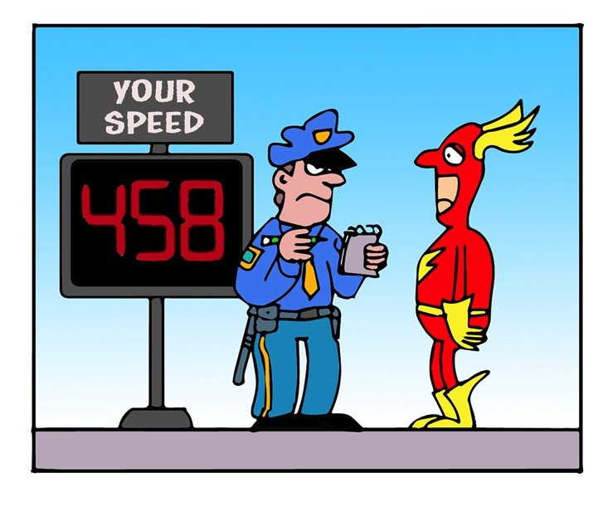
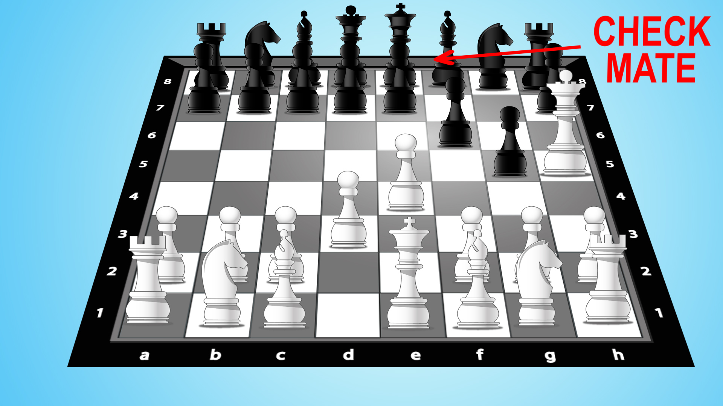
WALTON’S THEORY APPLIED
The Flash broke the law.
Black is checkmated.
The king is in check and there is no way to get out of it.
It is a rule of chess that whenever a player’s king is in check and there is no way to get out of it, then the player is checkmated.
The Flash was speeding down the highway at 458 mph.
It is illegal to exceed 40 mph on Burnett Rd.
Notes:
Transition: “Representational works of art generate make-believe truths” (Walton 1978, 12).

Slide 24
WALTON’S THEORY APPLIED
In the fiction: the floor is lava.
Whenever the asphalt is black, then it is true in the fiction that the floor is lava.
The asphalt is black.

Slide 25
WALTON’S THEORY APPLIED
In the fiction: the green slime is on the loose.
Facts about the image on screen.
Operative principles of make-believe.
Notes:
“Representational works of art generate make-believe truths” (Walton 1978, 12).

Slide 26
WALTON’S THEORY APPLIED
In the fiction: Charles fears the green slime.
Charles quasi-fear is the result of his belief that it is true in the fiction that the green slime is a real danger.
Whenever one’s quasi-fear is the result of such a belief, then it is true in the fiction that one is afraid.
Notes:
Transition: pause for questions.
Then show clip.

