Slide 1
FICTIONAL PROPOSITIONS
A sentential operator is an expression that combines with a sentence to form a new sentence.
The resulting sentence may differ in truth-value from the original.

Slide 2
FICTIONAL PROPOSITIONS
<unicorns, existence>
Not: <unicorns, existence>
<Mrs. Gamp, fondness of gin>
In the fiction: <Mrs. Gamp, fondness of gin>
<2, being prime>
In the fiction: <2, being prime>

Slide 3
QUIZ 1
Why is the sentence
The green slime is on the loose.
supposed to be philosophically more problematic than the sentence
In the fiction: the green slime is on the loose.
?
It is much more frightening.
It would have to be literally true.
It implies that truth is objective when it isn’t.
It can’t be literally true unless the green slime exists.

Slide 4
FICTIONAL PROPOSITIONS
Fictional propositions are those propositions that are true in a fiction.
Fictional worlds are collections of related fictional propositions.
Notes:
“There is, roughly, a distinct fictional world corresponding to each novel, painting, film, game of make-believe, dream, or daydream” (11).

Slide 5
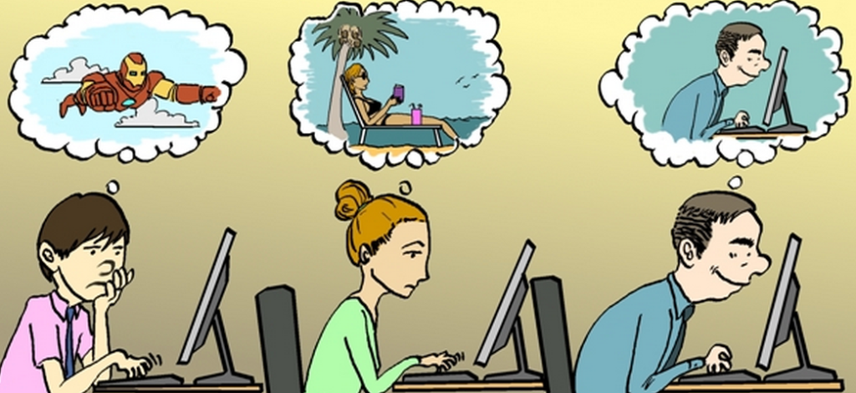
FICTIONAL PROPOSITIONS
imaginary propositions
Notes:
“Imagining is not always a deliberate, self-conscious act. We sometimes find ourselves imagining things more or less spontaneously, without having decided to do so. Thoughts pop into our heads unbidden. Dreams can be understood as simply very spontaneous imaginings” (11).

Slide 6
FICTIONAL PROPOSITIONS
make-believe propositions

Slide 7
FICTIONAL PROPOSITIONS
make-believe propositions

Slide 8
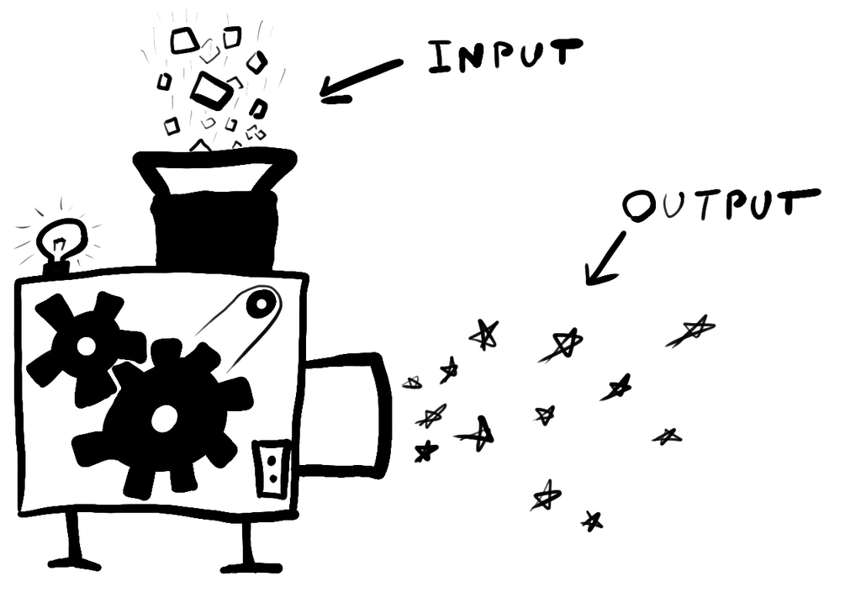
GAMES OF MAKE-BELIEVE
Games of make-believe generate fictional propositions.
They are made up of principles (or rules) concerning which kinds of propositions are to be counted as true in the fiction.
Whenever the asphalt is black, then it is make-believedly true that the floor is lava.
Whenever there is a glob of mud in a certain orange crate, then it is make-believedly true that there is a pie in the oven.
Notes:
Personal game

Slide 9
GAMES OF MAKE-BELIEVE
Principles of make-believe that are in force within a given game need not be explicitly formulated or deliberately adopted.
The fact that participants to a given game are disposed to non-deliberately, spontaneously imagine that certain propositions are true is typically good evidence that a given principle is in force within that game.
Notes:
“When children agree to let globs of mud ‘be’ pies they are in effect establishing a great many unstated principles linking make-believe properties of pies to properties of globs. It is implicitly understood that the size and shape of globs determine the make-believe size and shape of pies; it is understood, for example, that make-believedly a pie is one handspan across just in case that is the size of the appropriate glob. It is understood also that if Johnnie throws a glob at Mary then make-believedly Johnnie throws a pie at Mary. (It is not understood that if a glob is 40 per cent clay then make- believedly a pie is 40 per cent clay.)” (11).

Slide 10
WALTON’S THEORY APPLIED
“Why is it so natural to describe Charles as afraid of the slime, if he is not, and how is his experience to be characterized? In what follows I shall develop a theory to answer these questions” (Walton 1978, 10).

Slide 11
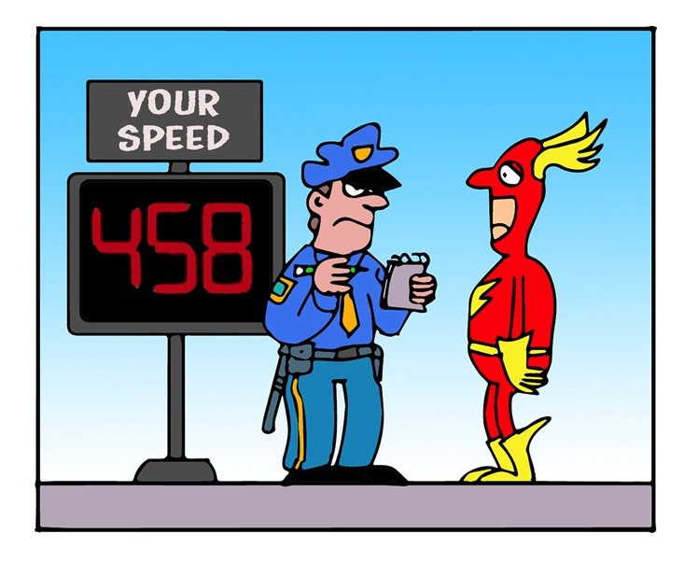
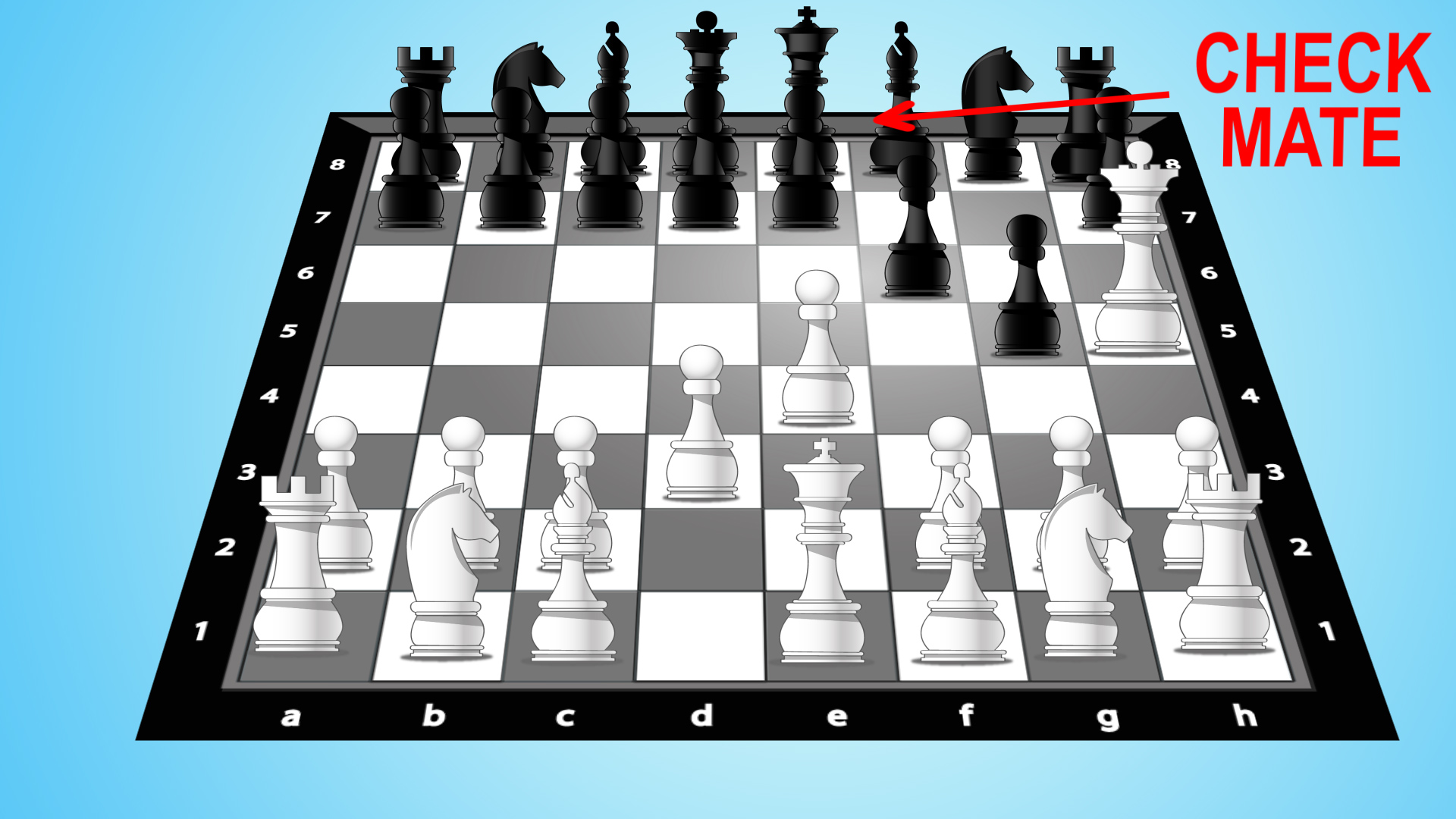
WALTON’S THEORY APPLIED
The Flash broke the law.
Black is checkmated.
The king is in check and there is no way to get out of it.
It is a rule of chess that whenever a player’s king is in check and there is no way to get out of it, then the player is checkmated.
The Flash was speeding down the highway at 458 mph.
It is illegal to exceed 40 mph on Burnett Rd.
Notes:
Transition: “Representational works of art generate make-believe truths” (Walton 1978, 12).

Slide 12
WALTON’S THEORY APPLIED
In the fiction: the floor is lava.
Whenever the asphalt is black, then it is true in the fiction that the floor is lava.
The asphalt is black.
Notes:
Transition: “Representational works of art generate make-believe truths” (Walton 1978, 12).

Slide 13
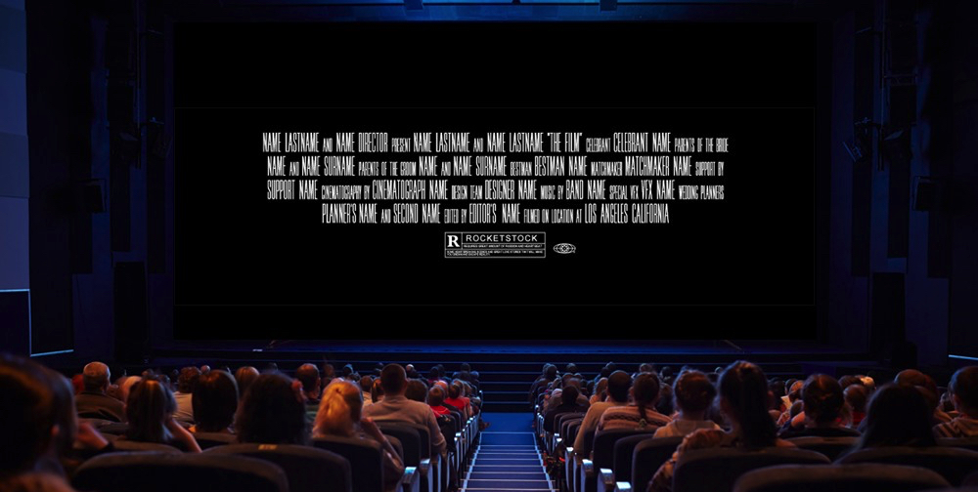
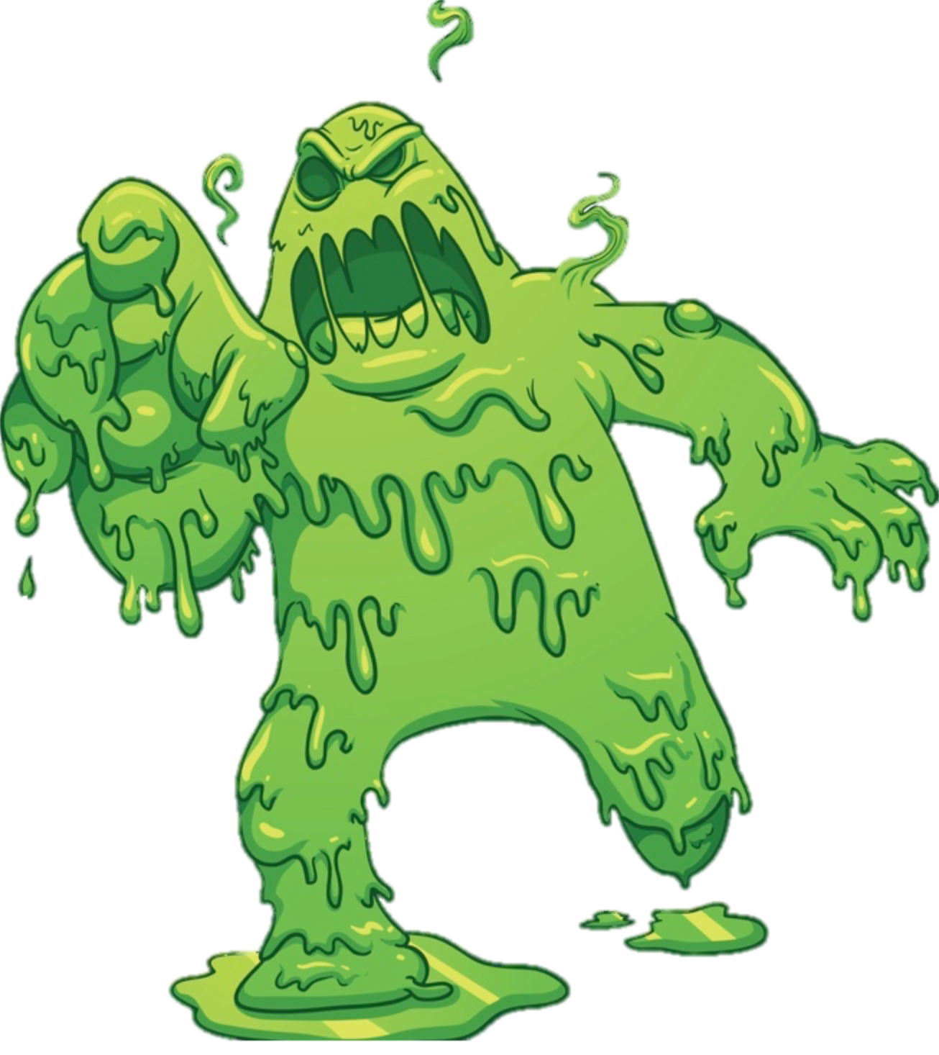
WALTON’S THEORY APPLIED
In the fiction: the green slime is on the loose.
Facts about the image on screen.
Operative principles of make-believe.
Notes:
“Representational works of art generate make-believe truths” (Walton 1978, 12).

Slide 14
QUIZ 2
According to Walton, the fact that Charles has quasi-fear symptoms (quickened pulse, tensed muscles, etc.) is sufficient to make it the case that make-believedly he fears the green slime.
True
False

Slide 15
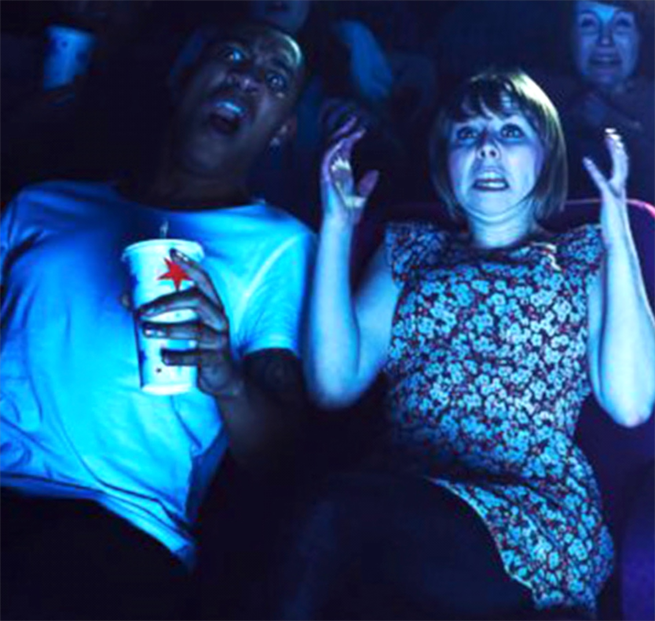
WALTON’S THEORY APPLIED
In the fiction: Charles fears the green slime.
Charles quasi-fear is the result of his belief that it is true in the fiction that the green slime is a real danger.
Whenever one’s quasi-fear is the result of such a belief, then it is true in the fiction that one is afraid.
Notes:
Transition: pause for questions.
Then show clip.

Slide 16
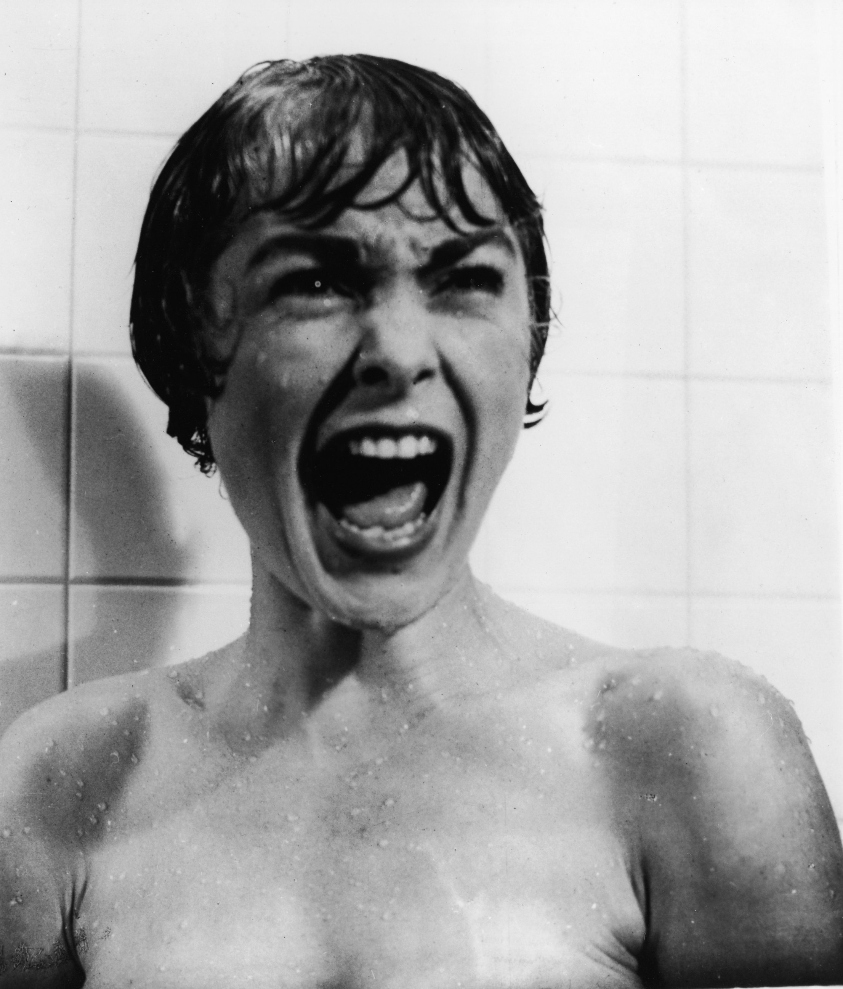
WALTON’S THEORY APPLIED
Janet Leigh portraying Marion Crane
Anthony Perkins portraying Norman Bates
Girl portraying a monster
Boy portraying himself
Prop on screen representing a green slime
Charles portraying himself
Notes:
“An on-stage actor, by contrast, generates make-believe truths solely by his acting, by his behavior. Whether it is make-believe that the character portrayed is afraid or not depends just on what the actor says and does and how he contorts his face, regardless of what he actually thinks or feels. It makes no difference whether his actual emotional state is anything like fear” (14).
“This is how our conventions for theater work, and it is entirely reasonable that they should work this way. Audiences cannot be expected to have a clear idea of an actor's personal thoughts and feelings while he is performing” (14).

Slide 17
WALTON’S THEORY APPLIED
Charles is akin to an actor in that he is engaged in a game of make-believe. We can regard him as treating the images on screen as props.
But unlike with some actors, the make-believe truth that he is afraid partly depends on his physiological/psychological symptoms of quasi-fear.
These symptoms are the product of Charles’ belief that make-believedly the green slime is a real threat.
Notes:
“An on-stage actor, by contrast, generates make-believe truths solely by his acting, by his behavior. Whether it is make-believe that the character portrayed is afraid or not depends just on what the actor says and does and how he contorts his face, regardless of what he actually thinks or feels. It makes no difference whether his actual emotional state is anything like fear” (14).
“This is how our conventions for theater work, and it is entirely reasonable that they should work this way. Audiences cannot be expected to have a clear idea of an actor's personal thoughts and feelings while he is performing” (14).
Transition: another difference is that the world is privately recognized.

Slide 18
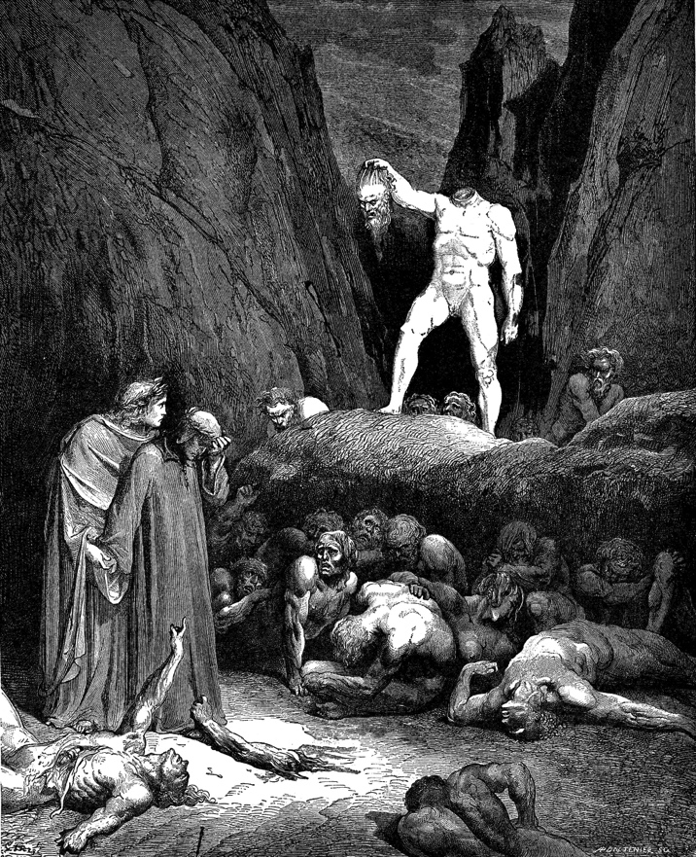
WALTON’S THEORY APPLIED
⊂
publicly recognized fictional worlds

Slide 19
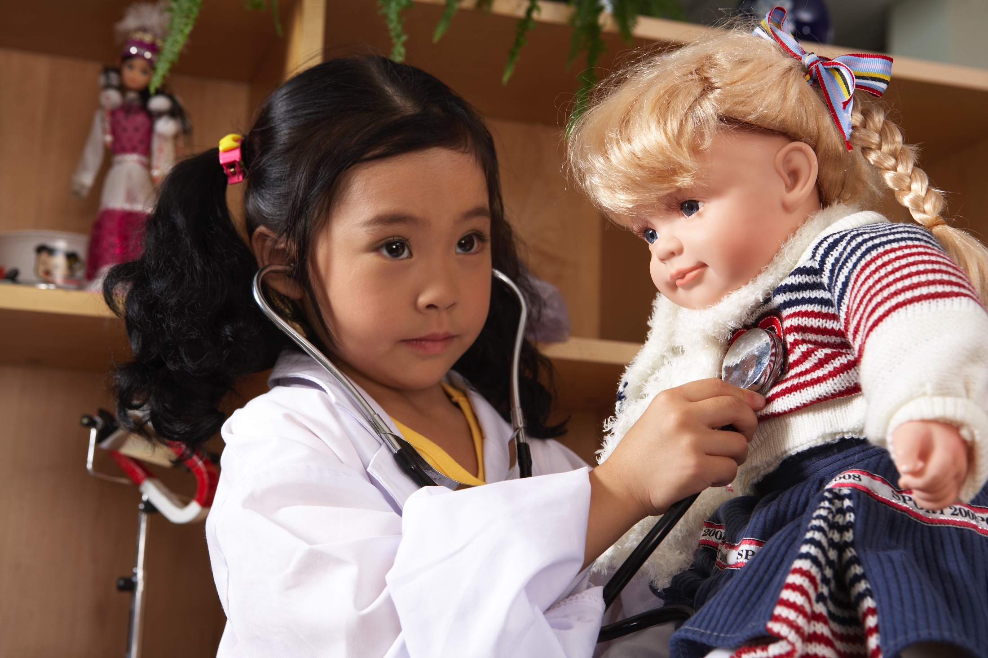
WALTON’S THEORY APPLIED
privately recognized fictional world

Slide 20
WALTON’S THEORY APPLIED
⊂
publicly recognized fictional world
privately recognized fictional worlds
Notes:
“But Charles recognizes, in addition, a larger world in which these make-believe truths are joined by truths generated by Charles's experience as he watches the movie, and also by truths generated by the images on the screen and Charles's experience together. It is only in this more inclusive world that make-believedly Charles fears the slime. (And it is the larger world that occupies Charles's attention when he is caught up in the movie.)” (18).

Slide 21
EVIDENCE
Charles’ participation in his game of make-believe is more or less automatic and non-deliberative.
But he might easily slip into participating in this game deliberately.
“Yikes, here it comes!”
This indicates that Charles regards the slime as headed toward him, that he himself belongs to a larger fictional world including the green slime.

Slide 22
EVIDENCE
The Flash broke the law.
Black is checkmated.
The king is in check and there is no way to get out of it.
Whenever a player’s king is in check and there is no way to get out of it, then the player is checkmated.
The Flash was speeding down the highway at 458 mph.
It is illegal to exceed the speed limit.
Notes:
Transition: “Representational works of art generate make-believe truths” (Walton 1978, 12).

Slide 23
EVIDENCE
In the fiction: Charles fears the green slime.
Charles quasi-fear is the result of his belief that it is true in the fiction that the green slime is a real danger.
Whenever one’s quasi-fear is the result of such a belief, then it is true in the fiction that one is afraid.
Notes:
“But more needs to be said in support of my claim that this is a make-believe truth. What needs to be established is that the relevant principle of make-believe is accepted or recognized by someone, that someone understands it to be in force. I contend that Charles, at least, does so understand it” (16).

Slide 24
EVIDENCE
In the fiction: Charles fears the green slime.
Charles quasi-fear is the result of his belief that it is true in the fiction that the green slime is a real danger.
Whenever one’s quasi-fear is the result of such a belief, then it is true in the fiction that one is afraid.
Notes:
Transition: pause for questions.
Then show clip.

Slide 25
EVIDENCE
Charles imagines himself to be afraid of the green slime.
This imaginative act is non-deliberate and spontaneous.
But recall that a disposition to non-deliberately, spontaneously imagine that certain propositions are true is typically good evidence that a given principle is in force within a given game of make-believe.
So: we have good reason to believe that Charles recognizes a principle to the effect that his quasi-fear partly determines that it is true in the fiction that he is afraid.

Slide 26
OBJECTION
If Charles’ assertion that he is terrified really means that in the fiction he is terrified, then it should be felicitous for Charles to just say that (“I’m afraid, in the fiction!”).
But that isn’t felicitous.
So: that’s not what Charles’ claim means.
QUIZ 3: What is Walton’s response to this objection?
Charles never asserted that he is terrified in the first place.
It is felicitous for Charles to say “I’m afraid, in the fiction!” because “I’m afraid” is merely an ellipsis for the former.
Charles pretended to assert (seriously) that he is terrified.
Both (A) and (C)
Notes:
“Compare how ridiculous it would be for an actor playing Horatio in a performance of Hamlet to exclaim, when the ghost appears, ‘Look, my lord, it comes, in the fictional world of the play!’” (19).

Slide 27
RESPONSE
Charles is not asserting that he is terrified at all.
He is instead pretending to assert that he is terrified.
When we later describe the situation, we may genuinely assert that Charles was terrified.
But in that context, it is not necessarily infelicitous to say it was only make-believedly true that Charles was terrified—he was simply playing along with the film.
Notes:
“Compare how ridiculous it would be for an actor playing Horatio in a performance of Hamlet to exclaim, when the ghost appears, ‘Look, my lord, it comes, in the fictional world of the play!’” (19).

Slide 28
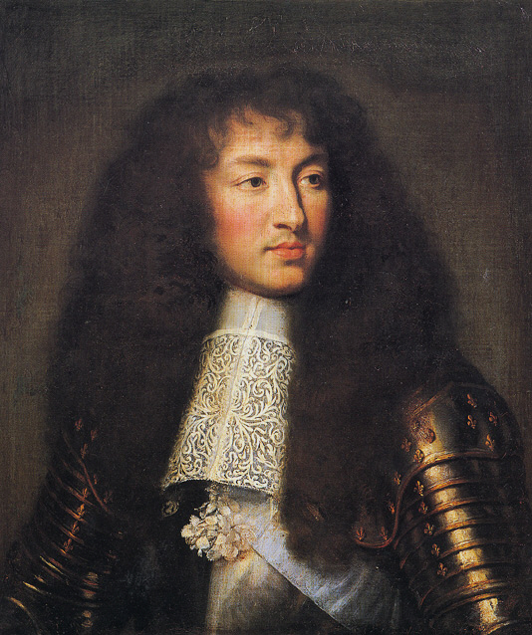
CONNECTIONS
Literally: seeing Florence.
Literally: Florence is frowning.
Literally: seeing a Louis-depiction.
Literally: seeing Louis.
In the fiction: Florence is frowning.
In the fiction: seeing Louis.
Florence Owens Thompson
Louis XIV
Notes:
You might say that photographs are distinctive in that they always have existential import.
“Those who see a sharp contrast between photographs and paintings clearly think that it obtains no less when paintings depict real things than when they do not, and even when viewers fully realize that they do” (251).

Slide 29
FURTHER APPLICATIONS
Charles fears the green slime.
Playgoers pity Willy Loman.
Cinemagoers detest Nurse Ratched.
Fans envy Wonder Woman.
Cognitive constraint: x has an emotion directed at y only if x believes that y exists.
Notes:
“But the person is, actually, in a distinctive psychological (emotional?) state, even if that state is not pity or worry or hate or envy. And his being in this state is a result of his awareness of certain make-believe truths: that make-believedly Willy is an innocent victim of cruel circumstances, that make-believedly Tom and Becky might perish in the cave, that make-believedly Iago deceived Othello about Desdemona, that make-believedly Superman can do almost anything. The fact that the person’s psychological state is as it is, and is caused by such beliefs, makes it make-believe that he pities willy, worries about Tom and Becky, hates Iago, or envies Superman” (21).

Slide 30
FURTHER APPLICATIONS
In the fiction: Charlotte envies Wonder Woman.
Charlotte’s quasi-envy is the result of her belief that it is true in the fiction that Wonder Woman is extremely powerful.
Whenever one’s quasi-envy is the result of such a belief, then it is true in the fiction that one experiences envy.
Notes:
“But more needs to be said in support of my claim that this is a make-believe truth. What needs to be established is that the relevant principle of make-believe is accepted or recognized by someone, that someone understands it to be in force. I contend that Charles, at least, does so understand it” (16).

Slide 31
FURTHER APPLICATIONS
Puzzle of contradictory desires: a reader or viewer may want the heroine to suffer a tragic fate, and yet when interacting with the fiction, become caught up in the story and “want” her to succeed. But intuitively, this rarely involves an irrational set of inconsistent desires. How could that be?
Puzzle of repeated investment: works of fiction can be effective even after numerous readings or viewings. But how can that be, given that readers or viewers know exactly how the plot will unfold?
Notes:
“My theory provides a neat explanation. It is merely make-believe that the spectator sympathizes with the heroine and wants her to escape. And he (really) wants it to be make-believe that she suffers a cruel end. He does not have conflicting desires. Nor, for that matter, is it make-believe that he does” (25).
Mention children
Transition… The Wailing

