Slide 1
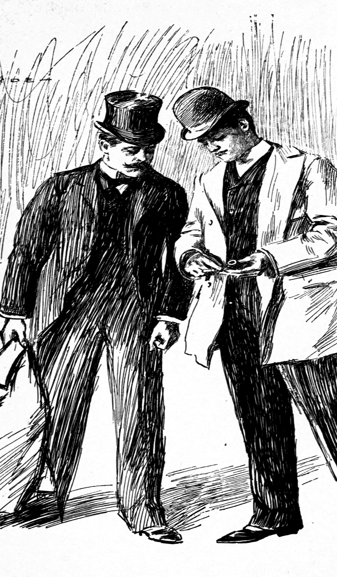
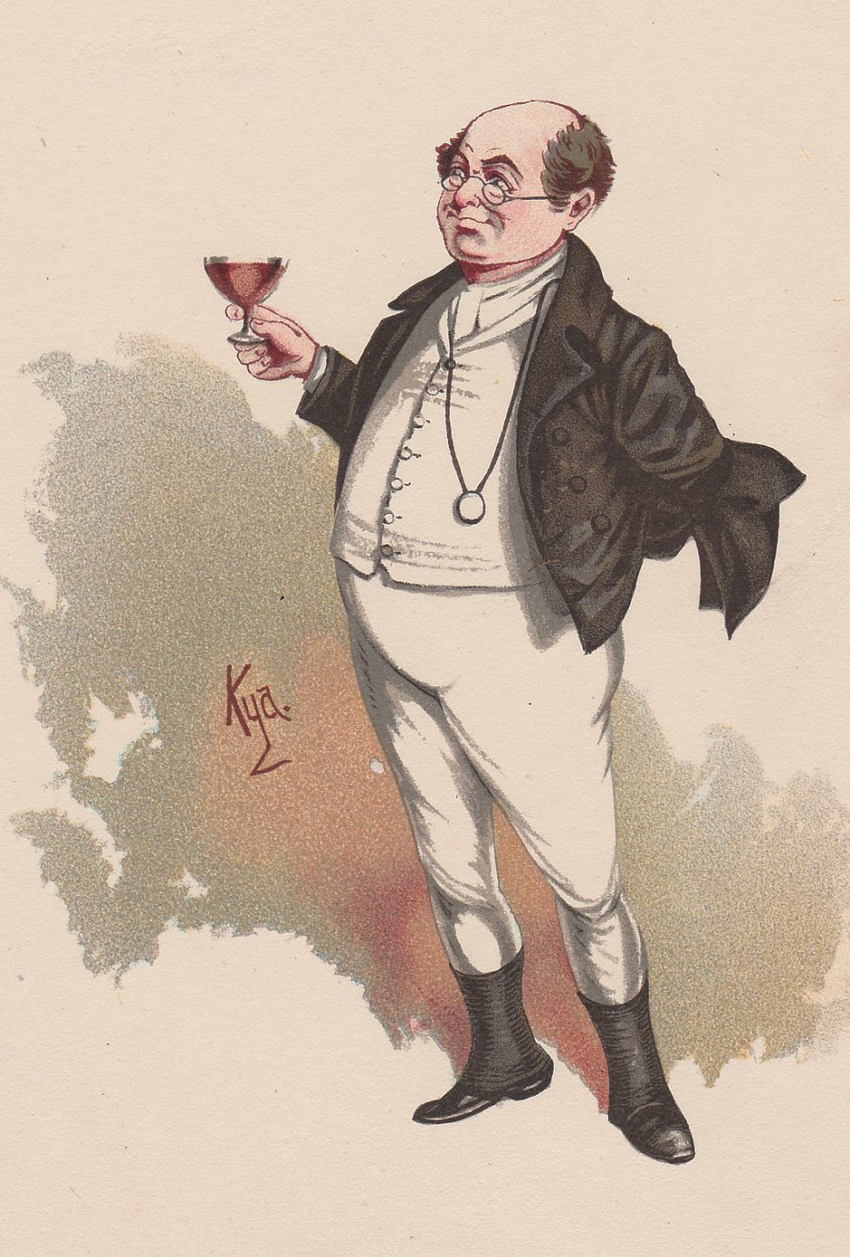
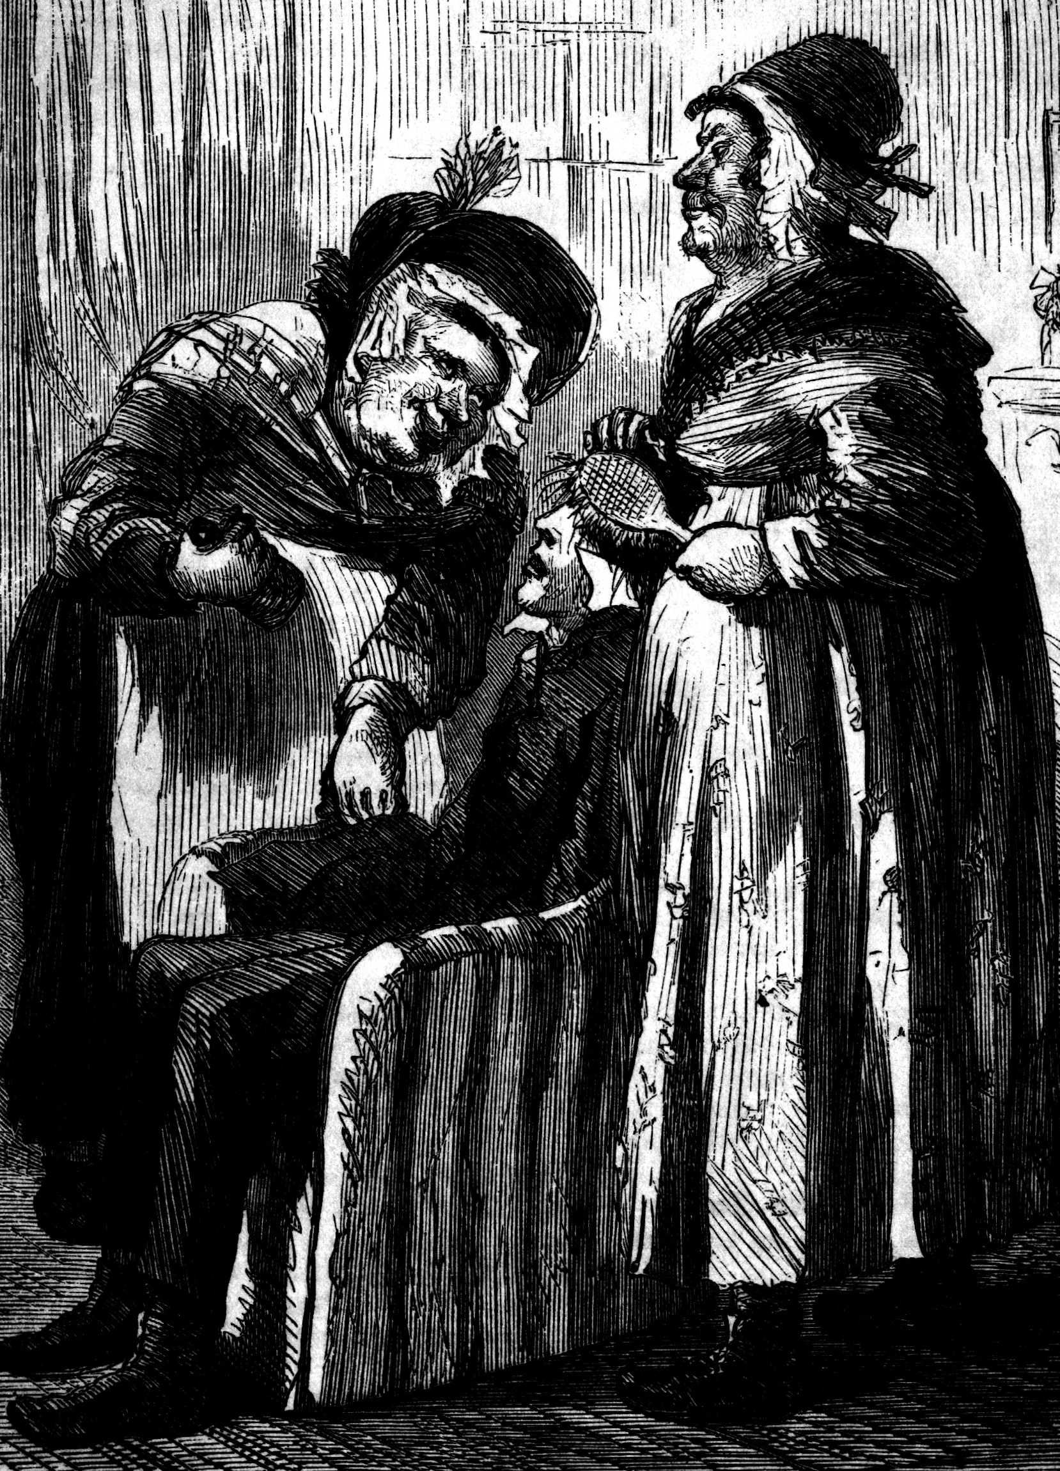
THE METAPHYSICS OF FICTION
Notes:
Russell: https://www.youtube.com/watch?v=80oLTiVW_lc

Slide 2
THE METAPHYSICS OF FICTION
The American Museum of Natural History is putting on a big new show of creatures that don’t actually exist, “Mythic Creatures: Dragons, Unicorns and Mermaids.”
– New Yorker, June 4, 2007: 38

Slide 3
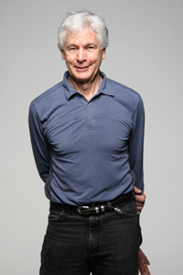
READING RECOMMENDATION

Slide 4
TWO QUESTIONS
General (problem of nonexistence): how can we make sense of sentences that are intuitively true but contain non-referring names?
Specific (problem of fiction): how can we make sense of sentences that are intuitively true but apparently make reference to fictional characters?

Slide 5
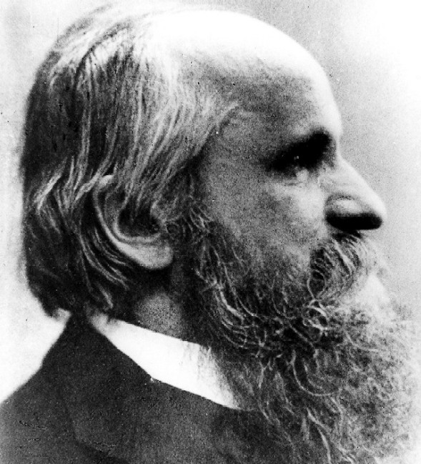
MEINONGIANISM
There are—really are!—a wide range of objects that are nonexistent.
Reality consists of more than what exists.
Alexius Meinong

Slide 6
MEINONGIANISM
The golden mountain

Slide 7
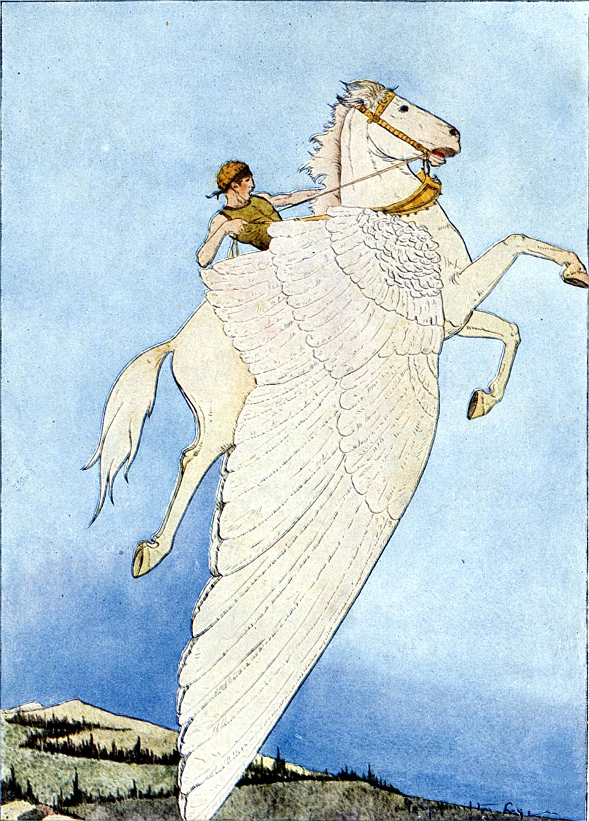
MEINONGIANISM
Pegasus

Slide 8
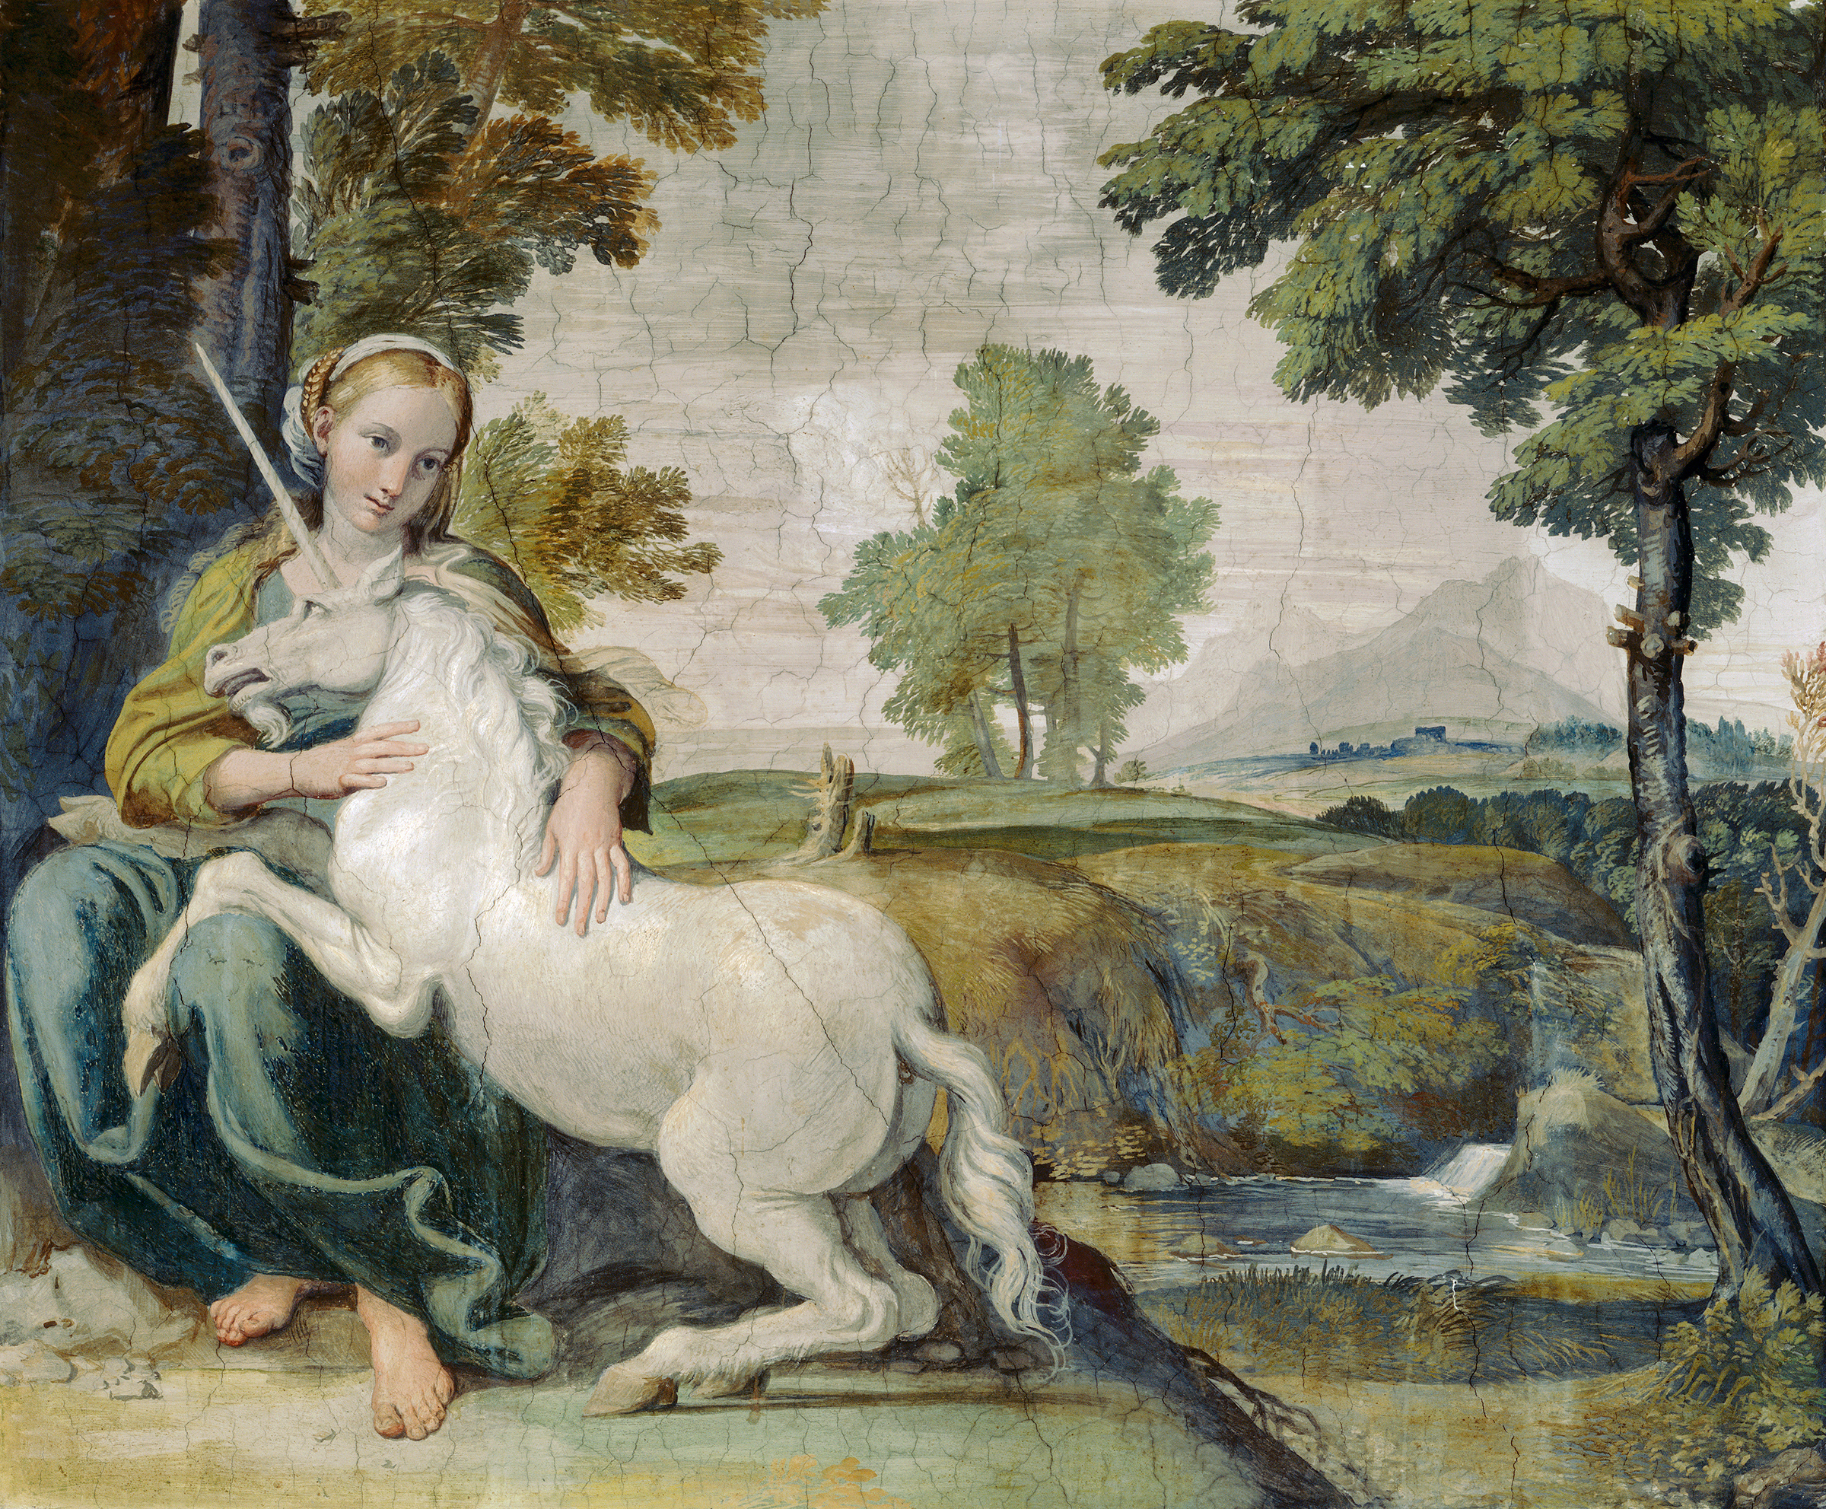
MEINONGIANISM
Unicorns

Slide 9
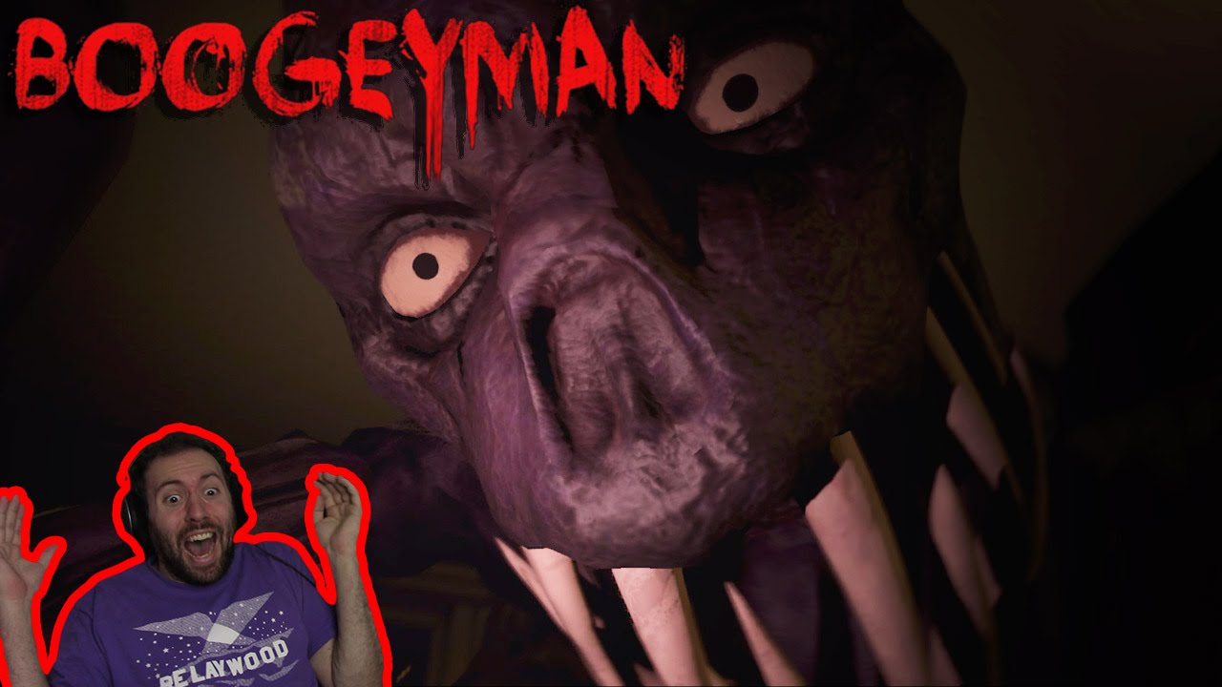
MEINONGIANISM
AGGHH!!!!

Slide 10
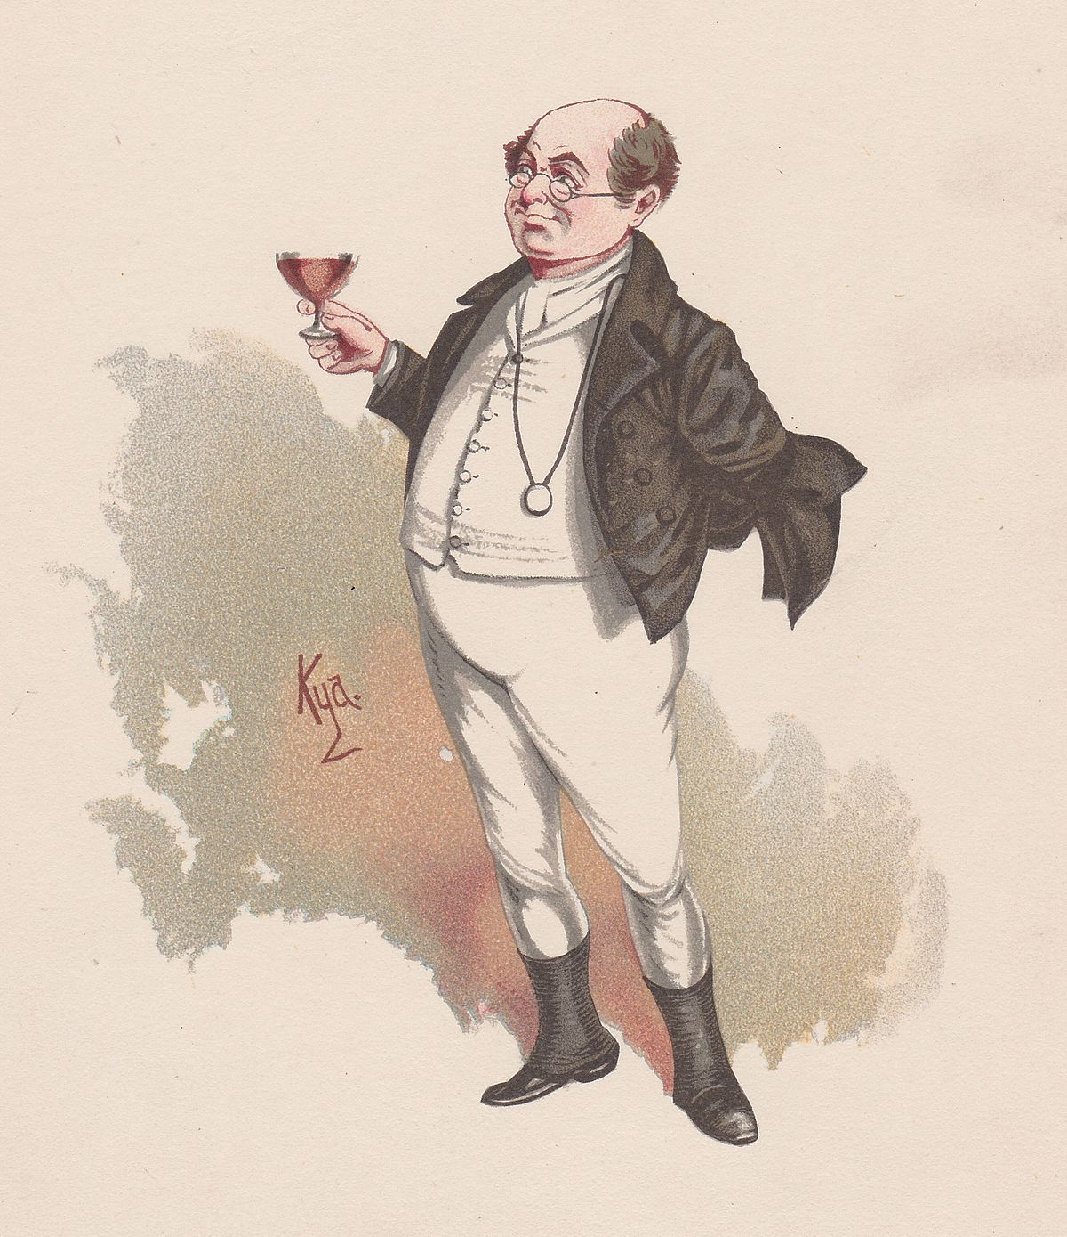
MEINONGIANISM
Mr. Pickwick

Slide 11
MEINONGIANISM
“[W]e are all prepared to cite examples of nonexistent objects: Pegasus, Sherlock Holmes, unicorns, centaurs. . . . With so many examples at hand, what is more natural than to conclude that there are nonexistent objects – lots of them!” (Parsons 1980, 2).
“(a) S’s V-ing o constitutes a relation between S and o when o exists, but (b) not when o doesn’t; but (c) S’s V-ing o is the same sort of thing whether o exists or not. Something plainly has to be given up here; what will it be?” (Prior 1971, 130).

Slide 12
PROBLEM OF NEGATIVE EXISTENTIALS
How can we even deny Meinongianism?
Ordinary English:
Golden mountains are nonexistent.
Winged-horses are nonexistent.
Unicorns are nonexistent.
Ordinary English:
Pegasus is nonexistent.
The bogeyman is nonexistent.

Slide 13
PROBLEM OF NEGATIVE EXISTENTIALS
<unicorns, nonexistence>
Not: <unicorns, existence>

Slide 14
PROBLEM OF NEGATIVE EXISTENTIALS
Ordinary English:
Golden mountains are nonexistent.
Winged-horses are nonexistent.
Unicorns are nonexistent.
Ordinary English:
Pegasus is nonexistent.
The bogeyman is nonexistent.
Logical form:
It is not the case that there is an x such that x is a golden mountain.
It is not the case that there is an x such that x is a winged-horse.
It is not the case that there is an x such that x is a unicorn.
Logical form:
It is not the case that there is an x such that x = Pegasus.
It is not the case that there is an x such that x = the bogeyman.

Slide 15
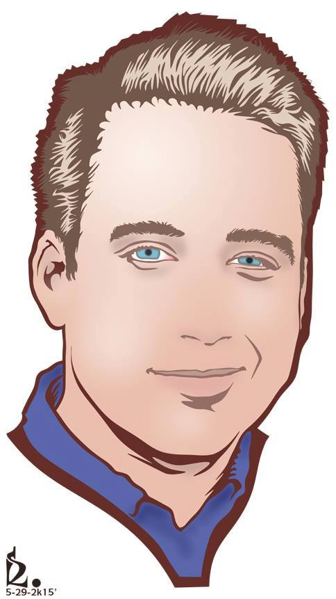
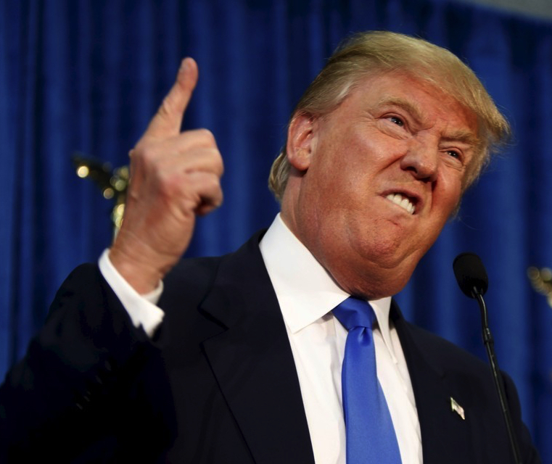
PROBLEM OF NEGATIVE EXISTENTIALS
“the president of the United States”
✓
“winged-horse”
✓
“Zach Blaesi”
“Pegasus”
∃xPx ✓
~∃xWx ✓
∃x(x = ZB) ✓
~∃x(x = Pegasus) ?
refers
?
unsatisfied
satisfied
domain of quantification

Slide 16
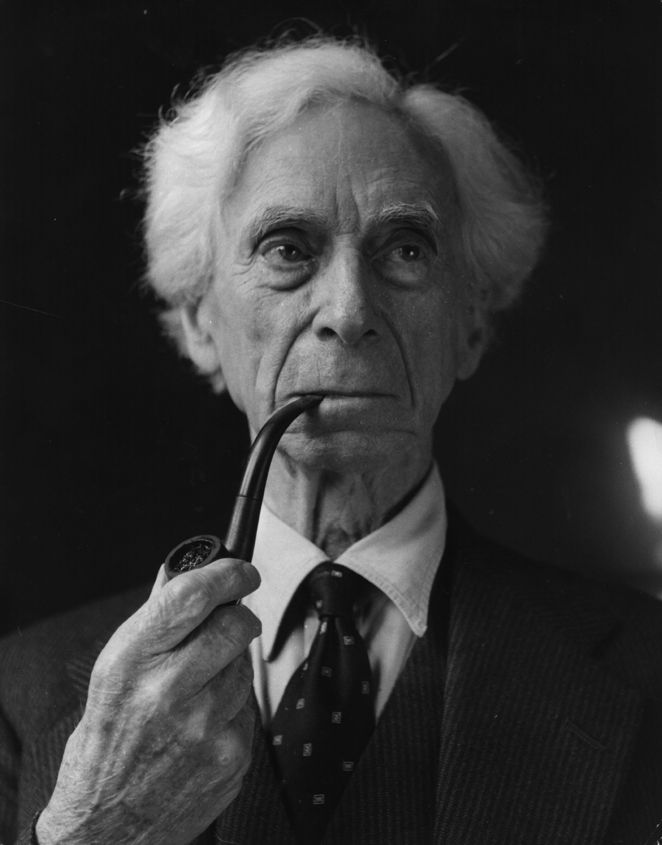
PROBLEM OF NEGATIVE EXISTENTIALS
Theory of descriptions: names are disguised descriptions.
“Pegasus” has the logical form of “the unique winged-horse who served the muses”—a description that can be satisfied or unsatisfied.
To say that Pegasus doesn’t exist is to say that there is no x such that x is the winged-horse who served the muses—that is, the description “the unique winged-horse who served the muses” isn’t satisfied by anything.
Bertrand Russell
Notes:
20th century

Slide 17
PROBLEM OF NEGATIVE EXISTENTIALS
“the president of the United States”
✓
“winged-horse”
✓
“Zach Blaesi”
“Pegasus”
∃xPx ✓
~∃xWx ✓
∃xZ!x ✓
~∃xP!x ✓
satisfied
unsatisfied
unsatisfied
satisfied
domain of quantification

Slide 18
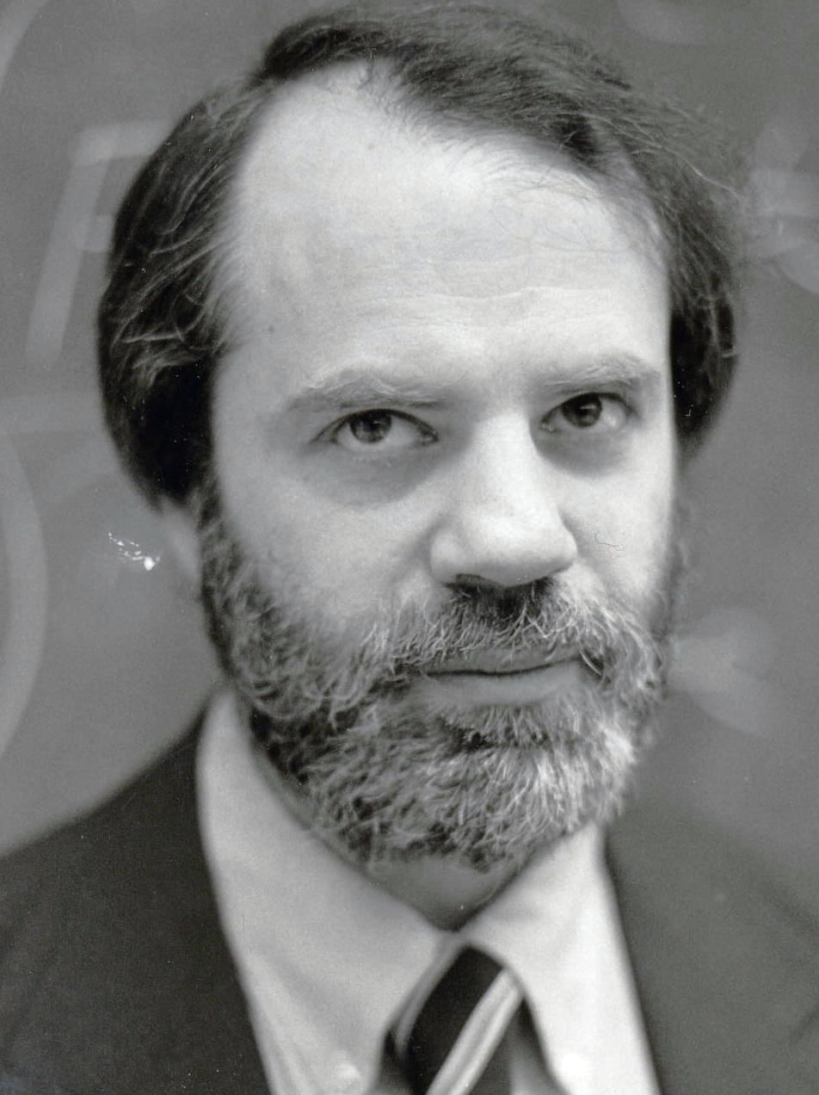
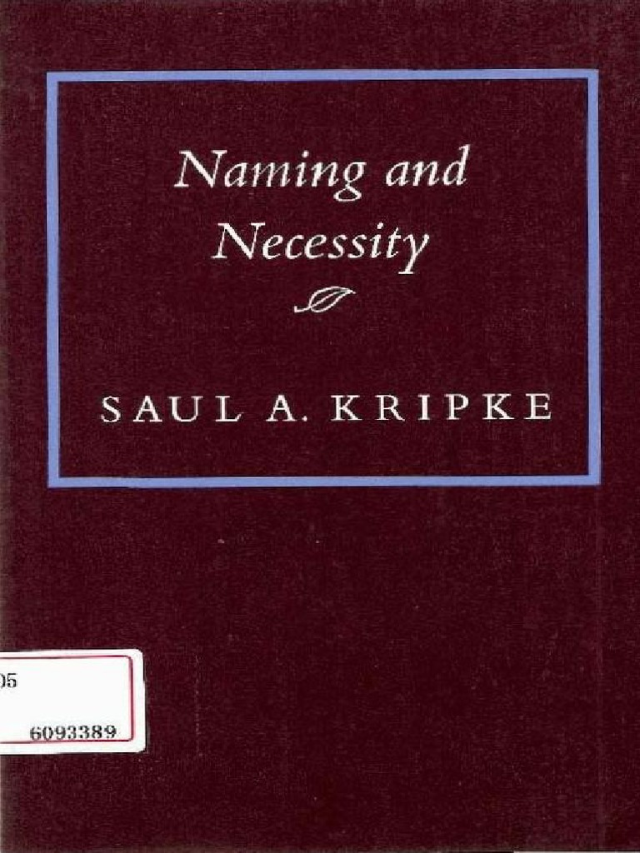
PROBLEM OF NEGATIVE EXISTENTIALS
Notes:
Contemporary

Slide 19
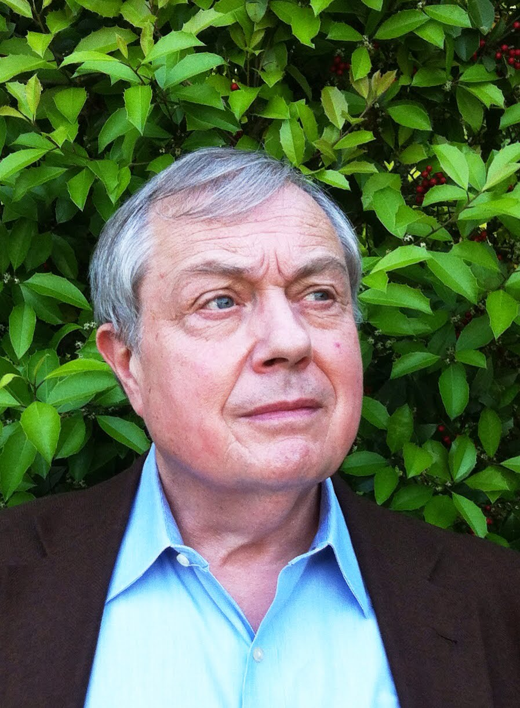
ANTI-MEINONGIANISM
Meinongians must abandon the “laws of logic.”
To say that there are things that don’t exist is to say that there is an x such that there is no y such that x = y.
The negation of that claim is a theorem of logic!
Law of excluded middle: for any x, either x is F or x is not F.
On the face of it, Meinongians have to reject this; they maintain that nonexistent objects are incomplete.
Peter van Inwagen

Slide 20
ANTI-MEINONGIANISM
The anti-Meinongian now has to explain why we can apparently use non-referring names to state truths.
The anti-Meinongian might attempt to supply paraphrases of these sentences that do not incur a commitment to nonexistent objects.
But that project looks hopeless!
Such paraphrases would have to be synonymous to those sentences.
Such paraphrases would also have to preserve the logical relationships that hold between those and further sentences.
But why bother? We can address (at least) the problem of fiction by adopting a form of realism.
Peter van Inwagen

Slide 21
LINGUISTIC DATA
She was a fat old woman, this Mrs. Gamp, with a husky voice and a moist eye, which she had a remarkable power of turning up, and only showing the white of it.
Mrs. Sarah Gamp was, four-and-twenty years ago, a fair representation of the hired attendant on the poor in sickness.
Mrs. Gamp . . . is the most fully developed of the masculine anti-women visible in all Dickens's novels.
Sherlock Holmes is a famous fictional character.
There are characters in some nineteenth-century novels who are presented with a greater wealth of physical detail than is any character in any eighteenth-century novel.

Slide 22
LINGUISTIC DATA
She was a fat old woman, this Mrs. Gamp, with a husky voice and a moist eye, which she had a remarkable power of turning up, and only showing the white of it.
Mrs. Sarah Gamp was, four-and-twenty years ago, a fair representation of the hired attendant on the poor in sickness.
Mrs. Gamp . . . is the most fully developed of the masculine anti-women visible in all Dickens's novels.
Sherlock Holmes is a famous fictional character.
There are characters in some nineteenth-century novels who are presented with a greater wealth of physical detail than is any character in any eighteenth-century novel.
Notes:
“[S]urely [the Meinongian] is wrong in so assimilating the writing of (1) to the writing of (2) and (3). Sentences (2) and (3) were used by their authors as vehicles of assertions; (1) was not” (301).
“It would make sense to say that the authors of (2) and (3), in writing these sentences, wrote something true or wrote something false” (301).
“But if someone had been looking over Dickens’s shoulder when Dickens was writing (1), and had said to him, ‘No, no, you’ve got her all wrong. She is quite thin, about twenty-four, and her voice is melodious,’ this would simply have made no sense” (301).
“There is no point in debating what sort of thing Dickens was writing about when he wrote (1) or debating what sort of fact or proposition he was asserting, since he was not writing about anything and was asserting nothing. Sentence (1) does not represent an attempt at reference or description” (301).

Slide 23
FICTIONAL REALISM
Sentences (2)–(5) express true propositions.
This is possible because the names “Sarah Gamp” and “Sherlock Holmes” denote existing entities: namely, fictional characters.

Slide 24
FICTIONAL REALISM
Question: Why should we take a sentence like
Sherlock Holmes is a famous fictional character
to to be about Sherlock Holmes, except in the uninteresting sense in which
The average American owns 1.02 cars
is about “the average American”?
Answer: “Sherlock Holmes” is a name, “the average American” is a definite description.

Slide 25
FICTIONAL REALISM
Question: Why should we think that there is such a thing as Sherlock Holmes?
Answer: Because there are fictional characters—they are heavily discussed by literary critics, after all! And if that is right, then surely Sherlock Holmes is one of them.

Slide 26
FICTIONAL REALISM
Question: But what do you mean when you say that fictional characters exist?!
Answer: The same sort of thing that is meant by claims like the following:
There are such things as countries—we live in one of them, namely, the United states.
Cabbages exist—you can find some of them at HEB.
There are numbers—after all, that is a straightforward consequence of the claim that 2 is a prime number.

Slide 27
FICTIONAL REALISM
Question: But if Sherlock Holmes exists, then what sort of thing is he?!?!
Answer: A character in a novel, or, more generally, a creature of fiction—or more generally still, a theoretical entity of literary criticism.

Slide 28
FICTIONAL REALISM
EVERYTHING
theoretical entities of literary criticism
plots, novels, poems, fictional characters, fictional locations, meters, rhyme schemes, …
theoretical entities of physics
quarks, electrons, antimatter, fields, strings, spacetime, …
theoretical entities of mathematics
integers, real numbers, irrational numbers, functions, sets, ordered pairs, …
…
…

