Slide 1
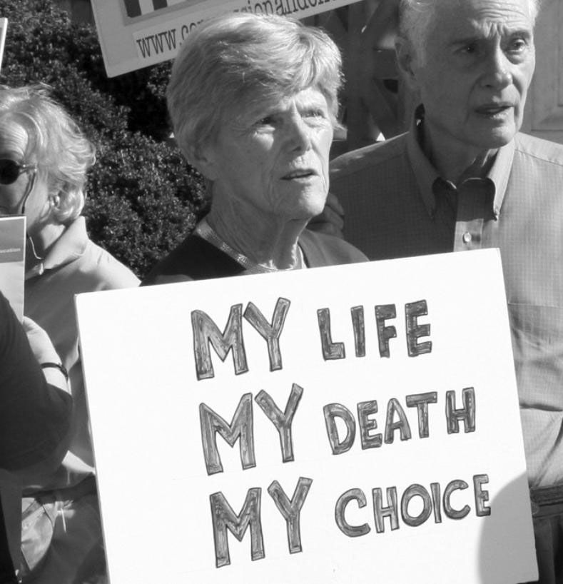
THE ETHICS OF EUTHANASIA
PHL 304
Fall 2018

Slide 2
IMPORTANT DISTINCTIONS
Euthanasia is derived from a Greek word for “good death.”
It can be voluntary, non-voluntary, or involuntary.
It can be passive or active.
Assisted suicide involves intentionally killing oneself with the assistance of another person who deliberately provides the knowledge and/or means to do so.
These acts raise both moral and legal issues.

Slide 3
THE UTILITARIAN ARGUMENT
Any action is morally right if it serves to increase the amount of happiness in the world or to decrease the amount of misery. Conversely, an action is morally wrong if it serves to decrease happiness or increase misery.
Killing a hopelessly ill patient, who is suffering great pain, at his own request, would decrease the amount of misery in the world.
So: such an action would be morally right.

Slide 4
THE ARGUMENT FROM MERCY
If an action promotes the best interests of everyone, then that action is morally acceptable.
In at least some cases, euthanasia promotes the best interests of everyone concerned.
So: in at least some cases, euthanasia is morally acceptable.

Slide 5
WHAT DO YOU THINK?
Suppose that Bob meets all of the following criteria:
he is suffering from a terminal illness;
he is extremely unlikely to benefit from a medical discovery during what remains of his life expectancy;
his illness is causing him to suffer intolerable pain;
he has repeatedly expressed a voluntary and competent wish to die in order to avoid the symptoms of his illness;
he is unable to end his life without assistance.
Bob begs his physician to end his life, and his physician responds by administering a lethal dose of barbiturates, killing him.

Slide 6
THE PRINCIPLE OF UNIVERSALIZABILITY
The principle of universalizability states that it is morally permissible to perform some action if and only if its maxim is universalizable.
A maxim is simply a principle of action you give yourself when you are about to do something.
It has the following form: perform some action A in a circumstance C in order to realize or produce some end E.

Slide 7
THE PRINCIPLE OF UNIVERSALIZABILITY
Formulate a maxim that captures your reason for performing the action you propose to perform under the circumstances.
Recast that maxim as a universal law that all rational agents must act as you propose to act in circumstances like your own.
Consider whether your maxim is even conceivable in a world governed by such a law. If it isn’t, then it is morally wrong.
If it is conceivable, then consider whether you could rationally will to act on your original maxim in such a world. If you could, then your action is morally permissible; otherwise, it is morally wrong.

Slide 8
WHAT ABOUT EUTHANASIA?
What does the principle of universalizability suggest for euthanasia?

