Slide 1
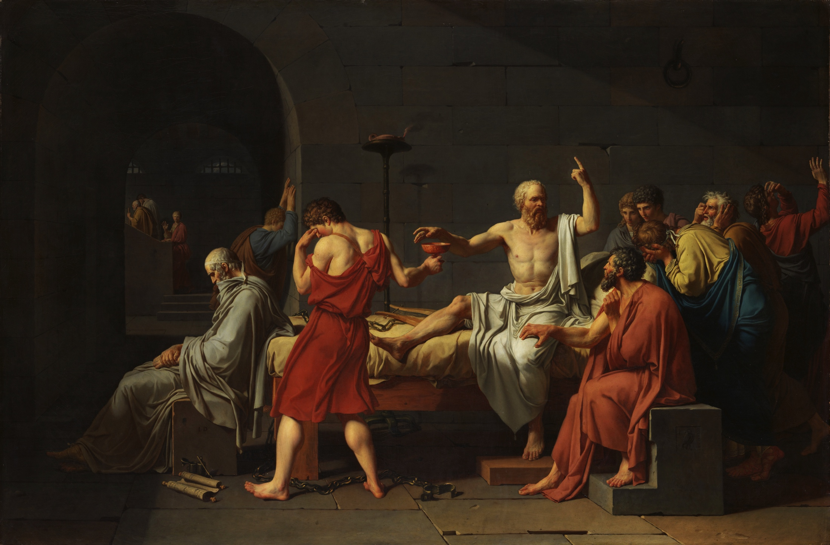
coda
PHL 304
Fall 2018

Slide 2
VIDEO CLIP
https://www.youtube.com/watch?v=BIUKMWbKwo4

Slide 5
Do you agree or disagree with the following statement? “There are true moral claims about right and wrong that in no way depend on the attitudes that people take toward those claims. For example, it is wrong to torture a human person against that person's consent just for the fun of it, and that would be true even if no one believed it and society did not endorse it.”

Slide 6
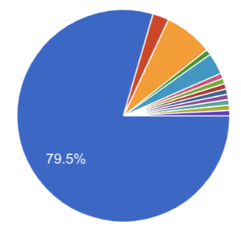
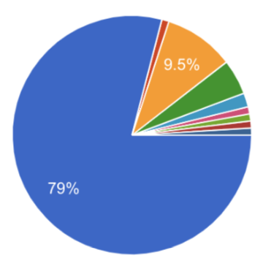
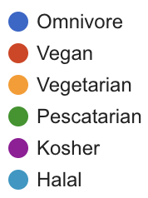
What best describes your current dietary lifestyle? In answering this question, please set aside any special circumstances in which you might depart from your usual routine (e.g., holidays).

Slide 7
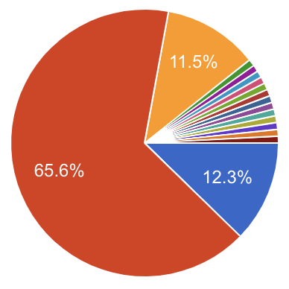
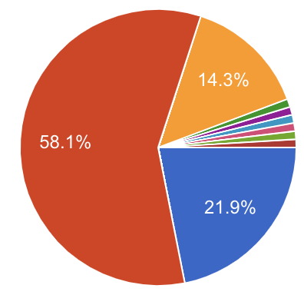
What best describes your current stance on animal ethics?
Except in rare circumstance, it is morally wrong to purchase animal products, such as factory-farmed meat.
Except in rare circumstances, it is morally permissible (i.e., NOT morally wrong) to purchase animal products, such as factory-farmed meat.
Undecided

Slide 10
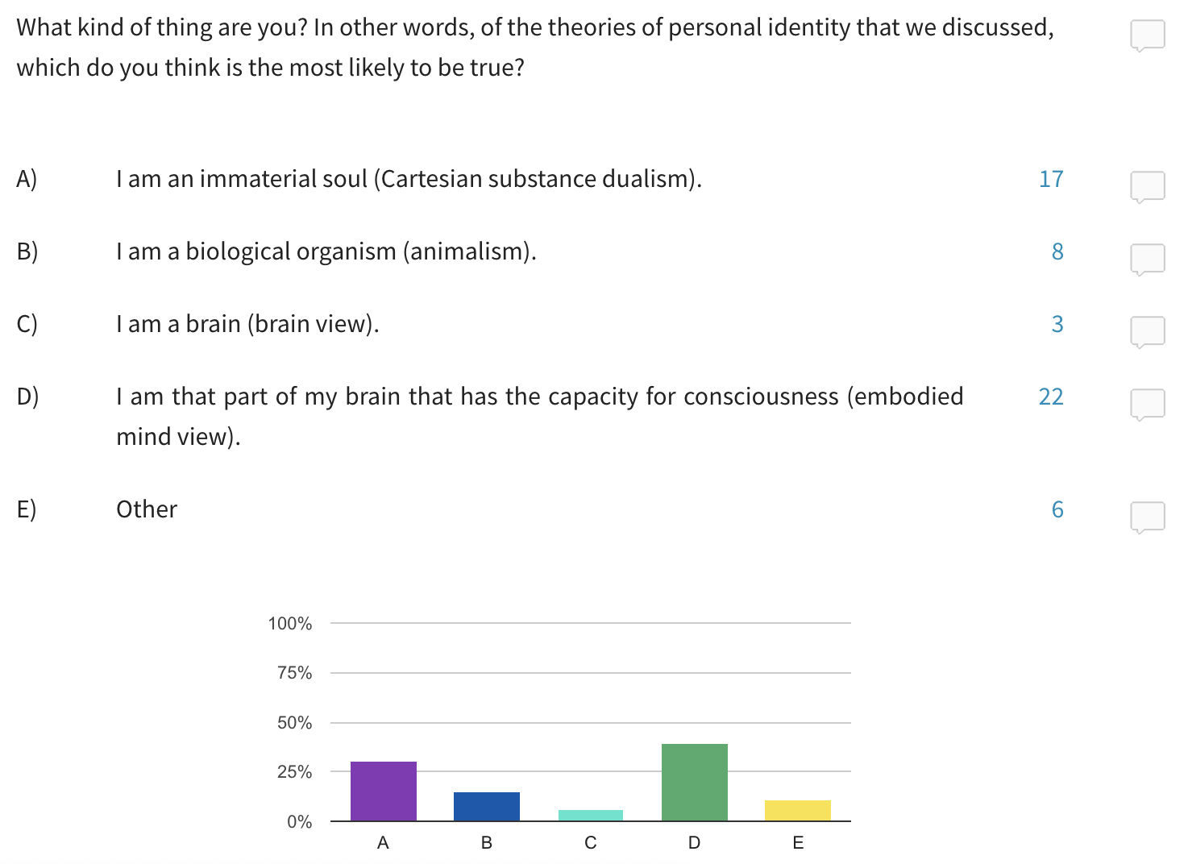

Slide 11
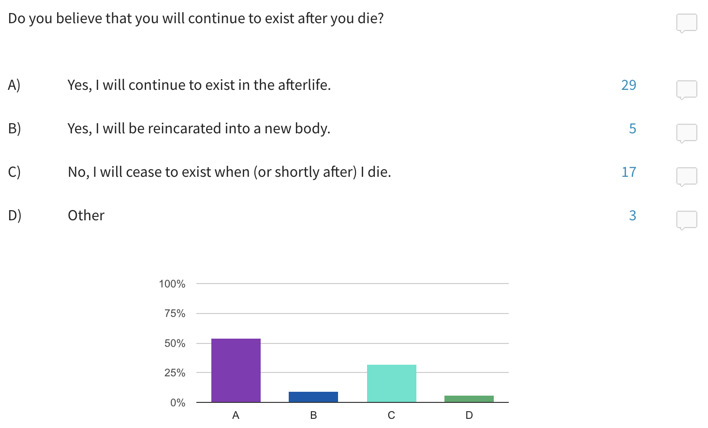

Slide 12
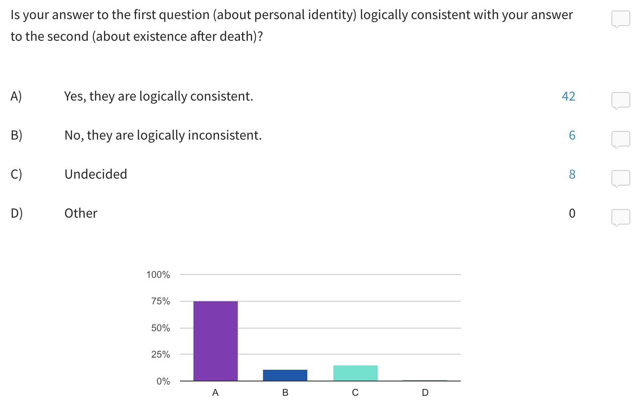

Slide 13
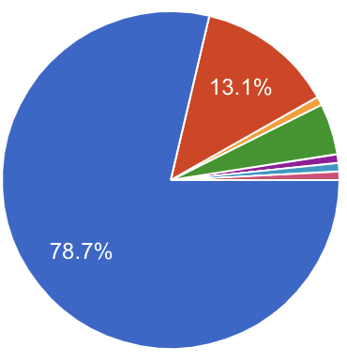
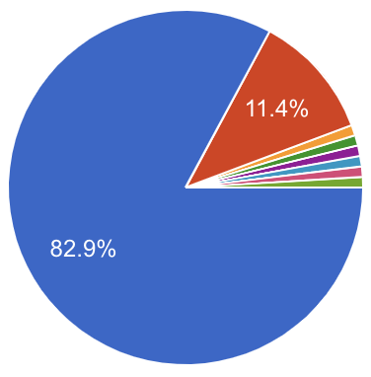
What best describes your current stance on procreation?
If one has the financial resources to properly raise a family and doesn’t already have a large number of children, it is morally permissible to bring a child into existence.
Children are a gift and bringing a child into existence is almost always a good thing.
It is almost always wrong to intentionally bring a child into existence.
Undecided

Slide 14
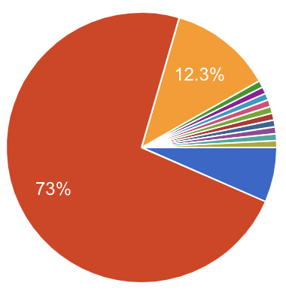
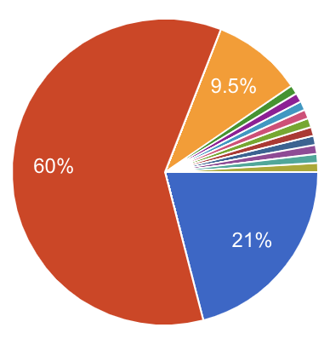
Is the average US citizen who has a stable income morally obligated to donate at least 10 percent of their income to charities aimed at alleviating global poverty?
Yes, the average US citizen is morally obligated to do that.
No, the average US citizen is not morally obligated to do that.
Undecided

Slide 15
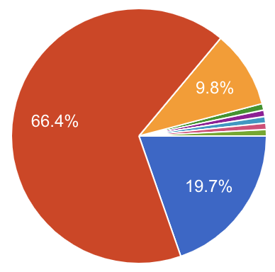
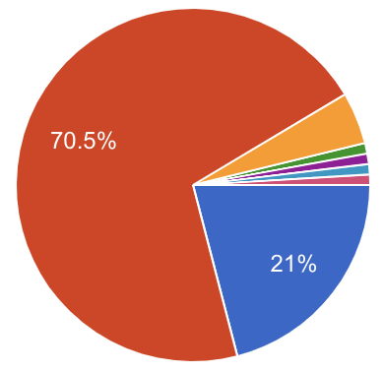
Once an individual decides to donate money to charity, is that individual morally obligated to pick whichever organization (or set of organizations) will bring about the most good in the world?
Yes, once the decision is made, it would be wrong to refrain from picking the option(s) that will bring about the most good in the world.
No, because it is morally permissible to donate one's money to a cause with which one has a personal connection, even if there are alternatives that are proven to produce more good in the world.
Undecided

Slide 16
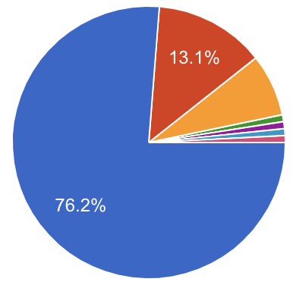
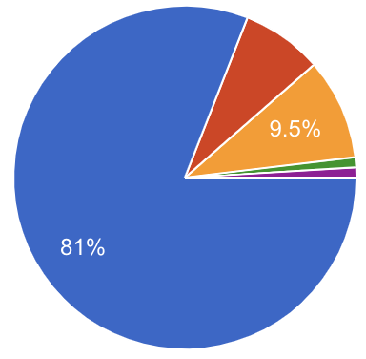
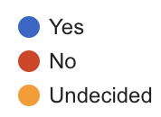
Are nations like the United States morally obligated to implement policies aimed at radically reducing CO2 emissions to the atmosphere in order to address the threat of climate change?

Slide 17
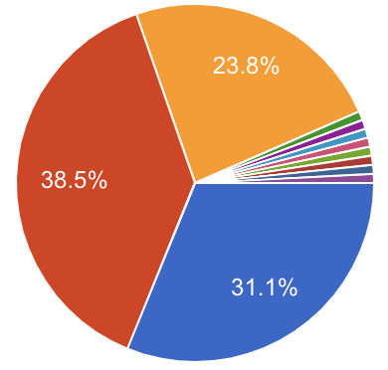
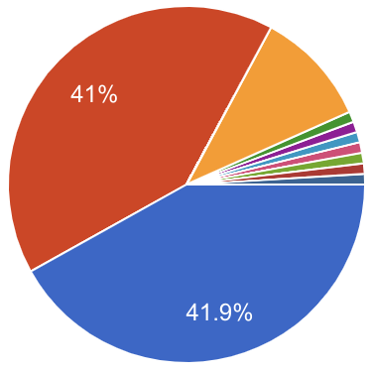
Should universities implement affirmative action policies (e.g., by using race as a factor in admissions)?

Slide 18
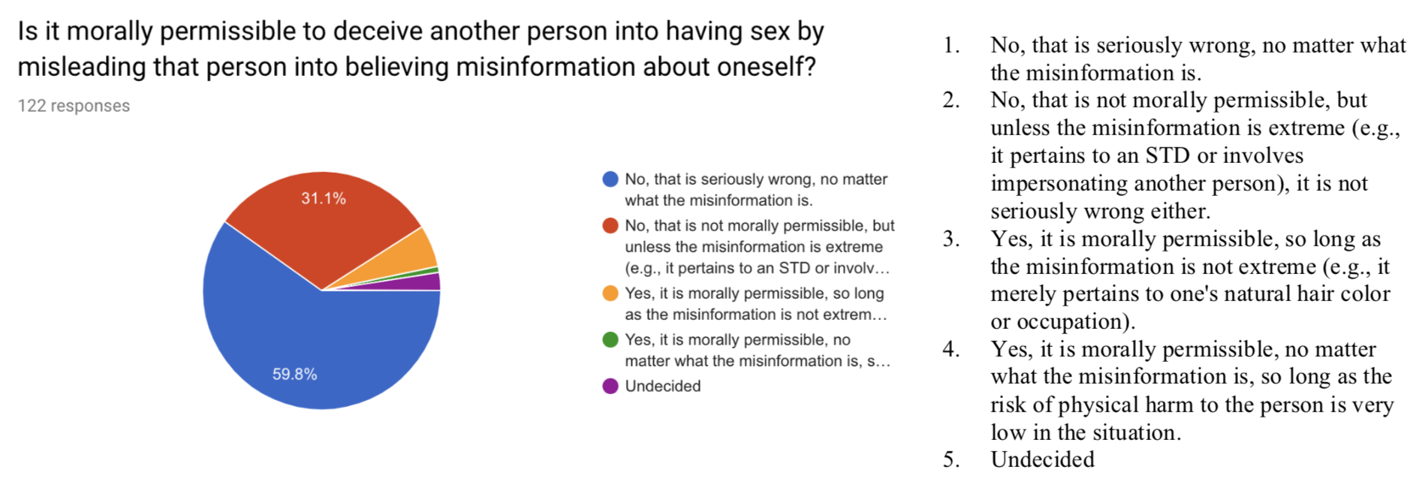
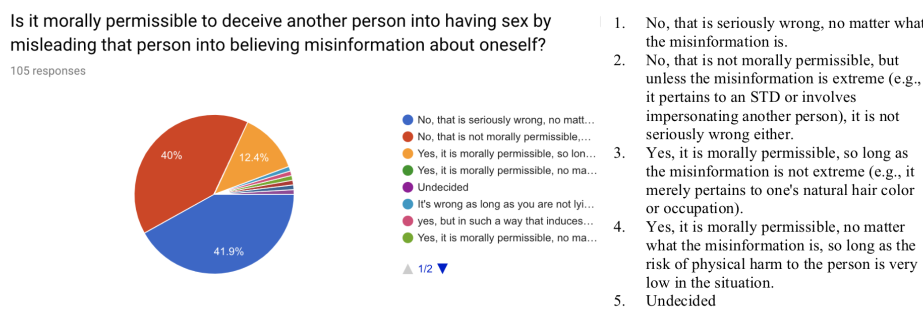

Slide 19
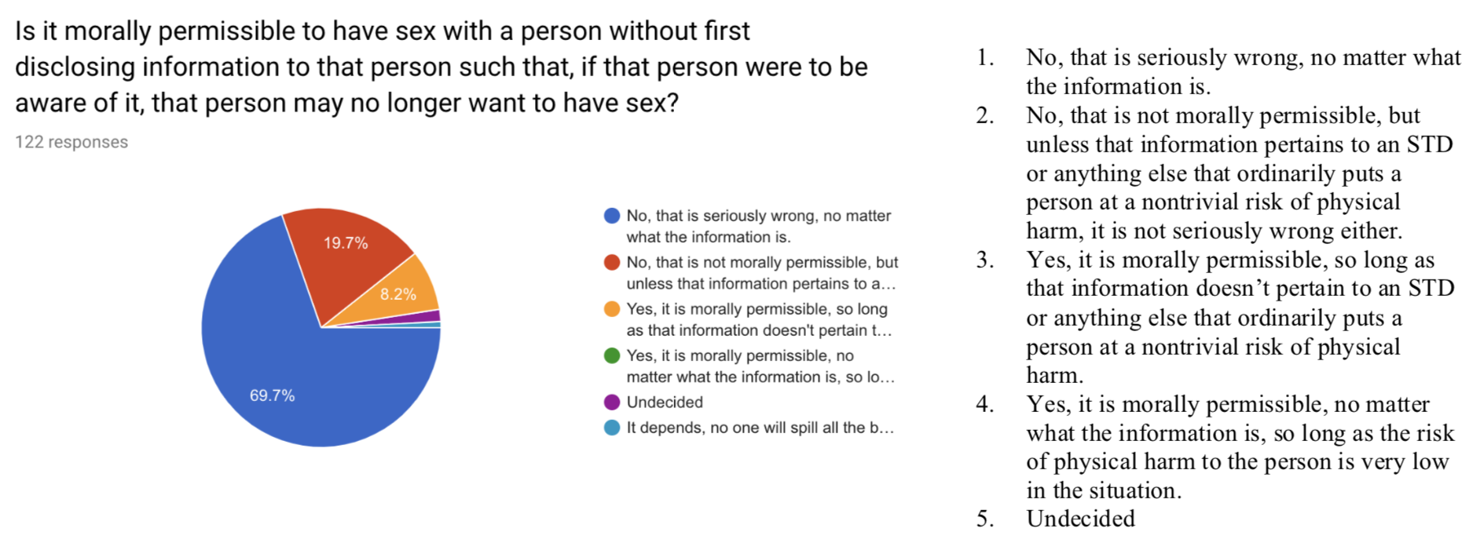
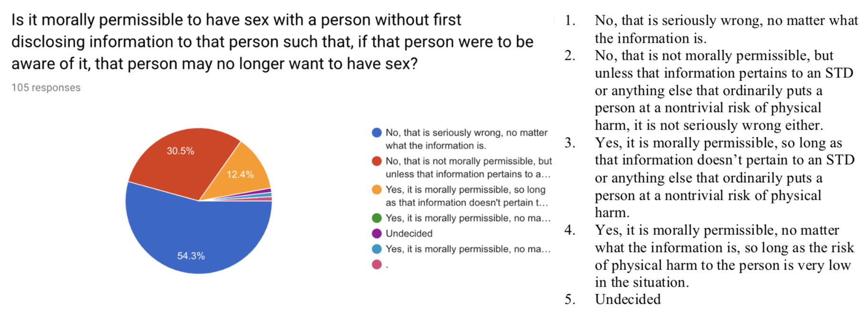

Slide 20
OPEN RESPONSE ANSWERS
“Yes, Zach mentioned in class that he is vegan. I felt this way even before he mentioned this fact because for that week’s reading he assigned arguments mainly centered on why eating meat is morally impermissible.”

Slide 21
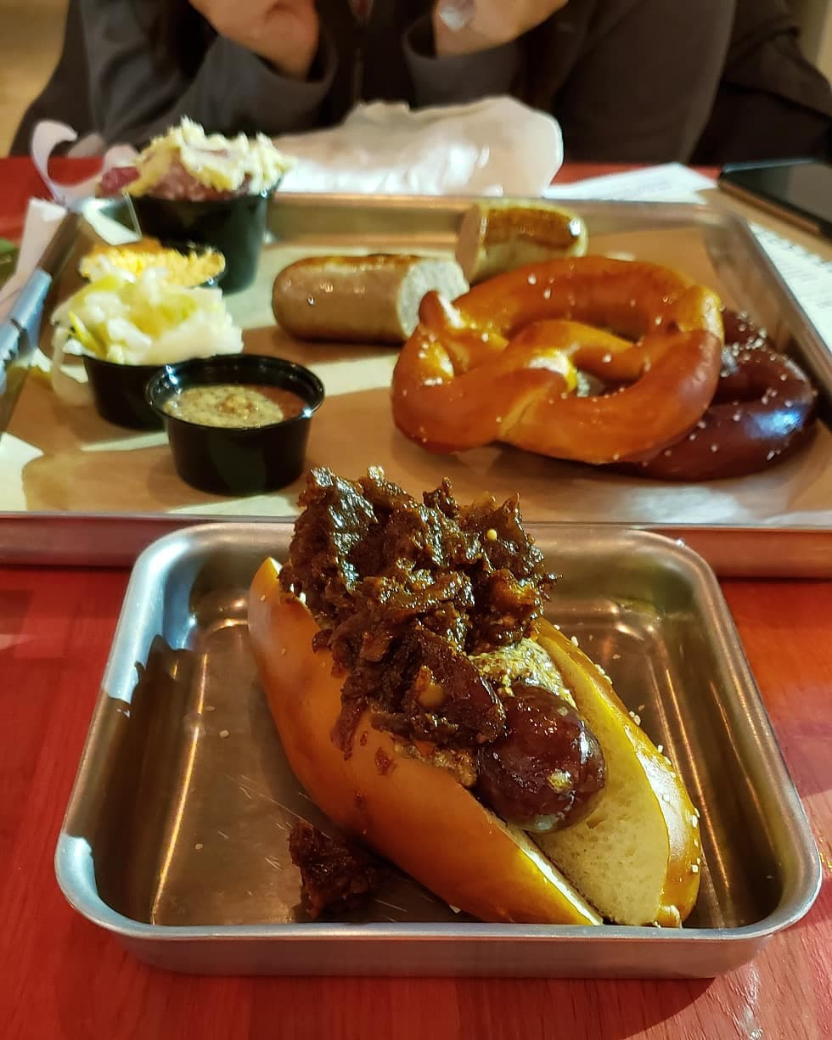
FROM MY INSTAGRAM
That’s meat

Slide 22
SOME POSSIBLE EXPLANATIONS
Zach started the course believing that it is typically wrong to purchase animal products, and he was vegan, but discussing the issue in class led him to change his mind. Now he’s no longer vegan.
Zach started the course believing that it is typically permissible to purchase animal products, and he was and isn’t vegan.
Zach believes that it is typically wrong to purchase animal products, but he sometimes does what he believes to be wrong. Arguably, Zach is both irrational and morally blameworthy.
Zach believes that it is typically wrong to purchase animal products, and he is typically vegan, but he considered the context in which the photo was taken to be atypical.
Zach believes that it is typically wrong to purchase animal products, and he typically refrains from purchasing animal products. However, he doesn’t consider all acts of eating meat to involve participating in a wrongful plan. He didn’t purchase the animal product pictured in the photo, but he did eat it.

