Slide 1
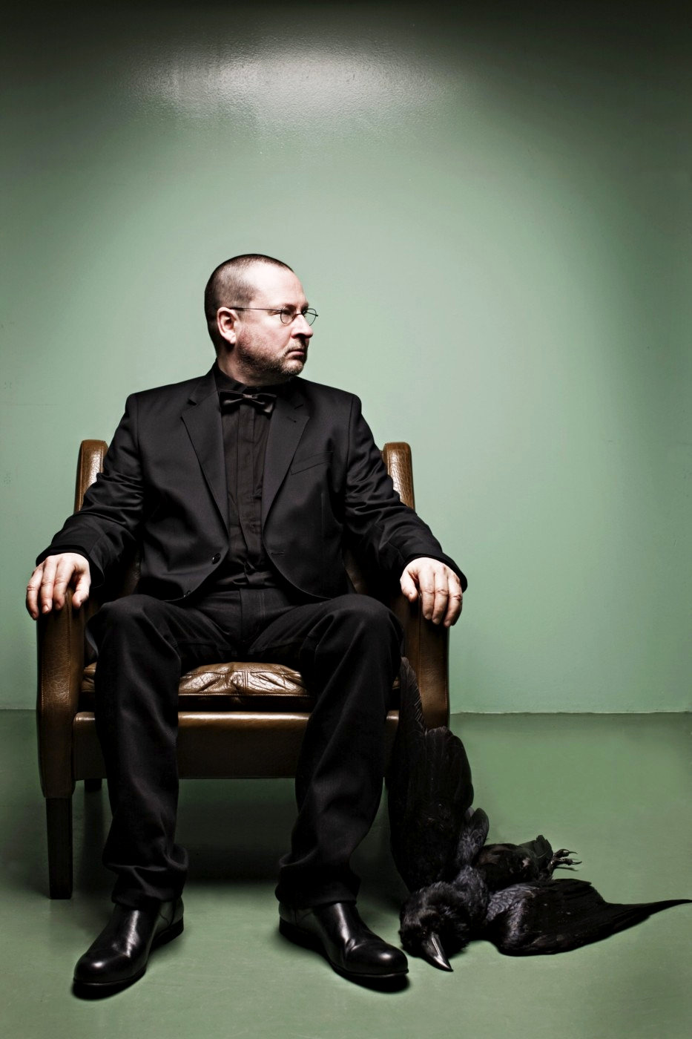
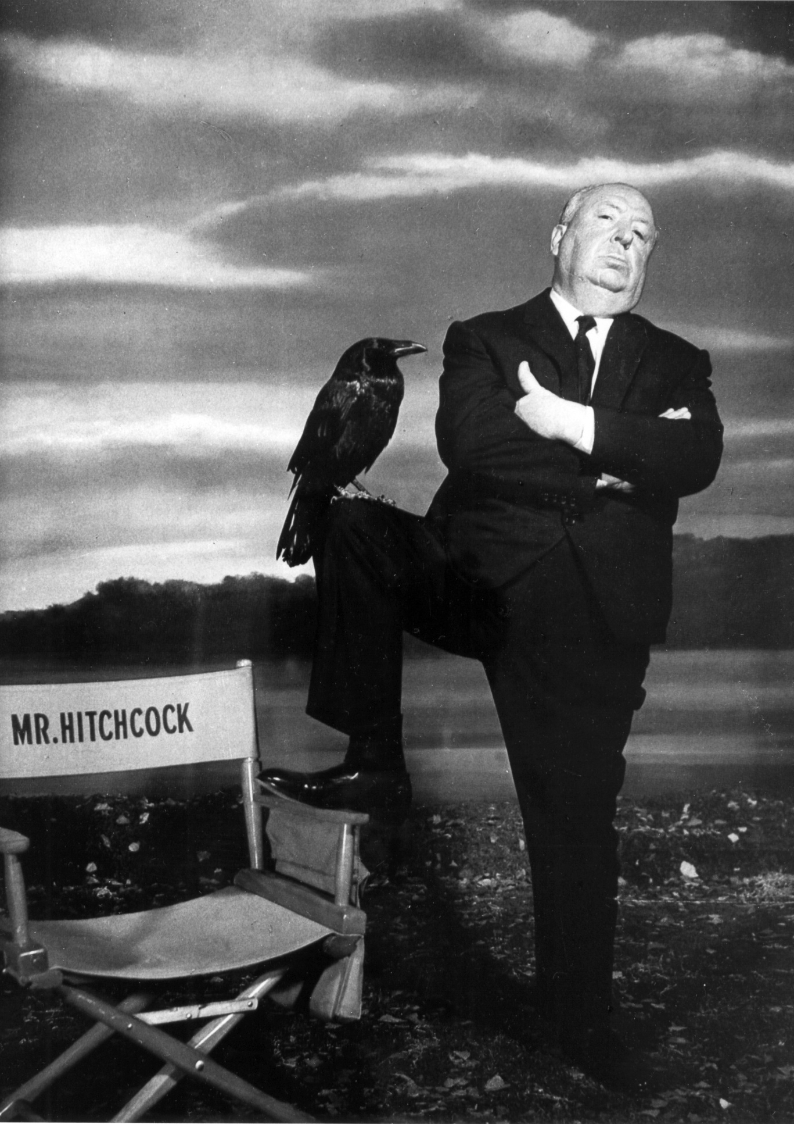
Course teaser: Authorship and Readymade Films
PHL 317K
Spring 2018
Notes:
Perfect Film:
https://www.youtube.com/watch?v=nQ_qJoqvzA4 (show from 0s to 1:40s)
https://www.youtube.com/watch?v=nQ_qJoqvzA4&t=3m27s (to 5:47)
AFS: https://www.youtube.com/watch?v=nRADqETcVo0

Slide 2
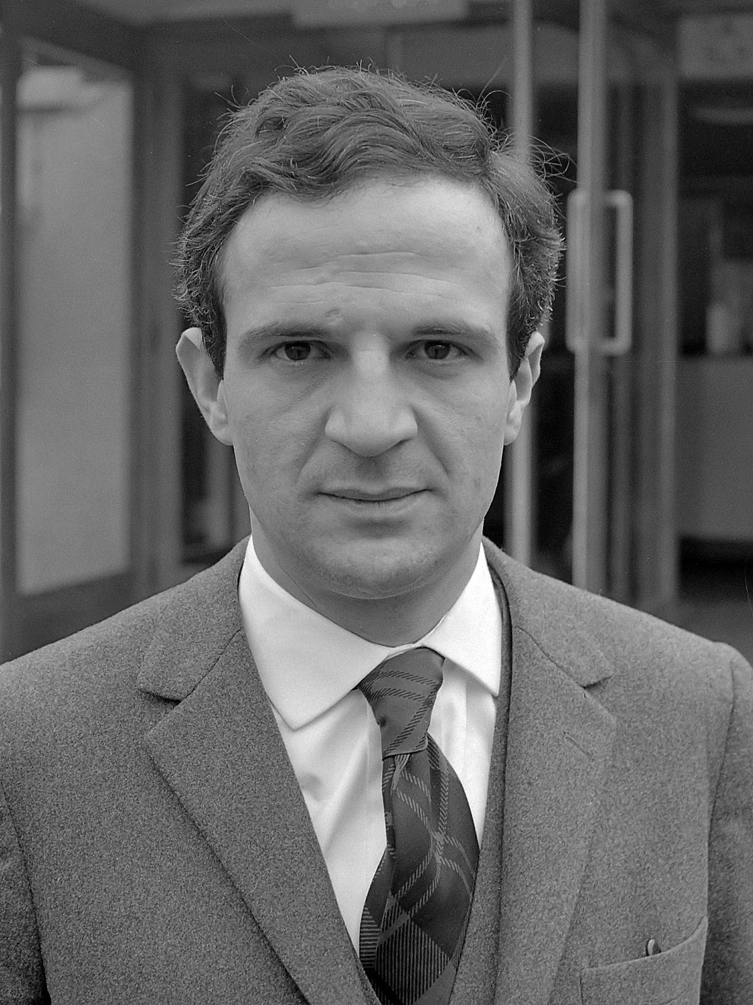
AUTEUR THEORY
A film is (in some sense) the product of a single individual, its auteur or author.
Some theorists took auteur theory to imply that the only films that deserve to be designated works of art are those over which the director had complete control.
François Truffaut
Notes:
One of the founders of the French New Wave

Slide 3
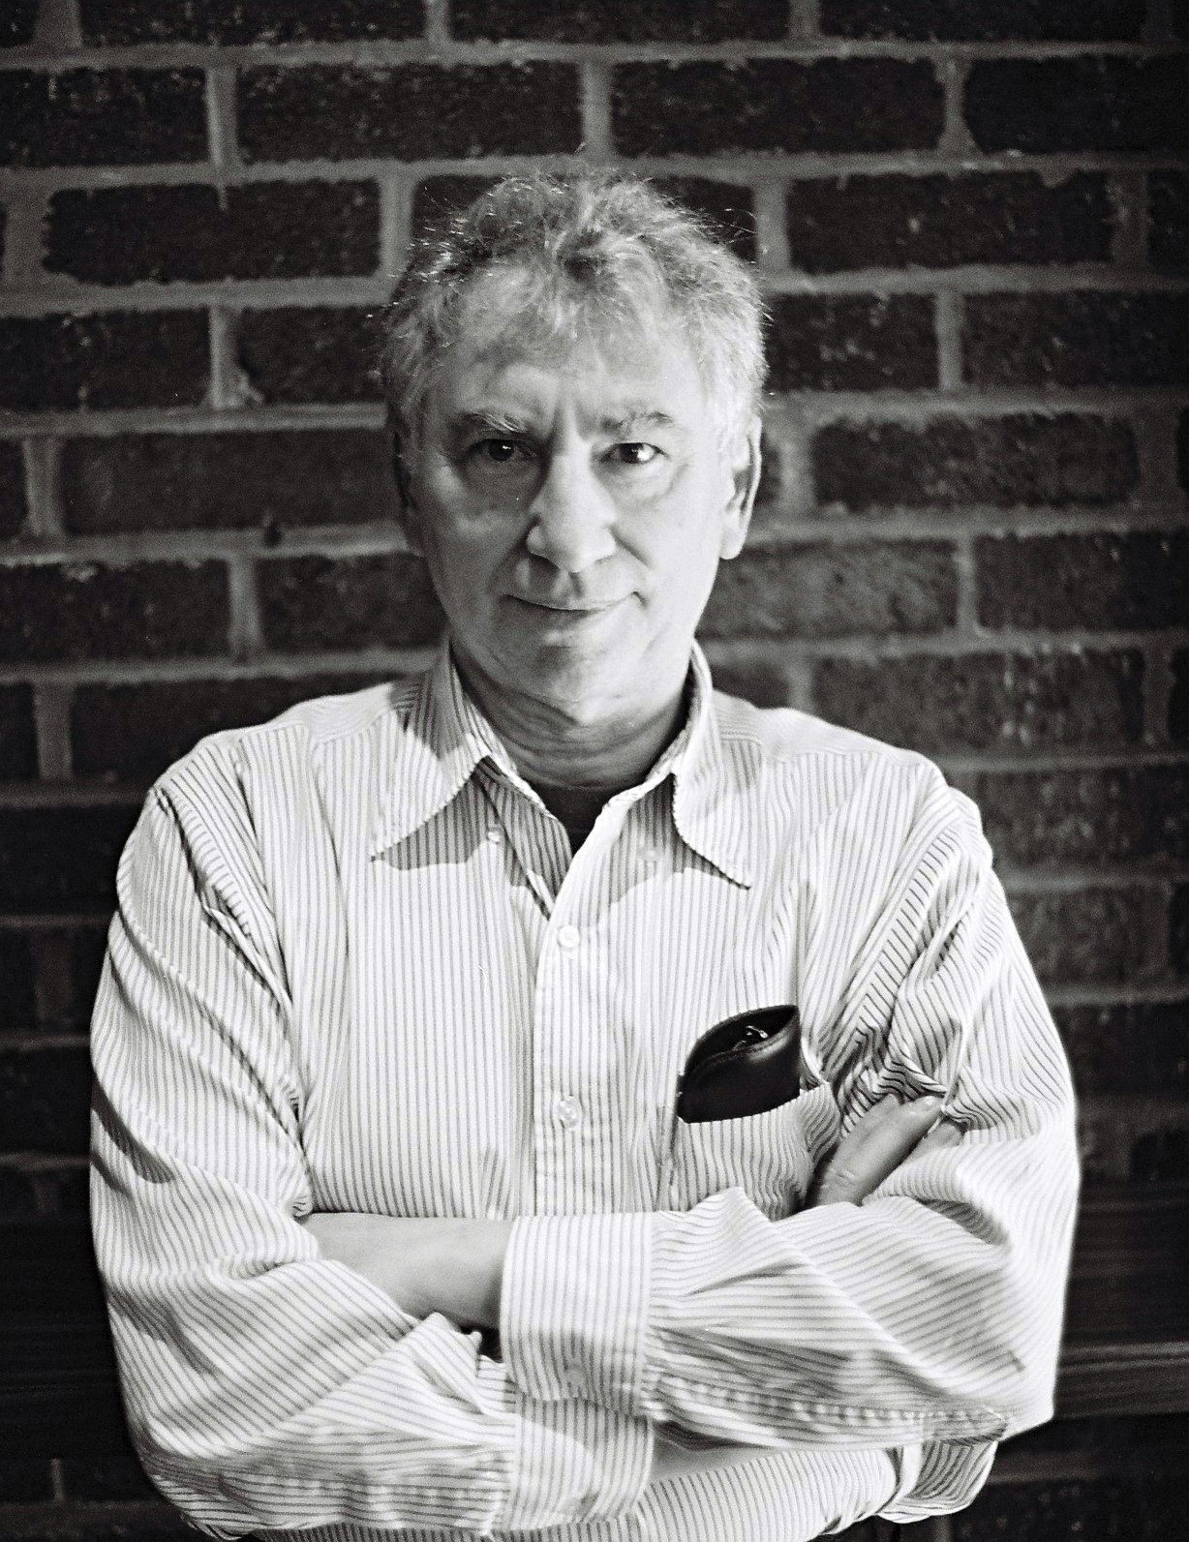
READYMADE FILMS?!
American experimental filmmaker.
“The chance arrangement of this material reveals a sense of loss and confusion around this event that is poetically and poignantly moving” (Skoller 2005, 197)
Ken Jacobs
Notes:
Found in the trash on Canal Street in NYC
Reel of outtakes of a news report on the assassination of Malcolm X
The outtakes were reassembled randomly by the editor after using alternative shots
Perfect Film: https://www.youtube.com/watch?v=nQ_qJoqvzA4
AFS: https://www.youtube.com/watch?v=nRADqETcVo0

Slide 4
PHILOSOPHICAL QUESTION
Who is the author of Perfect Film?
If Ken Jacobs is really the author, how could that be?
Why do at least some of us find that so counterintuitive?

Slide 5
DUCHAMP’S FOUNTAIN

Slide 6
DUCHAMP’S FOUNTAIN
“Duchamp reflected on the history of art and decided to make a statement. The artist is a not great creator—Duchamp went shopping at a plumbing store. The artwork is not a special object—it was mass-produced in a factory. The experience of art is not exciting and ennobling—at best it is puzzling and mostly leaves one with a sense of distaste. But over and above that, Duchamp did not select just any ready-made object to display. In selecting the urinal, his message was clear: Art is something you piss on” (Hicks 2004, 196).

Slide 7
OOPS…
Unless there is some relevant difference between Fountain and Perfect Film, Duchamp is the author of Fountain if and only if Jacobs is the author of Perfect Film.
There is no relevant difference between the two pieces.
Jacobs isn’t the author of Perfect Film.
So: Duchamp isn’t the author of Fountain.
Notes:
Transition: You might be tempted to deny that it is a work of art. Just accept the conclusion. But…

Slide 8
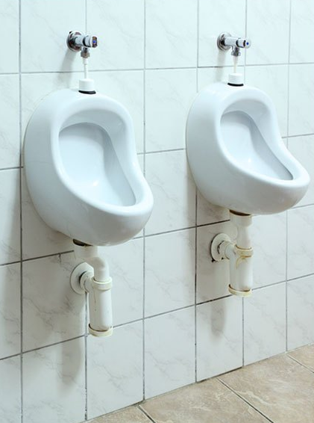
DUCHAMP’S FOUNTAIN
Notes:
Talk about how the asymmetry might be due to the one being a preexisting work of art and the other not

Slide 9
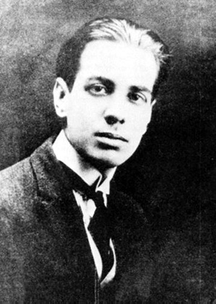
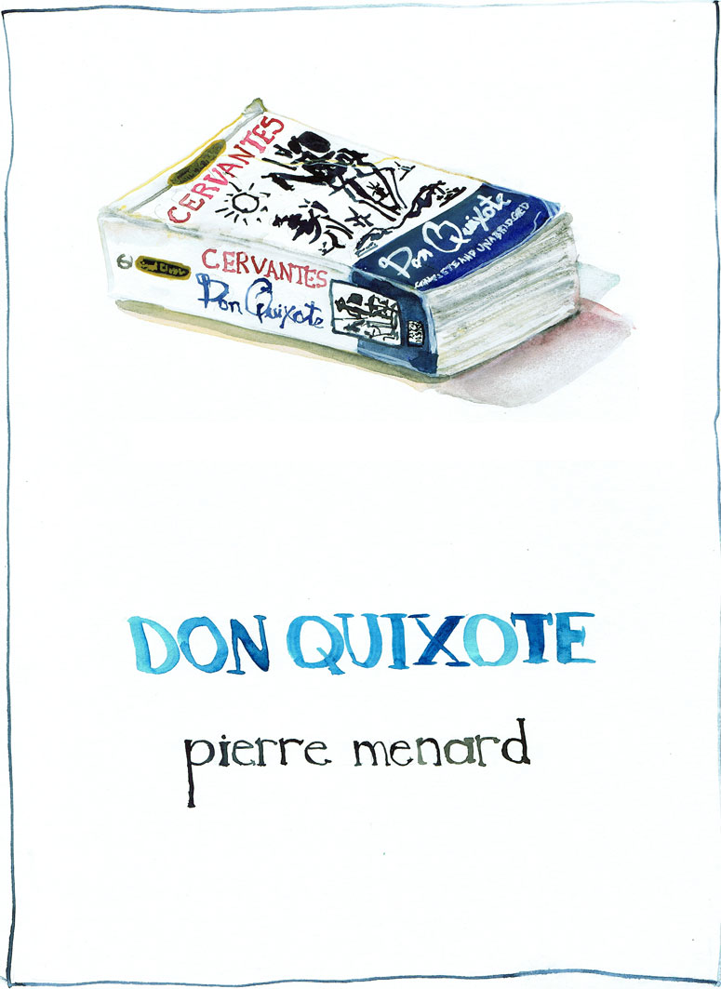
“Pierre Menard, Author of the Quixote”
Jorge Luis Borges
Notes:
Jorge Luis Borges
Written in the form of a literary critical piece about Pierre Menard, a fictional eccentric 20th-century French writer and polymath.
Describes Menard's efforts to go beyond a mere "translation" of Don Quixote by immersing himself so thoroughly in the work as to be able to actually "re-create" it, line for line, in the original 17th-century Spanish.
https://en.wikipedia.org/wiki/Pierre_Menard,_Author_of_the_Quixote

Slide 10
“Pierre Menard, Author of the Quixote”
“Those who have insinuated that Menard devoted his life to writing a contemporary Quixote besmirch his illustrious memory. Pierre Menard did not want to compose another Quixote, which surely is easy enough—he wanted to compose the Quixote. Nor, surely, need one be obliged to note that his goal was never a mechanical transcription of the original; he had no intention of copying it. His admirable ambition was to produce a number of pages which coincided—for for word and line for line—with those of Miguel de Cervantes” (91).
“Menard’s fragmentary Quixote is more subtle than Cervantes’” (93).

Slide 11
A HYPOTHESIS
He has beautiful handwriting.
He has beautiful handwriting.
Same sentence. Very different meanings.
Professor
Middle school teacher

Slide 12
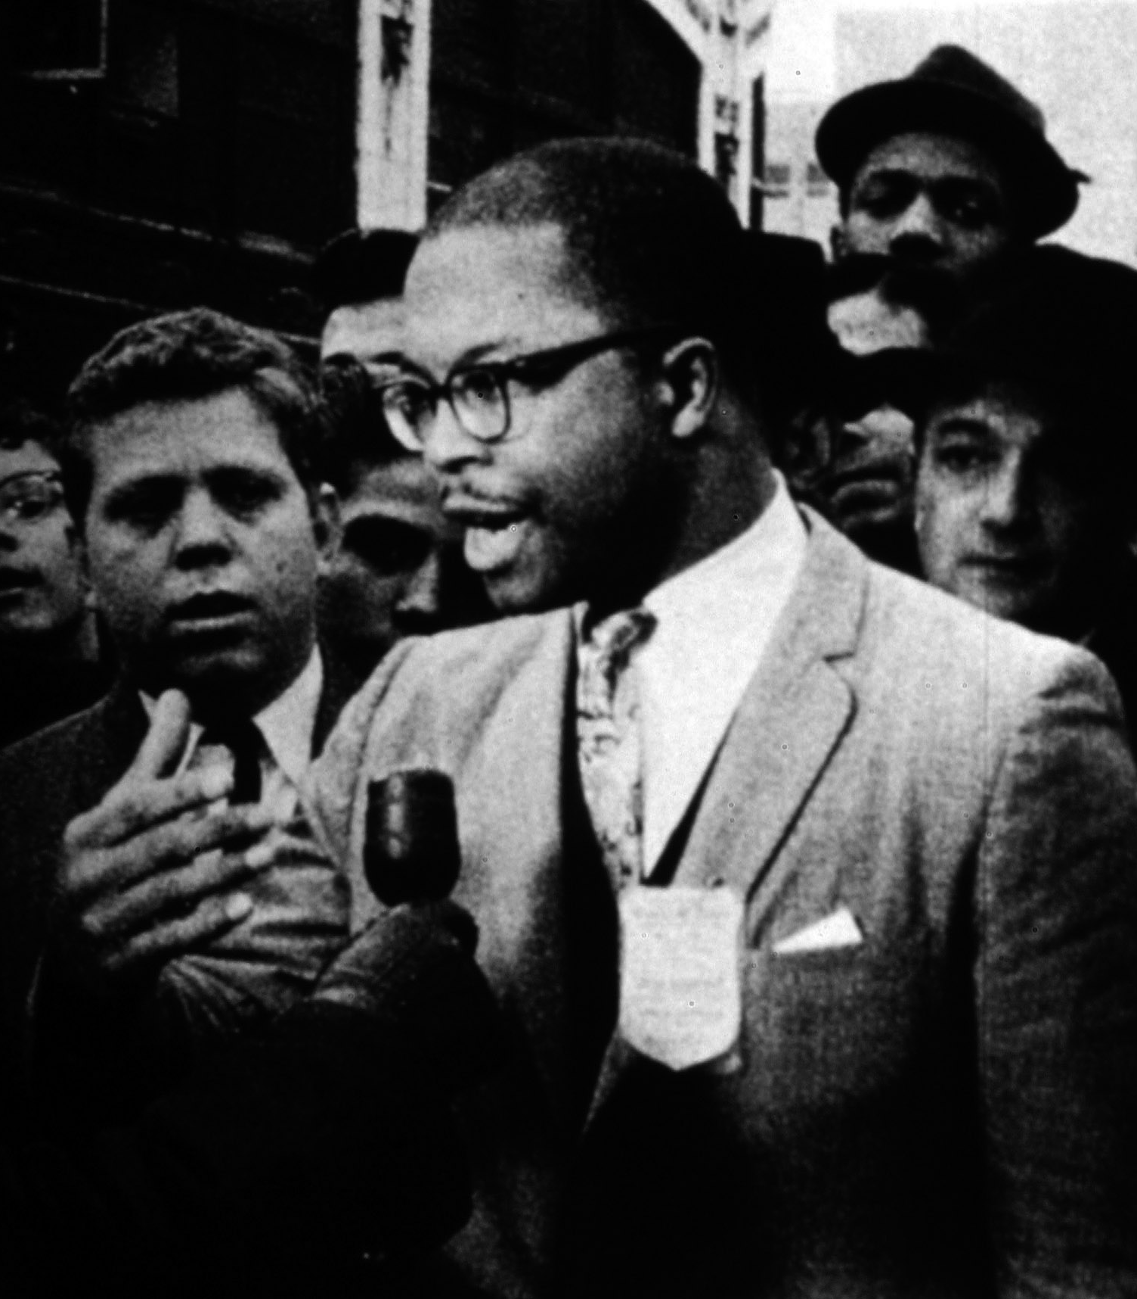
A HYPOTHESIS
“Syntactically” identical but “semantically” distinct objects.

Slide 13
READYMADE FILMS?!
It is possible to have visually indistinguishable objects with very different artistic (aesthetic?) features.
Intent (perhaps context) matters.
Ken Jacobs

