Slide 1
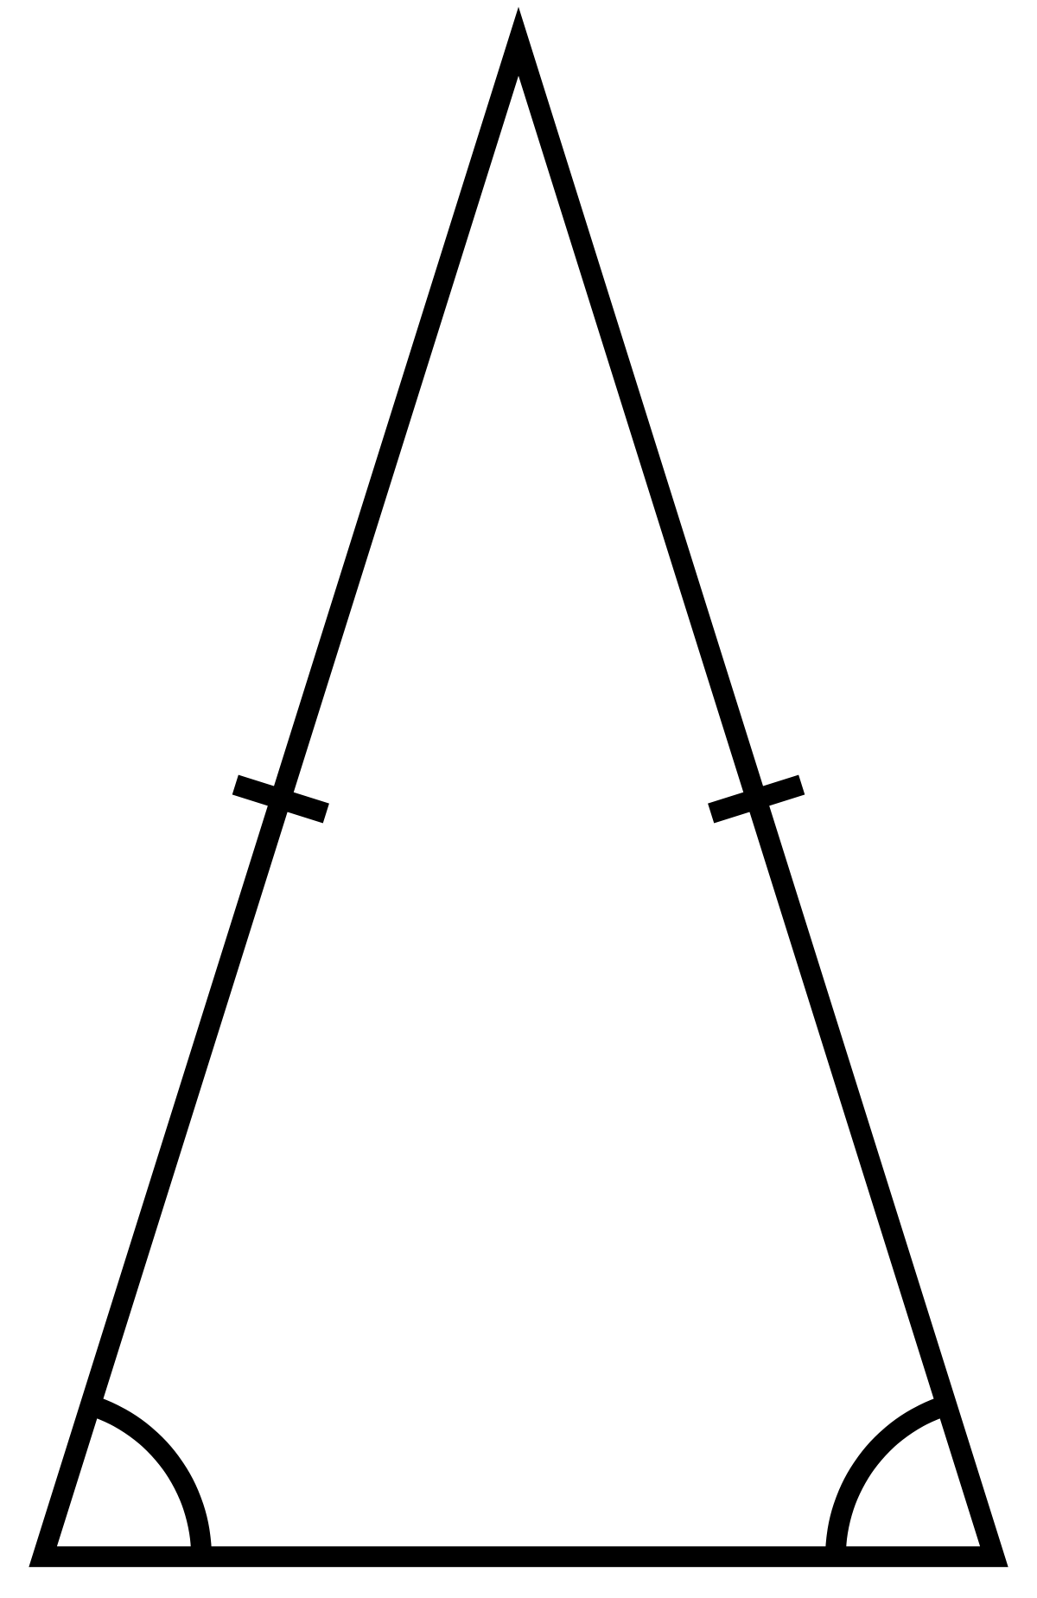
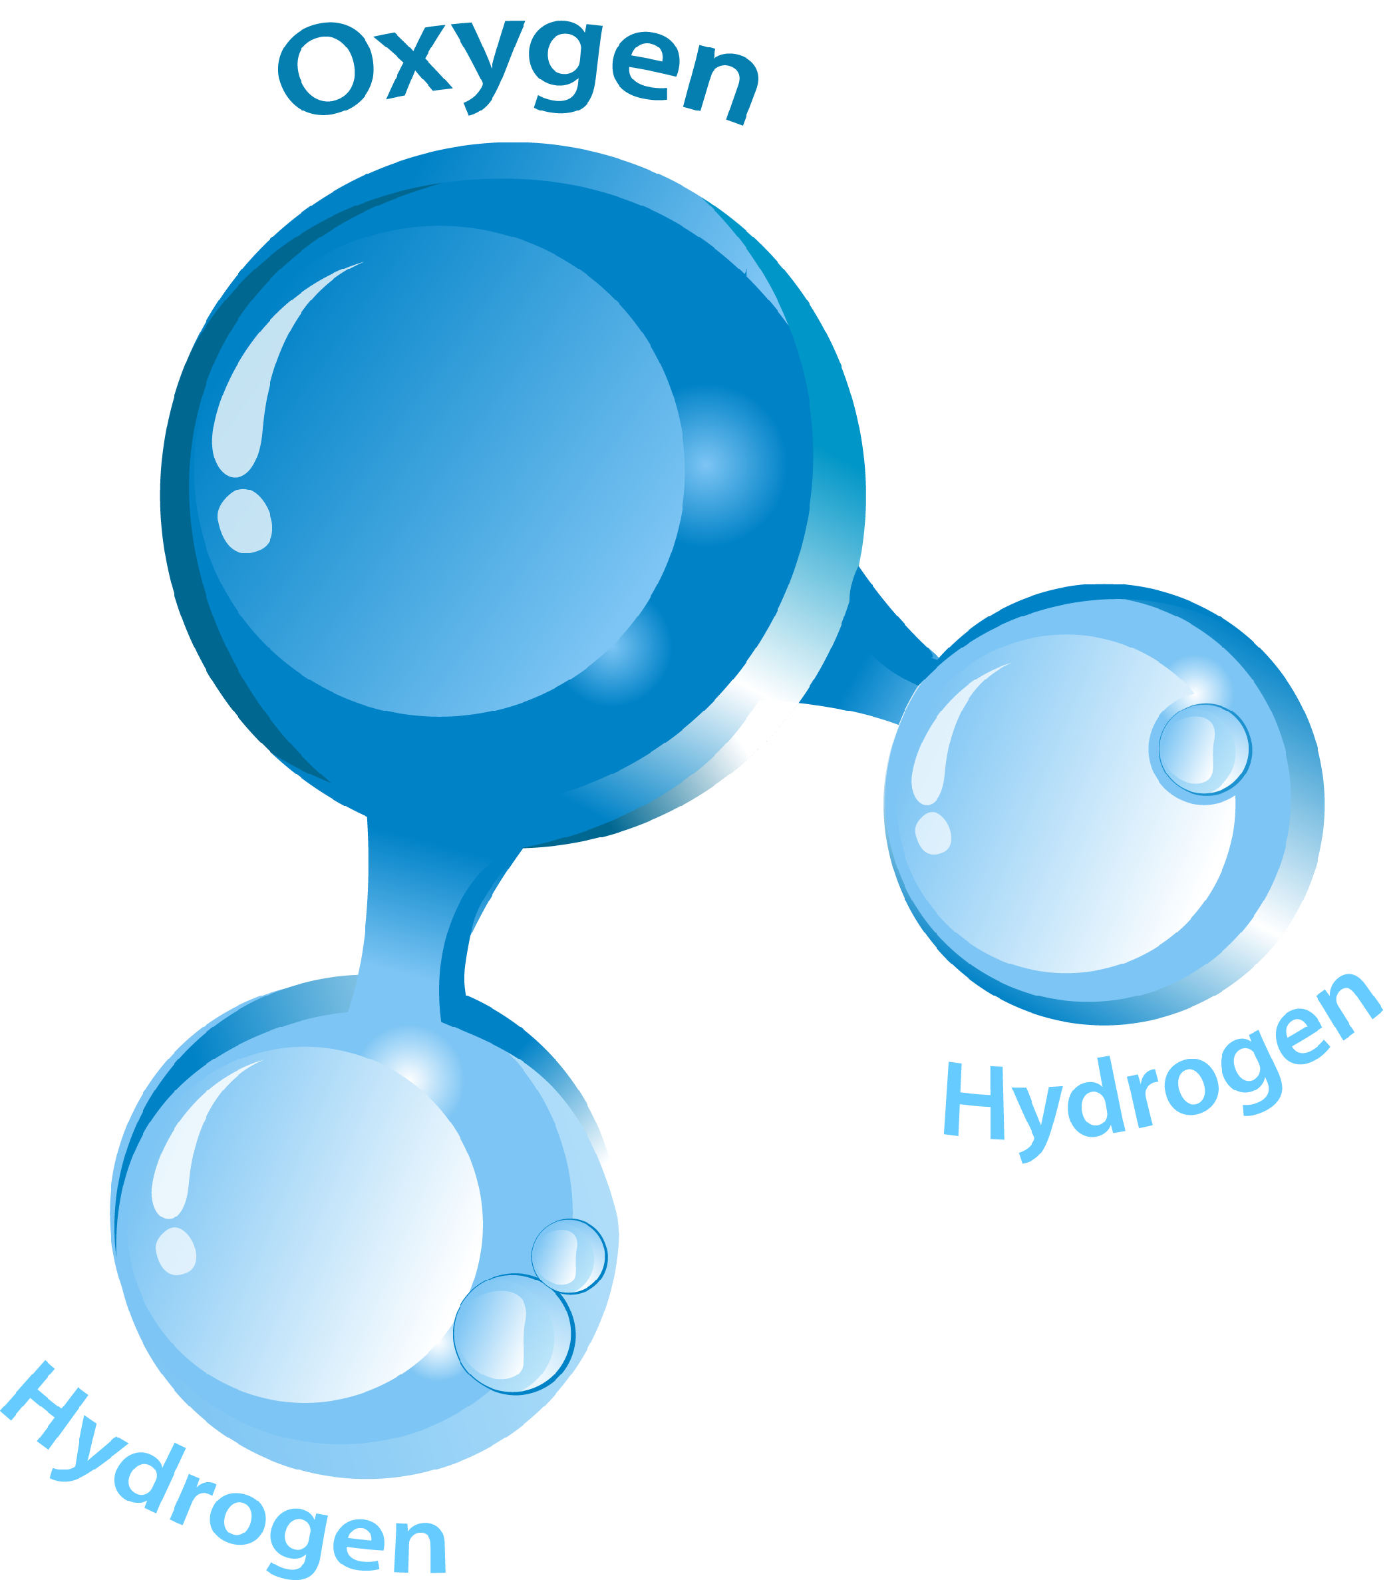
Necessary and sufficient conditions

Slide 2
REAL DEFINITION
What is justice?
What is it to be in pain?
What is it for an action to be right or wrong?

Slide 3
REAL DEFINITION
A real definition is not the same as a dictionary definition, which explains the normal use of a word by providing synonyms for its various uses.
A real definition tells us what it takes for something to qualify as a particular type of thing.
But what is this notion of something’s qualifying as a particular type of thing?
Notes:
This is controversial.
But necessary/sufficient conditions are useful heuristics.

Slide 4
NECESSARY CONDITIONS
The necessary conditions for being some thing or some phenomenon X are the conditions that a thing must satisfy if it is to count as an X.
If Y is a necessary condition for X, then it is absolutely impossible to be X without being Y.

Slide 5
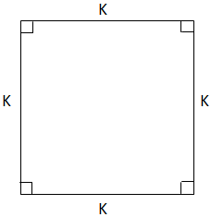
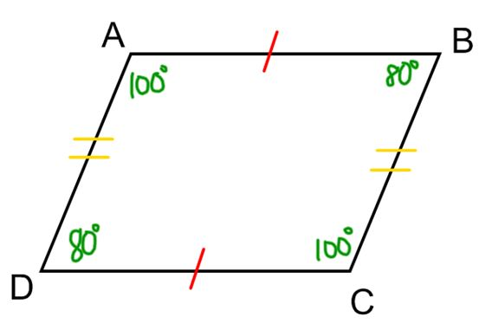
NECESSARY CONDITIONS
Having four sides is a necessary condition for something to count as a square.
Having four right angles is also a necessary condition for something to count as a square.
It is absolutely impossible for a plane figure to be a square and yet lack either of these two features.
Notes:
This quadrilateral (a four-sided figure) does not count as a square, because it does not meet a necessary condition for counting as a square: having four right angles.

Slide 6
SUFFICIENT CONDITIONS
The sufficient conditions for being some thing or some phenomenon X are the conditions such that if something meets them, that is enough for it to count as an X.
If Y is a sufficient condition for X, then meeting condition Y absolutely guarantees counting as an X.

Slide 7
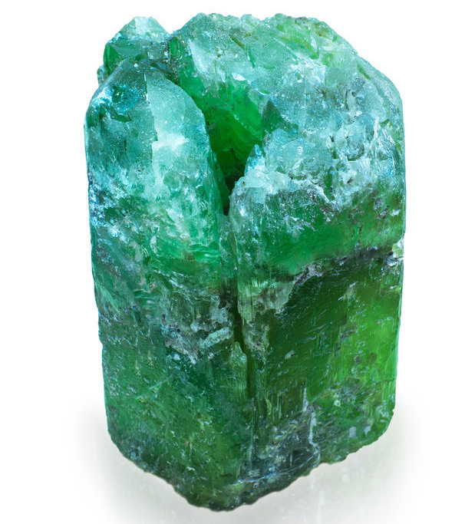
SUFFICIENT CONDITIONS
Being composed of jadeite is a sufficient condition for a rock to count as jade.
Being composed of nephrite is also a sufficient condition for a rock to count as jade.
NaAlSi₂O₆
Ca₂(Mg, Fe)₅Si₈O₂₂(OH)₂
Notes:
Is either one of these necessary for being jade?
What about their disjunction?

Slide 8
JOINTLY NECESSARY AND SUFFICIENT CONDITIONS
X’s being composed of H₂O is both necessary and sufficient for X’s counting as water.
X is water if and only if X is composed of H₂O.

Slide 9
JOINTLY NECESSARY AND SUFFICIENT CONDITIONS
X is a bachelor if and only if X is an unmarried male.

Slide 10
JOINTLY NECESSARY AND SUFFICIENT CONDITIONS
X is a bachelor if and only if X is an unmarried male.

Slide 11
JOINTLY NECESSARY AND SUFFICIENT CONDITIONS
X is a bachelor if and only if X is an unmarried male who is socially eligible to be married.

Slide 12
JOINTLY NECESSARY AND SUFFICIENT CONDITIONS
X is a bachelor if and only if X is an unmarried man who is socially eligible to be married.

Slide 13
COUNTEREXAMPLE
Something that fits the definition, but that we strongly believe isn’t an example of whatever is being defined.
Something that we strongly believe is an example of whatever is being defined, but which fails to meet the conditions suggested as necessary.
If a counterexample is successful, we can attempt to refine the proposed definition or else abandon it entirely.

Slide 14
CONNECTION TO DEDUCTIVE ARGUMENTS
Many deductive arguments have as premises statements of proposed necessary and/or sufficient conditions.
Conditionals: “If P, then Q,” “P only if Q,” etc.
Biconditionals: “P if and only if Q,” “P just in case Q,” and so on.
Necessary and sufficient conditions are converses of each other:
If Y is a necessary condition for X, then X is a sufficient condition for Y.
If X is a sufficient condition for Y, then Y is a necessary condition for X.

