Slide 1
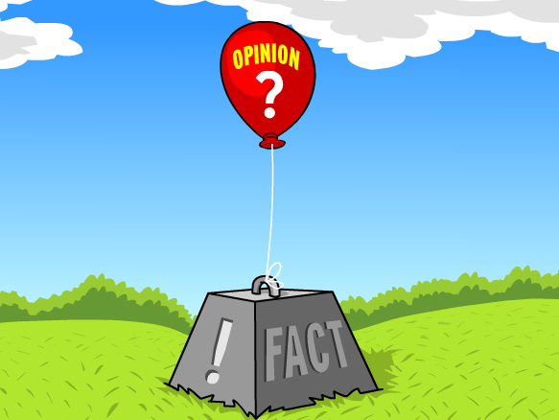
Facts and opinions
PHL 317K
Fall 2017
Notes:
Zodiac clip: https://www.youtube.com/watch?v=W91BHqxJIRg&t=18s
The Big Lebowski clip: https://www.youtube.com/watch?v=XkADiJCYS2k

Slide 2
TWO ARGUMENTS
The claim that facts and opinions stand in a dichotomous relationship is mistaken and distracts us from real and important dichotomies.
Lammer-Heindel (2016)
The claim “That's just your opinion” is pernicious and should be consigned to the fames!
Corvino (2015)

Slide 3
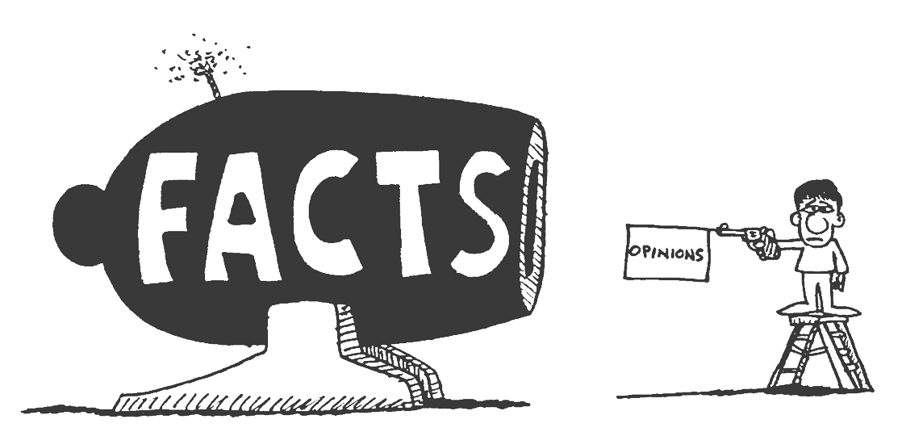
The fact–opinion DICHOTOMY

Slide 4
ASSUMED DICHOTOMY
Facts are opposed to opinions (and vice versa).
Every statement expresses either a fact or an opinion, but never both.

Slide 5
ASSUMED DICHOTOMY
Notes:
K12 lesson plan

Slide 6
EXAMPLES OF FACTS
Everyday: Zach Blaesi is the instructor of PHL 317K.
Historical: Barack Obama was elected president of the United States in 2008.
Scientific: The earth revolves around the sun.
Mathematical: 2 + 2 = 4.
Philosophical: You can’t know a falsehood.

Slide 7
WHAT IS A FACT?
Something’s being the case
A way the world is
“The ball is in the box.”
Obtaining state of affairs
<box, ball, containment>

Slide 8
DISPUTABILITY?
Lee Harvey Oswald killed John F. Kennedy.

Slide 9
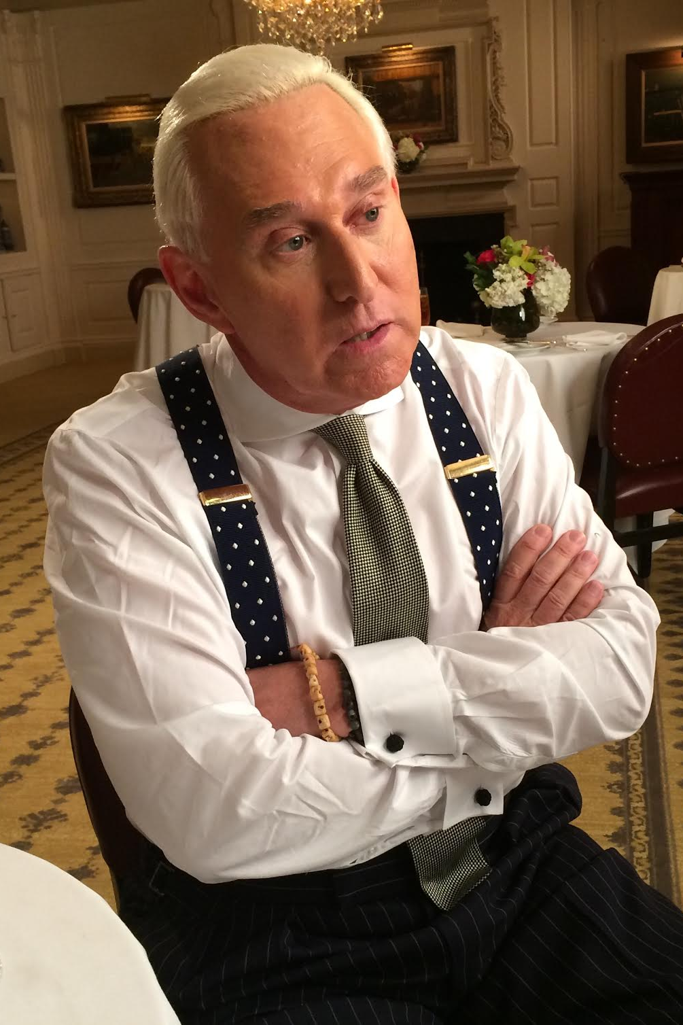
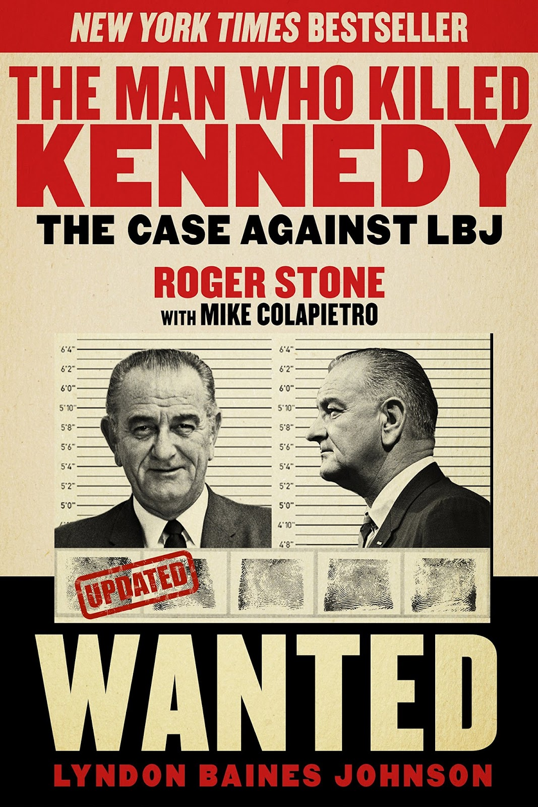
DISPUTABILITY?
Notes:
Roger Jason Stone Jr. (born August 27, 1952) is an American political consultant, lobbyist, and strategist, noted for his use of opposition research usually for candidates of the Republican Party.
The Man Who Killed Kennedy: The Case Against LBJ
https://en.wikipedia.org/wiki/Roger_Stone

Slide 10
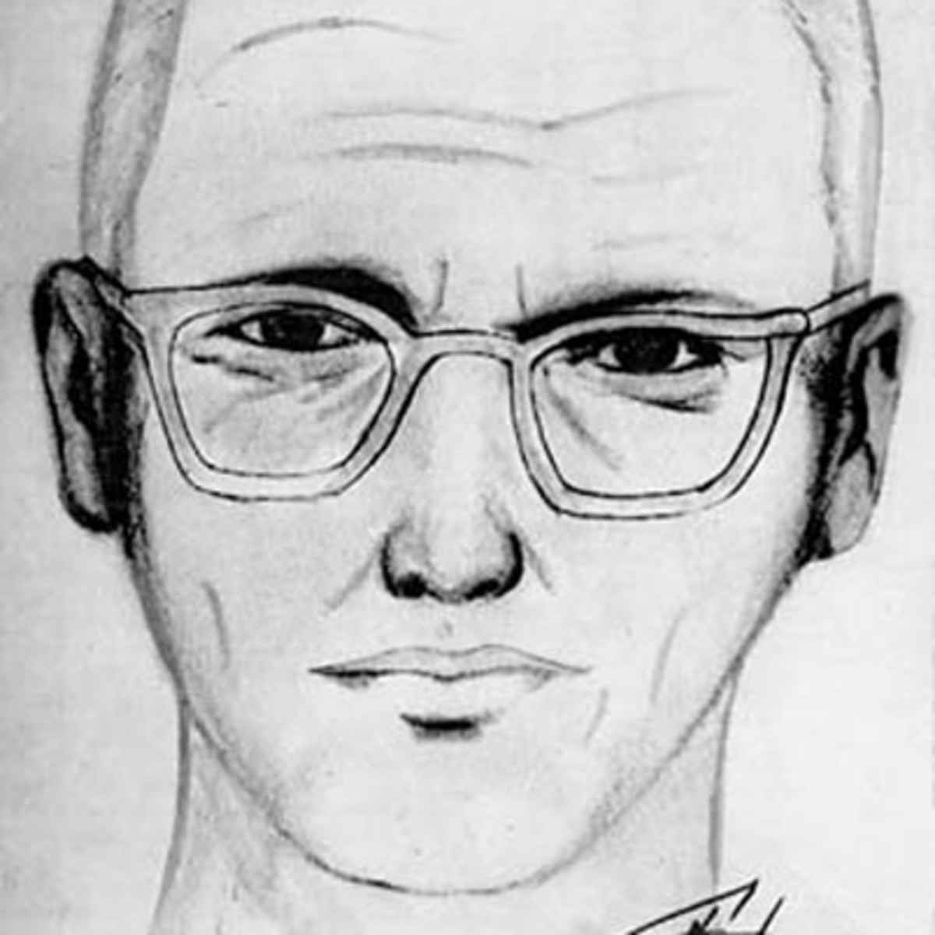
KNOWABILITY?
On July 4, 1969, in the parking lot of Blue Rock Springs Park in Vallejo, California, an unidentified man fired several gunshots at Michael Renault Mageau and Darlene Elizabeth Ferrin, injuring Mageau and killing Ferrin.

Slide 11
SUMMARY
A fact is something that is the case—a worldly state of affairs that makes certain statements—statements of fact—true.
It is possible for facts to be disputable.
It is possible for facts to be unknowable.

Slide 12
WHAT IS AN OPINION?
In most neutral terms, an opinion is a belief or judgment that something is the case.
Court opinions
Medical opinions
Opinion pieces
In common usage, an opinion—or mere opinion—is a belief that has not been sufficiently supported, substantiated, or justified in order to count as a considered judgment.

Slide 13
THE DICHTOMY DISSOLVED
A mere opinion can express a fact.
A considered judgment can express a falsehood.

Slide 14
THE REAL DICHOTMOTIES
Facts vs. falsehoods
Mere opinions vs. considered judgments

Slide 15
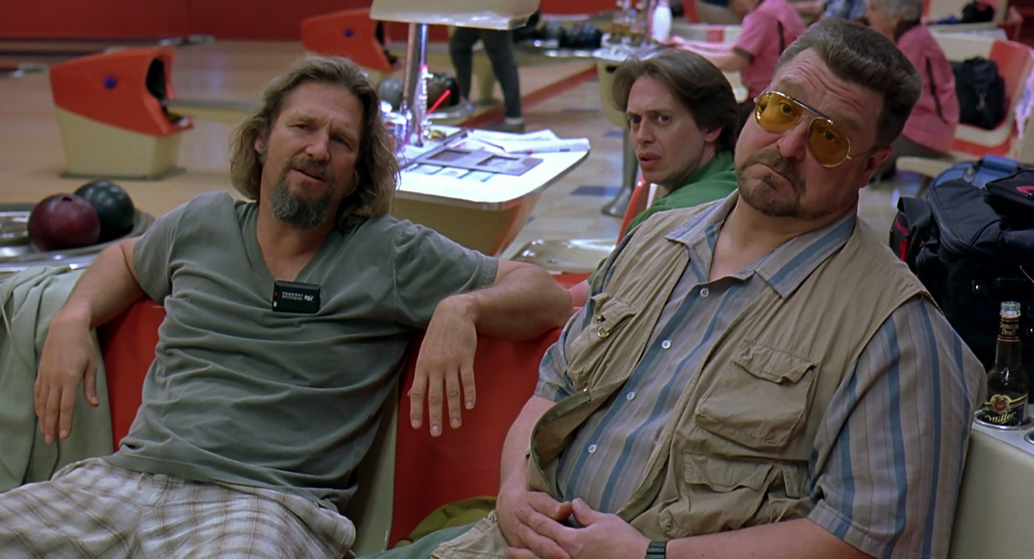
That’s just your opinion, man.

Slide 16
MOVING FORWARD
The expression “That’s just your opinion” has an unclear meaning.
But it has a clear use: it serves as a conversation stopper.
That isn’t intellectually productive.
We should instead focus on whether a given opinion is a considered judgment.
Are there good reasons to hold that opinion?
Notes:
https://www.youtube.com/watch?v=W91BHqxJIRg

