Slide 1
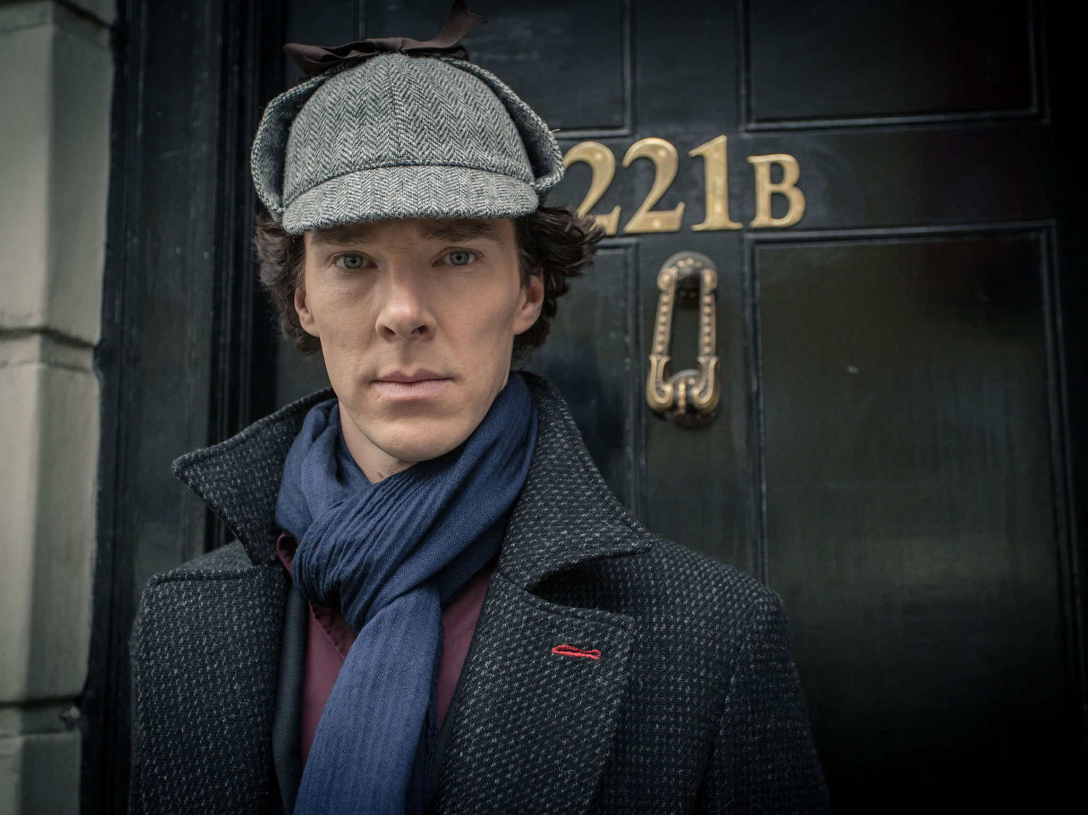
Deductive arguments

Slide 2
VALIDITY
An argument is valid if and only if there is no logically possible situation in which the premises of that argument are true and the conclusion is false.
Whenever we have a valid argument, if the premises are all true, then the conclusion must be true.
If you use only valid arguments in your reasoning, then if you start with true premises, you will never end up with a false conclusion.

Slide 3
VALIDITY
The sun has risen every day in the past.
So: the sun will rise again tomorrow.

Slide 4
VALIDITY
The sun has risen every day in the past.
So: the sun will rise again tomorrow.
A logically possible situation need not be a situation that is likely to occur.

Slide 5
VALIDITY
Zach Blaesi has been alive for 80 years.
So: Zach Blaesi has been alive for more than 18 years.
We can determine whether an argument is valid without determining whether the premises and conclusion are actually true.
Validity concerns the logical connections between the premises and the conclusion.
Notes:
Transition (after poll): but it could have a false conclusion.
Implicit premise: 80 > 50

Slide 6
VALIDITY
Zach Blaesi has been alive for 80 years.
So: Zach Blaesi has been alive for more than 50 years.
We can determine whether an argument is valid without determining whether the premises and conclusion are actually true.
Validity concerns the logical connections between the premises and the conclusion.
Notes:
Transition (after poll): but it could have a false conclusion.
Implicit premise: 80 > 50

Slide 7
MODUS PONENS
If pointless suffering exists, then a morally perfect, omnipotent, and omniscient God does not exist.
Pointless suffering exists.
So: a morally perfect, omnipotent, and omniscient God does not exist.
If P, then Q.
P.
So: Q.

Slide 8
MODUS TOLLENS
If God does not exist, then objective moral values do not exist.
Objective moral values do exist.
So: God exists.
If P, then Q.
¬Q.
So: ¬P.
If ¬P, then ¬Q.
¬¬Q.
So: ¬¬P.

Slide 9
AFFIRMING THE CONSEQUENT
If you’re in WAG 101, then you’re on UT campus.
You’re on UT campus.
So: You’re in WAG 101.

Slide 10
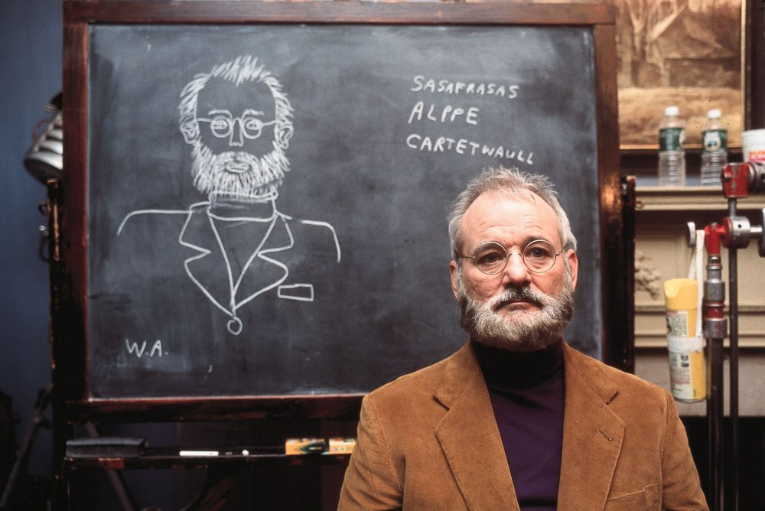
DENYING THE ANTECEDENT
If P, then Q.
¬P.
So: ¬Q.
If Zach is a philosopher, then Zach is an academic.
Zach is not a philosopher.
So: Zach is not an academic.

Slide 11
INVALIDITY
An argument that is not valid is invalid.
An argument is invalid so long as there is at least one logically possible situation in which its premises are true and its conclusion is false.
The situation (or invalidating counterexample) need not be realistic or actually occur so long as it is coherent and doesn’t entail any contradiction.
We can show that an argument is invalid by producing an invalidating counterexample.
But we can’t show that an argument is valid by failing to produce an invalidating counterexample—perhaps we just lack the imagination to do so.

Slide 12
SOUNDNESS
Validity does not tell us whether the premises or conclusion are actually true.
If an argument is valid, and all of the premises are true, then the argument is sound.
If the argument is invalid, and/or at least one of the premises is false, then the argument is unsound.
Sound arguments, unlike valid arguments, must have true conclusions.

Slide 13
MISLEADING LANGUAGE
That argument is true/false!

Slide 14
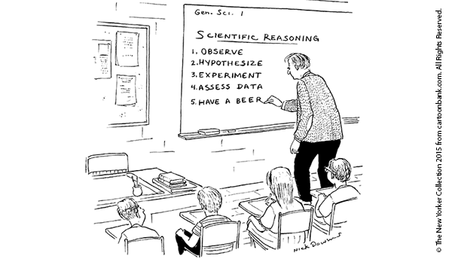
inductive arguments

Slide 15
INDUCTIVE ARGUMENTATION
The sun has risen every day in the past.
So: the sun will rise again tomorrow.
93% of Chinese people have lactose intolerance.
Lee is Chinese.
So: Lee has lactose intolerance.
Notes:
These arguments are invalid, but they’re still good arguments!
Lee might be among the 7% of Chinese people who can digest lactose.
The sun might explode tonight.

Slide 16
INDUCTIVE ARGUMENTATION
An argument is inductively strong if and only if:
It is invalid.
The conclusion is likely to be true given that the premises are true.
The true premises of a strong inductive argument do not logically guarantee the truth of the conclusion, but they make it rational for us to be confident in the truth of the conclusion.
Inductive reasoning is indispensable to science, philosophy, ethics, and everyday life.
Notes:
Discuss: You can’t prove that!
“We often have to make predictions about the future based on past experience. Our past experience can never logically guarantee that our predictions are correct, but they can tell us what is more likely to happen. Our lives would be completely paralyzed if we did not plan our actions on the basis of probability. As Bishop Butler (1692-1752) said in a famous quote, ‘Probability is the very guide of life’” (88)

Slide 17
INDUCTIVE ARGUMENTATION
93% of Chinese people have lactose intolerance.
Zach is Chinese.
So: Zach has lactose intolerance.
We can determine whether an argument is inductively strong whether the premises and conclusion are actually true.
Inductive strength concerns the evidential connection between the premises and conclusion.

Slide 18
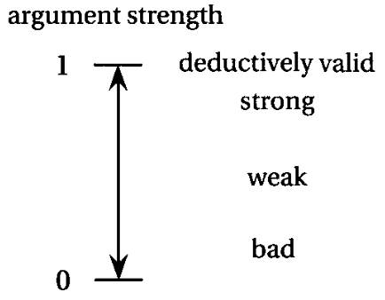
INDUCTIVE STRENGTH
x% of Chinese people have lactose intolerance.
Lee is Chinese.
So: Lee has lactose intolerance.
Notes:
The inductive strength of the argument is a measure of the degree of support that is provided.
Unlike validity, inductive strength is not an all-or-nothing matter.

Slide 19
DEFEASABILITY / AMPLIATIVITY
Zach fell from the UT Tower.
So: Zach is dead.
Notes:
Violation of monotonicity: “it may be possible to infer abductively certain conclusions from a subset of a set S of premises which cannot be inferred abductively from S as a whole.”

Slide 20
DEFEASABILITY / AMPLIATIVITY
Zach fell from the UT Tower.
He landed on a conveniently placed trampoline.
So: Zach is dead.
WEAKER
Notes:
Violation of monotonicity: “it may be possible to infer abductively certain conclusions from a subset of a set S of premises which cannot be inferred abductively from S as a whole.”

Slide 21
DEFEASABILITY / AMPLIATIVITY
Zach fell from the UT Tower.
He landed on a conveniently placed trampoline.
The trampoline has a huge hole in its center.
So: Zach is dead.
STRONGER
Notes:
Violation of monotonicity: “it may be possible to infer abductively certain conclusions from a subset of a set S of premises which cannot be inferred abductively from S as a whole.”

Slide 22
DEFEASABILITY / AMPLIATIVITY
The strength of an inductive argument can radically change with new information.
This is an important difference between mathematics and the empirical sciences.
Notes:
Violation of monotonicity: “it may be possible to infer abductively certain conclusions from a subset of a set S of premises which cannot be inferred abductively from S as a whole.”
Mathematics uses deductive reasoning to discover the logical consequences of definitions and axioms.

Slide 23
COGENCY
Strength does not tell us whether the premises or conclusion are actually true.
If an inductive argument is strong, and all of the premises are true, then the argument is cogent.
If the inductive argument is weak, and/or at least one of the premises is false, then the argument is uncogent.
Cogent arguments, unlike sound arguments, can have false conclusions, but that is unlikely.

Slide 24
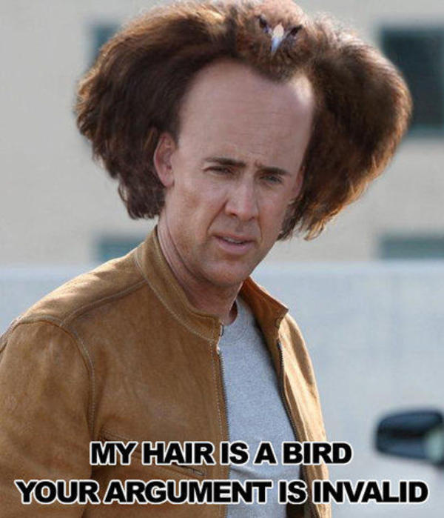
MISLEADING LANGUAGE

Slide 25
ARGUMENT BY ANALOGY
x and y are relevantly similar (they have properties F₁,…, F_{n} in common—properties that are relevant to having a property G).
x has property G.
So: y also has property G.

Slide 26
INFERENCE TO THE BEST EXPLANATION
We have a set of evidence E.
H₁,…, H_{n} are all theories compatible with E.
H_{i} provides the best explanation of E (and H_{i} is satisfactory/good enough qua explanation).
So: H_{i} is true.
Notes:
The importance of why-questions.
“[T]he best way to distinguish between induction and abduction is this: both are ampliative, meaning that the conclusion goes beyond what is (logically) contained in the premises (which is why they are non-necessary inferences), but in abduction there is an implicit or explicit appeal to explanatory considerations, whereas in induction there is not; in induction, there is only an appeal to observed frequencies or statistics.”
“Abduction is also said to be the predominant mode of reasoning in medical diagnosis: physicians tend to go for the hypothesis that best explains the patient’s symptoms.”
“Its core idea is often said to be that explanatory considerations have confirmation-theoretic import, or that explanatory success is a (not necessarily unfailing) mark of truth.”
“[I]t will not be a sound rule of inference in the strict logical sense, however abduction is explicated exactly. It can still be reliable in that it mostly leads to a true conclusion whenever the premises are true.”
https://plato.stanford.edu/entries/abduction/

Slide 27
INFERENCE TO THE BEST EXPLANATION
H₁: Your roommate made himself a late dinner and was too tired to clean up.
H₂: Someone burgled the apartment and took the time to make food on the job.
H₃: Your roommate dirtied the dishes without eating just to make you form the false belief that he ate a late dinner.
E:
Notes:
“But these hypotheses strike you as providing much more contrived explanations of the data than the one you infer to.”
https://plato.stanford.edu/entries/abduction/
Make the point about medical science.

Slide 28
THEORETICAL VIRTUES
Predictive power: The theory makes a number of precise and accurate predictions, and it doesn’t have a track record of being adjusted simply to avoid disconfirmation (which would make it ad hoc).
Mechanism/fruitfulness: The theory explains apparent coincidences by unifying them under general principles, enables us to detect and explain connections we otherwise wouldn’t have noticed, and helps us to reach principled verdicts about future cases.
Coherence: The theory is internally consistent and consistent with well-understood data and other well-confirmed theories.
Simplicity: The theory makes fewer assumptions and/or posits fewer entities than its competitors.

Slide 29
THEORETICAL VIRTUES

Slide 30
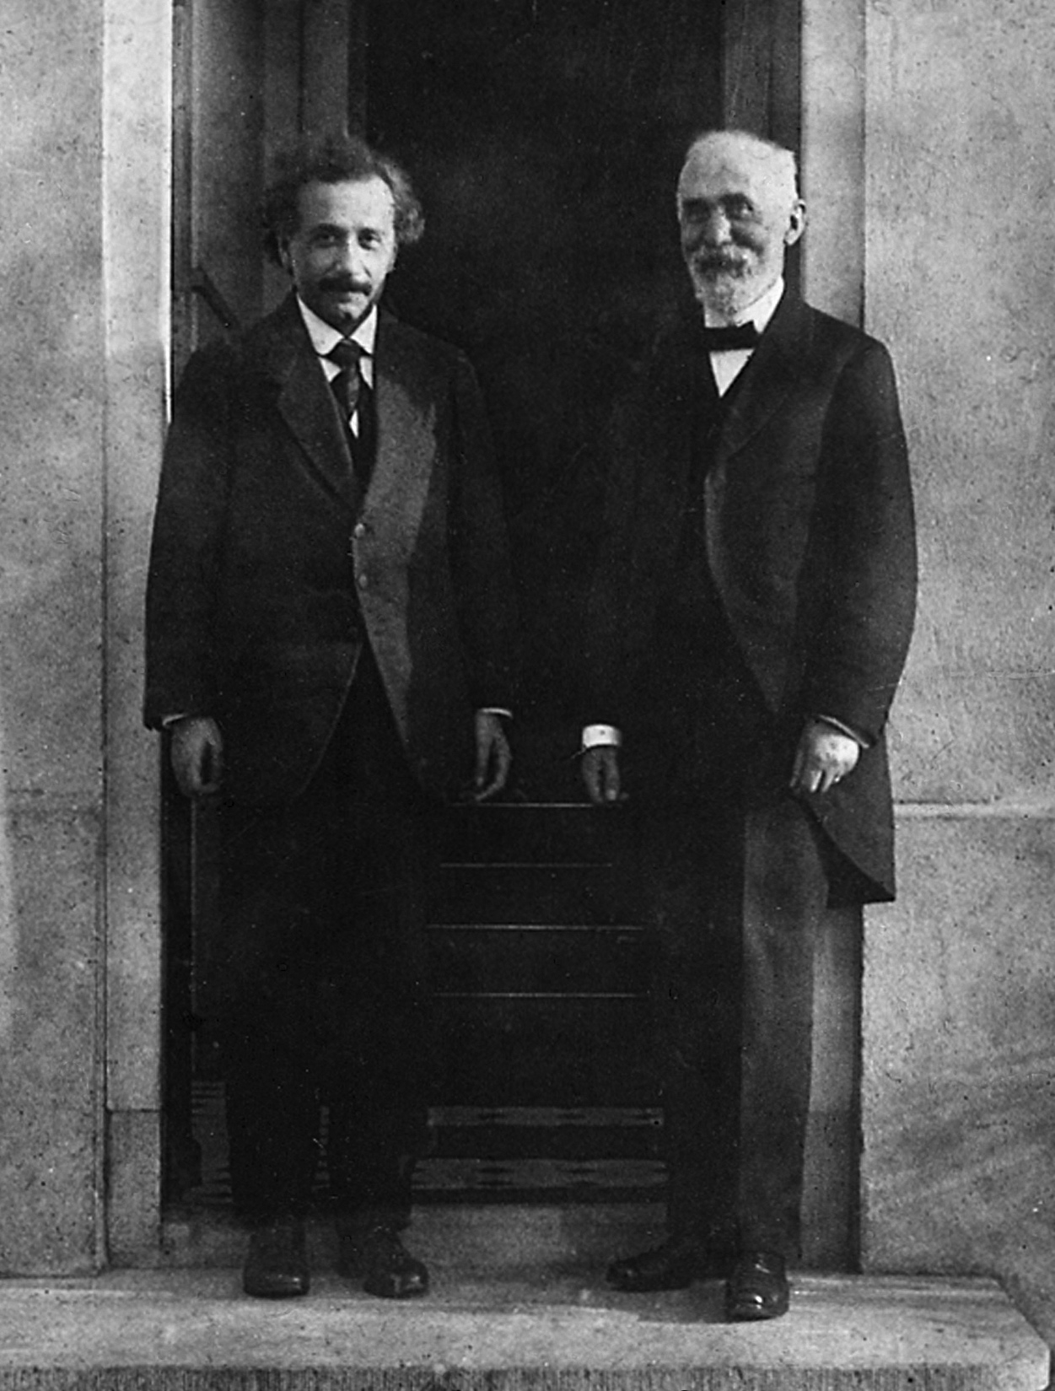
THEORETICAL VIRTUES
Einstein and Lorentz

Slide 31
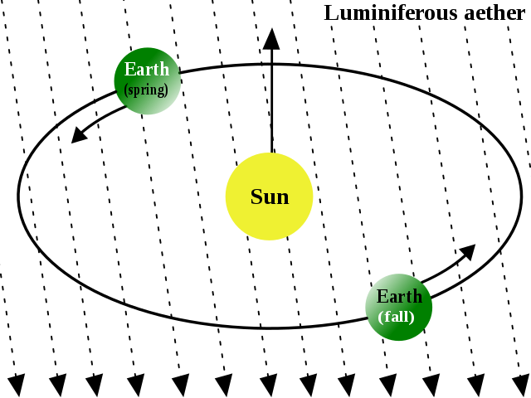
THEORETICAL VIRTUES

