Slide 1
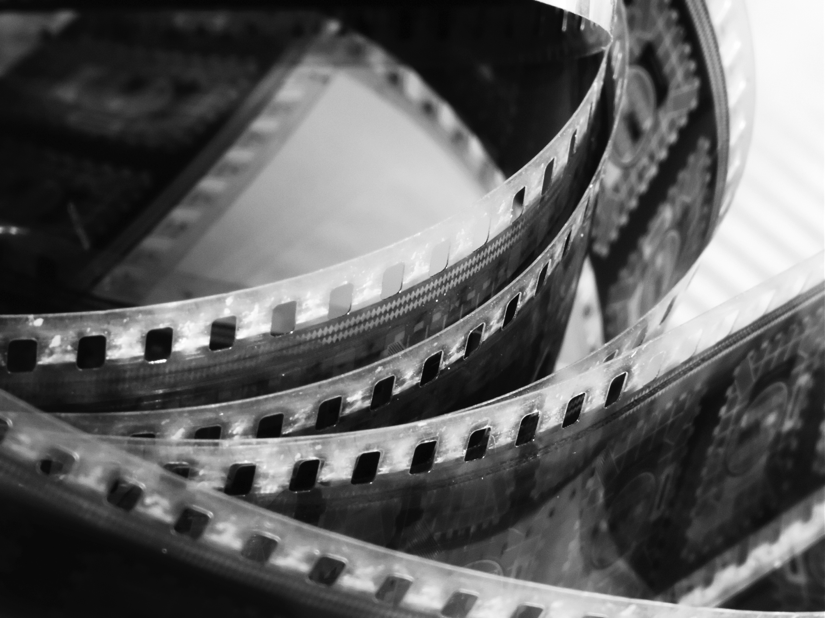
FILM AS ART
PHL 317K
Fall 2017
Notes:
Surveillance camera example: https://www.washingtonpost.com/news/true-crime/wp/2017/08/04/its-extremely-creepy-camera-catches-man-sneaking-into-attic/?utm_term=.e44f82698a3e
One Nation Under God, Jon McNaughton – http://jonmcnaughton.com/one-nation-under-god-52-x-72/
Lumiere Brothers - https://www.youtube.com/watch?v=4nj0vEO4Q6s
Chaplin scene - https://www.youtube.com/watch?v=kPcEFHA3X0c

Slide 2
skeptical arguments

Slide 3
THE QUESTION
Can film be art?
Are all films works of art?
Are some films works of art?
Notes:
Show Jon McNaughton example – Utah based artist, prints available for $130. – http://jonmcnaughton.com/one-nation-under-god-52-x-72/
Show surveillance camera example.
“This debate, moreover, was (and remains) a philosophical one, because it presupposes views about what is required of an object, if it is to be legitimately classified or categorized as an instance of the concept of art” (7).
Draw analogy with the question, “Who is the author?”
Transition – the skeptic argues: no.

Slide 4
NOTIFICATIONS
No new readings for Friday
Update to Matthew’s office hours: MF 10:00–11:00 am

Slide 5
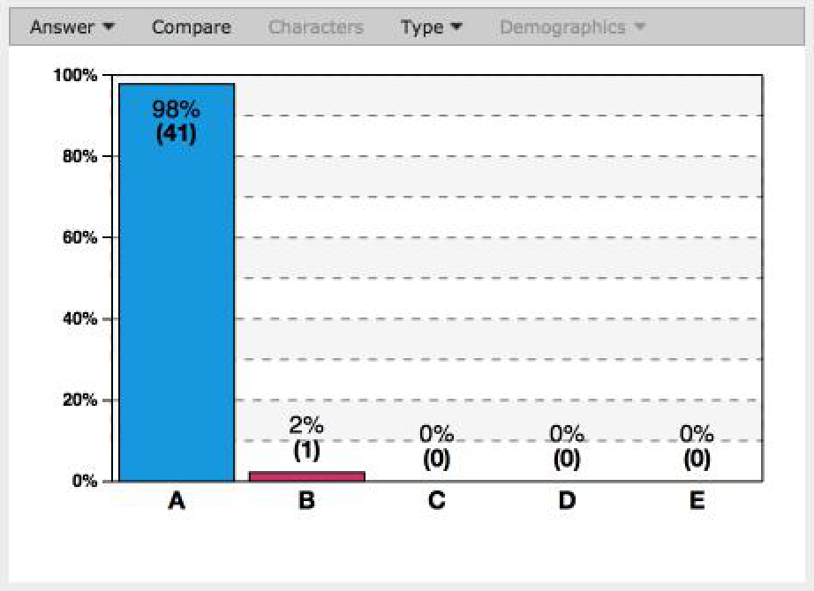
POLL
Can film be art?
Yes
No

Slide 6
ALTERNATIVE EXPLANATION
“[I]f photography be not quite art, that is precisely because the element of nature in it remains more or less unconquered and ineradicable” – Benedetto Croce

Slide 7
ALTERNATIVE EXPLANATION
Notes:
Show Chaplin clip.

Slide 8
ALTERNATIVE EXPLANATION
Non-fiction films cannot be art, because they do not involve artistic expression at all.
Fiction films involve artistic expression, but they are not works of art themselves; they are merely recordings or preservations of art (e.g., dramatic art).
Notes:
Transition: so why think that film can’t be art?

Slide 9
THE MASTER ARGUMENT
Photography is not art.
A film is at best a photographic recording of a work of dramatic art.
Therefore, film itself is not art.
Notes:
Arguments focus on the first premise.
Second premise is just assumed.

Slide 10
The causation argument
If something is art, then it belongs to a medium that necessarily involves the expression of thought.
If a work belongs to a medium that necessarily involves the expression of thought, then it belongs to a medium that necessarily has a mental dimension (also known as intentionality).
Intentionality is not a necessary feature of photography.
So: no photograph is a work of art.
Notes:
Start with premises (1) and (2)

Slide 11
MINIMAL EXPRESSIVISM
X is a work of art only if X is the expression of thought.
Thought is understood broadly to include ideas, feelings, attitudes, points of view, or the articulation of a formal conception.
These phenomena involve intentionality (or aboutness).
Notes:
Premise 1

Slide 12
INTENTIONALITY
X is intentional if and only if X is about (or directed at) something.
Derived intentionality is the product of minds: if a sign or symbol has intentional features, that is usually because someone intended that sign or symbol to be about something.
A mark of intentionality is referential opacity: from the fact that X is about Y, we cannot infer that there exists a Y such that X is about it.
Notes:
Give example of hand/finger example
Landscape painting example

Slide 13
POLL
Minimal expressivism proposes intentionality as a ________________ for counting as art.
A necessary condition
A sufficient condition
Both a necessary and sufficient condition

Slide 14
WHY MINIMAL EXPRESSIVISM?
Notes:
No intentionality at all
Wouldn’t be art

Slide 15
WHY MINIMAL EXPRESSIVISM?
Painting is a paradigmatic artistic medium.
All paintings have the property of intentionality: they are about something.
This is because each painter intends his or her painting to be about something.
They are also referentially opaque.

Slide 16
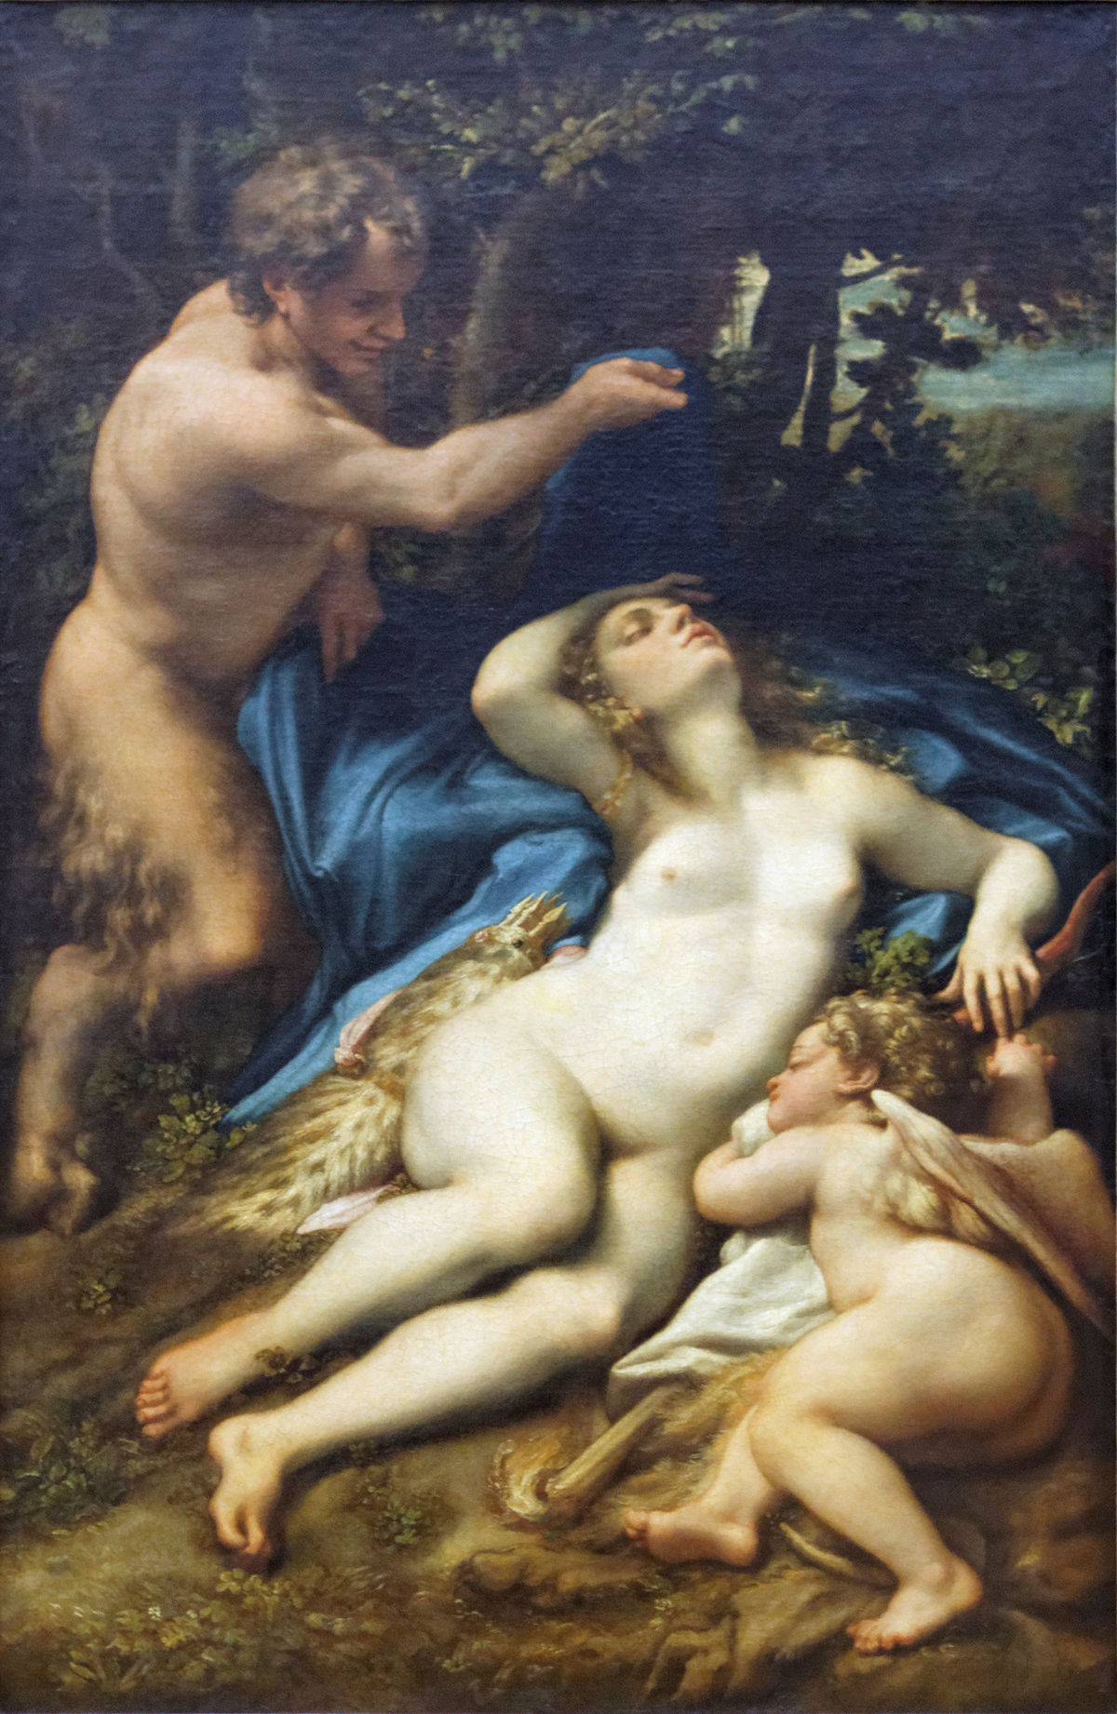
WHY MINIMAL EXPRESSIVISM?
Notes:
Venus and Cupid with a Satyr by Antonio Allegri da Correggio.

Slide 17
PREMISE (3)
Premise (3): Intentionality is not a necessary feature of photography.
Photographs (motion pictures) are the causal consequences of a series of physio-chemical processes that unfold in accord with brute laws of nature.
Given the nature of photographic technology, it is possible for there to be photographs that do not involve any human agency at all.
Such photographs wouldn’t express any thoughts whatsoever.

Slide 18
PREMISE (3)
Given that photographs are the products of causal processes, they are referentially transparent.
From the fact that X is a photograph, we can always infer that there was a Y such that X is a photograph of Y.
This is at least some evidence that they are not intentional in the relevant sense.
Notes:
Connect to Bazin

Slide 19
The causation argument
If something is art, then it belongs to a medium that necessarily involves the expression of thought.
If a work belongs to a medium that necessarily involves the expression of thought, then it belongs to a medium that necessarily has a mental dimension (also known as intentionality).
Intentionality is not a necessary feature of photography.
So: no photograph is a work of art.

Slide 20
THE CONTROL ARGUMENT
If a photograph is a work of art, then it expresses thought.
If it expresses thought, then it belongs to a medium that affords an artist a high level of control.
Photography is not a medium that affords an artist a high level of control.
So: no photograph is a work of art.

Slide 21
PREMISE (2)
Premise (2): If a work expresses thought, then it belongs to a medium that affords an artist a high level of control.

Slide 22
PREMISE (3)
Premise (3): Photography is not a medium that affords an artist a high level of control.
Notes:
Mistakes
Akin to a mirror
Show Bergman clip: 1:07:58

Slide 23
The Aesthetic Interest Argument
If something is a work of art, then it is the kind of thing that can command aesthetic interest.
Photographs are not the kinds of things that can command aesthetic interest.
So: no photograph is a work of art.

Slide 24
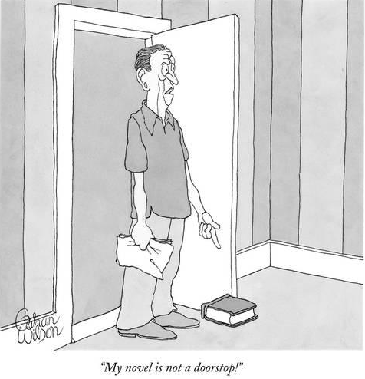
PREMISE (1)

Slide 25
PREMISE (2)
Mirrors are not the kinds of things that can command aesthetic interest.
Photographs are relevantly similar to mirrors (e.g., in that they are both transparent).
So: photographs are not the kinds of things that can command aesthetic interest.
Notes:
Mention that this will come up again in Walton’s paper

Slide 26
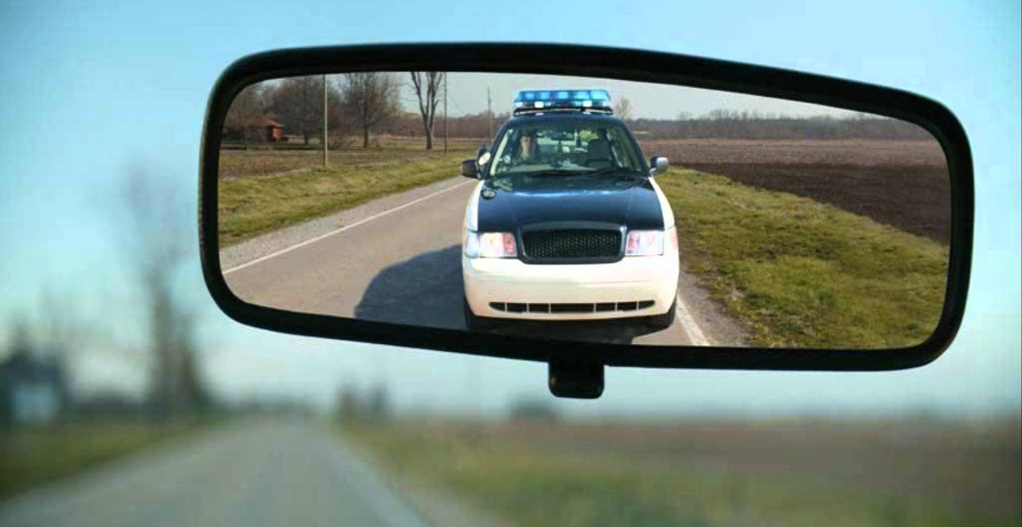
PREMISE (2)

Slide 27
PREMISE (2)

