Slide 1
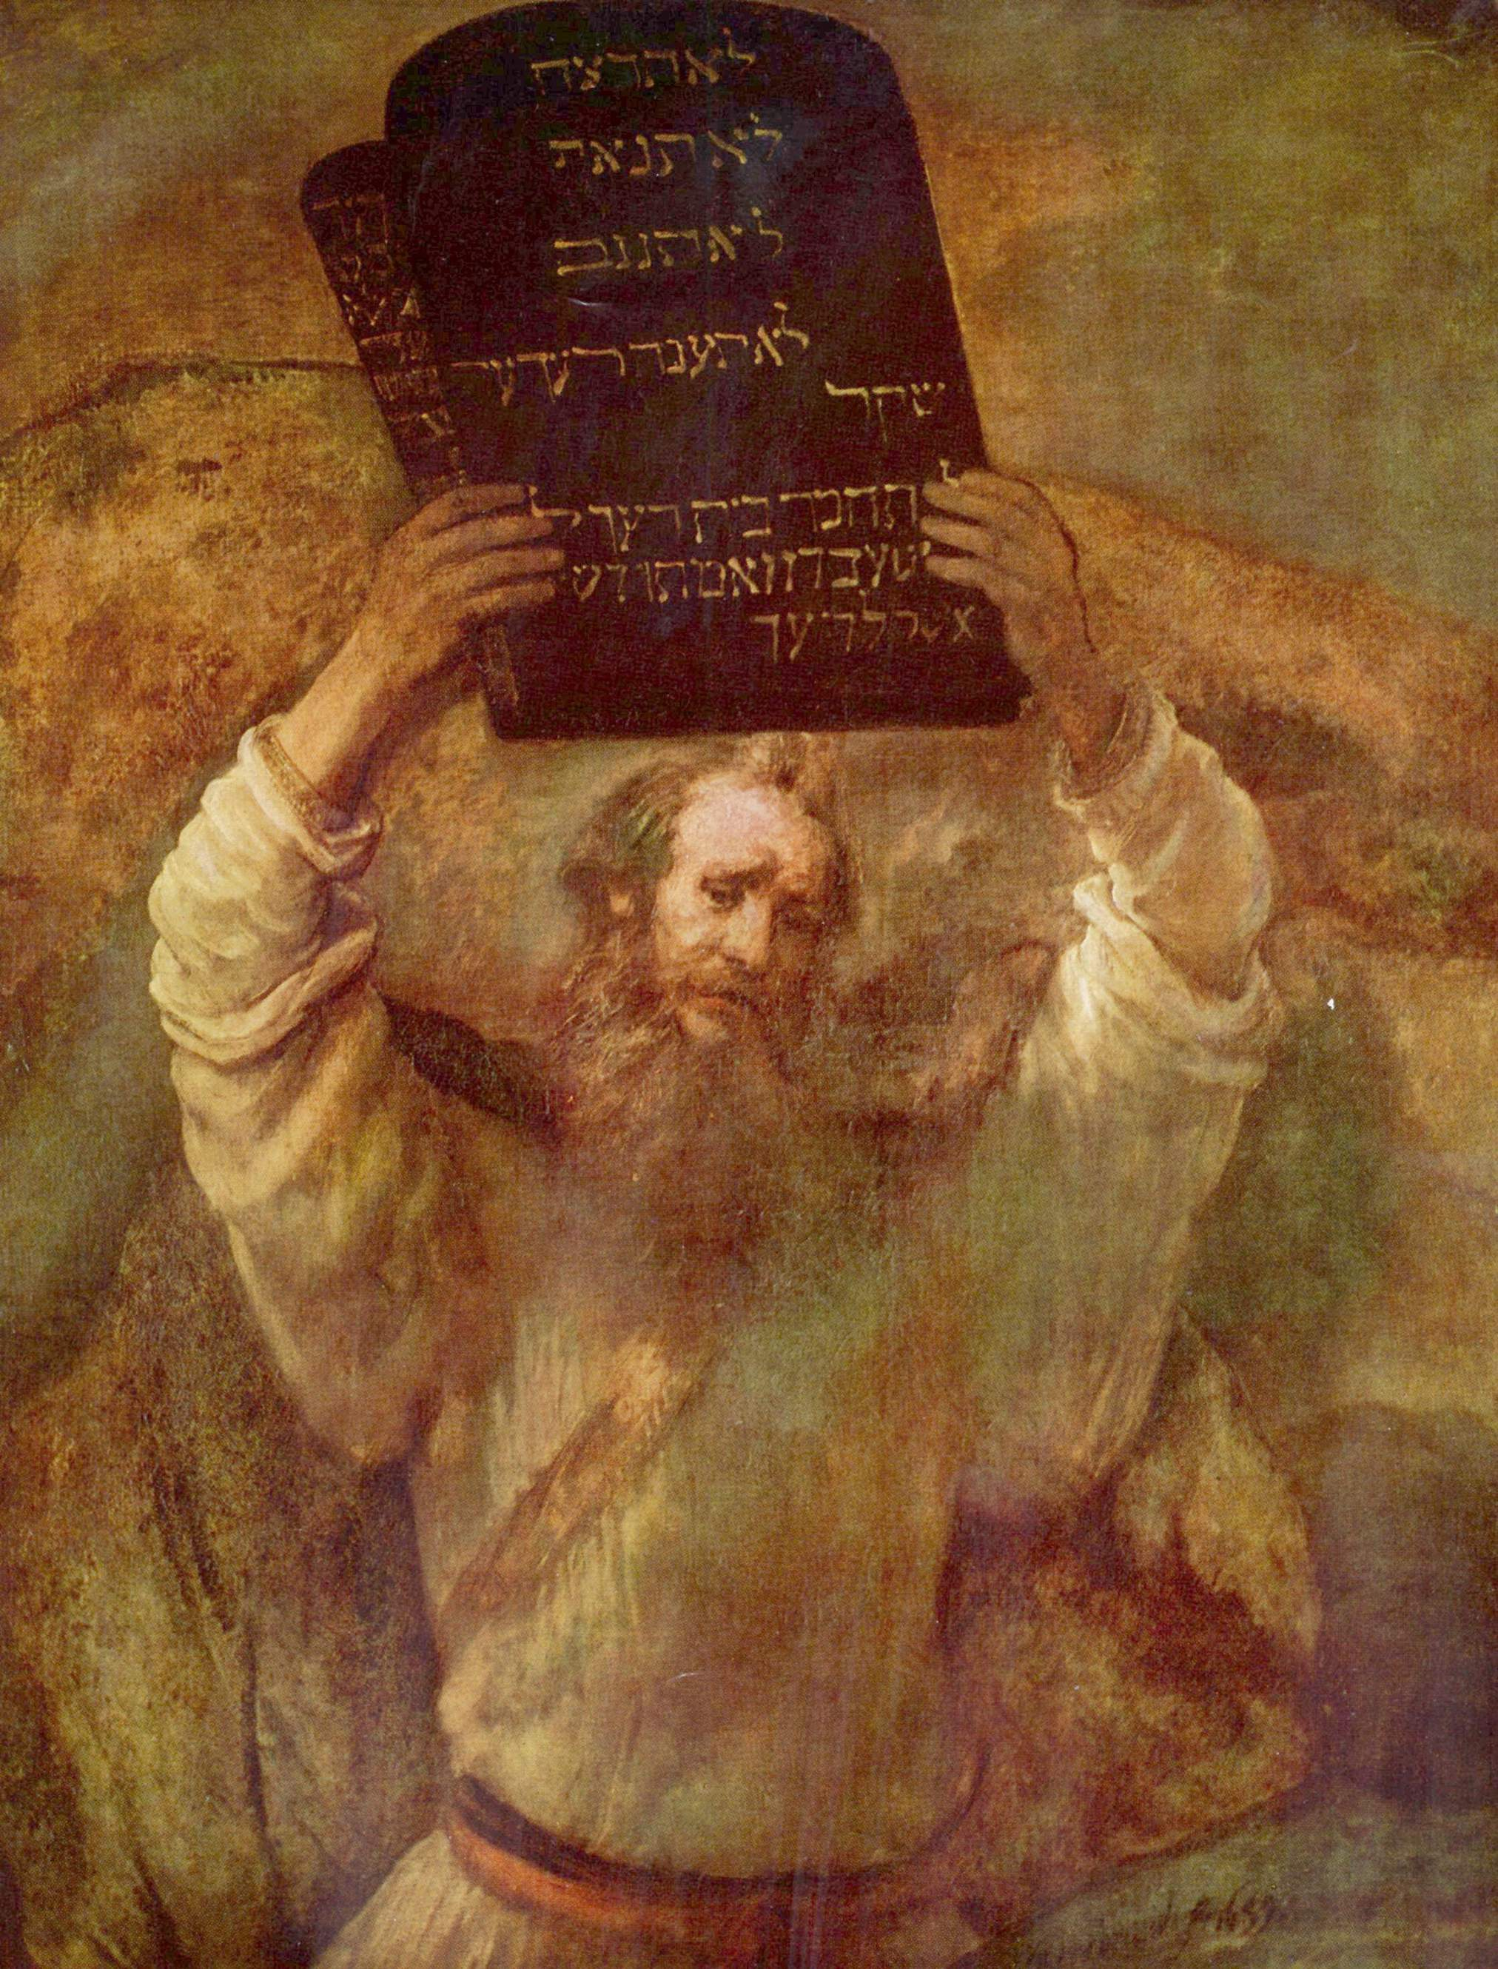
Metaethics: a crash course
Notes:
The Act of Killing trailer, https://www.youtube.com/watch?v=SD5oMxbMcHM

Slide 2
FIELDS OF ETHICS
Applied ethics: Is it morally permissible to bring children into existence? Are we morally obligated to use our financial resources to alleviate global poverty? How should we address the threat of climate change (if at all)? Is it morally permissible to buy meat and other animal products?
Normative ethics: Are there moral principles? If so, what are they? If not, how should we make ethical decisions and approach moral problems? How are, e.g., reasons, values, rights, permissibility, and obligation connected to each other?
Metaethics: What is the best account of moral thought and language? How do moral facts (if there are any) fit into a scientific picture of the world (if at all)? How can we come to know moral facts (if at all)?
Notes:
Overlap with philosophy of language and mind, metaphysics, and epistemology

Slide 3
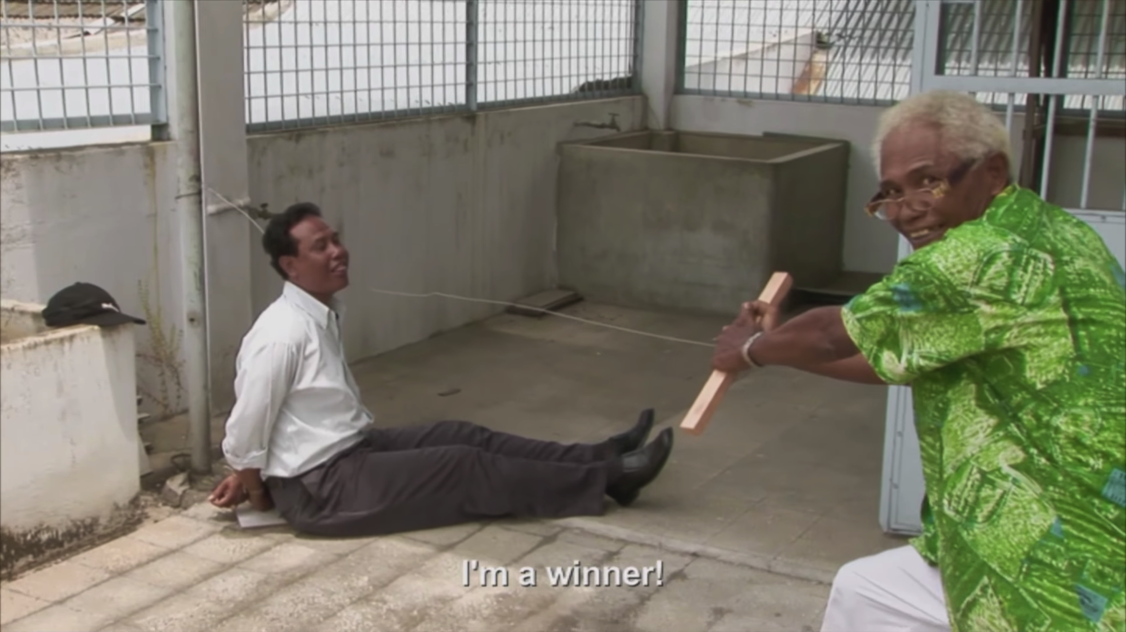
IDEALLY COHERENT ANWAR (POLL)

Slide 4
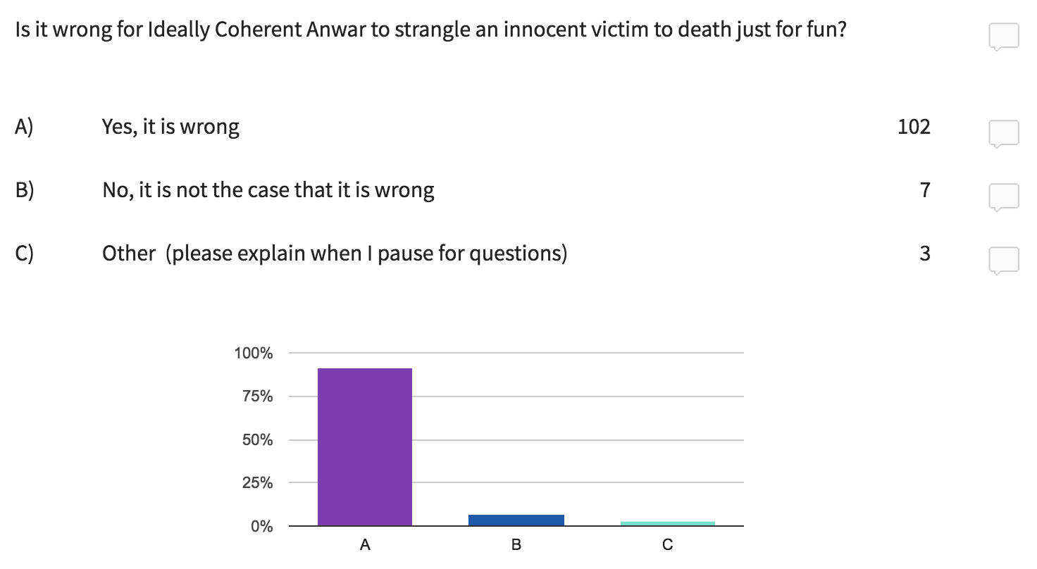

Slide 5
MORAL REALISM
Cognitivism: Moral sentences are apt for truth or falsity, and the state of mind of accepting a moral judgment is typically one of belief.
Success: At least one moral judgment is true.
Mind-independence: The moral facts are in no way dependent on being endorsed, or regarded as true, by any human being or institution.
Knowledge: We know at least one moral fact.

Slide 6
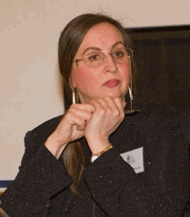
THE SPINACH TEST
Because if I liked it, I would have eaten it, and it’s yucky!
Christine Korsgaard
Notes:
“A child hates spinach. He then reports that he’s glad he hates spinach. To the question ‘Why?’ he responds: ‘Because if I liked it, I would have eaten it, and it’s yucky!’” (193).

Slide 7
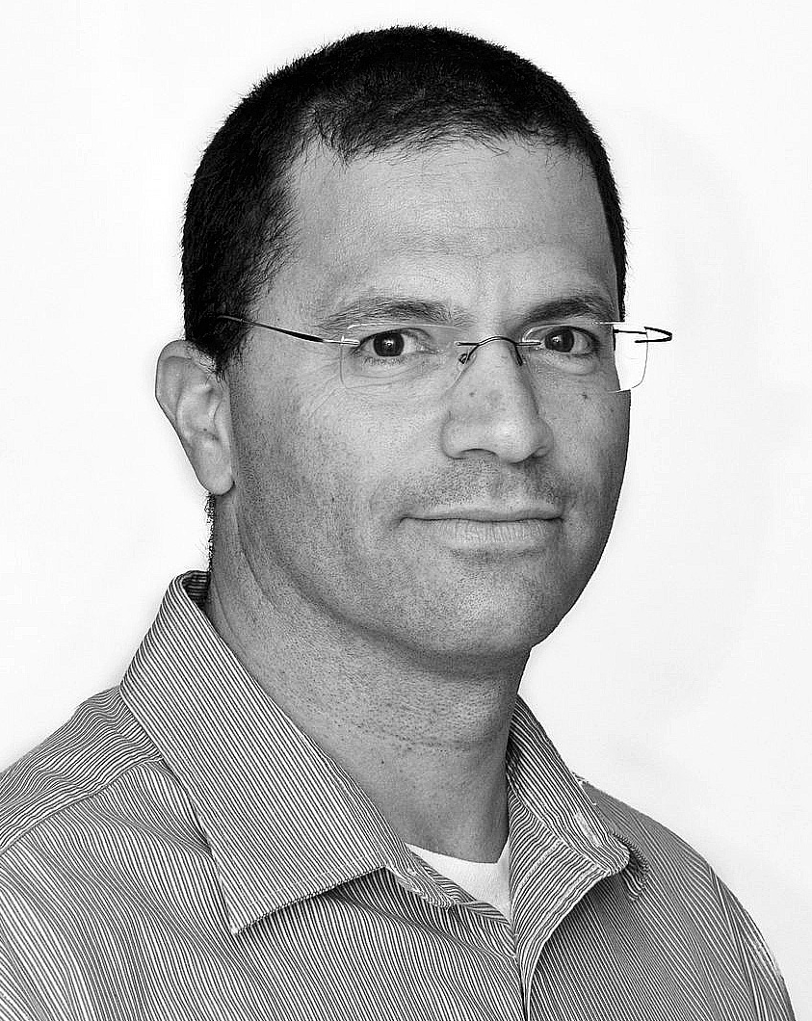
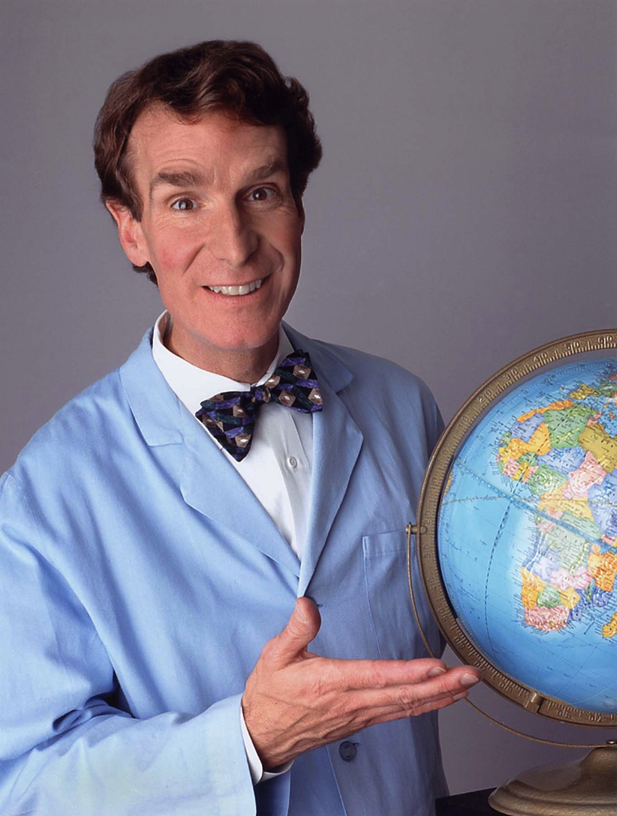
THE SPINACH TEST
I’m sure glad I didn’t grow up in the Middle Ages, because if I had, I would have believed that the earth is in the center of the universe, and that belief is false!
David Enoch
Notes:
“Consider . . . someone who grew up in the twentieth-century West and who believes that the earth revolves around the sun. Also, she reports to be happy she wasn’t born in the Middle Ages, ‘because had I grown up in the Middle Ages, I would have believed that the earth is in the center of the universe, and that belief is false!’” (194).
“The response in the earth-revolves-around-the-sun case sounds perfectly sensible, precisely in a way in which the analogous response does not sound sensible in the spinach case” (194).
“Suppose someone grew up in the United States in the late twentieth century and rejects any manifestation of racism as morally wrong. He then reports that he’s happy that that’s when and where he grew up, ‘because had I grown up in the eighteenth century, I would have accepted slavery and racism. And these things are wrong!’” (194).

Slide 8
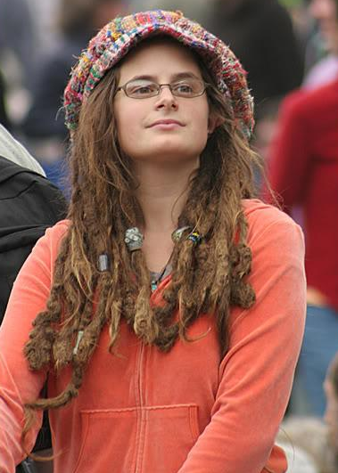
THE SPINACH TEST
I’m sure glad I didn’t grow up in the eighteenth century, because if I had, I would have accepted slavery and racism. And these things are wrong!
David Enoch
Notes:
“Suppose someone grew up in the United States in the late twentieth century and rejects any manifestation of racism as morally wrong” (194).
“Usually, our attitude towards our own likings and dislikings (when it comes to food, for instance) is that it’s all about us. If you don’t like spinach, the reason you shouldn’t have it is precisely that you don’t like it” (194).
“So if we’re imagining a hypothetical scenario in which you do like it, then you no longer have any reason not to eat it. This is what the child in the first example gets wrong: he’s holding fixed his dislike for spinach, even in thinking about the hypothetical case in which he likes spinach. But because these issues are all about him and what he likes and dislikes, this makes no sense” (194).
“But physics is different: What we want, believe or do—none of this affects the earth’s orbit. The fact that the earth revolves around the sun is just not about us at all” (194).

Slide 9
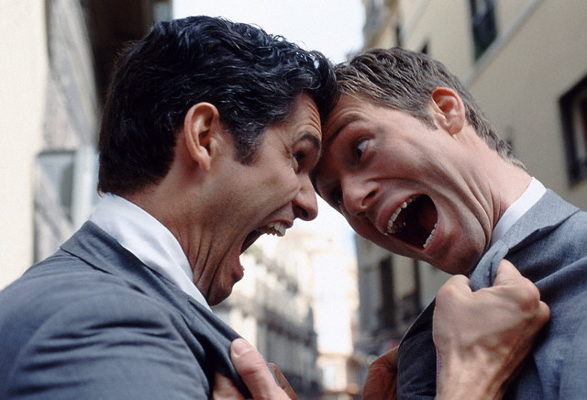
GASTRONOMIC DISAGREEMENT
No, it’s delicious! Starbucks just over roasts their beans.
Black coffee tastes like dirty water! I want a mocha latte.
Notes:
“What does such disagreement feel like? In particular, does it feel more like disagreeing over which chocolate is better, or like disagreeing over factual matters (such as whether human actions contribute to global warming)?” (195).
“In the chocolate case, it feels like stating one’s own preference, and perhaps trying to influence the listener into getting his own preferences in line. In the global warming case, though, it feels like trying to get at an objective truth, one that is there anyway, independently of our beliefs and preferences” (195).

Slide 10
SCIENTIFIC DISAGREEMENT
No, that’s a myth!
Human actions influence global warming! Admit it!
Notes:
“What does such disagreement feel like? In particular, does it feel more like disagreeing over which chocolate is better, or like disagreeing over factual matters (such as whether human actions contribute to global warming)?” (195).
“In the chocolate case, it feels like stating one’s own preference, and perhaps trying to influence the listener into getting his own preferences in line. In the global warming case, though, it feels like trying to get at an objective truth, one that is there anyway, independently of our beliefs and preferences” (195).

Slide 11
MORAL DISAGREEMENT
Life begins at conception, so abortion is morally wrong, you monster!
No, it’s not! Fetuses are just clumps of cells, you sexist!
Notes:
“What does such disagreement feel like? In particular, does it feel more like disagreeing over which chocolate is better, or like disagreeing over factual matters (such as whether human actions contribute to global warming)?” (195).
“You have to think about what it feels like for you when you are engaged in moral disagreement. But I can say that in my case such moral disagreement feels exactly like the one about global warming—it’s about an objective matter of fact, that exists independently of us and our disagreement” (195–6).

Slide 12
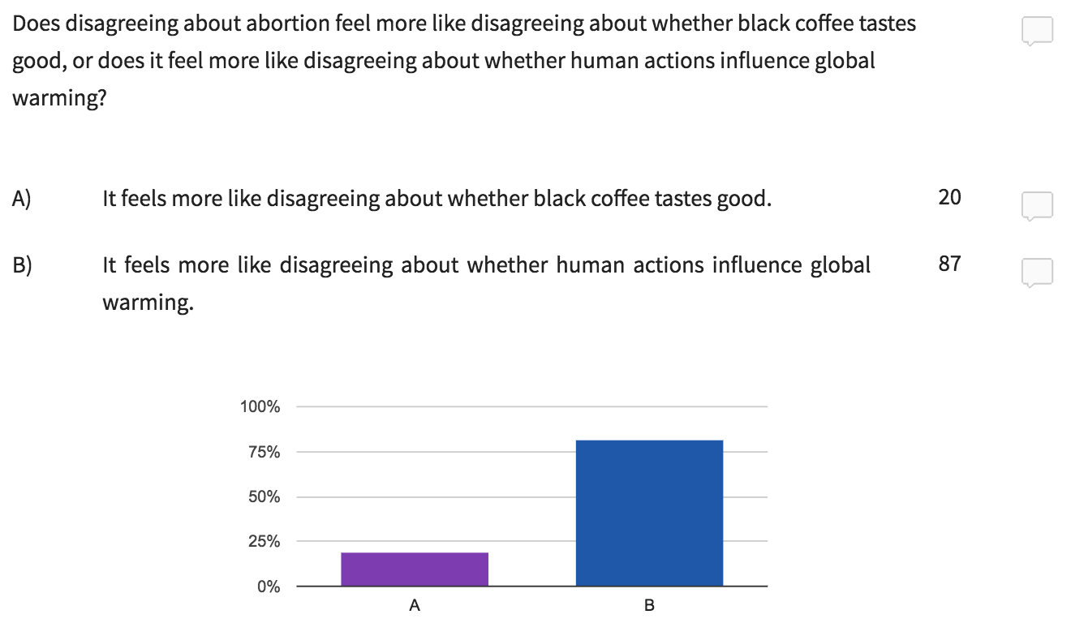

Slide 13
WHAT’S AT ISSUE?
“I suggest that we care about the objectivity of morality for roughly the reasons specified in the previous section. . . . We want morality’s objectivity to vindicate the phenomenology of deliberation and disagreement. . . . We want morality’s objectivity to explain why the moral analogue of the spinach test isn’t funny. . . . Very well, then, in what sense must morality be objective[?] The answer, it seems to me, is that a subject matter is objective if the truths or facts in it exist independently of what we think or feel about them” (198).
David Enoch

Slide 14
NATURALISM
So far, all of the objects, properties, and facts that have been subjected to extensive scientific scrutiny have turned out to be wholly natural.
So: all of the objects, properties, and facts that exist are wholly natural.

Slide 15
NATURALISM
Suppose after extensive moral theorizing, we come to conclude that an act is right if and only if it maximizes utility. Why is that?
The naturalist will answer: because rightness just is utility maximization!

Slide 16
NATURALISM
Moral properties are natural properties, which are (in principle) amenable to understanding in scientific terms.
For example, just as we might maintain that lightning = electrical discharge, some naturalists maintain that rightness = pleasure-maximization.

Slide 17
THE OPEN QUESTION ARGUMENT
If rightness = utility maximization, then the terms “right” and “utility maximization” must be analytically equivalent.
If the terms “right” and “utility maximization” are analytically equivalent, then questions like “This act maximizes utility, but is it right?” should be closed questions.
It is not the case that such questions are closed—rather, they are open questions.
So: it is not the case that rightness = utility maximization.
Notes:
“The question ‘This act maximizes utility, but is it right?’ would have to be one whose answer is immediately obvious to anyone who understands the meanings of the words used, being equivalent to the question ‘This act maximizes utility, but does it maximize utility?’”
“However, as a moment’s reflection reveals, the questions clearly are not equivalent. We can, without self-contradiction, agree that an act maximizes utility but deny that it is right.”
“It therefore follows that the question ‘This act maximizes utility, but is it right?’ is not a closed question – one whose answer is immediately obvious to anyone who understands the meanings of the words – but is rather an open question – one whose answer is open to reasoned argument. ‘Rightness’ and ‘utility maximization’ are thus not analytic equivalents. They do not pick out the same feature” (28).

Slide 18
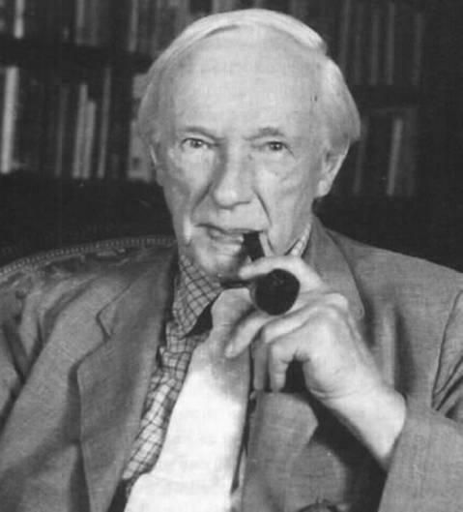
NON-NATURALISM
Goodness is an irreducible, sui generis, non-natural property.
It can’t (even in principle) be explained in naturalistic terms.
G. E. Moore

Slide 19
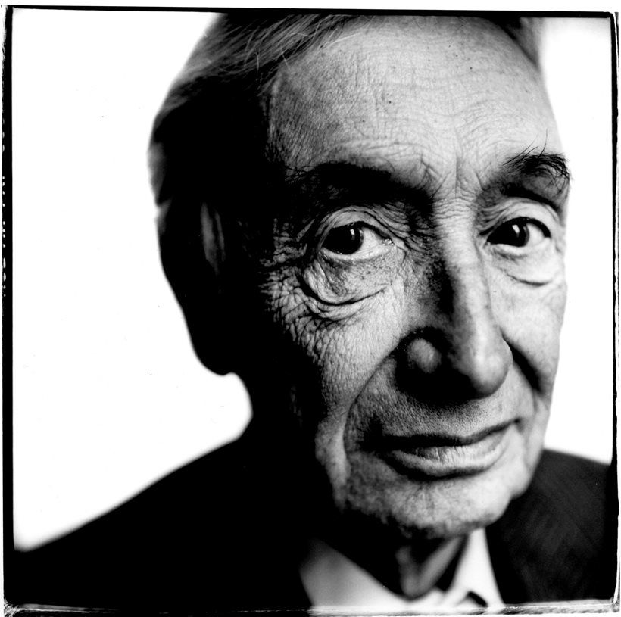
EMOTIVISM
“If now I generalise my previous statement and say, ‘Stealing money is wrong,’ I produce a sentence which has no factual meaning—that is, expresses no proposition which can be either true or false. It is as if I had written ‘Stealing money!!’—where the shape and thickness of the exclamation marks show, by a suitable convention, that a special sort of moral disapproval is the feeling which is being expressed. It is clear that there is nothing said here which can be true or false” (107).
A. J. Ayer

Slide 20
MORAL DISAGREEMENT
Life begins at conception, so abortion is morally wrong, you monster!
No, it’s not! Fetuses are just clumps of cells, you sexist!
Notes:
“What does such disagreement feel like? In particular, does it feel more like disagreeing over which chocolate is better, or like disagreeing over factual matters (such as whether human actions contribute to global warming)?” (195).
“You have to think about what it feels like for you when you are engaged in moral disagreement. But I can say that in my case such moral disagreement feels exactly like the one about global warming—it’s about an objective matter of fact, that exists independently of us and our disagreement” (195–6).

Slide 21
PRACTICAL DISAGREEMENT
I intend that we go to the party at 9:00 pm!
I intend that we go to the cinema at 9:00 pm!
Notes:
“What does such disagreement feel like? In particular, does it feel more like disagreeing over which chocolate is better, or like disagreeing over factual matters (such as whether human actions contribute to global warming)?” (195).
“You have to think about what it feels like for you when you are engaged in moral disagreement. But I can say that in my case such moral disagreement feels exactly like the one about global warming—it’s about an objective matter of fact, that exists independently of us and our disagreement” (195–6).

Slide 22
MOTIVATIONAL INTERNALISM
If someone makes a sincere moral judgment, then that person will be motivated (at least to some extent) to act in accord with that judgment.
Emotivism is the best explanation of this datum.
So: emotivism is true.

Slide 23
THE EMBEDDING PROBLEM
How is the emotivist to make sense of complex sentences built up from simpler sentences involving moral terms?
For example:
“If lying is wrong, then so is misleading truth-telling.”
“Sam believes that lying is wrong.”
“Either lying is wrong, or Sam is mistaken.”

Slide 24
MORAL ERROR THEORY
Cognitivism: Moral sentences are apt for truth or falsity, and the state of mind of accepting a moral judgment is typically one of belief.
Presupposition: Moral judgments presuppose that there are moral properties.
Error: There are no such properties, and so no moral judgment is true.

Slide 25
MORAL ERROR THEORY
If moral properties are queer, then they are ontologically suspicious.
If moral properties are ontologically suspicious, and they are explanatorily redundant, then a theory that dispenses with such properties is better than one that countenances them.
Moral properties are queer and explanatorily redundant.
So: a theory that dispenses with such properties is better than one that countenances them.

Slide 26
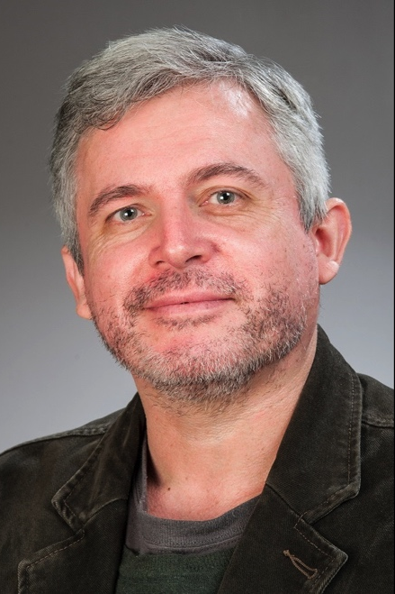
MORAL ERROR THEORY
“The moral error theorist may, for example, perceive that moral imperatives are imbued with a kind of mystical practical authority. . . . Moral properties have a ‘to-be-pursuedness’ to them. . . . [M]oral facts would require that ‘the universe takes sides.’ . . . [M]oral believers are committed to ‘demands as real as trees and as authoritative as orders from headquarters.’ . . . Indeed, it may be the vague, equivocal, quasi-mystical, and/or ineliminably metaphorical imponderabilia of moral discourse that so troubles the error theorist.”
Richard Joyce

Slide 27
BUT THEN WHAT?
Rationality demands that error theorists abandon their moral beliefs.
But there may be extremely strong practical reasons to continue using moral language and to engage in ethical debates.
Moral fictionalism is the view that error theorists pragmatically ought to engage in a game of make-believe with respect to morality.
Richard Joyce

Slide 28
Do moral judgments purport to describe the world?
Are at least some of them (mind-independently) true and known?
Moral realism
Moral error theory
Are moral facts natural facts?
Naturalism
Non-naturalism
Cognitivism
Non-cognitivism
Emotivism
Should we continue using moral sentences?
Fictionalism
Eliminativism

Slide 29
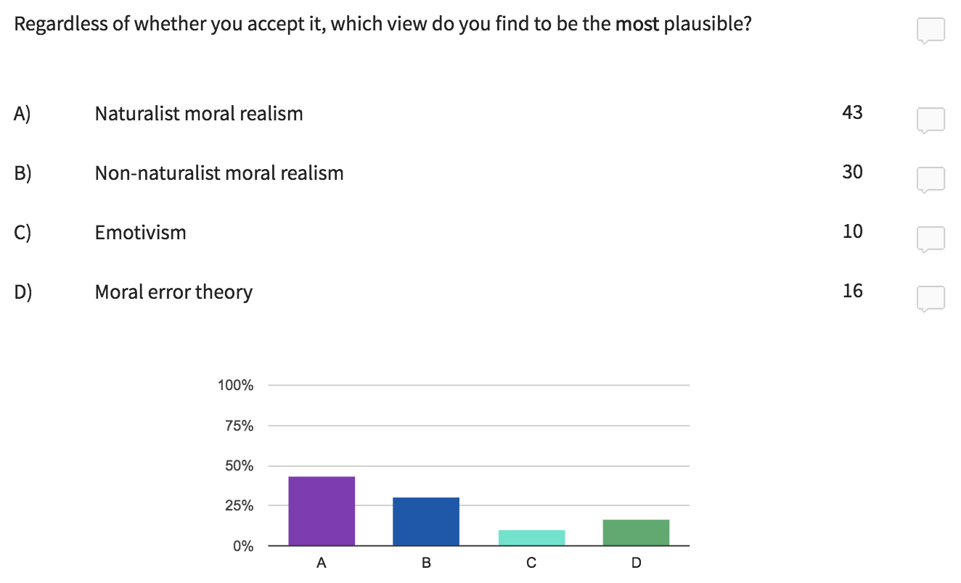
UNGRADED POLL (question 1)
Which view do you find to be the most plausible?

