Slide 1
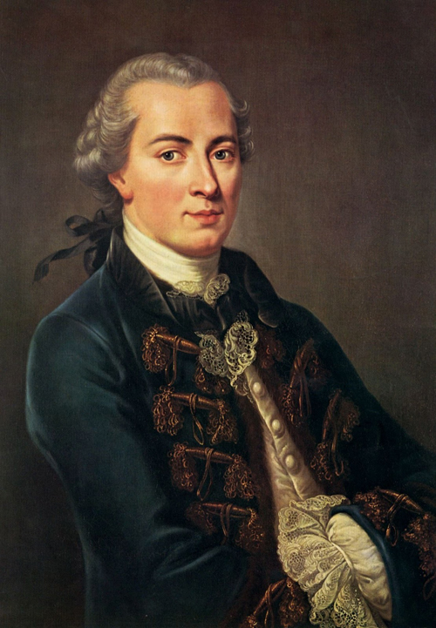
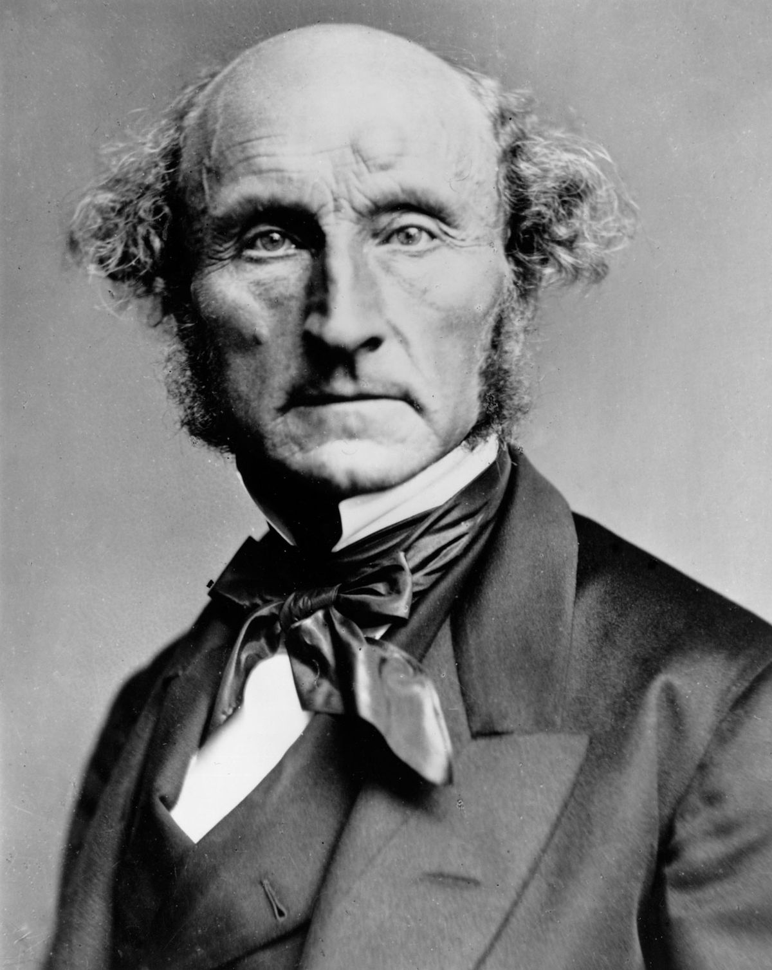
Normative ethics: a crash course
PHL 304
Fall 2018
Notes:
The Matrix scene, https://www.youtube.com/watch?v=6gL0xQHI0wo

Slide 2
THEORY BUILDING
Simplicity: the theory yields a complex body of moral judgments out of a sparse base of more fundamental moral principles.
Power: the theory offers guidance on unclear cases.
Coherence: the theory is internally consistent and includes mutually supportive principles and judgments.
Explanatoriness: the theory helps us to understand the moral realm by explaining data that is in need of explanation, such as why certain principles, distinctions, and so on should matter; it minimizes “dangling distinctions.”
Notes:
“Thus, the principles themselves may give us grounds for rejecting some of our initial intuitions, and the altered set of intuitions may in turn give us grounds for altering the principles” (11–12).
“In this manner, we work back and forth between intuitions and principles until a stable point is reached” (12).
“The remaining intuitions represent our considered judgments, and the moral principles at which we have arrived can guide us in difficult cases” (12).
“If the slaveholder cannot offer an explanation, then the distinction hangs free of the rest of his moral theory, and considerations of coherence give him reason to reject the distinction as morally irrelevant, as well as repudiating the intuitions which turn on it” (14).

Slide 3
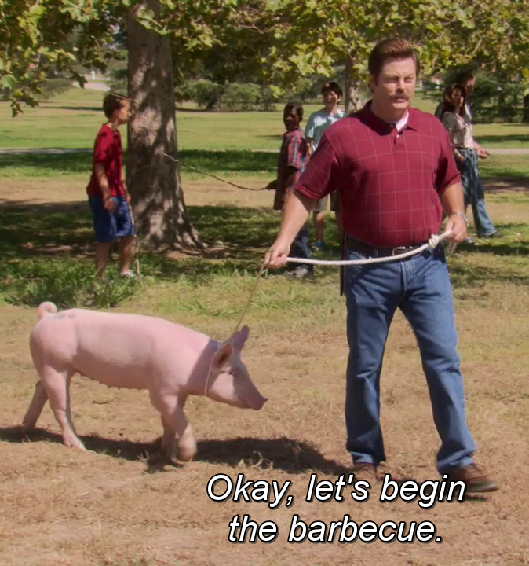
THEORETICAL APPROACH
Animal slaughter
step 1
Discover the correct moral theory
step 2
Plug in particular cases to get verdicts
step 3
Act accordingly
moral theory

Slide 4
begin
Describe the case in detail
Does it illicit strong moral intuitions?
INTUITIVE APPROACH
Make a list of any extraneous factors (distorting biases, background moral theories, etc.) that may be responsible for these intuitions
Yes
No
Is it similar to more clear-cut cases?
Expand list of extraneous factors and isolate any morally relevant features shared by these cases
Yes
No
Build or refine a theory that best explains this data and discard any extraneous factors that conflict with it
Test predictions against other cases
No
reflective equilibrium
Considered moral judgements and principles
Is the theory stable?
Yes

Slide 5
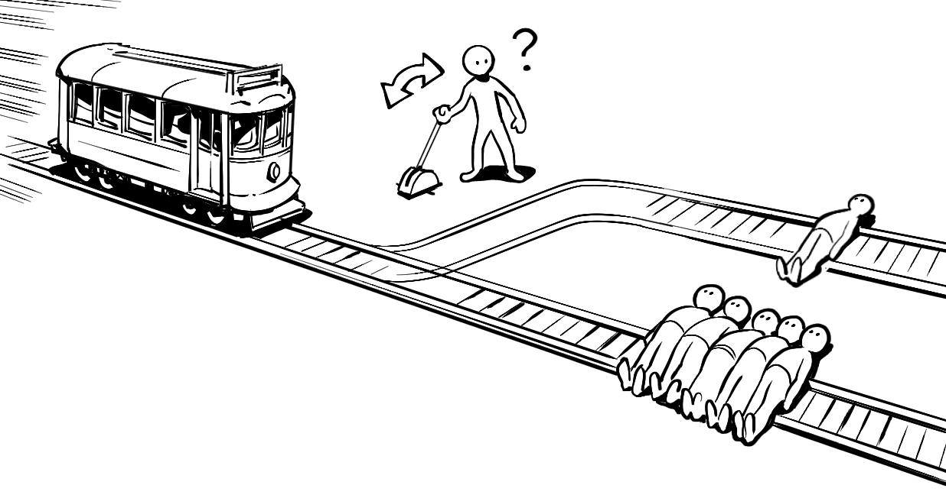

Slide 7
CONSEQUENTIALISM
Consequentialists hold that the normative status of an action—whether it is right or wrong—is always a function of its consequences, e.g., whether it will produce more good than bad.
They take stands on two important questions (a question of value and a question of obligation):
Which kinds of things are intrinsically valuable?
What makes an action right (or wrong)?
Notes:
“Philosophers call such things instrumental goods, things that are valuable because of the good things they bring about” (21).
“If there are instrumental goods, then there must also be something worth pursuing for its own sake, whose goodness is self-contained, some- thing valuable in its own right, even if it brings nothing else in its wake. Such things are intrinsically valuable” (21).

Slide 8
QUIZ (question 2)

Slide 9
CLASSICAL ACT UTILITARIANISM
The only intrinsic good is happiness.
If anything else is good, that is only because it is instrumental to bringing about happiness.
An action is right if and only if (and because) it maximizes happiness.
…or is reasonably expected to maximize it.
…or tends to promote the greatest happiness.
…or something along those lines.
John Stuart Mill
Notes:
19th century

Slide 10
Notes:
?

Slide 11
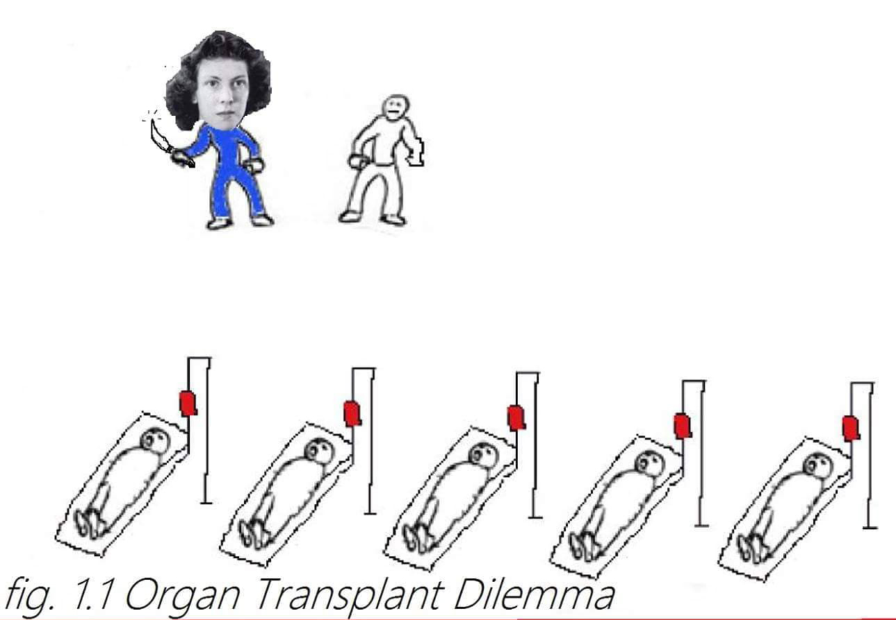
Notes:
Lungs, heart, liver, kidney
Philippa Foot

Slide 12
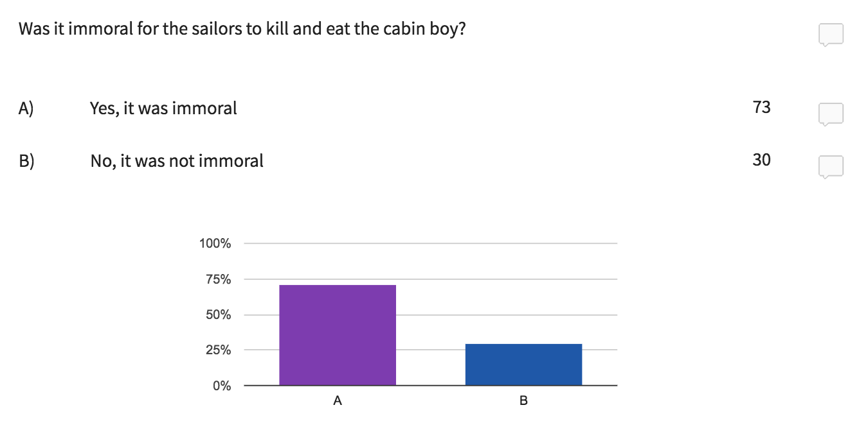
UNGRADED POLL (question 3)

Slide 14
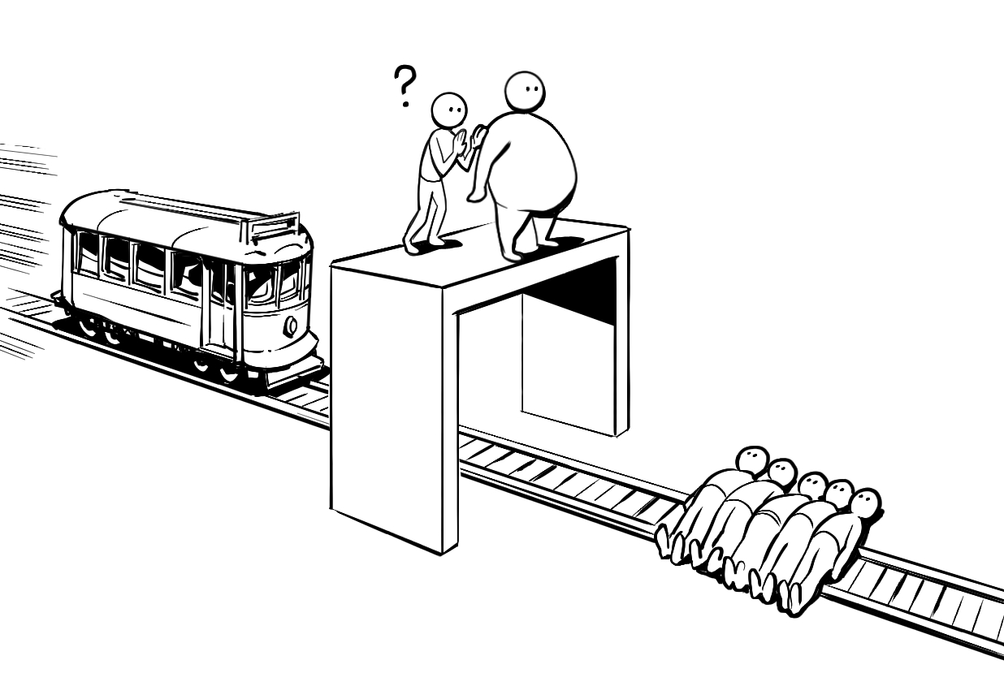

Slide 15
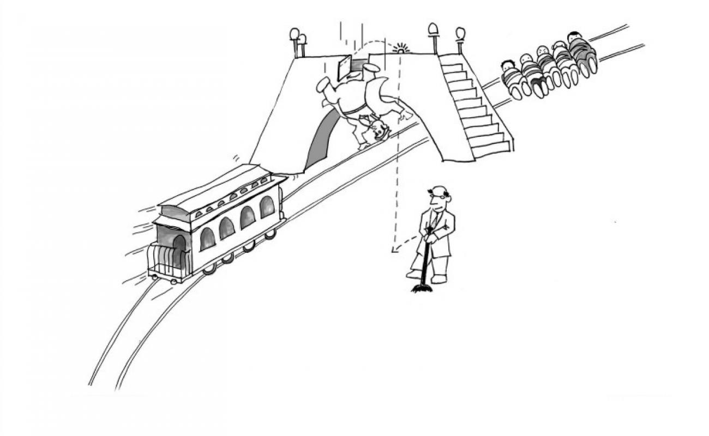

Slide 16
THE EXPERIENCE MACHINE
Ungraded poll: If it were an option, would you choose to enter the experience machine?

Slide 17
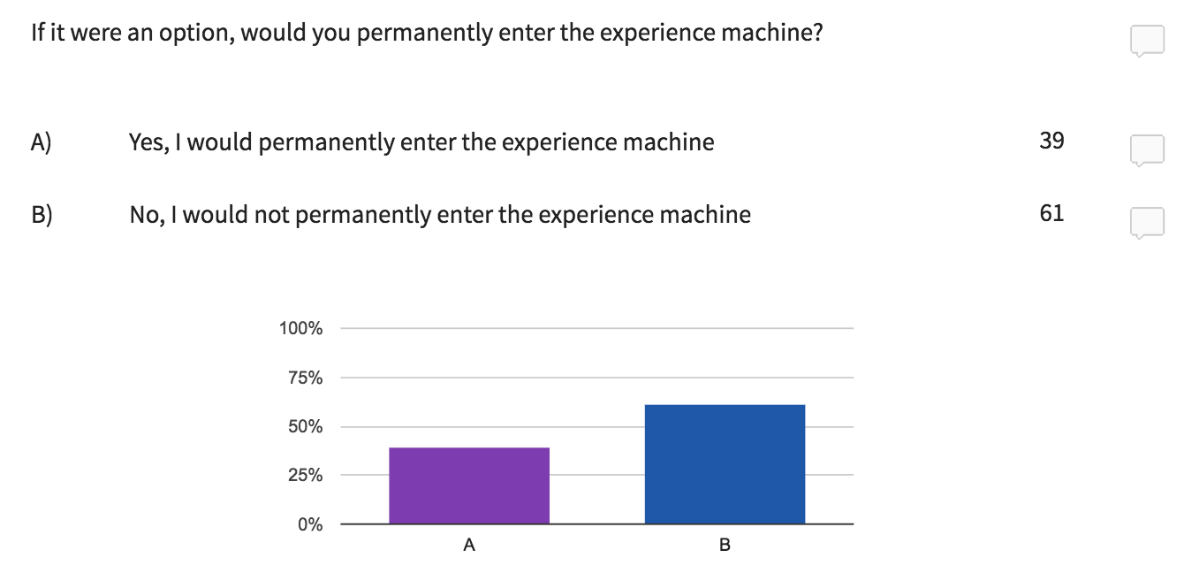
THE EXPERIENCE MACHINE

Slide 18
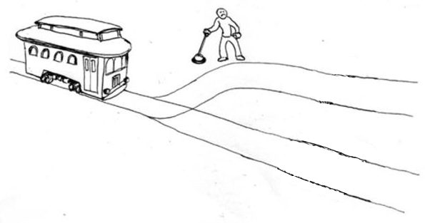
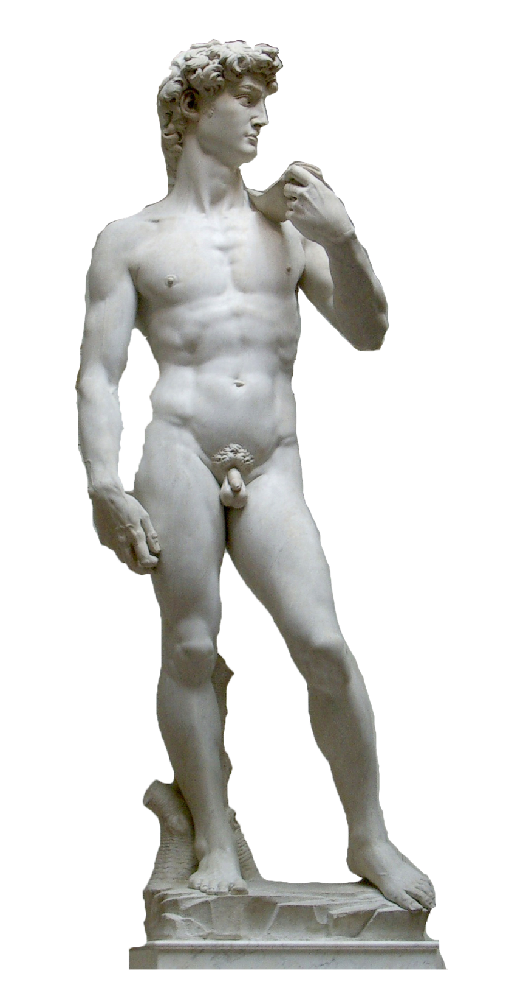
VALUE PLURALISM—WHAT THEN?
Notes:
Show documentary clip

Slide 19
DEONTOLOGY
Deontologists maintain that certain actions are intrinsically right or wrong.
Some deontologists hold that these actions are never permissibly performed, even when doing so will have extremely good consequences.
These actions might include:
Intentionally deceiving another person
Intentionally killing another person
Breaking a promise
Stealing another person’s property
Violating a person’s right not to be used only for the sake of someone else’s pleasure
Notes:
Greek δέον, deon, "obligation, duty”

Slide 20
THE CATEGORICAL IMPERATIVE
A hypothetical imperative is a requirement of reason to do something given that it is a means to some end.
If Allison is a physician who wills that her patient recover from some illness, and a certain drug is a known cure for that illness, then Allison ought to will that she administer the drug.
If Walter wills that he kill a person without getting caught, and a certain poison is both deadly and untraceable, then Walter ought to will that he use that poison to kill his victim.
A categorical imperative is a requirement of reason that applies to all individuals, regardless of one’s ends.
A categorical imperatives is violated at the cost of one’s own irrationality.
Immanuel Kant
Notes:
Late 18th century

Slide 21
THE PRINCIPLE OF UNIVERSALIZABILITY
The principle of universalizability states that it is morally permissible to perform some action if and only if its maxim is universalizable.
A maxim is simply a principle of action you give yourself when you are about to do something.
It has the following form: perform some action A in a circumstance C in order to realize or produce some end E.

Slide 22
THE PRINCIPLE OF UNIVERSALIZABILITY
Formulate a maxim that captures your reason for performing the action you propose to perform under the circumstances.
Recast that maxim as a universal law that all rational agents must act as you propose to act in circumstances like your own.
Consider whether your maxim is even conceivable in a world governed by such a law. If it isn’t, then it is morally wrong.
If it is conceivable, then consider whether you could rationally will to act on your original maxim in such a world. If you could, then your action is morally permissible; otherwise, it is morally wrong.

Slide 23
THE PRINCIPLE OF UNIVERSALIZABILITY
Maxim: make a false promise to get what you want.

Slide 24
THE PRINCIPLE OF UNIVERSALIZABILITY
Notes:
“Thus we are imagining a world in which the agent and everyone with his purpose is making a certain sort of promise, but also a world in which there is no such thing” (501).
“On the Practical Contradiction Interpretation, the contradiction arises because the agent wills to engage in a conventional action, but he also wills a state of affairs in which the action will no longer work” (507).
“[T]he reason the action no longer works is because it no longer exists” (507).

Slide 25
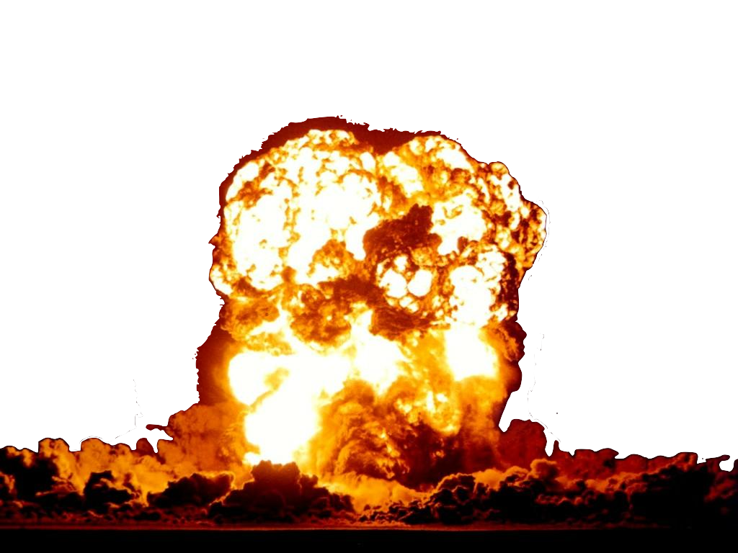
THE PRINCIPLE OF UNIVERSALIZABILITY
Notes:
“Thus we are imagining a world in which the agent and everyone with his purpose is making a certain sort of promise, but also a world in which there is no such thing” (501).
“On the Practical Contradiction Interpretation, the contradiction arises because the agent wills to engage in a conventional action, but he also wills a state of affairs in which the action will no longer work” (507).
“[T]he reason the action no longer works is because it no longer exists” (507).

Slide 26
THE PRINCIPLE OF UNIVERSALIZABILITY
Maxim: kill a coworker to secure a job for yourself.
Notes:
“Staying alive matters in this example because it is a necessary condition of having the job” (507).
“The method of dealing with natural acts which I have just suggested focuses on the question of whether you could really achieve your purpose – with everything that purpose involves (i.e., security in its possession) in a world where your action was the universal method of achieving that purpose” (507–8).

Slide 27
THE PRINCIPLE OF UNIVERSALIZABILITY
Notes:
“Staying alive matters in this example because it is a necessary condition of having the job” (507).
“The method of dealing with natural acts which I have just suggested focuses on the question of whether you could really achieve your purpose – with everything that purpose involves (i.e., security in its possession) in a world where your action was the universal method of achieving that purpose” (507–8).

Slide 28
THE PRINCIPLE OF UNIVERSALIZABILITY
Notes:
“Staying alive matters in this example because it is a necessary condition of having the job” (507).
“The method of dealing with natural acts which I have just suggested focuses on the question of whether you could really achieve your purpose – with everything that purpose involves (i.e., security in its possession) in a world where your action was the universal method of achieving that purpose” (507–8).

Slide 29
IMMORALITY AS IRRATIONALITY
If you are rational, then you are consistent.
If you are consistent, then you obey the principle of universalizability.
If you obey the principle of universalizability, then you act morally.
So: if you are rational, then you act morally.
So: if you act immorally, then you are irrational.
Russ Shafer-Landau

Slide 30
THE PRINCIPLE OF HUMANITY
The principle of humanity states that one ought to treat a person (oneself included) as an end, and never as a mere means.
A morally permissible act is one that respects the autonomy of other agents.
There is a difference between treating someone as a means and treating someone as a mere means—the latter implies a lack of consent.
Immanuel Kant

Slide 31
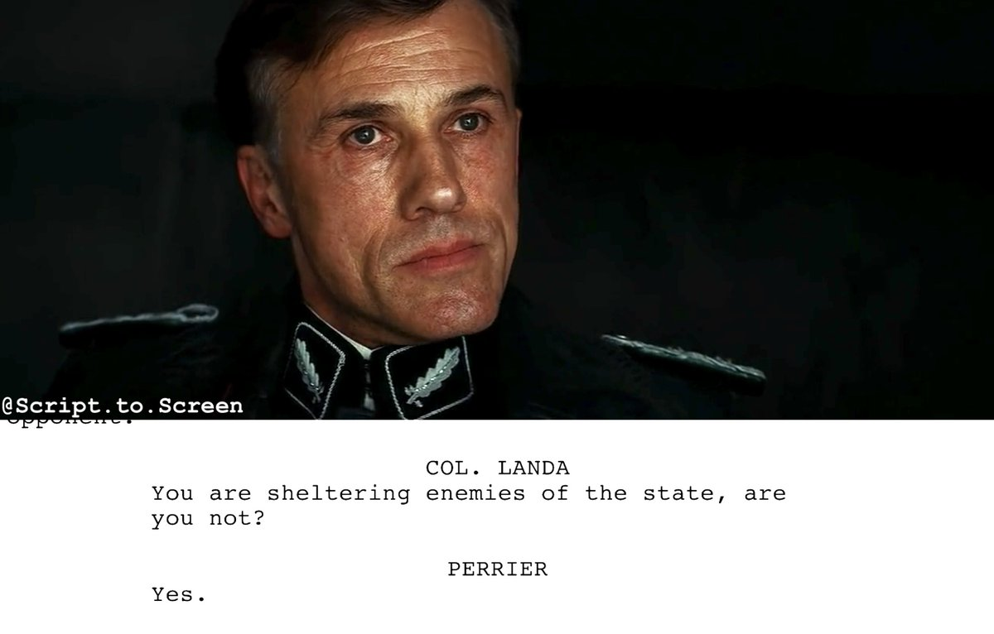
THE PRINCIPLE OF HUMANITY (?)
Error theorist
Kantian

Slide 32
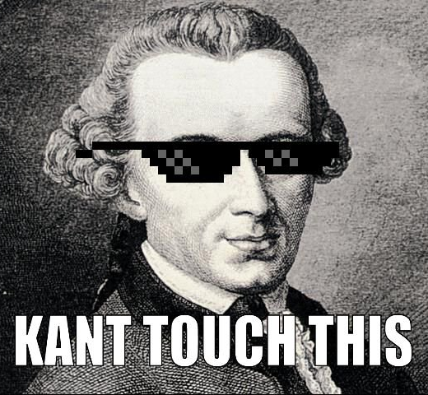
THE PRINCIPLE OF HUMANITY (?)
To be truthful in all declarations is … a sacred and unconditionally commanding law of reason which admits of no expediency whatever.
Error theorist
Kantian

Slide 33
ROSS’S MIDDLE WAY
Ross maintained that there are various prima facie duties (better: pro tanto reasons) that interact in various ways to generate duties proper.
These are considerations that count in favor of acting in certain ways—they make a contribution to the overall normative status of an action.
But these considerations can be outweighed by countervailing considerations such that the end result is a duty not to act on them.
W. D. Ross

Slide 34
ROSS’S MIDDLE WAY
Drinking is pleasurable
unjustified
is a reason to
drink another pint
is a reason not to
Having another drink is likely to give you a hangover
is a reason not to
Your outline is due tomorrow

Slide 35
ROSS’S MIDDLE WAY
Fidelity: keeping our promises, being faithful to our word.
Reparations: repairing harm that we have done.
Gratitude: appropriately acknowledging benefits that others have given us.
Justice: ensuring that virtue is rewarded and vice punished.
Beneficence: enhancing the intelligence, virtue, or pleasure of others.
Self-improvement: making oneself more intelligent or virtuous.
Nonmaleficence: preventing harm to others.
W. D. Ross
Notes:
Referenced from Schaffer-Landau, p. 233, The Fundamentals of Ethics.

Slide 36
ROSS’S MIDDLE WAY
nonmaleficence
Extreme harm will befall the child
duty proper
pro tanto duty to
save the drowning child
pro tanto duty not to
fidelity
You will break your promise to be on time for the wedding
pro tanto duty not to
fidelity
You will violate an agreement to return your suit in good condition

