Slide 1
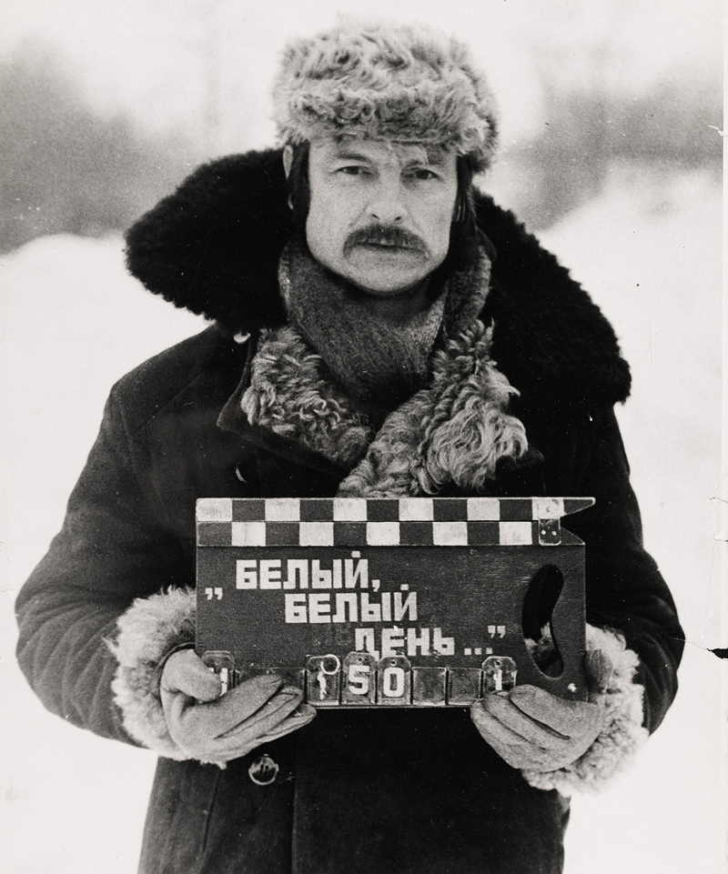
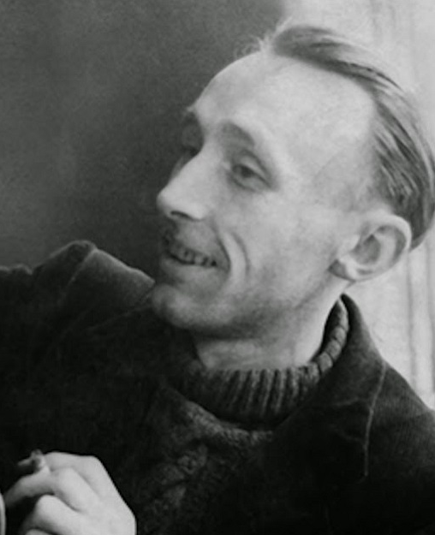
Classical film theory, representation, and realism: BAZIN AND TARKOVSKY
PHL 317K
Spring 2018
Notes:
Tarkovsky: https://www.youtube.com/watch?v=mqrpfjXiR8Q
Deep focus in Citizen Kane: https://www.youtube.com/watch?v=2LX27W51kB0
Haneke on the long-take: https://www.youtube.com/watch?v=EPtWbkzXGe4
Tarkovsky sequence shot: https://www.youtube.com/watch?v=3dA60D-j290

Slide 2
CLASSICAL FILM THEORY
Rudolf
Arnheim
1904 – 2007
Andrei
Tarkovsky
1932 – 1986
1898 – 1948
Sergei
Eisenstein
1918 – 1958
Andrei
Bazin
1936 – 2016
V. F. Perkins
Notes:
Make a point about the radical shift in view (from the Tarkovsky quote)

Slide 3
CLASSICAL FILM THEORY
“I still cannot forget that work of genius, shown in the last century, the film with which it all started—L'Arrivee d'un Train en Gare de La Ciotat. . . . The spectacle, which only lasts half a minute, shows a section of railway platform, bathed in sunlight, ladies and gentlemen walking about, and the train coming from the depths of the frame and heading straight for the camera. As the train approached panic started in the theatre: people jumped up and ran away. That was the moment when cinema was born; it was not simply a question of technique, or just a new way of reproducing the world. What came into being was a new aesthetic principle” (Tarkovsky 1989, 62).

Slide 4
CLASSICAL FILM THEORY
Three interrelated questions:
What is the primary role or value of film?
What are the determinant (or essential) characteristics of film that enable it to fulfill that role or value?
Which filmmaking techniques are instances of the determinant characteristics of film that best realize the value or role of film?

Slide 5
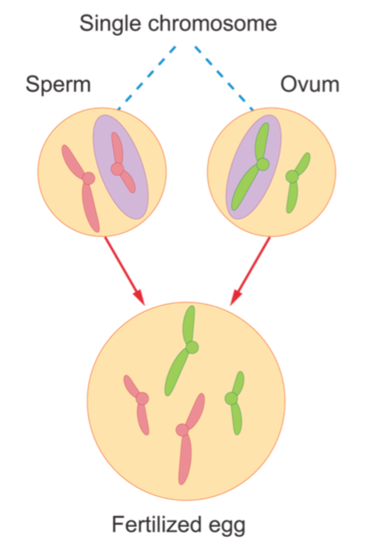
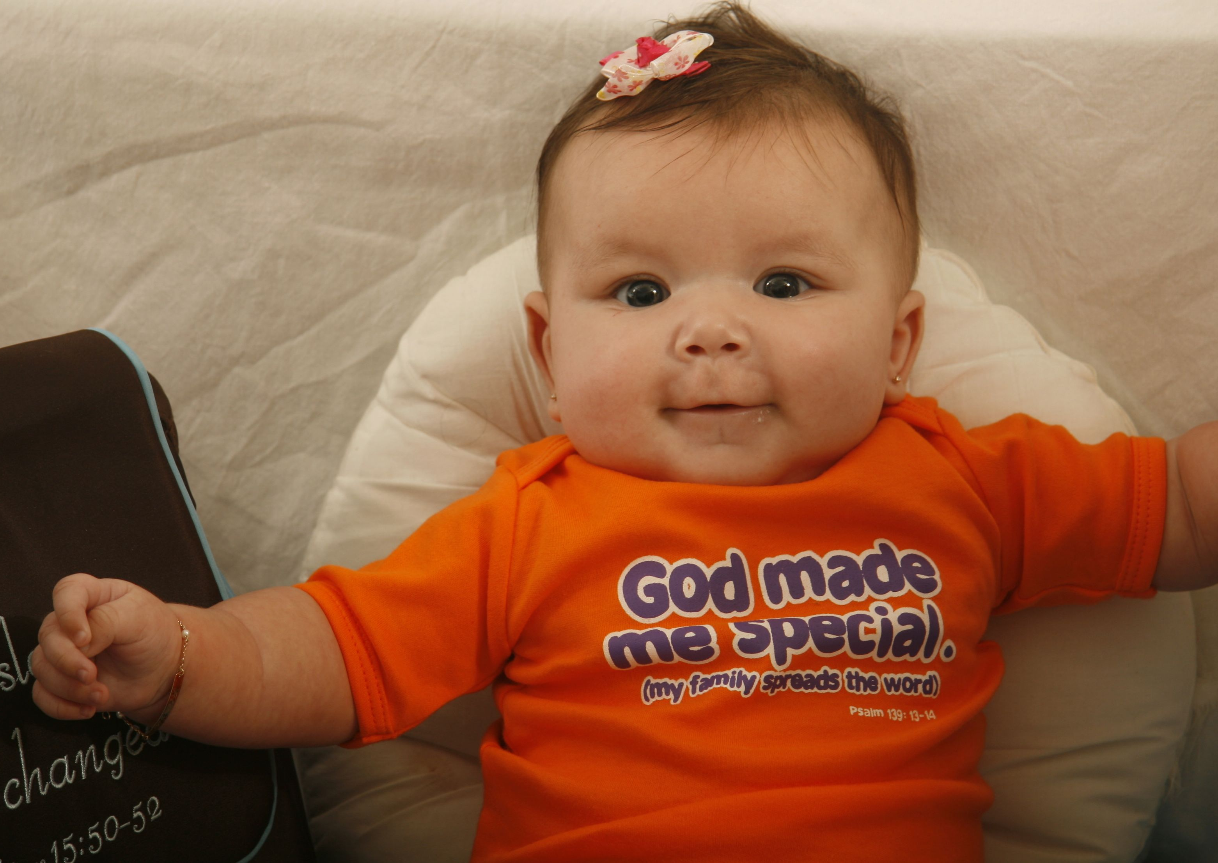
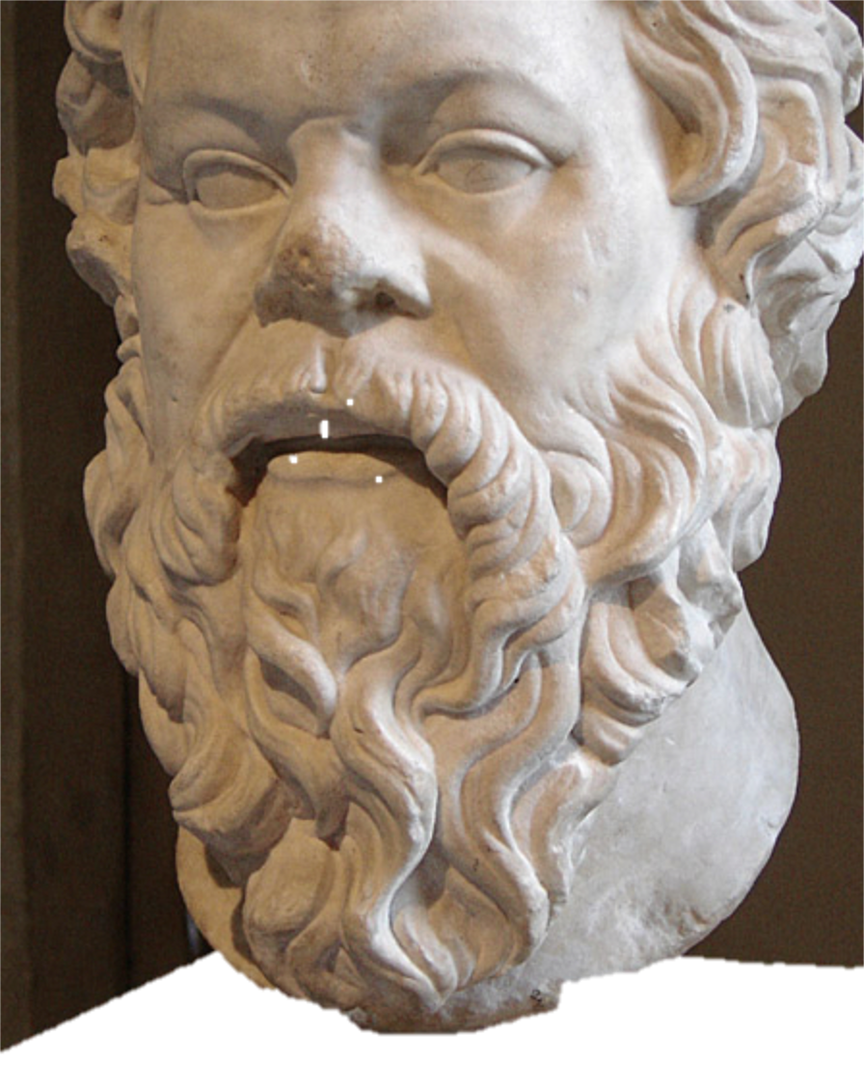
CLASSICAL FILM THEORY
OR
NaAlSi₂O₆
Ca₂(Mg, Fe)₅Si₈O₂₂(OH)₂

Slide 6
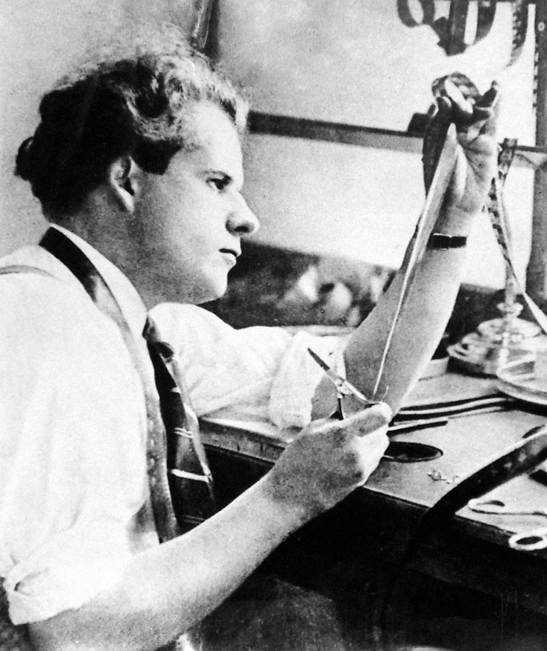
EISENSTEIN’S MONTAGE THEORY
An important role of both theater and cinema is to “guide the spectator in the desired direction (frame of mind)” (78).
The central means for achieving this role is that of an “attraction.”
Attractions can be juxtaposed through editing to create new meaning.
Notes:
“An attraction (in relation to the theatre) is any aggressive aspect of the theatre; that is, any element of the theatre that subjects the spectator to a sensual or psychological impact, experimentally regulated and mathematically calculated to produce in him certain emotional shocks which, when placed in their proper sequence within the totality of the production, become the only means that enable the spectator to perceive the ideological side of what is being demonstrated—the ultimate ideological conclusion” (78).

Slide 7
ARNHEIM’S THEORY
The primary role and value of film is to produce art.
The determinant (essential) characteristics of film that enable it to fulfill that role or value are the unique limitations of the medium that enable it to (a) diverge from duplicating the matter-of-fact experience of reality and (b) be expressive.
The techniques that are instances of those determinant characteristics include montage and framing.

Slide 8
BACKGROUND ON TARKOVSKY
Tarkovsky is widely considered to be one of the most important Russian filmmakers.
He is rare among filmmakers in that he wrote about his craft from a philosophical perspective.
He was subject to ideological censorship by the Soviet Union.
He died of cancer in exile—sadly, before he could witness the emergence of a more tolerant Soviet Union at the end of the 1980s.
He completed ten films before his death in 1986 (at the age of 54).
Notes:
Show retrospective clip

Slide 9
BACKGROUND ON TARKOVSKY
“Tarkovsky sought not to impose an interpretive scheme upon reality, but to imprint or record it together with all its contingency and potentiality; Tarkovsky was not an orator, but an observer and a listener” (Bird 2008, 9).

Slide 10
BACKGROUND ON BAZIN
He was neither an academic nor a philosopher.
He is regarded as one of the most important and influential figures in film theory.
He wrote “The Ontology of the Photographic Image” at the age of 26 and published more than 2,500 pieces throughout his career before dying of leukemia at the age of 40.
Cool guy – co-founded the famous film magazine, Cahiers du Cinéma, and exerted an influence on a number of filmmakers working within the French New Wave.

Slide 11
BACKGROUND ON BAZIN
“The formation of Bazin’s theory was closely related to the transition to sound, especially in terms of the gradual emergence of a certain realist tradition of sound films that defines itself against the aesthetics of the silent film—notably the tendencies toward montage and expressionism” (Carroll 1988, 100).
“[I]n the thirties a filmmaker like Renoir responded to the introduction of sound as an augmentation of film’s recording capacities, and he evolved a realist style that roughly correlated with the notion of film as recording. Bazin described and sought foundations for Renoir’s practice, and in doing so charted the predominating ethos of the sound film until the sixties” (100).

Slide 12
OVERVIEW OF BAZIN’S POSITION
Overview of Bazin’s position:
The primary role and value of film is to immortalize the past by capturing and preserving objects and events.
The determinant (essential) characteristic of film that enables it to fulfill that role or value is the mechanical recording aspect of the medium. This aspect enables the medium to re-present the objects and events that causally give rises to its images.
The essence of the medium in some sense implies a kind of realism together with certain filmmaking techniques that are somehow related to that realism.
Notes:
“The aesthetic qualities of photography are to be sought in its power to lay bare the realities” (8).

Slide 13
SPATIAL REALISM
A reliance on medium-long shots as opposed to close-ups
The use of deep-focus to include more information in the frame
The use of multiplanar compositions for dramatic purposes as opposed to situating action only in the foreground
The use of the long-take (or sequence shot) as opposed to a heavy reliance on editing to construct a given scene
The use of camera movement as opposed to editing to follow the action within a given scene
A nontheatrical, nonpainterly use of the frame that has a more fluid relation to what is off-screen
The exploitation of these and other techniques to approach a realistic representation of space that is “more like our ordinary experience of space than the constructed, artificially bounded, elliptical space found in [films that synthesize] scenes by means of editing and soft focus” (Carroll 1988, 106)
Notes:
Show Citizen Kane clip
Show Tarkovsky clip
Show Haneke clip

Slide 14
BAZIN’S MASTER ARGUMENT
Cinema is essentially representational (in some important sense).
The representational nature of cinema implies realism.
A commitment to realism implies a commitment to spatial realism.
Notes:
Not a logically valid argument
Transition: Bazin seemed to think that films ought to be made in this style and that it followed from the nature of the medium. However, some of his arguments were distinctively normative in character.

Slide 15
BAZIN’S NORMATIVE ARGUMENTS
All else being equal, you shouldn't use this baby just to pick the kids up from school.
Notes:
Hennessey Venom GT

Slide 16
BAZIN’S NORMATIVE ARGUMENTS
“[Spatial realism] implies . . . both a more active mental attitude on the part of the spectator and a more positive contribution on his part to the action in progress. While analytical montage only calls for him to follow his guide, to let his attention follow along smoothly with that of the director who will choose what he should see, here he is called upon to exercise at least a minimum of personal choice. It is from his attention and his will that the meaning of the image in part derives” (Bazin 1967, 35–6; emphasis added).

