Slide 1
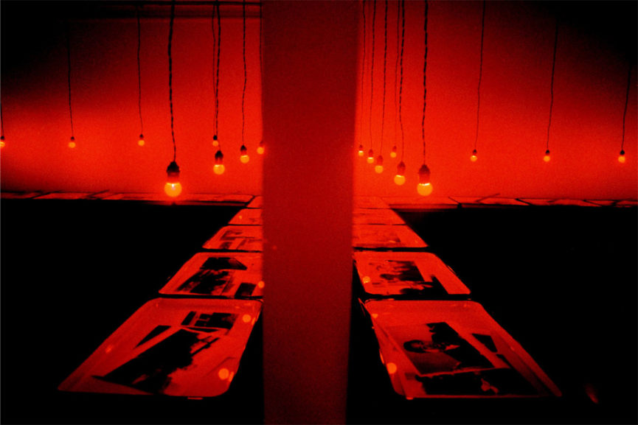
The ontology of the photographic image

Slide 2
ONTOLOGICAL RESTLESSNESS
“A photograph does not present us with ‘likenesses’ of things; it presents us, we want to say, with the things themselves. But wanting to say that may well make us ontologically restless. ‘Photographs present us with things themselves’ sounds, and ought to sound, paradoxical. . . . It is no less paradoxical or false to hold up a photograph of Garbo and say, ‘That is not Garbo,’ if all you mean is that the object you are holding up is not a human creature. Such troubles in notating so obvious a fact suggest that we do not know what a photograph is; we do not know how to place it ontologically. We might say that we don’t know how to think of the connection between a photograph and what it is a photograph of” (Cavell 1979, 16–17)

Slide 3
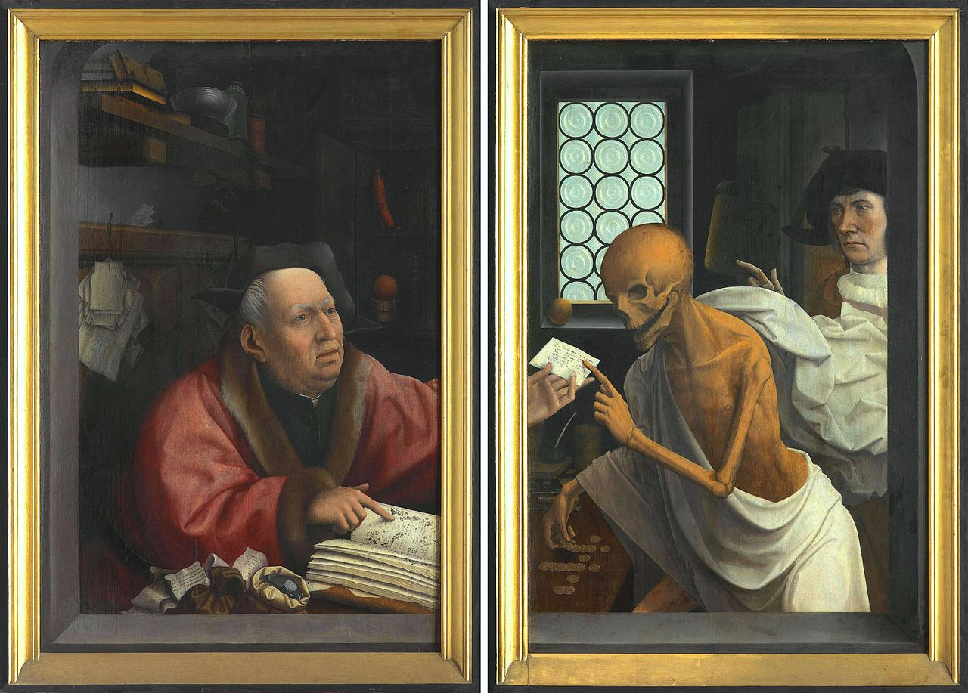
THE MUMMY COMPLEX
“[D]eath is but the victory of time” (Bazin 1960, 4).

Slide 4
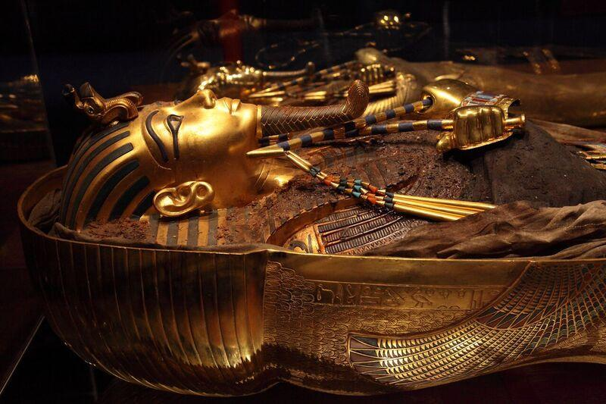
THE MUMMY COMPLEX
“Thus, by providing a defense against the passage of time it satisfied a basic psychological need in man, for death is but the victory of time. To preserve, artificially, his bodily appearance is to snatch it from the flow of time, to stow it away neatly, so to speak, in the hold of life. . . . The first Egyptian statue, then, was a mummy, tanned and petrified in sodium” (4–5).
Notes:
“Art emerges when this ambition moves away from preserving the actual body in favor of creating a representation of the dead person” (Morgan 2006, 446)
Transition: that might explain why very powerful people are content to ‘live on’ in pictorial representations, rather than to literally mummify themselves.

Slide 5
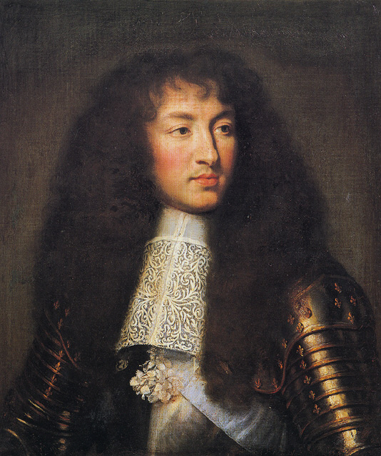
THE MUMMY COMPLEX
Louis XIV

Slide 6
THE MUMMY COMPLEX
The visual (representational) arts were born out of this mummy complex, but they evolved to express “spiritual realities” through “the creation of an ideal world in the likeness of the real” (6).
The best visual artists balanced the symbolic with realism.

Slide 7
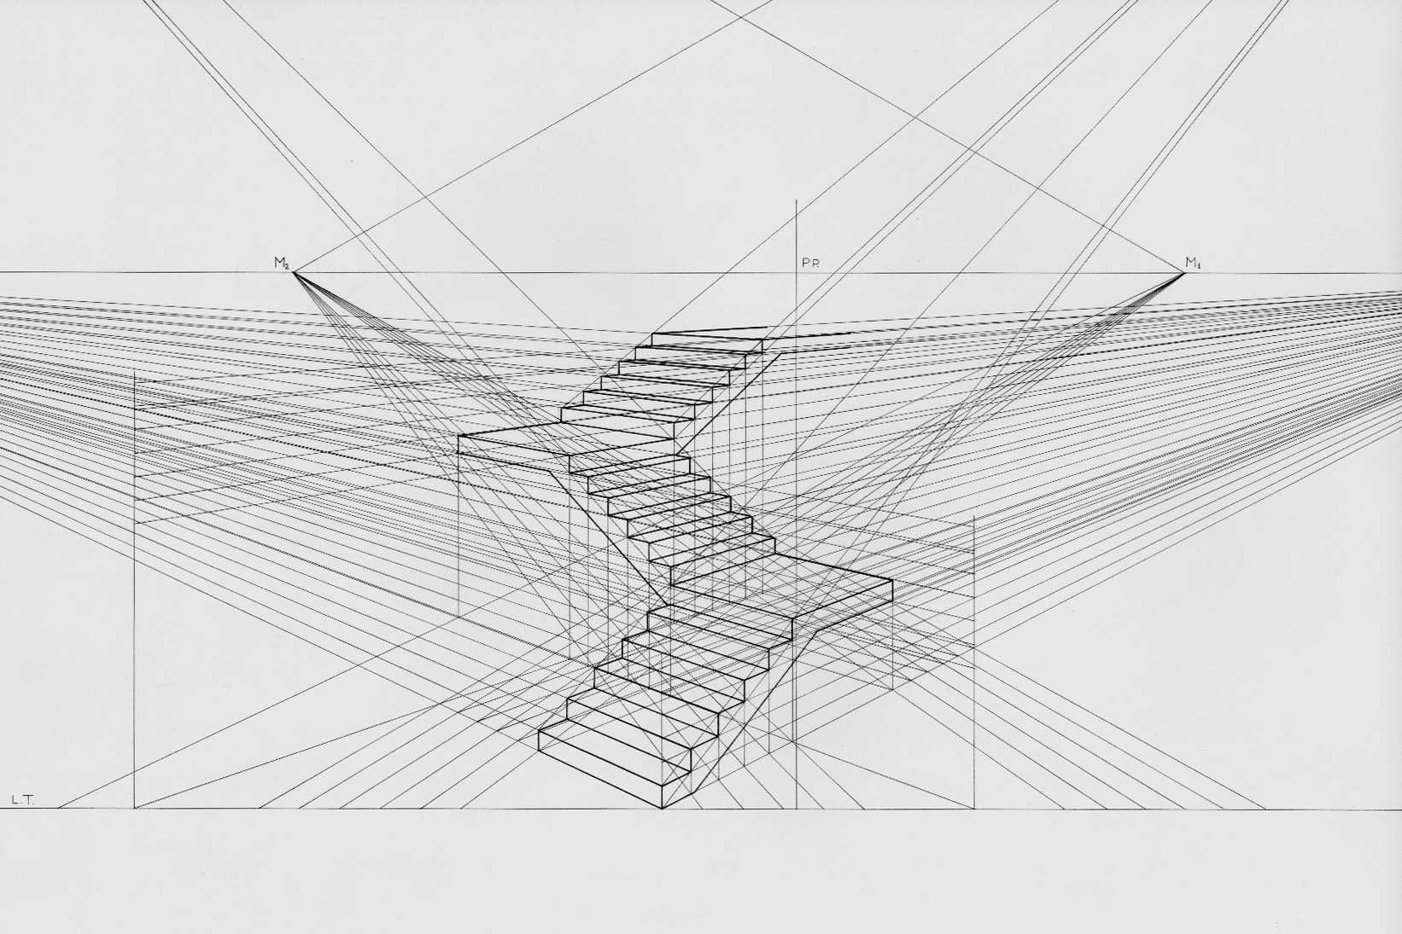
THE MUMMY COMPLEX
The discovery of perspective brought these two functions of art (symbolism and realism) into conflict.
The visual arts became consumed with producing “as complete an imitation as possible of the outside world” (6).
The visual arts were still incapable of giving expression to the “moment” (6).
These arts also relied upon illusion and deception to satisfy a need for realism.
Notes:
“Perspective . . . in the graphic arts is an approximate representation, generally on a flat surface (such as paper), of an image as it is seen by the eye. The two most characteristic features of perspective are that objects are smaller as their distance from the observer increases; and that they are subject to foreshortening, meaning that an object's dimensions along the line of sight are shorter than its dimensions across the line of sight” – https://en.wikipedia.org/wiki/Perspective_(graphical)
It was easy to treat this as a failing of the medium.
However, photography came to fulfill the psychological need so that the other visual arts didn’t have to.

Slide 8
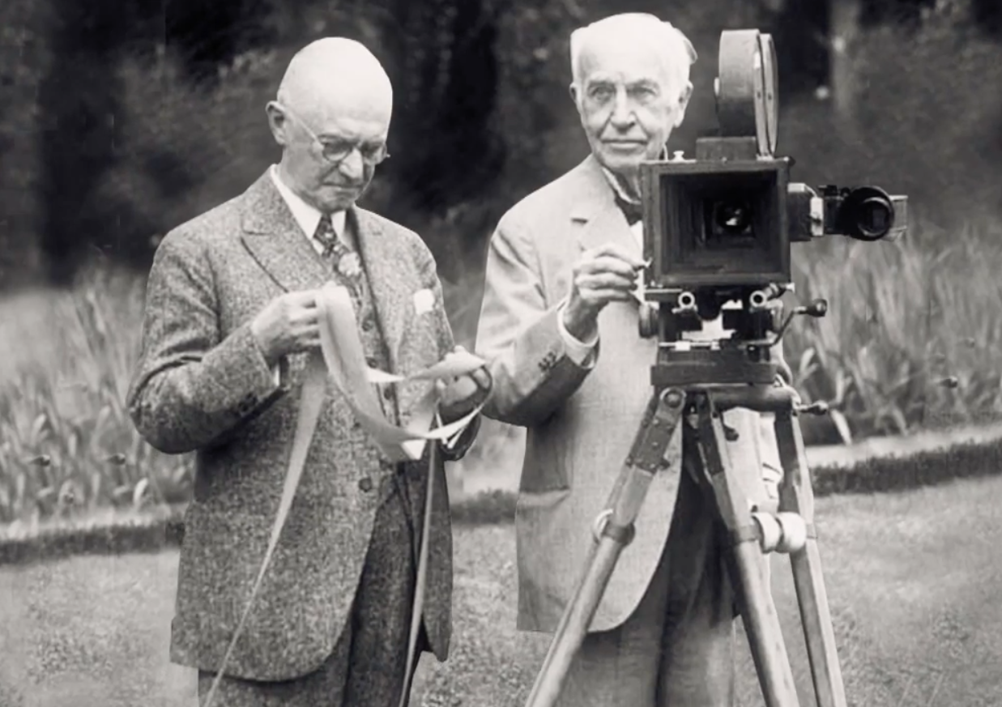
THE MUMMY COMPLEX
Photography freed the visual arts from “their obsession with likeness” (7).
“Photography and the cinema . . . are discoveries that satisfy, once and for all and in its very essence, our obsession with realism” (7).

Slide 9
THE PHOTOGRAPHIC IMAGE
Painting cannot escape the “subjectivity” of the artist, which is why painting does not have existential import: “The fact that a human hand intervened cast a shadow of doubt over the image” (7).
The fact that photography and cinematography proceed via an automatic, mechanical process has a radical impact on our psychology.
“In spite of any objections our critical spirit may offer, we are forced to accept as real the existence of the object reproduced, actually re-presented, set before us, that is to say, in time and space. Photography enjoys a certain advantage in virtue of this transference of reality from the thing to its reproduction” (8; emphasis added).
What the hell does that mean?!
Notes:
Transition: we have no choice but to look at his other quotations and see if we can put it together.

Slide 10
THE PHOTOGRAPHIC IMAGE
“Only a photographic lens can give us the kind of image of the object that is capable of satisfying the deep need man has to substitute for it something more than a mere approximation, a kind of decal or transfer. The photographic image is the object itself, the object freed from the conditions of time and space that govern it. No matter how fuzzy, distorted, or discolored, no matter how lacking, in documentary value the image may be, it shares, by virtue of the very process of its becoming, the being of the model of which it is the reproduction; it is the model” (8; emphasis added).

Slide 11
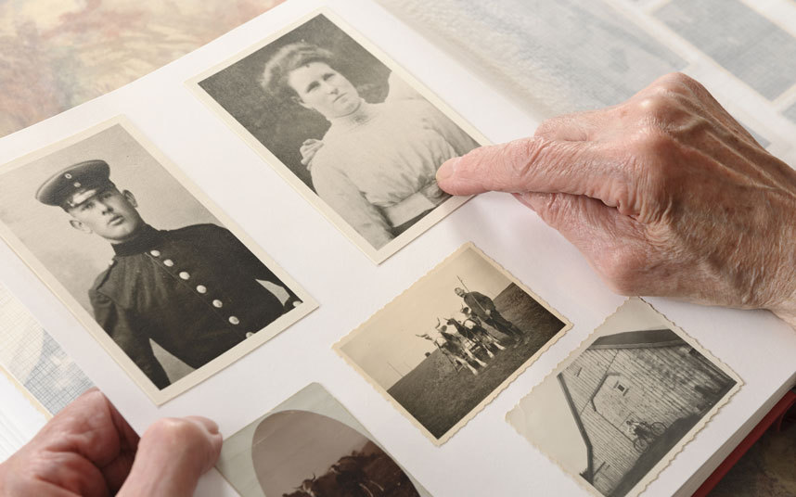
THE PHOTOGRAPHIC IMAGE
“Hence the charm of family albums. Those grey or sepia shadows, phantomlike and almost undecipherable, are no longer traditional family portraits but rather the disturbing presence of lives halted at a set moment in their duration, freed from their destiny; not, however, by the prestige of art but by the power of an impassive mechanical process: for photography does not create eternity, as art does, it embalms time, rescuing it simply from its proper corruption” (8).

Slide 12
THE PHOTOGRAPHIC IMAGE
“But photography is something else again. In no sense is it the image of an object or person, more correctly it is its tracing. Its automatic genesis distinguishes it radically from the other techniques of reproduction. The photograph proceeds by means of the lens to the taking of a veritable luminous impression in light—to a mold. As such it carries with it more than mere resemblance, namely a kind of identity” (Bazin 1967, 96; emphasis added).

Slide 13
THE PHOTOGRAPHIC IMAGE
“The photograph as such and the object in itself share a common being, after the fashion of a fingerprint. Wherefore, photography actually contributes something to the order of natural creation instead of providing a substitute for it” (Bazin 1960, 8; emphasis added).
Notes:
Transition: what about cinema?

Slide 14
SUMMARY
Photography and film function to satisfy our psychological need to overcome death by immortalizing the past and capturing time.
Photographs and films have a radical impact on our attitudes and have existential import (“we are forced to accept as real the existence of the object reproduced”).
There is an important connection between light and the film stock (photographs involve “a veritable luminous impression in light—to a mold”).
Photographs are somehow analogous to fingerprints and do not simply provide a substitute for reality.
It at least seems that there is an important connection—some kind of “identity” relation—between a photographic or cinematic image and its model (the “photographic image is the object itself”).

Slide 15
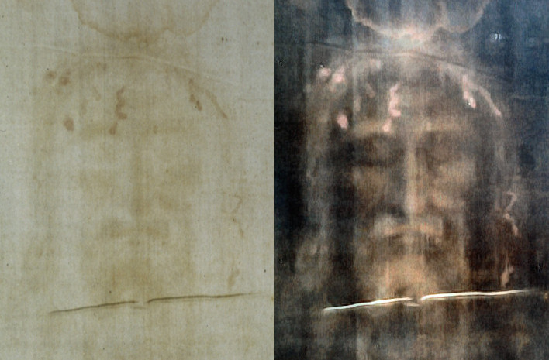
MASS-PRODUCED RELICS
Shroud of Turin

Slide 16
MASS-PRODUCED RELICS
“[T]he shroud became particularly famous when Secundo Pia was given permission to remove protective glass in front of it and expose it to his camera. Around midnight on 20 May 1898, he stood by for twenty minutes during which low light reflected from the shroud made contact through a lens with a sensitive emulsion that, in a state of excited anticipation, he promptly developed: the negative seemed to show the visage of Christ (Mondzain 2005)! Every photograph that was later made (and millions were sold at churches and shrines) could now claim to be a relic because, in an ‘ontological’ sense, each shared an actual connection to the original body of Christ, so long as all intermediaries had been produced ‘automatically’. . . . A photo could be venerated since it had been in touch with what it purports to show, light having passed directly from shroud (‘model’) to emulsion (‘image’)” (Andrew 2014, 334).
Notes:
“Even after the shroud was determined to be false – scientific tests suggest that it dates from the thirteenth century – these photographs are not in themselves fakes. The sceptical scientist still believes something: that the photo in Bazin’s book is ‘of’ a thirteenth-century piece of cloth, and not of something else” (334).

Slide 17
THE CINEMATIC IMAGE
“The film is no longer content to preserve the object, enshrouded as it were in an instant, as the bodies of insects are preserved intact, out of the distant past, in amber. The film delivers baroque art from its convulsive catalepsy. Now, for the first time, the image of things is likewise the image of their duration, change mummified as it were” (Bazin 1960, 8; emphasis added).
“The cinema does something strangely paradoxical. It makes a molding of the object as it exists in time and, furthermore, makes an imprint of the duration of the object” (Bazin 1967, 96–7; emphasis added).
“For the first time in the history of the arts, in the history of culture, man found the means to take an impression of time. And simultaneously the possibility of reproducing that time on screen as often as he wanted, to repeat it and go back to it. He acquired a matrix for actual time. Once seen and recorded, time could now be preserved in metal boxes over a long period (theoretically for ever). . . . What is the essence of the director’s work? We could define it as sculpting in time” (Tarkovsky 1989, 62–3).

Slide 18
BAZIN’S MASTER ARGUMENT (AGAIN)
The film medium, given the nature of its mechanical processes, is essentially representational (in some important sense).
This type of representation somehow implies realism.
A commitment to realism somehow implies a commitment to spatial realism.
Notes:
Not a logically valid argument
Transition: Bazin seemed to think that films ought to be made in this style and that it followed from the nature of the medium. However, some of his arguments were distinctively normative in character.

Slide 19
PHENOMENOLOGICAL INTERPRETATION
Photography and film are able to satisfy our psychological need to preserve the past and capture time because they affect our attitudes in such a way that we believe or are under the illusion that each photographic/filmic image and its corresponding model is identical.
That is how photographs and films present themselves to our experiences.
Whether or not our experiences are accurate is irrelevant.

Slide 20
INTENTIOANLTIY INTERPRETATION
Just as the meaning of a name is its referent, or the object of a thought is that which the thought is about, so also the object in an image is that which gave rise to it.
We shouldn’t think of “in” here as expressing a physical relation of containment.

Slide 21
INTENTIONALITY INTERPRETATION
Florence Owens Thompson
Louis XIV
Notes:
“Those who see a sharp contrast between photographs and paintings clearly think that it obtains no less when paintings depict real things than when they do not, and even when viewers fully realize that they do” (251).

Slide 22
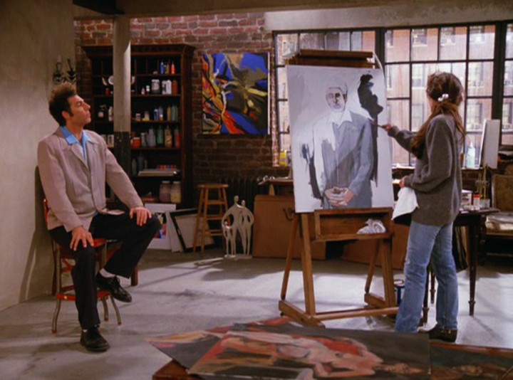
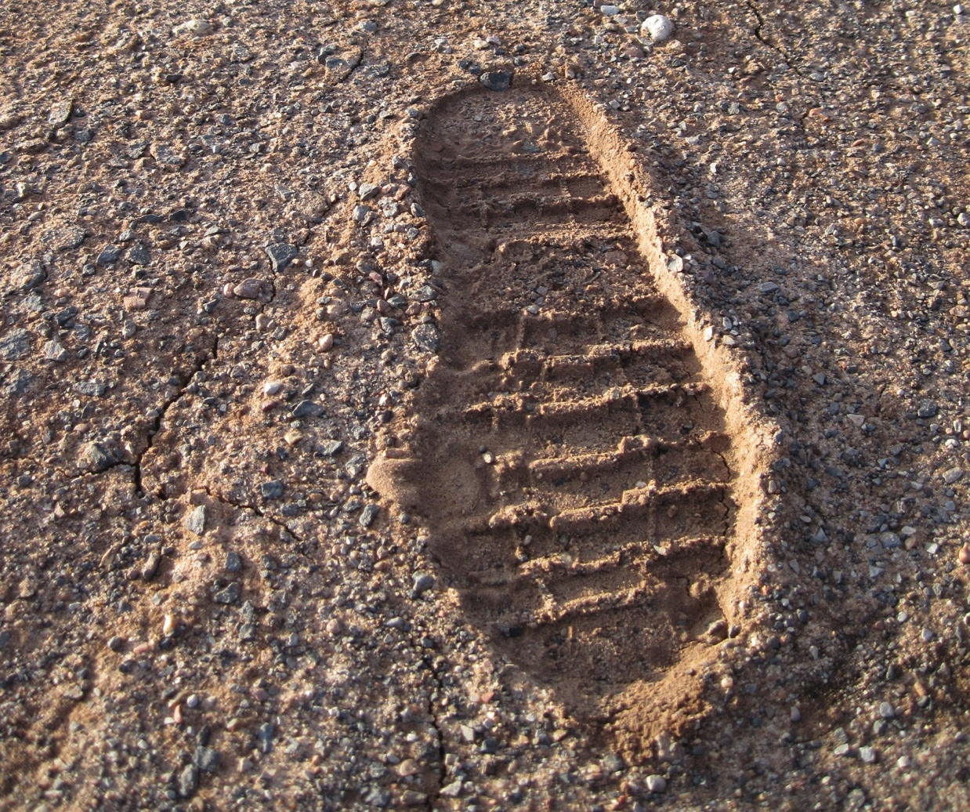
SEMIOTIC INTERPRETATION
Symbolic signs represent as a matter of convention.
Iconic signs represent as a matter of resemblance.
Indexical signs represent as a result of a direct, causal, and existential relationship between sign and object.
“DOG”
Notes:
Semiotics – the study of signs and symbols and their use or interpretation.

Slide 23
SEMIOETIC INTERPRETATION
Photographs and films are indexical signs that point back in time to the models that gave rise to them.
If they also represent iconically, that is a result of their representing indexically.
Notes:
Fits with the metaphors of “tracing” and the analogy to a fingerprint.
“The photograph as such and the object in itself share a common being, after the fashion of a fingerprint. Wherefore, photography actually contributes something to the order of natural creation instead of providing a substitute for it” (Bazin 1960, 8).
What do photographs contribute on this view?
“transference of reality from the thing to its reproduction”
What is this transference of reality?
“every image is to be seen as an object and every object as an image” (15–6).
This suggests that the tie is closer
“No one argues that a footprint is a foot or that the barometer is the air pressure, despite the fact that there is a direct, nonsubjective causal relation between them. However we want to describe what it is that Bazin is arguing, and whatever we think of it as an argument, it is clear that we cannot account for his description of the photograph along the model of an indexical sign” (Morgan 2006, 450).

Slide 24
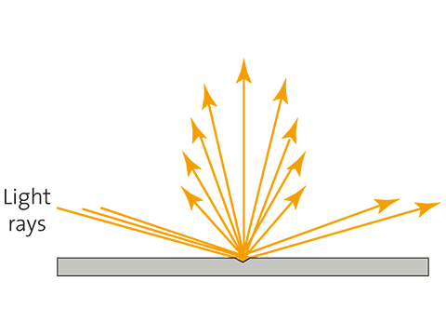
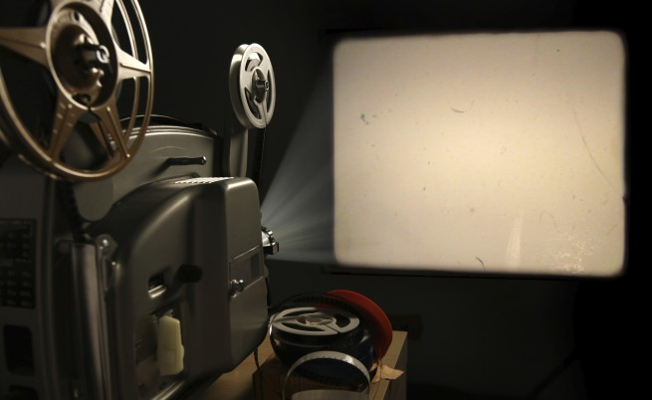
IDENTITY OF LIGHT INTERPRETATION
“The photograph proceeds by means of the lens to the taking of a veritable luminous impression in light—to a mold. As such it carries with it more than mere resemblance, namely a kind of identity” (Bazin 1967, 96).
This identity holds with respect to patterns of light.
For any photographic or cinematic image x and its model y, x represents y if and only if (i) the patterns of light emitted from x are identical to pertinent patterns of light emitted from y and (ii) y is a causal factor in the production of x.
Notes:
“The film image re-presents or presents again a manifold of light patterns to perception” (Carroll 1988, 127).
“Barring identical patterns of light, the only plausible reading of Bazinian re-presentation seems to be that the process of projection re-presents the exact impression or imprint of light that was reflected by objects and people in the past. This is probably true enough, but it makes out-of-focus shots, shots with vaseline on the lens, in fact, every kind of shot, no matter how distorted, representational” (135).

Slide 25
IDENTITY OF LIGHT INTERPRETATION
Is identity of patterns of light (plus causal production) sufficient for re-presentation?
POLL: What would you need to do to give a counterexample to the sufficiency claim?
Point to a case in which the condition is met (the patterns of light are identical, etc.), but in which it is highly implausible that the model is re-presented.
Point to a case in which it is highly plausible that the model is re-presented, but in which the condition isn’t met.
Both (A) and (B).
Notes:
“The Ames experiments have shown that we can, for example, build all sorts of distorted rooms that, among other things, will deliver to a pre-arranged monocular viewing point or camera position the same retinal image and the same patterns of light as a normal room” (133).
Not sufficient – three different shots that emit the same light patterns; superimpose them in printing; they are all involved in the causal production of the new image; but it is impossible to say which of them it re-presents. Identity and causal efficacy are not sufficient.
Not sufficient – different lenses, same subject.
“That is, to define re-presentation in terms of an imprint of light from the past defines every shot whether it is of the variety we normally call representational or not. The consequence of this explication of re-presentation is that any image that results is a representation. In fact, in this sense, representation becomes trivialized; it is any shot in any style. An out-of-focus Brakhage close-up whose model even Brakhage can no longer remember or identify is still a projected imprint, and, therefore, still a Bazinian representation. Obviously, this is not a strong starting point from which to launch an attack on German expressivism” (135).

Slide 26
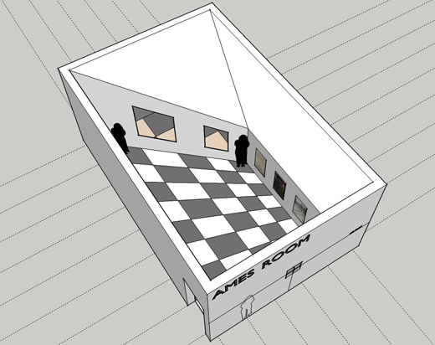
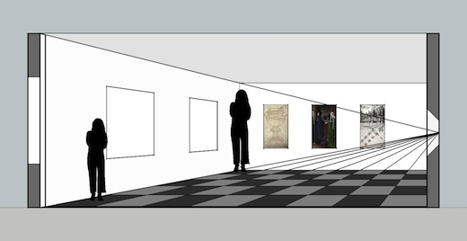
IDENTITY OF LIGHT INTERPRETATION
Is identity of patterns of light (plus causal production) sufficient for re-presentation?
Notes:
“The Ames experiments have shown that we can, for example, build all sorts of distorted rooms that, among other things, will deliver to a pre-arranged monocular viewing point or camera position the same retinal image and the same patterns of light as a normal room” (133).
Not sufficient – three different shots that emit the same light patterns; superimpose them in printing; they are all involved in the causal production of the new image; but it is impossible to say which of them it re-presents. Identity and causal efficacy are not sufficient.
Not sufficient – different lenses, same subject.
“That is, to define re-presentation in terms of an imprint of light from the past defines every shot whether it is of the variety we normally call representational or not. The consequence of this explication of re-presentation is that any image that results is a representation. In fact, in this sense, representation becomes trivialized; it is any shot in any style. An out-of-focus Brakhage close-up whose model even Brakhage can no longer remember or identify is still a projected imprint, and, therefore, still a Bazinian representation. Obviously, this is not a strong starting point from which to launch an attack on German expressivism” (135).

Slide 27
IDENTITY OF LIGHT INTERPRETATION
Is identity of patterns of light (plus causal production) necessary for re-presentation?
Notes:
“The Ames experiments have shown that we can, for example, build all sorts of distorted rooms that, among other things, will deliver to a pre-arranged monocular viewing point or camera position the same retinal image and the same patterns of light as a normal room” (133).
Not sufficient – three different shots that emit the same light patterns; superimpose them in printing; they are all involved in the causal production of the new image; but it is impossible to say which of them it re-presents. Identity and causal efficacy are not sufficient.
Not sufficient – different lenses, same subject.
“That is, to define re-presentation in terms of an imprint of light from the past defines every shot whether it is of the variety we normally call representational or not. The consequence of this explication of re-presentation is that any image that results is a representation. In fact, in this sense, representation becomes trivialized; it is any shot in any style. An out-of-focus Brakhage close-up whose model even Brakhage can no longer remember or identify is still a projected imprint, and, therefore, still a Bazinian representation. Obviously, this is not a strong starting point from which to launch an attack on German expressivism” (135).

Slide 28
WTF INTERPRETATION
“Bazin seems to say that our desire to speak of the content of a photograph as if we were present to it—‘She’s in front of the building,’ ‘He’s wearing red shirt,’ ‘See?’—registers not a temptation but an ontological fact. There are several ways to describe such a claim. It could mean that a car in a photograph is the same car as the car the photograph is of. Or that they are instances of the same kind of thing, namely, cars. Or is it that the car in the photograph is real in the same way that the car in the world is real?
It’s not clear that any of these formulations, or similar ones we could construct to make sense of Bazin’s claim, are coherent” (Morgan 2006, 451).

Slide 29
PROBLEMS
Why think that photography re-presents anything?
What about fiction?
How do we get from realism to spatial realism?
There is a medium–specificity assumption operative even with respect to Bazin’s mummy complex hypothesis.
Notes:
“A representation, rather, presents a stand-in or a proxy of a model; it does not re-represent either the model or the sight of the model. . . . For we may say instead that what photography does is to produce a stand-in for its model (at least in cases of what in the next section will be called physical portrayal; what is stood for is more complex). Therefore, the image does not literally re-present anything whatsoever” (146).
There isn’t always existential import.
“The first reading is that realism follows from representation automatically—that the nature of the medium makes every shot realistic. This is not the case; consider out-of-focus shots. Furthermore, if re-presentation defines cinema then obviously it is the case that a German expressionist film like The Cabinet of Dr. Calagiri re-presents its distorted sets. Here Bazin’s theory teeters on the border of self-contradiction again” (138).
With respect to the medium–specificity assumption, it might explain home movies, but what about fiction films?

