Slide 1
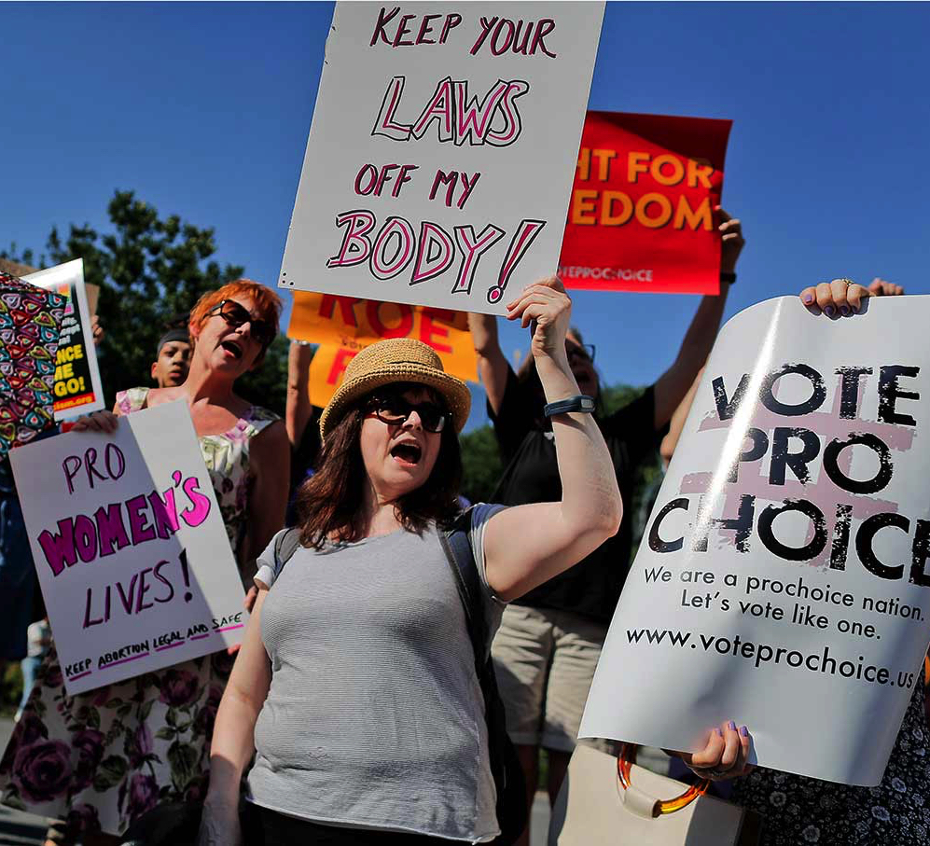
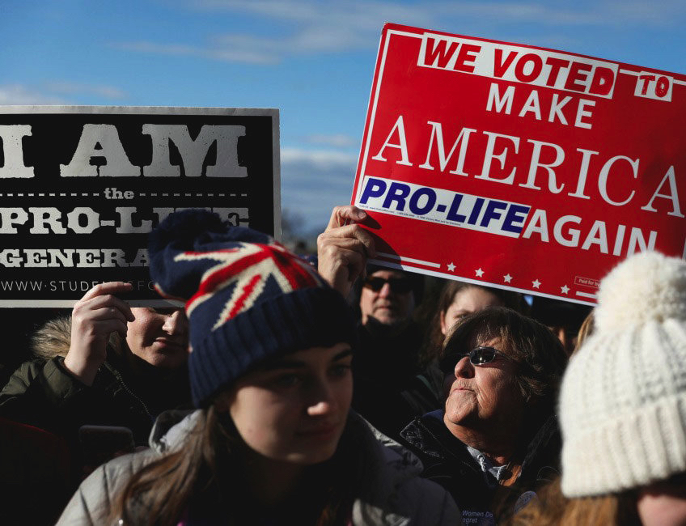
The ethics of abortion
PHL 304
Fall 2018
Notes:
Parts Unknown, Libya episode, 33:02

Slide 2
CLARIFYING THE DEBATE
SOCRATES: And then, as offspring are born, won’t they be taken by the officials appointed for this purpose, whether these are men or women or both—for surely our offices are also open to both women and men.
GLAUCON: Yes.
SOCRATES: And I suppose they will take the offspring of good parents to the rearing pen and hand them over to special nurses who live in a separate part of the city. But those of inferior parents, or any deformed offspring of the others, they will hide in a secret and unknown place, as is fitting.[2]
[2] Infanticide by exposure was commonly used in ancient Greece as a method of birth control.
Plato

Slide 3
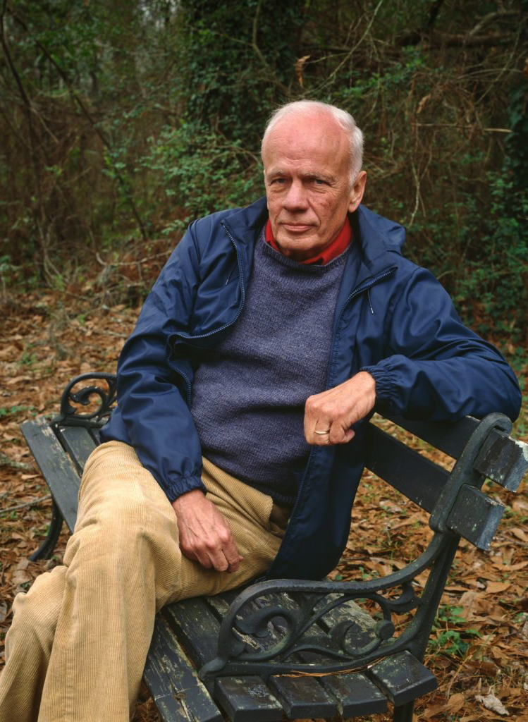
CLARIFYING THE DEBATE
“The current con . . . is that since there is no agreement about the beginning of human life, it is therefore a private religious or philosophical decision. . . . [I] submit that religion, philosophy, and private opinion have nothing to do with this issue. I further submit that it is a commonplace of modern biology, known to every high-school student and no doubt to you the reader as well, that the life of every individual organism, human or not, begins when the chromosomes of the sperm fuse with the chromosomes of the ovum to form a new DNA complex that thenceforth directs the ontogenesis of the organism” (341)
Walker Percy
Notes:
“But from the fact that something living and human begins to exist around the time of conception it does not follow that you or I began to exist at conception” (4)
“The answer to the question ‘When did I begin to exist?’ somehow seems to depend upon the answer to the question ‘What am I?’” (77)
Bronze/statue example
“There are no empirical tests that could settle this issue, which is a matter of metaphysics rather than science” (4)

Slide 4
CLARIFYING THE DEBATE
Percy is making a number of big assumptions. What are some of those assumptions?

Slide 5
PRUSS’S MASTER ARGUMENT
If you were once a fetus, and it is wrong to kill you now, then it was wrong to kill you when you were a fetus.
If it was wrong to kill you when you were a fetus, and there is no moral difference between the fetus you once were and any other ordinary human fetus, then abortion is wrong in the same circumstances in which it is wrong to kill an adult.
You were once a fetus.
It is wrong to kill you now.
There is no moral difference between the fetus you once were and any other ordinary human fetus.
So: abortion is wrong in the same circumstances in which it is wrong to kill an adult.

Slide 6
WERE YOU ONCE A FETUS?

Slide 7
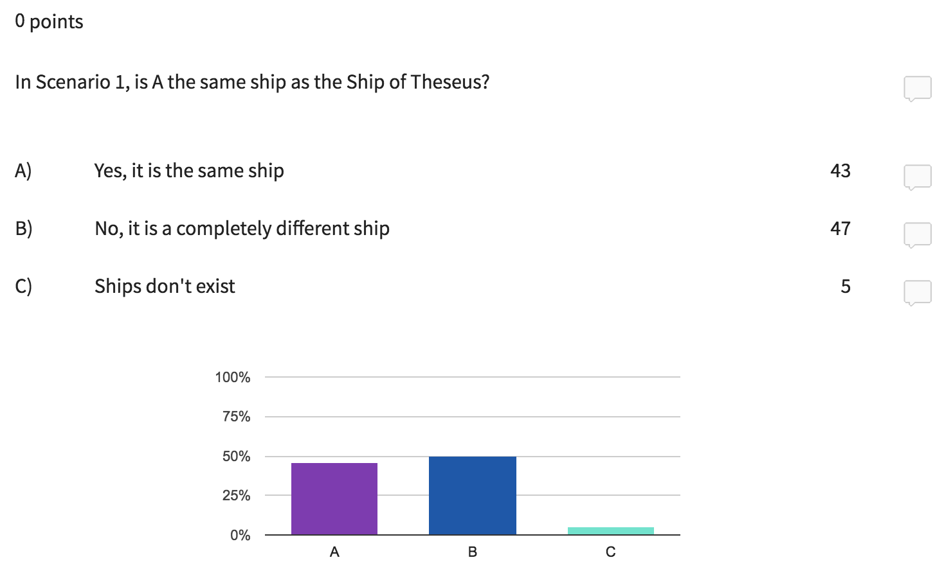

Slide 8
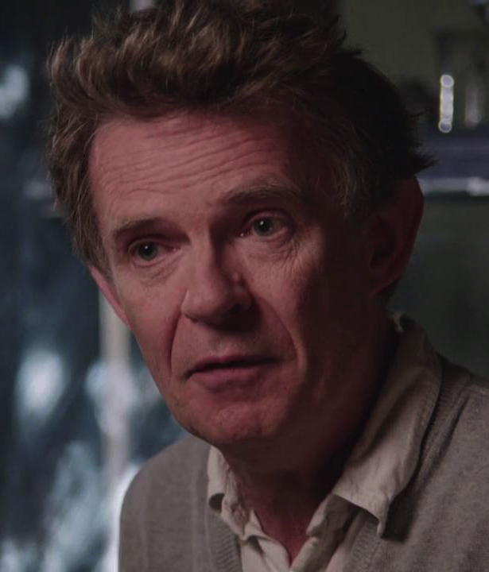
WERE YOU ONCE A FETUS?
“One’s blood is circulating, one’s digestive system is on active service, one is shifting and breathing, one’s electrochemistry is indefatigably at work, one’s cells are leading dramatic lives, every atom in one’s body is a strictly temporary resident—about 1,000,000,000,000,000 of them are replaced every second—and each of them is in internal uproar” (279)
Galen Strawson

Slide 9
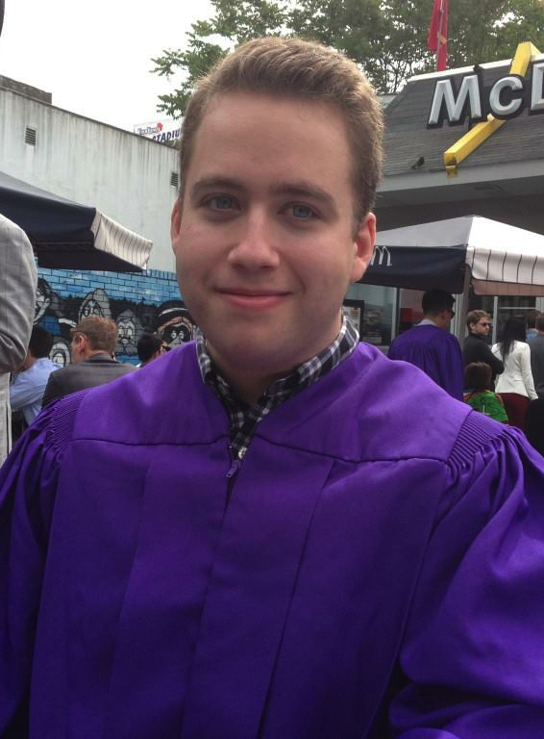
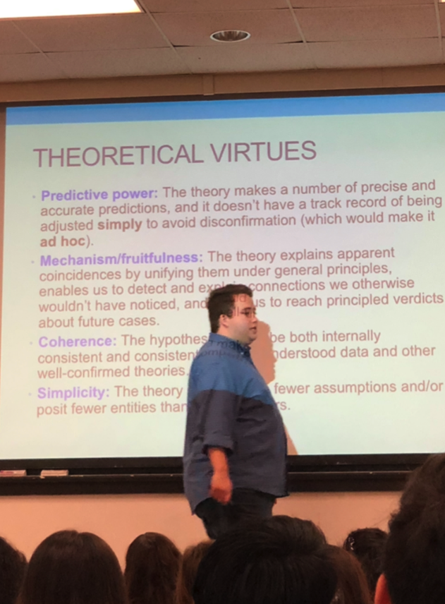
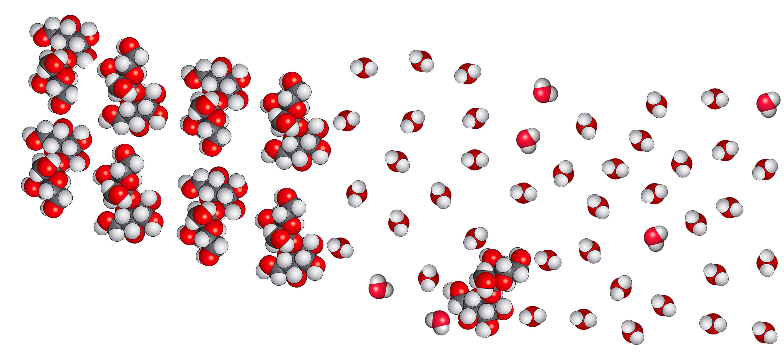
WERE YOU ONCE A FETUS?
“Zach Blaesi”
2013
“Instructor Blaesi”
2018
Zach Blaesi = Instructor Blaesi (?)

Slide 10
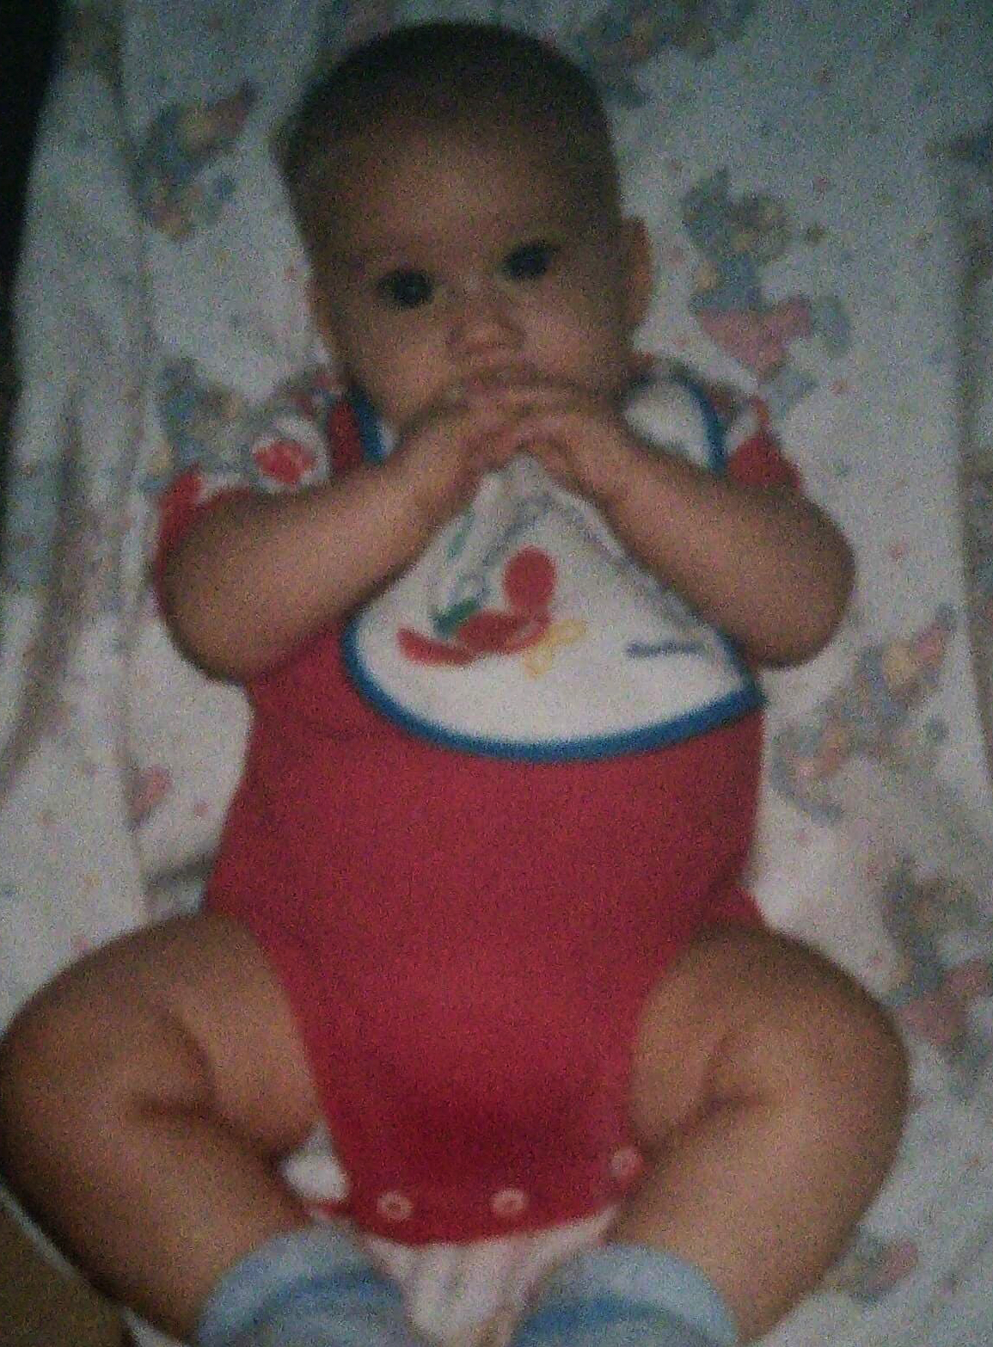
WERE YOU ONCE A FETUS?
“Junior”
(too long ago)
“Zach Blaesi”
2013
“Instructor Blaesi”
2018
Junior = Instructor Blaesi (?)

Slide 11
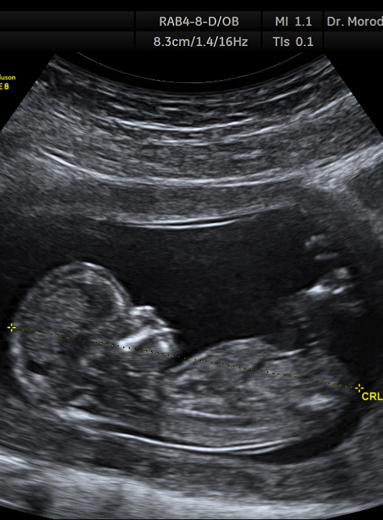
WERE YOU ONCE A FETUS?
“Zachary”
(wow, “I’m” old)
“Junior”
(too long ago)
“Zach Blaesi”
2013
“Instructor Blaesi”
2018
Zachary = Instructor Blaesi (?)

Slide 12
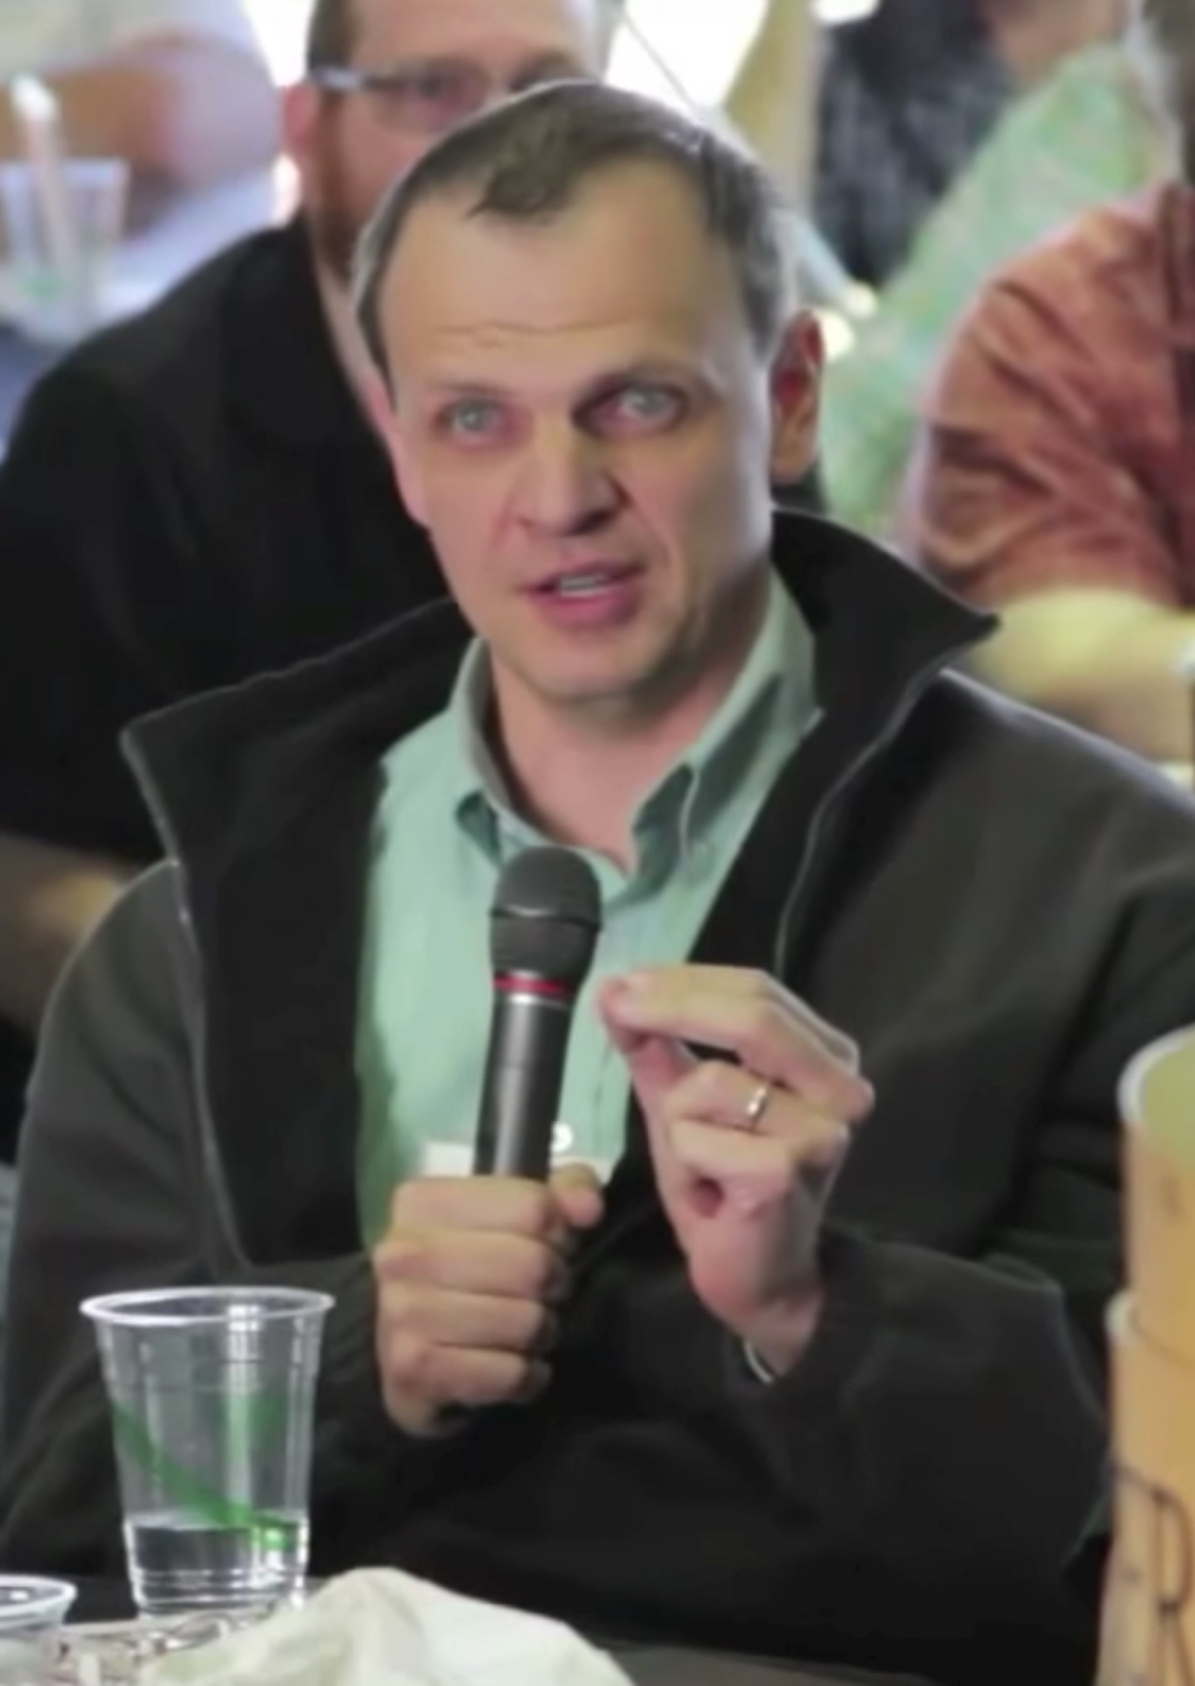
YOU WERE ONCE A FETUS (?)
Linguistic evidence
“I was pregnant with you when I was in my 20s”
Face value: Pregnant-with(Mom, me)
Alexander Pruss
Notes:
“The early human organism’s ability to twin—to split into two organisms—is no challenge to the claim that we have a single individual here. We do not deny that an amoeba is an individual organism on the grounds that in the future it will split in two” (20)
“But if this is not accepted, then we’ll just have to start the argument a little later, after implantation (losing the free-floating part of the argument in the previous paragraph), and limit the conclusions of the argument to prohibit abortion after the first 2 weeks of pregnancy” (20)

Slide 13
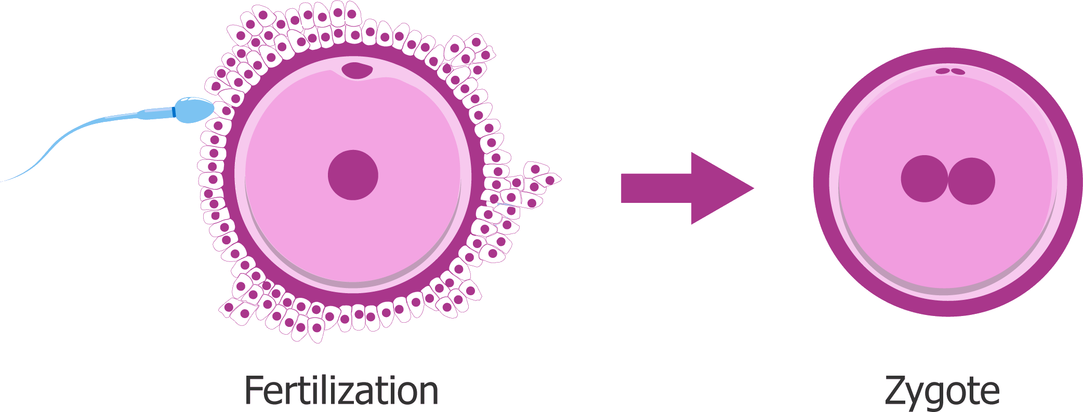
YOU WERE ONCE A FETUS (?)
Metaphysical considerations
Existence–life link: If an organism that once existed has never died or traveled in time, then this organism still exists.
“Bob”
Genetically distinct
Functionally autonomous
Not a part of some other organism
Notes:
“For another, this organism’s functioning was directed towards its own benefit—selfishly, the organism colonized the womb, released hormones that triggered changes in my mother beneficial to it, and so on” (20)
“The early human organism’s ability to twin—to split into two organisms—is no challenge to the claim that we have a single individual here. We do not deny that an amoeba is an individual organism on the grounds that in the future it will split in two” (20)
“But if this is not accepted, then we’ll just have to start the argument a little later, after implantation (losing the free-floating part of the argument in the previous paragraph), and limit the conclusions of the argument to prohibit abortion after the first 2 weeks of pregnancy” (20)
“If x yesterday climbed into a time machine to take her to the year 3000, and has never returned, then today x doesn’t exist, even though x hasn’t died yet” (40)

Slide 14
YOU WERE ONCE A FETUS (?)
Metaphysical considerations
Existence–life link: If an organism that once existed has never died or traveled in time, then this organism still exists.
“Bob”
Genetically distinct
Functionally autonomous
Not a part of some other organism
Notes:
“Bob’s cells have divided, differentiated, and Bob has developed. But nowhere in the continuous history I described have we seen anything we could identify as ‘the death of Bob.’ . . . [W]e have a process of growth, directed at the goal of adulthood. . . . True, it ceased to be an embryo after a while, and at the end of the 9 months it ceased to be a fetus. But this is no more a literal death than my passing from childhood to adolescence or from adolescence to adulthood was a death” (21)
“Where, then, is Bob? But surely there is no mystery there. Every part of Bob—other than the cells in the placenta and the umbilical cord that were shed3—developed continuously into a part of me, and every part of me has developed ultimately out of a part of Bob. . . . If Bob is anywhere, he is right here, where I am” (21)
“It may be true that most of the original cells in Bob are no longer around, but that does not stop the survival of an organism: organisms replace their cells regularly, and do not perish thereby” (21)
“Now, Bob can’t be a proper part of my body, because all of my body has continuously come from Bob’s body. Therefore, one can’t set aside some special part of my body and say ‘that part of me is Bob.’ So, where is Bob? The answer is simple: right here. I am Bob” (21)

Slide 15
YOU WERE ONCE A FETUS (?)
Notes:
“The only large animal here is Alexander Pruss, and hence Bob and Alexander Pruss are one and the same animal. I, thus, am Bob. If Bob is here, and if no part of me is a large animal, and if Bob is a large animal, Bob and I must be one and the same entity” (22)
“[T]he identity between Bob’s genome and my genome provides significant evidence of Bob and me being the same entity. This evidence is defeasible—both identical twins have the same genome as the embryo from which they are derived—but it is, nonetheless, evidence” (22)
“Besides, given how organic development works, it is easy to see that every organ of mine is an organ of Bob’s, since Bob’s organs have developed into being my organs, and yet without any transplant happening. Thus, I and Bob are organisms having all of our organs in common” (22)

Slide 16
ANIMALISM
Animalism is the view that you are an animal—that is, a biological organism.
If Bob was a biological organism, and Bob still exists, and Bob is located exactly where I am—then Bob and I are one and the same.

Slide 17
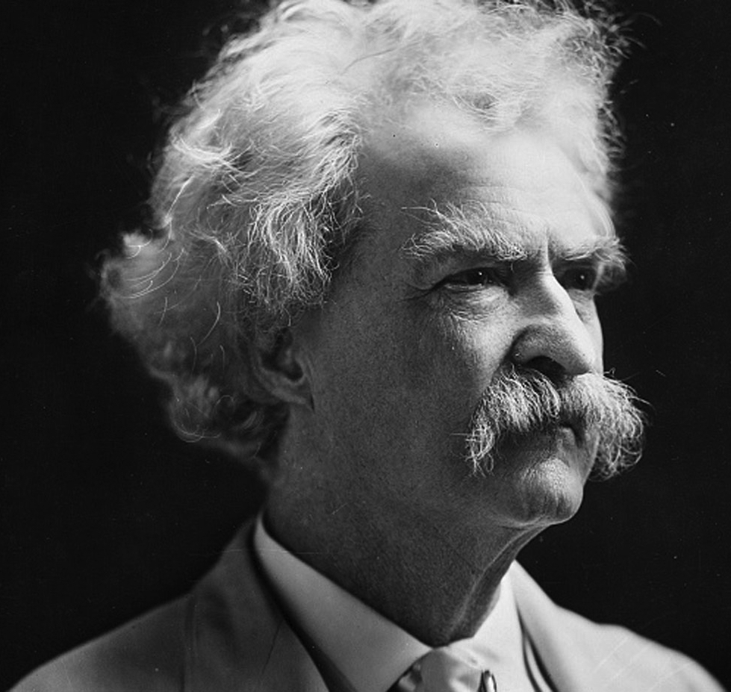
ANIMALISM
Mark Twin = Samuel Clemens
Bob = Zach

Slide 18
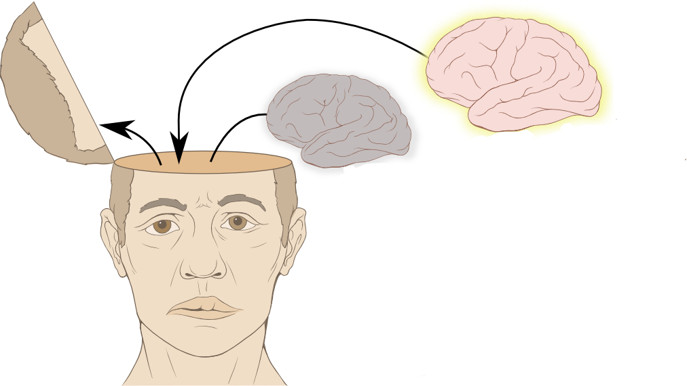
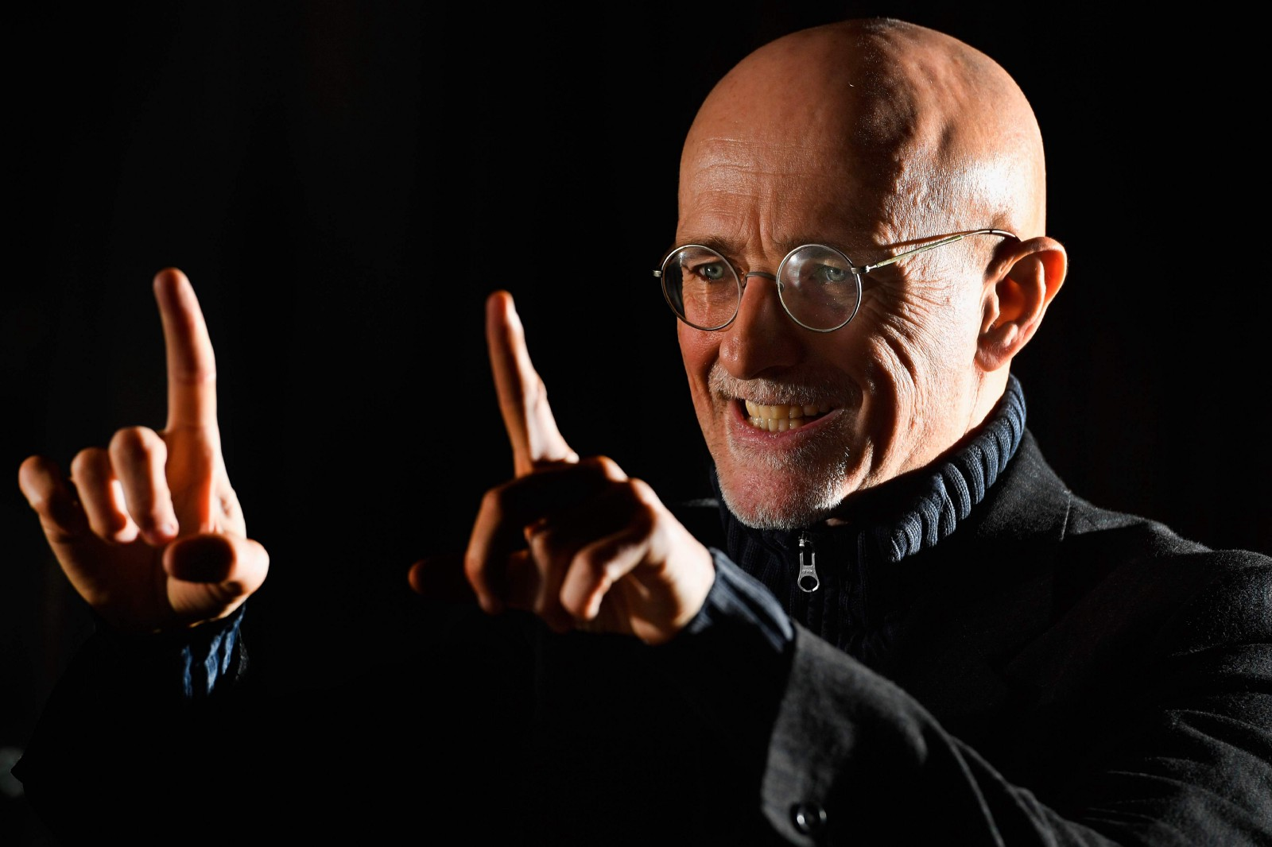
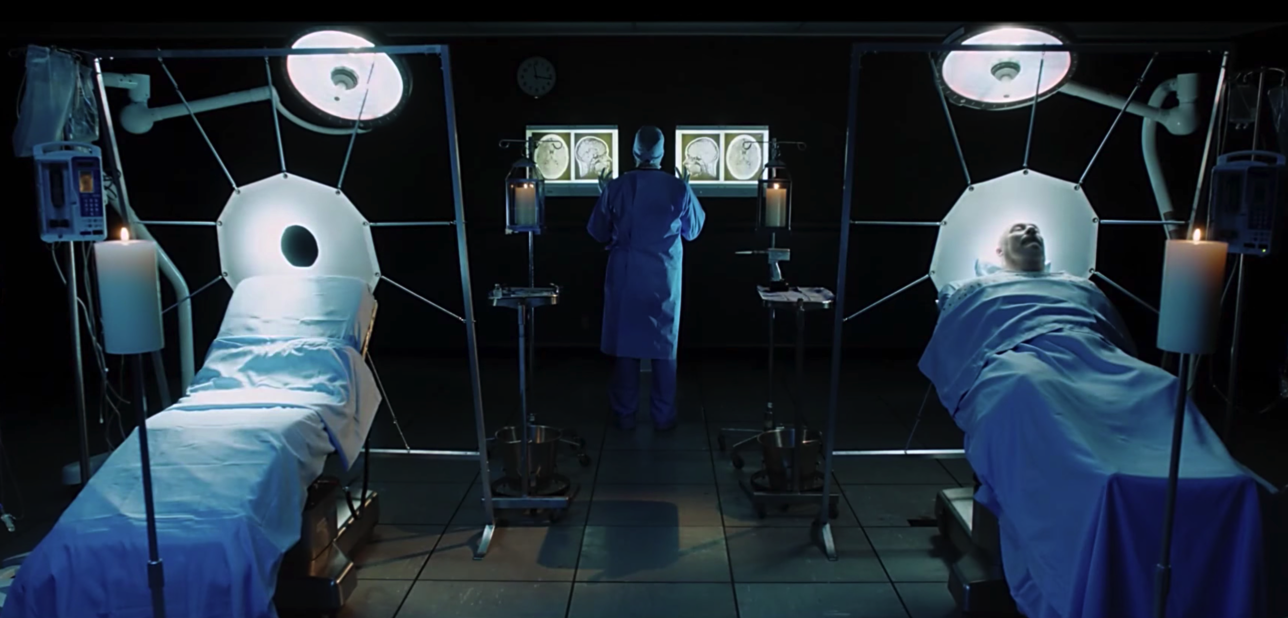
ANIMALISM
Sergio Canavero
BED A
BED B

Slide 19
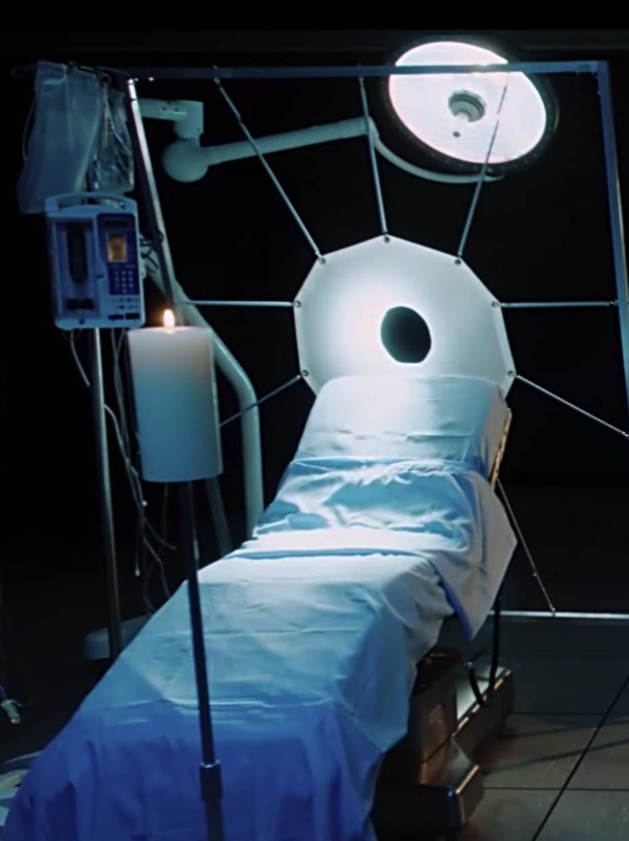
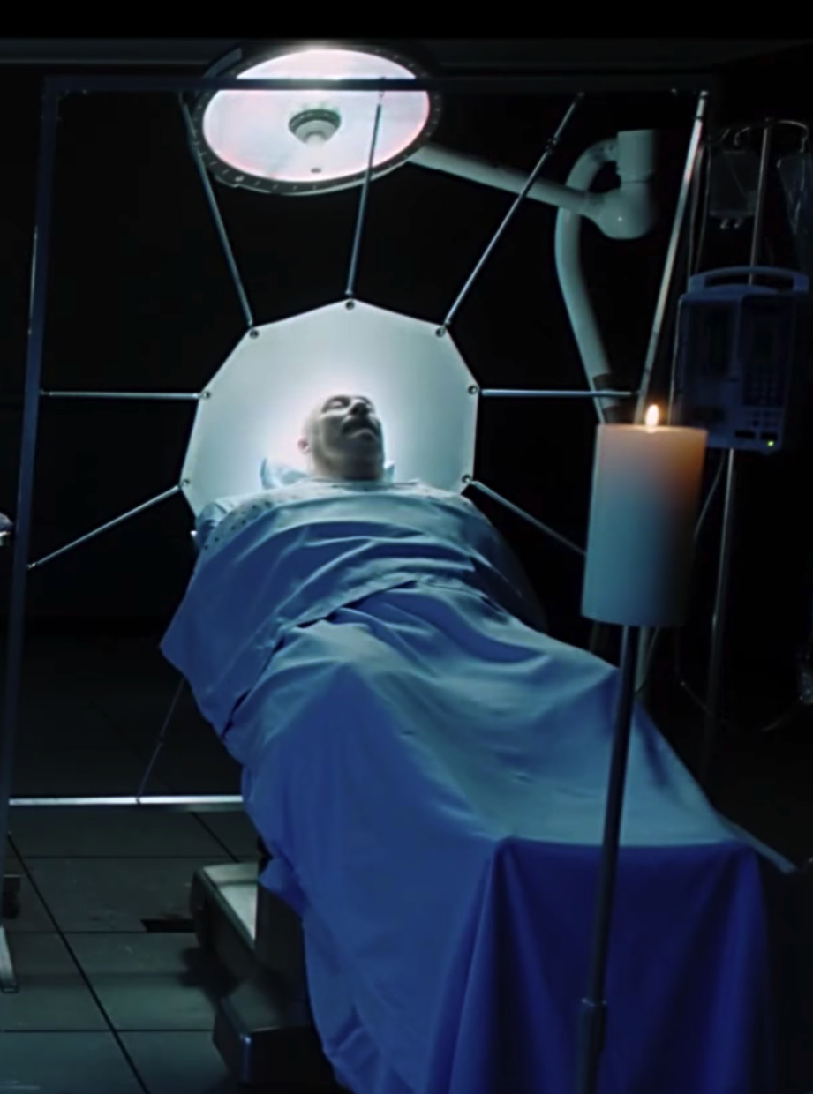
ANIMALISM
– UNGRADED POLL
Sergio Canavero

Slide 20
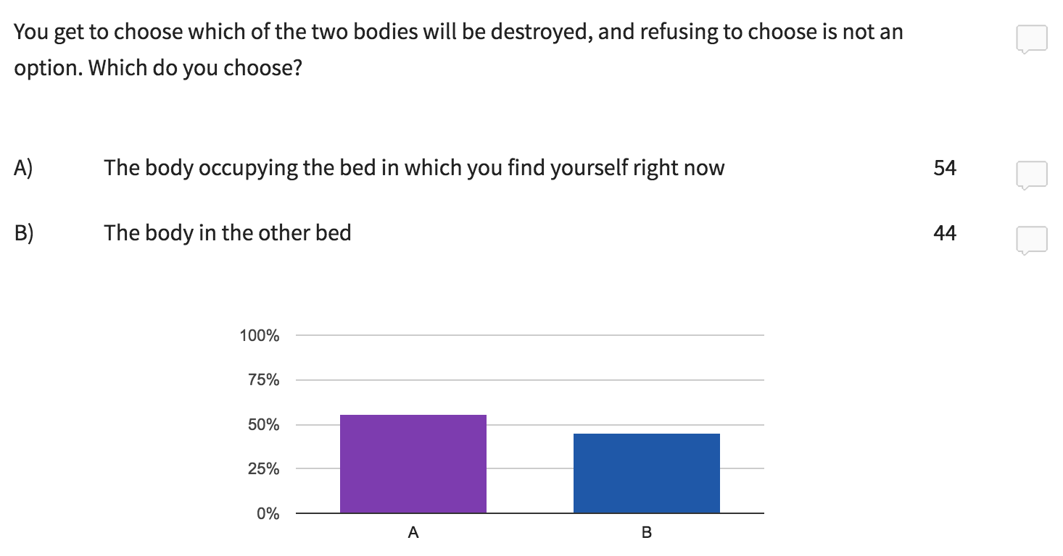

Slide 21
INTERPRETING THE POLL
If you selected Option A, perhaps that’s because you think that you will wake up in Bed B, and you don’t want to be killed.
However, some students selected Option B for ethical reasons. These students might nonetheless agree that they would wake up in Bed B.
The point is that to the extent that we want to avoid our own deaths, many of us are motivated (to some extent) to prefer Option A—and that’s because many of us seem to believe that we go where our (living) brains go. Is that a problem for animalism? Why or why not?

Slide 22
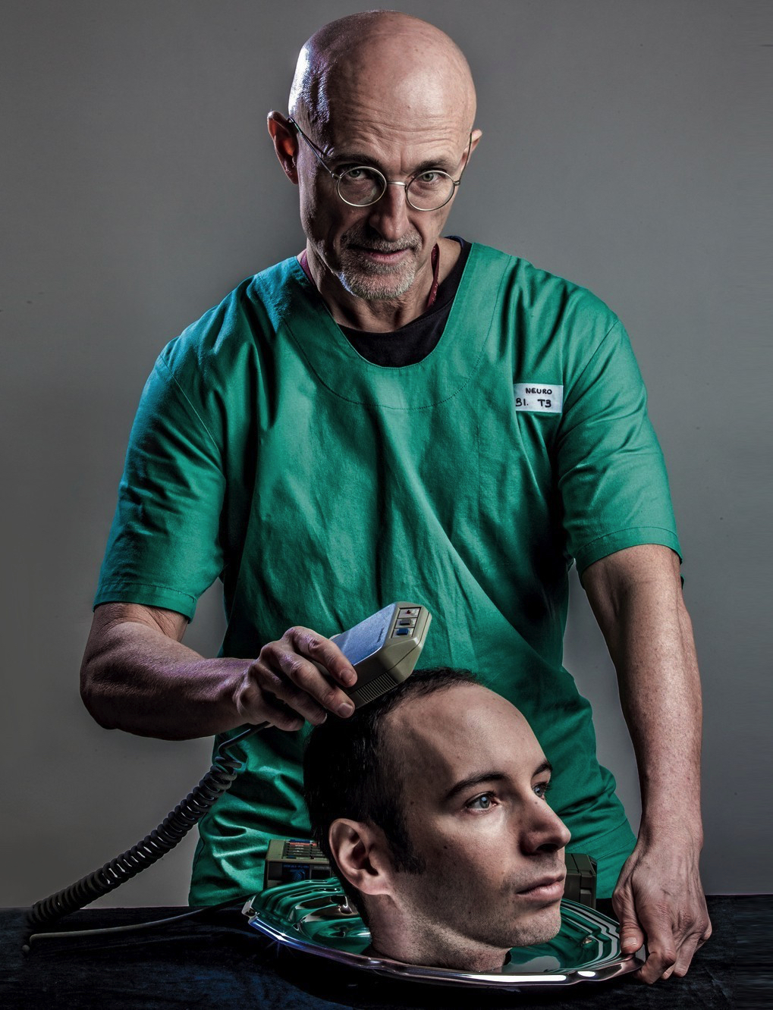
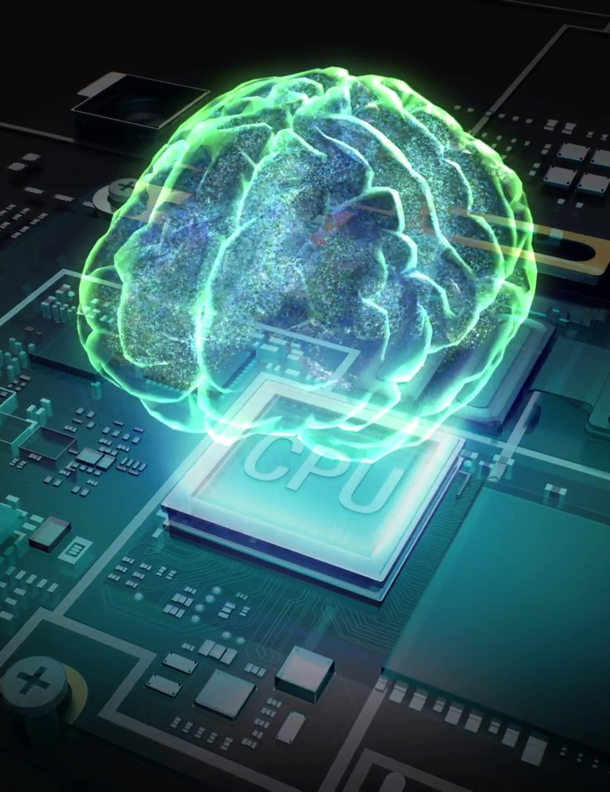
ANIMALISM
Notes:
“Instead, we should say that the animal suffers from an amputation of every physical part but the cerebrum.
“At this point, however, there is a puzzle. You could not survive if every part of you other than your foot was destroyed. Why say that you can survive if every part of you other than your cerebrum is destroyed?” (24)
“This is obvious in the case of higher-level activity, but the amount of control we can achieve over breathing and—with more practice—heartbeat, the uncanny effectiveness of placebos for a wide variety of bodily problems, and the crucial elements of the voluntary in normal adult human reproductive and nutritive behavior all point to the centrality of cerebral activity once it develops. It is plausible that when the central control system of an organism survives and is separated from the rest of the body, the animal goes where that central control system goes” (23)

Slide 23
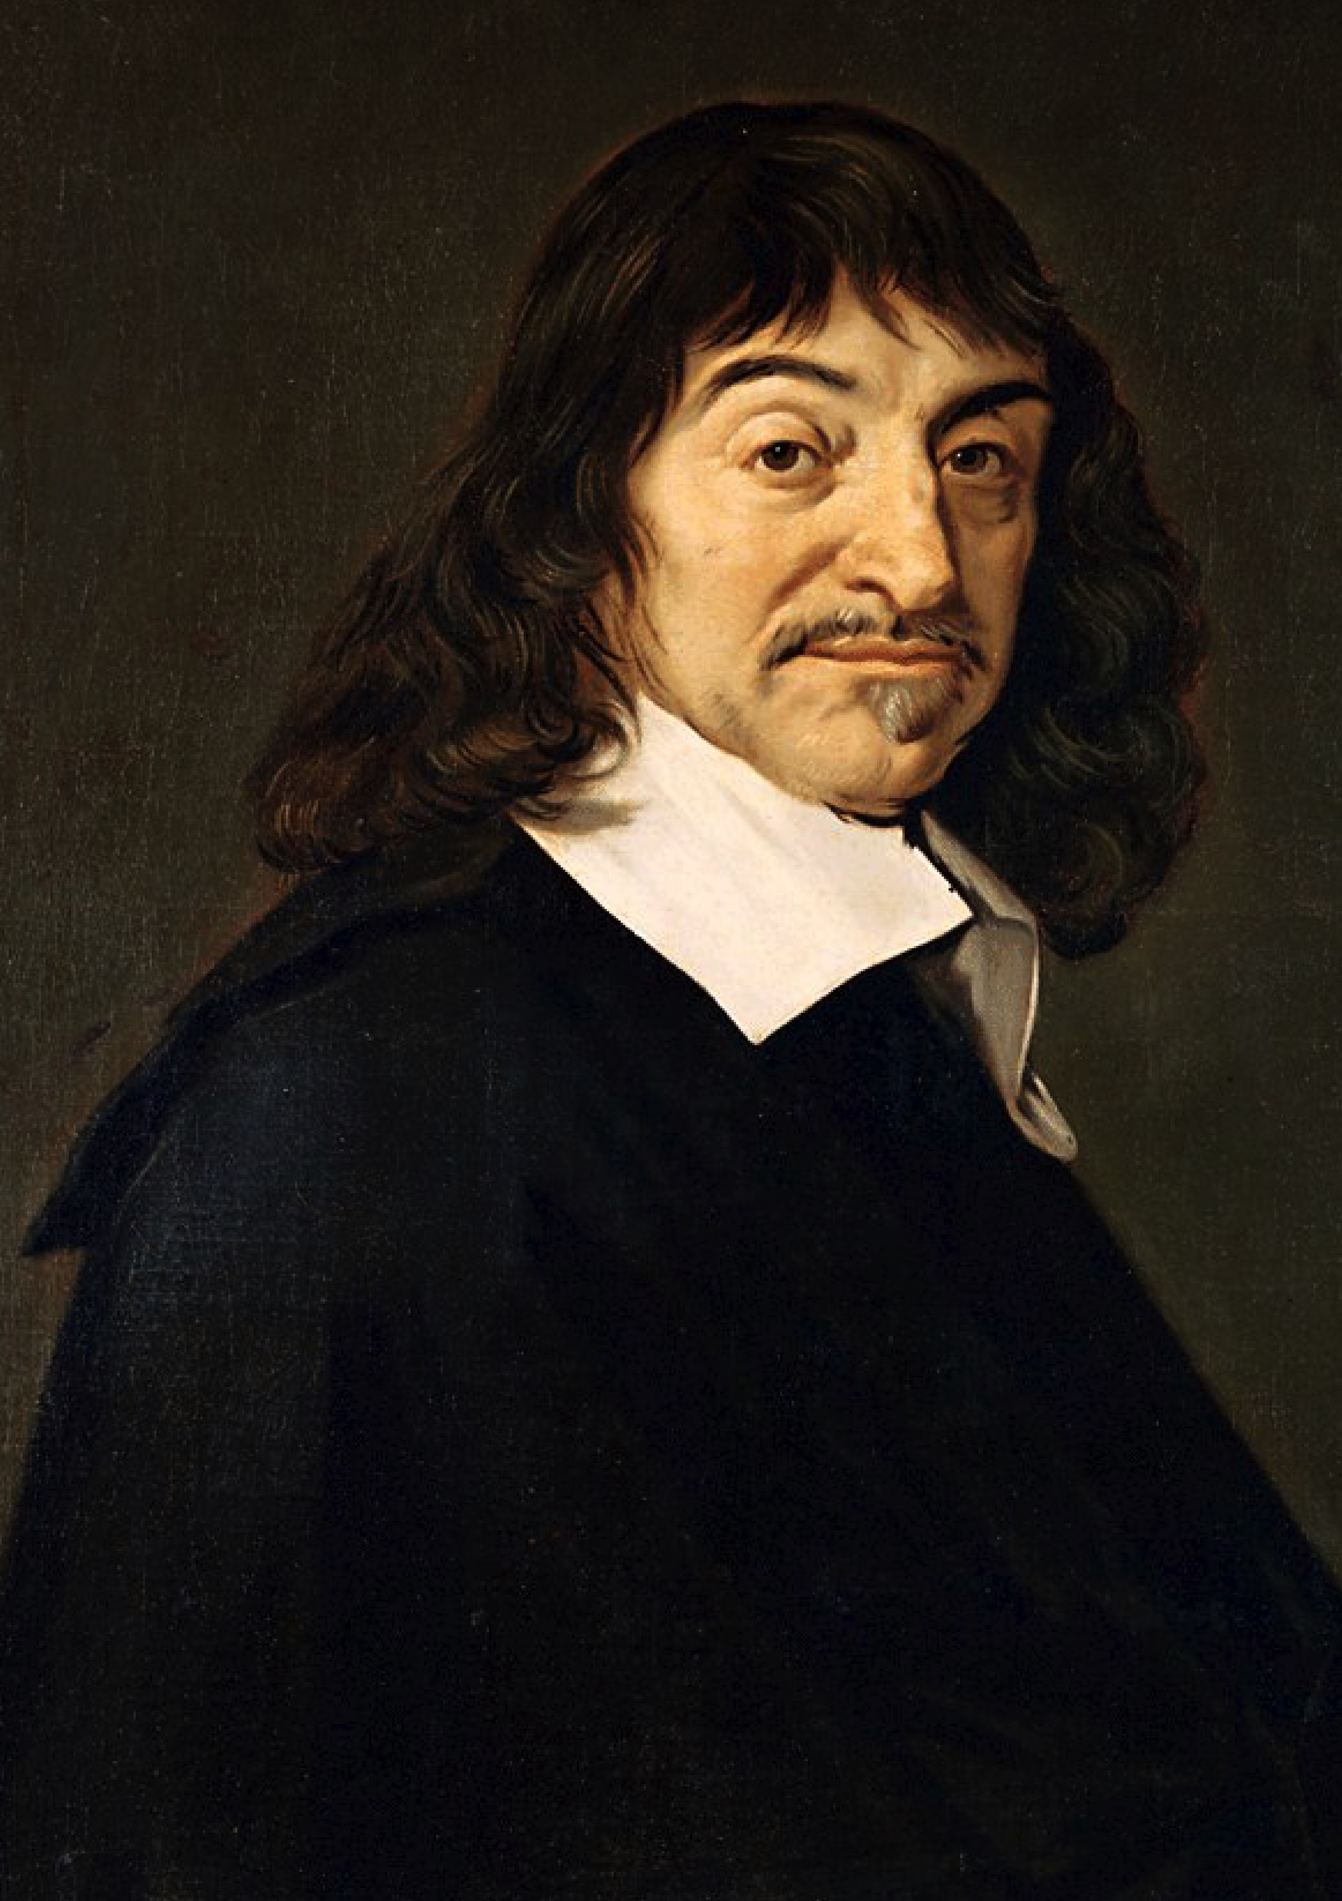
SUBSTANCE DUALISM
Substance dualism is the view that you are an immaterial soul.
Take me, for example. Bob may be located right here—but I am not located anywhere.
Still, Bob and I are intimately connected.
If you shoot Bob in the foot, I will experience pain.
If I decide to lift “my” arm, Bob’s arm will move.
René Descartes

Slide 24
SUBSTANCE DUALISM
You have never been kissed, even if you thought you have—at best, a biological organism to which you are connected has been kissed.
Stealing one of your kidneys is a mere property crime—it is stealing a part of a body that you “own,” but not a part of you.
Pairing problem: what explains why you are connected to that body rather than to this body?
Even if it were true, how would it help to avoid the conclusion that ordinary cases of abortion are wrong?
Alexander Pruss
Notes:
“These consequences are ethically unacceptable. After all, the government can legitimately take away some of my property for the greater good, and does so in taxes. If my body were mere property, then the government would in principle have a right, when necessary, to extract a kidney from me as a tax payment” (24)

Slide 25
BODY–BRAIN DUALISM
You are a proper part of a biological organism—namely, a brain.
Take me, for example. Bob is located right here—and so am I! But I’m not Bob—I’m Bob’s brain.
Still, Bob and I are intimately connected.
If you shoot Bob in the foot, I will experience pain.
If I decide to lift “my” arm, Bob’s arm will move.
I go where my brain goes.
“Zach has been in that jar for quite a while now!”

Slide 26
BODY–BRAIN DUALISM
You can’t be kissed without undergoing surgery.
Again, stealing one of your kidneys is a mere property crime—it is stealing a part of a body that you “own,” but not a part of you.
Alexander Pruss
Notes:
“My brain developed out of earlier cells guided by the genetic information already present in the embryo: there was, first, a neural tube, and earlier there were precursors to that. Brain development was gradual, cells specializing more and more and arranging themselves. Why should the cells that were the precursors of the brain cells not be counted as having been the same organ as the brain, but in inchoate form? If so, then perhaps I was there from conception, even on a brain view” (25)

Slide 27
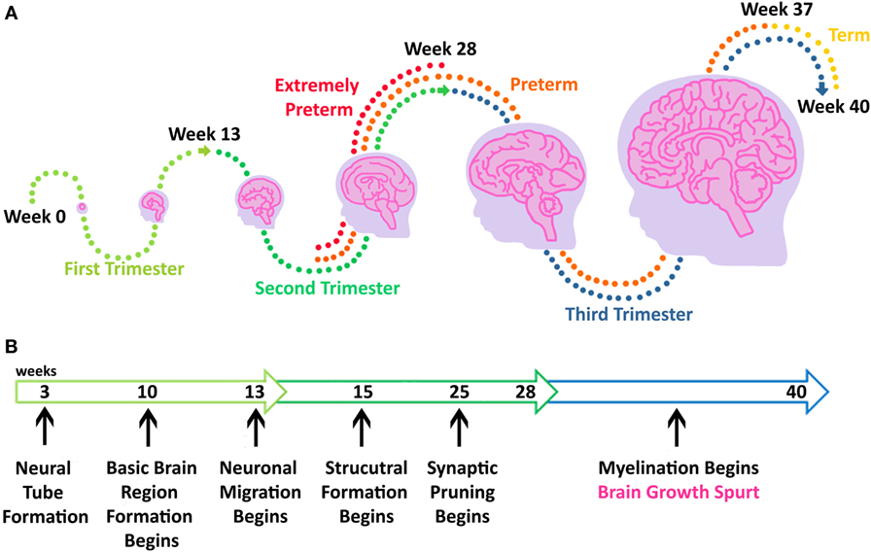
BODY–BRAIN DUALISM
Again, even if it were true, how would it help to avoid the conclusion that ordinary cases of abortion are wrong?
Alexander Pruss
Notes:
“My brain developed out of earlier cells guided by the genetic information already present in the embryo: there was, first, a neural tube, and earlier there were precursors to that. Brain development was gradual, cells specializing more and more and arranging themselves. Why should the cells that were the precursors of the brain cells not be counted as having been the same organ as the brain, but in inchoate form? If so, then perhaps I was there from conception, even on a brain view” (25)

Slide 28
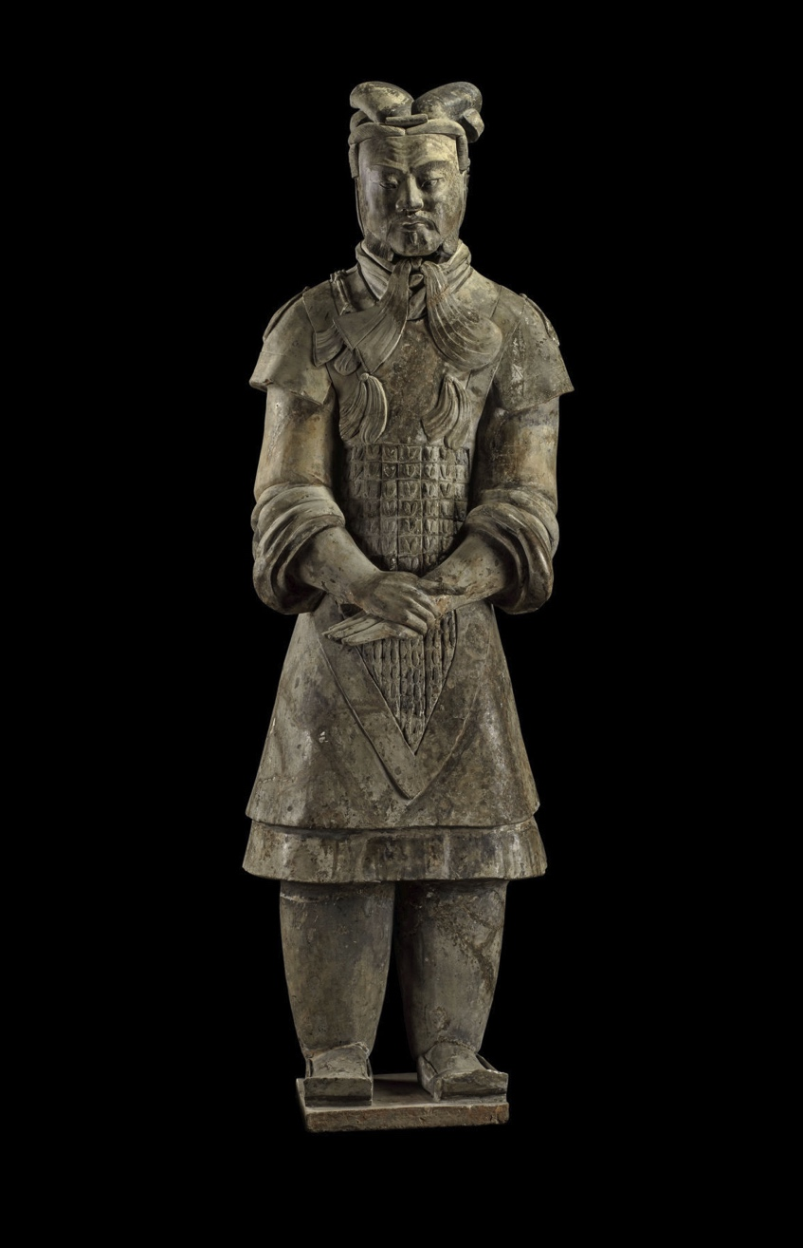
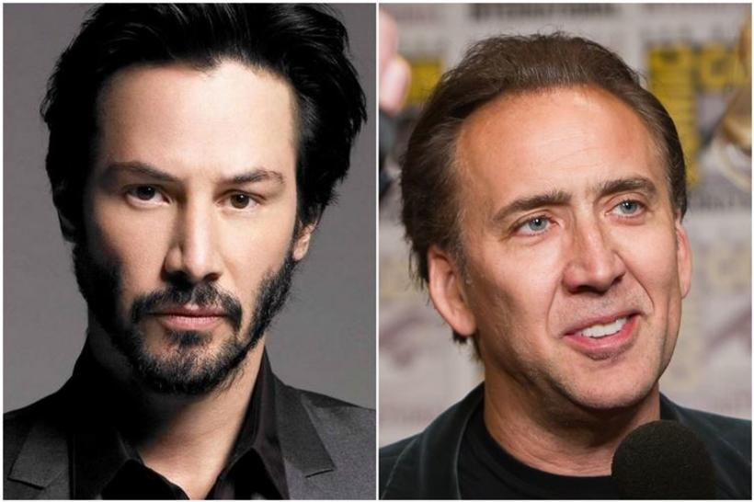
THE CONSTITUTION VIEW
If x constitutes y, then x and y are spatially coincident.
It is a synchronic relation: it holds between two objects at a single time.
Unlike numerical identity, it is an asymmetric relation: if x constitutes y, then y doesn’t constitute x.
same age as
materially constitutes
Notes:
Keanu Reeves is taller than Nicholas Cage, but Nicholas Cage isn’t taller than Reeves
Reeves is the same age as Cage, and Cage is the same age as Reeves

Slide 29
THE CONSTITUTION VIEW
If x constitutes y, then x and y are spatially coincident.
It is a synchronic relation: it holds between two objects at a single time.
Unlike numerical identity, it is an asymmetric relation: if x constitutes y, then y doesn’t constitute x.
taller than
materially constitutes
Notes:
Keanu Reeves is taller than Nicholas Cage, but Nicholas Cage isn’t taller than Reeves
Reeves is the same age as Cage, and Cage is the same age as Reeves

Slide 30
THE CONSTITUTION VIEW
Notes:
“The only large animal here is Alexander Pruss, and hence Bob and Alexander Pruss are one and the same animal. I, thus, am Bob. If Bob is here, and if no part of me is a large animal, and if Bob is a large animal, Bob and I must be one and the same entity” (22)
“[T]he identity between Bob’s genome and my genome provides significant evidence of Bob and me being the same entity. This evidence is defeasible—both identical twins have the same genome as the embryo from which they are derived—but it is, nonetheless, evidence” (22)
“Besides, given how organic development works, it is easy to see that every organ of mine is an organ of Bob’s, since Bob’s organs have developed into being my organs, and yet without any transplant happening. Thus, I and Bob are organisms having all of our organs in common” (22)

Slide 31
THE CONSTITUTION VIEW
According to the constitution view, you are a person that is constituted by a biological organism—but you aren’t a biological organism yourself.
Sitting in your chair at this very moment are two distinct individuals—a biological organism belonging to the species Homo sapiens, and you!

Slide 32
THE CONSTITUTION VIEW
Dilemma: either the biological organism sitting in your chair isn’t conscious, or it is.
If the former, then:
Help me out!
Alexander Pruss

Slide 33
THE CONSTITUTION VIEW
Dilemma: either the biological organism sitting in your chair isn’t conscious, or it is.
If the former, then:
Help me out!
If the latter, then:
What’s wrong with that option?
Alexander Pruss

Slide 34
QUESTION
Recall that animalism is the view that you are an animal—that is, a biological organism.
Why does Pruss spend so much time discussing alternatives to animalism?
One student answered that Pruss is anticipating and countering objections to further support his thesis. Good answer!
But the deeper answer is that these other views are logically compatible with the view that we don’t begin to exist until after conception.
His argument fails unless he can either show that these other views are false or that we have independent reason to believe that we (as souls, brains, or persons constituted by organisms) come into existence at conception.

Slide 35
PRUSS’S MASTER ARGUMENT
If you were once a fetus, and it is wrong to kill you now, then it was wrong to kill you when you were a fetus.
If it was wrong to kill you when you were a fetus, and there is no moral difference between the fetus you once were and any other ordinary human fetus, then abortion is wrong in the same circumstances in which it is wrong to kill an adult.
You were once a fetus.
It is wrong to kill you now.
There is no moral difference between the fetus you once were and any other ordinary human fetus.
So: abortion is wrong in the same circumstances in which it is wrong to kill an adult.

Slide 36
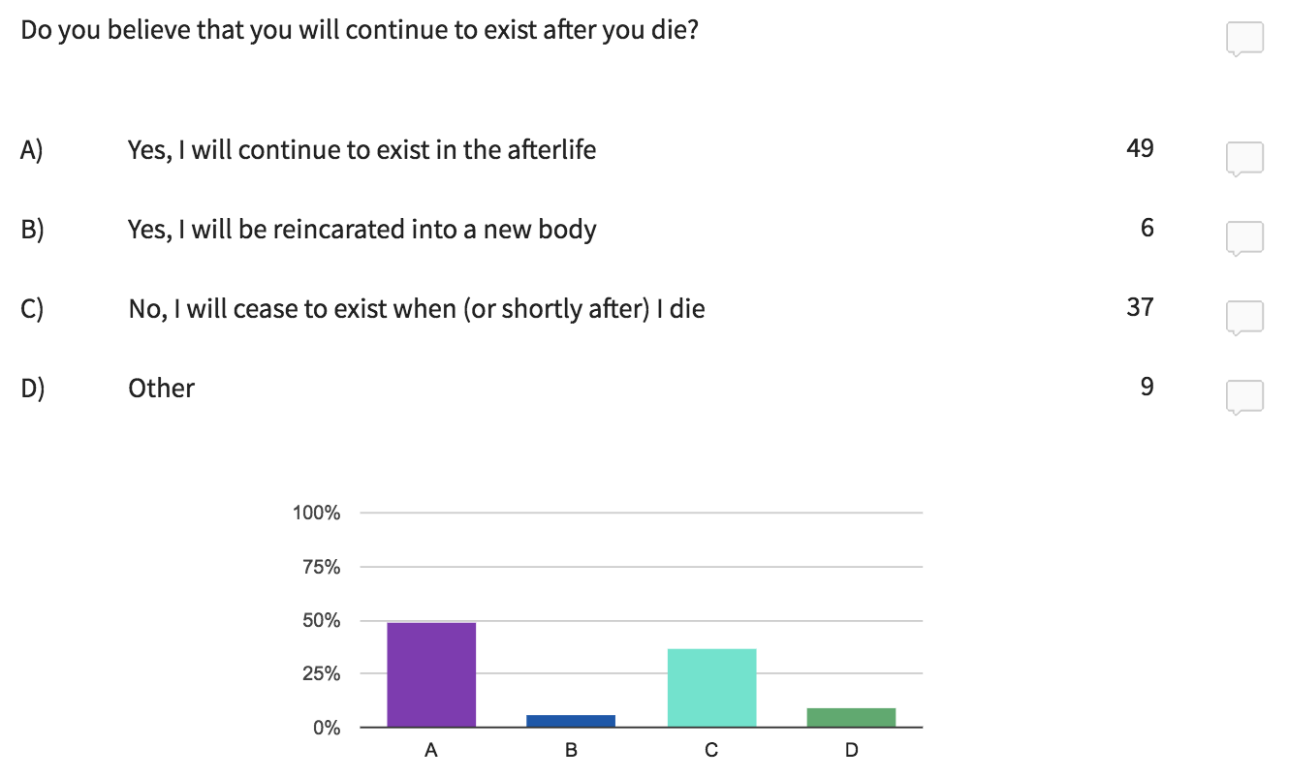
UNGRADED POLL (question 3)

Slide 37
UNGRADED POLL (question 3)
Premise (3) of Pruss’s argument is true only if animalism (or some view close to it) is true.
If you selected (A), (B), or (D), should you accept premise (3) of Pruss’s argument?
The worry is that if you are one and the same as a biological organism, and biological organisms cease to exist at or shortly after death (e.g., when their parts cease to be organized in the right ways), then you cease to exist at or shortly after death.

Slide 38
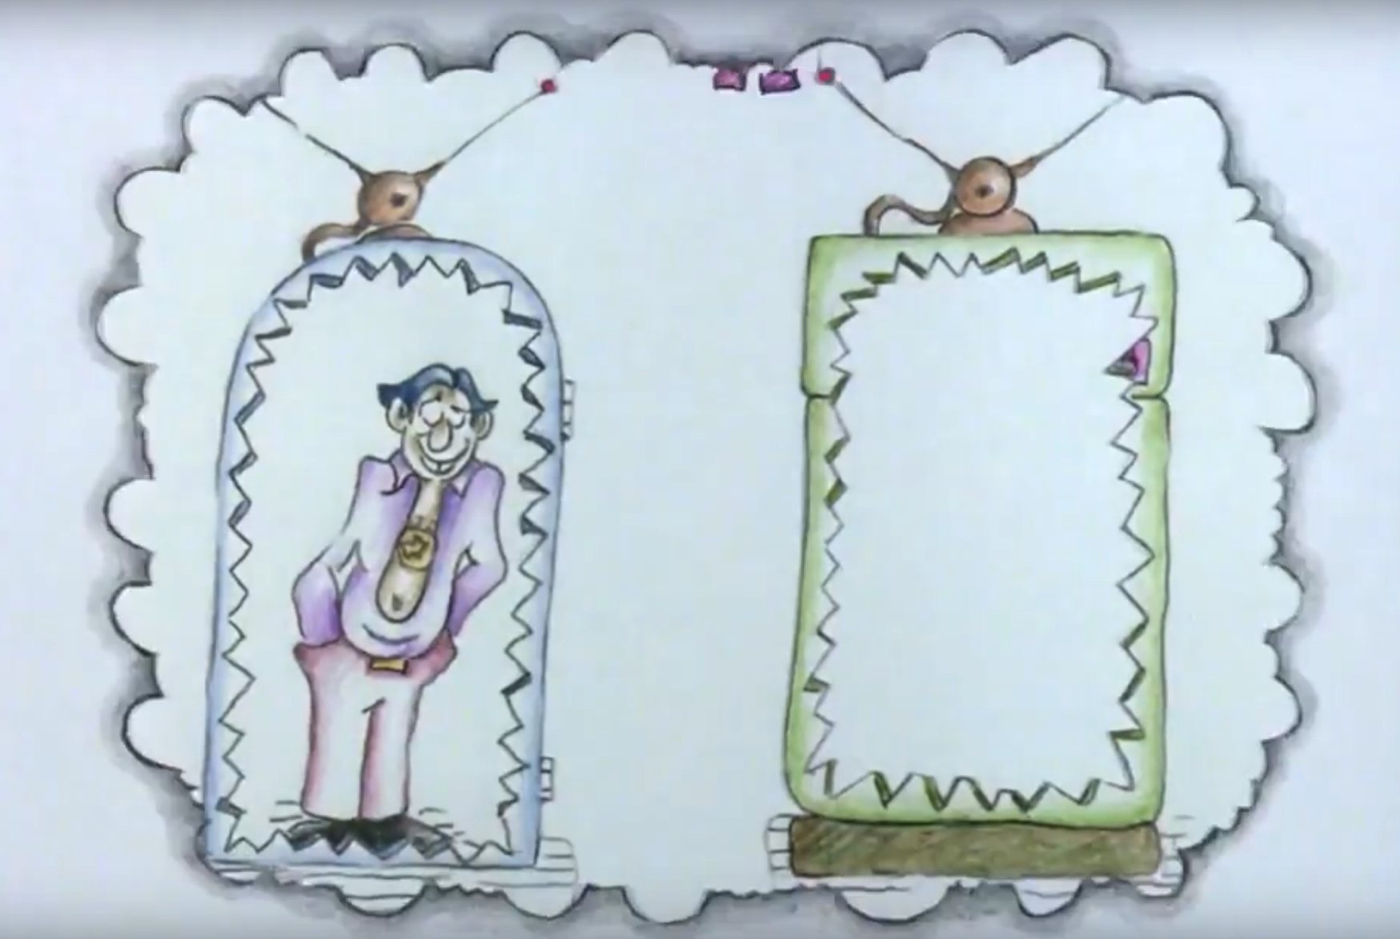
OPTIONS
teletransporter

Slide 39
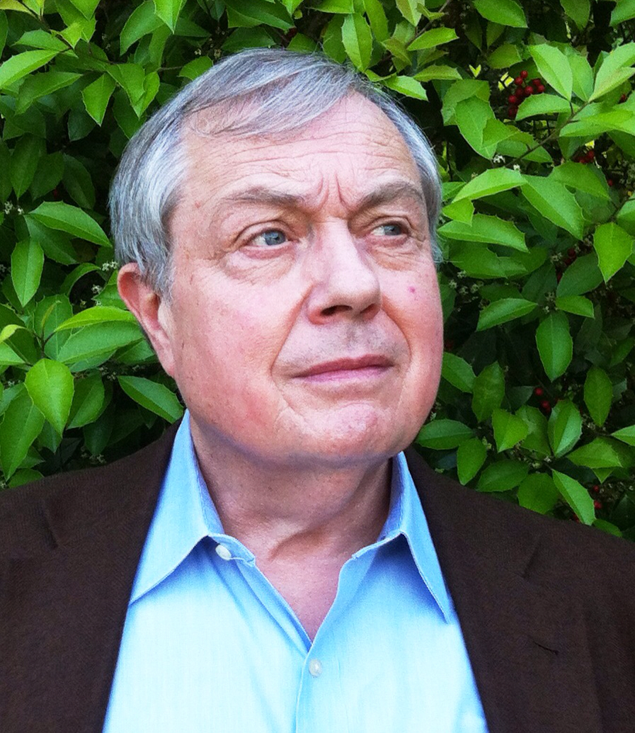
UNGRADED POLL (question 3)
“Perhaps at the moment of each man’s death, God removes his corpse and replaces it with a simulacrum which is what is burned or rots. Or perhaps God is not quite so wholesale as this: perhaps He removes for ‘safekeeping’ only the ‘core person’—the brain and central nervous system—or even some special part of it. . . . I take it that this story shows that the resurrection is a feat an almighty could accomplish. I think this is the only way such an almighty being could accomplish it. Perhaps I’m wrong, but that’s of little importance. What is important is that God can accomplish it this way or some other” (121)
Peter van Inwagen

Slide 40
PRUSS’S TRUMP CARDS (?)
Suppose animalism is false.
The best alternatives are substance dualism, body–brain dualism, and the constitution view.
Even if one of these alternative theories is true, there is still reason to believe that individuals with valuable futures come into existence at conception.
The conclusion that abortion is typically wrong may still follow.
Alexander Pruss

Slide 41
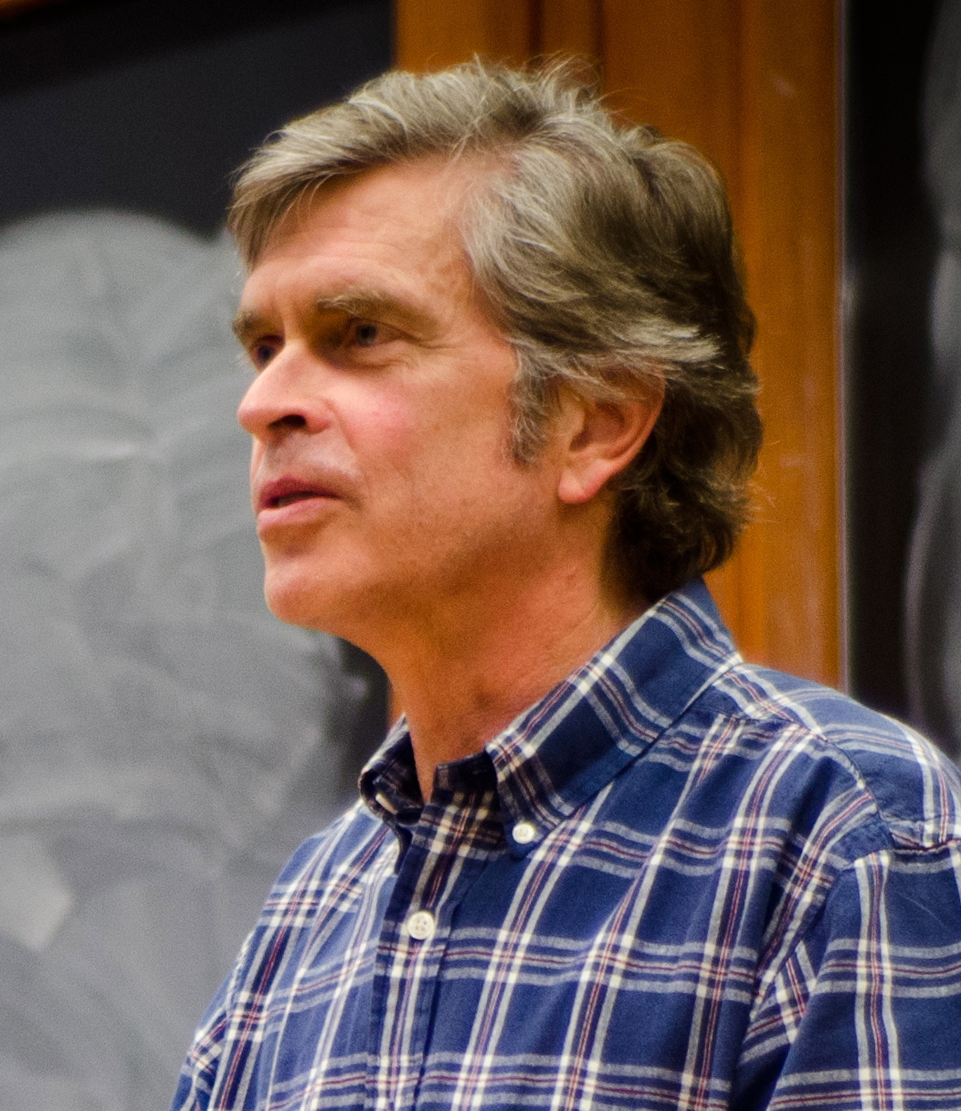
PRUSS’S TRUMP CARDS (?)
Aquinas maintained that the “rational soul”—that which distinguishes human persons from non-human animals—doesn’t appear until after forty days into pregnancy for males and after ninety days into pregnancy for females.
“[I]n The Anatomy of Melancholy, published in 1621, several centuries after Aquinas’s death, Robert Burton states the prevailing view that ‘the soul . . . is infused into the child or embryo in his mother’s womb, six months after conception’” (16).
“Views of this sort appear to have guided the comparatively permissive stance on early abortion that prevailed in many places until about the middle of the nineteenth century” (16–17).
Jeff McMahan
Notes:
“This was not sexism but simply an acceptance of the biological claims of Aristotle, who was misled by the primitive means of observation available to him to believe that the male fetus begins to move at forty days while the female does not move until ninety days have elapsed” (13)

Slide 42
PRUSS’S TRUMP CARDS (?)
Either the soul is essentially a conscious thing, or it is essentially a thing with the capacity for consciousness.
Either way, the most plausible view is that we don’t begin to exist at conception.
Jeff McMahan

Slide 43
PRUSS’S TRUMP CARDS (?)
Any view according to which we begin to exist at conception has a surprising consequence.
“There are some who hold that abortion is wrong on the basis of two claims: first, that we begin to exist at conception and, second, that it is a terrible loss when one of us dies, even in utero. Those who hold this view seem to be committed to the conclusion that monozygotic twinning is bad, as it involves the ceasing to exist of one of us” (26).
Jeff McMahan

Slide 44
PRUSS’S TRUMP CARDS (?)
“When I noted this problem in an earlier paper, I assumed that it would strike anyone as absurd to suppose that monozygotic twinning is bad or regrettable on the ground it involves a serious and uncompensated loss” (26).
“Subsequently, however, David Oderberg has explicitly embraced this consequence of the pair of assumptions that lead to it. He notes that, while we do not in fact respond to instances of monozygotic twinning with a sense of loss, ‘our practice could change in conformity with our deeper appreciation of what happens when twinning occurs. . . . [It] is arguably proper for us to mourn the lost embryo in an appropriate way (which would be suitably restrained given the bareness of its relationship to anyone)” (26).
Jeff McMahan

Slide 45
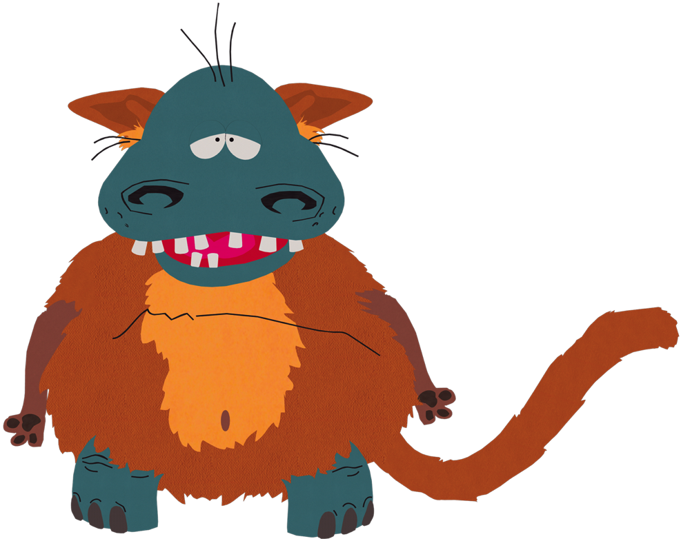
PRUSS’S TRUMP CARDS (?)
I know whether animalism is true or false. If it is false, I’ll pay your tuition and see to it that you land an amazing job. If it is true, I’ll kill a human being. What do you choose?

Slide 46
PRUSS’S TRUMP CARDS (?)
I know whether substance dualism is true or false. If it is false, you get to go on eating whatever you want until the day you die. If it is true, I’ll kill billions of immaterial souls.

Slide 47
PRUSS’S MASTER ARGUMENT
If you were once a fetus, and it is wrong to kill you now, then it was wrong to kill you when you were a fetus.
If it was wrong to kill you when you were a fetus, and there is no moral difference between the fetus you once were and any other ordinary human fetus, then abortion is wrong in the same circumstances in which it is wrong to kill an adult.
You were once a fetus.
It is wrong to kill you now.
There is no moral difference between the fetus you once were and any other ordinary human fetus.
So: abortion is wrong in the same circumstances in which it is wrong to kill an adult.

Slide 48
THE DEPRIVATION ACCOUNT
Such an act of nonconsensual killing is wrong because…
It interferes with the victim’s autonomy
It disrespects the victim’s autonomy
It deprives the victim of a valuable future
Notes:
“That is, killing someone deprives them of valuable experiences, activities, relationships, (etc.) that they would otherwise have had” (10)

Slide 49
THE DEPRIVATION ACCOUNT
Such an act of nonconsensual killing is wrong because…
It interference with the victim’s autonomy
It disrespects the victim’s autonomy
It deprives the victim of a valuable future
Notes:
“That is, killing someone deprives them of valuable experiences, activities, relationships, (etc.) that they would otherwise have had” (10)

Slide 50
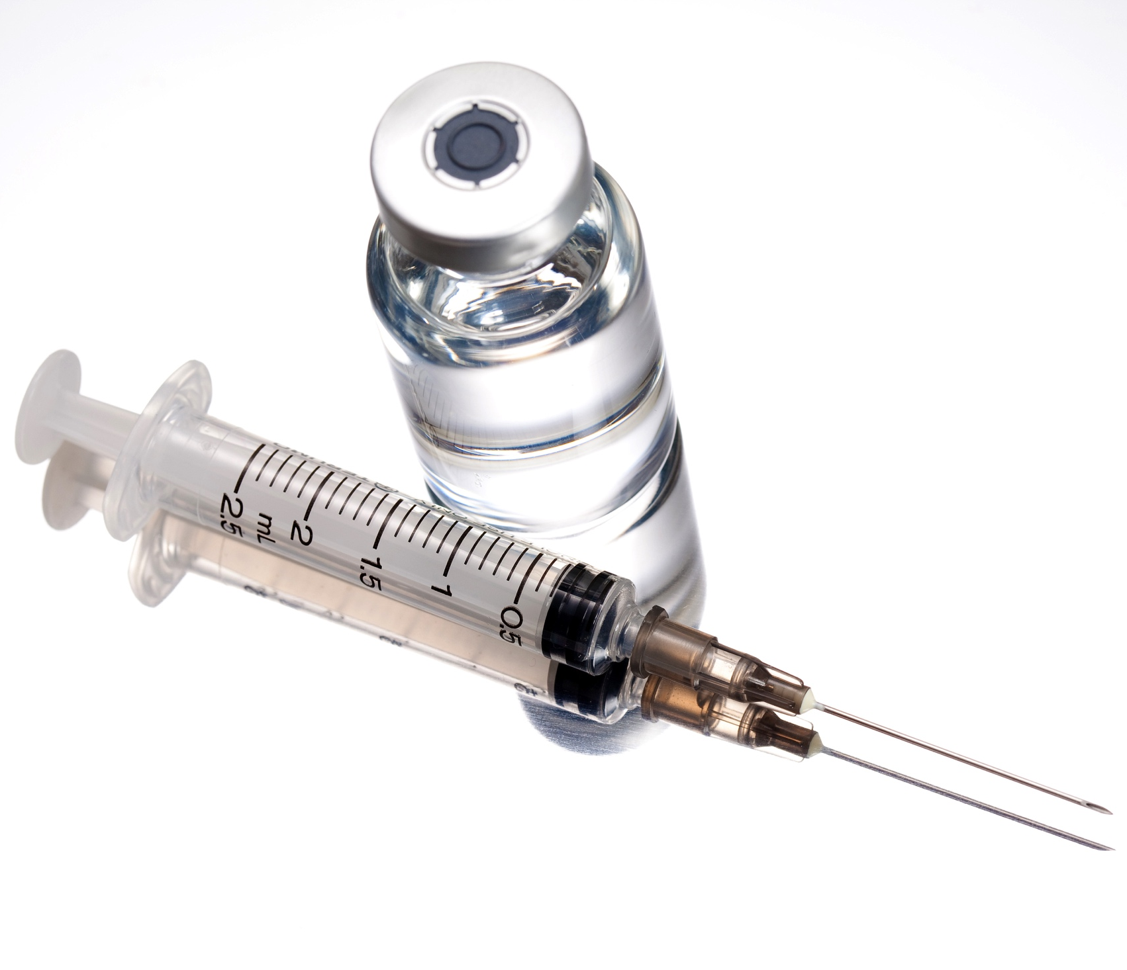
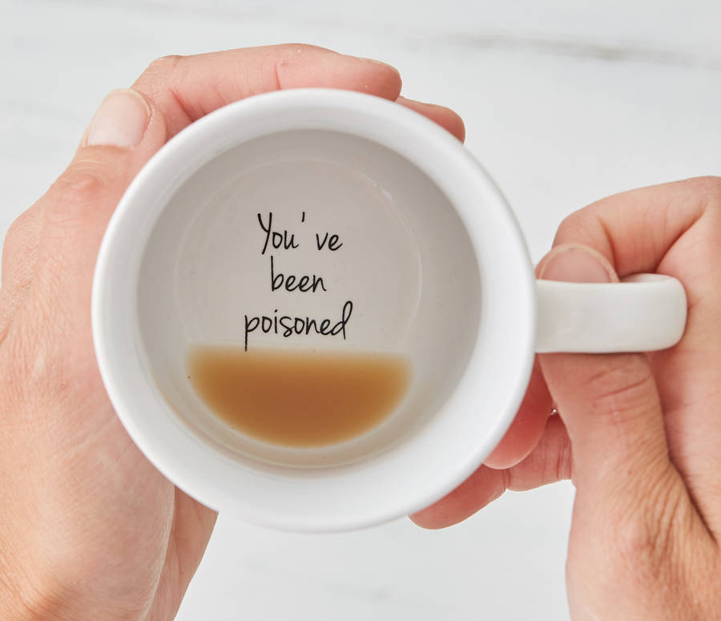
THE DEPRIVATION ACCOUNT
delayed-action drug
the only cure
Notes:
Ask students how the case goes
“However, suppose that this drug is also the only antidote to a poison that you have just accidentally ingested, which will kill you within the hour unless treated” (11–12)
What is the best explanation of this?

Slide 51
IMPLICATIONS
deprived of those 2 years plus n-number of years
deprived of 2 years
more wrong than

Slide 52
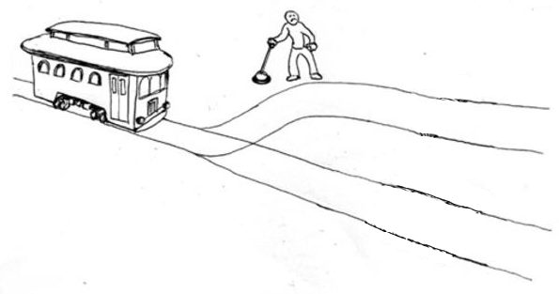
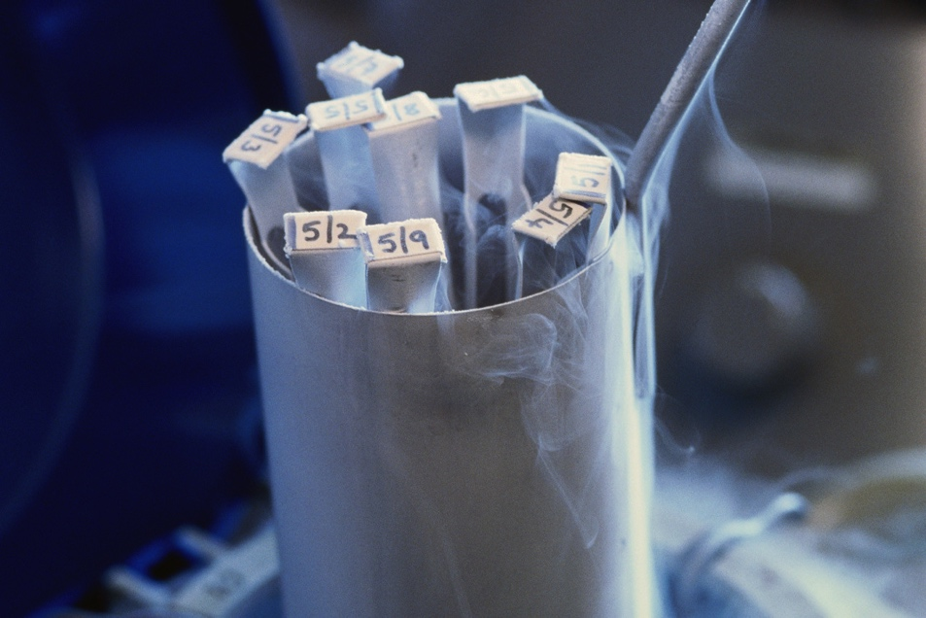
IMPLICATIONS

Slide 53
IMPLICATIONS

Slide 54
PRUSS’S MASTER ARGUMENT
If you were once a fetus, and it is wrong to kill you now, then it was wrong to kill you when you were a fetus.
If it was wrong to kill you when you were a fetus, and there is no moral difference between the fetus you once were and any other ordinary human fetus, then abortion is wrong in the same circumstances in which it is wrong to kill an adult.
You were once a fetus.
It is wrong to kill you now.
There is no moral difference between the fetus you once were and any other ordinary human fetus.
So: abortion is wrong in the same circumstances in which it is wrong to kill an adult.

Slide 55
REJECT PREMISE (3)
“[W]e are embodied minds that begin to exist when the foetal brain develops the capacity to support consciousness, which occurs sometime between 22 and 30 weeks after conception” (1).
“If this is right, abortions performed prior to 22 weeks (which constitute the vast majority of abortions) do not kill someone like you or me but instead prevent one of us from existing. What they kill is merely an unoccupied human organism that has neither interests nor rights” (2).
“These abortions are therefore morally comparable to contraception” (2).
Jeff McMahan

Slide 56
REJECT PREMISE (1)
Rough proposal: x has a right to life if and only if: if x desires to continue living, then others are under a pro tanto obligation to refrain from actions that would deprive x of continued life.
Michael Tooley

Slide 57
REJECT PREMISE (1)
Refined proposal: x has a right to life if and only if:
x is a subject of experiences and other mental states,
x is capable of desiring to continue to exist as a subject of experiences and other mental states, and
if x does or would now desire (under ideal circumstances) to continue to exist as such an entity, then others are under a pro tonto obligation not to prevent him from doing so.
Michael Tooley

Slide 58
REJECT PREMISE (1)
“The claim I wish to defend is this: An organism possesses a serious right to life only if it possesses the concept of a self as a continuing subject of experiences and other mental states, and believes that it is itself a continuing entity” (390).
“For the fundamental way of describing a given desire is as a desire that a certain proposition be true. Then, since one cannot desire that a certain proposition be true unless one understands it, and since one cannot understand it without possessing the concepts involved in it, it follows that the desires one can have are limited by the concepts one possesses. . . .Moreover, an entity cannot desire that it itself continue existing as a subject of experiences and other mental states unless it believes that it is now such a subject” (391)
Michael Tooley

Slide 59
REJECT PREMISE (1)
“[A]t what point [does] an organism [come] to possess the concept of a self as a continuing subject of experiences and other mental states, together with the belief that it is itself such a continuing entity[?] This is obviously a matter for detailed psychological investigation, but everyday observation makes it perfectly clear, I believe, that a newborn baby does not possess the concept of a continuing self, any more than a newborn kitten possesses such a concept. If so, infanticide during a time interval shortly after birth must be morally acceptable” (398)
Michael Tooley

Slide 60
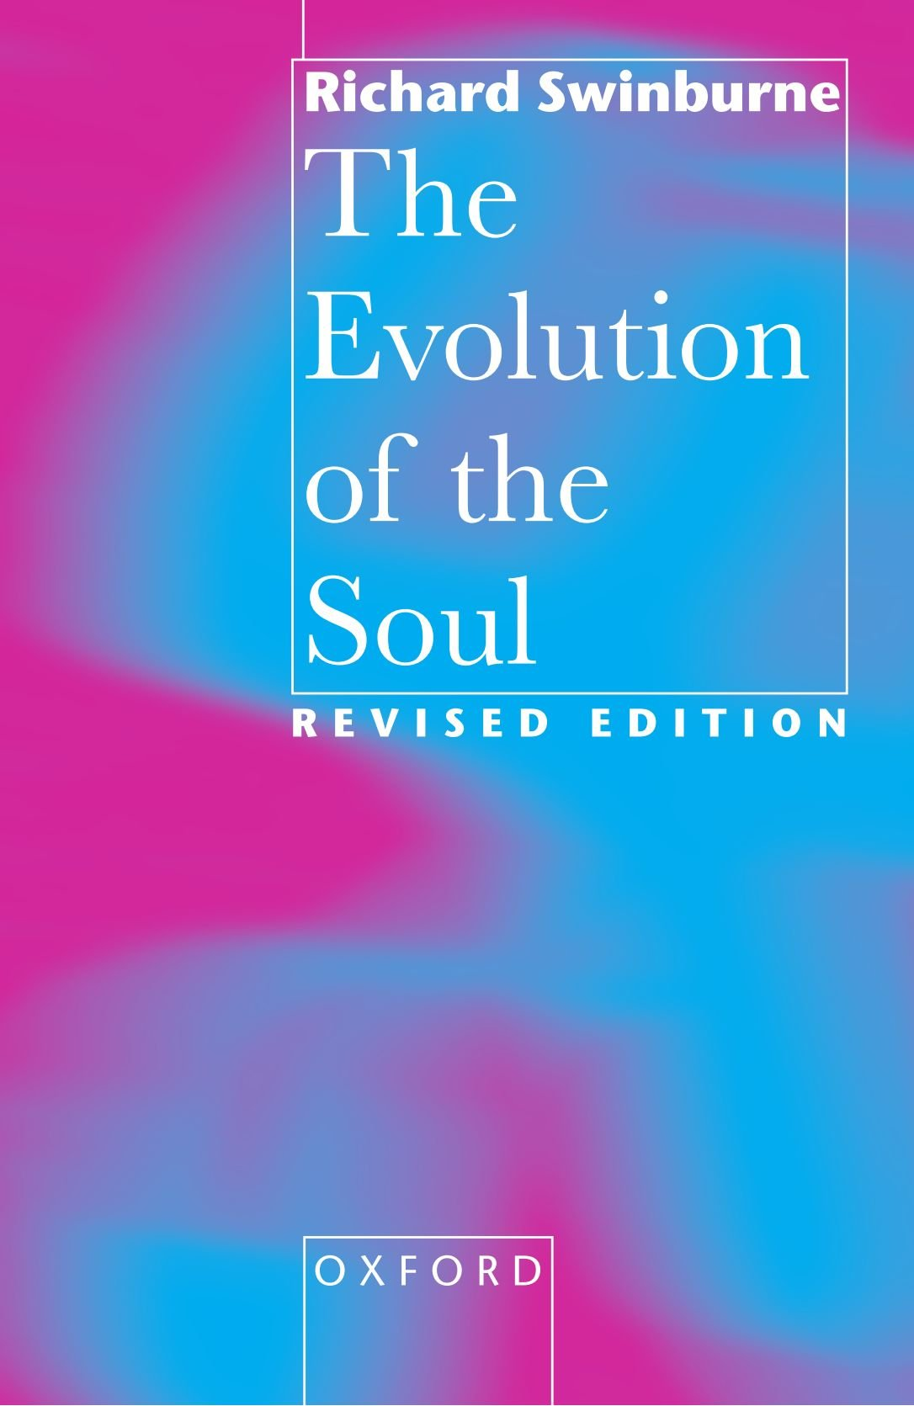
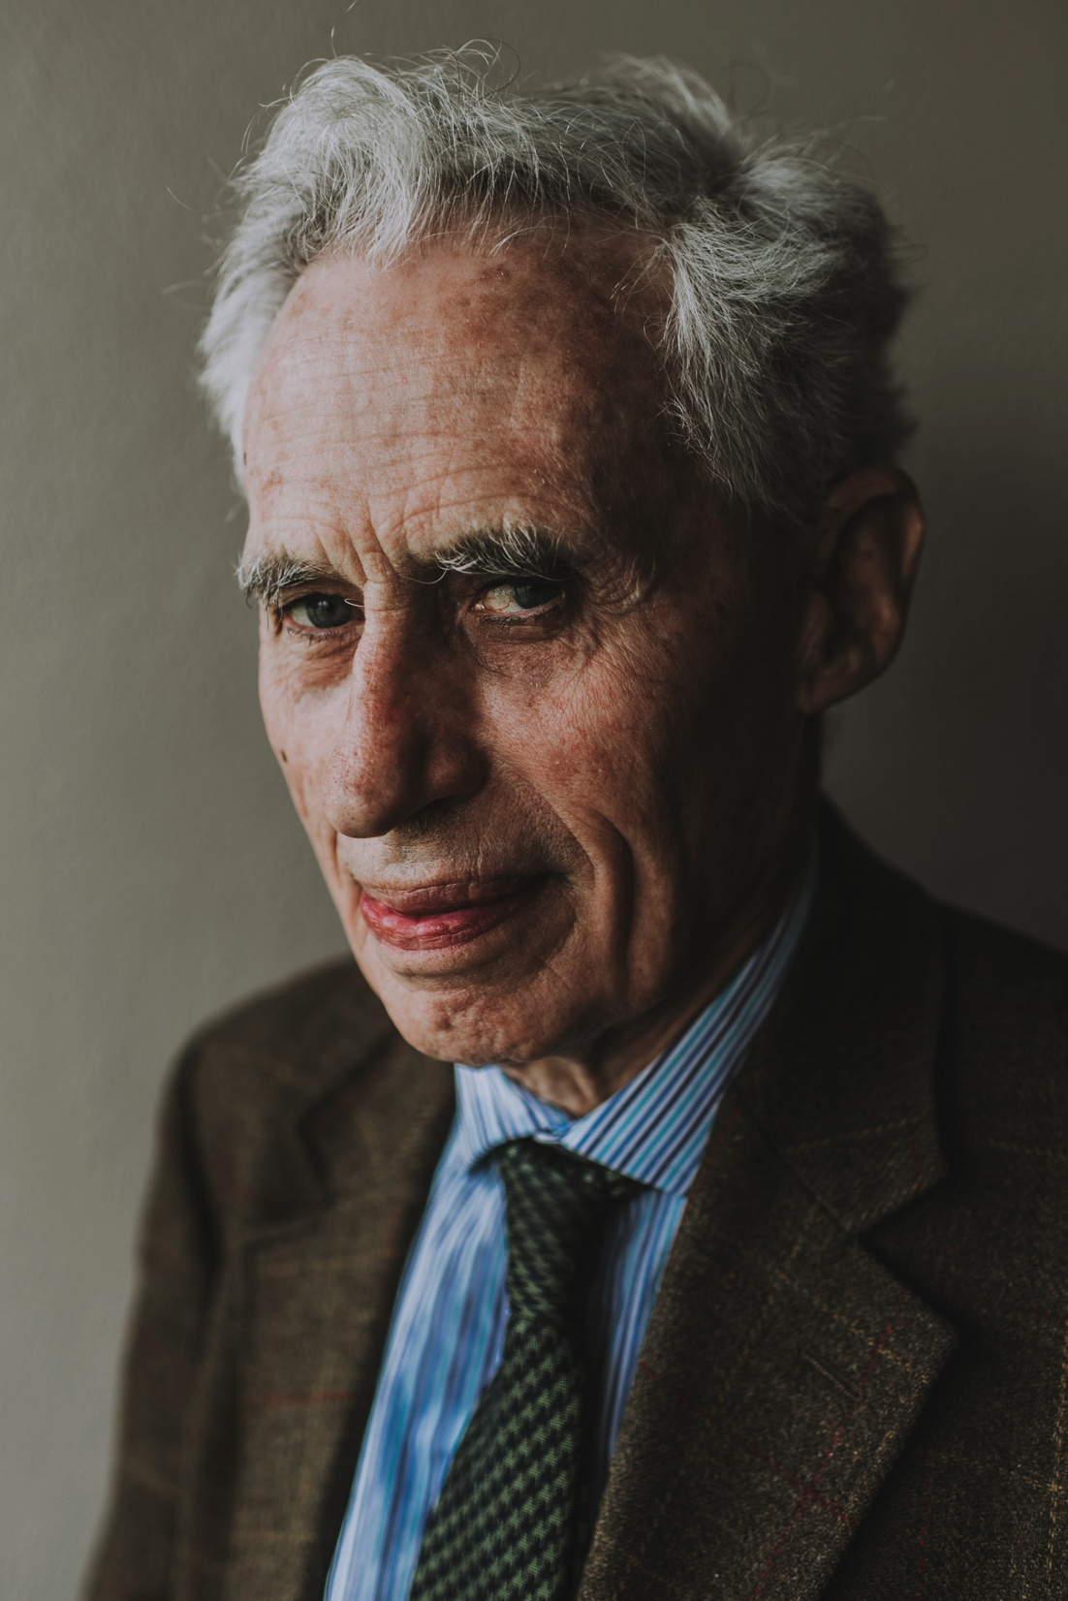
SWINBURNE ON ABORTION

Slide 61
SWINBURNE ON ABORTION
“What we value about being alive depends on having a conscious life. . . . There is, however, no evidence that before that first glimmer of consciousness it is predetermined who a given foetus will be (i.e. which soul will be associated with a given foetus). . . . Hence to abort the early foetus would not be to end the existence of a particular person” (315)
“So I conclude that it is reasonable to suppose (in the absence of any further evidence) that only when there is first a conscious life, will abortion constitute the ending of the life of a particular person, and so constitute murder” (315)
“When does consciousness begin? We don’t know. But there is substantial reason to believe that a foetus is conscious only when it evinces the same kind of electrical rhythms as are characteristic of consciousness after birth — maybe as late as twenty weeks after conception, or maybe earlier” (316)
Richard Swinburne
Notes:
“it is in no way improbable that, instead of the soul which did become associated with that foetus, quite another soul could have done so”

Slide 62
UNGRADED POLL (question 1)
frozen embryos

Slide 63
UNGRADED POLL (question 2)

Slide 64
UNGRADED POLL (question 2)

Slide 65
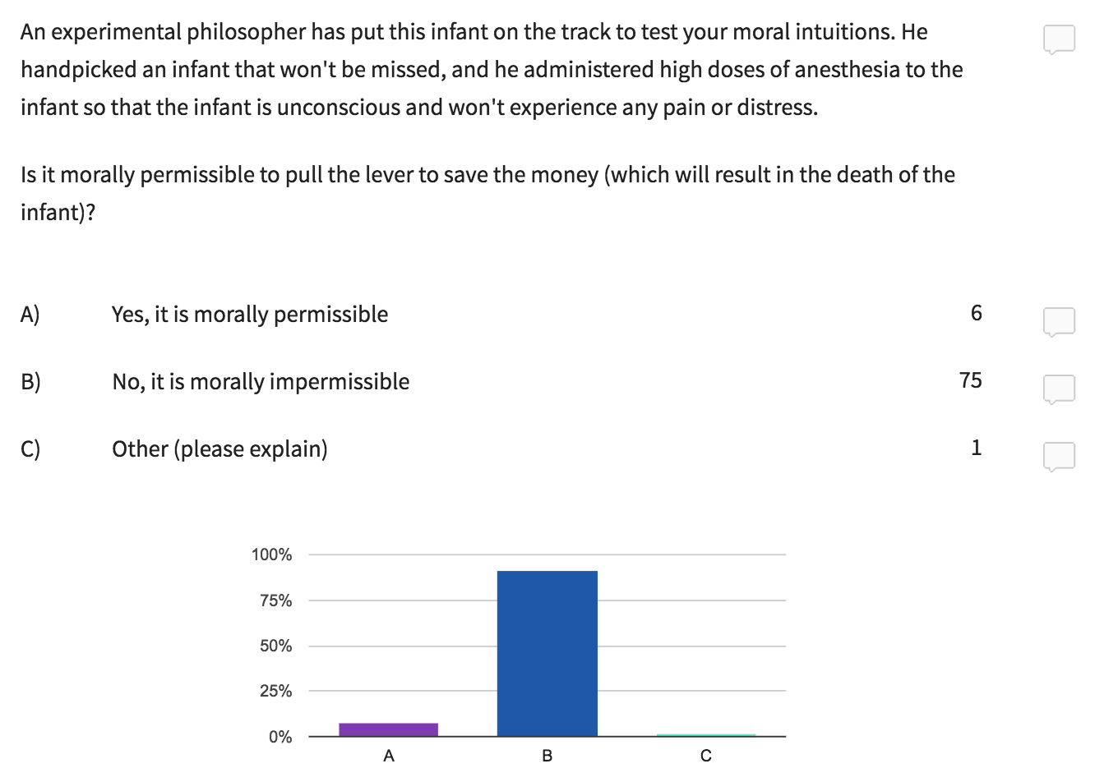
UNGRADED POLL (question 2)

Slide 66
begin
Describe the case in detail
Does it illicit strong moral intuitions?
INTUITIVE APPROACH
Make a list of any extraneous factors (distorting biases, background moral theories, etc.) that may be responsible for these intuitions
Yes
No
Is it similar to more clear-cut cases?
Expand list of extraneous factors and isolate any morally relevant features shared by these cases
Yes
No
Build or refine a theory that best explains this data and discard any extraneous factors that conflict with it
Test predictions against other cases
No
reflective equilibrium
Considered moral judgements and principles
Is the theory stable?
Yes

