Slide 1
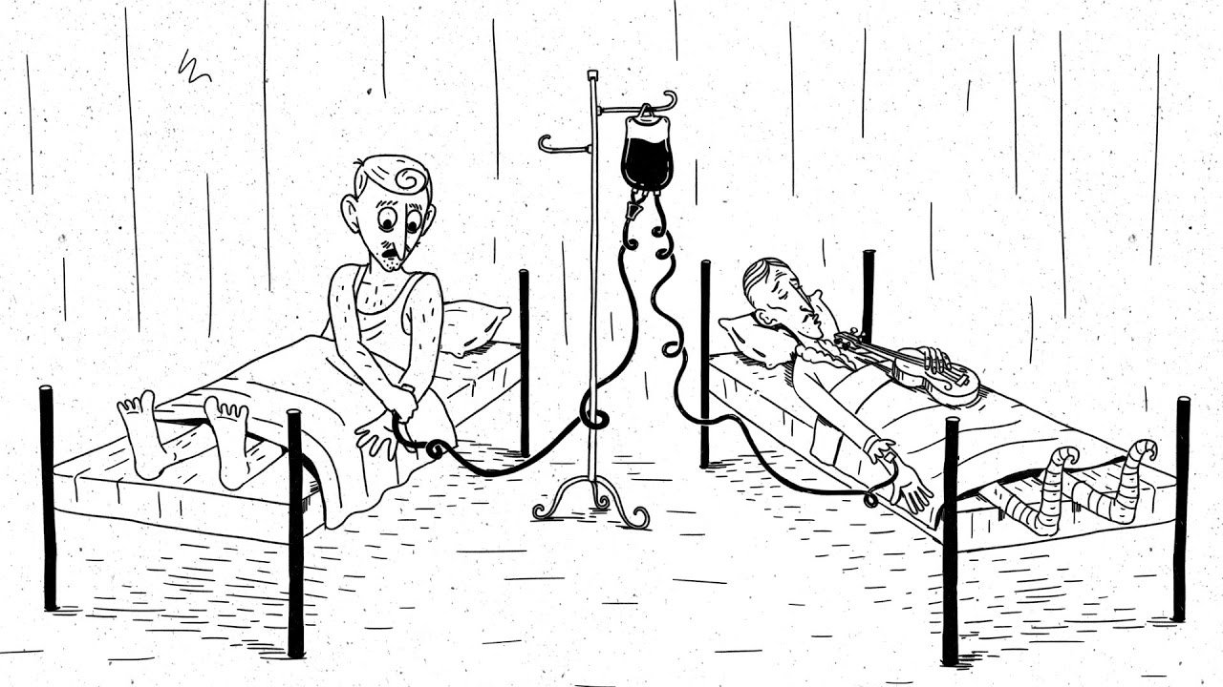
The ethics of abortion
PHL 304
Fall 2018

Slide 2
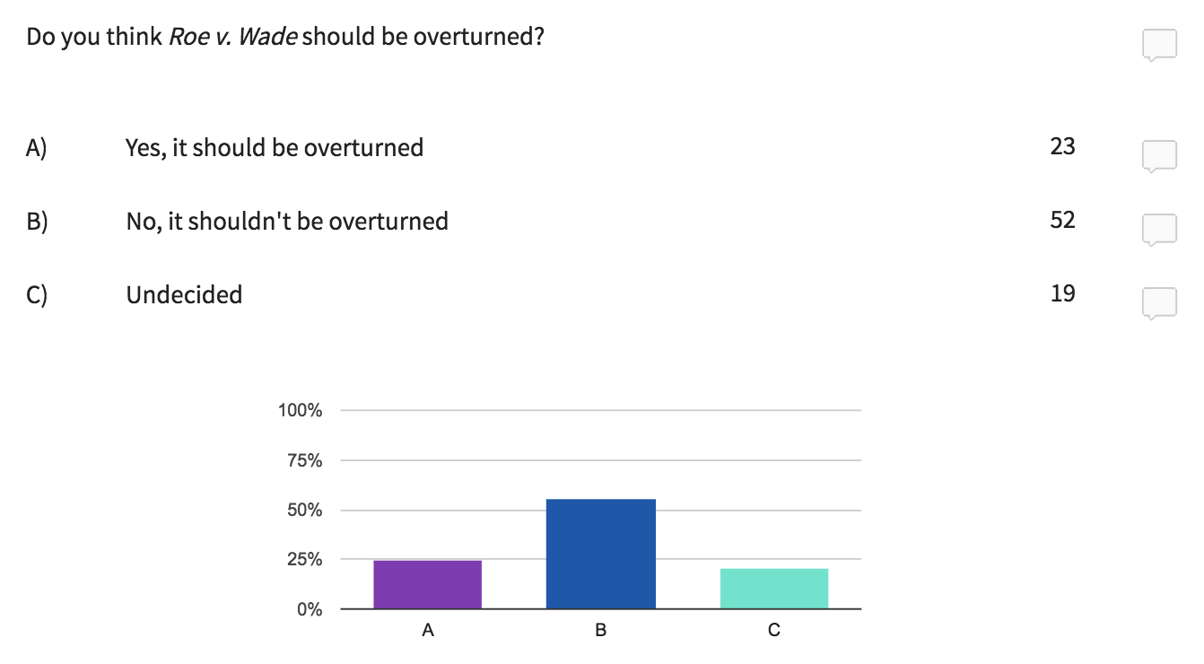
UNGRADED POLLS (questions 1–2)

Slide 3
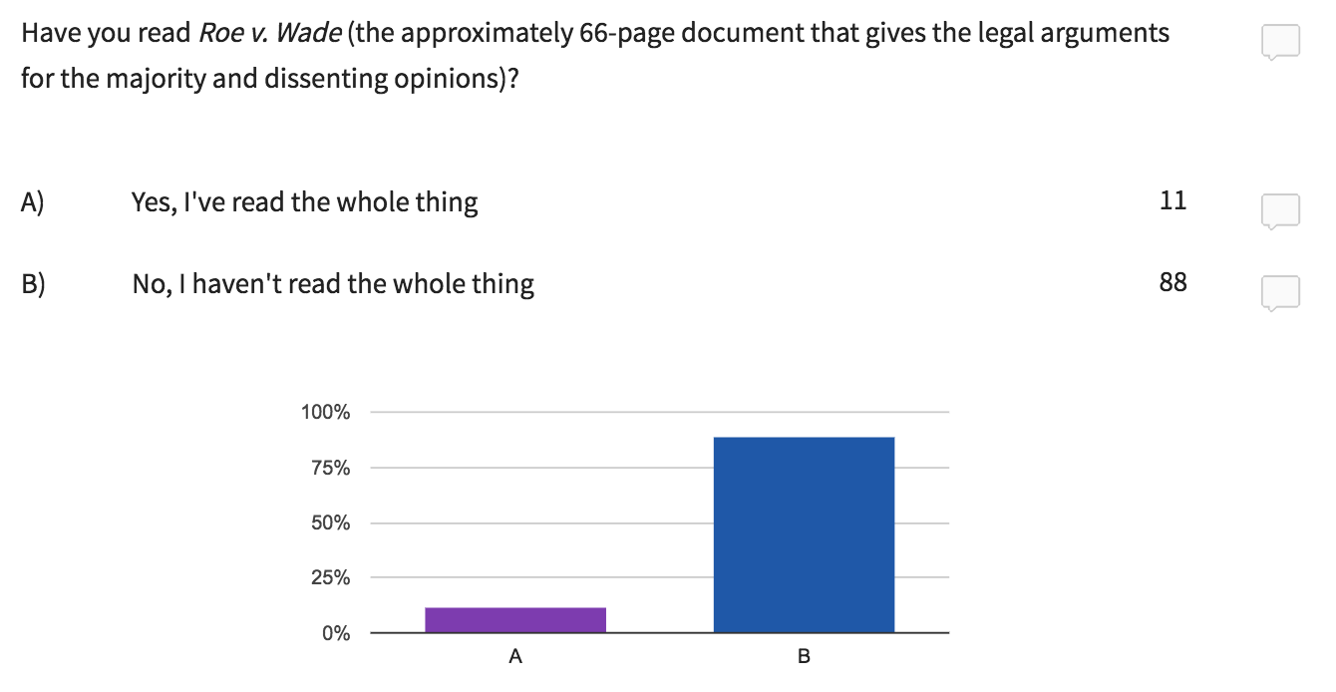
UNGRADED POLLS (questions 1–2)

Slide 4
ROE V. WADE
In 1970, Norma “Jane Roe” Nelson, a pregnant single woman, filed a class action lawsuit challenging the constitutionality of Texas abortion laws.
Dr. James Hallford sought injunction against prosecution for performing abortions that were criminalized by the laws.
The Does, a childless couple, sought injunction against enforcement of the laws.
These laws made it a crime to obtain or attempt an abortion—except in the special case of obtaining or attempting an abortion in response to medical advice for the purpose of saving the life of the mother.
That year, the Dallas District Court ruled 3–0 that Roe and Hallford had standing to sue and that declaratory relief was warranted.
The plaintiffs appealed to the Supreme Court, and Henry Wade, the district attorney of Dallas and defendant in the case, cross-appealed.

Slide 5
ROE V. WADE
The Supreme Court dismissed the complaints of Dr. Hallford and the Does.
The Court maintained that Roe had standing to sue, because “[l]itigation involving pregnancy, which is ‘capable of repetition, yet evading review,’ is an exception to the usual federal rule that an actual controversy must exist at review stages and not simply when the action is initiated” (114).
In 1973, the Court issued a 7–2 ruling that the Texas laws were unconstitutional.
Justice Harry Blackmun authored the majority opinion.
Notes:
“The District Court correctly refused injunctive, but erred in granting declaratory, relief to Hallford, who alleged no federally protected right not assertable as a defense against the good-faith state prosecutions pending against him” (114)
“The Does' complaint, based as it is on contingencies, any one or more of which may not occur, is too speculative to present an actual case or controversy” (114)

Slide 6
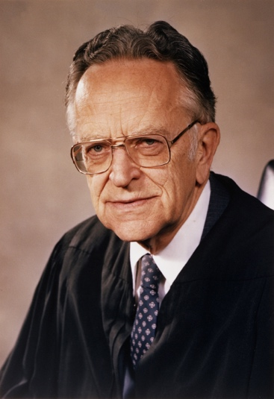
ROE V. WADE
The due process clause of the Fourteenth Amendment states that no state shall “deprive any person of life, liberty, or property, without due process of law.”
The Court maintains that this amendment guarantees a right to privacy that is “broad enough to encompass a woman’s decision whether or not to terminate her pregnancy” (157).
But this right is not absolute: it must be weighed against competing state interests in protecting the health of the mother as well as “potential life.”
Each of these state interests “grows in substantiality as the woman approaches term and, at a point during pregnancy, each becomes ‘compelling’” (163).
Justice Blackmun
Notes:
While the Constitution does not explicitly mention a right to privacy, this interpretation coheres with prior rulings.
What about “person”?

Slide 7
THE TRIMESTER SYSTEM
“The majority of abortions in 2014 took place early in gestation: 91.5% of abortions were performed at ≤13 weeks’ gestation; a smaller number of abortions (7.2%) were performed at 14–20 weeks’ gestation, and even fewer (1.3%) were performed at ≥21 weeks’ gestation.”
– Centers for Disease Control and Prevention

Slide 8
WHOSE RIGHT TO PRIVACY?
“The decision vindicates the right of the physician to administer medical treatment according to his professional judgment up to the points where important state interests provide compelling justifications for intervention. Up to those points, the abortion decision in all its aspects is inherently, and primarily, a medical decision, and basic responsibility for it must rest with the physician” (165–66).
Justice Blackmun

Slide 9
WHOSE RIGHT TO PRIVACY?
“This was, perhaps, not a surprising focus for a decision that voided criminal abortion laws; after all, it was not the woman but the doctor who faced criminal liability under every existing law. In addition, the briefs filed with the Court from many corners of the medical establishment portrayed existing abortion laws as a threat to women’s safety, a substantial public health problem. If anyone’s ‘liberty’ was threatened, it was that of doctors. Nonetheless, the Court’s emphasis on the rights of doctors was striking” (99).
Linda Greenhouse

Slide 10
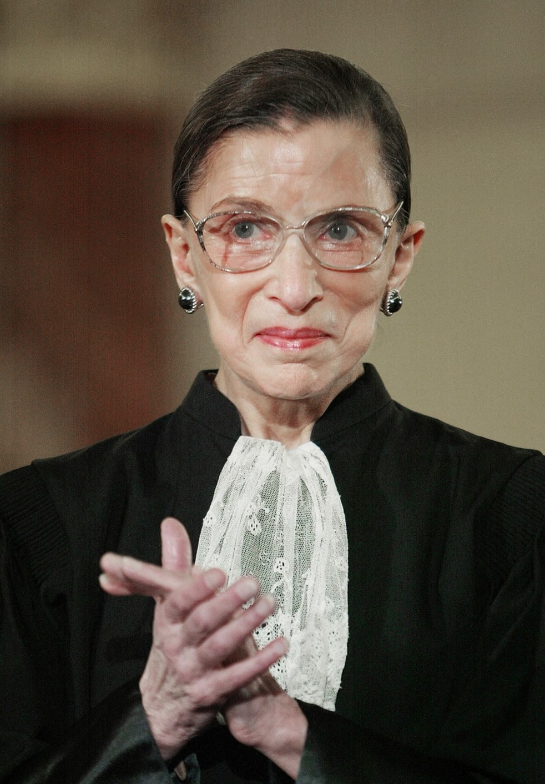
WHOSE RIGHT TO PRIVACY?
“[Roe v. Wade is] about a doctor’s freedom to practice his profession as he thinks best. . . . It wasn’t woman-centered. It was physician-centered.”
Ruth Bader Ginsburg

Slide 11
MORAL RELVANCE?
“The point at which the fetus can survive outside the mother’s body varies according to the state of medical technology. . . . In light of these medical developments, do we say that a six-month-old fetus should not be aborted now, but could have been aborted without wrongdoing thirty years ago?” (140)
“Suppose that for some reason a woman, six months pregnant, was to fly from New York to New Guinea village and that, once she had arrived in the village, there was no way she could return quickly to a city with modern medical facilities. Are we to say that it would have been wrong for her to have an abortion before she left New York, but now that she is in the village she may go ahead?” (140)
Peter Singer
Notes:
“Thirty years ago it was generally accepted that a baby born more than two months premature could not survive. Now a six-month fetus – three months premature – can often be pulled through, thanks to sophisticated techniques, and fetuses born after as little as five and a half months of gestation can survive” (140)
“This threatens to undermine the Supreme Court’s neat division of pregnancy into trimesters, with the boundary of viability lying between the second and third trimesters” (140)
“A six-month-old fetus might have a fair chance of survival if born in a city where the latest medical techniques are used, but no chance at all if born in a remote village in Chad or New Guinea” (140)

Slide 12
RIGHTS-BASED THEORIES
Intuitively, a right is entitlement (not) to act in some way or (not) to be in a certain state, or an entitlement that others (not) act in some way or (not) be in a certain state.
Rights can be claims: when someone else has a duty to act toward the right-holder in a certain way.
They also be privileges: when the right-holder has no duty not to act in a certain way.
Right-holders have powers: they have the ability to alter how their rights interact with the duties of other people.
They may also have immunities: they are such that other individuals lack the ability to alter their claims, privileges, powers, and other immunities.

Slide 13
RIGHTS-BASED THEORIES
GIVEN THAT YOU HAVE A PROPERTY RIGHT OVER YOUR COMPUTER, YOU HAVE…
POWER to wave, annul, or transfer your… | IMMUNITY against others altering your…
PRIVILEGE to use the computer | CLAIM against others using the computer

Slide 14
RIGHTS-BASED THEORIES
Rights generate reasons for other people to act (or not to act) in certain ways.
These reasons are very strong. With respect to some rights, these reasons may be decisive.
They may also generate exclusionary reasons: second-order reasons not to act on first-order reasons.
But some rights may have higher priority than others, so that reasons that are decisive in some cases may not be in other cases.

Slide 15
RIGHTS-BASED THEORIES
“Natural rights is simple nonsense: natural and imprescriptible rights, rhetorical nonsense,—nonsense upon stilts” (501)
Jeremy Bentham

Slide 16
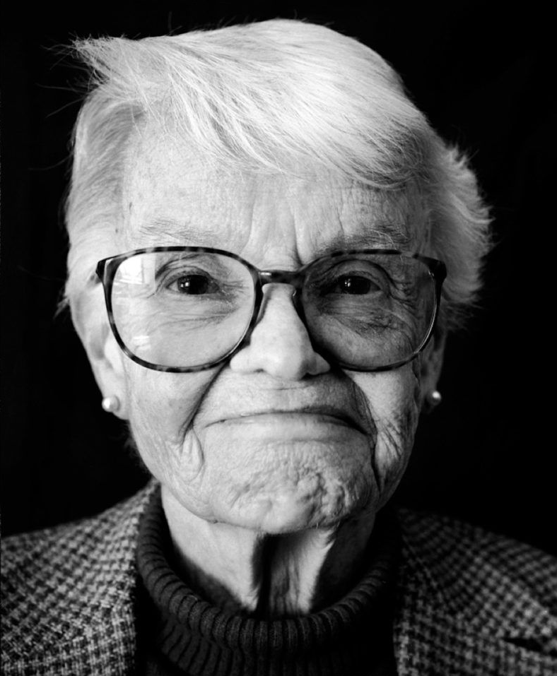
OPPOSITION TO ABORTION
“Most opposition to abortion relies on the premise that the fetus is a human being, a person, from the moment of conception” (47)
“How, precisely, are we supposed to get from there to the conclusion that abortion is morally impermissible?” (48)
“I suggest that [this step] is neither easy nor obvious, that it calls for closer examination than it is commonly given, and that when we do give it this closer examination we shall feel inclined to reject it” (48)
Judith Jarvis Thomson
Notes:
“I propose, then, that we grant that the fetus is a person from the moment of conception. How does the argument go from here?” (48)

Slide 17
OPPOSITION TO ABORTION
Every person has a right to life.
If the fetus has a right to life, then it is impermissible to kill the fetus (unless the fetus’s right is outweighed by a conflicting right).
If it is impermissible to kill the fetus (unless the fetus’s right is outweighed by a conflicting right), then abortion is morally impermissible (unless the mother’s right to bodily autonomy outweighs the fetus’s right to life).
The fetus is a person.
It is not the case that the mother’s right to bodily autonomy outweighs the fetus’s right to life.
So: abortion is morally impermissible.

Slide 18
THE VIOLINIST ANALOGY
We're sorry the Society of Music Lovers did this to you. But it’s only for nine months!
It sounds plausible. But now let me ask you to imagine this.

Slide 19
THE VIOLINIST ANALOGY
To unplug you would be to kill him, so you must wait!
It sounds plausible. But now let me ask you to imagine this.

Slide 20
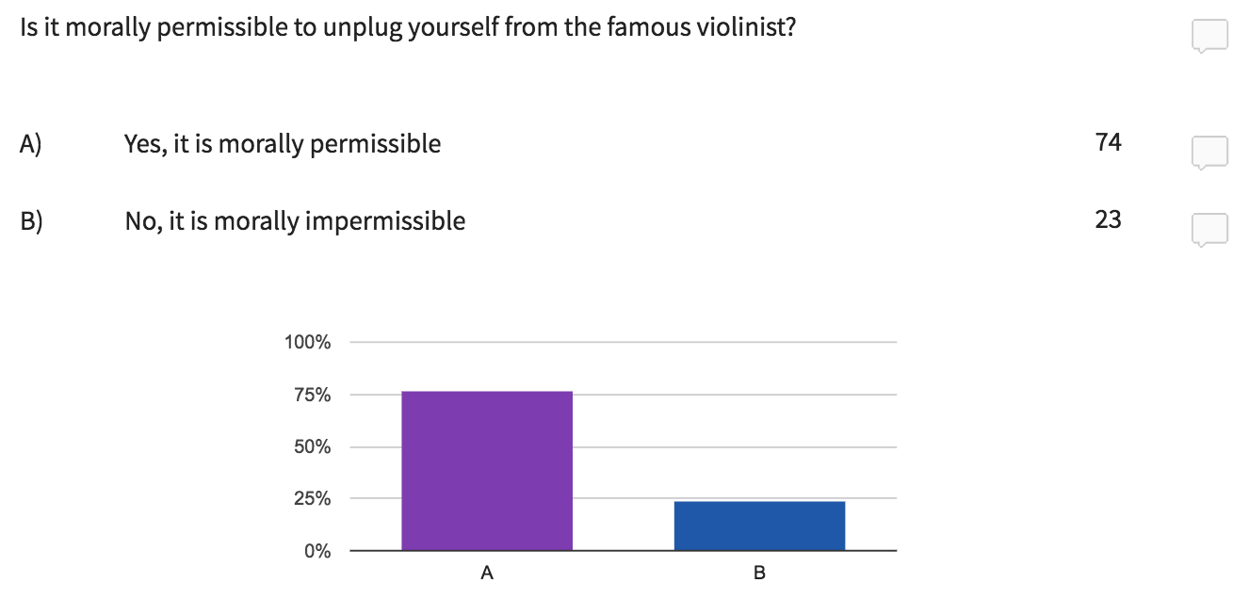
UNGRADED POLL (question 3)

Slide 21
THE VIOLINIST ANALOGY
The famous violinist has a right to life.
You have a right to bodily autonomy.
It is morally permissible to unplug yourself.
Notes:
What follows from this with respect to abortion?

Slide 22
OPPOSITION TO ABORTION
Can we argue by analogy that abortion is also morally permissible?
It might be objected that, in this case, you didn’t volunteer the use of your kidneys.
Perhaps this thought experiment only shows that it is morally permissible for rape victims to have abortions.
Judith Jarvis Thomson
Notes:
“They can say that persons have a right to life only if they didn’t come into existence because of rape; or they can say that all persons have a right to life, but that some have less of a right to life than others, in particular, that those who came into existence because of rape have less. But these statements have a rather unpleasant sound” (49)
“Surely the question of whether you have a right to life at all, or how much of it you have, shouldn’t turn on the question of whether or not you are the product of a rape” (49)

Slide 23
THE EXTREME VIEW
According to the extreme view, abortion is morally impermissible even to save the life of the mother.
Why one anyone hold this view?
Directly killing an innocent person is always and absolutely impermissible.
Directly killing an innocent person is murder, and murder is always and absolutely impermissible.
One’s duty to refrain from directly killing an innocent person is more stringent than one’s duty to keep a person from dying.
If one’s only options are directly killing an innocent person or letting a person die, it is impermissible to kill the innocent person.
Notes:
“How is it supposed to come out that an abortion may not be performed? If mother and child have an equal right to life, shouldn’t we perhaps flip a coin? Or should we add to the mother’s right to life her right to decide what happens in and to her body, which everybody seems to be ready to grant—the sum of her rights now outweighing the fetus’ right to life?” (50)
Performing an abortion is an act of direct killing
Letting the mother die is not an act of direct killing
The child is innocent and does not aim at the mother’s death

Slide 24
THE EXTREME VIEW
(1) Directly killing an innocent person is always and absolutely impermissible.
(2) Directly killing an innocent person is murder.
(3) One’s duty to refrain from directly killing an innocent person is more stringent than one’s duty to keep a person from dying.
(4) If one’s only options are directly killing an innocent person or letting a person die, it is impermissible to kill the innocent person.
Notes:
“How is it supposed to come out that an abortion may not be performed? If mother and child have an equal right to life, shouldn’t we perhaps flip a coin? Or should we add to the mother’s right to life her right to decide what happens in and to her body, which everybody seems to be ready to grant—the sum of her rights now outweighing the fetus’ right to life?” (50)
Performing an abortion is an act of direct killing
Letting the mother die is not an act of direct killing
The child is innocent and does not aim at the mother’s death

Slide 25
THE EXTREME VIEW
If anything in the world is true, it is that you do not commit murder, you do not do what is impermissible, if you reach around to your back and unplug yourself from that violinist to save your life. (52)
(1) Directly killing an innocent person is always and absolutely impermissible.
(2) Directly killing an innocent person is murder.
(3) One’s duty to refrain from directly killing an innocent person is more stringent than one’s duty to keep a person from dying.
(4) If one’s only options are directly killing an innocent person or letting a person die, it is impermissible to kill the innocent person.
Notes:
“How is it supposed to come out that an abortion may not be performed? If mother and child have an equal right to life, shouldn’t we perhaps flip a coin? Or should we add to the mother’s right to life her right to decide what happens in and to her body, which everybody seems to be ready to grant—the sum of her rights now outweighing the fetus’ right to life?” (50)
Performing an abortion is an act of direct killing
Letting the mother die is not an act of direct killing
The child is innocent and does not aim at the mother’s death

Slide 26
OPPOSITION TO ABORTION
“[T]he question asked is what a third party may do, and what the mother may do, if it is mentioned at all, is deduced, almost as an afterthought, from what is concluded that third parties may do” (52)
“But it seems to me that to treat the matter in this way is to refuse to grant to the mother that very status of person which is so firmly insisted on for the fetus. For we cannot simply read off what a person may do from what a third party may do” (52)
Judith Jarvis Thomson
Notes:
“They can say that persons have a right to life only if they didn’t come into existence because of rape; or they can say that all persons have a right to life, but that some have less of a right to life than others, in particular, that those who came into existence because of rape have less. But these statements have a rather unpleasant sound” (49)
“Surely the question of whether you have a right to life at all, or how much of it you have, shouldn’t turn on the question of whether or not you are the product of a rape” (49)

Slide 27
THE EXPANDING CHILD ANALOGY
rapidly expanding child
I cannot be the one to decide who is to live! I mustn’t intervene!
bystander
Notes:
“[Y]ou are already up against the wall of the house and in a few minutes you’ll be crushed to death” (52)
“The child on the other hand won’t be crushed to death; if nothing is done to stop him from growing he’ll be hurt, but in the end he’ll simply burst open the house and walk out a free man” (52)
“But it cannot be concluded that you too can do nothing, that you cannot attack it to save your life” (52)
“However innocent the child may be, you do not have to wait passively while it crushes you to death” (52)
“Perhaps a pregnant woman is vaguely felt to have the status of house, to which we don’t allow the right of self-defense. But if the woman houses the child, it should be remembered that she is a person who houses it” (53)
“[T]his shows not merely that the theses in (1) through (4) are false; it shows also that the extreme view of abortion is false” (53)

Slide 28
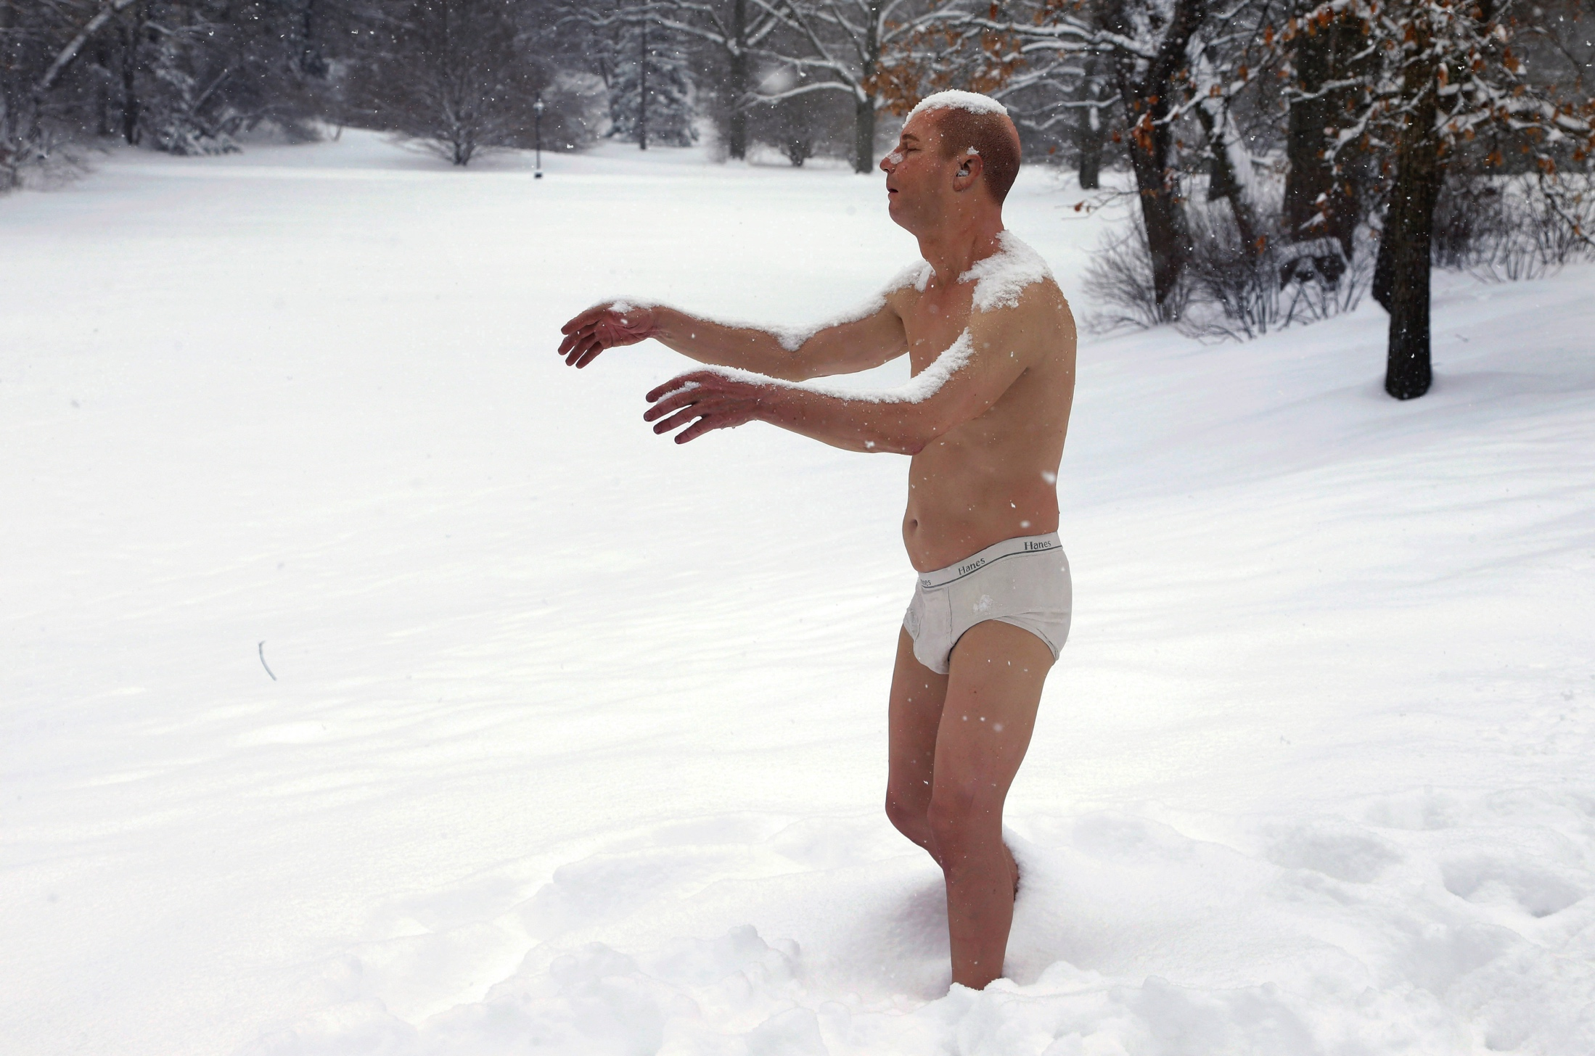
THE STOLEN COAT ANALOGY
I cannot be the one to decide who is to live! I mustn’t intervene!
owner of coat
bystander
jones
smith
Notes:
“[T]he mother owns the house” (53)
“[I]t casts a bright light on the supposition that third parties can do nothing” (53)
“[I]t is not impartiality that says ‘I cannot choose between you’ when Smith owns the coat” (53)
“Women have said again and again ‘This is my body!’ and they have reason to feel angry, reason to feel that it has been like shouting into the wind’ (53)
“Smith, after all, is hardly likely to bless us if we say to him, ‘Of course it’s your coat, anybody would grant that it is. But no one may choose between you and Jones who is to have it” (54)
“I have not been arguing that any given third party must accede to the mother’s request that he perform an abortion to save her life, but only that he may” (54)

Slide 29
UPSHOTS
“[T]he arguments against abortion we are looking at do grant that the woman has a right to decide what happens in and to her body. . . . [But] they do not take seriously what is done in granting it” (54)
VIOLINIST/EXPANDING CHILD | STOLEN COAT ANALOGY
It can be permissible to kill when one’s own rights conflict with another’s. | It can be permissible for a bystander to kill when someone else’s rights conflict with another’s.

Slide 30
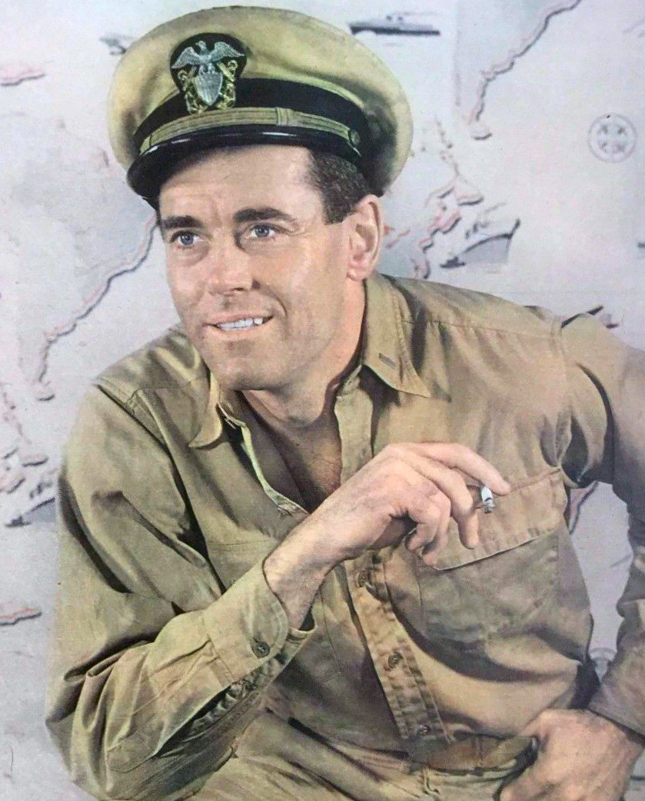
WHAT THE RIGHT TO LIFE IS NOT
The right to life doesn’t give rise to a right to be given the bare minimum one needs for continued life.
no right to the cool hand of henry fonda
Notes:
“If I am sick unto death, and the only thing that will save my life is the touch of Henry Fonda’s cool hand on my fevered brow, then all the same, I have no right to be given the touch of Henry Fonda’s cool hand on my fevered brow” (55)
“I have no right at all against anybody that he should do this for me” (55)

Slide 31
WHAT THE RIGHT TO LIFE IS NOT
The right to life doesn’t give rise to a positive right to be given the bare minimum one needs for continued life.
Nor does it give rise to a negative right not to be killed.
Otherwise, the right to life would give rise to the right to the use of another person’s body—and it doesn’t.
no right to the use of your kidneys
Notes:
“For nobody has any right to use your kidneys unless you give him such a right; and nobody has the right against you that you shall give him this right—if you do allow him to go on using your kidneys, this is a kindness on your part, and not something he can claim from you as his due” (55)
“But does he have a right against everybody that they shall refrain from plugging you from him? To refrain from doing this is to allow him to continue to use your kidneys” (56)
“It could be argued that he has a right against us that we should allow him to continue to use your kidneys. That is, while he had no right against us that we should give him the use of your kidneys, it might be argued that he anyway has a right against us that we shall not now intervene and deprive him of the use of your kidneys” (56)
“But certainly the violinist has no right against you that you shall allow him to continue to use your kidneys” (56)

Slide 32
THE RIGHT TO LIFE
So what does the right to life amount to?
unjust treatment
a right to half the gifts
Notes:
In the violinist case, “You surely are not being unjust to him, for you gave him no right to your kidneys, and no one else can have given him any such right” (57)

Slide 33
THE RIGHT TO LIFE
So what does the right to life amount to?
The right to life consists in the right not to be killed unjustly.
unplugging yourself isn’t unjust
no right to the use of your kidneys
Notes:
In the violinist case, “You surely are not being unjust to him, for you gave him no right to your kidneys, and no one else can have given him any such right” (57)

Slide 34
THE RIGHT TO LIFE
So what does the right to life amount to?
The right to life consists in the right not to be killed unjustly.
“But if this emendation is accepted, the gap in the argument against abortion stares us plainly in the face: it is by no means enough to show that the fetus is a person, and to remind us that all persons have a right to life—we need to be show also that killing the fetus violates its right to life, i.e., that abortion is unjust killing. And is it?” (57)

Slide 35
IS ABORTION UNJUST KILLING?
It might be argued that in the vast majority of cases, the fetus has acquired the right to the use of another’s body.
This move might force the conclusion that it is morally permissible for rape victims to have abortions, because a rape victim has not given the fetus a right to the use of her body.
It might also have the surprising consequence that it is morally impermissible to have an abortion when it is necessary to save the life of the mother.
But perhaps it can restore the conclusion that most other abortions are morally impermissible as well.
Notes:
“Suppose a woman voluntarily indulges in intercourse, knowing of the chance it will issue in pregnancy, and then she does become pregnant; is she not in part responsible for the presence, in fact the very existence, of the unborn person inside her?” (57)
“[D]oesn’t her partial responsibility for its being there itself give it a right to the use of her body?” (58)
“If so, then her aborting it would be more like the boy’s taking away the chocolates, and less like your unplugging yourself from the violinist—doing so would be depriving it of what it does have a right to, and thus would be doing it an injustice” (58)
“And then, too, it might be asked whether or not she can kill it even to save her own life: If she voluntarily called it into existence, how can she now kill it, even in self-defense?” (58)
“[T]his argument would give the unborn person a right to its mother’s body only if her pregnancy resulted from a voluntary act, undertaken in full knowledge of the chance a pregnancy might result from it” (58)

Slide 36
IS ABORTION UNJUST KILLING?
no right to the use of your house
Notes:
“[S]he’s given him a right to the use of her house—for she is partially responsible for his presence there, having voluntarily done what enabled him to get in, in full knowledge that there are such things as burglars, and that burglars burgle” (59)
“It would be still more absurd to say this if I had had bars installed outside my windows, precisely to prevent burglars from getting in, and a burglar got in only because of a defect in the bars” (59)

Slide 37
IS ABORTION UNJUST KILLING?
no right to the use of your house
Notes:
“You don’t want children, so you fix up your windows with fine mesh screens, the very best you can buy. As can happen, however, and on very, very rare occasions does happen, one of the screens is defective; and a seed drifts in and takes root. Does the person-plant who now develops have a right to the use of your house?” (59)

Slide 38
IS ABORTION UNJUST KILLING?
Someone may argue that you are responsible for its rooting, that it does have a right to your house, because after all you could have lived out your life with bare floors and furniture, or with sealed windows and doors. (59)
no right to the use of your house
Notes:
“You don’t want children, so you fix up your windows with fine mesh screens, the very best you can buy. As can happen, however, and on very, very rare occasions does happen, one of the screens is defective; and a seed drifts in and takes root. Does the person-plant who now develops have a right to the use of your house?” (59)

Slide 39
IS ABORTION UNJUST KILLING?
But this won’t do—for by that same token anyone can avoid a pregnancy due to rape by having a hysterectomy, or anyway by never leaving home without a (reliable!) army. (59)
no right to the use of your house
Notes:
“You don’t want children, so you fix up your windows with fine mesh screens, the very best you can buy. As can happen, however, and on very, very rare occasions does happen, one of the screens is defective; and a seed drifts in and takes root. Does the person-plant who now develops have a right to the use of your house?” (59)

Slide 40
IS ABORTION UNJUST KILLING?
It seems that the argument we are looking at can establish at most that there are some cases in which the unborn person has a right to the use of the mother’s body, and therefore some cases in which abortion is unjust killing. (59)
no right to the use of your house
Notes:
“You don’t want children, so you fix up your windows with fine mesh screens, the very best you can buy. As can happen, however, and on very, very rare occasions does happen, one of the screens is defective; and a seed drifts in and takes root. Does the person-plant who now develops have a right to the use of your house?” (59)

Slide 41
SUMMARY
Does the right to life give rise to a right to be given the bare minimum one needs for continued life and/or a right not to be killed? | Does the right to life give rise to a right not to be killed unjustly? | Can it be permissible for a third party to bring about x’s death when x has no right to something of y’s and doing so is necessary to respect y’s right to that thing? | If x voluntarily performs actions that x knows to put one at risk of becoming pregnant, and x becomes pregnant, does the fetus acquire a right to the use of x’s body?
Violinist analogy | Sibling analogy | Stolen coat analogy | Burglar analogy
Expanding child analogy |  | Violinist analogy | People-seeds analogy
Henry Fonda analogy

Slide 42
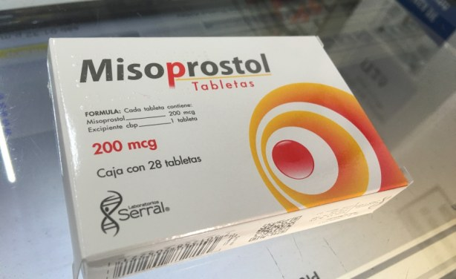
THIRD-PARTY INTERVENTION

Slide 43
THIRD-PARTY INTERVENTION
To give you the resources to unplug yourself would be to kill the violinist, so I mustn’t do so!
Notes:
“There you are, you were kidnapped, and nine years in bed with that violinist lie ahead of you. You have your own life to lead. You are sorry, but you simply cannot see giving up so much of your life to the sustaining of his” (64)
“You cannot extricate yourself, and ask us to do so” (64)
“I should have thought that—in light of his having no right to the use of your body—it was obvious that we do not have to accede to your being forced to give up so much. We can do what you ask. There is no injustice to the violinist in our doing so” (64)

Slide 44
TWO DIFFERENT COMPLAINTS
Suppose the violinist only needs one hour of your life, and doing so would not have any negative impact on your health.
YOU OUGHT TO WAIT
no right to the use of your kidneys
Notes:
In the violinist case, “You surely are not being unjust to him, for you gave him no right to your kidneys, and no one else can have given him any such right” (57)

Slide 45
TWO DIFFERENT COMPLAINTS
Suppose only one of the boys was granted ownership of the chocolates.
he ought to share (but refraining is not unjust)
no right to half the gifts

Slide 46
TWO DIFFERENT COMPLAINTS
Suppose from the fact that Fonda ought to touch the patient’s fevered brow it follows that the patient has a right against Fonda to do so.
It follows that whether the patient has such a right turns on how easy it is for others to respect it.
HE OUGHT TO DO SO
right to the cool hand of henry fonda????

Slide 47
TWO DIFFERENT COMPLAINTS
“So my own view is that even though you ought to let the violinist use your kidneys for the one hour he needs, we should not conclude that he has a right to do so” (61)
“And similarly, that even supposing a case in which a woman pregnant due to rape ought to allow the unborn person to use her body for the hour he needs, we should not conclude that he has a right to do so; we should conclude that she is self-centered, callous, indecent, but not unjust, if she refuses” (61)
“The complaints are no less grave; they are just different” (61)
Judith Jarvis Thomson
Notes:
“—we should say that if you refuse, you are, like the boy who owns all the chocolates and will give none away, self-centered and callous, indecent in fact, but not unjust” (61)

Slide 48
TWO DIFFERENT COMPLAINTS
Even if a rights-claim can be deduced from an ought-claim, the defense appears to stand.
“Except in such cases as the unborn person has a right to demand [the use of the mother’s body], nobody is morally required to make large sacrifices, of health, of all other interests and concerns, of all other duties and commitments, for nine years, or even for nine months, in order to keep another person alive” (62)
Judith Jarvis Thomson

Slide 49
OBLIGATION / SUPEREROGATION
Minimally Good Samaritans do what they are morally required to do.
Good Samaritans not only do what they are morally required to do but also act so as to maximize the good—even when doing so comes with the risk of great personal cost.
Judith Jarvis Thomson

Slide 50
OBLIGATION / SUPEREROGATION
“[I]t is worth drawing attention to the fact that in no state in this country is any man compelled by law to be even a Minimally Decent Samaritan to any person. . . . By contrast, in most states in this country women are compelled by law to be not merely Minimally Decent Samaritans, but Good Samaritans to unborn persons inside them” (63)
“[This shows] that there is a gross injustice in the existing state of the law. And it shows also that the groups currently working against liberallzation of abortion laws, in fact working toward having it declared unconstitutional for a state to permit abortion, had better start working for the adoption of Good Samaritan laws generally, or earn the charge that they are acting in bad faith” (63–64)
Judith Jarvis Thomson
Notes:
“And I am suggesting that if assuming responsibility for it would require large sacrifices, then they may refuse. A Good Samaritan would not refuse-or anyway, a Splendid Samaritan, if the sacrifices that had to be made were enormous. But then so would a Good Samaritan assume responsibility for that violinist; so would Henry Fonda, if he is a Good Samaritan, fly in from the West Coast and assume responsibility for me” (65)

Slide 51
IS THIS “PRO CHOICE” ENOUGH?
“My argument will be found unsatisfactory on two counts by many of those who want to regard abortion as morally permissible” (65)
The argument is consistent with claiming that abortion is sometimes impermissible.
“[W]hile I am arguing for the permissibility of abortion in some cases, I am not arguing for the right to secure the death of the unborn child” (66)
Judith Jarvis Thomson
Notes:
“I am inclined to think it a merit of my account precisely that it does not give a general yes or a general no” (65)
“It would be indecent in the woman to request an abortion, and indecent in a doctor to perform it, if she is in her seventh month, and wants the abortion just to avoid the nuisance of postponing a trip abroad” (66)
“You may detach yourself even if this costs him his life; you have no right to be guaranteed his death, by some other means, if unplugging yourself does not kill him” (66)
“There are some people who may feel dissatisfied by this feature of my argument. A woman may be utterly devastated by the thought of a child, a bit of herself, put out for adoption and never seen or heard of again. . . . All the same, I agree that the desire for the child’s death is not one which anybody may gratify, should it turn out to be possible to detach the child alive” (66)

Slide 52
SINGER’S OBJECTION
Thomson does not accept that we are always obligated to take the best course of action, all things considered. (148)
Notes:
“The utilitarian would hold that, however outraged I may be at having been kidnapped, if the consequences of disconnecting myself from the violinist are on balance, and taking into consideration the interests of everyone affected, worse than the consequences of remaining connected, I ought to remain connected” (148)

Slide 53
SINGER’S OBJECTION
Natural rights is simple nonsense: natural and imprescriptible rights, rhetorical nonsense,—nonsense upon stilts. (501)
Notes:
“The utilitarian would hold that, however outraged I may be at having been kidnapped, if the consequences of disconnecting myself from the violinist are on balance, and taking into consideration the interests of everyone affected, worse than the consequences of remaining connected, I ought to remain connected” (148)

Slide 54
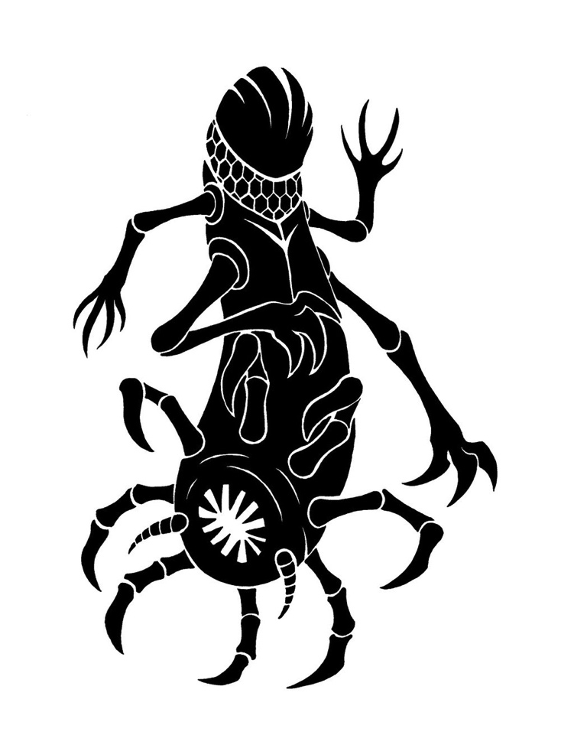
TOOLEY’S OBJECTION
I have a right to bodily autonomy!
It is possible to compensate the host for violating his right, but not possible to compensate the parasite for violating its right.
I have a right to life!
justice
parasite
host
stronger right than
Notes:
“Let it be granted, for the sake of argument, that a woman’s right to free her body of parasites which will inhibit her freedom of action and possibly impair her health is stronger than the parasite’s right to life, and is so even if the parasite has as much right to life as an adult human” (394)
“For if A’s right is stronger than B’s, and it is impossible to satisfy both, it does not follow that A’s should be satisfied rather than B’s” (394)
“It may be possible to compensate A if his right isn’t satisfied, but impossible to compensate B if his right isn’t satisfied. In such a case the best thing to do may be to satisfy B’s claim and to compensate A” (394)
“Abortion may be a case in point. If the fetus has a right to life and the right is not satisfied, there is certainly no way the fetus can be compensated. On the other hand, if the woman’s right to rid her body of harmful and annoying parasites is not satisfied, she can be compensated” (394)
“Thus it would seem that the just thing to do would be to prohibit abortion but to compensate women for the burden of carrying a parasite to term” (394)

