Slide 1
BACKGROUND: AESTHETICS & FORMALISM
PHL 317K
Fall 2017

Slide 2
THE AESTHETIC
The concept of the aesthetic descends from the concept of taste.
The eighteenth-century theory of taste was a reaction to rationalism.
The debate focused mainly on beauty and ugliness.

Slide 3
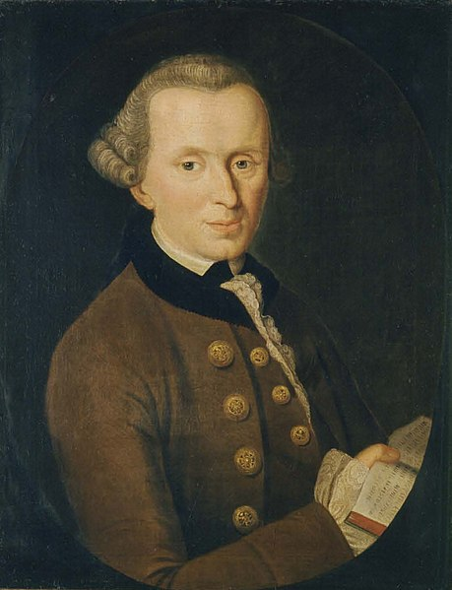
THE AESTHETIC
Subjectivity: judgments of taste are immediate and based on feelings of pleasure or displeasure.
Disinterest: they are neither based in nor result in desire.
Normativity: they claim “universal validity” in that we take them to demand or require agreement from others. Some of them are correct/incorrect or better/worse than others.
Immanuel Kant
Notes:
That is how they differ from empirical judgments
Not simply mere sensuous gratification, as in the pleasure of sensation or of eating and drinking. It arises from the perceptual representation of a thing.
Disinterest differs from morality in that regard.
Some responses are better or worse than others.

Slide 4
THE AESTHETIC
An aesthetic judgment is the attribution of an aesthetic property—such as beauty—to an object or scene.
But what about daintiness, dumpiness, delicacy, and elegance? Or “the sense of mystery and tension of a painting . . . the energy, exuberance, and coherence of a sonata . . . the balance and serenity of a Gothic cathedral” (335)?
We might view these as ways of being beautiful or ugly.
Should we add representational properties to this list? What about originality?

Slide 5
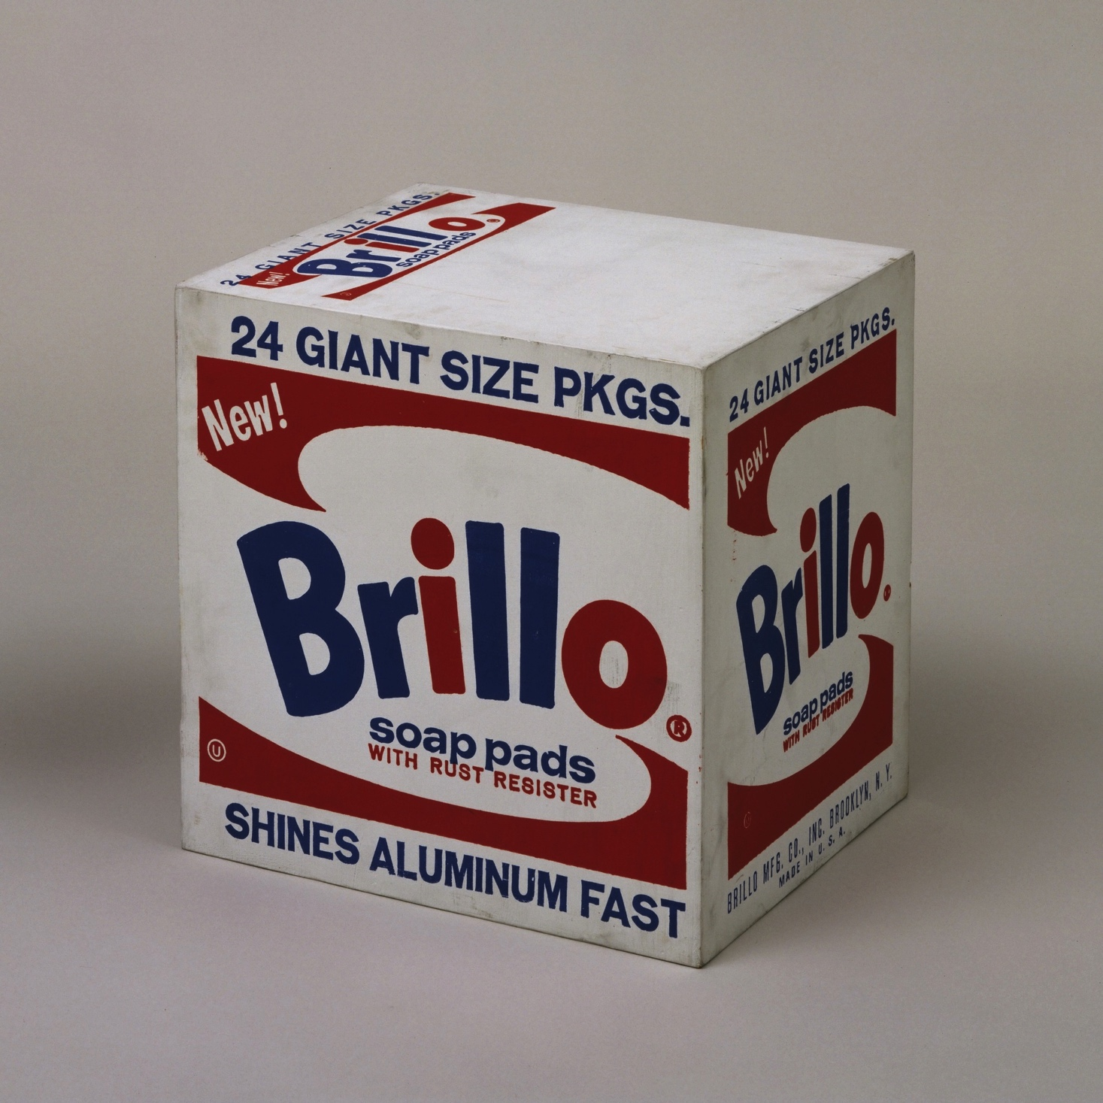
THE AESTHETIC
visually indistinguishable
Brillo Box (Soap Pads)
– Andy Warhol
Household cleaning supply

Slide 6
AESTHETIC DETERMINATION
Metaphysics: What is it to be (some particular thing)? What is more fundamental than what?
Epistemology: What puts us in a position to know, or have justification to believe, that something is the case?
Notes:
The term “determined” is ambiguous between these two endeavors, so be careful.

Slide 7
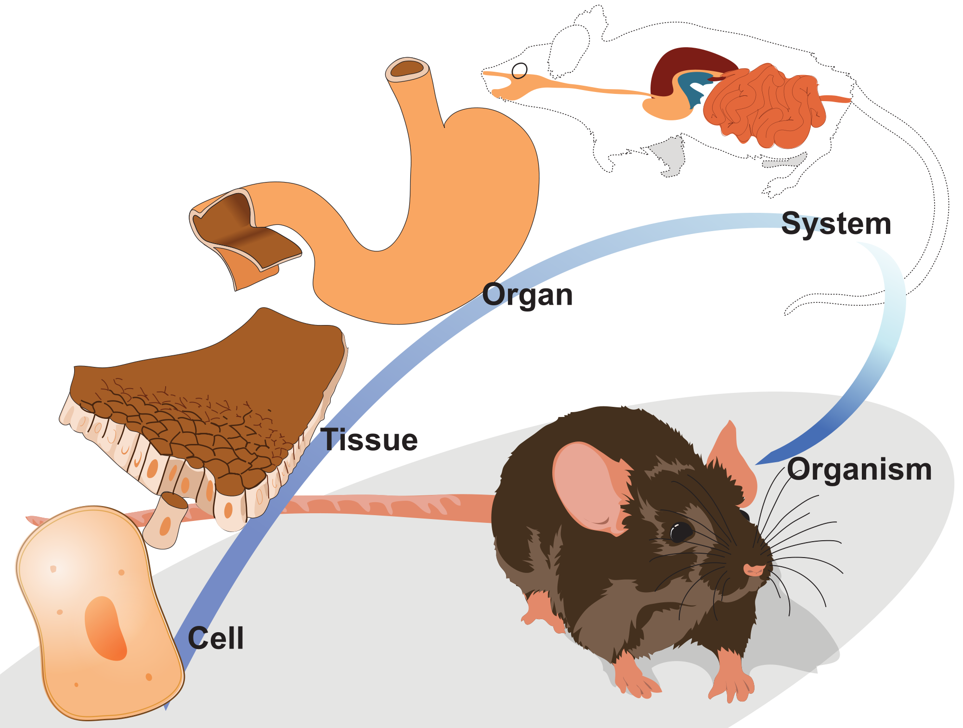
AESTHETIC DETERMINATION
“determines”
“in virtue of”
“makes it the case that”

Slide 8
FORMALISM
The aesthetic properties of a work of art are wholly determined by the formal properties of that work.
Formal properties are (in principle) graspable by sight or hearing alone.
In the visual arts, they are connected to the arrangements of lines, colors, shapes, volumes, vectors, space, and so on.

Slide 9
“Categories of art”

Slide 10
THE TARGET
If the aesthetic properties of a work are wholly determined by the formal properties of a work, then “[c]ircumstances connected with a work’s origin . . . have no essential bearing on an assessment of its aesthetic nature—for example, who created the work, how, and when; the artist’s intentions and expectations concerning it, his philosophical views, psychological state, and love life; the artistic traditions and intellectual atmosphere of his society” (334).
According to Walton, the second claim is false: “[F]acts about the origins of works of art have an essential role in criticism, that aesthetic judgments rest on them in an absolutely fundamental way” (337).
If that is right, then the formalist thesis about aesthetic properties is false.

Slide 11
WALTON’S STRATEGY
Establish a psychological thesis about aesthetic judgment.
Argue for a philosophical thesis on the basis of that psychological thesis.

Slide 12
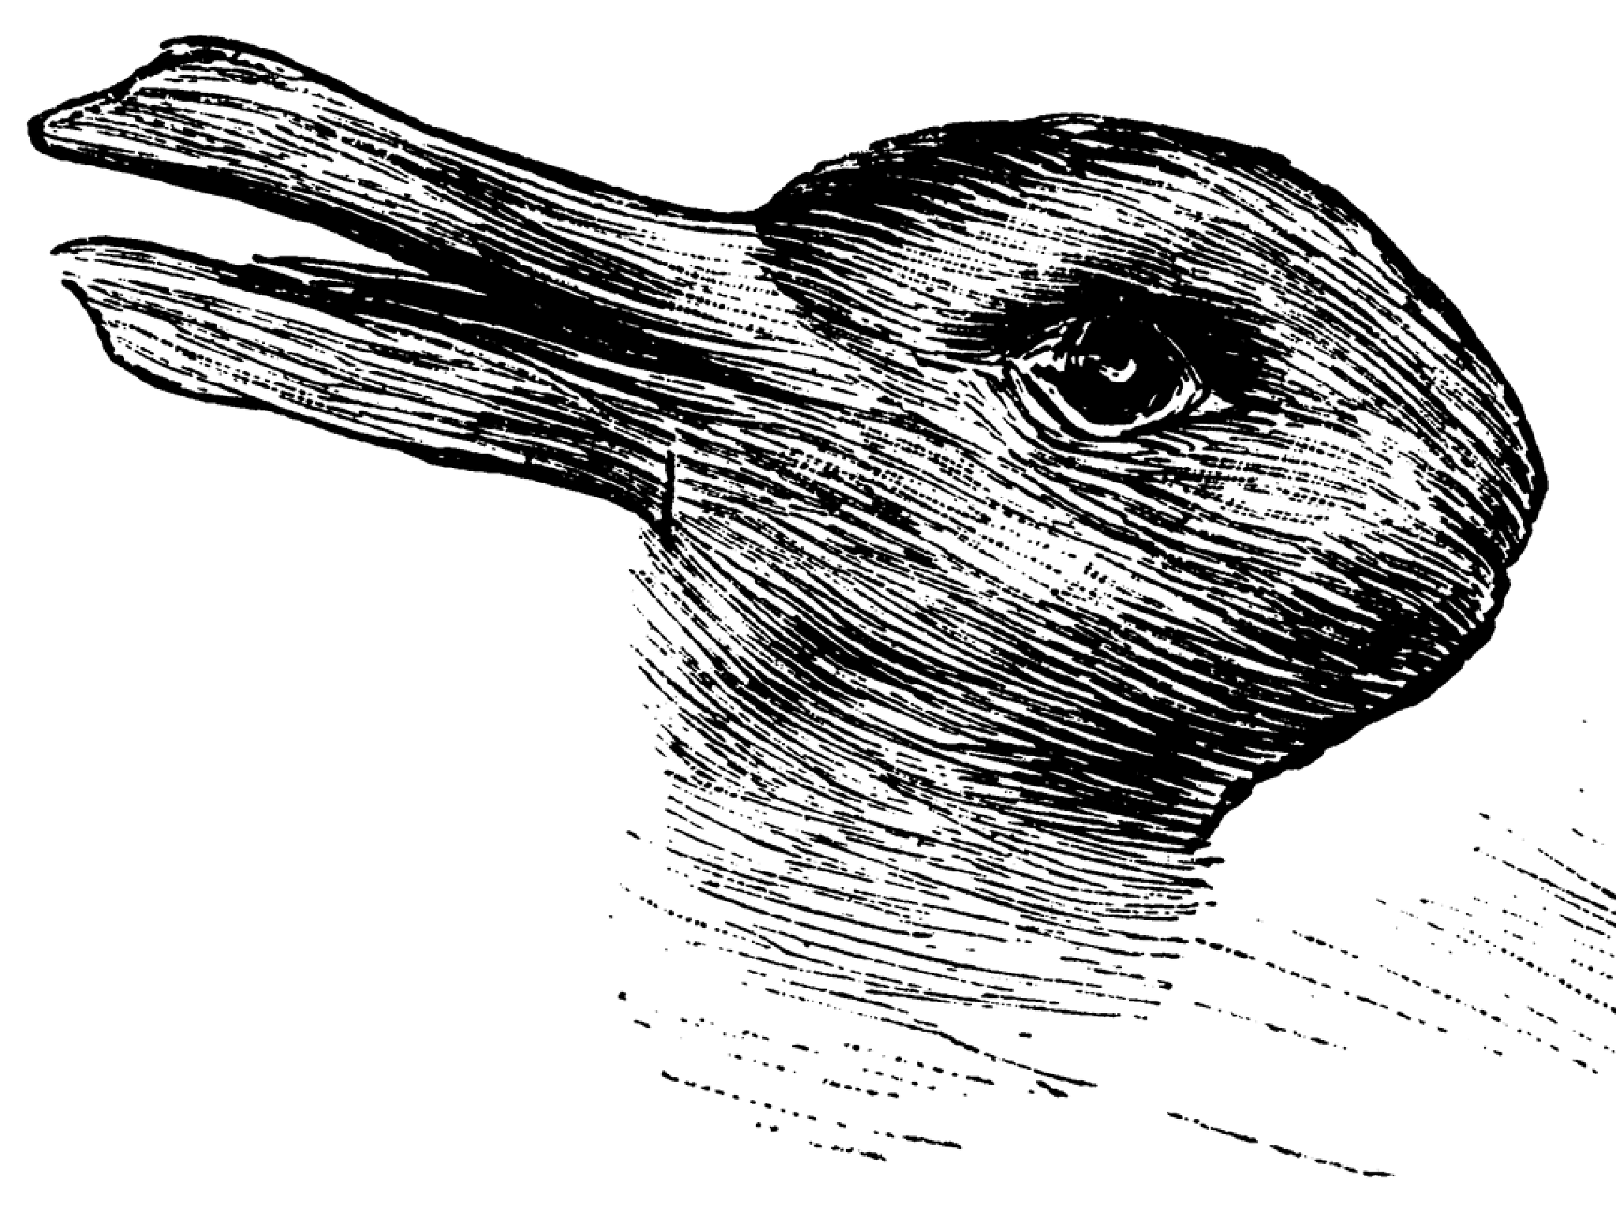
SEEING-AS

Slide 13
SEEING-AS
A
B

Slide 14
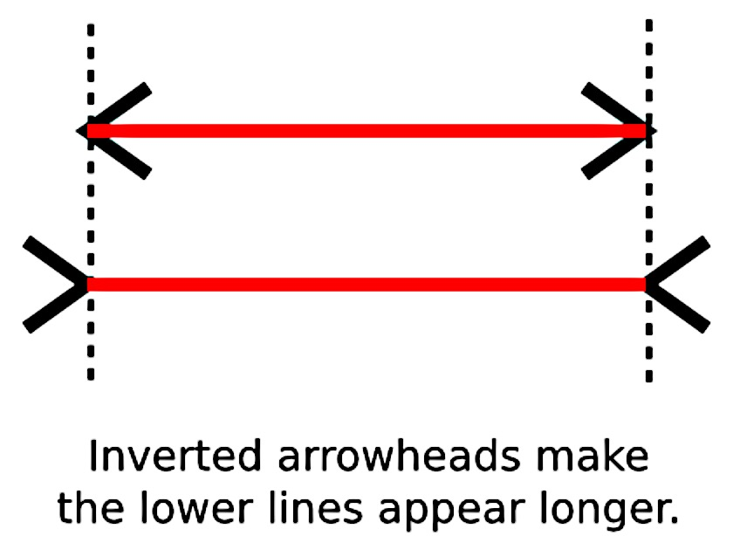
SEEING-AS
A
B

Slide 15
CATEGORIES OF ART
Categories of art include media, genre, styles, forms, and so on.
Examples include paintings, cubist paintings, Gothic architecture, classical sonatas, paintings in the style of Cézanne, and music in the style of late Beethoven.
Category membership is determined solely by features that can be perceived in a work when it is experienced in the normal manner.
Such features can be standard, variable, or contra-standard.
Notes:
“Thus whether or not a piece of music was written in the eighteenth century is irrelevant to whether it belongs to the category of classical sonatas” (339).
“A category will not count as ‘perceptually distinguishable’ in my sense if in order to determine perceptually whether something belongs to it, it is necessary (in some or all cases) to determine which categories it is correctly perceived in partly or wholly on the basis of non-perceptual considerations” (339).

Slide 16
STANDARD, VARIABLE, AND CONTRA-STANDARD
Standard:
A feature F is standard with respect to a category C if and only if F is among those features in virtue of which works in C belong to C.
A feature F is standard for a person on a particular occasion if and only if it is standard relative to some category in which (s)he perceives it and not contra-standard relative to any category in which (s)he perceives it.
Variable:
A feature F is variable with respect to a category C if and only if F has nothing to do with works belonging to C; F is irrelevant to whether a work belongs to C.
A feature F is variable for a person on an occasion if and only if it is variable relative to all of the categories in which (s)he perceives it.
Contra-standard:
A feature F is contra-standard with respect to a category C if and only if the presence of F tends to disqualify works as belonging to C.
A feature is contra-standard for a person on an occasion if and only if it is contra-standard relative to any of the categories in which (s)he perceives it.
Notes:
“just in case the lack of that feature would disqualify, or tend to disqualify, a work from that category” (39).

Slide 17
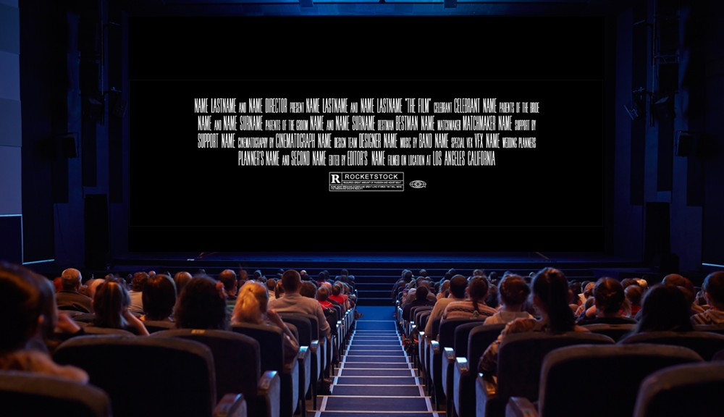
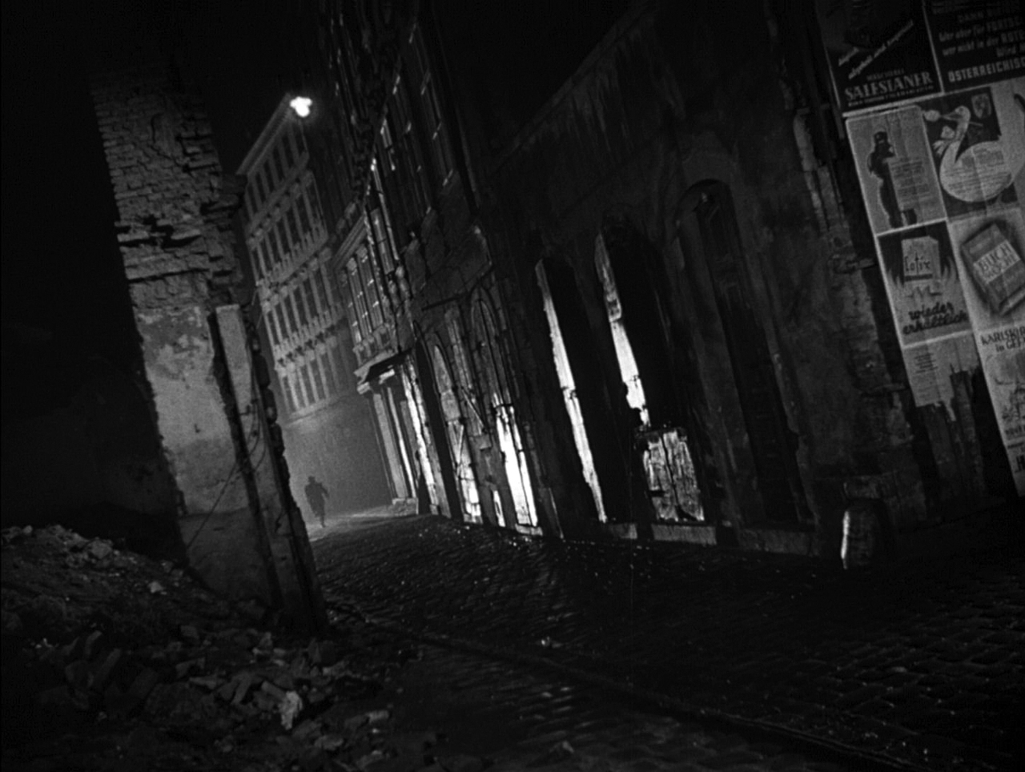
STANDARD, VARIABLE, AND CONTRA-STANDARD
CINEMA
Standard: flat projection surface, moving subjects, etc.
Variable: format (digital/film), etc.
Contra-standard: uneven projection surface, motionless subjects, etc.
FILM NOIR
Standard: B&W, canted angles, etc.
Variable: format (digital/film), etc.
Contra-standard: color, etc.
- CINEMA
- NOIR

Slide 18
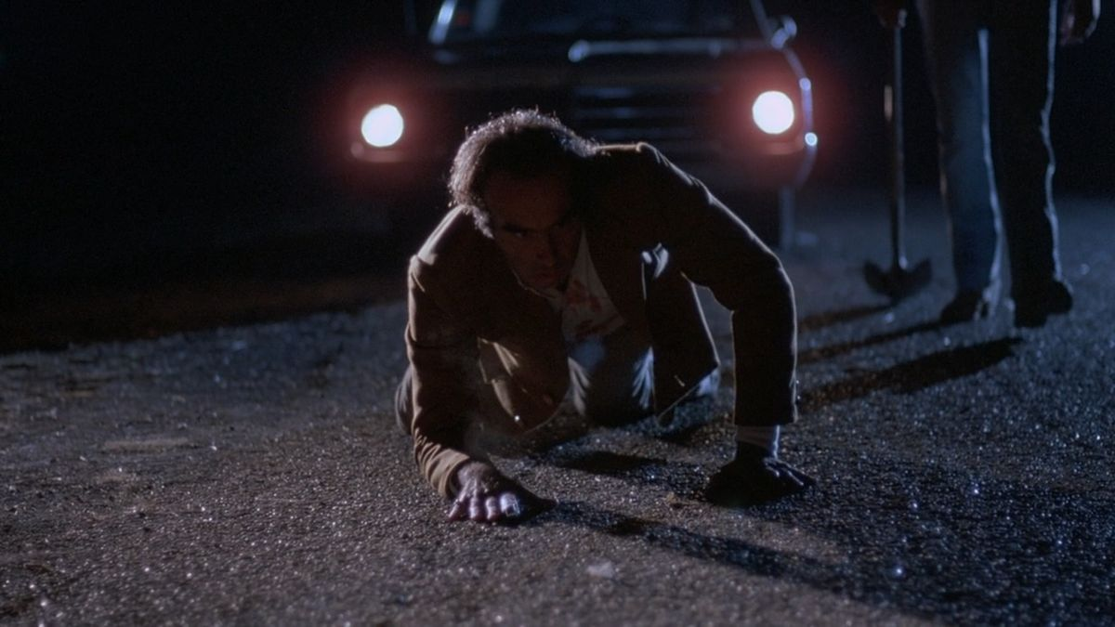
STANDARD, VARIABLE, AND CONTRA-STANDARD
CINEMA
Standard: flat projection surface, moving subjects, etc.
Variable: format (digital/film), etc.
Contra-standard: uneven projection surface, motionless subjects, etc.
FILM NOIR
Standard: B&W, canted angles, etc.
Variable: format (digital/film), etc.
Contra-standard: color, etc.
- CINEMA
- NOIR

Slide 19
CAUSES OF CATEGORY-SEEING
We are familiar with other works of the same category.
We have been influenced by critics to note certain similarities between works.
We have been introduced to a work within a certain context.

