Slide 1
“Categories of art”
PHL 317K
Fall 2017
Notes:
Wolves in the Throne Room: https://www.youtube.com/watch?v=8GDK0tcnlk0&t=9m21s
Gorguts: https://www.youtube.com/watch?v=ZCNOeOzMzNo
Wagner: https://www.youtube.com/watch?v=Ty80gJfKDlE
Schoenberg: https://www.youtube.com/watch?v=2lFZf69B2gQ

Slide 2
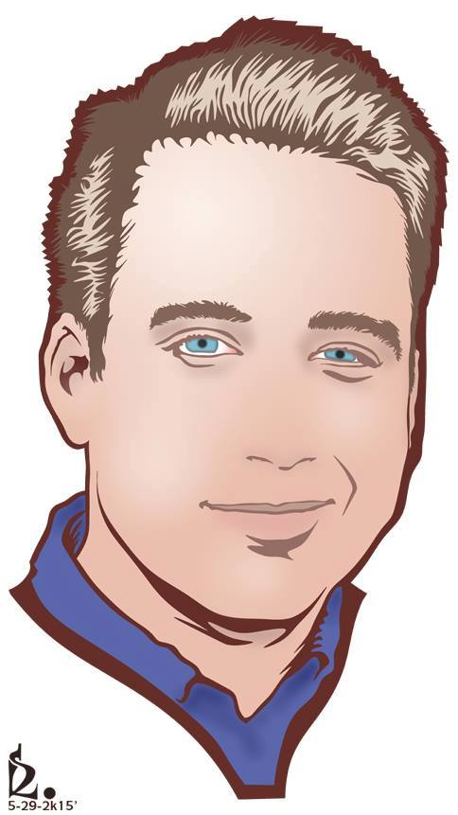
EXHIBIT A: REPRESENTATION
Notes:
Resemblance as a necessary condition for depiction.
Resemblance not as perceptual indistinguishability

Slide 3
EXHIBIT A: REPRESENTATION
“More than one ethnographer has reported the experience of showing a clear photograph of a house, a person, a familiar landscape to people living in a culture innocent of any knowledge of photography, and to have the picture held at all possible angles, or turned over for an inspection of its blank back, as the native tried to interpret this meaningless arrangement of varying shades of grey on a piece of paper” (Herskovits 1948, 381).
Notes:
“Melville Jean Herskovits was an American anthropologist who firmly established African and African-American studies in American academia. He is known for exploring the cultural continuity from African cultures as expressed in African-American communities.” - https://en.wikipedia.org/wiki/Melville_J._Herskovits

Slide 4
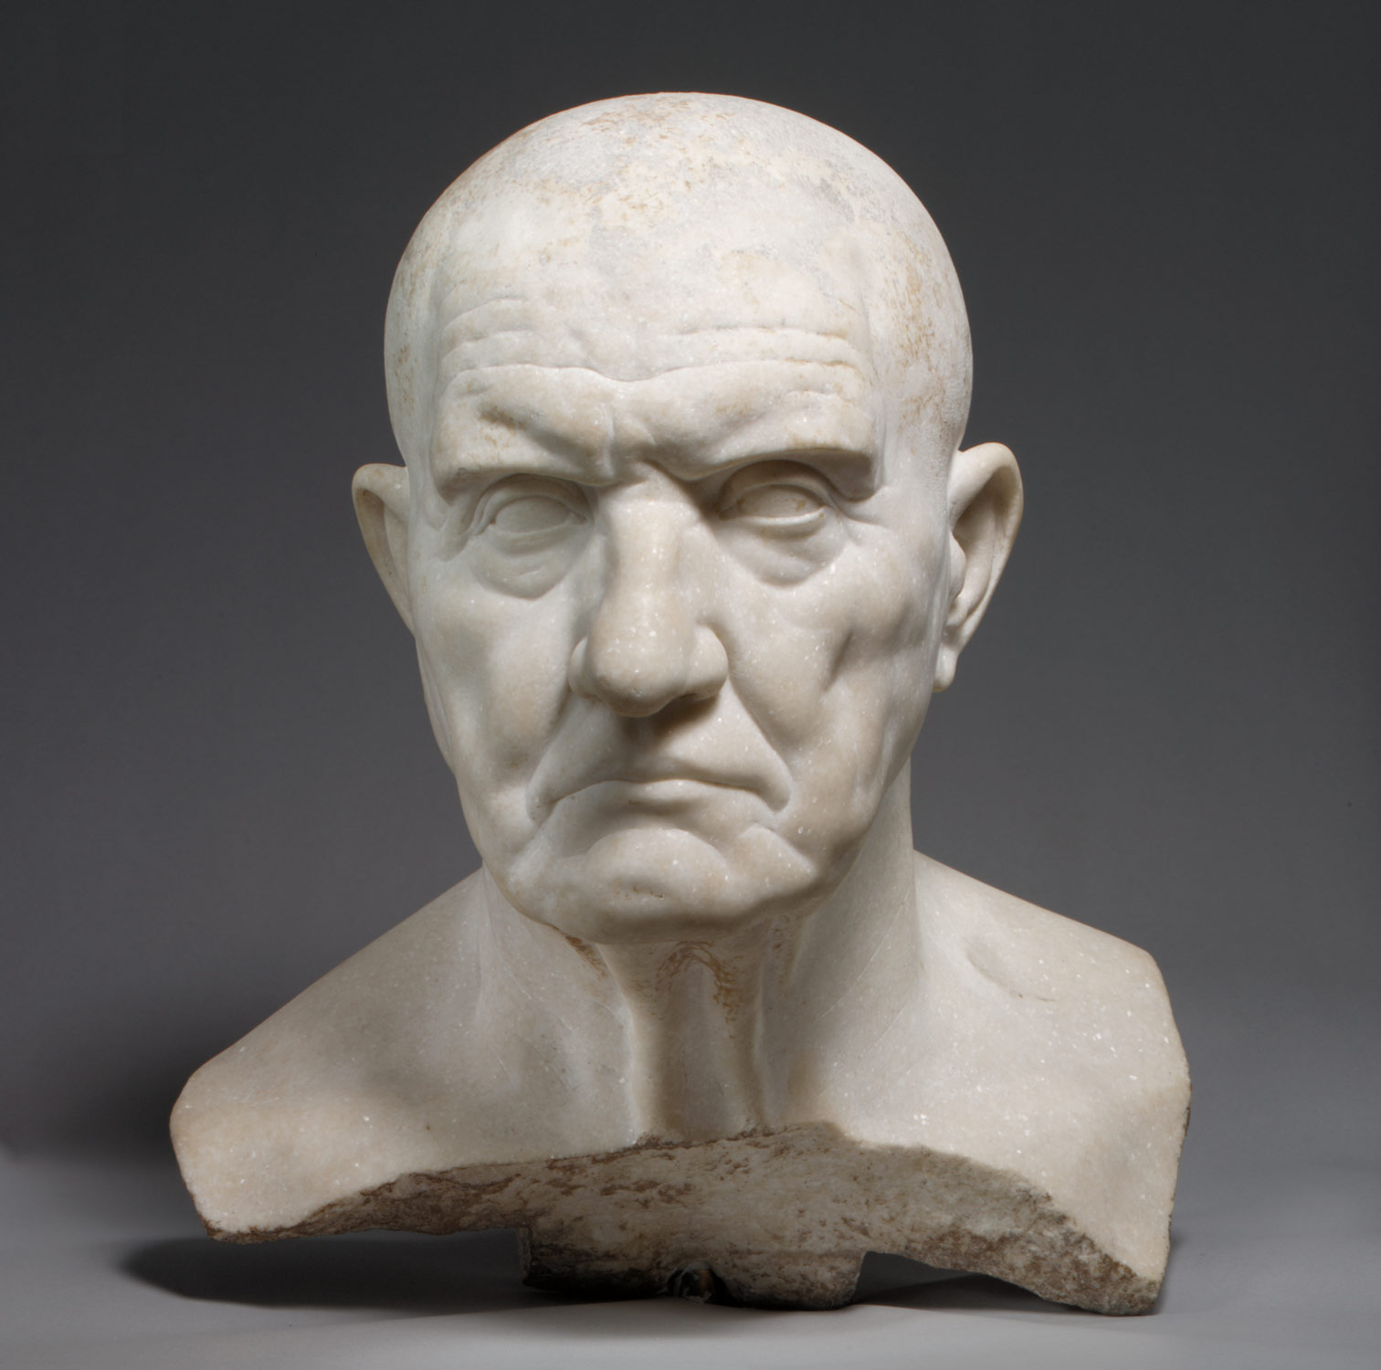
EXHIBIT A: REPRESENTATION

Slide 5
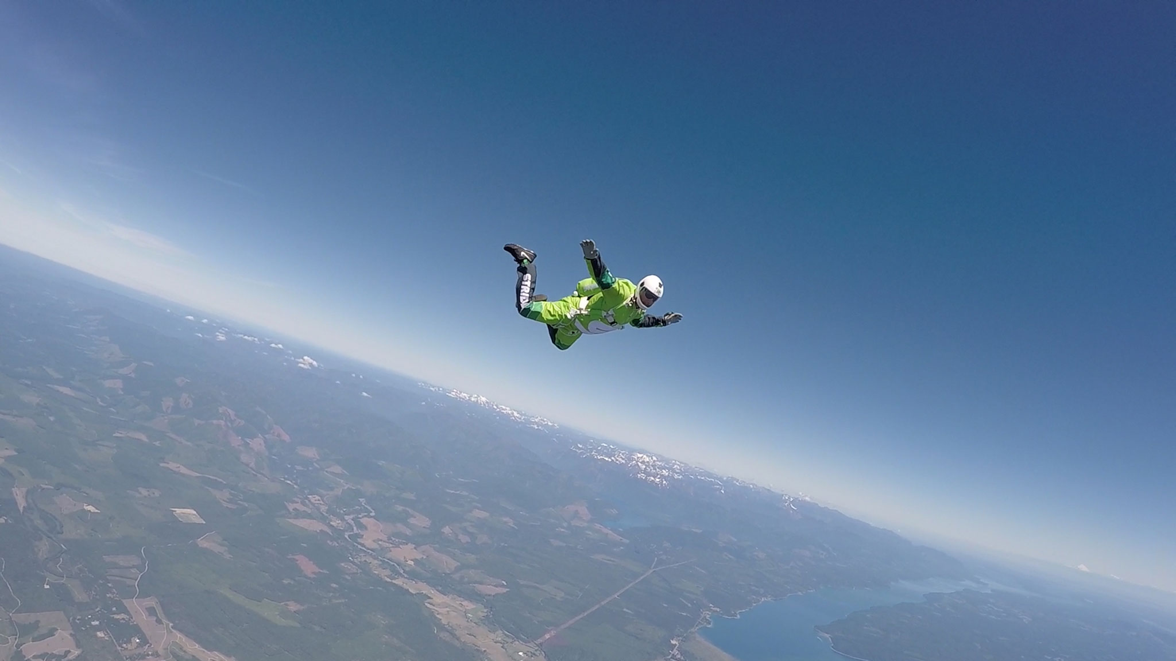
EXHIBIT A: REPRESENTATION
Notes:
“This Man Jumped Out of a Plane With No Parachute,” http://www.nationalgeographic.com/adventure/features/skydiver-luke-aikins-freefalls-without-parachute/

Slide 6
EXHIBIT A: REPRESENTATION
Resemblance is a necessary condition on visual depiction.
But resemblance is not to be thought of as visual indistinguishability.
Resemblance and thus depiction depend on which properties are variable for us.
Standard properties determine what kind of representation a work is.
If representational properties are aesthetic properties, then our disposition to make aesthetic judgments also depends on which properties are standard or variable for us.

Slide 7
EXHIBIT B: GEURNICAS
Notes:
“An accurate depiction of a cruel, dramatic situation, Guernica was created to be part of the Spanish Pavilion at the International Exposition in Paris in 1937. Pablo Picasso’s motivation for painting the scene in this great work was the news of the German aerial bombing of the Basque town whose name the piece bears, which the artist had seen in the dramatic photographs published in various periodicals, including the French newspaper L'Humanité. Despite that, neither the studies nor the finished picture contain a single allusion to a specific event, constituting instead a generic plea against the barbarity and terror of war”
http://www.museoreinasofia.es/en/collection/artwork/guernica

Slide 8
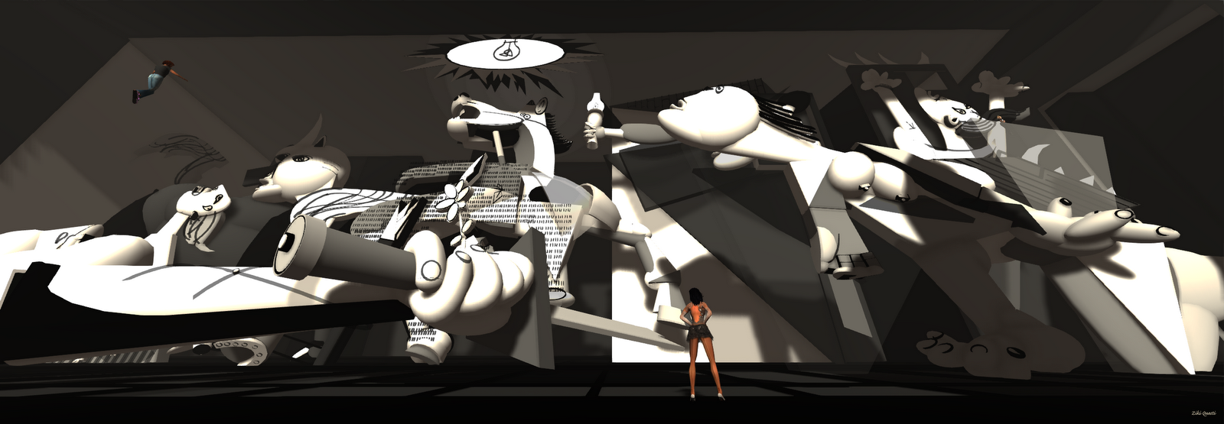
EXHIBIT B: GEURNICAS
Notes:
“It seems violent, dynamic, vital, disturbing to us. But I imagine it would strike them as cold, stark, lifeless, or serene and restful, or perhaps bland, dull, boring—but in any case not violent, dynamic, and vital” (347).

Slide 9
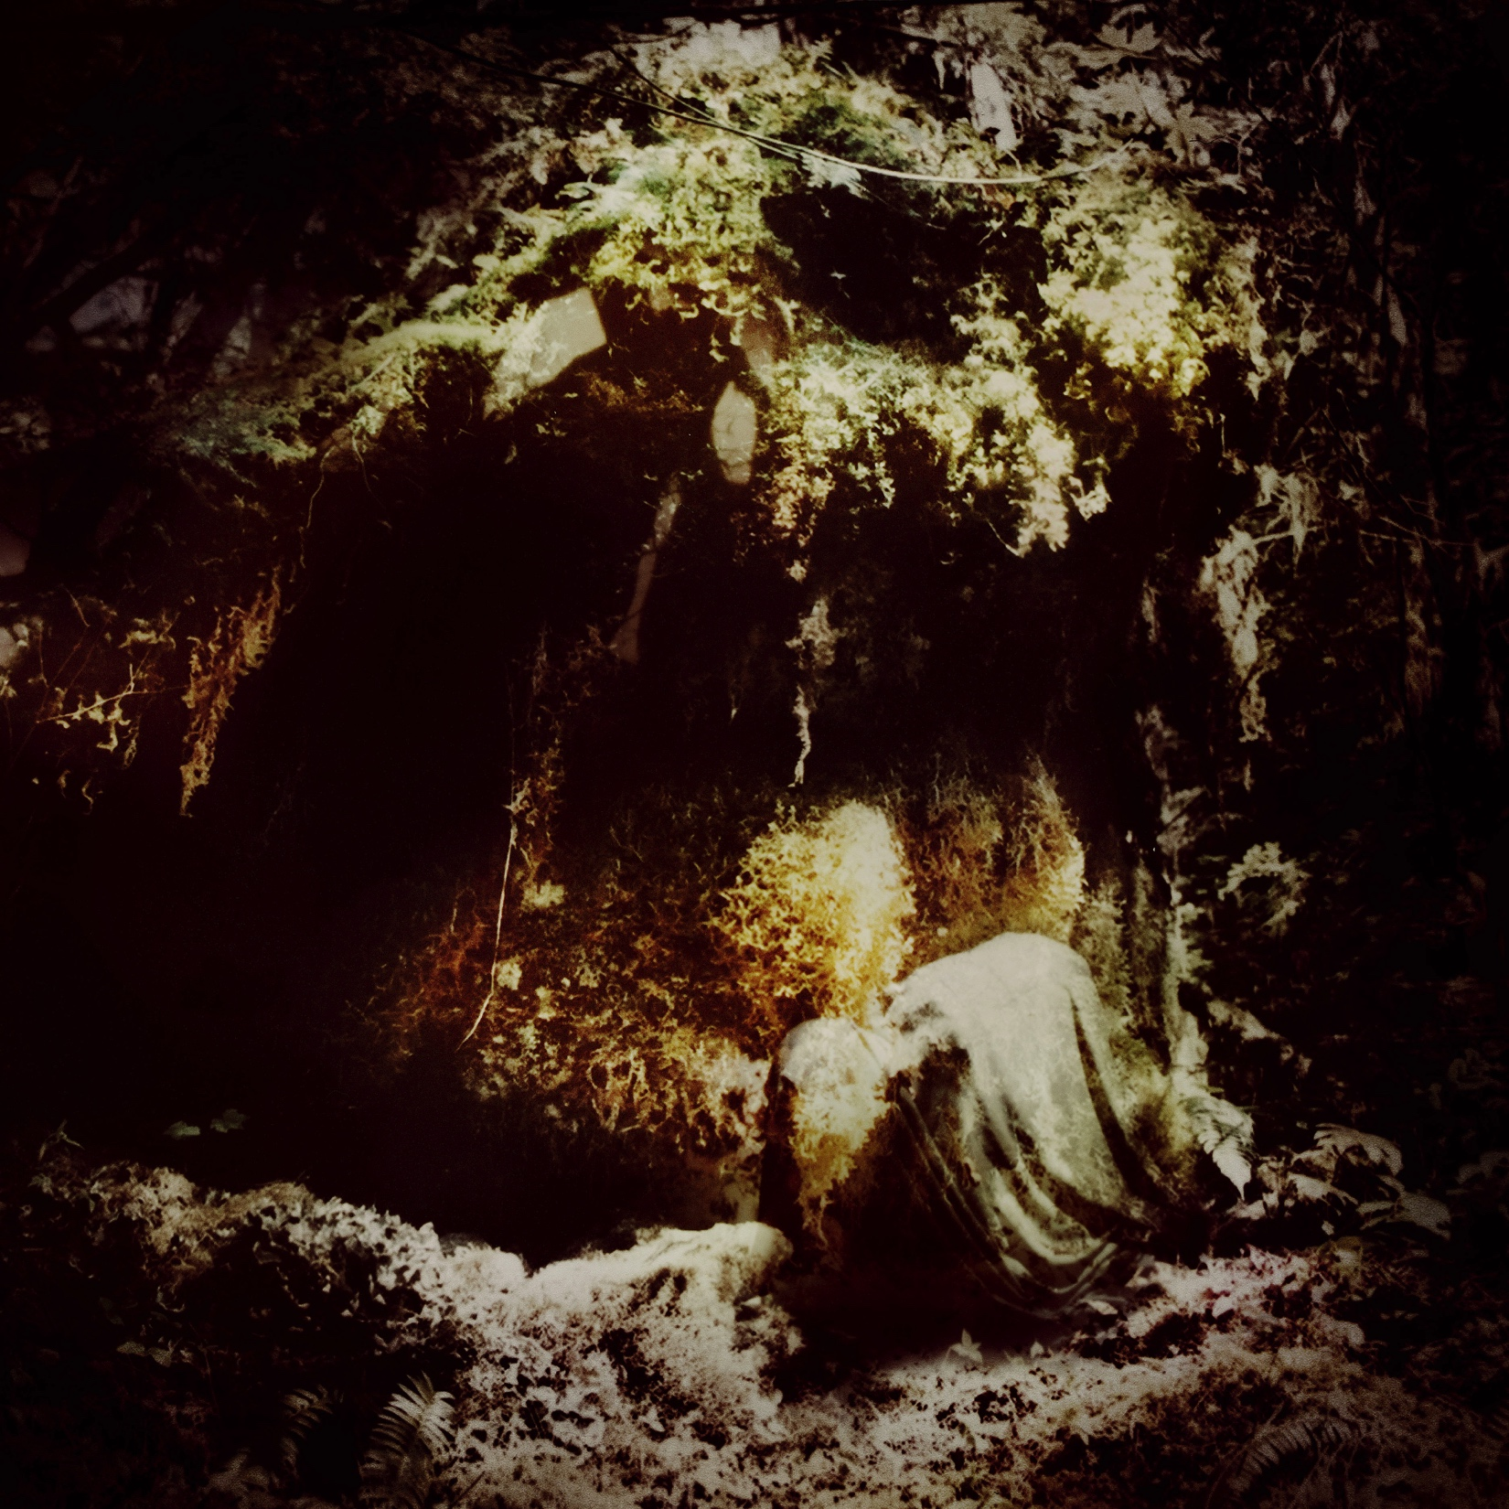
EXHIBIT: ZACH GETS FIRED BECAUSE OF NOISE COMPLAINTS
Celestial Lineage –
Wolves in the Throne Room
Colored Sands –
Gorguts

Slide 10
EXHIBIT F: CONTRA-STANDARDNESS
Features that are contra-standard for us may contribute to the shockingness of a work.
If we are exposed to a number of works that have features that are contra-standard for us, we might adjust our categories to accommodate those features, so that they become standard for us.
Notes:
Play Wagner.
Play Schoenberg.
“The technique is a means of ensuring that all 12 notes of the chromatic scale are sounded as often as one another in a piece of music while preventing the emphasis of any one note through the use of tone rows, orderings of the 12 pitch classes” - https://en.wikipedia.org/wiki/Twelve-tone_technique

Slide 11
UPSHOT

Slide 12
UPSHOT
The predicate “is tall” appears to be a one-place predicate.
But the logical form of tallness attributions is relational.
When we say that “x is tall,” what we really mean is that “x is tall for a C.”

Slide 13
QUIZ 2
Walton maintains that all aesthetic judgments are just like attributions of tallness.
True
False

Slide 14
UPSHOT
Aesthetic judgments are often mistaken in a way that attributions of tallness are not.
But what explains that?

Slide 15
UPSHOT
Metaphysics:
What metaphysically determines the aesthetic properties of a work?
What makes it the case that a work has the aesthetic properties that it does?
Epistemology:
How can we determine (come to know) which aesthetic properties a work really has?
Which kinds of considerations give us justification to believe that a work has certain aesthetic properties?
Notes:
The term “determined” is ambiguous between these two endeavors, so be careful.

Slide 16
UPSHOT
The presence in W of a relatively large number of features standard with respect to C.
The fact, if it is one, that W is better, or more interesting or pleasing aesthetically, or more worth experiencing when perceived in C than it is when perceived in alternative ways.
The fact, if it is one, that the artist who produced W intended or expected it to be perceived in C, or thought of it as a C.
The fact, if it is one, that C is well established in and recognized by the society in which W was produced.
Notes:
“It cannot be correct to perceive Rembrandt's ‘Titus Reading’ as a kinetic sculpture, if this is possible, just because that work has too few of the features which make kinetic sculptures kinetic sculptures” (357).

Slide 17
UPSHOT
The presence in W of a relatively large number of features standard with respect to C.
The fact, if it is one, that W is better, or more interesting or pleasing aesthetically, or more worth experiencing when perceived in C than it is when perceived in alternative ways.
The fact, if it is one, that the artist who produced W intended or expected it to be perceived in C, or thought of it as a C.
The fact, if it is one, that C is well established in and recognized by the society in which W was produced.
Notes:
“It cannot be correct to perceive Rembrandt's ‘Titus Reading’ as a kinetic sculpture, if this is possible, just because that work has too few of the features which make kinetic sculptures kinetic sculptures” (357).

Slide 18
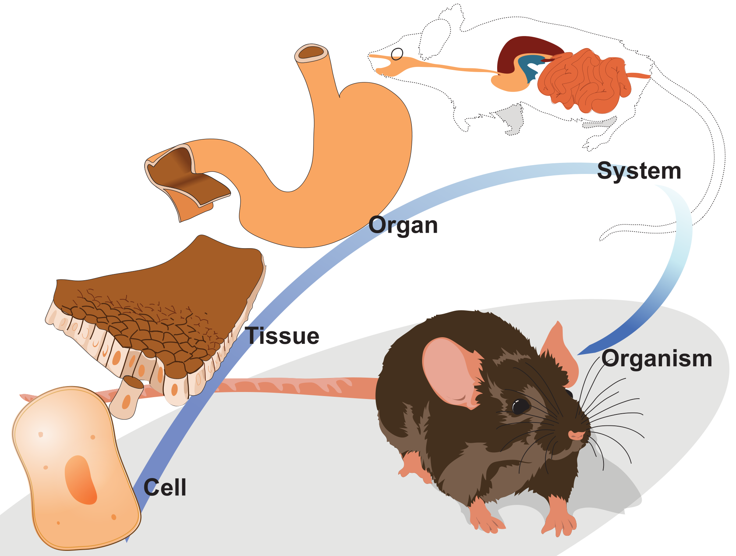
UPSHOT
“determines”
“in virtue of”
“makes it the case that”

Slide 19
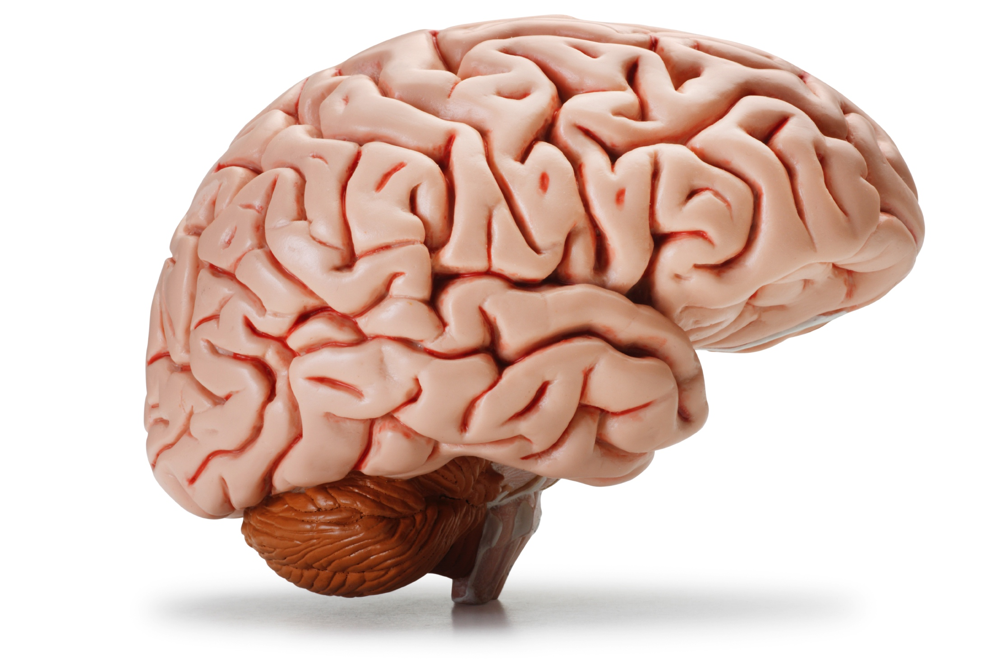
UPSHOT
“Guernica” is dynamic.
dynamic
Correctly perceived as a painting
Formal features
Historical considerations
Non-aesthetic perceptual features

Slide 20
UPSHOT
“Guernica” is dynamic.
dynamic
Formal features
Non-aesthetic perceptual features

Slide 21
POLL
Do you agree with Walton’s thesis, that the aesthetic properties of a work are not wholly determined by features that can be perceived in the work (but instead are partly determined by historical facts as well)?
Yes, I agree with Walton
No, I disagree with Walton

Slide 22
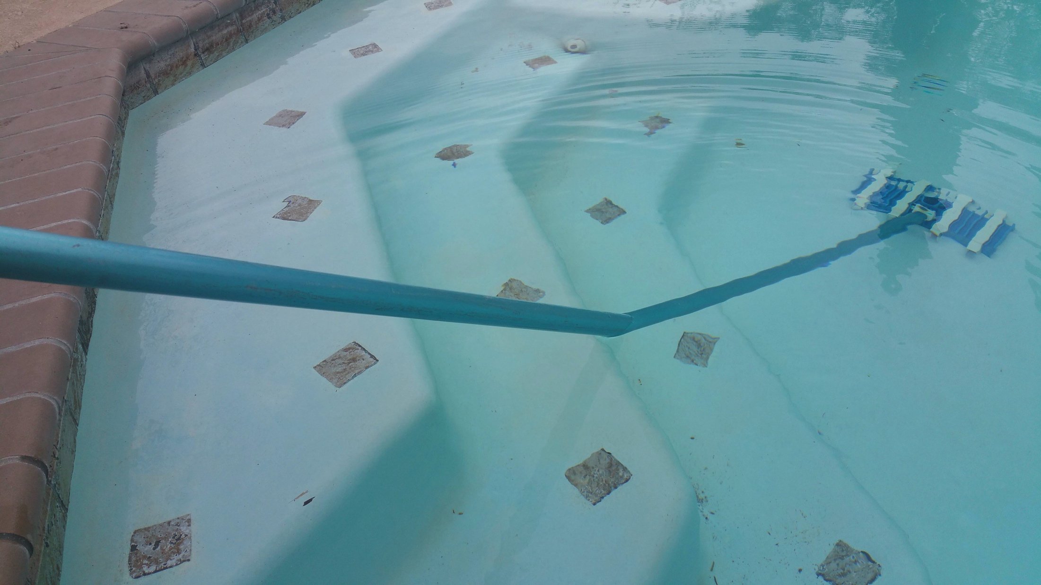
ALTERNATIVE HYPOTHESIS?

Slide 23
SUMMARY
Psychological thesis: what we see in a work and how we judge it is influenced by what category we see that work as belonging to.
Philosophical thesis: whether an aesthetic judgments is correct and which aesthetic properties a work has are partly determined by the fact (if it is one) that we perceive the work correctly (which is in turn determined by historical facts).

Slide 24
SUMMARY
If Walton’s philosophical thesis is correct, then formalism is false: the aesthetic properties of a work are not wholly determined by the formal properties of that work.
This has interesting implications for art appreciation and criticism.

