Slide 1
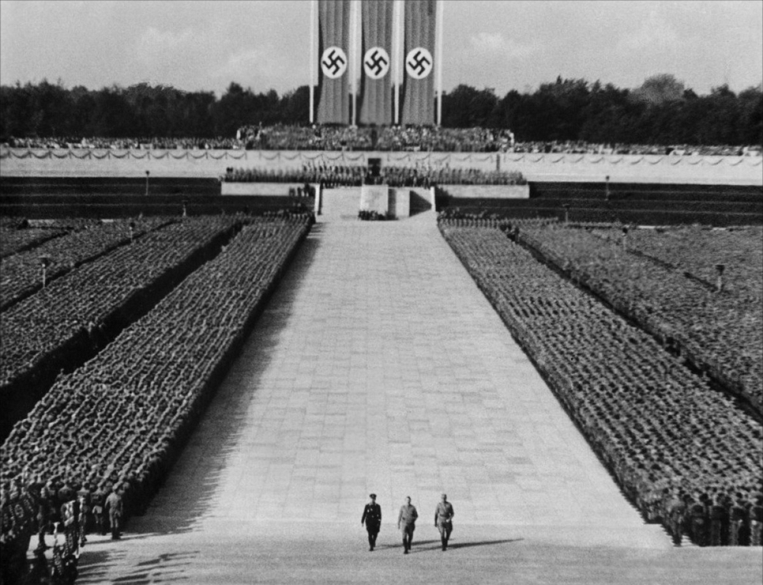
ART AND ETHICS
Notes:
Needle Drop: https://www.youtube.com/watch?v=kJM08F9aQtw
Haneke interview: https://www.youtube.com/watch?v=Y_osgrcpes4&t=2m22s
Triumph of the Will: https://www.youtube.com/watch?v=cDwEnwxnGjY
Blackface: https://www.youtube.com/watch?v=UYCaob7MDA8
No Country scene: https://www.youtube.com/watch?v=3B_rRmkbA9I
Dexter scene: https://www.youtube.com/watch?v=8va7QpzKTPU
The Room - https://www.youtube.com/watch?v=k27mr6p-yhY

Slide 2
SOME ETHICAL QUESTIONS
Does exposure to works of art that are ethically flawed tend to corrupt audiences?
Do artists have a moral responsibility to constrain their artistic or aesthetic choices?
Does the ethical badness of a work justify censoring or banning it?
Do we have moral obligations towards artworks to preserve them in certain ways (even at great costs)?
Notes:
Psychology/sociology

Slide 3
SOME ETHICAL QUESTIONS

Slide 4
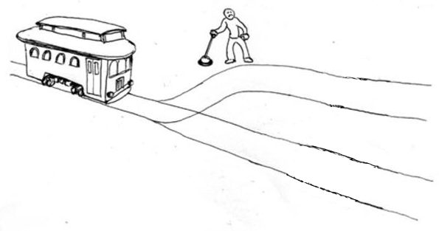
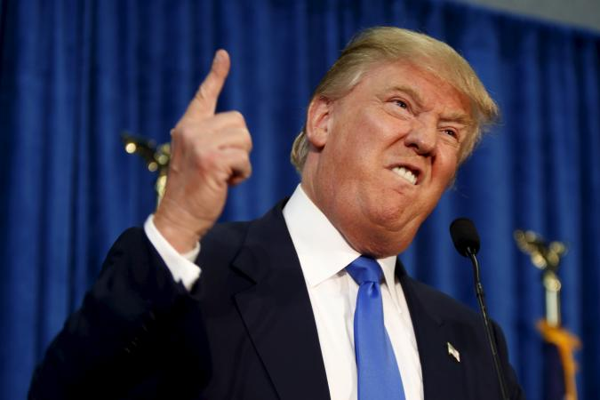
SOME ETHICAL QUESTIONS
Peter Singer has strapped the world’s finest artistic achievements to the bottom track, and the trolley is heading toward them. They possess tremendous aesthetic value. But human persons possess at least some moral value. Do you pull the lever?

Slide 5
SOME ETHICAL QUESTIONS
Peter Singer has strapped the world’s finest artistic achievements to the bottom track, and the trolley is heading toward them. They possess tremendous aesthetic value. But human persons possess at least some moral value. Do you pull the lever?

Slide 6
GAUT’S QUESTION
How are aesthetic judgments related to ethical judgments?
Are the moral flaws of artworks aesthetic flaws in them?
Is the aesthetic value of a work partly determined by the moral value of a work?
Berys Gaut

Slide 7
GAUT’S QUESTION
Three possible answers:
Autonomism (or aestheticism)
Moralism (or ethicism)
Immoralism (or contextualism)
“[T]here are reasons to reject autonomism, contextualism and extreme moralism and that there are plausible arguments for ethicism. Ethicism . . . emerges as the leading position in the long debate over art and ethics” (442).
Berys Gaut

Slide 8
bACKGROUND

Slide 9
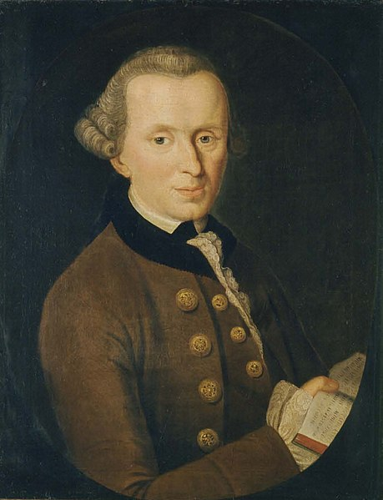
THE AESTHETIC
Subjectivity: judgments of taste are immediate and based on feelings of pleasure or displeasure.
Disinterest: they are neither based in nor result in desire.
Normativity: they claim “universal validity” in that we take them to demand or require agreement from others. Some of them are correct/incorrect or better/worse than others.
Immanuel Kant
Notes:
That is how they differ from empirical judgments
Not simply mere sensuous gratification, as in the pleasure of sensation or of eating and drinking. It arises from the perceptual representation of a thing.
Disinterest differs from morality in that regard.
Some responses are better or worse than others.

Slide 10
THE AESTHETIC
An aesthetic judgment is the attribution of an aesthetic property—such as beauty—to an object or scene.
But what about daintiness, dumpiness, delicacy, and elegance? Or “the sense of mystery and tension of a painting . . . the energy, exuberance, and coherence of a sonata . . . the balance and serenity of a Gothic cathedral” (335)?
We might view these as ways of being beautiful or ugly.
Should we add representational properties to this list? What about originality?

Slide 11
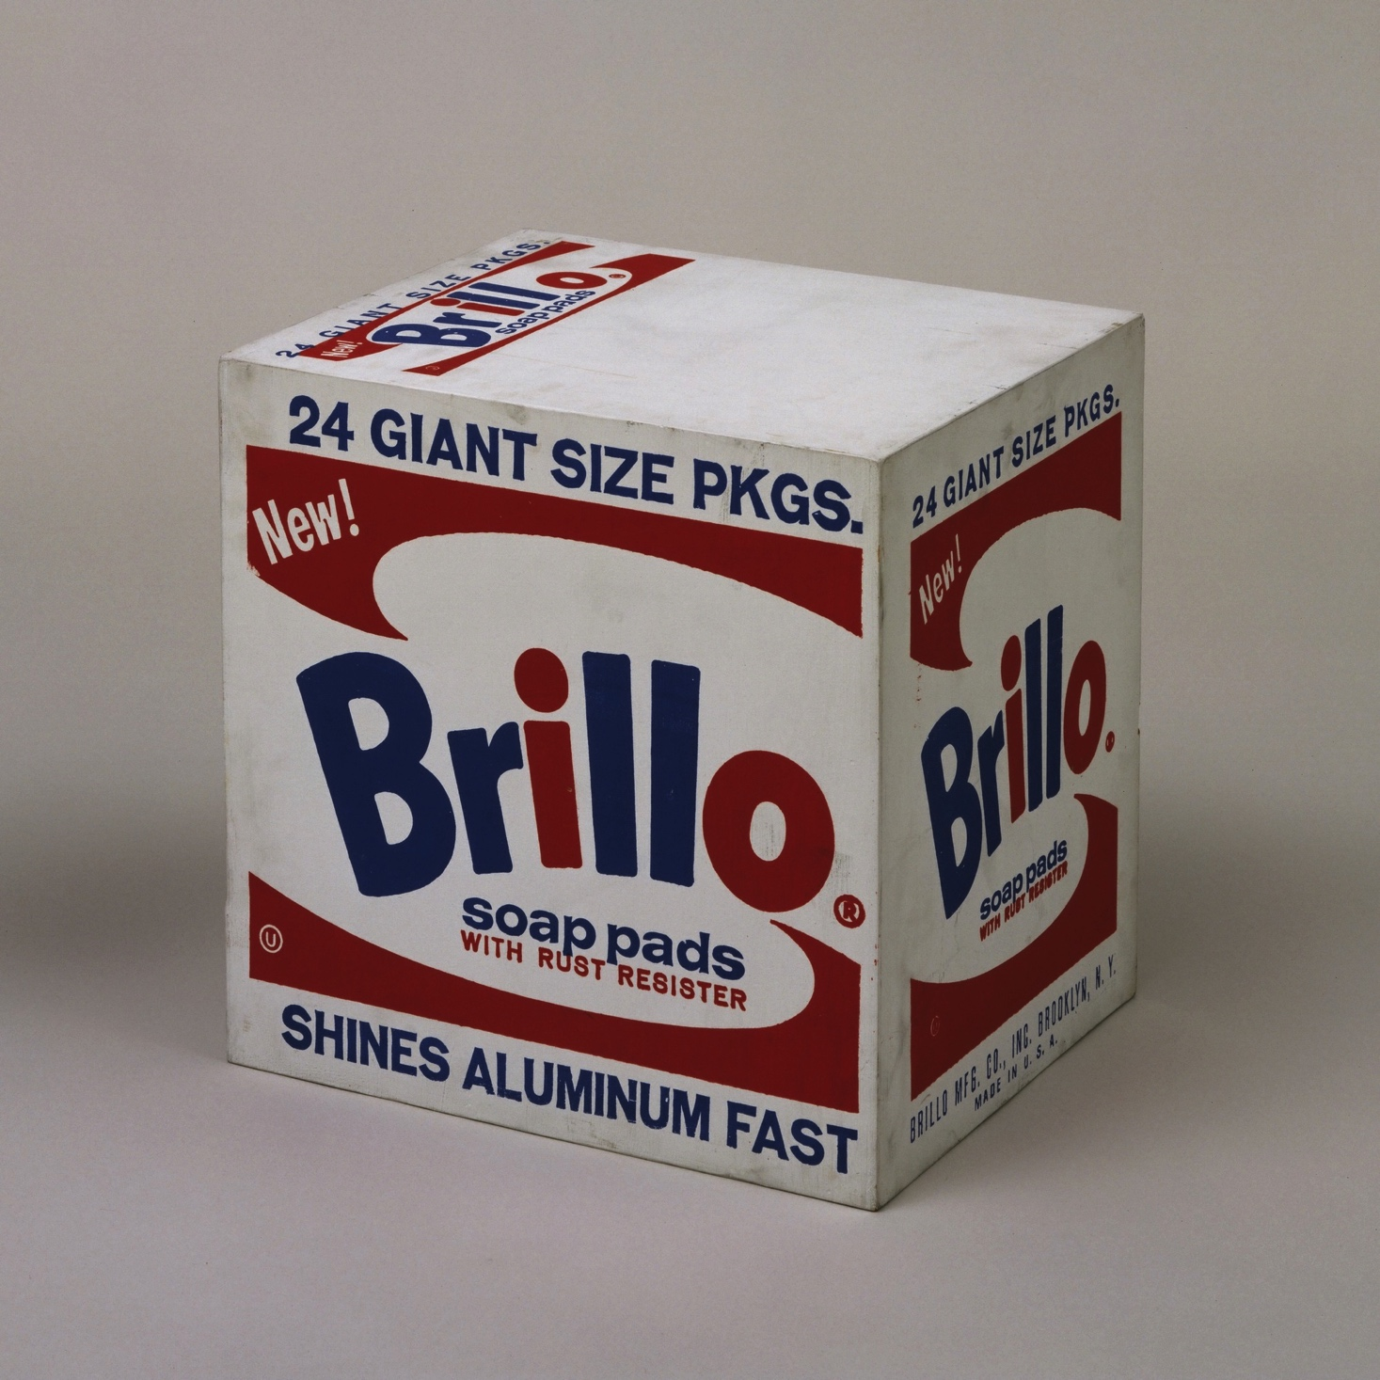
THE AESTHETIC
visually indistinguishable
Brillo Box (Soap Pads)
– Andy Warhol
Household cleaning supply

Slide 12
DIVISIONS OF ETHICAL INQUIRY
Metaethics: What is the best account of moral thought and discourse? What is it for an action to be right or wrong, good or bad? How do such features fit into a scientific picture of the world? How can we come to know moral truths?
Normative ethics: If there are moral principles, what are they? If not, how can we figure out what to do on any given occasion?
Applied ethics: Is abortion permissible? What about infanticide or euthanasia? Is it wrong to support the meat industry? Are we morally obligated to donate substantial portions of our income to charity?
Notes:
The term “determined” is ambiguous between these two endeavors, so be careful.

Slide 13
DIVISIONS OF ETHICAL INQUIRY
Parties to the debate can simply assume for the sake of argument that there are good answers to the the metaethical and normative ethical questions.
Certain things are good or bad, right or wrong (at least in some sense).
Once we settle on some examples of uncontroversially immoral artworks, we can then ask how the moral features of those works relate to the aesthetic features of those works.

Slide 14
PRO TANTO VS. ALL THINGS CONSIDERED
ACTION
Good w/rt
kindness
bad w/r/t
lying
Good w/rt
????
all things considered good
Notes:
“insofar as”

Slide 15
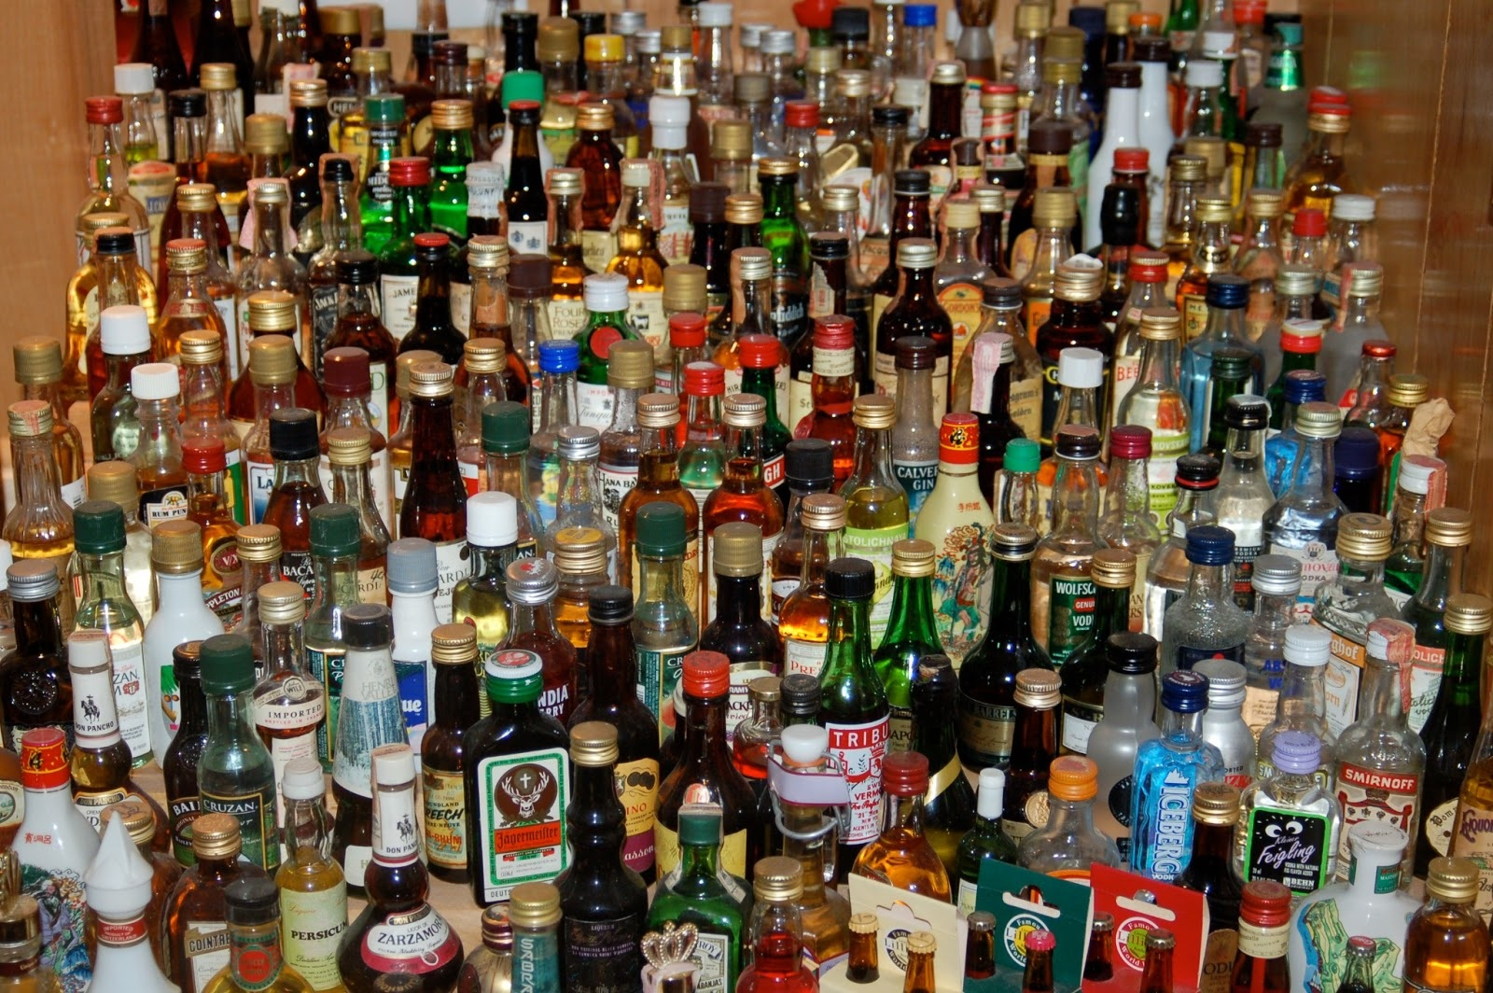
PRO TANTO VS. ALL THINGS CONSIDERED
Drinking is pleasurable.
Having another drink is likely to give me a hangover.
counts in favor of
counts against
ACTION
all things considered
My outline is due in two days.

Slide 16
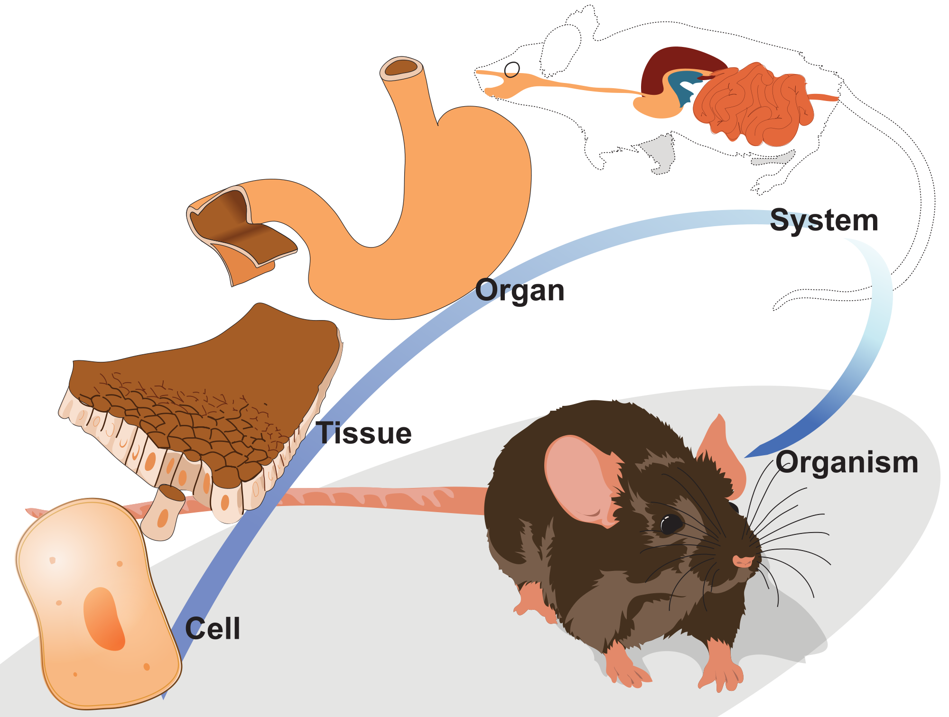
PRO TANTO VS. ALL THINGS CONSIDERED
“determines”
“in virtue of”
“makes it the case that”

Slide 17
PRO TANTO VS. ALL THINGS CONSIDERED
all things considered good
GOOD-MAKER
BAD-MAKER
kind
deceptive
F, G, …
ACTION
Notes:
Mention principles

Slide 18
PRO TANTO VS. ALL THINGS CONSIDERED
What are we saying (or denying) when we say (or deny) that a moral flaw is an aesthetic flaw?
Editing might contribute to or partially determine the coherence of a film—an aesthetic merit. Should we then say the editing is an aesthetic merit, or that it simply determines one (that it is an aesthetic goodness maker)?

Slide 19
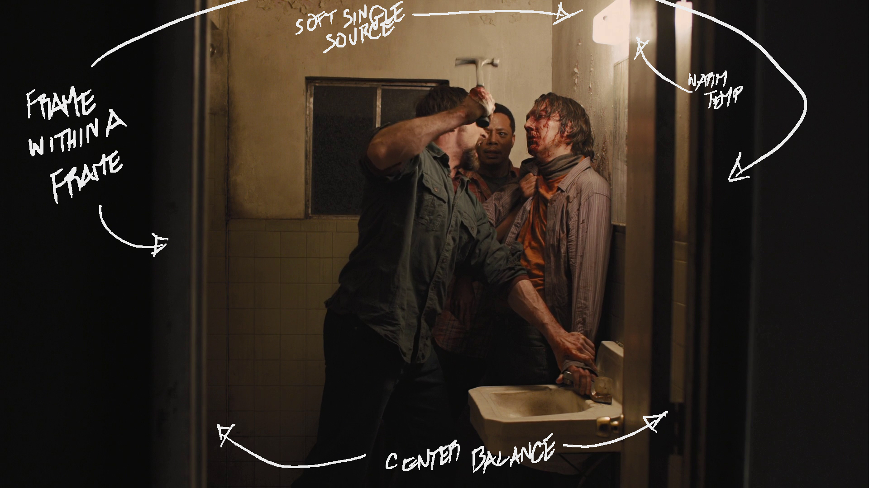
ENDORSEMENT VS. NON-ENDORSEMENT
Prisoners (2013)
Notes:
Mention explicit or implied author
Show clips

Slide 20
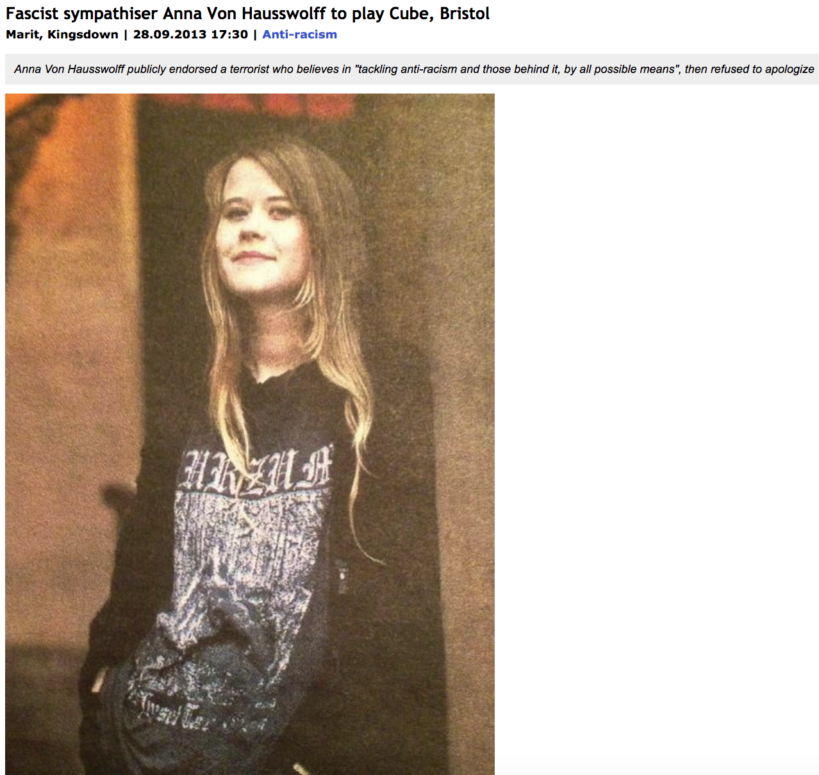
ENDORSEMENT VS. NON-ENDORSEMENT

Slide 21
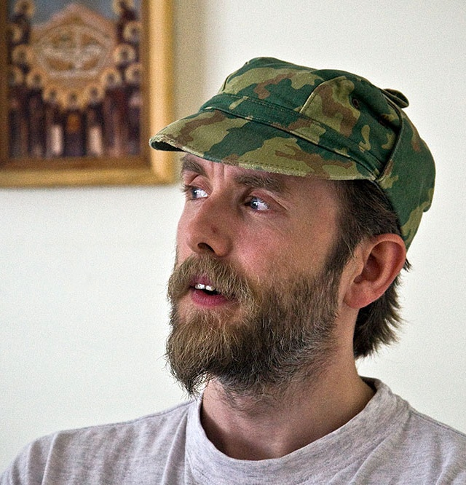
ENDORSEMENT VS. NON-ENDORSEMENT
Varg Vikernes
“Burzum” (self-titled debut)
Notes:
True that it might incite people to hold racist views
Not directly relevant to the issue

Slide 22
ENDORSEMENT VS. NON-ENDORSEMENT

Slide 23
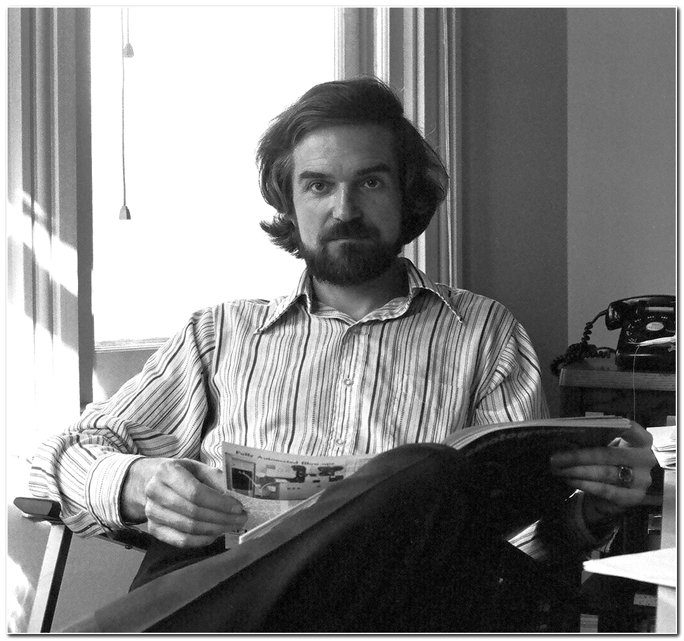
ENDORSEMENT VS. NON-ENDORSEMENT
“Attacks on the film have invariably centred on the rape scene. Very few, to my knowledge, have raised the question of homophobia, and then only casually, as if it didn’t really matter much.”
“Clear message of film (I said it was mindboggling): sex is for procreation! Those who disagree will go to Hell, the ultimate Hell being preserved for men who carry their disagreement to its logical conclusion. Essentially, it’s the Victorian view of sexuality, at least a hundred years out of date, which (Roman Catholics aside) disappeared with the public acceptance of birth control.”
Robin Wood

Slide 24
SUMMARY OF THE DEBATE
It is unclear whether a narrow or broad sense of the “aesthetic” is intended. So be suspicious!
We can agree for the sake of argument that some things are immoral (at least in some sense).
We can set aside the question of whether a given work is all things considered aesthetically good or bad.
The question is whether a work can be aesthetically good or bad insofar as it is immoral.
The kind of pro tanto badness we should focus on has something to do with the perspective of a work (or what it endorses or prescribes), rather than what it merely represents.

Slide 25
SUMMARY OF THE DEBATE
Moralists and immoralists take different positions on what we might call a “valence constraint” (see Harold 2008).
Moralists think that negative moral features sometimes decrease the aesthetic value of a work (but never increase it).
Immoralists deny this: they maintain that negative moral features sometimes decrease aesthetic value and other times increase it.
Autonomists think there is no relationship here at all.

