Slide 1
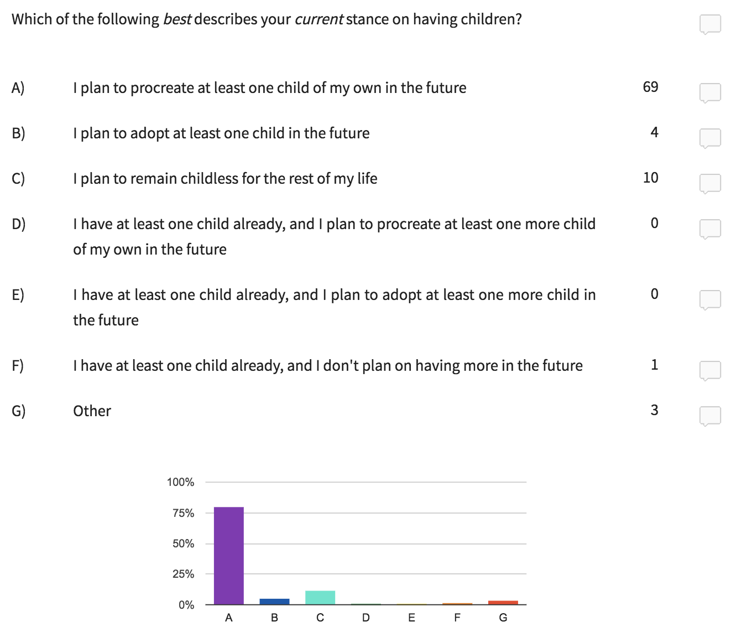
PARTICIPATION POLL

Slide 2
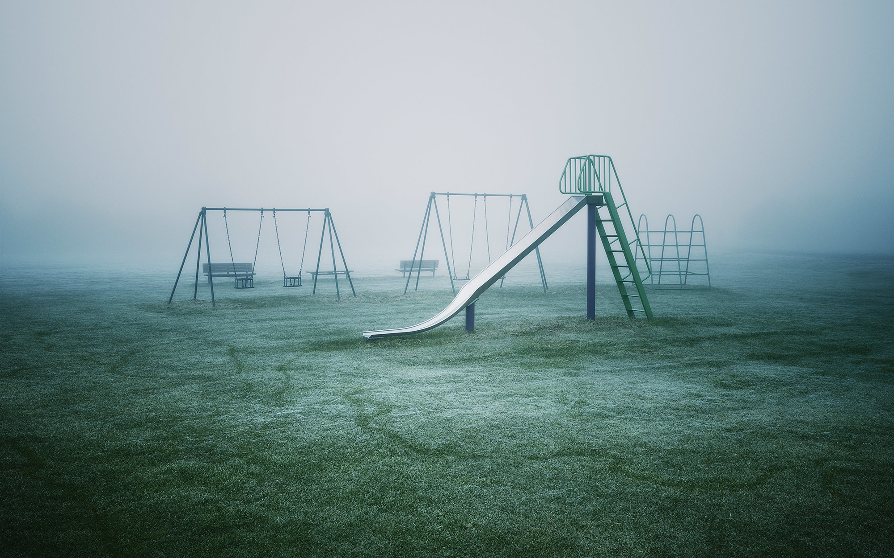
The ethics of procreation
PHL 304
Fall 2018
Notes:
Mad Men scene, S2:E5, 37:40
https://www.youtube.com/watch?v=AjET8ToF8vI

Slide 3
I call heaven and earth to record this day against you, that I have set before you life and death, blessing and cursing: therefore choose life, that both thou and thy seed may live.
—Deuteronomy 30:19
Cursed be the day on which I was born. . . . Cursed be the man . . . because he slew me not from the womb; so that my mother might have been my grave and her womb always great. Why did I come out of the womb to see labour and sorrow?
—Jeremiah 20:14–18

Slide 4
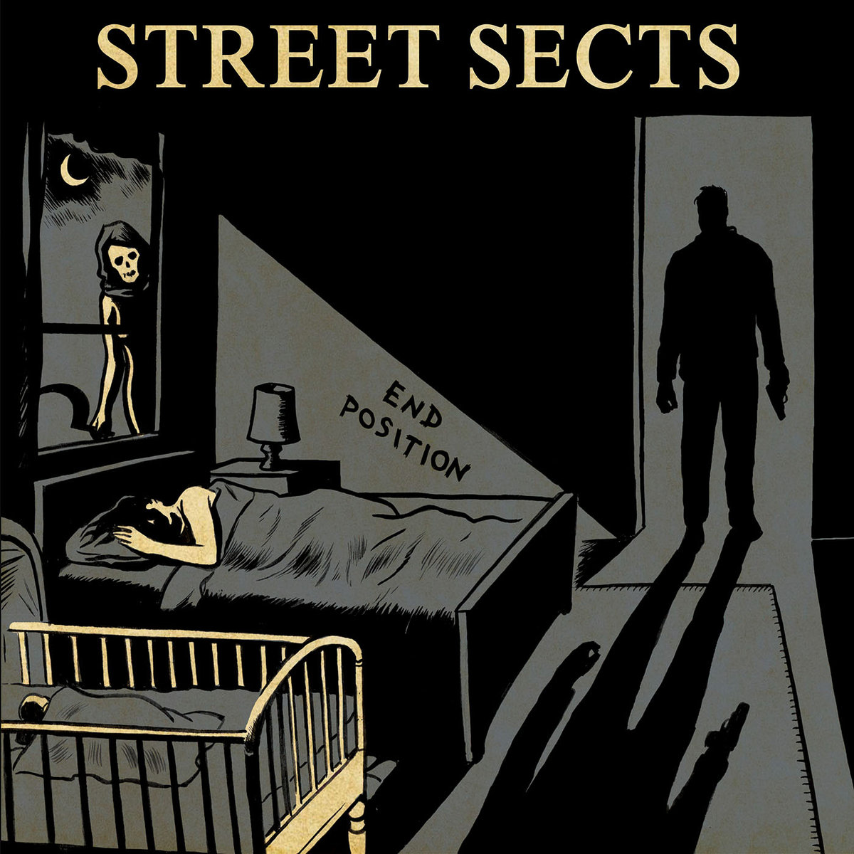
we are a virus
we’re a product of bad luck
we scream our way into existence
nine months after someone else gets fucked
—Street Sects
Notes:
https://streetsects.bandcamp.com
“End Position is a harsh noise industrial hammer punk album about numbing your feelings, chastising the nostalgic, smoking crack, hurting your loved ones, and eventually killing yourself. Debut album.”
https://www.tinymixtapes.com/music-review/street-sects-end-position

Slide 5
FUNNY STORY
Yaniv’s daughter
Yaniv (from Transcending the Cognitive)
www.youtube.com/watch?v=bwt_iKFGN6M
Notes:
Story about Yaniv
https://www.youtube.com/watch?v=bwt_iKFGN6M

Slide 6
Why Have Children?: The Ethical Debate
Under what conditions is having children morally justified or unjustified?
Do women ever have a moral obligation to have a child or not to have a child?
What are good reasons for having a child or for not having a child?
Christine Overall

Slide 7
Why Have Children?: The Ethical Debate
Choosing whether or not to procreate is one of the most significant ethical decisions one can make.
The burden of justification rests on those who choose to procreate, not on those who choose to be childless.
Both deontological and consequentialist arguments for procreating fail: they ultimately treat children as mere means to an end.
The best reason for having a child has to do with the distinctive features of the (biological) parent–child relationship.
Christine Overall
Notes:
Even if there is no obligation to do x, x may still be a good thing to do.

Slide 8
RATIOANL DECISION MAKING
We can all agree that deciding whether or not to have children involves a number of complicated factors.
Feelings
Emotions
Memories
Impulses
Biological and social pressures
Self-interest
But the same is true of most (if not all) decisions!
The process of deciding whether or not to have children should involve careful reflection.
Notes:
Naturalistic fallacy

Slide 9
RATIOANL DECISION MAKING
It might be objected that deciding whether or not to have children is irrational (or at least non-rational).
Consider other valuable activities:
Art
Love
Sex
Dancing
Recreational drug use
Perhaps the decision of whether or not to have children should be based on a Pascalian wager: considering the potential payoffs of the two decisions and then making the decision that is most likely to produce the biggest payoff.
Notes:
“not susceptible to a straightforward tally of pros and cons” (206)
“Recreational drug and alcohol use may indeed be irrational if it is self-destructive, but feeling love or going dancing doesn’t seem irrational at all: they may very well be entirely consistent with one’s interests, purposes, and well-being. Perhaps Bennett ought to be making the point that certain activities are nonrational rather than irrational” (205)
Leap of faith?
“[W]e must weigh not the reasons for and against reproducing, but rather the potential payoff of the procreation bet—the ‘winnings’ both from having children and from not having children” (207)

Slide 10
RATIOANL DECISION MAKING
The potential payoffs of not having children are many:
Greater disposable income
More leisure
More personal freedom
Less responsibility
Less conflict with one’s partner (if one has a partner)
Fewer worries
There are also potential downsides:
The possibility of future regret
The possibility of unfulfilled longing for a child
The possibility of unfulfilled biological and social pressures
The possibility of being alone in old age
Notes:
“[W]e must weigh not the reasons for and against reproducing, but rather the potential payoff of the procreation bet—the ‘winnings’ both from having children and from not having children” (207)

Slide 11
RATIOANL DECISION MAKING
The potential payoffs of having children are also many:
The joy and rewards of raising a child
Fulfilled biological and social pressures
Companionship in old age (assuming one’s child is still alive)
The potential downsides include:
More responsibility
More housework
More conflict with one’s partner (if one has a partner)
More worries
Less disposable income
Less leisure
Less personal freedom
Less spontaneity
Notes:
“[W]e must weigh not the reasons for and against reproducing, but rather the potential payoff of the procreation bet—the ‘winnings’ both from having children and from not having children” (207)

Slide 12
RATIOANL DECISION MAKING
The problem with this model is that it focuses the decision entirely on personal benefits to oneself.
It ignores the moral dimensions of the decision.
Notes:
“Although one is certainly entitled to take into account the effects of having a child on oneself, if one decides only on the basis of a gamble about one’s future well-being, then one is refusing to treat procreation as a fully moral matter” (209)

Slide 13
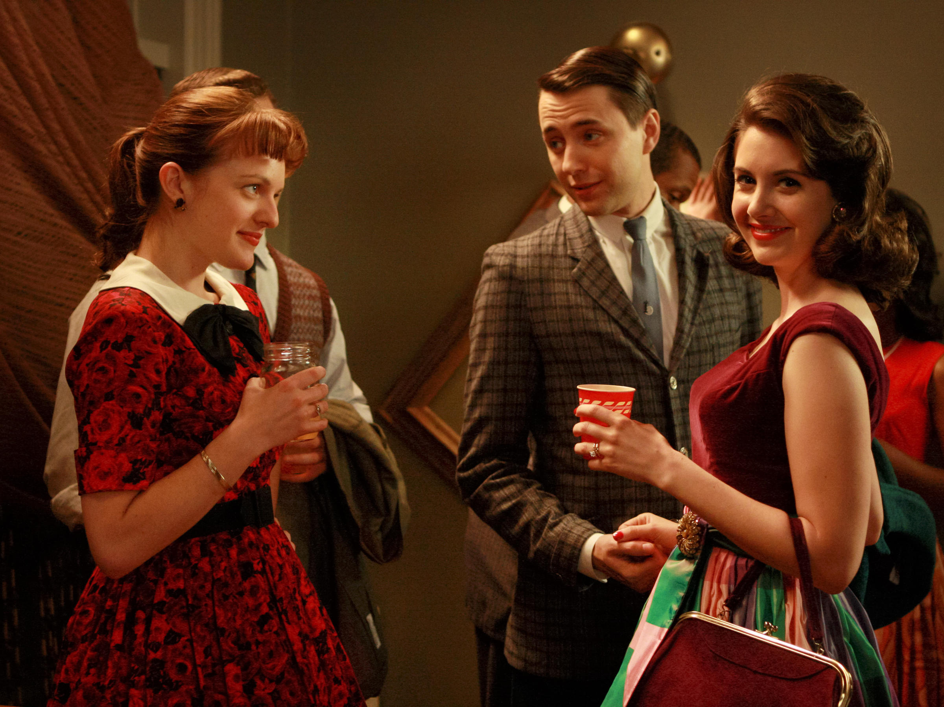
RATIOANL DECISION MAKING
I just took a gamble that it would pay off better for me personally than being childless.
^{A thing like that.}

Slide 14
RATIOANL DECISION MAKING
I just took a gamble that it would pay off better for me personally than being childless.
^{A thing like that.}
Notes:
“A life well lived is not just a matter of personal payoff” (209)

Slide 15
ETHICAL SIGNIFICANCE
The decision of whether or not to procreate is a decision of whether or not to bring a new person into existence—a person who cannot possibly consent to the decision!
The decision can’t be for child’s sake, because nonexistent children don’t have any interests!
The decision to have a child is a decision to assume responsibilities that last a lifetime.
This decision also has repercussions for the wellbeing of oneself and other sentient creatures.
The decision is irreversible.
If we ignore the ethical dimensions of the decision, then we risk viewing procreation not as something that women do, but as something that merely happens to women.

Slide 16
THE BURDEN OF JUSTIFICATION
It is an unstated social norm that people are expected to provide reasons for not having children.
It is often assumed that the decision to have children rarely (if ever) requires justification.
The burden of justification should be the other way around.
Procreation brings into existence a dependent, needy, and vulnerable being whose future is uncertain.
The decision to procreate is therefore the morally riskier decision.

Slide 17
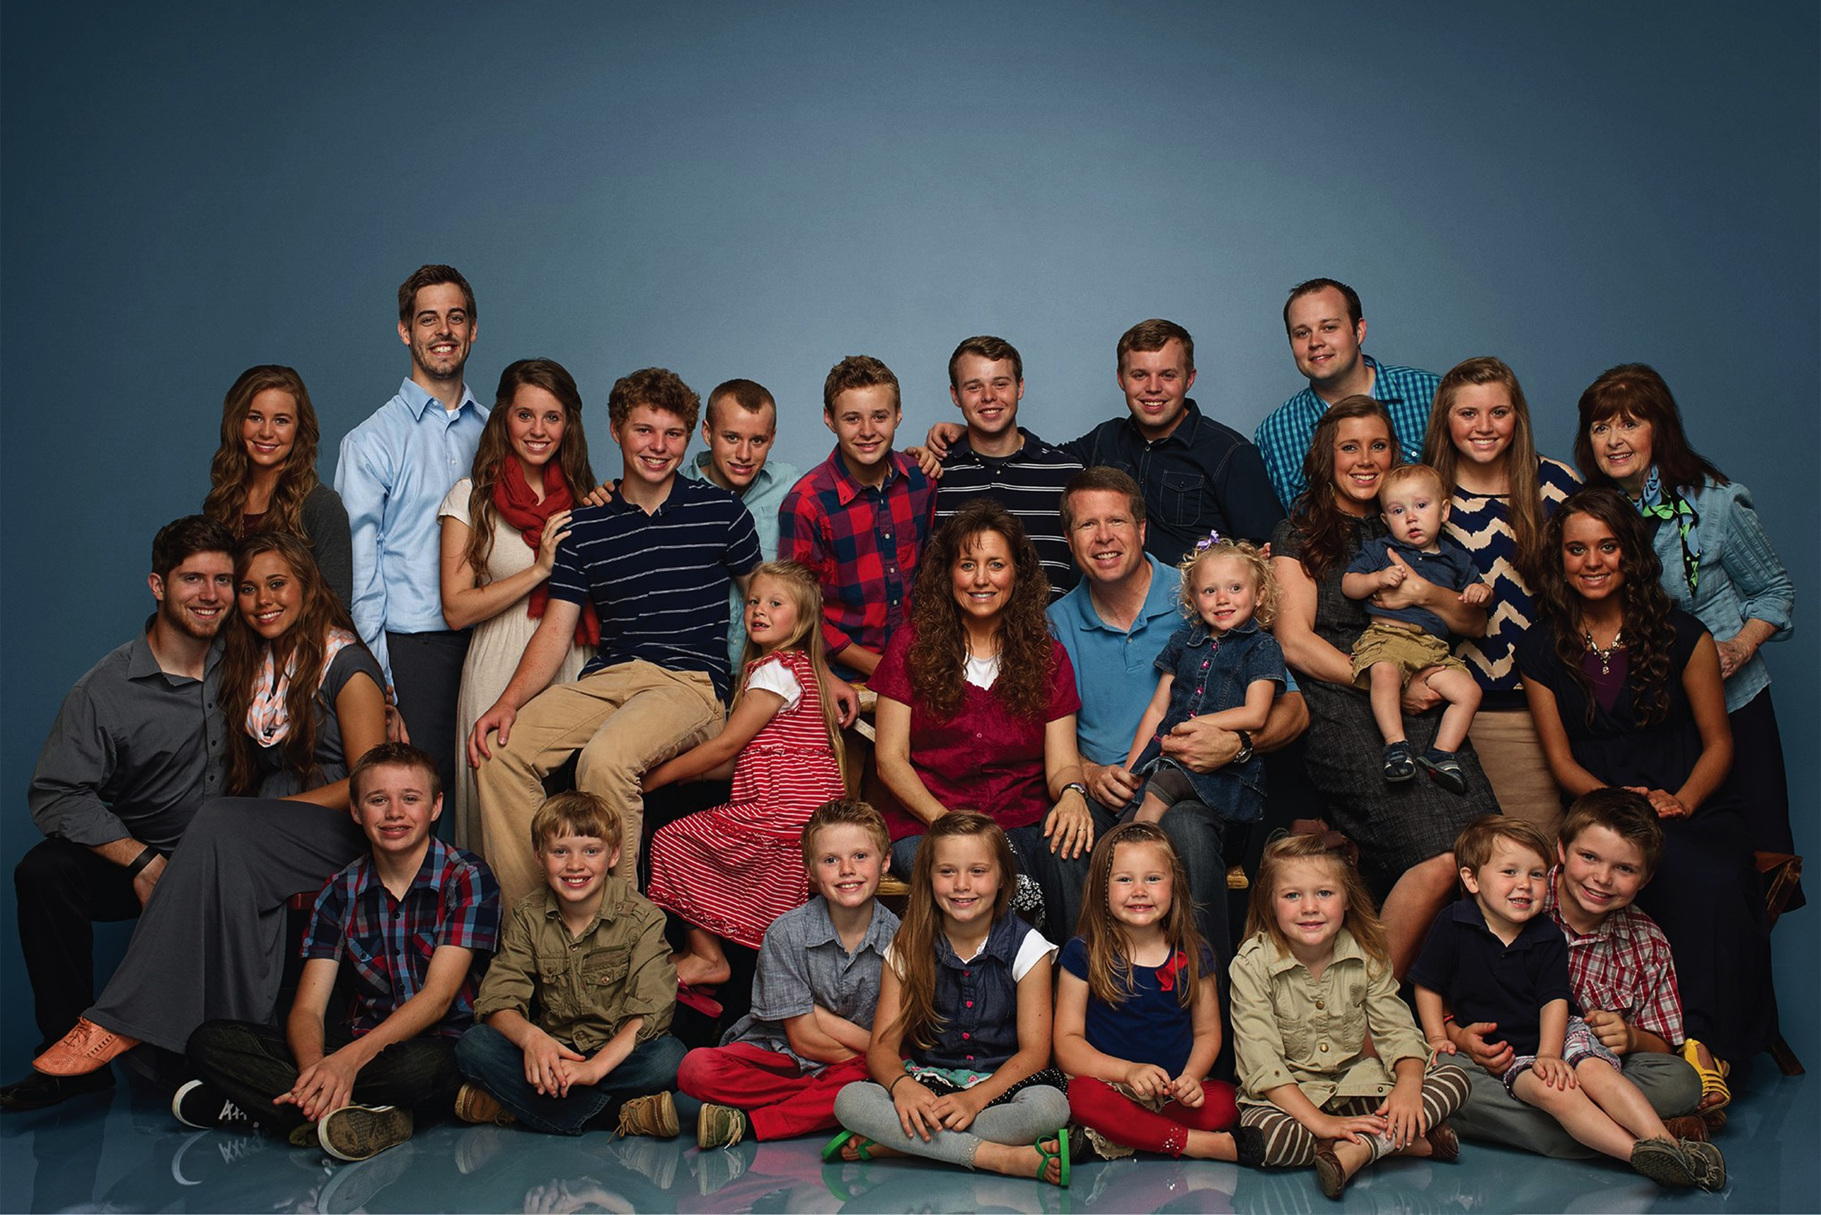
VIDEO CLIP

Slide 18
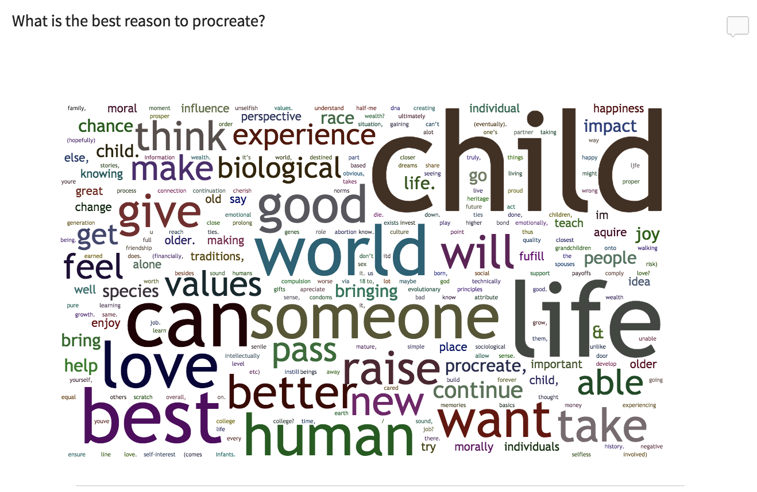
REASONS TO PROCREATE (?)
See Files --> Squarecap --> Open response for the anonymized answers
Notes:
Repugnant conclusion?

Slide 19
SUMMARY OF OPEN RESPONSE
Biological impulse
Emotional impulse
Self-interest and personal happiness
Continuation of one’s family line
Continuation of the species
Continuation of values, traditions, or information
Completing personal projects
Religious reasons
Positive consequences for others
Moral obligation
Loving relationship
“I think im a cool guy; I think my kid would be equally cool. Society would be better with more cool people.”
Notes:
No good reason

Slide 20
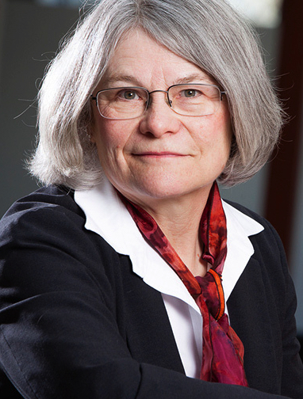
REASONS TO PROCREATE (?)
Children are neither products nor property.
Children are (or will become) self-conscious, autonomous entities with their own unique abilities, preferences, and needs.
Parents go wrong when they regard their children as objects to be molded to their own purposes.
Many bad reasons for having children are indicative of such a morally flawed attitude.
Christine Overall
Notes:
“A healthy pregnancy and delivery are an important achievement, and successfully raising children is an admirable accomplishment. Nonetheless, I am uneasy about seeing children as a product—even a valuable product such as art” (211)
“Children, like adult women and men, should be treated as ends that are valuable in themselves. If we ask ourselves ‘What are children for?’ the most important answer must be that they are for themselves, not for their parents or for their society” (211)

Slide 21
REASONS TO PROCREATE (?)
The essence of the parent–child relationship is to give (and often receive) a special kind of “love.”
It is tempting to describe it as “unconditional love,” which involves treasuring the loved one no matter what.
Perhaps unconditional love is warranted for certain non-autonomous beings (or beings who have some special excuse).
Otherwise, unconditional love is undesirable.
Real love is love for a particular being: we love people for who they are, and we want to be loved for who we are.
Christine Overall
Notes:
“We all want to be loved, and we hope that people will continue to love us even when we are irritable, impatient, rude, careless, or unkind. We want our parents, our children, our lovers, and our close friends to overlook our faults and focus on our good qualities. We want them to cherish us, even—or maybe especially—on our bad days. The idea of unconditional love implies that we should treasure the loved one no matter what he or she does and that all behavior, no matter how abominable, should be forgiven and forgotten” (212)
“The exceptions are people who are not yet or not any longer autonomous and hence not responsible for their behavior. Thus, toward an infant or young child, unconditional love may be an appropriate goal. One loves one’s baby or toddler through colic, tantrums, diaper changes, vomiting, and inconsolable wailing—whatever the child may do” (213)
“But as the child grows up, behavior that was formerly appropriate and tolerable becomes much less so. Babyish behavior in a two-year-old is not unexpected; in a ten-year-old, though, it becomes a problem. Unless the child has developmental problems, unconditional love as a response to inappropriate behavior is not desirable” (213)
“They want their own personal characteristics to be appreciated. They hope that it is their individual features, values, and behavior that are lovable. From the parent’s point of view, a child is loved and lovable precisely because of who the child is” (213)
“Maybe that’s why some people are attracted only to babies: as a child becomes autonomous and develops a mind of his own, he must be seen as an independent person, not simply an object to be enveloped in unconditional love” (213)

Slide 22
REASONS TO PROCREATE (?)
We must distinguish between two different kinds of conditional love.
School playground love is love offered to a person on condition that the beloved conforms to the lover’s demands and decrees.
Identity-based love is love for a person on the basis of who the beloved is and the kind of person the beloved chooses to be.
It is the possibility of this latter kind of love that makes the parent–child relationship truly worthwhile.
Christine Overall
Notes:
“This kind of conditional love is what some parents offer their unfortunate children when they give their kids the message that they will be loved only if they behave according to the parents’ standards, if they achieve in school, or if they become outstanding athletes. This kind of conditional love says, ‘I will love you if you do what I want, say what I think you should say, and become the kind of person that I favor.’ That kind of love is conditional on the love object’s conformity to the parent’s demands and decrees” (214)
“But another and much better kind of conditional love is the kind that says, ‘I love you for who you are; I love you because you are you. I love you because of what you do, what you say, and what you are becoming. Your needs, hopes, and choices endear you to me.’ I suggest that it is conditional love in this second sense that makes procreation worthwhile. This kind of conditional love is conditional on who the child is; it values the child for what he chooses to be. It is compassionate—it sees the child realistically, not as a doll to be played with or a pet to be manipulated, but as a person in his own right. This kind of conditional love is also forgiving. It accepts that the child is fallible and will make mistakes, as everyone does” (214)
“But this kind of conditional love is not ‘unconditional’ toward the child’s behavior. This kind of love recognizes that cruelty, dishonesty, manipulativeness, and violence are not to be embraced or loved unconditionally. Instead, the parent loves the child enough to help the child become a better person” (214)

Slide 23
REASONS TO PROCREATE (?)
The parent–child relationship differs from other expressions of identity-based love.
It is both inherently and contingently asymmetric.
It is impossible for children to choose their (biological) parents.
In the beginning, the child is vulnerable, dependent, and needy, and throughout the relationship, the parent’s flourishing depends on the flourishing of the child.
Christine Overall
Notes:
“The developing relation- ship between parent and child is significantly different from developing a friendship or other love relationship with another adult. The difference in procreation is that the parents not only start to build a relationship with the child but actually create the person with whom they have the relation- ship. They choose to have their child” (215)
To choose to have a child is, at best, to choose to love and care for an unknown but related person, a person whom one will gradually get to know better and better even as that child goes through all the changes generated by maturing and growing up” (215)
“This relationship is different from a connection between two adults or two children, where in the usual case each one chooses the other, and each one consents to be in the relationship” (215)
“To choose to have a child is thus to choose to nurture and care for an initially helpless being—to be a literal life preserver for many years, committed to helping the child to achieve her own self-sufficiency” (215)
“[H]er attachment to the child makes her need him, and this fact also applies to loving fathers. It is a kind of dependence—the sort we have when our own flourishing is contingent upon another person’s flourishing. The parent is vulnerable to the child because the parent’s life cannot go well unless the child’s life goes well” (216)

Slide 24
REASONS TO PROCREATE (?)
When procreation is based on the desire to form a loving relationship, it may be self-oriented but it needn’t be selfish.
The best reason to procreate is to (literally) create a new relationship by bringing a person into existence and valuing that relationship for its own sake.
For some people, the desire for such a relationship is crucial to their sense of self, and the decision to enter such a relationship involves choosing to be a particular kind of person.
This may not be the only path to a good life, but it is one of them.
Christine Overall
Notes:
“Nonetheless, procreation cannot be entirely altruistic either: potential parents cannot have a child for the child’s sake because before being created, the child does not exist to have a sake, an interest, in anything. Procreation is the parents’ project, but it is not a project they can undertake to benefit a potential baby. As a result, procreating is, for the parents, self-oriented. But it is not inevitably selfish if one is seeking a relationship with the child that will be based on the kind of love that I described in the previous section” (217)
“In choosing to have a child, one is deciding both to fulfill one’s sense of who one is and at the same time aspiring to be a different person than one was before the child came along. In becoming a parent, one creates not only a child and a relationship, but oneself; one creates a new and ideally better self-identity” (218)
“There are of course many paths to self-transformation and a good life—through artistic creativity, scientific discovery, athletic striving, teaching, practicing medicine, nursing, farming, animal care, gardening, building, designing, fixing things, being a worthy political leader, and so on” (219)

Slide 25
SUMMARY
When the parent–child relationship has two distinctive features, it has a special kind of value.
The relationship is formed out of a desire to love.
The relationship is asymmetric.
Having a child for this reason avoids treating the child as a mere means to an end.
The best reason to procreate is to bring about such a unique relationship.
Having more than one child risks undermining this reason.
Christine Overall
Notes:
“Nonetheless, procreation cannot be entirely altruistic either: potential parents cannot have a child for the child’s sake because before being created, the child does not exist to have a sake, an interest, in anything. Procreation is the parents’ project, but it is not a project they can undertake to benefit a potential baby. As a result, procreating is, for the parents, self-oriented. But it is not inevitably selfish if one is seeking a relationship with the child that will be based on the kind of love that I described in the previous section” (217)
“In choosing to have a child, one is deciding both to fulfill one’s sense of who one is and at the same time aspiring to be a different person than one was before the child came along. In becoming a parent, one creates not only a child and a relationship, but oneself; one creates a new and ideally better self-identity” (218)
“There are of course many paths to self-transformation and a good life—through artistic creativity, scientific discovery, athletic striving, teaching, practicing medicine, nursing, farming, animal care, gardening, building, designing, fixing things, being a worthy political leader, and so on” (219)

Slide 26
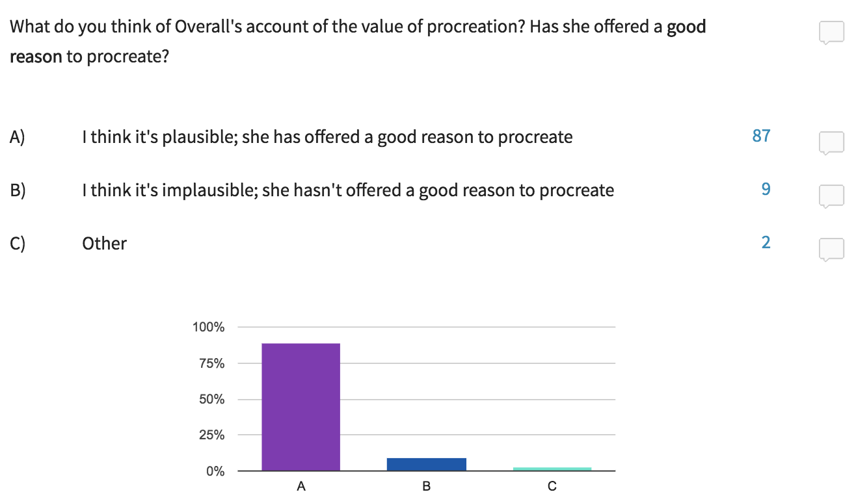
PARTICIPATION POLL

Slide 27
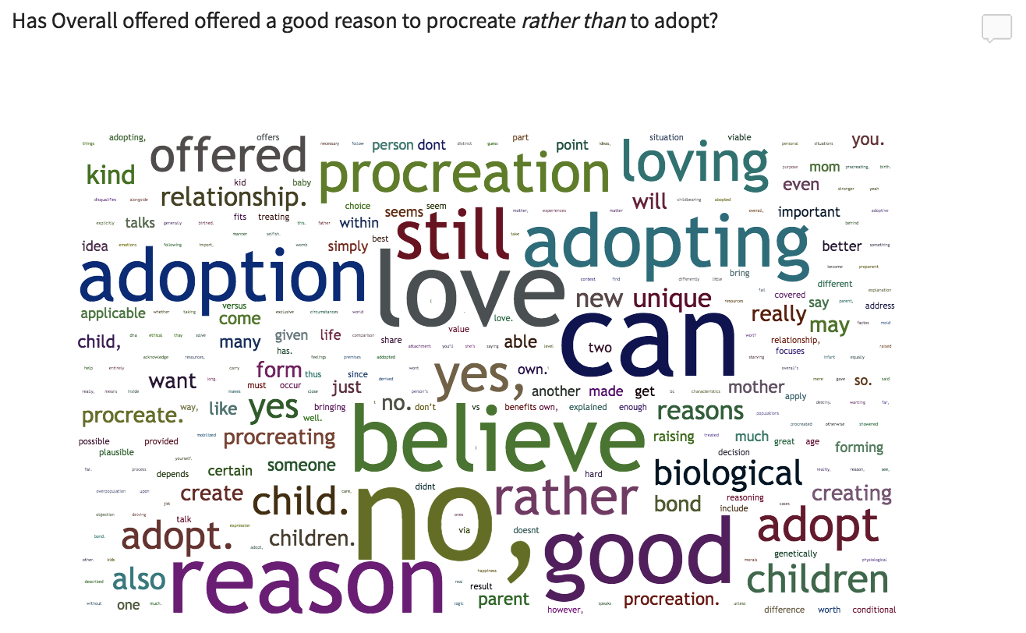
OPEN RESPONSE
See Files --> Squarecap --> Open response for the anonymized answers

