Slide 1
NOTIFICATIONS (10/17)
I greatly dislike the widespread assumption that the aim of philosophy should be the vindication of everyday beliefs.
—Richard Joyce

Slide 2
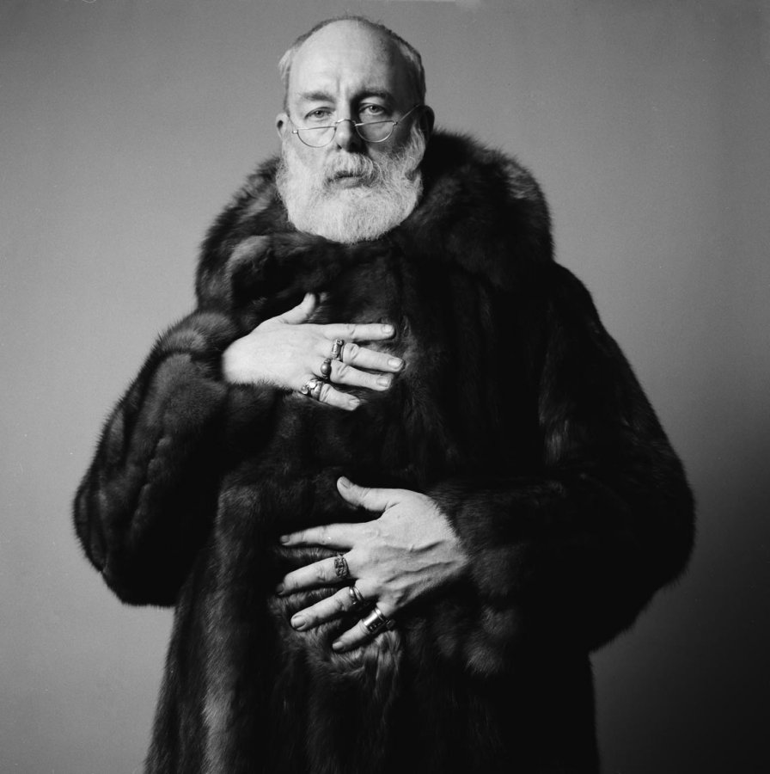
NOTIFICATIONS (10/17)
My mission in life is to make everybody as uneasy as possible. I think we should all be as uneasy as possible, because that’s what the world is like.
—Edward Gorey

Slide 3
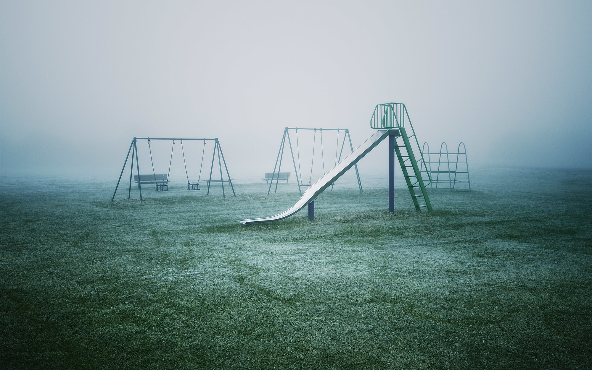
THE ETHICS OF PROCREATION
PHL 304
Fall 2018
Notes:
Mad Men scene, S2:E5, 37:40
https://www.youtube.com/watch?v=AjET8ToF8vI

Slide 4
Cursed be the day on which I was born. . . . Cursed be the man . . . because he slew me not from the womb; so that my mother might have been my grave and her womb always great. Why did I come out of the womb to see labour and sorrow?
—Jeremiah 20:14–18

Slide 5
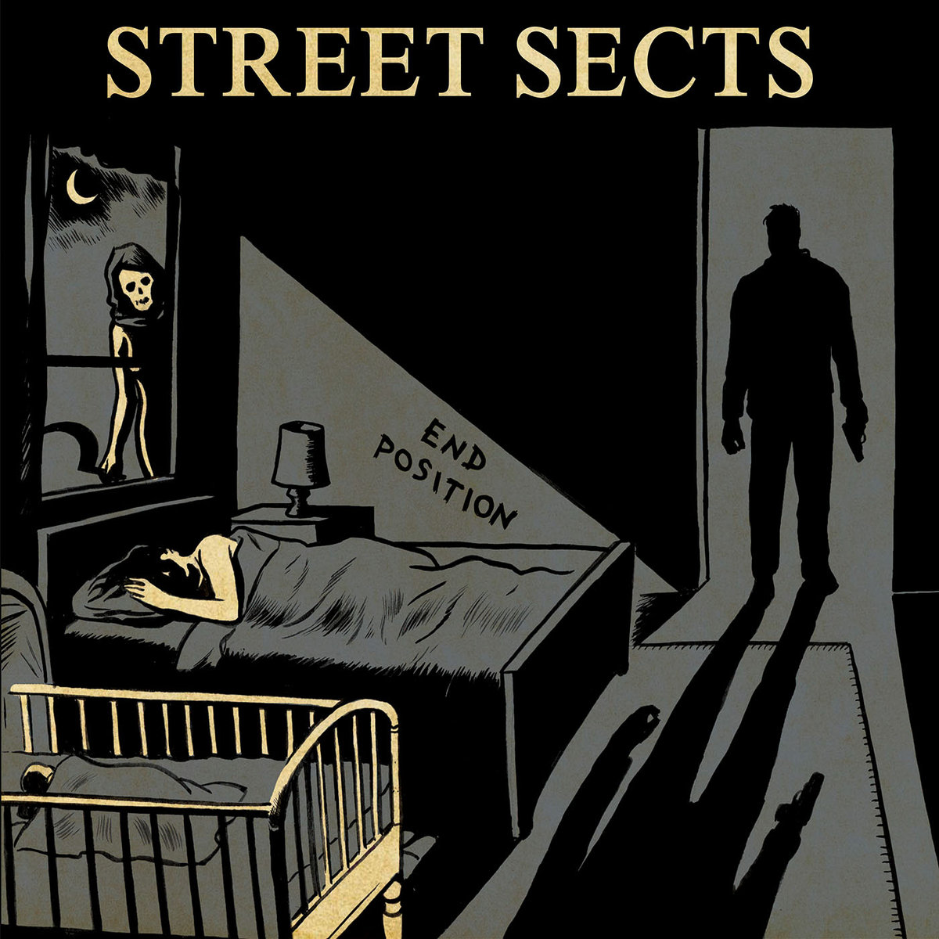
we are a virus
we’re a product of bad luck
we scream our way into existence
nine months after someone else gets fucked
—Street Sects
Notes:
https://streetsects.bandcamp.com
“End Position is a harsh noise industrial hammer punk album about numbing your feelings, chastising the nostalgic, smoking crack, hurting your loved ones, and eventually killing yourself. Debut album.”
https://www.tinymixtapes.com/music-review/street-sects-end-position

Slide 6
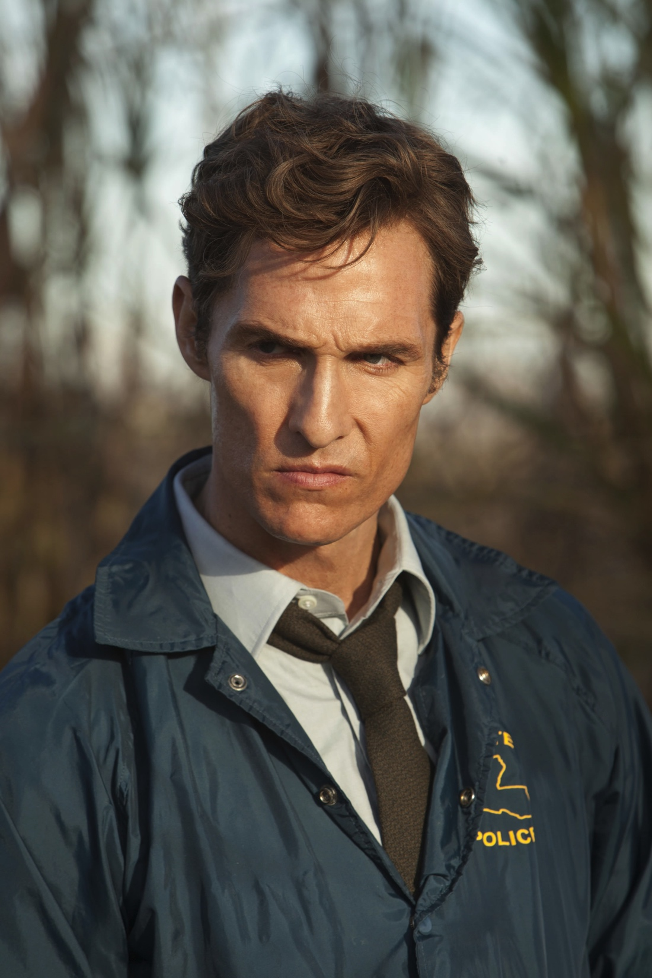
DAVID BENATAR
David Benatar
Rust Cohle
Notes:
“Benatar was born in South Africa in 1966.”
“He is the head of the philosophy department at the University of Cape Town, where he also directs the university’s Bioethics Centre, which was founded by his father, Solomon Benatar, a global-health expert.”
“Benatar dedicated ‘Better Never to Have Been’ ‘to my parents, even though they brought me into existence.’”
Extremely private
“A few years ago, Nic Pizzolatto, the screenwriter behind ‘True Detective,’ read the book and made Rust Cohle, Matthew McConaughey’s character, a nihilistic anti-natalist. (‘I think human consciousness is a tragic misstep in evolution,’ Cohle says.) When Pizzolatto mentioned the book to the press, Benatar, who sees his own views as more thoughtful and humane than Cohle’s, emerged from an otherwise reclusive life to clarify them in interviews.”
https://www.newyorker.com/culture/persons-of-interest/the-case-for-not-being-born

Slide 7
ANTI-NATALISM
Benatar argues for anti-natalism: the view that it is morally wrong to procreate.
Together with even further premises, anti-natalism entails a “pro-death” position.
Many will find these views deeply unsettling and too counterintuitive to take seriously.
But are there any arguments that rationally compel us to accept them?
Misanthropic arguments
Philanthropic arguments
David Benatar

Slide 8
MISANTHROPIC ARGUMENTS
Stabbing
Hacking
Slashing
Hanging
Gassing
Poisoning
Drowning
Bombing
David Benatar

Slide 9
MISANTHROPIC ARGUMENTS
Persecuting
Oppressing
Beating
Branding
Maiming
Tormenting
Torturing
Raping
Kidnapping
Enslaving
David Benatar

Slide 10
MISANTHROPIC ARGUMENTS
“More than 63 billion terrestrial animals and . . . more than 103 billion aquatic animals are killed for human consumption every year” (8)
“[E]very human (who is not a vegetarian or vegan) is, on average, responsible for the death of 27 animals per year, or 1,690 animals over the course of a lifetime” (8)
David Benatar

Slide 11
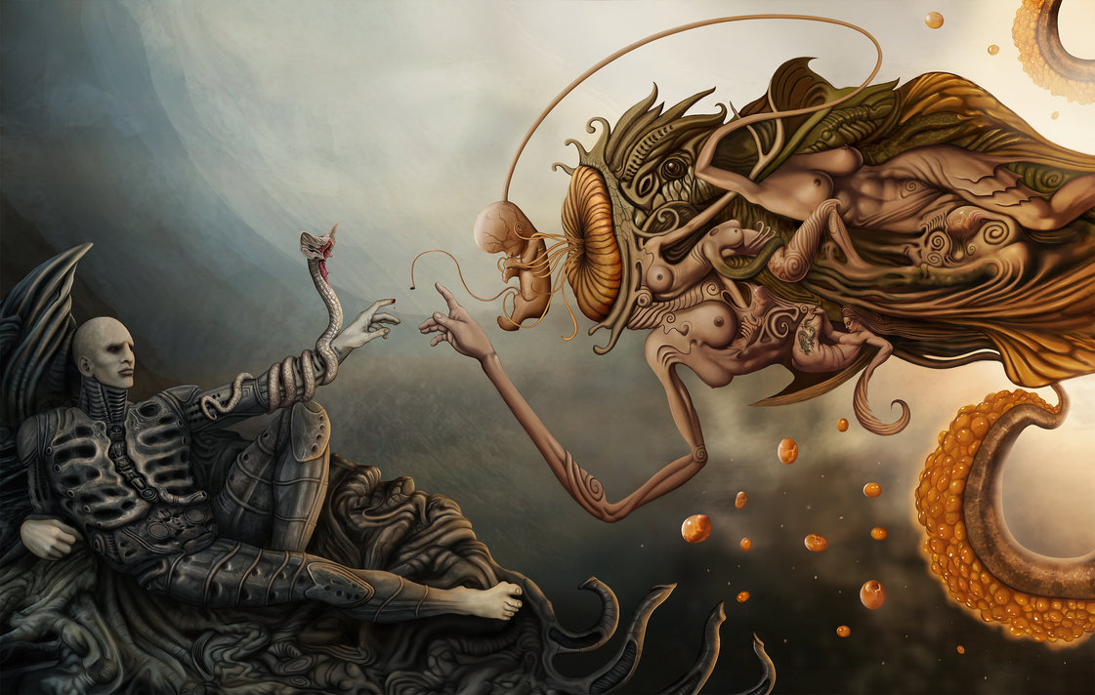
MISANTHROPIC ARGUMENTS

Slide 12
PHILANTHROPIC ARGUMENTS
Bad things happen to all of us.

Slide 13
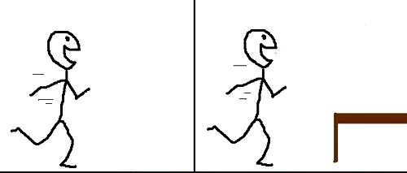
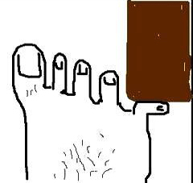
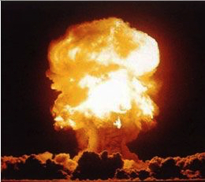
PHILANTHROPIC ARGUMENTS
Bad things happen to all of us.
Pain is intrinsically bad, and most human beings will experience pain at least once.

Slide 14
PHILANTHROPIC ARGUMENTS
Bad things happen to all of us.
Pain is intrinsically bad, and most human beings will experience pain at least once.
We all face death: “every birth is a death in waiting” (6)
None of this befalls the nonexistent.

Slide 15
PHILANTHROPIC ARGUMENTS
Many of us believe that our lives are good on balance.
There is a distinction between how much good and bad we believe our lives contain and how much our lives actually contain.
There are biological drives and cognitive biases that may lead us to overestimate how much good our lives contain and to underestimate how much bad our lives contain.
It is easy to forget that the worst things tend to happen to people later in life.
Notes:
“It is curious that the same logic is rarely applied to those who are depressed or suicidal. In these cases, most optimists are inclined to think that subjective assessments can be mistaken” (3)

Slide 16
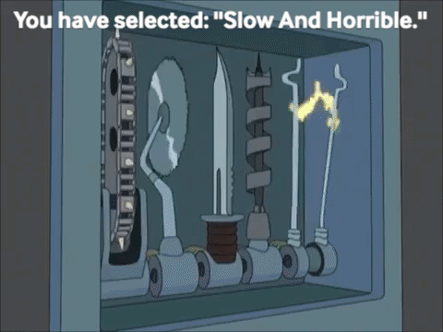
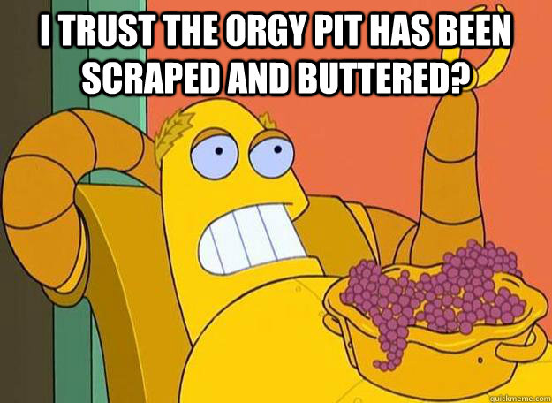
PHILANTHROPHIC ARGUMENTS
10 minutes of the worst tortures
15 minutes of the greatest delights
Notes:
“The worst pains, for instance, are worse than the best pleasures are good. If you doubt this, ask yourself – honestly – whether you would accept a minute of the worst tortures in exchange for a minute or two of the greatest delights” (3)

Slide 17
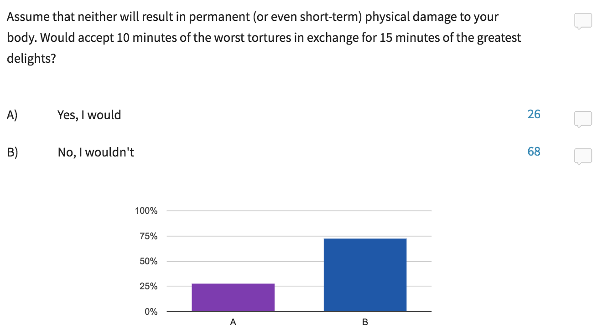
PARTICIPATION POLL

Slide 18
THE OPTIMIST’S REPLY
Good things also happen to us.
So long as the goods outweigh the bads, life is worth living.
The expression “life worth living” is ambiguous.
Present-life sense
Future-life sense
Different standards apply to these concepts.
David Benatar
Notes:
“One important explanation for this is that in deliberating about whether their lives were worth starting, many people actually (but typically unwittingly) consider a different question, namely whether their lives are worth continuing. Because they imagine themselves not existing, their reflection on non-existence is with reference to a self that already exists. It is then quite easy to slip into thinking about the loss of that self, which is what death is. Given the life drive, it is not surprising that people come to the conclusion that existence is preferable” (5)
“Asking whether it would be better never to have existed is not the same as asking whether it would be better to die. There is no interest in coming into existence. But there is an interest, once one exists, in not ceasing to exist” (5)
“By contrast, because there is no interest in coming into existence, there is no interest that the bad things need to override in order for us to say that it would be better not to create the life. So the quality of a life must be worse in order for the life to be not worth continuing than it need be in order for it to be not worth starting” (5)

Slide 19
THE OPTIMIST’S REPLY
It would have been better not to go
Now that you’re there, it is better to stay

Slide 20
THE OPTIMIST’S REPLY
Assumption 1: All else being equal, it is morally permissible to bring a person into existence whose life will be good on balance, even if doing so harms that person.
Assumption 2: Bringing a person into existence (whose life will be filled with various goods) benefits that person.
Benatar argues that being brought into existence is never a benefit but always a harm.
David Benatar

Slide 21
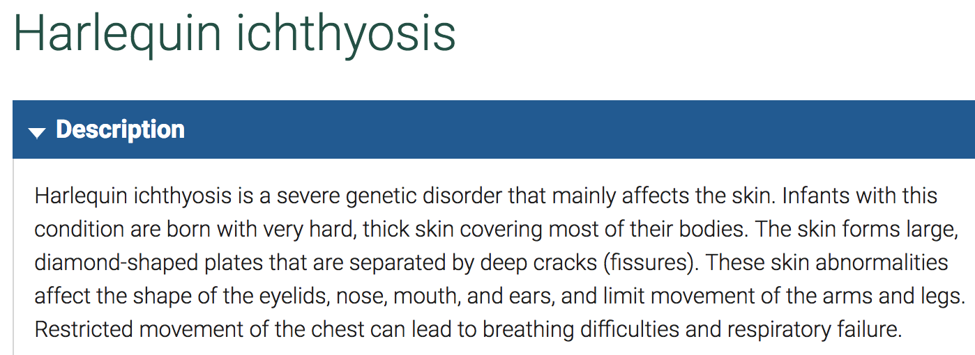
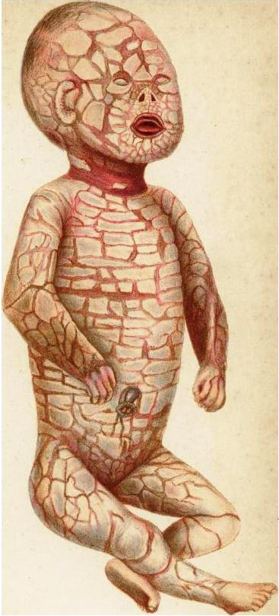

Slide 22
THE SMITHS
The Smiths
“Sally”
munchausen syndrome by proxy
in vitro fertilization

Slide 23
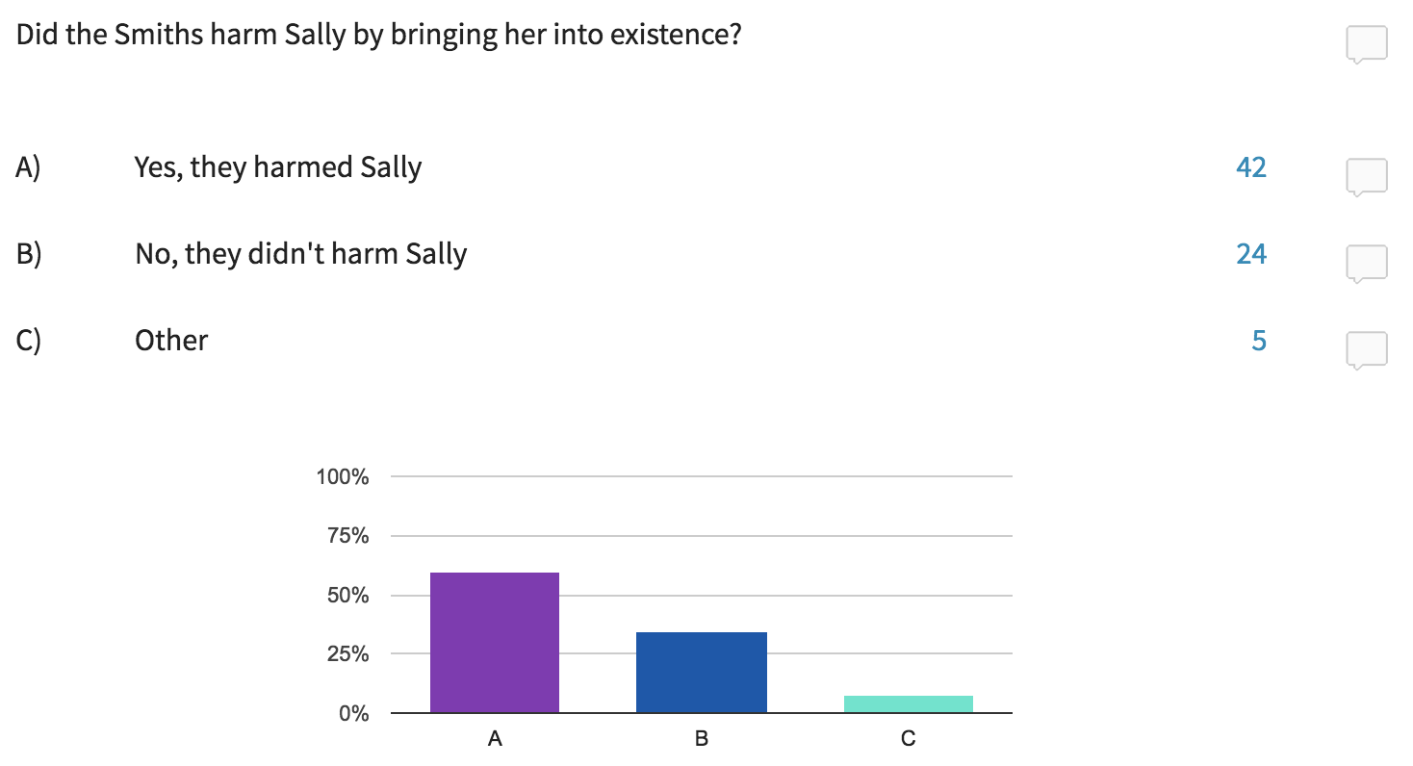
PARTICIPATION POLL

Slide 24
THE ASYMMETRY ARGUMENT
If there is an asymmetry between pain and pleasure, then it is better never to come into existence.
If it is better never to come into existence, then bringing a person into existence harms but does not benefit that person.
There is an asymmetry between pain and pleasure.
So: bringing a person into existence harms but does not benefit that person.

Slide 25
THE ASYMMETRY ARGUMENT
The presence of pain is bad.
The presence of pleasure is good.
The absence of pain is good, even if that good is not enjoyed by anyone.
The absence of pleasure is not bad, unless there is somebody for whom this absence is a deprivation.
Notes:
“However, this conclusion does not follow. This is because there is a crucial difference between harms and benefits which makes the advantages of existence over non-existence hollow but the disadvantages real” (345)

Slide 26
THE ASYMMETRY ARGUMENT
Even if there is a moral obligation to avoid bringing suffering people into existence, there is no moral obligation to bring happy people into existence.
The asymmetry between pain and pleasure provides the best explanation of this datum.
So: there is an symmetry between pain and pleasure.
Notes:
“In other words, the reason why we think that there is a duty not to bring suffering people into existence is that the presence of this suffering would be bad (for the sufferers) and the absence of the suffering good (even though there is nobody to enjoy the absence of suffering)” (346)
“In contrast to this, we think that there is no duty to bring happy people into existence because, while their pleasure would be good, its absence would not be bad (given that there would be nobody who would be deprived of it)” (346)
“Positive utilitarians who are sympathetic to the asymmetry could draw a distinction between (i) promoting the happiness of people (that exist, or will exist independently of one’s choices) and (ii) increasing happiness by making people” (347)
“They could then, consistent with positive utilitarianism, judge only (i) to be a requirement of morality. This is the preferable version of positive utilitarianism. If one took (ii) also to be a requirement of morality, then one would be regarding persons merely as means to the production of happiness” (347)

Slide 27
THE ASYMMETRY ARGUMENT
It is strange to give as a reason for having a child that the child will be benefited.
If there is such a reason, then many people have a reason to have more (perhaps very many!) children.
It is not strange to give as a reason for not having a child that the child (once brought into existence) will suffer immensely.
It is sometimes good to avoid having children who will suffer.
The asymmetry between pain and pleasure provides the best explanation of (1)–(4).
So: there is an asymmetry between pain and pleasure.
Notes:
“If absent pleasures were bad irrespective of whether they were bad for anybody, then having children for their own sakes would not seem odd” (346)
“And if it were not the case that absent pains are good even where they are not good for anybody, then we could not say that it would be good to avoid bringing suffering children into being” (346)

Slide 28
THE ASYMMETRY ARGUMENT
It sometimes makes sense to regret bringing a person into existence for the sake of that person.
It never makes sense to regret not bringing a person into the existence for the sake of that person.
The asymmetry between pain and pleasure provides the best explanation of (1)–(2).
So: there is an asymmetry between pain and pleasure.
Notes:
“One might grieve about not having had children, but not because the children which one could have had have been deprived of existence” (346)
“Remorse about not having children is remorse for ourselves, sorrow about having missed child-bearing and child-rearing experiences” (346)
“However, we do regret having brought into existence a child with an unhappy life, and we regret it for the child’s sake, even if also for our own sakes” (347)
“The reason why we do not lament our failure to bring somebody into existence is because absent pleasures are not bad” (347)

Slide 29
THE ASYMMETRY ARGUMENT
If there is an asymmetry between pain and pleasure, then it is better never to come into existence.
If it is better never to come into existence, then bringing a person into existence harms but does not benefit that person.
There is an asymmetry between pain and pleasure.
So: bringing a person into existence harms but does not benefit that person.

Slide 30
THE ASYMMETRY ARGUMENT
DIAGRAM 1 (asymmetry)
Scenario A Zach exists | Scenario B Zach never exists
(1) Presence of Pain (Bad) | (3) Absence of Pain (Good)
(2) Presence of Pleasure (Good) | (4) Absence of Pleasure (Not Bad)
Notes:
“It is uncontroversially the case that 1) is bad and 2) is good” (347)
“However, in accordance with the intuitions mentioned above, 3) is good even though there is nobody to enjoy the good, but 4) is not bad because there is nobody who is deprived of the absent pleasures” (347)
“To determine the relative advantages and disadvantages of coming into existence and never coming to be, we need to compare 1) with 3) and 2) with 4)” (348)
“In the first comparison we see that non-existence is preferable to existence. The advantage is a real one” (348)
“In the second comparison, however, the pleasures of the existent, although good, are not a real advantage over non existence, because the absence of pleasures is not bad” (348)
“For the good to be a real advantage over non-existence, it would have to be the case that its absence were bad” (348)
“Comparing somebody’s existence with his non-existence is not to compare two possible conditions of that person. Rather it is to compare his existence with an alternative state of affairs in which he does not exist.”
“The judgement made in (3) is made with reference to the (potential) interests of a person who either does or does not exist.”
“This objection would be mistaken because (3) can say something about a counterfactual case in which a person who does actually exist never did exist.”
“Claim (3) says that this absence is good when judged in terms of the interests of the person who would otherwise have existed. We may not know who that person would have been, but we can still say that whoever that person would have been, the avoidance of his or her pains is good when judged in terms of his or her potential interests. If there is any (obviously loose) sense in which the absent pain is good for the person who could have existed but does not exist, this is it. Clearly (3) does not entail the absurd literal claim that there is some actual person for whom the absent pain is good.”

Slide 31
THE ASYMMETRY ARGUMENT
better off (?)
Sickly Sam
Healthy Harry
Gets sick regularly
Has a capacity for quick recovery
Never gets sick
Has no such capacity
Notes:
“It is bad for S that he gets sick and it is good for him that he recovers quickly” (348)
“It is good that H never gets sick, but it is not bad that he lacks the capacity to heal speedily” (48)
“The capacity for quick recover, although good for S, is not a real advantage over H” (348)
“This is because the absence of that capacity is not bad for H (and H is not worse off than he would have been had he had the recuperative powers of S)” (348)
“This, in turn, is because the absence of that capacity is not a deprivation for H” (42)
“S is not better off than H in any way, even though S is better off than he himself would have been had he lacked the capacity for rapid recovery” (348)

Slide 32
THE ASYMMETRY ARGUMENT
DIAGRAM 1 (asymmetry)
Scenario A Zach exists | Scenario B Zach never exists
(1) Presence of Pain (Bad) | (3) Absence of Pain (Good)
(2) Presence of Pleasure (Good) | (4) Absence of Pleasure (Not Bad)
Notes:
“It is uncontroversially the case that 1) is bad and 2) is good” (347)
“However, in accordance with the intuitions mentioned above, 3) is good even though there is nobody to enjoy the good, but 4) is not bad because there is nobody who is deprived of the absent pleasures” (347)
“To determine the relative advantages and disadvantages of coming into existence and never coming to be, we need to compare 1) with 3) and 2) with 4)” (348)
“In the first comparison we see that non-existence is preferable to existence. The advantage is a real one” (348)
“In the second comparison, however, the pleasures of the existent, although good, are not a real advantage over non existence, because the absence of pleasures is not bad” (348)
“For the good to be a real advantage over non-existence, it would have to be the case that its absence were bad” (348)
“Comparing somebody’s existence with his non-existence is not to compare two possible conditions of that person. Rather it is to compare his existence with an alternative state of affairs in which he does not exist.”
“The judgement made in (3) is made with reference to the (potential) interests of a person who either does or does not exist.”
“This objection would be mistaken because (3) can say something about a counterfactual case in which a person who does actually exist never did exist.”
“Claim (3) says that this absence is good when judged in terms of the interests of the person who would otherwise have existed. We may not know who that person would have been, but we can still say that whoever that person would have been, the avoidance of his or her pains is good when judged in terms of his or her potential interests. If there is any (obviously loose) sense in which the absent pain is good for the person who could have existed but does not exist, this is it. Clearly (3) does not entail the absurd literal claim that there is some actual person for whom the absent pain is good.”

Slide 33
THE ASYMMETRY ARGUMENT
If there is an asymmetry between pain and pleasure, then it is better never to come into existence.
If it is better never to come into existence, then bringing a person into existence harms but does not benefit that person.
There is an asymmetry between pain and pleasure.
So: bringing a person into existence harms but does not benefit that person.

Slide 34
THE ASYMMETRY ARGUMENT
Premise (2) states: if it is better never to come into existence, then bringing a person into existence harms but does not benefit that person.
Why accept this?
Harm–benefit theory:
To harm someone is to cause effects that are worse for that individual than the alternative.
To benefit someone is to cause effects that are better for that individual than the alternative.

Slide 35
SUMMARY
If the argument is sound, it follows that it is better never to come into existence—even if one’s life is worth continuing once one exists.
If the harm–benefit theory is true, coming into existence is always a harm but never a benefit.
This doesn’t tell us how great the harm is.
But it raises serious doubts about the moral permissibility of procreation and gives us a reason to take anti-natalism seriously.
If the argument is unsound, there is much to be learned by figuring out why it is unsound.

