Slide 1
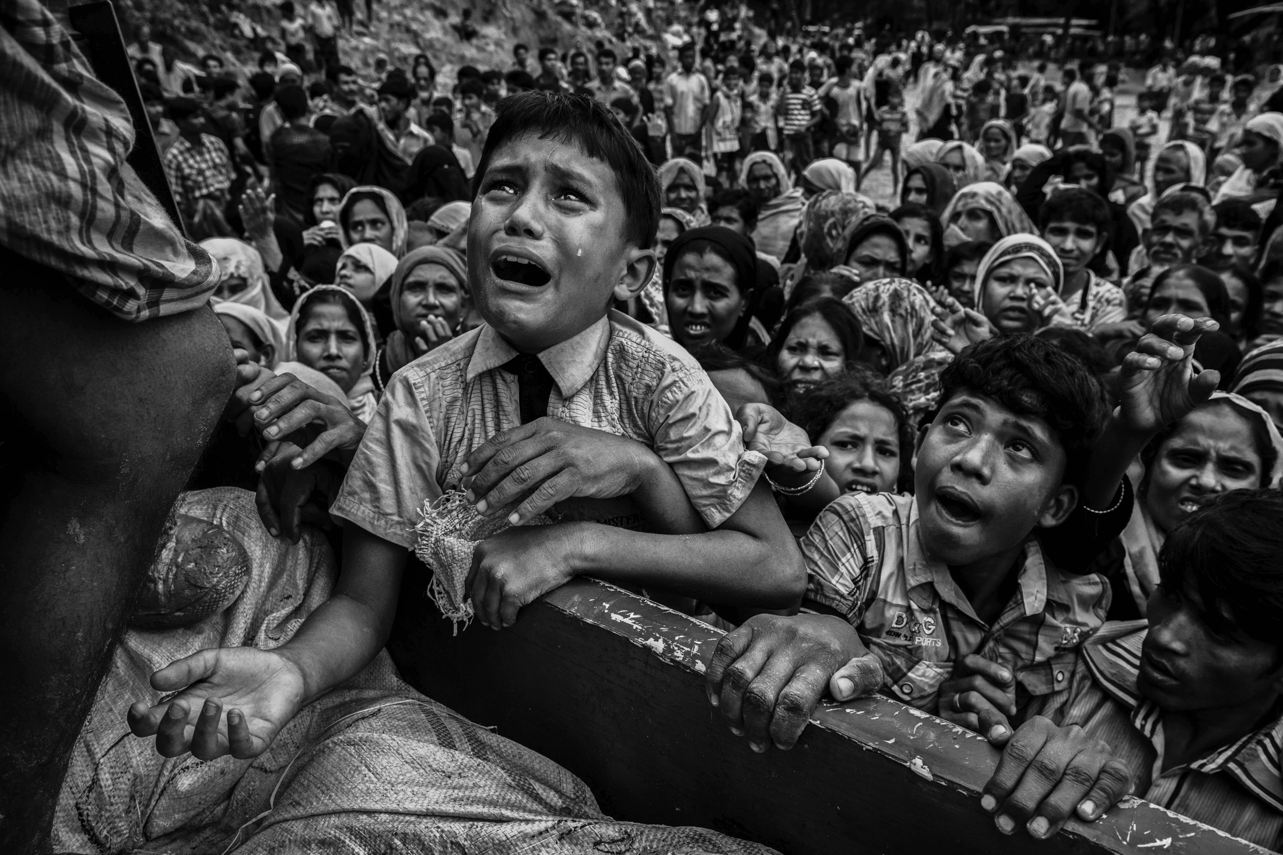
Puzzles of charitable giving
PHL 304
Fall 2018
Notes:
https://globalnews.ca/news/3815462/myanmar-rohingya-children/

Slide 2
LEONA HELMSLEY (VIDEO)
https://www.youtube.com/watch?v=Fv3yEoPi2Zg

Slide 3
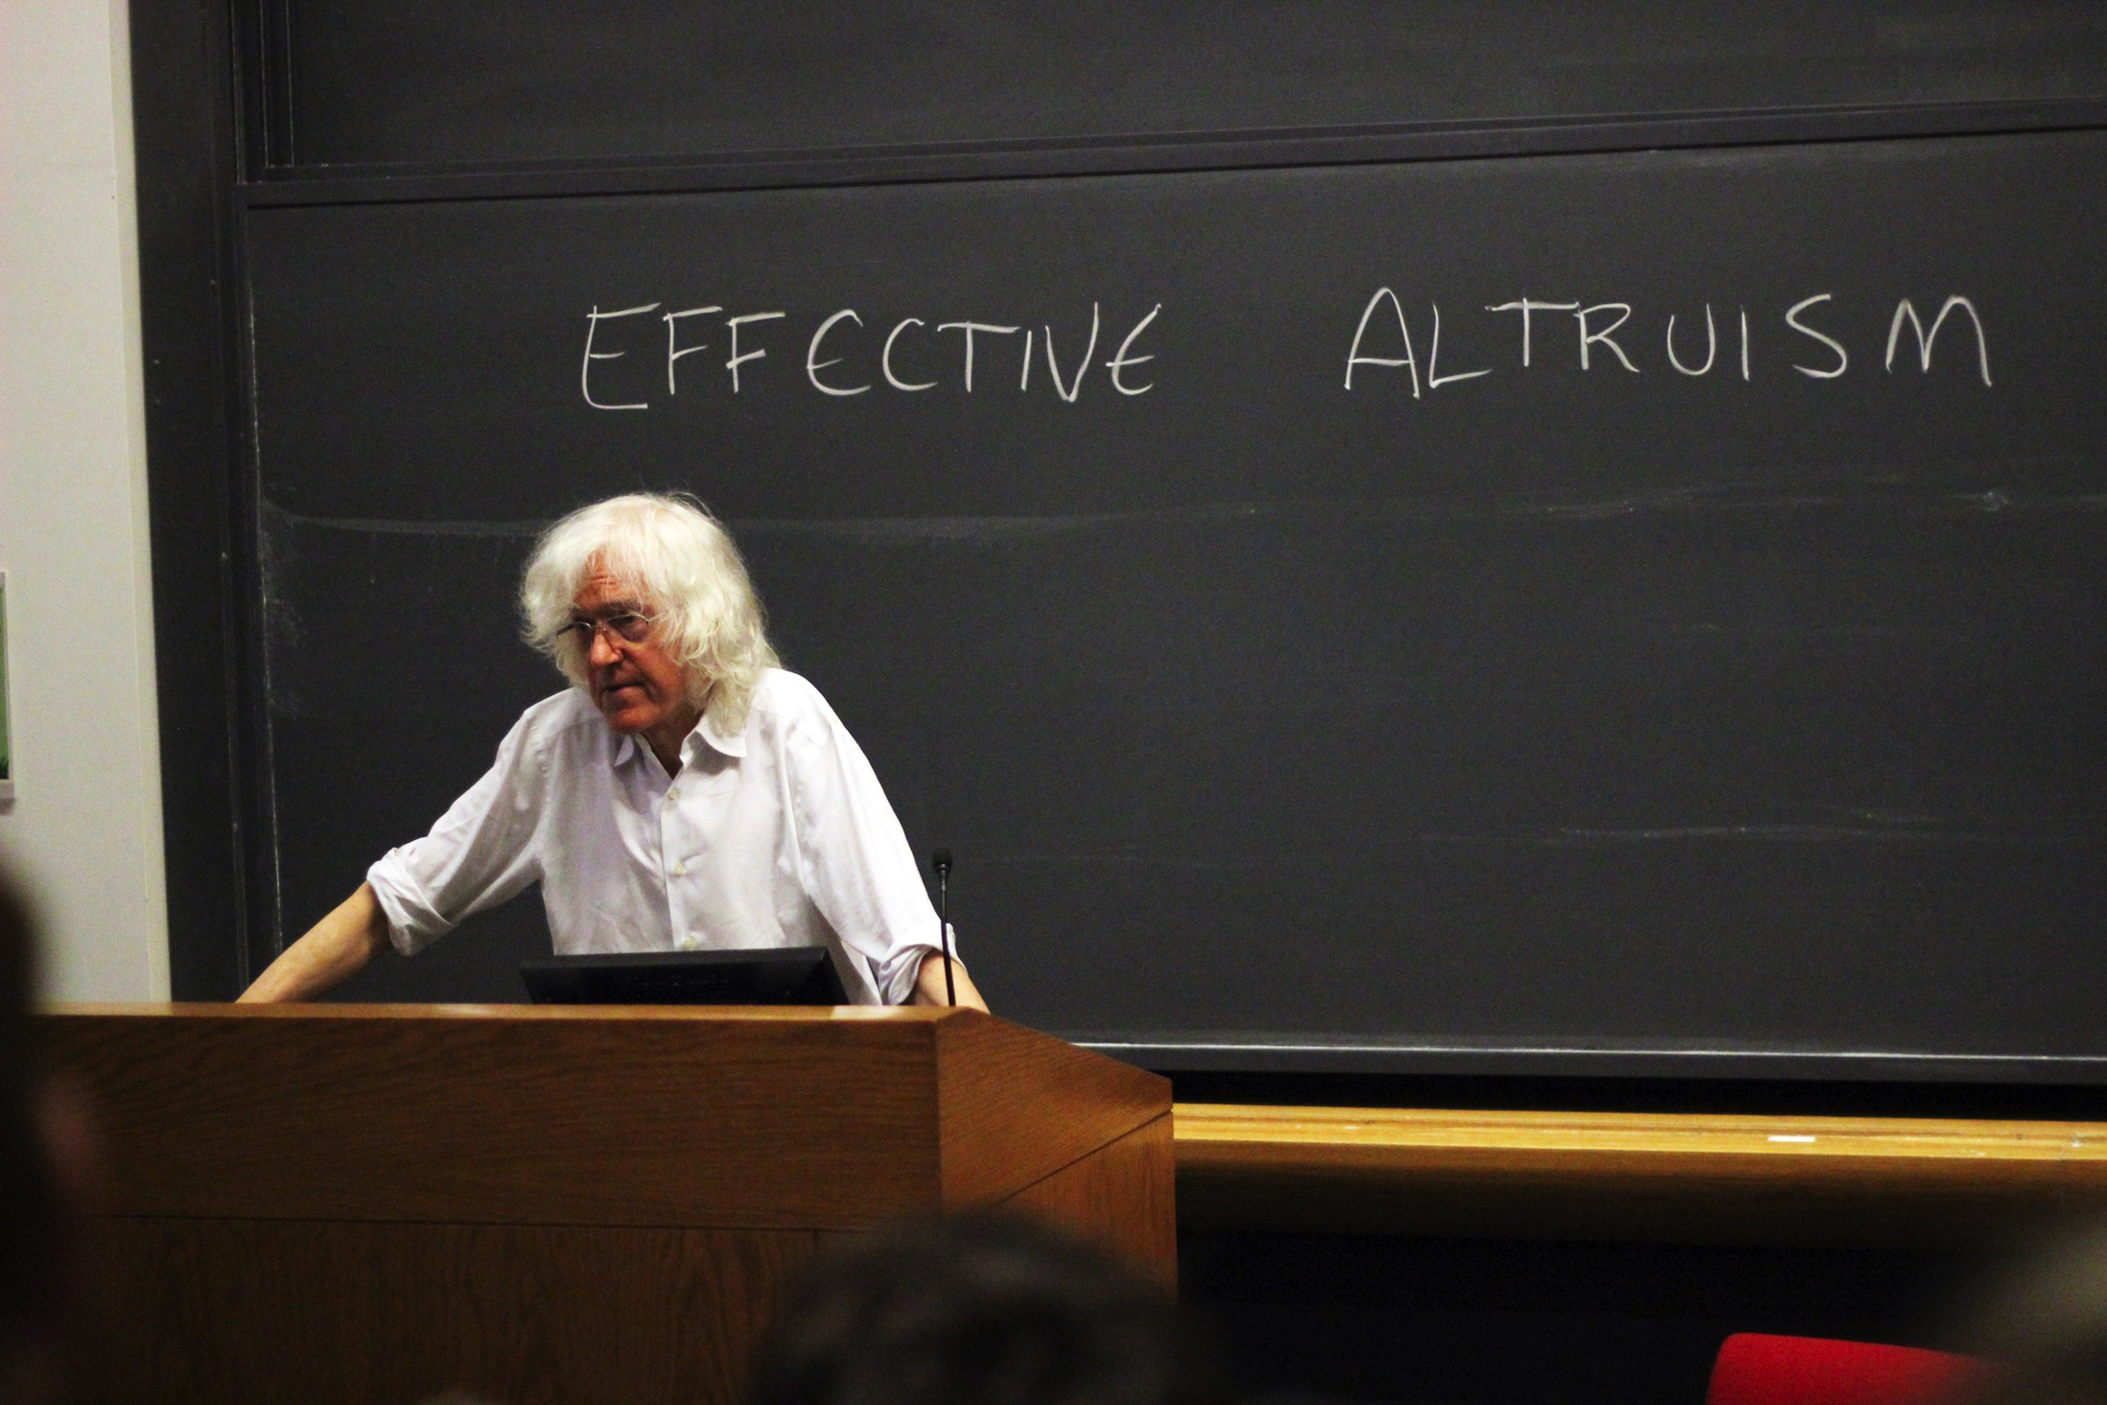
PARFIT’S CASE
Derek Parfit

Slide 4
PARFIT’S CASE
At some great cost to yourself, save a stranger’s right arm;
do nothing;
at the same cost to yourself, save both of the stranger’s arms.
potential similarities
Supererogatory Choice between less and more good No additional cost
Notes:
“Parfit claims that, although the cost to the agent of either of the two acts of rescue may make it permissible for him to do neither, once he accepts the cost of saving one arm, it becomes impermissible for him not to save the other” (82)
“That is, while it is permissible to save neither arm, it is not permissible to save only one arm” (82)
“[T]he agent can choose between doing less good and doing more good at an equivalent personal cost. And one might thus infer that, because the agent in Parfit’s case is morally required to bestow the greater benefit, the same must be true in cases of charitable giving” (82)
“[O]nce the agent in Parfit’s case has ruled out the option of doing nothing, he can either confer only one benefit at great cost to himself or confer that same benefit to the same person and confer another equally great benefit at no further personal cost” (82)
No reason to provide only one benefit (rather than both); it would be gratuitous to do that; “to allow a great harm to occur when one could prevent it at no cost to anyone is wrong” (82)
“For Helmsley’s action to have been relevantly like that of the agent in Parfit’s case, she would have had to benefit only dogs rather than providing the same benefits to the same dogs while also benefiting people at no additional cost” (83)
“In general, when one gives to a less effective charity, one does not gratuitously fail to benefit those who would have benefited, and by more, if one had given to a more effective charity. Each charitable option would have victims in the sense that each would be worse for those who would have benefited from a different option. The failure to benefit any potential beneficiary is not gratuitous because it enables someone else to be benefited instead, even if to a lesser degree” (83)

Slide 5
PARFIT’S CASE
At some great cost to yourself, save a stranger’s right arm;
do nothing;
at the same cost to yourself, save both of stranger’s arms.
potential similarities
Supererogatory Choice between less and more good No additional cost
potential differences
Impossible to confer multiple benefits Personal cost
Notes:
“[O]nce the agent in Parfit’s case has ruled out the option of doing nothing, he can either confer only one benefit at great cost to himself or confer that same benefit to the same person and confer another equally great benefit at no further personal cost” (82)
No reason to provide only one benefit (rather than both); it would be gratuitous to do that; “to allow a great harm to occur when one could prevent it at no cost to anyone is wrong” (82)
“For Helmsley’s action to have been relevantly like that of the agent in Parfit’s case, she would have had to benefit only dogs rather than providing the same benefits to the same dogs while also benefiting people at no additional cost” (83)
“In general, when one gives to a less effective charity, one does not gratuitously fail to benefit those who would have benefited, and by more, if one had given to a more effective charity. Each charitable option would have victims in the sense that each would be worse for those who would have benefited from a different option. The failure to benefit any potential beneficiary is not gratuitous because it enables someone else to be benefited instead, even if to a lesser degree” (83)
“A second way in which Parfit’s case differs from ordinary charitable giving is that, as the case is presented, there is no reason why the agent might prefer to save only one arm rather than both, whereas people often have reasons for preferring to give to a less effective rather than a more effective charity” (83)
“Helmsley, for example, like many good people who volunteer to work at animal shelters, cared specially about dogs. It was important to her to provide care for dogs who would otherwise have been killed or suffered miser- able lives. There would therefore have been a cost to her in forgoing the option of helping dogs. Because of this, the overall cost to her of using her money to save people would have been greater than the cost to her of using the same amount of money to save dogs” (83)
“People often give to a less effective charity because they have some personal reason for caring about the work of that particular charity, and their failure to prevent more harm is not gratuitous in the way that the failure to save the stranger’s other arm is. This is because, if they had given to a more effective charity, that would have been worse for those who benefited from their donation to the less effective charity” (84)

Slide 6
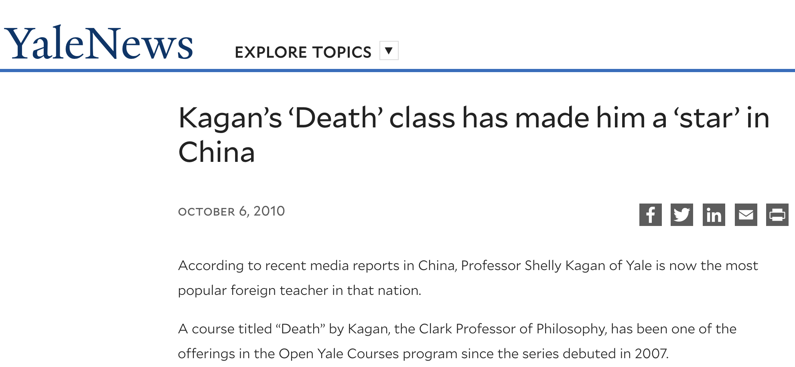
Notes:
https://news.yale.edu/2010/10/06/kagan-s-death-class-has-made-him-star-china
“Ever since Kagan’s philosophy class ‘Death’ appeared on the internet through Open Yale Courses, many young people in China scramble for the lectures given by this unconventional professor who could have been considered ‘out of line’ according to the traditional Chinese standard of teaching style and manner.”
“‘To teach and inspire the students, one doesn’t need to read off a textbook and follow all the doctrines,’ added China National Radio.”

Slide 7
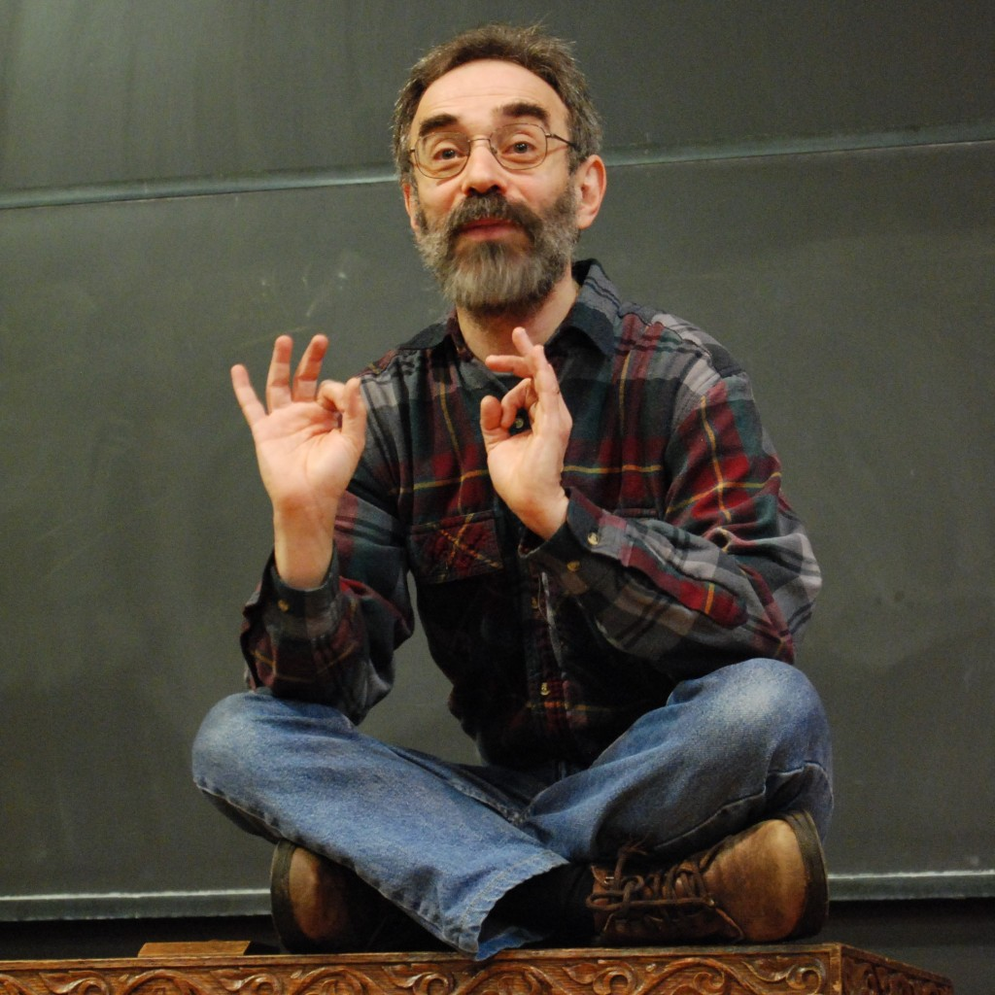
KAGAN’S CASE (VERSION 1)
Shelly Kagan

Slide 8
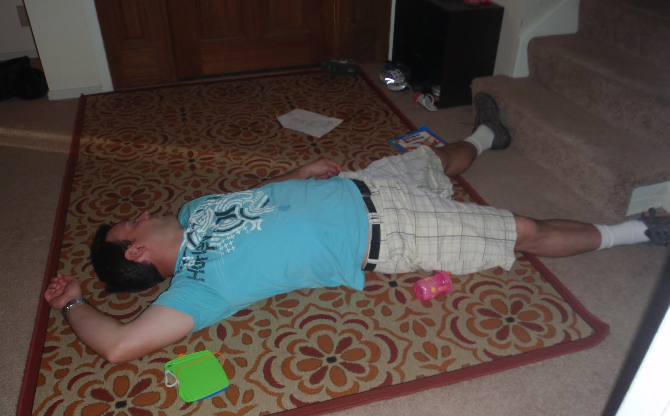
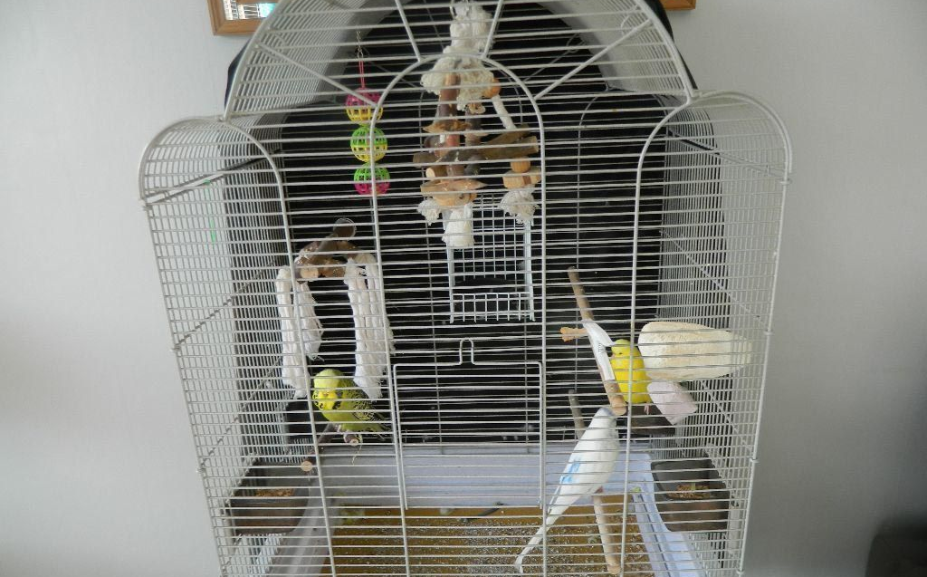
KAGAN’S CASE (VERSION 1)
Option A
Option B
Notes:
“This case is different from Parfit’s in that, if the agent had chosen the option that would produce the greater good, she would not have achieved the lesser good and some additional good as well; rather her saving the child would have excluded the saving of the bird” (85)
“But the Helmsley case, in which she chose to save many animals rather than many people, may seem just like Kagan’s case, only on a larger scale—that is, Kagan’s case writ large” (85)
“If that is right, and if Kagan’s judgment about his own case is correct, we should conclude both that Helmsley ought to have donated her fortune to save people rather than to save dogs and that, more generally, people who decide to engage in supererogatory charitable giving then acquire a conditional duty to give to the charity that, according to the evidence they can reasonably be expected to have gathered, would achieve the most good, or prevent or alleviate the most harm” (85)

Slide 9
MAN RESCUED (VIDEO)
https://www.youtube.com/watch?v=CTq8WLpDOL4

Slide 10
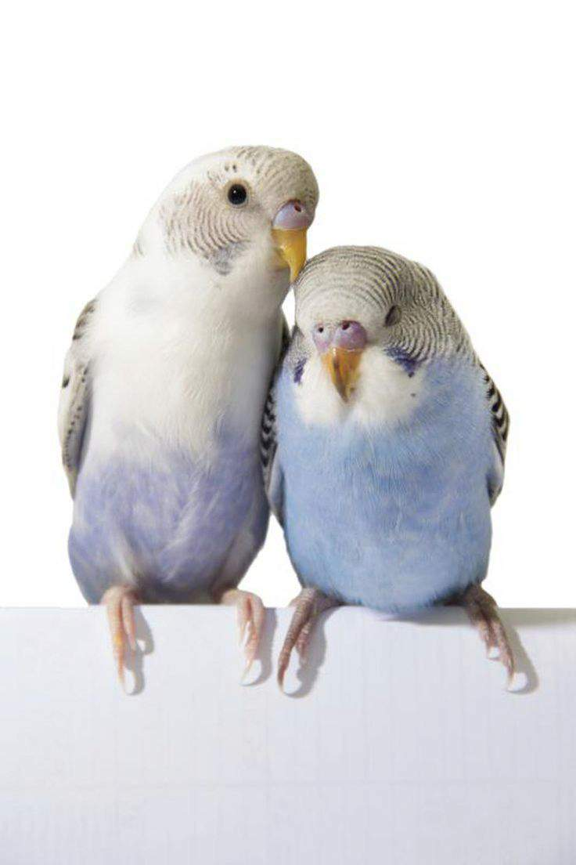
KAGAN’S CASE (VERSION 1)
We’re saved!
Please take PHL 304!!!!
Notes:
“This case is different from Parfit’s in that, if the agent had chosen the option that would produce the greater good, she would not have achieved the lesser good and some additional good as well; rather her saving the child would have excluded the saving of the bird” (85)
“But the Helmsley case, in which she chose to save many animals rather than many people, may seem just like Kagan’s case, only on a larger scale—that is, Kagan’s case writ large” (85)
“If that is right, and if Kagan’s judgment about his own case is correct, we should conclude both that Helmsley ought to have donated her fortune to save people rather than to save dogs and that, more generally, people who decide to engage in supererogatory charitable giving then acquire a conditional duty to give to the charity that, according to the evidence they can reasonably be expected to have gathered, would achieve the most good, or prevent or alleviate the most harm” (85)

Slide 11
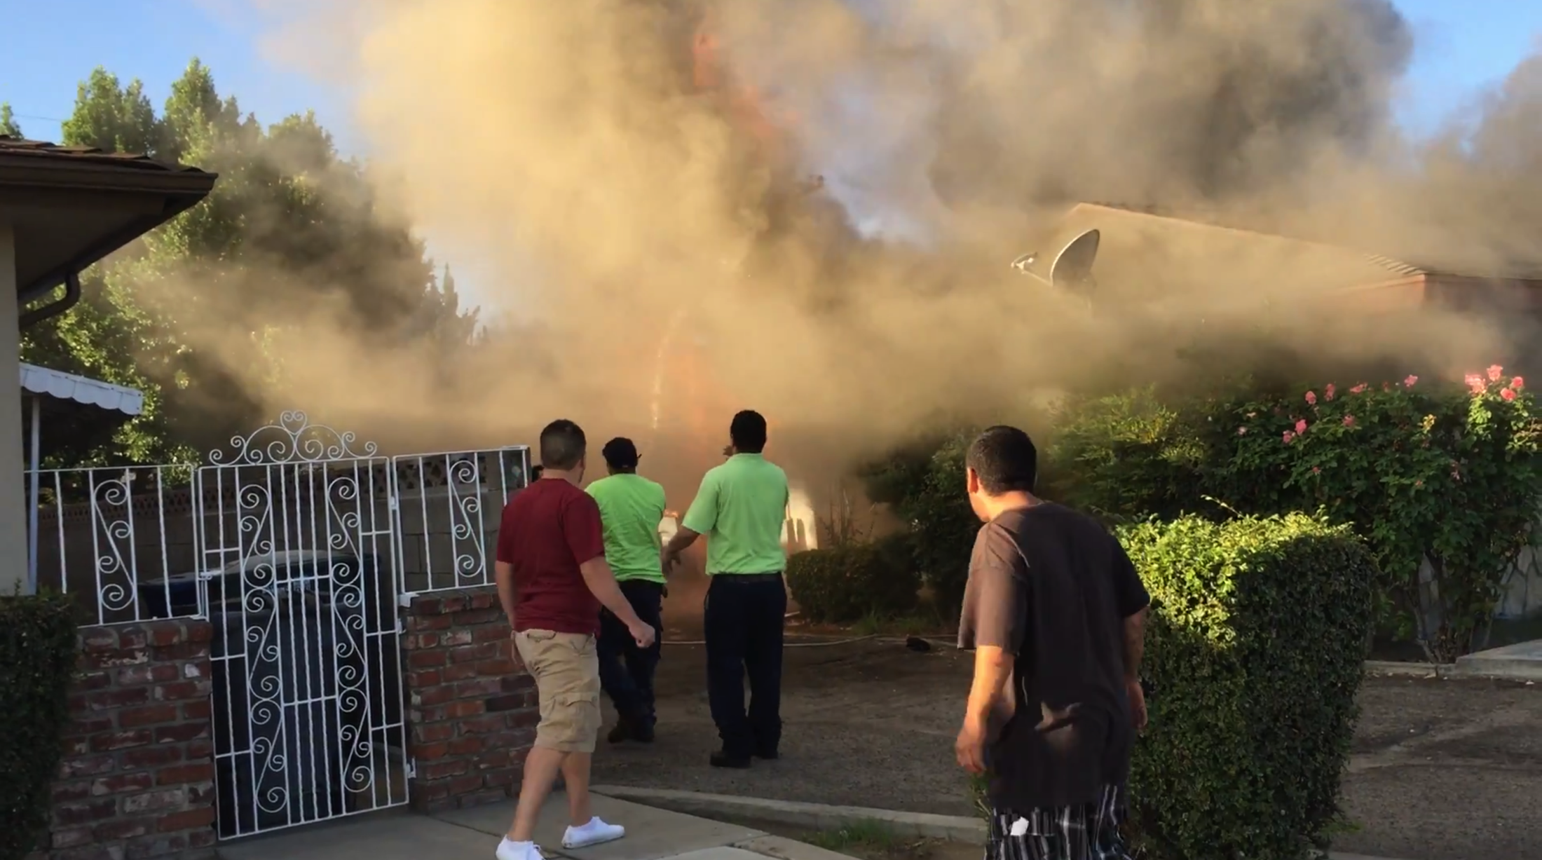
KAGAN’S CASE (VERSION 2)
doing no good (permissible)
doing some good (wrong)
Notes:
“Can we really believe that, of all these people, the only one who acts wrongly is the only one who has done any good at all—and in conditions in which it was permissible for her not to do any?” (87–88)
“Although she has done less good than she could have, her failure to do more good is not gratuitous, as there were one or two individuals for whom her doing more good would have been worse—namely, the bird and perhaps herself, if she had an interest in saving the bird but not in saving the child” (88)
“This reasoning is specious. As long as the agent remains outside the building with the others, her situation is the same as theirs. But once she is inside the building, her situation is relevantly different: unlike the others, she can save the child at no cost, and it therefore becomes her duty to save it” (88)

Slide 12
THE ALL OR NOTHING PROBLEM
If it is morally permissible to A and morally wrong to B, then it is morally obligatory to A rather than B.
It is morally permissible to do nothing.
It is morally wrong to produce the lesser good.
It is morally obligatory to do nothing rather than produce the lesser good.
Notes:
“Can we really believe that, of all these people, the only one who acts wrongly is the only one who has done any good at all—and in conditions in which it was permissible for her not to do any?” (87–88)
“Although she has done less good than she could have, her failure to do more good is not gratuitous, as there were one or two individuals for whom her doing more good would have been worse—namely, the bird and perhaps herself, if she had an interest in saving the bird but not in saving the child” (88)
“This reasoning is specious. As long as the agent remains outside the building with the others, her situation is the same as theirs. But once she is inside the building, her situation is relevantly different: unlike the others, she can save the child at no cost, and it therefore becomes her duty to save it” (88)

Slide 13
KAGAN’S CASE (VERSION 2)
Option A
Option B
Notes:
“Hence she can no longer appeal to considerations of cost as a justification for not saving the child. Saving the child is thus no longer supererogatory” (87)
“She is now in the position of someone who can save either a child or a bird, though not both, at no cost to herself (or at only a very small cost to herself ). Such a person has a duty to save the child, thereby allowing the bird to die” (87)
“In these conditions, it makes no difference if this person is a misanthropic bird lover who has a personal interest in saving the bird. That interest is sufficiently minor that, if its frustration is the only cost to her of saving the child, this cost cannot justify her failing to save the child” (87)
“This reasoning is specious. As long as the agent remains outside the building with the others, her situation is the same as theirs. But once she is inside the building, her situation is relevantly different: unlike the others, she can save the child at no cost, and it therefore becomes her duty to save it” (88)

Slide 14
PARFIT’S CASE
At some great cost to yourself, save a stranger’s right arm;
do nothing;
at the same cost to yourself, save both of stranger’s arms.
deeper explanation
In saving one arm, the sacrifice has already been made The additional good comes at no cost
Notes:
“It is not in fact essential to his acquiring a duty to save both arms that saving both would involve producing the same lesser good and an additional good as well” (88)
“Rather, what is essential is that, in saving one arm, the agent has already incurred the cost that made both options supererogatory. He is thus in a situation in which he can save a person’s arm at no cost to himself or others” (88)
“Assuming that he has a duty to save a stranger’s arm if he can do so at no cost to anyone, he then has a duty to save the second arm” (88)

Slide 15
THE ALL OR NOTHING PROBLEM
If it is morally permissible to A and morally wrong to B, then it is morally obligatory to A rather than B.
It is morally permissible to do nothing (prior to making the sacrifice!).
It is morally wrong to produce the lesser good (once the sacrifice has been made!).
It is morally obligatory to do nothing rather than produce the lesser good.

Slide 16
KAGAN’S CASE (VERSION 2)
potential similarities
Supererogatory Choice between less and more good Impossible to confer multiple benefits One has a reason to choose the lesser good
potential differences
The sacrifice has already been made The greater good comes at little to no cost Helmsley didn’t incur a cost until she decided how to spend her money
Notes:
“Hence she can no longer appeal to considerations of cost as a justification for not saving the child. Saving the child is thus no longer supererogatory” (87)
“She is now in the position of someone who can save either a child or a bird, though not both, at no cost to herself (or at only a very small cost to herself ). Such a person has a duty to save the child, thereby allowing the bird to die” (87)
“In these conditions, it makes no difference if this person is a misanthropic bird lover who has a personal interest in saving the bird. That interest is sufficiently minor that, if its frustration is the only cost to her of saving the child, this cost cannot justify her failing to save the child” (87)
“This reasoning is specious. As long as the agent remains outside the building with the others, her situation is the same as theirs. But once she is inside the building, her situation is relevantly different: unlike the others, she can save the child at no cost, and it therefore becomes her duty to save it” (88)
“They do not incur the cost of giving prior to deciding to which charity to give; rather, they incur it when they give, so that their giving to any remains supererogatory” (90)
“Their choice is thus unlike that which the agents in Parfit’s, Kagan’s, and Horton’s cases face; that is, it is not a choice between doing good at no cost and not doing that good. If potential donors to charity have a duty to give to the most effective charity, it is not for the same reason that the agents in Parfit’s, Kagan’s, and Horton’s cases are required to do more good rather than less” (90)

Slide 17
KAGAN’S CASE (VERSION 3)
Option A
Option B
You can enter the front door (Option A) or the back door (Option B).
Notes:
“She must choose one of three options: go in one entrance and save the child, go in the other and save the bird, and not go in at all” (91)
“The reason it is wrong for the agent to save the bird in Kagan’s original case does not apply in this version. In both versions, for the agent to be able to save the bird, she must have first incurred the risk of entering the building. In the original case, saving the child is still an option after she has incurred that risk” (91)
“But in this variant, if she incurs the risk necessary to save the bird, it is no longer possible for her to save the child. In short, in Kagan’s case, the sacrifice precedes the choice between acts of saving, whereas in this variant, the choice between acts of saving precedes the sacrifice” (91)
[M]erely deciding to take the risk does not seem sufficient to make it obligatory to save the child” (91)
“It does not become obligatory to save the child until the risk has already been incurred, so that there is no further cost in saving the child. Again, this presupposes that saving either is supererogatory” (91)

Slide 18
THE ALL OR NOTHING PROBLEM
If it is morally permissible to A and morally wrong to B, then it is morally obligatory to A rather than B.
It is morally permissible to do nothing (prior to making the sacrifice!).
It is morally wrong to produce the lesser good (prior to and when making the sacrifice!). ????
It is morally obligatory to do nothing rather than produce the lesser good.
Notes:
“The All or Nothing Problem in these cases is, again, that if it is supererogatory to save the child or both arms or both children and one is unwilling to do that supererogatory act, the only remaining option that is permissible is not to save anyone or not to save either arm” (99)

Slide 19
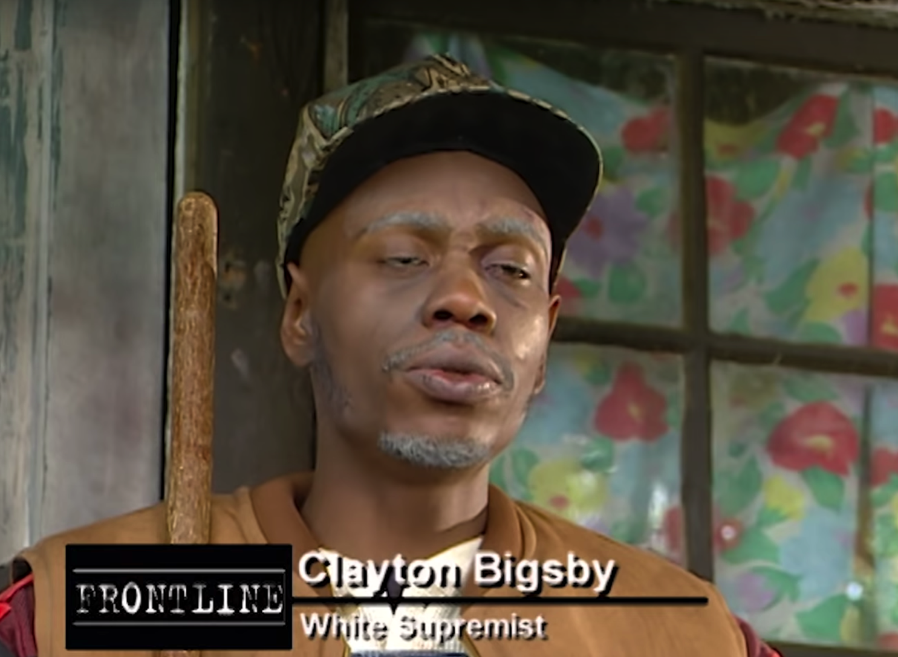
MCMAHAN’S CASE
At some great cost to himself, save the white person;
do nothing;
at the same cost to himself, save both the white person and the black person.
I’m willing to make the sacrifice, but the idea of going for Option C is so repugnant to me that I’d rather do nothing!
racist
Notes:
“It seems perverse to suppose that, given that morality does not require him to save both arms and that, in the absence of such a requirement, he will not save both, morality implies that this person may not save one of the stranger’s arms when he is willing to do that but must in- stead choose the permissible option of allowing the stranger to lose both arms” (94)
“The racist is willing to accept this great cost to save the white person but is simply unwilling to save a black person. Indeed the idea of saving a black person is so repugnant to him that he would rather allow a white person to die than save a black person” (95)
“Assuming that morality does not require him to save both and that in the absence of that requirement he will not save both, my previous reasoning, which explains and justifies the judgments of Parfit and Kagan about this sort of case, implies that morality forbids the racist to save the white person despite his willingness to do it” (95)
“I find that impossible to believe. It seems to me inconceivable that morality itself could require the innocent white person to pay with her life for the racist’s attitudes” (95)
“[T]he racist cannot, in this emergency situation, instantly divest himself of the beliefs, attitudes, and habits of a lifetime, thereby becoming at least as willing to save both people as he is to save the white person” (95)
“Saving the bird, or saving only one arm or one child is wrong for the reason I have given—namely, that each of these acts involves allowing a child to die, or a person to lose an arm, when one could save the child or the arm at no cost to anyone, or perhaps at the personal cost of saving a child or arm when one is averse to doing so” (99)
“In the latter case, whether the aversion derives from the opportunity cost of saving a child (as in the case of the bird fancier in Kagan’s case) or from a dislike of the potential beneficiary (as in the case of the racist), it is not sufficient to justify one’s allowing a person to die or lose an arm” (99)

Slide 20
THE ALL OR NOTHING PROBLEM
If it is morally permissible for Clayton to save neither person, morally wrong for Clayton to save only the white person (after making the sacrifice), and Clayton is unwilling to save both people, then Clayton is morally obligated to save neither rather than only one.
It is morally permissible for Clayton to save neither.
It is morally wrong for Clayton to save only the white person (after making the sacrifice).
Clayton is unwilling to save both people.
Clayton is morally obligated to save neither rather than only one. ????
Notes:
“The All or Nothing Problem in these cases is, again, that if it is supererogatory to save the child or both arms or both children and one is unwilling to do that supererogatory act, the only remaining option that is permissible is not to save anyone or not to save either arm” (99)

