Slide 1
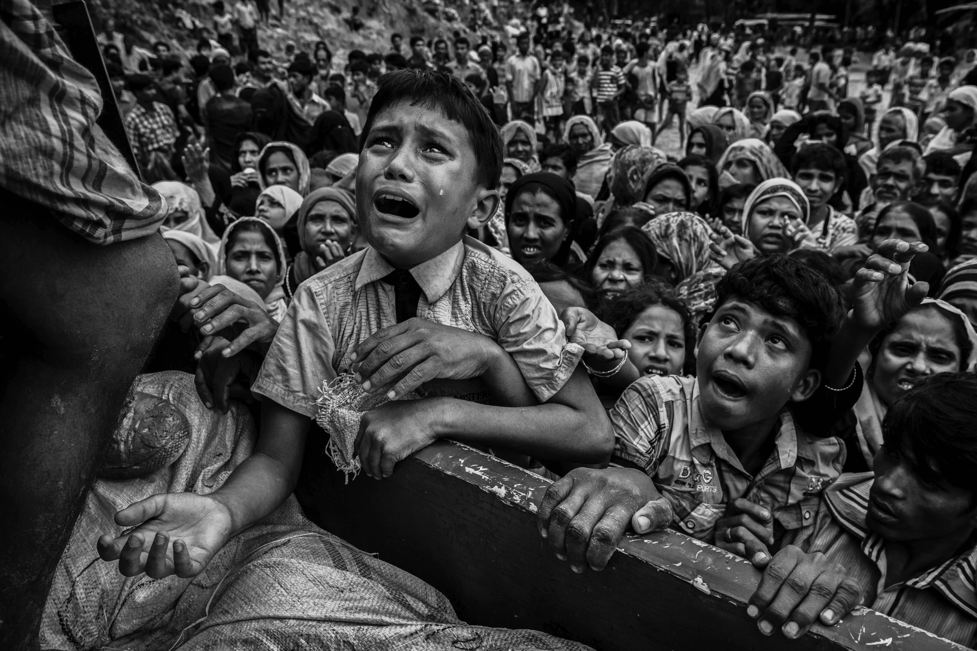
effective altruism
PHL 304
Fall 2018
Notes:
https://globalnews.ca/news/3815462/myanmar-rohingya-children/

Slide 2
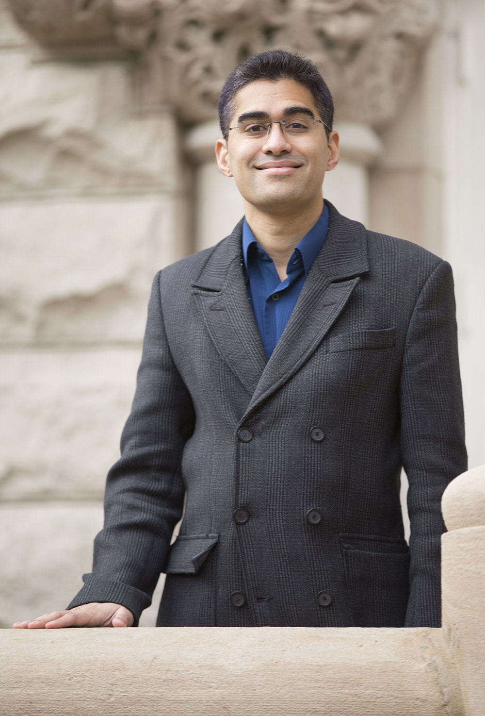
TWO FUNNY STORIES
Neil Sinhababu
Associate Professor of Philosophy
National University of Singapore

Slide 3
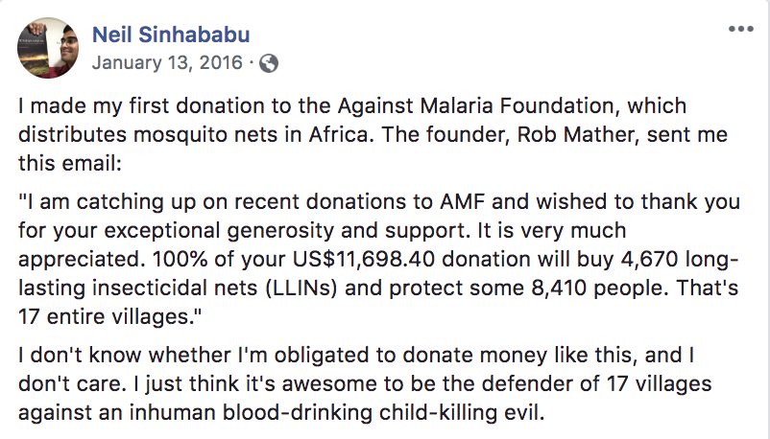
TWO FUNNY STORIES

Slide 4
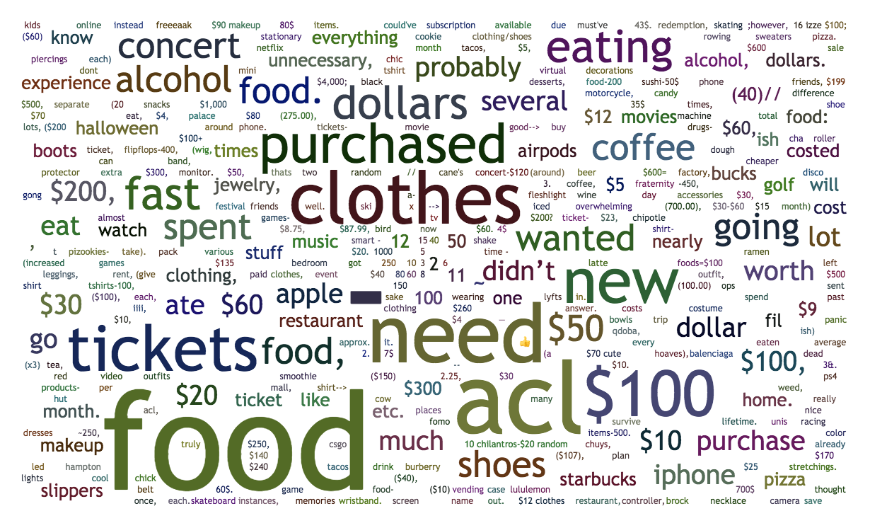
OPEN RESPONSE (PARTICIPATION)
In the last month, what are some things that you purchased that you wanted but didn’t truly need?
Approximately how much did each purchase cost?

Slide 5
OPEN RESPONSE (PARTICIPATION)
Go to Files ---> Squarecap ---> Open response to see the anonymous results.

Slide 6
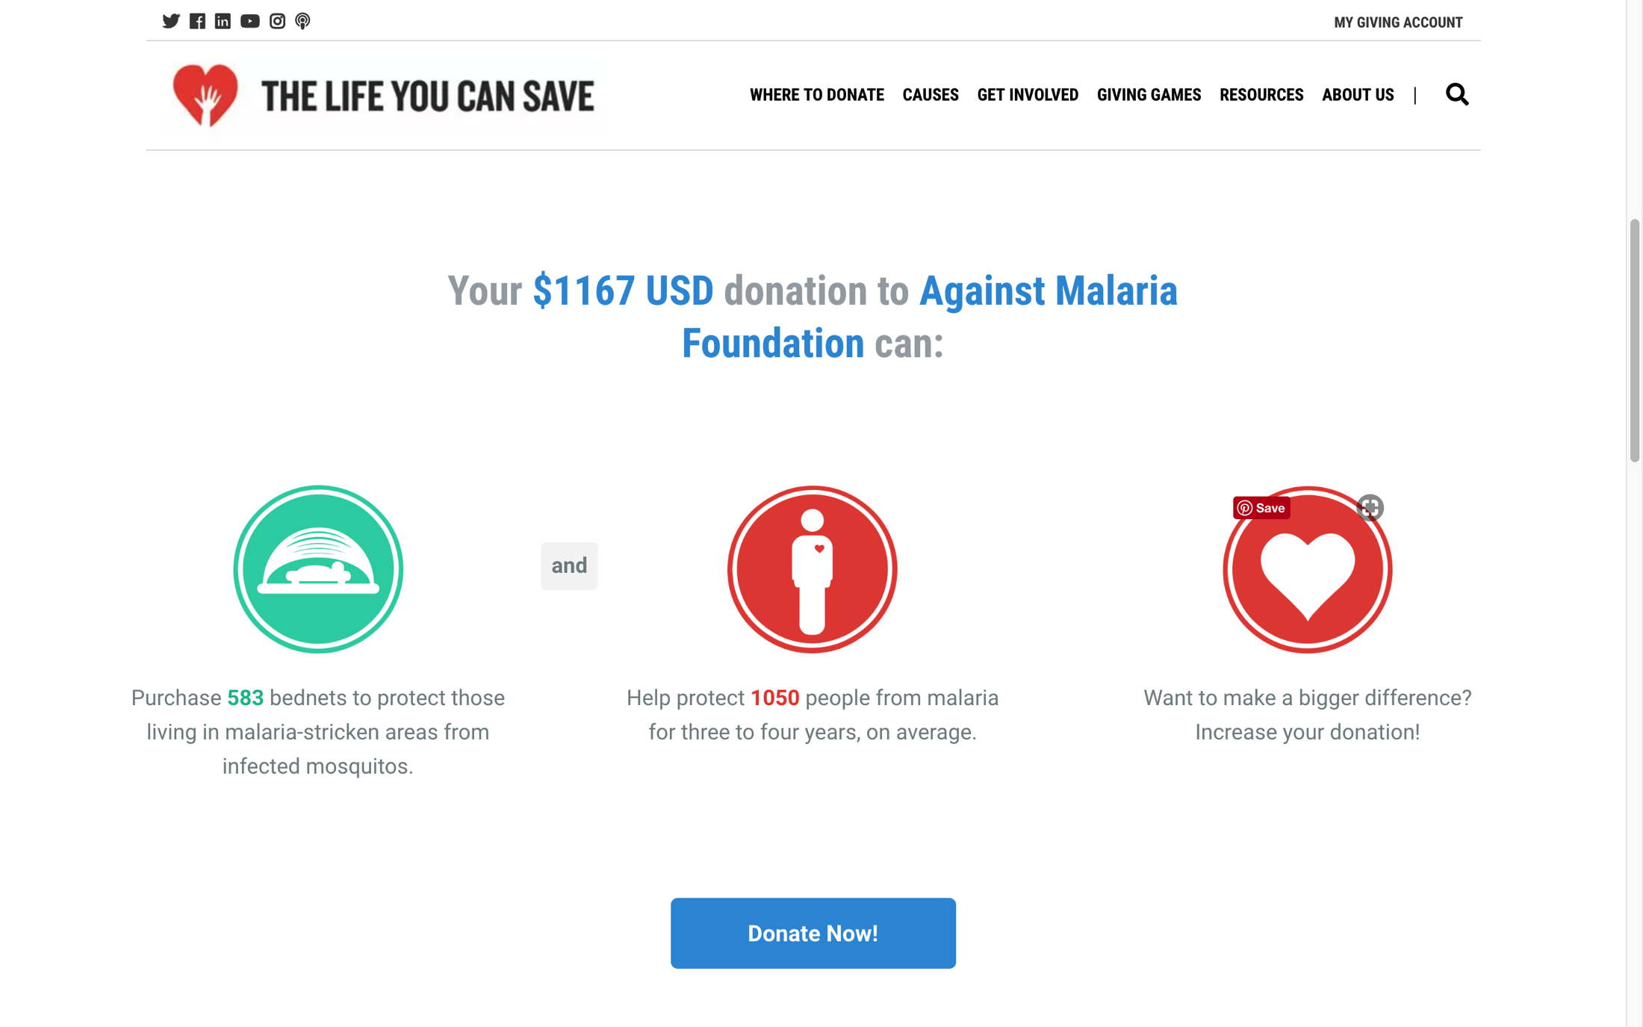
OPEN RESPONSE (PARTICIPATION)

Slide 7
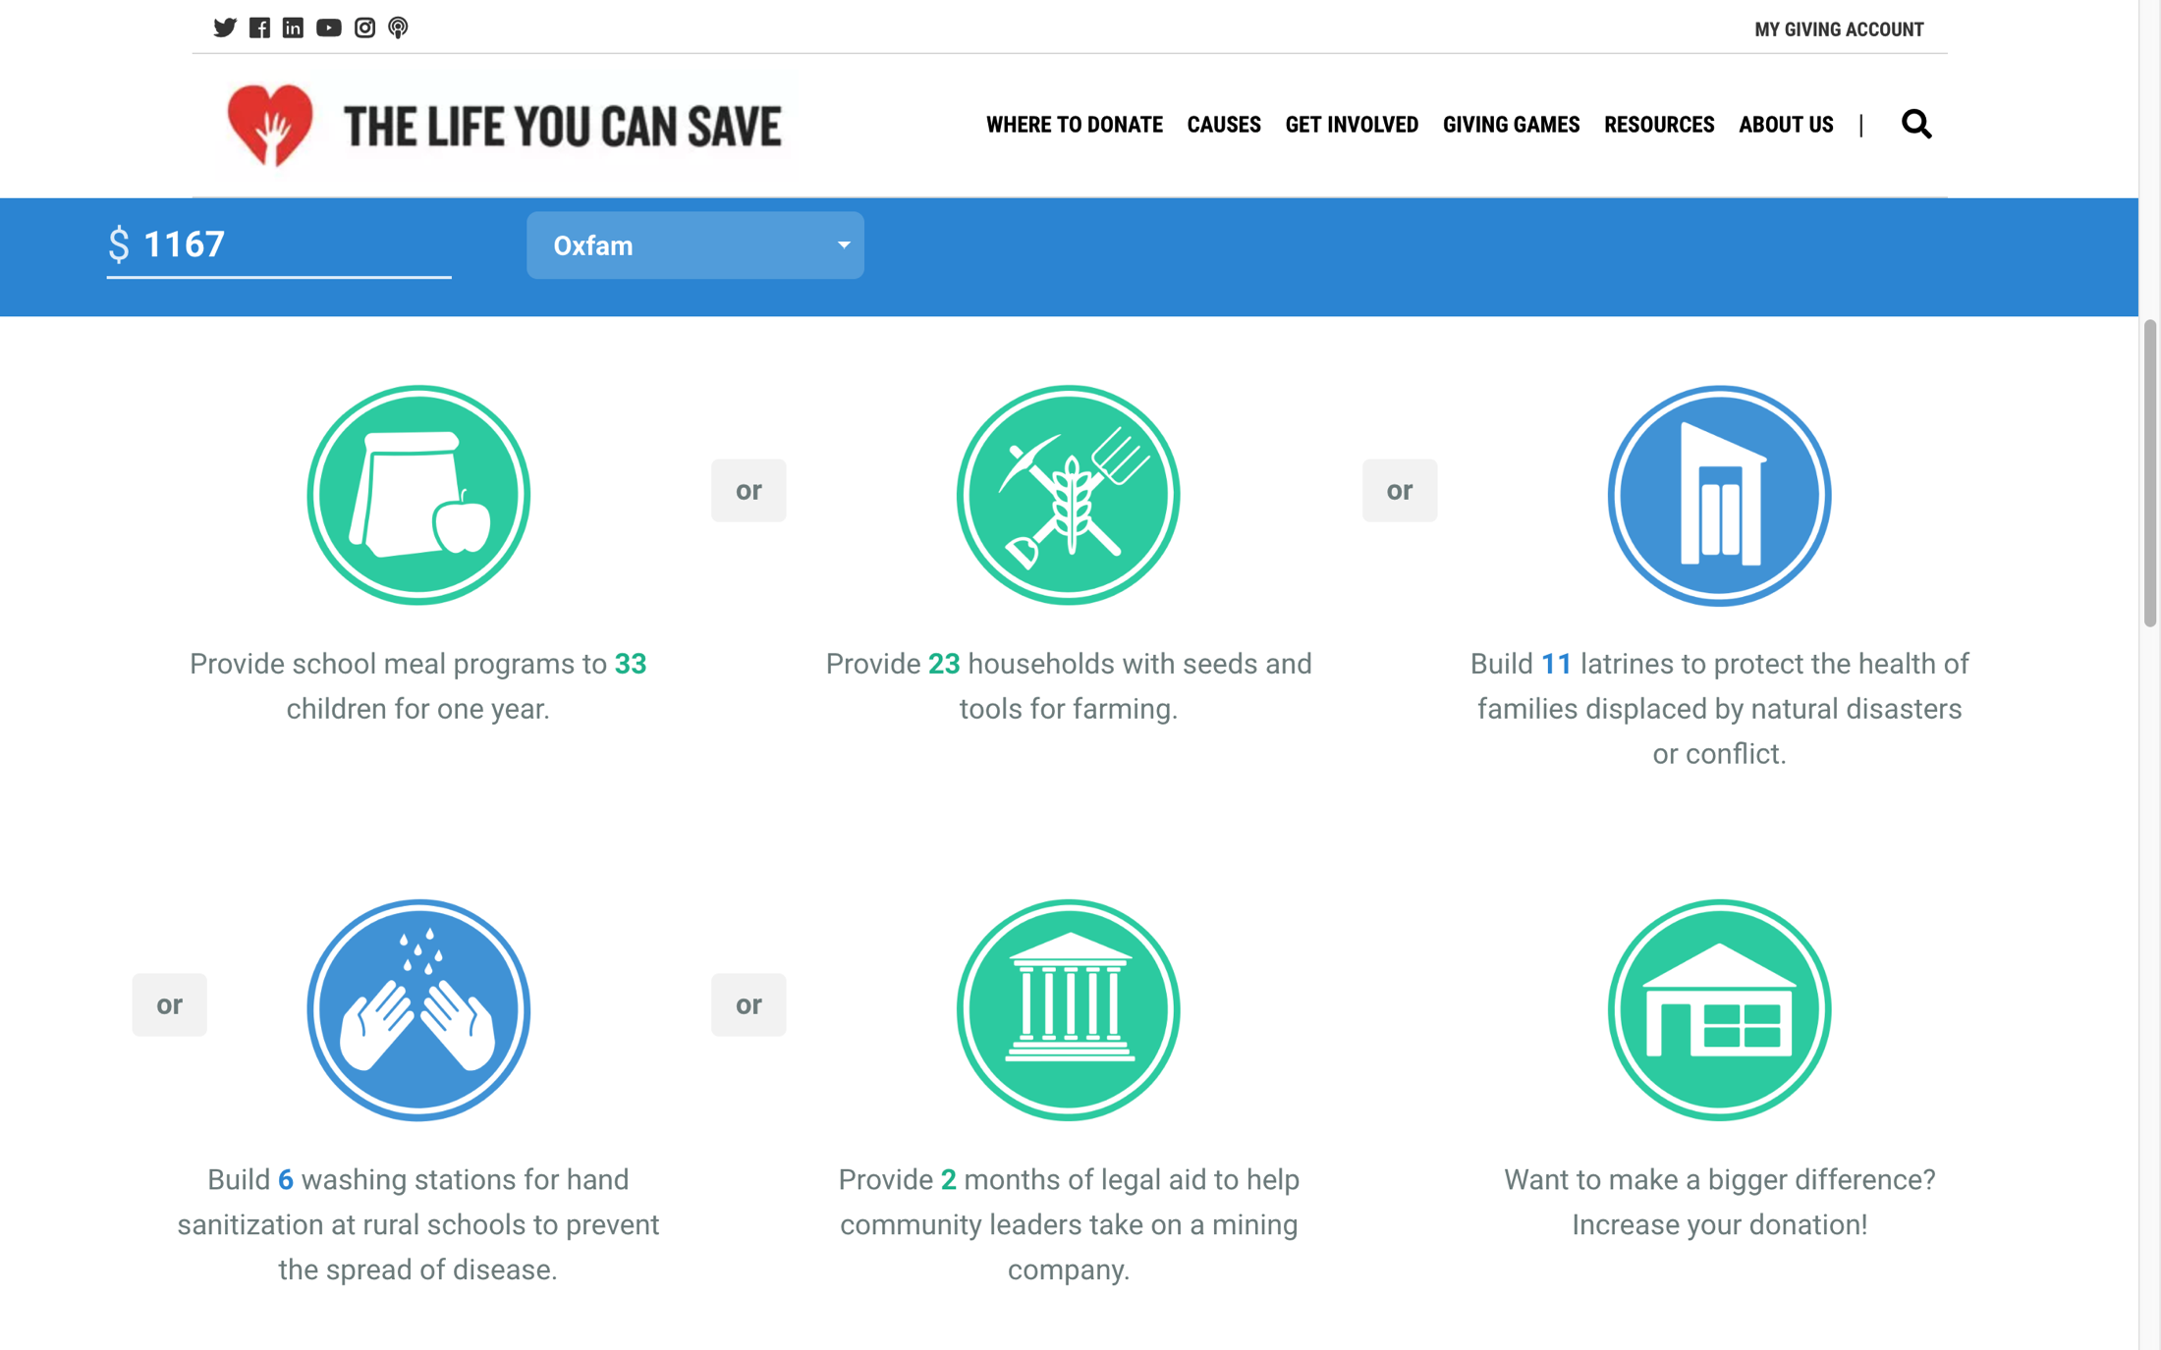
OPEN RESPONSE (PARTICIPATION)

Slide 8
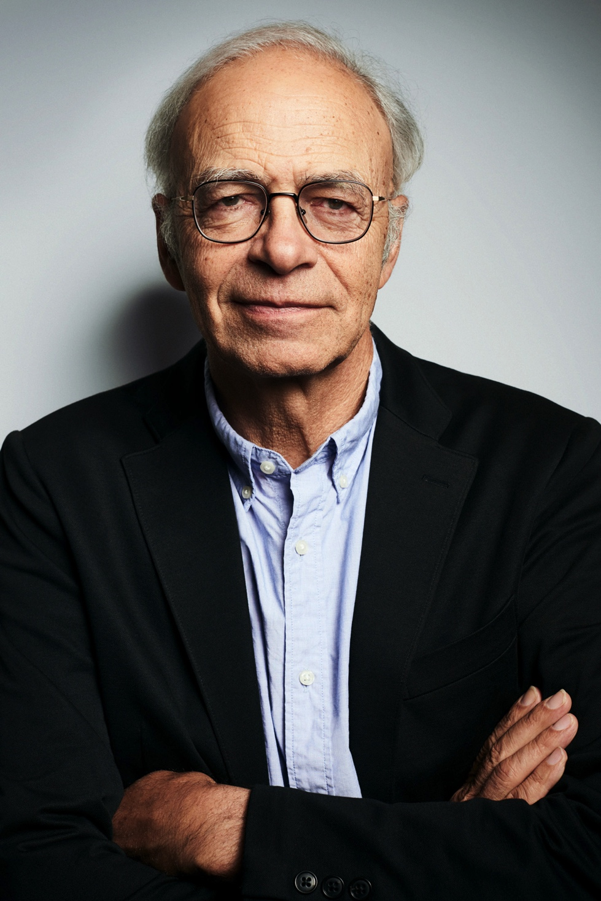
EFFECTIVE ALTRUISM
There are obligations to the needy.
Individuals in affluent countries like the United States ought to make changes to their lifestyles to relieve the suffering and death of the needy.
Campaign for legislative change
Protest
Send money to effective agents who will use that money to prevent suffering and death
It is morally wrong not to do so.
Peter Singer

Slide 9
THE POND
drowning child
Notes:
“The uncontroversial appearance of the principle just stated is deceptive. If it were acted upon, even in its qualified form, our lives, our society, and our world would be fundamentally changed” (467)
“For the principle takes, firstly, no account of proximity or distance. It makes no moral difference whether the person I can help is a neighbor’s child ten yards from me or a Bengali whose name I shall never know, ten thousand miles away” (467)
“Secondly, the principle makes no distinction between cases in which I am the only person who could possibly do anything and cases in which I am just one among millions in the same position” (467)

Slide 10
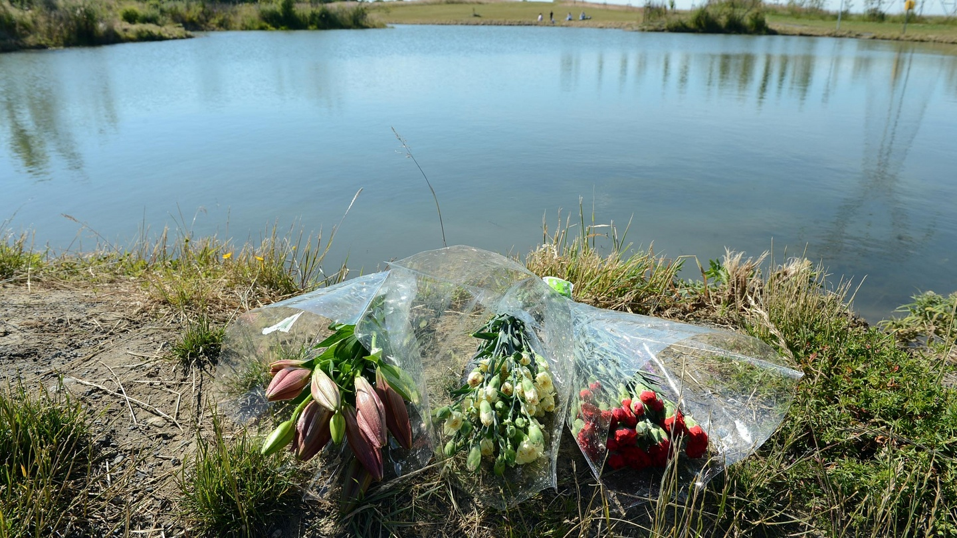
THE POND
crisis averted: expensive suit saved
Notes:
“The uncontroversial appearance of the principle just stated is deceptive. If it were acted upon, even in its qualified form, our lives, our society, and our world would be fundamentally changed” (467)
“For the principle takes, firstly, no account of proximity or distance. It makes no moral difference whether the person I can help is a neighbor’s child ten yards from me or a Bengali whose name I shall never know, ten thousand miles away” (467)
“Secondly, the principle makes no distinction between cases in which I am the only person who could possibly do anything and cases in which I am just one among millions in the same position” (467)

Slide 11
TWO VIDEOS
https://www.nbcnews.com/nightly-news/video/groom-saves-young-boy-from-drowning-during-wedding-shoot-1055615043891
https://www.cnn.com/2018/06/26/us/florida-teens-no-charges-drowning-man/index.html

Slide 12
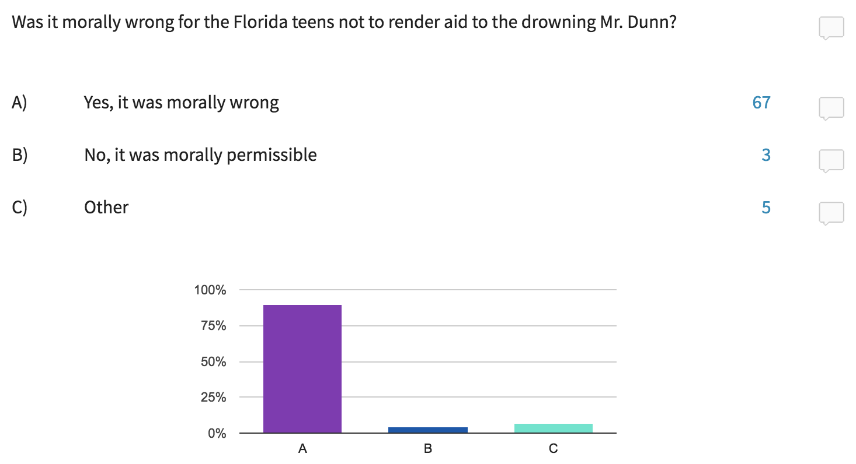
UNGRADED POLL

Slide 13
PRINCIPLE 2
Principle 2: If it is in our power to prevent something very bad from happening, without thereby sacrificing anything morally significant, we morally ought to do it.
This requires us to prevent what is bad.
It doesn’t require us to promote what is good.
It doesn’t require us to do anything that would cause something comparably bad to happen, or that would be intrinsically wrong, or that would rule out promoting a comparable good.
Notes:
“The uncontroversial appearance of the principle just stated is deceptive. If it were acted upon, even in its qualified form, our lives, our society, and our world would be fundamentally changed” (467)
“For the principle takes, firstly, no account of proximity or distance. It makes no moral difference whether the person I can help is a neighbor’s child ten yards from me or a Bengali whose name I shall never know, ten thousand miles away” (467)
“Secondly, the principle makes no distinction between cases in which I am the only person who could possibly do anything and cases in which I am just one among millions in the same position” (467)

Slide 14
THE POND
Notes:
“The uncontroversial appearance of the principle just stated is deceptive. If it were acted upon, even in its qualified form, our lives, our society, and our world would be fundamentally changed” (467)
“For the principle takes, firstly, no account of proximity or distance. It makes no moral difference whether the person I can help is a neighbor’s child ten yards from me or a Bengali whose name I shall never know, ten thousand miles away” (467)
“Secondly, the principle makes no distinction between cases in which I am the only person who could possibly do anything and cases in which I am just one among millions in the same position” (467)

Slide 15
PRINCIPLE 2
Principle 2: If it is in our power to prevent something very bad from happening, without thereby sacrificing anything morally significant, we morally ought to do it.
The principle takes no account of proximity or distance.
It makes no distinction between cases in which only one individual is able to prevent suffering and death and cases in which many individuals are able to prevent suffering and death.
Notes:
“The uncontroversial appearance of the principle just stated is deceptive. If it were acted upon, even in its qualified form, our lives, our society, and our world would be fundamentally changed” (467)
“For the principle takes, firstly, no account of proximity or distance. It makes no moral difference whether the person I can help is a neighbor’s child ten yards from me or a Bengali whose name I shall never know, ten thousand miles away” (467)
“Secondly, the principle makes no distinction between cases in which I am the only person who could possibly do anything and cases in which I am just one among millions in the same position” (467)

Slide 16
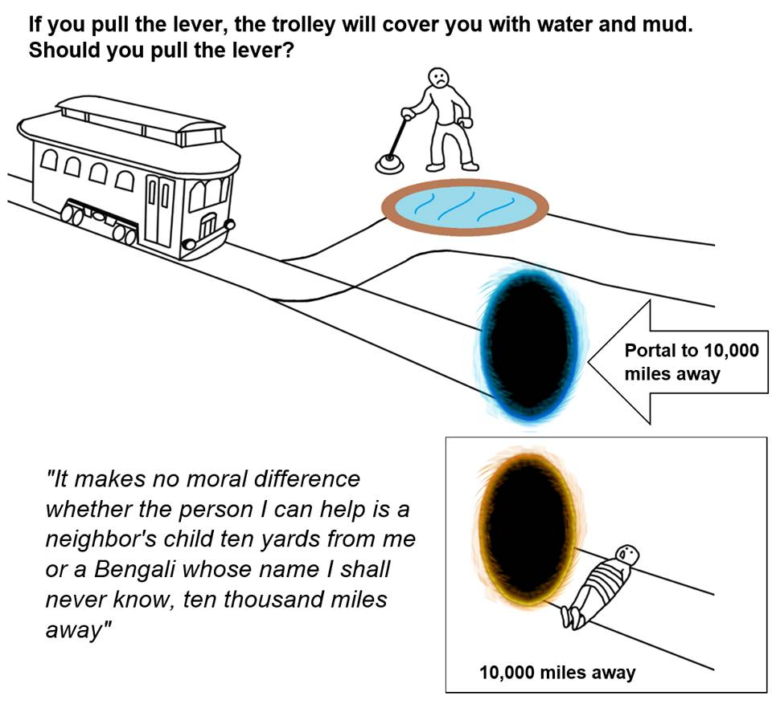
THE PORTAL POND
Notes:
“I do not think I need to say much in defense of the refusal to take proximity and distance into account. The fact that a person is physically near to us, so that we have personal contact with him, may make it more likely that we shall assist him, but this does not show that we ought to help him rather than another who happens to be further away. If we accept any principle of impartiality, universalizability, equality, or whatever, we cannot discriminate against someone merely because he is far away from us (or we are far away from him)” (467)
“Admittedly, it is possible that we are in a better position to judge what needs to be done to help a person near to us than one far away, and perhaps also to provide the assistance we judge to be necessary. If this were the case, it would be a reason for helping those near to us first” (467)
[I]nstant communication and swift transportation have changed the situation. From the moral point of view, the development of the world into a ‘global village’ has made an important, though still unrecognized, difference to our moral situation” (467)
“Expert observers and supervisors, sent out by famine relief organizations or permanently stationed in famine-prone areas, can direct our aid to a refugee in Bengal almost as effectively as we could get it to someone in our own block. There would seem, therefore, to be no possible justification for discriminating on geographical grounds” (467)

Slide 17
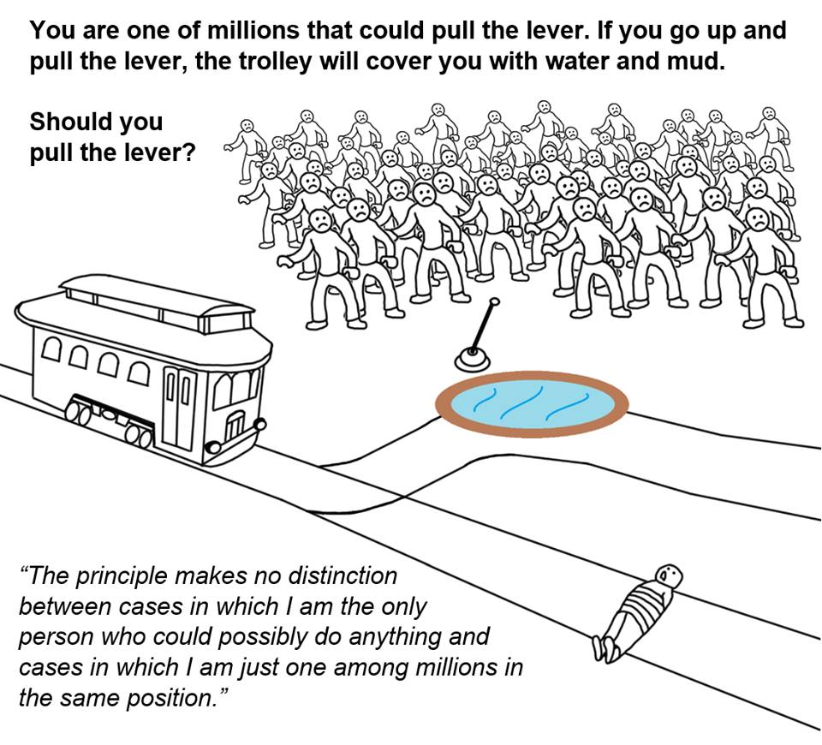
THE BYSTANDER POND
Notes:
“Should I consider that I am less obliged to pull the drowning child out of the pond if on looking around I see other people, no further away than I am, who have also noticed the child but are doing nothing? One has only to ask this question to see the absurdity of the view that numbers lessen obligation. It is a view that is an ideal excuse for inactivity; unfortunately most of the major evils – poverty, overpopulation, pollution – are problems in which everyone is almost equally involved” (468)

Slide 18
SINGER’S MASTER ARGUMENT
Principle 1: Suffering and death from lack of food, shelter, and medical care are bad.
Principle 2: If it is in our power to prevent something very bad from happening, without thereby sacrificing anything morally significant, we morally ought to do it.
If we are spending money on luxury and frills, it is in our power to prevent suffering and death from lack of food, shelter, and medical care (by sending that money to effective agents who will use it to prevent suffering and death), without thereby sacrificing anything morally significant.
We are spending money on luxury and frills.
So: We morally ought to send the money we would otherwise spend on luxury and frills to effective agents.
Notes:
Stronger principle: if it is in our power to prevent something bad from happening, without thereby sacrificing anything of comparable moral importance, we ought, morally, to do it.

Slide 19
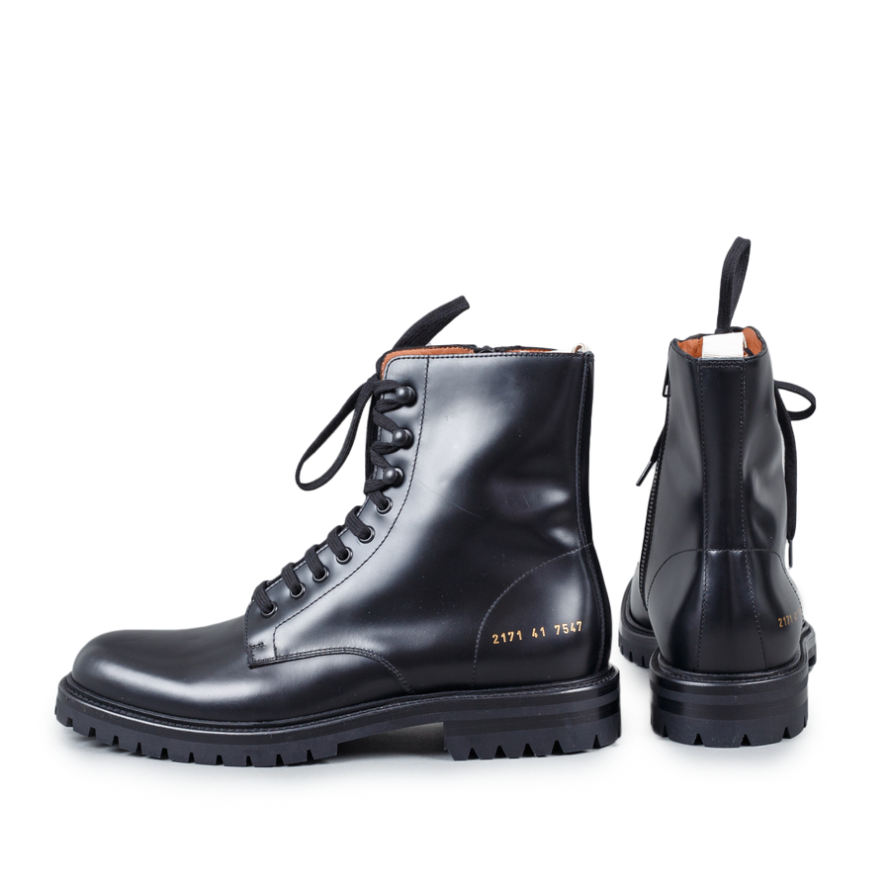
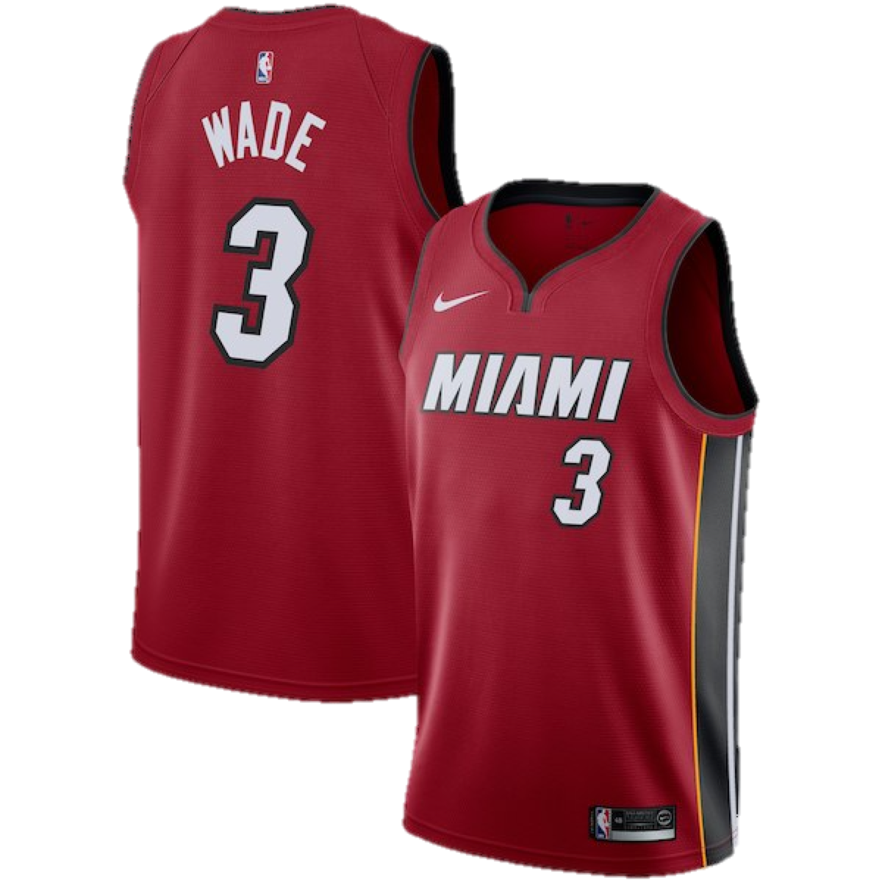
THE CONSUMERIST POND
stuff
Shit…
Notes:
“When we buy new clothes not to keep ourselves warm but to look ‘well-dressed’ we are not providing for any important need. We would not be sacrificing anything significant if we were to continue to wear our old clothes, and give the money to famine relief” (469)
Common Project boots
Bouquet of flowers
Miami Heat Dwyane Wade Jersey
Chipotle
ACL tickets

Slide 20
PRACTICAL IMPLICATIONS
Singer’s solution: you morally ought to give away whatever money you’re currently spending on luxuries and frills (as opposed to necessities).
An American household with an income of $50,000 spends approximately $30,000 annually on necessities.
This estimate holds for households at higher incomes as well.
A household bringing in $50,000 a year should donate as close as possible to $20,000 per year.
A household bringing in $100,000 a year should donate as close as possible to $70,000 per year.
Peter Singer
Notes:
https://www.nytimes.com/1999/09/05/magazine/the-singer-solution-to-world-poverty.html
Singer’s article published in 1999
Conference Board, a nonprofit economic research organization

Slide 21
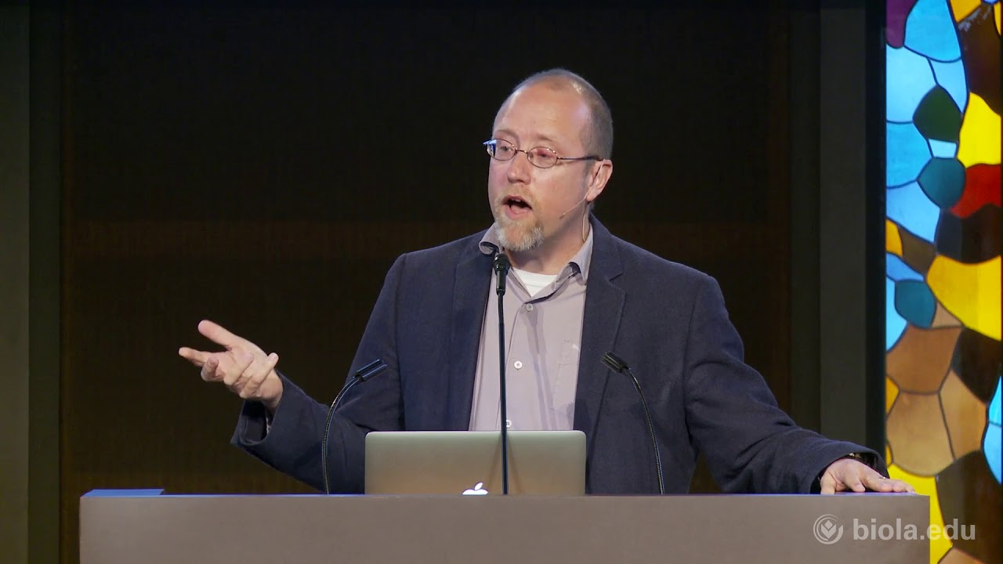
RELIGIOUS ANALOG (?)
the love command
You morally ought to love your neighbor as yourself.
Thomas Crisp
Jesus
Notes:
https://thomasmcrisp.com/

Slide 22
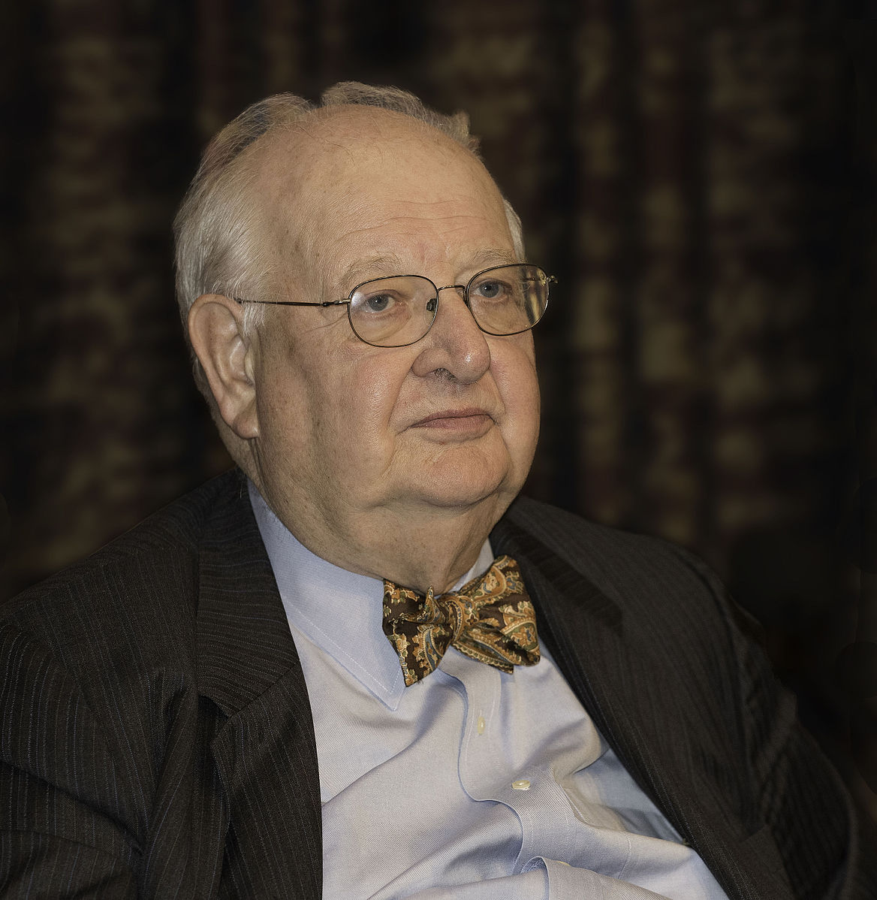
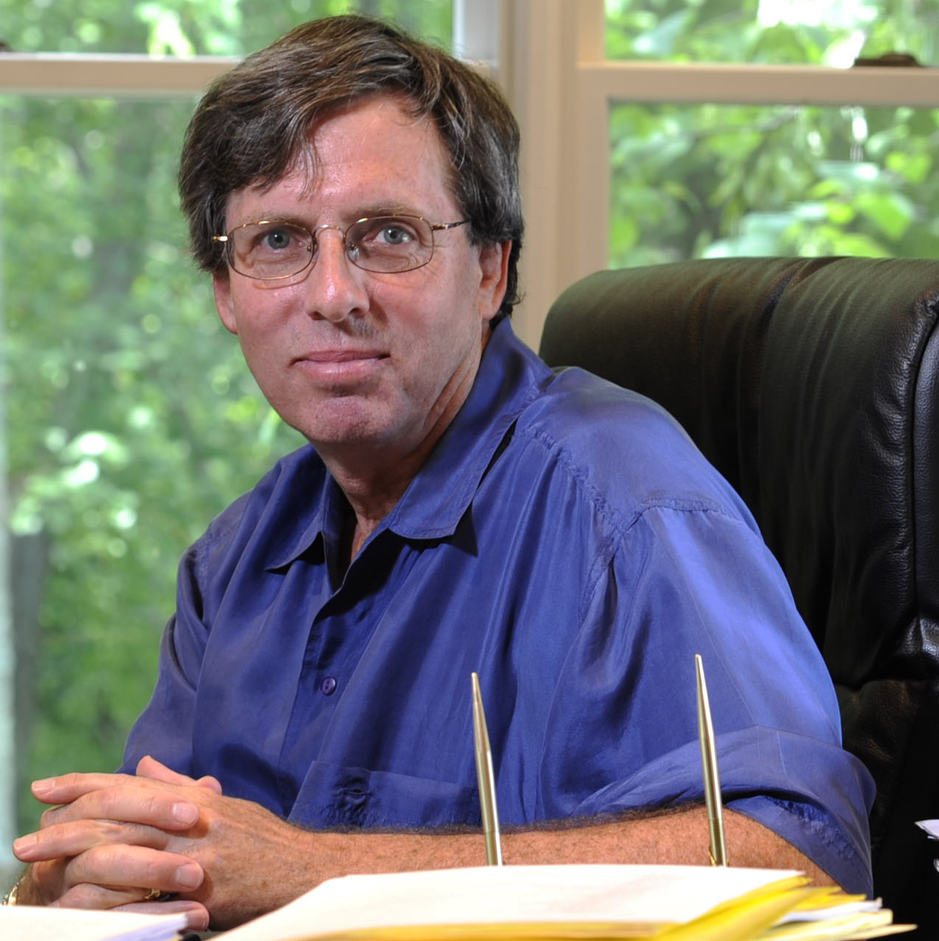
EMPIRICAL COMPLICATIONS
Angus Deaton
Larry Temkin
Notes:
“In 2015, he was awarded the Nobel Memorial Prize in Economic Sciences for his analysis of consumption, poverty, and welfare”

Slide 23
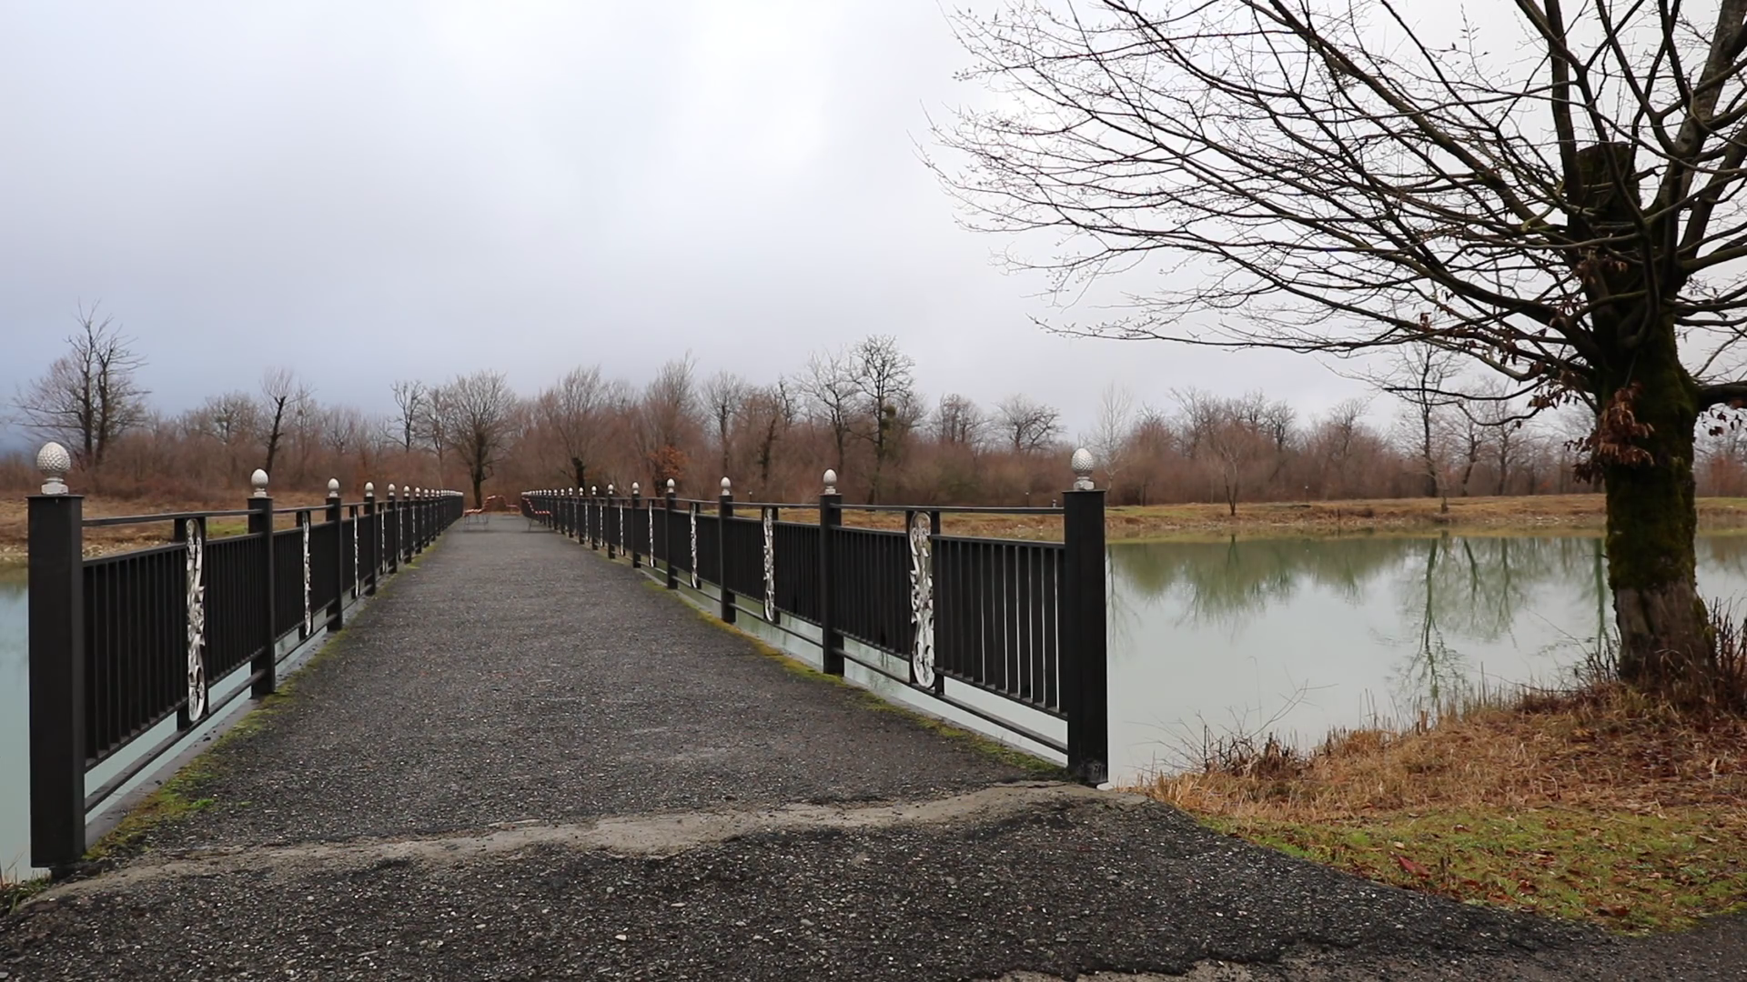
EMPIRICAL COMPLICATIONS
[Stop] entertaining students who try to work their way out of moral questions/are disregarding the point of the hypothetical question.

Slide 24
EMPIRICAL COMPLICATIONS

Slide 25
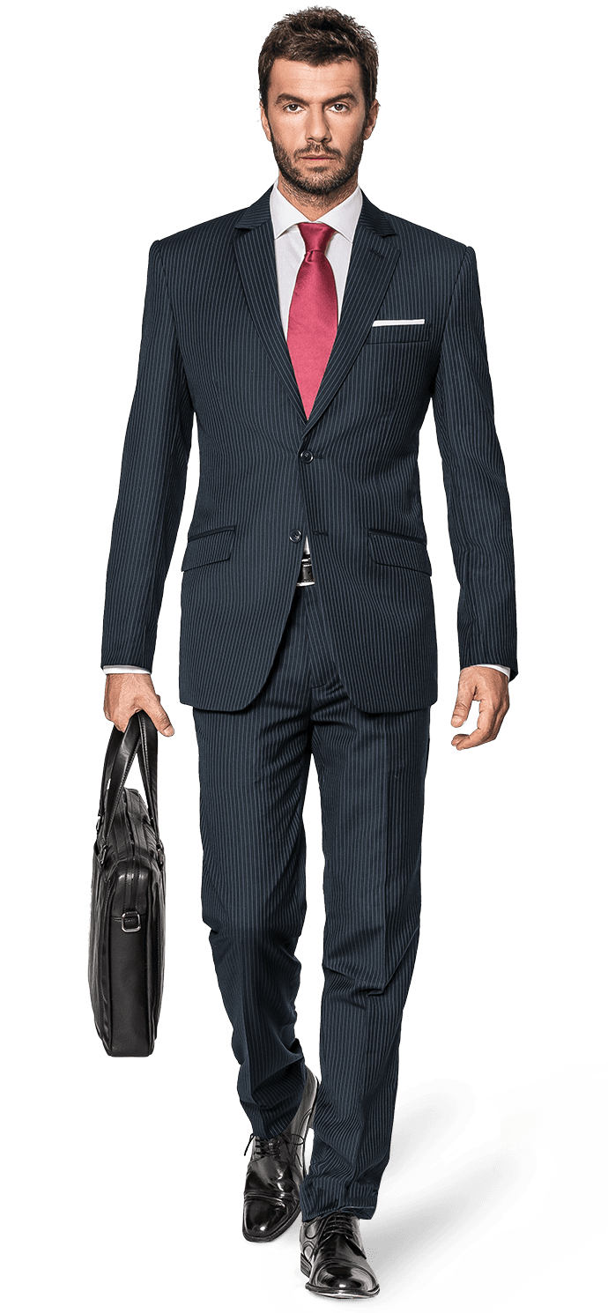
MORAL COMPLICATIONS
Notes:
$79,700

Slide 26
MORAL COMPLICATIONS

Slide 27
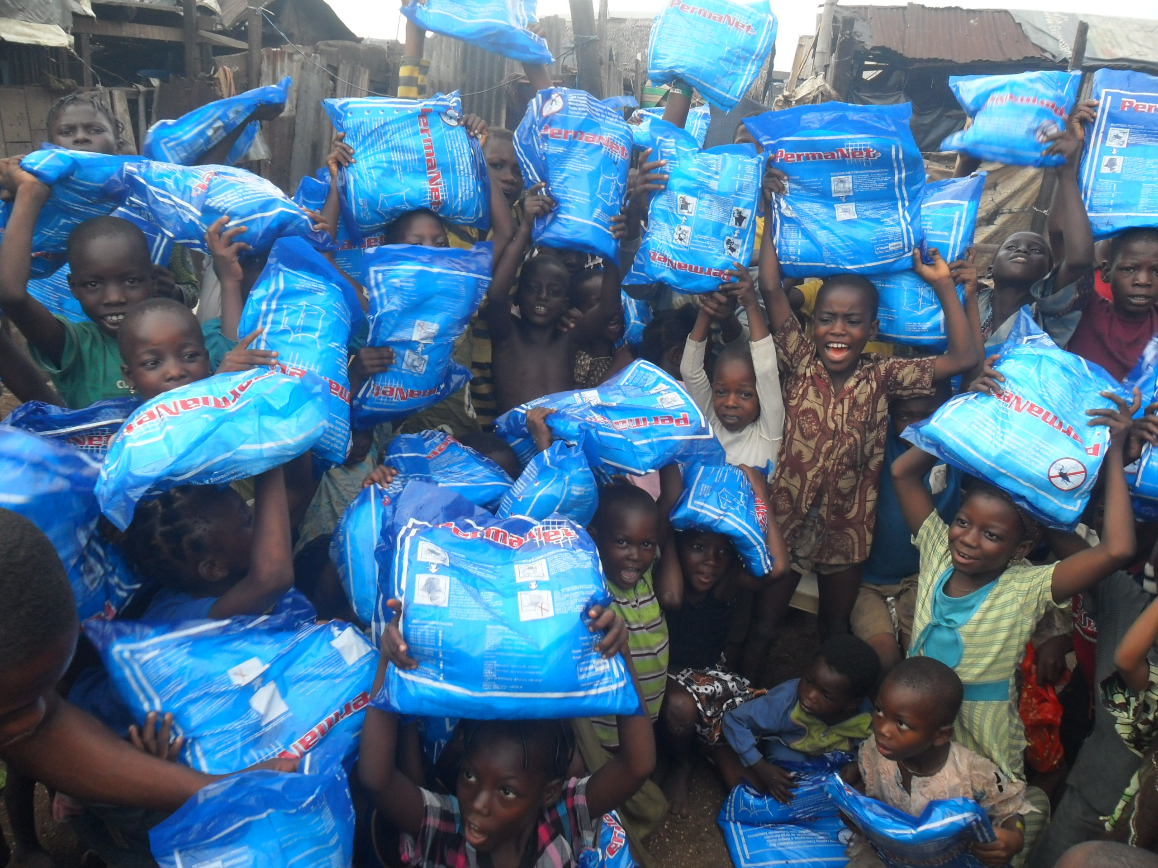
MORAL COMPLICATIONS
crisis averted: more children saved!
Notes:
https://www.irishtimes.com/news/crime-and-law/boy-5-who-drowned-loved-to-throw-stones-in-water-1.2410688

Slide 28
MORAL COMPLICATIONS
We have an agent-neutral reason to prevent bad things from happening (and perhaps to promote the good).
We have agent-relative reasons to act in ways that needn’t coincide with preventing the worst bads (or promoting the greatest goods).
This is consistent with the claim that we have strong obligations toward the needy.
But perhaps proximity does matter: perhaps we morally ought to help the needy people we encounter daily.

Slide 29
OBLIGATION / SUPEREROGATION
Moral obligation concerns what one is morally required to do. It is wrong for one not to do what is morally required to do.
Supererogation concerns what is above and beyond the call of duty. It is good for one to do what is supererogatory, but not wrong to refrain from doing it.
Singer’s argument is consistent with this distinction.
If Singer’s argument is sound, it simply shows we are mistaken to regard many acts of “charity” as supererogatory.
Notes:
“There would be many other possible ways of drawing the distinction – for instance, one might decide that it is good to make other people as happy as possible, but not wrong not to do so” (469)

Slide 30
OBLIGATION / SUPEREROGATION
Suppose Singer is wrong: it is supererogatory—not obligatory—to perform actions that come at personal costs.
Some of us are still motivated to do good by giving money to charity, volunteering to help others, and so on.
What then?
Some philosophers maintain that—at least when it comes to charitable giving—once you decide to do some good, you’re morally obligated to do the best.
It is wrong to do otherwise.
Notes:
“There would be many other possible ways of drawing the distinction – for instance, one might decide that it is good to make other people as happy as possible, but not wrong not to do so” (469)

