Slide 1
Inference to best explanation in ethics
EAGxAustin 2024
zachblaesi.com/EA (slides available)

Slide 2
JUSTIFIED BELIEF / KNOWLEDGE
Justified beliefs are reasonable beliefs, beliefs that you are rationally entitled to hold.
Knowledge = belief + truth + justification + …

Slide 3
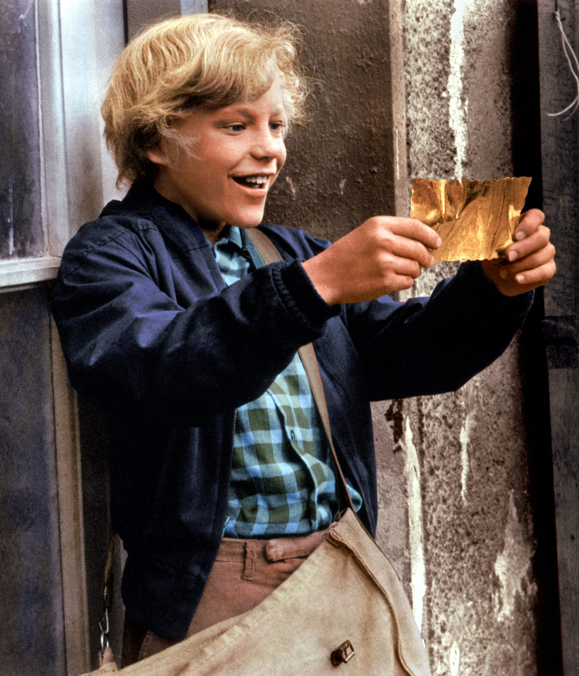
JUSTIFIED BELIEF / KNOWLEDGE
I knew I’d win!
Notes:
It has been said that man is a rational animal. All my life I have been searching for evidence which could support this. Read more at https://www.brainyquote.com/authors/bertrand-russell-quotes

Slide 4
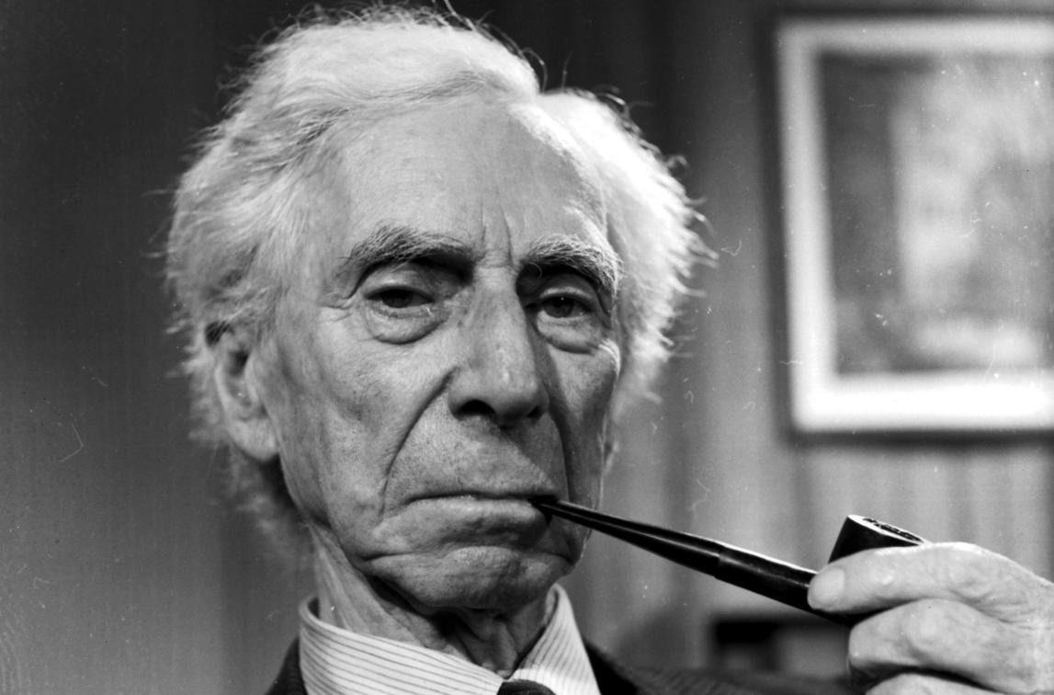
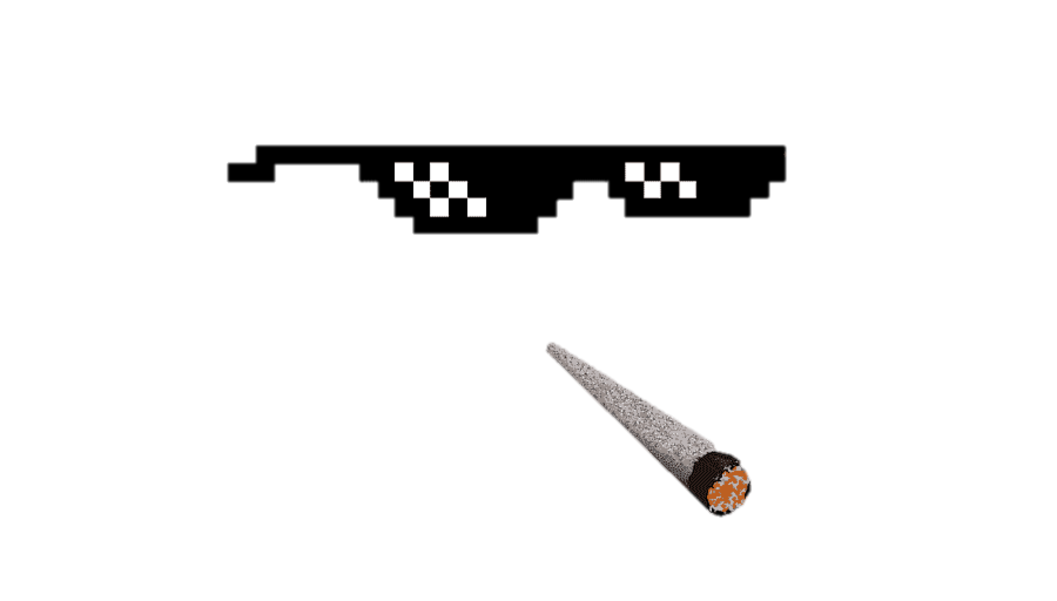
JUSTIFIED BELIEF / KNOWLEDGE
I knew I’d win!
It is the things for which there is no evidence that are believed with passion.
Notes:
It has been said that man is a rational animal. All my life I have been searching for evidence which could support this. Read more at https://www.brainyquote.com/authors/bertrand-russell-quotes

Slide 5
How could our moral beliefs about hard cases ever be justified or count as knowledge?

Slide 6
INFERENCE TO THE BEST EXPLANATION
We have a set of evidence E.
H₁,…, H_{n} are available hypotheses compatible with E.
H_{i} provides the best explanation of E.
So: H_{i} is true.
Notes:
The importance of why-questions.
“[T]he best way to distinguish between induction and abduction is this: both are ampliative, meaning that the conclusion goes beyond what is (logically) contained in the premises (which is why they are non-necessary inferences), but in abduction there is an implicit or explicit appeal to explanatory considerations, whereas in induction there is not; in induction, there is only an appeal to observed frequencies or statistics.”
“Abduction is also said to be the predominant mode of reasoning in medical diagnosis: physicians tend to go for the hypothesis that best explains the patient’s symptoms.”
“Its core idea is often said to be that explanatory considerations have confirmation-theoretic import, or that explanatory success is a (not necessarily unfailing) mark of truth.”
“[I]t will not be a sound rule of inference in the strict logical sense, however abduction is explicated exactly. It can still be reliable in that it mostly leads to a true conclusion whenever the premises are true.”
https://plato.stanford.edu/entries/abduction/

Slide 7
MORAL THEORY
We can think of a moral theory as a collection of moral principles (or “laws”)—“general” moral facts posited to explain “particular” moral facts.
They are analogous to the laws of nature posited by a scientific theory to explain natural phenomena.

Slide 8
begin
Describe the case in detail
Does it illicit strong moral intuitions?
INTUITIVE APPROACH
Make a list of any extraneous factors (distorting biases, etc.) that may call these intuitions into question and then examine the case again.
Yes
No
Is it similar to more clear-cut cases?
Expand list of extraneous factors and isolate any morally relevant features shared by these cases.
Yes
No
Build or refine a theory that best explains the data so far and temporarily discard anything that conflicts with it.
Test predictions against other cases.
No
justified moral beliefs
Is the theory stable?
Yes
Notes:
“There are practical reasons why inconsistent moral beliefs are problematic: they may, for example, provoke indecision and, ultimately, paralysis of the will” (112).
“More importantly, the achievement of greater coherence among one’s beliefs diminishes the likelihood of error by helping one to identify and eliminate moral beliefs produced by self-interest, faulty reasoning, failure of imagination, illusory metaphysical beliefs, impaired faculties, and other sources of distorted or mistaken belief” (112).

Slide 9
THEORY CHOICE IN ETHICS
Simplicity: the theory yields a complex body of moral facts out of a sparse and elegant base of more fundamental moral principles.
Power: the theory offers guidance on unclear cases and is apt to inform our decisions in future circumstances.
Explanatoriness: the theory increases our understanding of the moral realm by explaining less basic moral facts in terms of fundamental moral principles.
Notes:
“The shopping lists fail on this [the simplicity] criterion, requiring a principle for each case” (11).
“The shopping lists fail here [on power], too, being no help in those cases where our original intuitions offer us no guidance” (11)
“Thus, the principles themselves may give us grounds for rejecting some of our initial intuitions, and the altered set of intuitions may in turn give us grounds for altering the principles” (11–12).
“In this manner, we work back and forth between intuitions and principles until a stable point is reached” (12).
“The remaining intuitions represent our considered judgments, and the moral principles at which we have arrived can guide us in difficult cases” (12).
“If the slaveholder cannot offer an explanation, then the distinction hangs free of the rest of his moral theory, and considerations of coherence give him reason to reject the distinction as morally irrelevant, as well as repudiating the intuitions which turn on it” (14).

Slide 10
CLOSING QUESTION
Generalism: there is at least one interesting moral principle or law. Some moral theory is true.
Particularism: while there are “particular” moral facts, there are no interesting moral principles or laws. All moral theories are (strictly speaking) false.

Slide 11
CLOSING QUESTION
Does the intuitive approach force us to take a stand on the debate over generalism and particularism?
If particularism is true, how could we ever form justified beliefs about hard cases in ethics?

Slide 12
Inference to best explanation in ethics
EAGxAustin 2024
zachblaesi.com/EA (slides available)

